Slide 1
Large Language Models
Introduction to Large Language Models

Slide 2
Language models
Remember the simple n-gram language model
  Assigns probabilities to sequences of words
  Generate text by sampling possible next words
  Is trained on counts computed from lots of text
Large language models are similar and different:
  Assigns probabilities to sequences of words
  Generate text by sampling possible next words
  Are trained by learning to guess the next word

Slide 3
Large language models
Even through pretrained only to predict words
Learn a lot of useful language knowledge
Since training on a lot of text

Slide 4
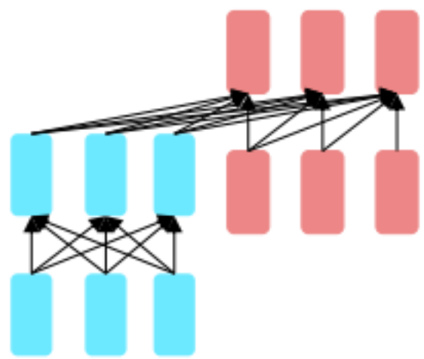
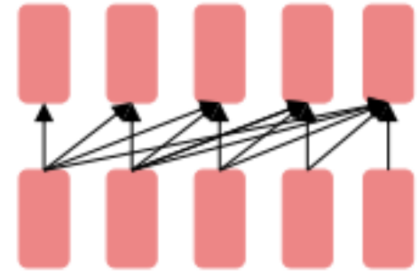
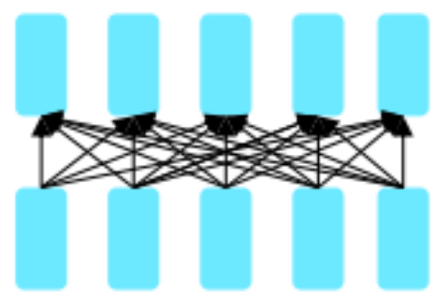
Three architectures for large language models
Decoders Encoders Encoder-decoders
GPT, Claude, BERT family, Flan-T5, Whisper
Llama HuBERT
Mixtral

Slide 5
Encoders
Many varieties!
Popular: Masked Language Models (MLMs)
BERT family
Trained by predicting words from surrounding words on both sides
Are usually finetuned (trained on supervised data) for classification tasks.

Slide 6
Encoder-Decoders
Trained to map from one sequence to another
Very popular for:
  machine translation (map from one language to another)
  speech recognition (map from acoustics to words)

Slide 7
Large Language Models
Introduction to Large Language Models

Slide 8
Large Language Models
Large Language Models: What tasks can they do?

Slide 9
Big idea
Many tasks can be turned into tasks of predicting words!

Slide 10
This lecture: decoder-only models
Also called:
Causal LLMs
Autoregressive LLMs
Left-to-right LLMs
Predict words left to right

Slide 11
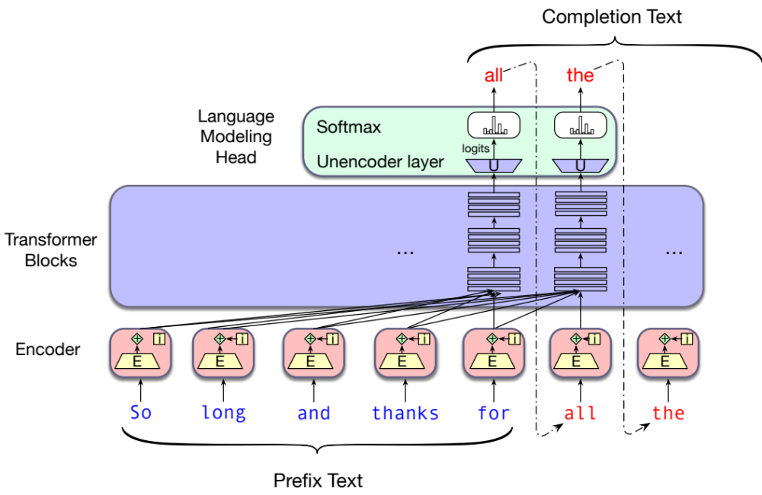
Conditional Generation: Generating text conditioned on previous text!
Notes:
In predicting each next word, the model can see a representation of all the previous words

Slide 12
Many practical NLP tasks can be cast as word prediction!
Sentiment analysis: “I like Jackie Chan”
We give the language model this string:
The sentiment of the sentence "I like Jackie Chan" is:
And see what word it thinks comes next:

Slide 13
Framing lots of tasks as conditional generation
QA: “Who wrote The Origin of Species”
We give the language model this string:
And see what word it thinks comes next:
And iterate:

Slide 14
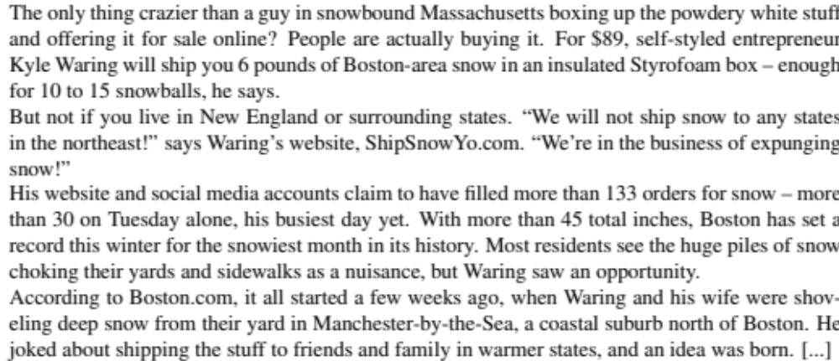
Summarization
Original
Summary

Slide 15
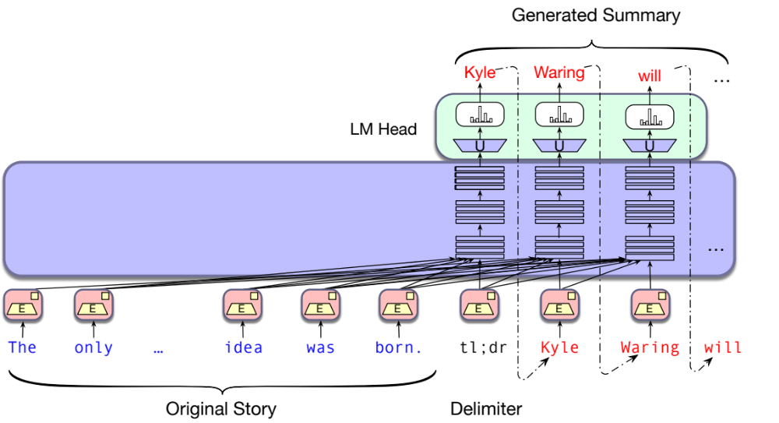
LLMs for summarization (using tl;dr)

Slide 16
Large Language Models
Large Language Models: What tasks can they do?

Slide 17
Large Language Models
Sampling for LLM Generation

Slide 18
Decoding and Sampling
This task of choosing a word to generate based on the model’s probabilities is called decoding.
The most common method for decoding in LLMs: sampling.
Sampling from a model’s distribution over words:
choose random words according to their probability assigned by the model.
After each token we’ll sample words to generate according to their probability conditioned on our previous choices,
A transformer language model will give the probability

Slide 19
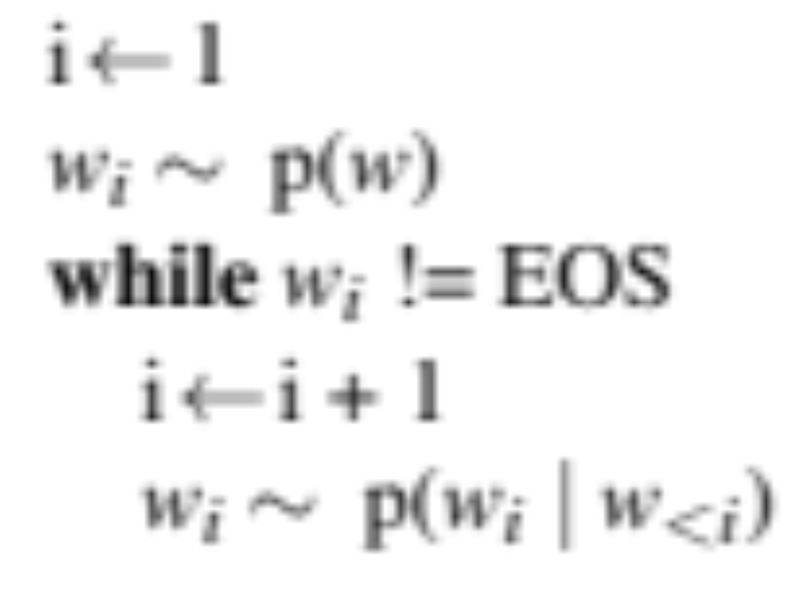
Random sampling

Slide 20
Random sampling doesn't work very well
Even though random sampling mostly generate sensible, high-probable words,
There are many odd, low- probability words in the tail of the distribution
Each one is low- probability but added up they constitute a large portion of the distribution
So they get picked enough to generate weird sentences

Slide 21
Factors in word sampling: quality and diversity
Emphasize high-probability words
+ quality: more accurate, coherent, and factual,
- diversity: boring, repetitive.
Emphasize middle-probability words
+ diversity: more creative, diverse,
- quality: less factual, incoherent

Slide 22
Top-k sampling:
Choose # of words k
For each word in the vocabulary V , use the language model to compute the likelihood of this word given the context p(wt |w_{<t} )
Sort the words by likelihood, keep only the top k most probable words.
Renormalize the scores of the k words to be a legitimate probability distribution.
Randomly sample a word from within these remaining k most-probable words according to its probability.
Notes:
When k = 1, top-k sampling is identical to greedy decoding.
Setting k to a larger number than 1 leads us to sometimes select a word which is not necessarily the most probable, but is still probable enough, and whose choice results in generating more diverse but still high-enough-quality text.

Slide 23
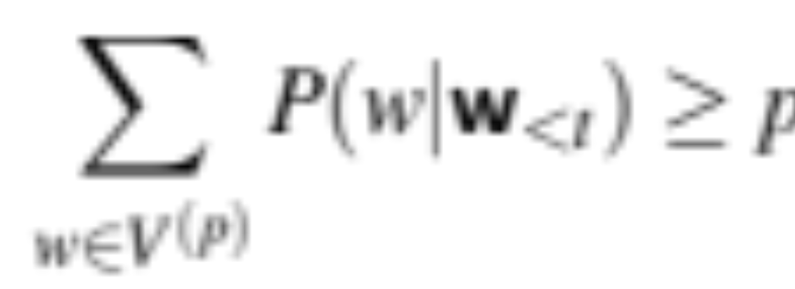
Top-p sampling (= nucleus sampling)
Holtzman et al., 2020
Problem with top-k: k is fixed so may cover very different amounts of probability mass in different situations
Idea: Instead, keep the top p percent of the probability mass
Given a distribution P(w_{t} |w_{<t} ), the top-p vocabulary V ( p) is the smallest set of words such that
Notes:
sometimes the top k words will be very likely and include most of the probability mass, but other times flatter and the top 10 words will only include a small part of the probability mass.

Slide 24
Temperature sampling
Reshape the distribution instead of truncating it
Intuition from thermodynamics,
a system at high temperature is flexible and can explore many possible states,
a system at lower temperature is likely to explore a subset of lower energy (better) states.
In low-temperature sampling, (τ ≤ 1) we smoothly
increase the probability of the most probable words
decrease the probability of the rare words.

Slide 25
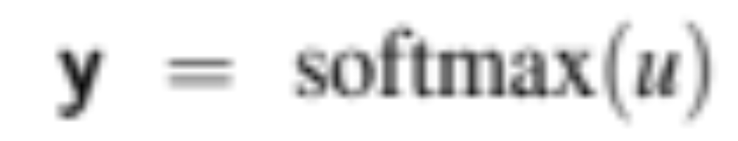
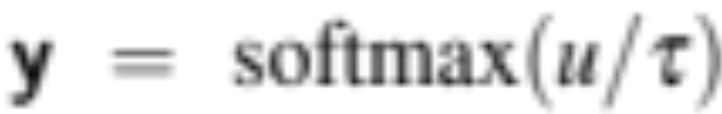
Temperature sampling
Divide the logit by a temperature parameter τ before passing it through the softmax.
Instead of
We do

Slide 26
Temperature sampling
0 ≤ τ ≤ 1
Why does this work?
When τ is close to 1 the distribution doesn’t change much.
The lower τ is, the larger the scores being passed to the softmax
Softmax pushes high values toward 1 and low values toward 0.
Large inputs pushes high-probability words higher and low probability word lower, making the distribution more greedy.
As τ approaches 0, the probability of most likely word approaches 1
Notes:
(dividing by a smaller fraction τ ≤ 1 results in making each score larger).

Slide 27
Large Language Models
Sampling for LLM Generation

Slide 28
Large Language Models
Pretraining Large Language Models: Algorithm

Slide 29
Pretraining
The big idea that underlies all the amazing performance of language models
First pretrain a transformer model on enormous amounts of text
Then apply it to new tasks.

Slide 30
Self-supervised training algorithm
We just train them to predict the next word!
Take a corpus of text
At each time step t
  ask the model to predict the next word
  train the model using gradient descent to minimize the error in this prediction
  "Self-supervised" because it just uses the next word as the label!

Slide 31
Intuition of language model training: loss
Same loss function: cross-entropy loss
  We want the model to assign a high probability to true word w
  = want loss to be high if the model assigns too low a probability to w
CE Loss: The negative log probability that the model assigns to the true next word w
  If the model assigns too low a probability to w
  We move the model weights in the direction that assigns a higher probability to w

Slide 32
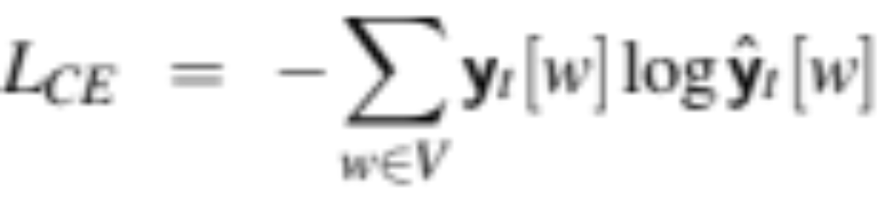
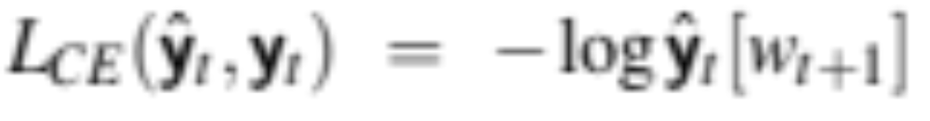
Cross-entropy loss for language modeling
CE loss: difference between the correct probability distribution and the predicted distribution
The correct distribution y_{t} knows the next word, so is 1 for the actual next word and 0 for the others.
So in this sum, all terms get multiplied by zero except one: the logp the model assigns to the correct next word, so:

Slide 33
Teacher forcing
At each token position t, model sees correct tokens w_{1:t},
  Computes loss (–log probability) for the next token w_{t+1}
At next token position t+1 we ignore what model predicted for w_{t+1}
  Instead we take the correct word w_{t+1}, add it to context, move on

Slide 34
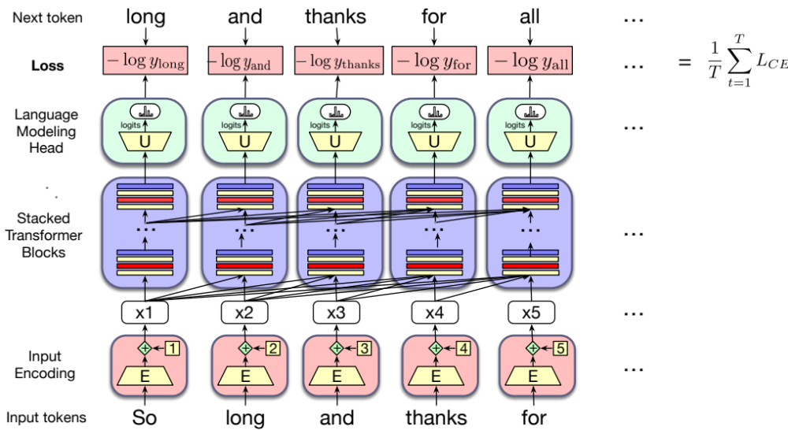
Training a transformer language model

Slide 35
Large Language Models
Pretraining Large Language Models: Algorithm

Slide 36
Large Language Models
Pretraining data for LLMs

Slide 37
LLMs are mainly trained on the web
Common crawl, snapshots of the entire web produced by the non- profit Common Crawl with billions of pages
Colossal Clean Crawled Corpus (C4; Raffel et al. 2020), 156 billion tokens of English, filtered
What's in it? Mostly patent text documents, Wikipedia, and news sites

Slide 38
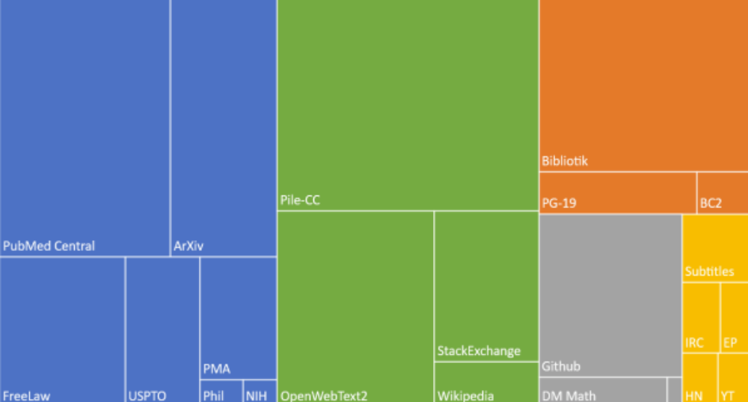
The Pile: a pretraining corpus
academics
web
books
dialog

Slide 39
Filtering for quality and safety
Quality is subjective
Many LLMs attempt to match Wikipedia, books, particular websites
Need to remove boilerplate, adult content
Deduplication at many levels (URLs, documents, even lines)
Safety also subjective
Toxicity detection is important, although that has mixed results
Can mistakenly flag data written in dialects like African American English

Slide 40
What does a model learn from pretraining?
There are canines everywhere! One dog in the front room, and two dogs
It wasn't just big it was enormous
The author of "A Room of One's Own" is Virginia Woolf
The doctor told me that he
The square root of 4 is 2

Slide 41
Big idea
Text contains enormous amounts of knowledge
Pretraining on lots of text with all that knowledge is what gives language models their ability to do so much

Slide 42
But there are problems with scraping from the web
Copyright: much of the text in these datasets is copyrighted
Not clear if fair use doctrine in US allows for this use
This remains an open legal question
Data consent
Website owners can indicate they don't want their site crawled
Privacy:
Websites can contain private IP addresses and phone numbers

Slide 43
Large Language Models
Pretraining data for LLMs

Slide 44
Large Language Models
Finetuning

Slide 45
Finetuning for daptation to new domains
What happens if we need our LLM to work well on a domain it didn't see in pretraining?
Perhaps some specific medical or legal domain?
Or maybe a multilingual LM needs to see more data on some language that was rare in pretraining?

Slide 46
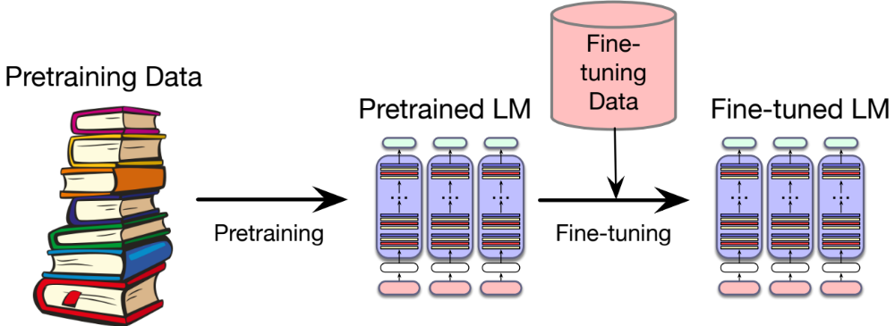
Finetuning

Slide 47
"Finetuning" means 4 different things
We'll discuss 1 here, and 3 in later lectures
In all four cases, finetuning means:
taking a pretrained model and further adapting some or all of its parameters to some new data
Notes:
But they differ on exactly which parameters get updated.

Slide 48
1. Finetuning as "continued pretraining" on new data
Further train all the parameters of model on new data
  using the same method (word prediction) and loss function (cross-entropy loss) as for pretraining.
  as if the new data were at the tail end of the pretraining data
Hence sometimes called continued pretraining

Slide 49
Large Language Models
Finetuning

Slide 50
Large Language Models
Evaluating Large Language Models

Slide 51
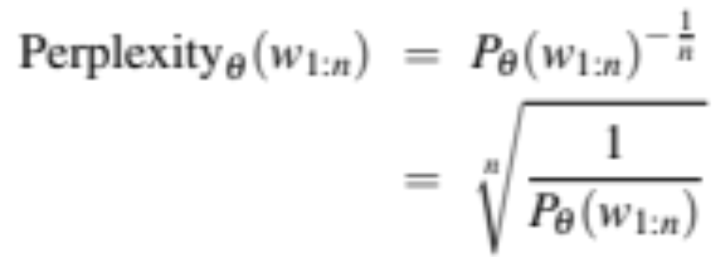
Perplexity
Just as for n-gram grammars, we use perplexity to measure how well the LM predicts unseen text
The perplexity of a model θ on an unseen test set is the inverse probability that θ assigns to the test set, normalized by the test set length.
For a test set of n tokens w_{1:n} the perplexity is :

Slide 52
Why perplexity instead of raw probability of the test set?
Probability depends on size of test set
  Probability gets smaller the longer the text
  Better: a metric that is per-word, normalized by length
Perplexity is the inverse probability of the test set, normalized by the number of words
  (The inverse comes from the original definition of perplexity from cross-entropy rate in information theory)
  Probability range is [0,1], perplexity range is [1,∞]
Notes:
There's a problem with using probability. And that is that the probability of a test set depends very directly on the length of the test set. This is because probability gets smaller the longer the text. For n-gram models, this is very clear; the chain rule of probability means that for a test set of N words we are multiplying together N n-gram probabilities! It would be better to normalize the probabilities by length to get a metric that is per-word. Perplexity is just such a metric. Perplexity is the inverse probability of the test set, normalized by the number of words. We normalize by taking the N-th root of the probability of the test set.

Slide 53
Perplexity
The higher the probability of the word sequence, the lower the perplexity.
Thus the lower the perplexity of a model on the data, the better the model.
Minimizing perplexity is the same as maximizing probability
Also: perplexity is sensitive to length/tokenization so best used when comparing LMs that use the same tokenizer.

Slide 54
Many other factors that we evaluate, like:
Size
Big models take lots of GPUs and time to train, memory to store
Energy usage
Can measure kWh or kilograms of CO2 emitted
Fairness
Benchmarks measure gendered and racial stereotypes, or decreased performance for language from or about some groups.

Slide 55
Large Language Models
Dealing with Scale

Slide 56
Scaling Laws
LLM performance depends on
Model size: the number of parameters not counting embeddings
Dataset size: the amount of training data
Compute: Amount of compute (in FLOPS or etc
Can improve a model by adding parameters (more layers, wider contexts), more data, or training for more iterations
The performance of a large language model (the loss) scales as a power-law with each of these three

Slide 57
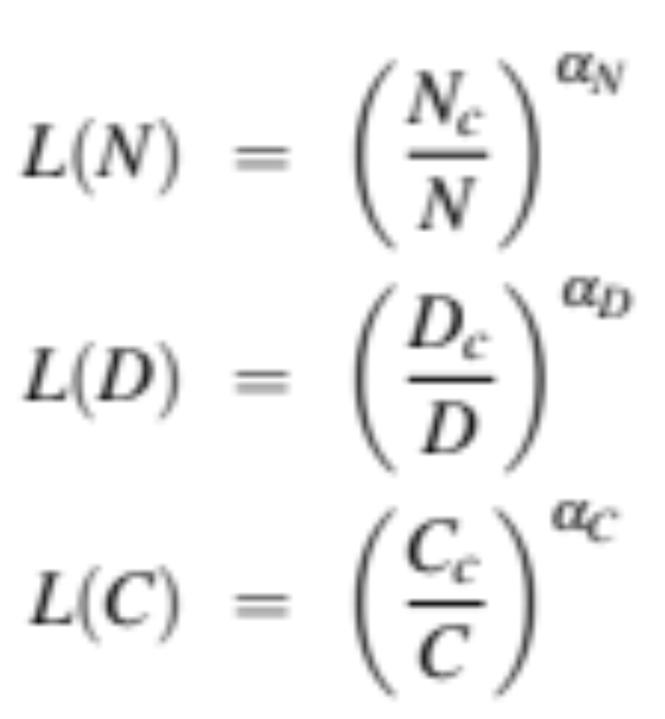
Scaling Laws
Loss L as a function of # parameters N, dataset size D, compute budget C (if other two are held constant)
Scaling laws can be used early in training to predict what the loss would be if we were to add more data or increase model size.
Notes:
The values of Nc, Dc, Cc, αN, αD, and αC depend on the exact transformer architecture, tokenization, and vocabulary size, so rather than all the precise values, scaling laws focus on the relationship with loss.2

Slide 58
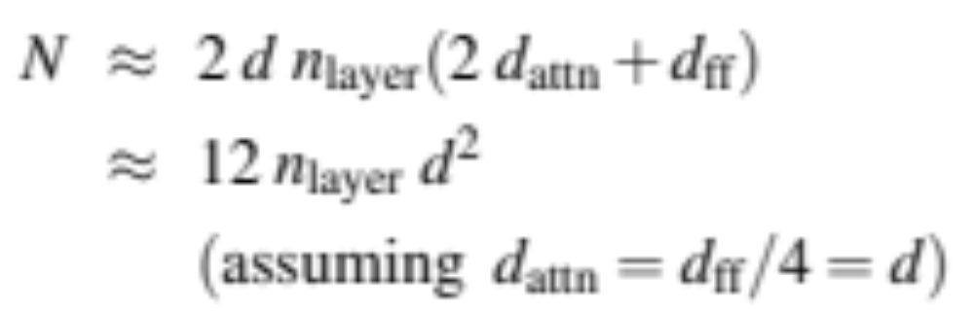
Number of non-embedding parameters N
Thus GPT-3, with n = 96 layers and dimensionality d = 12288, has 12 × 96 × 122882 ≈ 175 billion parameters.

Slide 59
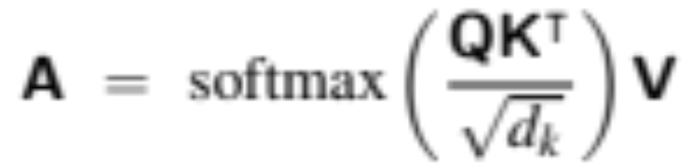
KV Cache
In training, we can compute attention very efficiently in parallel:
But not at inference! We generate the next tokens one at a time!
For a new token x, need to multiply by W^{Q}, W^{K}, and W^{V} to get query, key, values
But don't want to recompute the key and value vectors for all the prior tokens x_{<i}
Instead, store key and value vectors in memory in the KV cache, and then we can just grab them from the cache

Slide 60
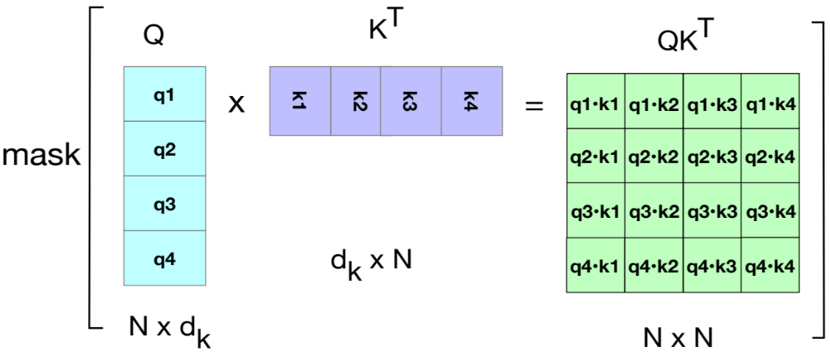
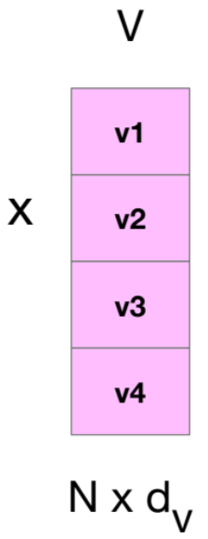
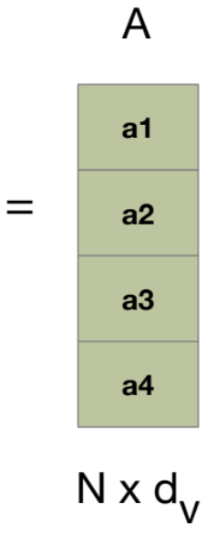
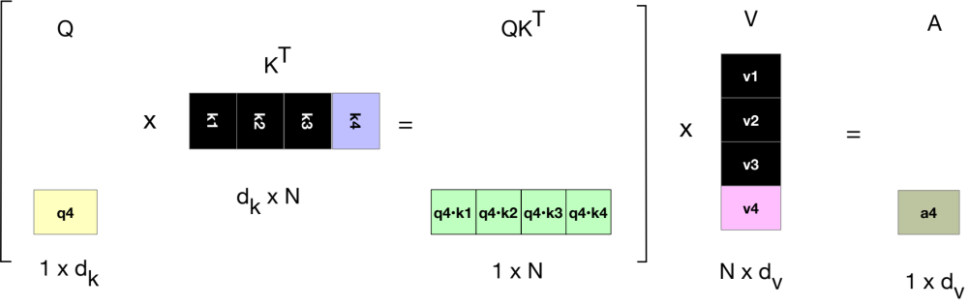
KV Cache
Notes:
showing, in black, the vectors that can be stored in the cache rather than recomputed when computing the atten- tion score for the 4th token.

Slide 61
Parameter-Efficient Finetuning
Adapting to a new domain by continued pretraining (finetuning) is a problem with huge LLMs.
Enormous numbers of parameters to train
Each pass of batch gradient descent has to backpropagate through many many huge layers.
Expensive in processing power, in memory, and in time.
Instead, parameter-efficient fine tuning (PEFT)
Efficiently select a subset of parameters to update when finetuning.
E.g., freeze some of the parameters (don’t change them),
And only update some a few parameters.

Slide 62
LoRA (Low-Rank Adaptation)
Trransformers have many dense matrix multiply layers
  Like W^{Q}, W^{K}, W^{V}, W^{O} layers in attention
Instead of updating these layers during finetuning,
  Freeze these layers
  Update a low-rank approximation with fewer parameters.

Slide 63
LoRA
Consider a matrix W (shape [N × d]) that needs to be updated during finetuning via gradient descent.
  Normally updates are ∆W (shape [N × d])
In LoRA, we freeze W and update instead a low-rank decomposition of W:
  A of shape [N×r],
  B of shape [r×d], r is very small (like 1 or 2)
  That is, during finetuning we update A and B instead of W.
  Replace W + ∆W with W + BA.
Forward pass: instead of
h = xW
We do
h = xW + xAB

Slide 64
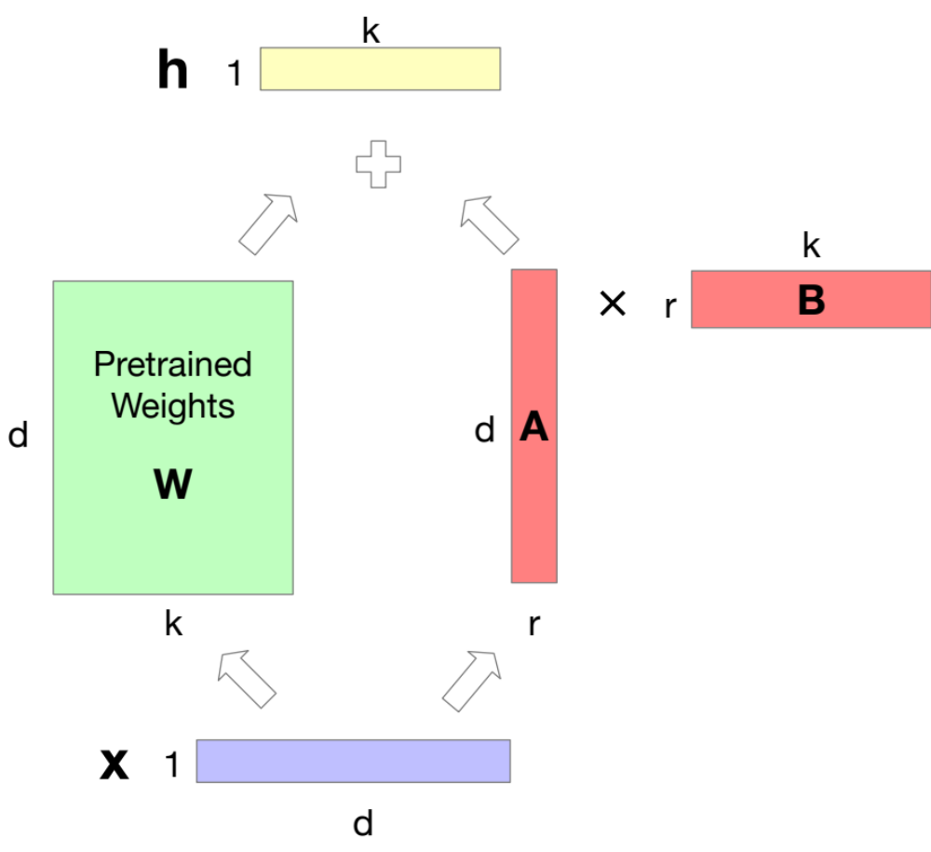
LoRA
Notes:
We freeze W to its pretrained values, and instead finetune by training a pair of matrices A and B, updating those instead of W, and just sum W and the updated AB.

Slide 65
Large Language Models
Dealing with Scale

Slide 66
Large Language Models
Harms of Large Language Models

Slide 67
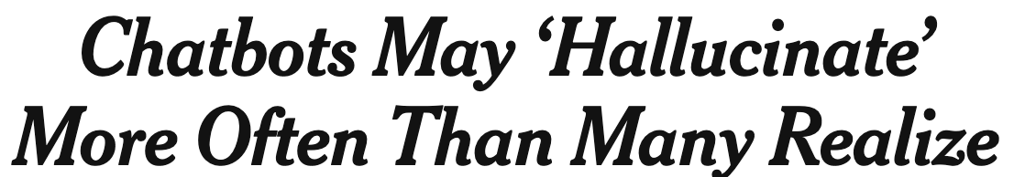
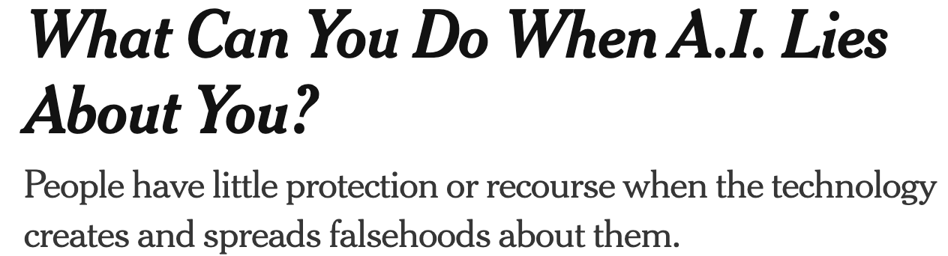
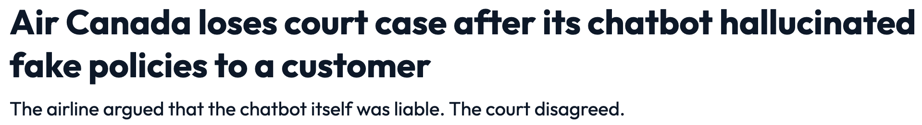
Hallucination
Notes:
LLMs make stuff up!

Slide 68
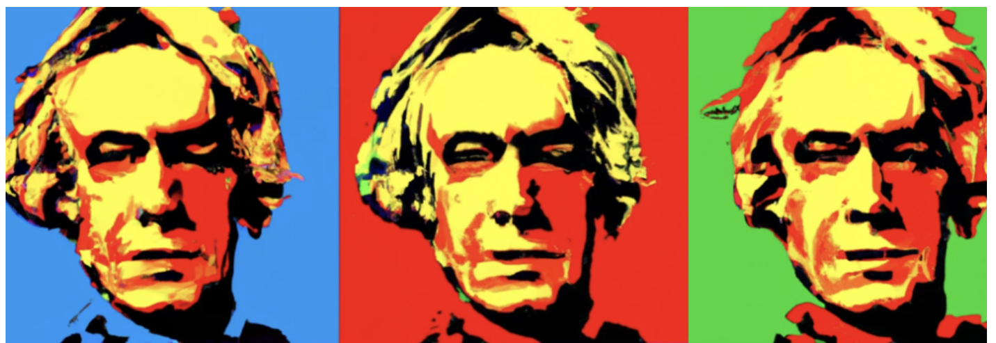
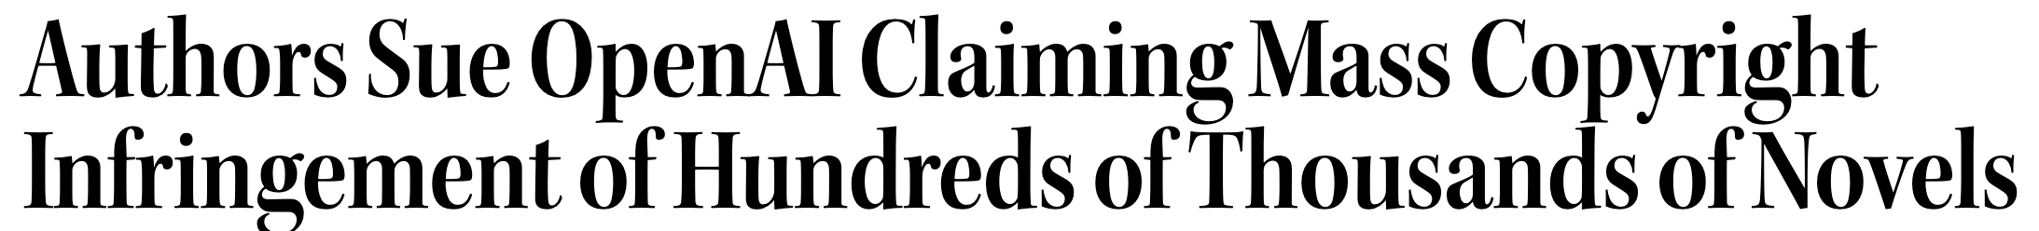
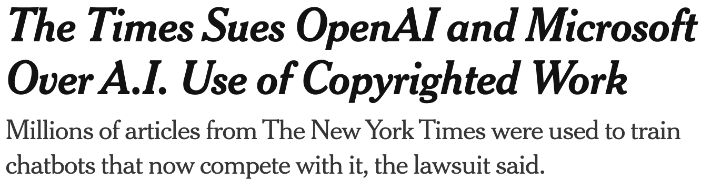

Copyright
Notes:
Who owns all that data that we trained the models on?

Slide 69
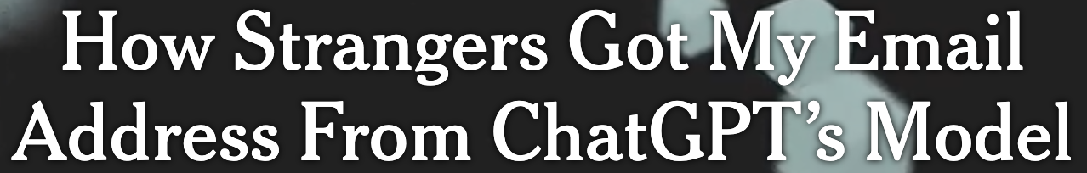
Privacy
Notes:
Training data can be leaked

Slide 70
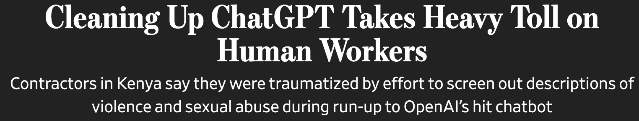
Toxicity and Abuse

Slide 71
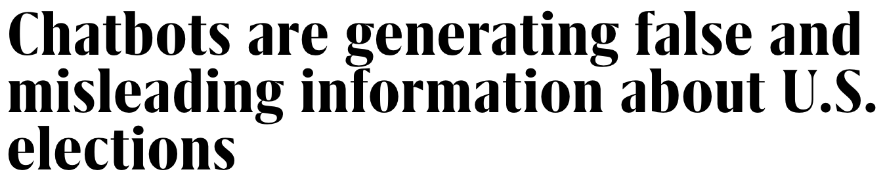
Misinformation

Slide 72
Large Language Models
Harms of Large Language Models

