Slide 1
Energy-Efficient Communications Protocol for wireless microsensor networks
W. Heinzelman, A. Chandrakasan, H. Balakrishnan, Published in 2000

Slide 2
Overview
Problem Description
Energy Models
Conventional Methods
LEACH Algorithm
Conclusions

Slide 3
Sensor Network Reachback Problem
Sensor nodes distributed randomly (~U)
Homogenous, finite energy nodes
Distant processing station (Direct communication expensive)
Sensor coordination
  Clustering
  Preprocessing
Goal: Maximize lifetime of the system
  Detailed Energy model

Slide 4
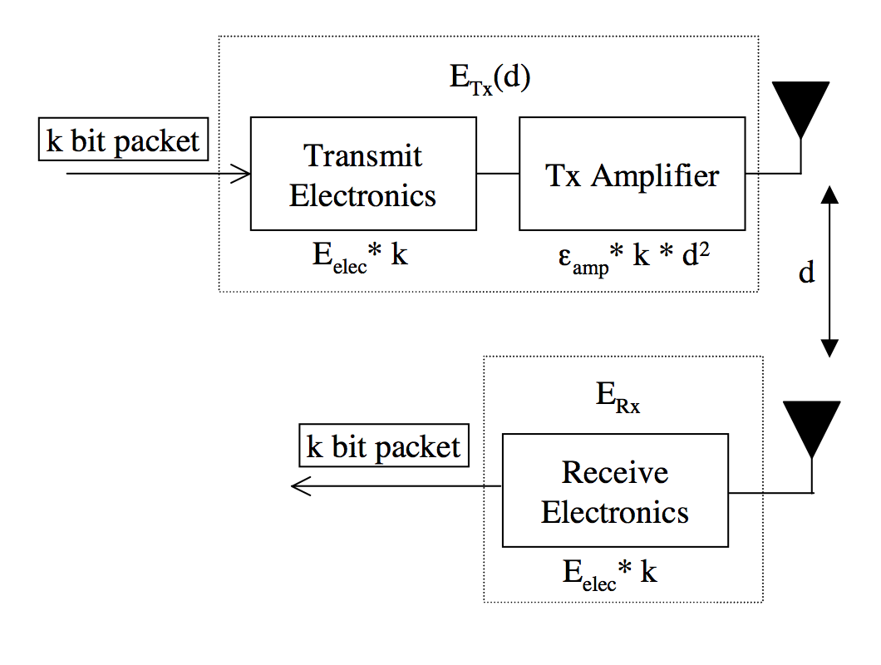
Energy Model
First-Order Model:
  E_{Tx}(k, d) = k (E_{elec} + d² ε_{amp})
  E_{Rx}(k) = k E_{elec}
k Number of bits/packet
d Distance to destination
E_{elec} Circuit energy/bit
ε_{amp} Amplifier Energy
Parameter values chosen for Bluetooth specifications
  E_{elec} = 50 nJ/bit
  ε_{amp} = 100 pJ/bit/m²

Slide 5
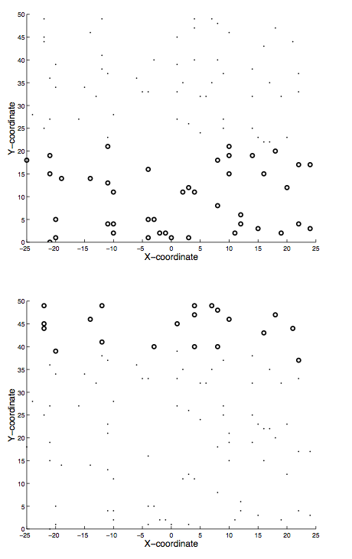
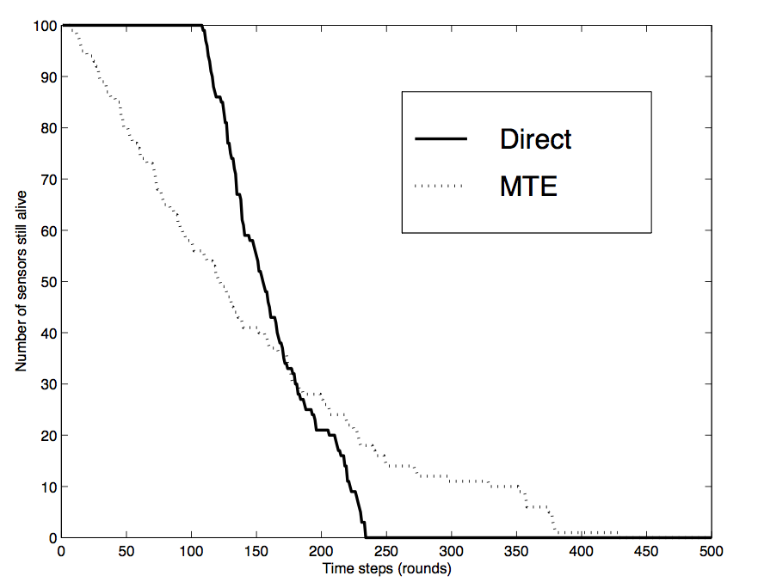
Conventional Approaches
Direct Transmission: Every node communicates directly with processing station
Minumum Transmit Energy (MTE): Multi-hop routing to minimize distances
Problem: Uneven energy burden
  Leads to spatial death and poor sampling
Y-coordinate
X-coordinate
Number of Nodes Alive
Y-coordinate
Time Step
X-coordinate

Slide 6
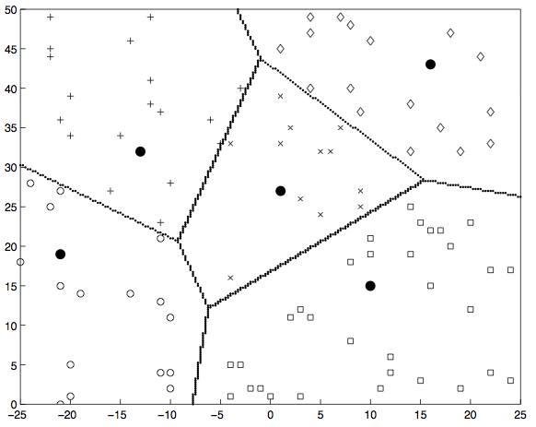
Clustering
Hybrid of Direct and MTE strategies
  Cluster head collects data from cluster (MTE)
  Compresses data
  Cluster head sends data to processing center (Direct)
However…
  Static clustering inherits drawbacks:
  Cluster heads die quickly
  Lose entire clusters at a time
Low Energy Adaptive Clustering Hierarchy (LEACH)

Slide 7
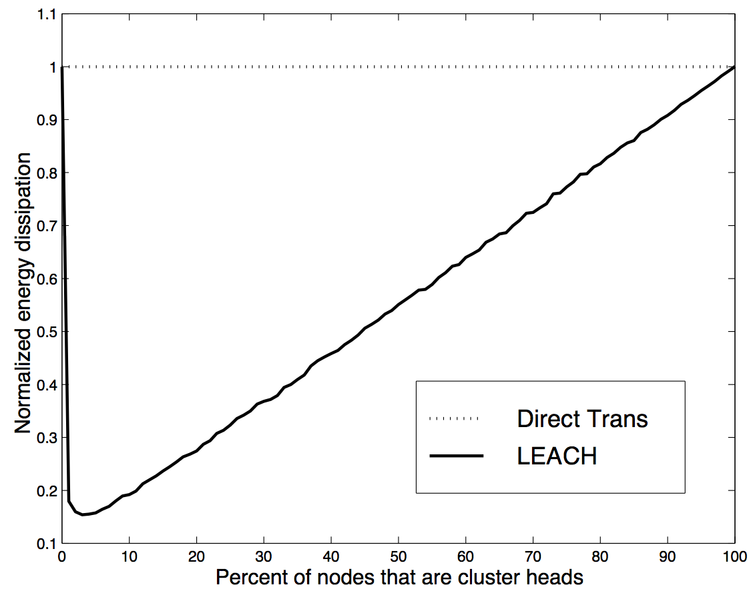

LEACH: Adaptive Clustering
Self Organizing Clusters
  Nodes decide to become ‘cluster heads’ at each time step
Adaptive Clustering
  Choice determined by time since last choice and remaining energy
Optimal P depends on topology
Normalized Energy Dissipation
P – Desired percentage of cluster heads
T(n) – Decision threshold
r – current round
G – Set of nodes which have not been cluster heads in the last 1/P rounds
Percent of nodes that are cluster heads

Slide 8
LEACH: Algorithm
Advertise
  Compare random variable ~U[0,1] to T(n)
Set-up
  Use RSS to determine which cluster to join
Schedule
  Cluster head sends TDMA schedule
Data Transmission
  Nodes send raw data to cluster head
  Cluster head compresses data
  Compressed data sent to processing station

Slide 9
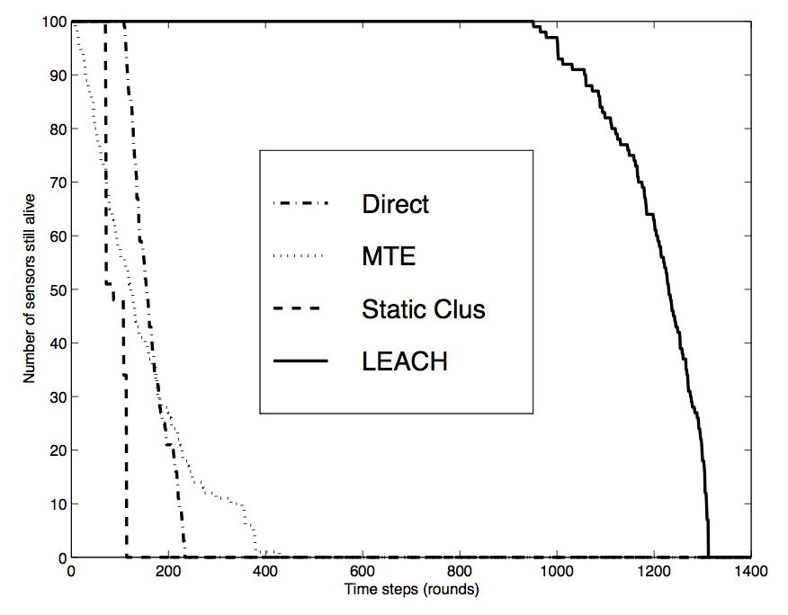
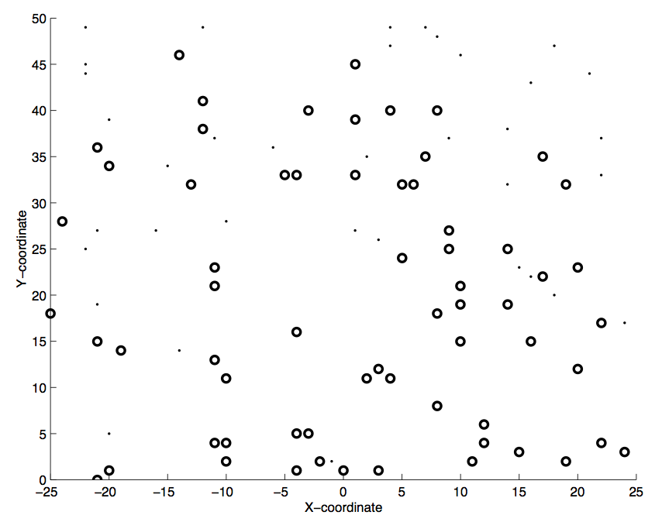
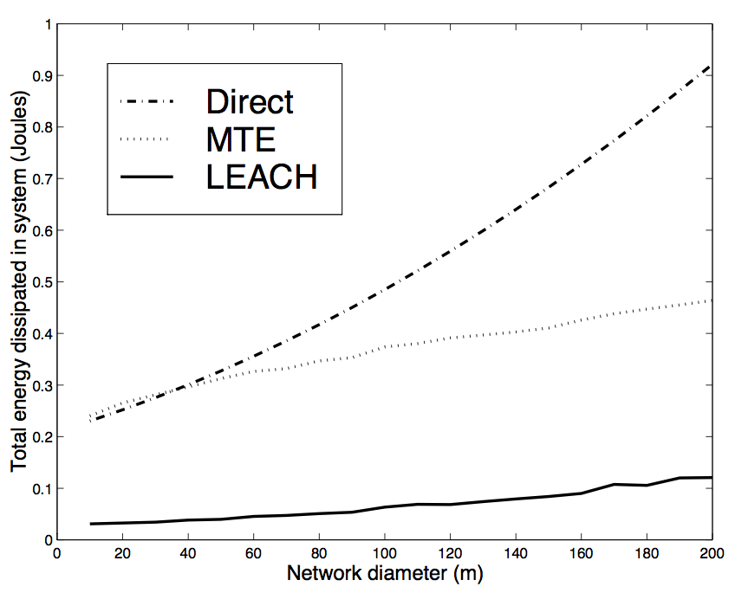
LEACH: Improves Network Lifetime
P = 5%, k = 2000
Life energy: 0.5J,
Compression: 5nJ/bit/packet
Random node death
Improves lifetime
  8x Direct
  6x MTE
Number of nodes alive
Time Step
Y-coordinate
Total Energy Dissipated (J)
X-coordinate
Network diameter (m)

Slide 10
LEACH: Issues
Poor performance in very dense networks
Not guaranteed to have valid schedules
  Overloading one cluster head
Old Multi-access techniques
  CSMA, TDMA

Slide 11
Conclusions
Detailed model uncovers new challenges
Adaptive approach for energy balancing
Significant improvement in lifetime
Paved the way for many other projects

