Slide 1
Interference Alignment and Cancellation
Shyamnath Gollakota, Samuel David Perli and Dina Katabi
MIT CSAIL
EE360 Presentation
Omid Aryan

Slide 2
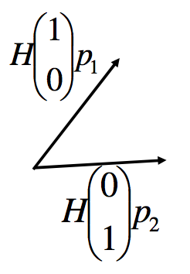
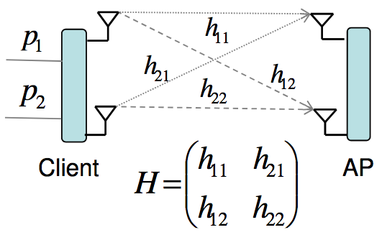
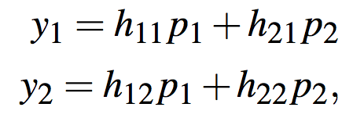
MIMO Background

Slide 3
MIMO Background

Slide 4
MIMO Background
Decoding Vector
P1
P2
Decoding Vector

Slide 5

Problem Statement
Room 1
Client 1
AP 1
Room 2
Client 2
AP 2
2 Packets/Time
Can we do better?

Slide 6
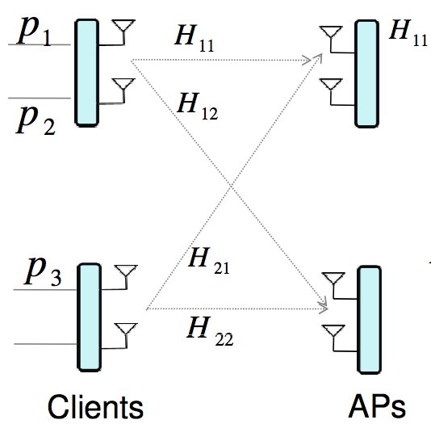
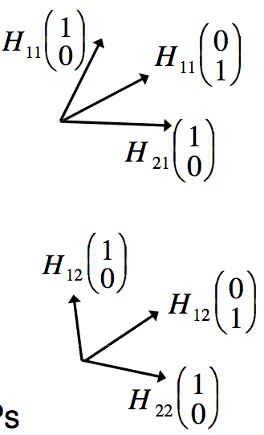
Interference Alignment and Cancellation (IAC)
IAC exploits two properties of MIMO LANs:
MIMO transmitters can control the alignment of their signals at a receiver
APs are typically connected to a backend Ethernet

Slide 7
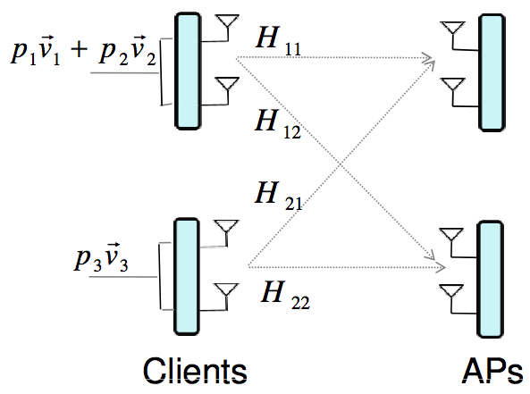
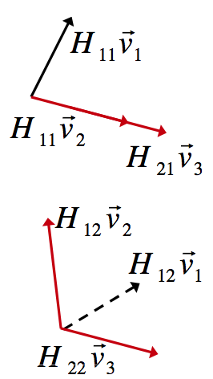

IAC - Uplink
Ethernet
3 Packets/Time
Choose the encoding vectors v1, v2, and v3 such that (interference alignment)
AP1 can now decode p1 by projecting the vector corresponding to p1 on the direction orthogonal to the aligned vectors corresponding to p2 and p3.
AP1 sends the decoded p1 symbol to AP2.
AP2 can now subtract the vector corresponding to p1 (interference cancellation) and decode the symbols p2 and p3.

Slide 8
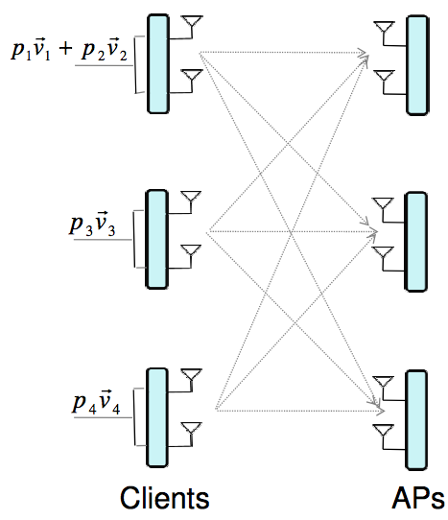
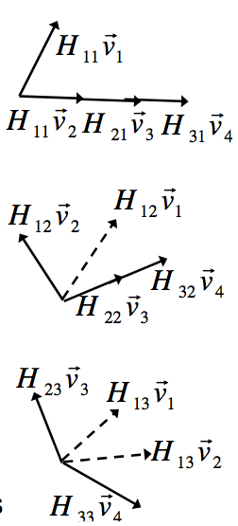
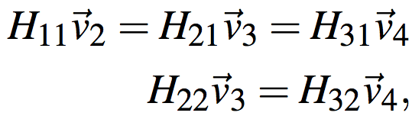
IAC - Uplink
Yes!
Can we achieve more packets/time with M=2?
Ethernet
4 Packets/Time

Slide 9
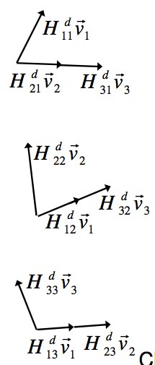
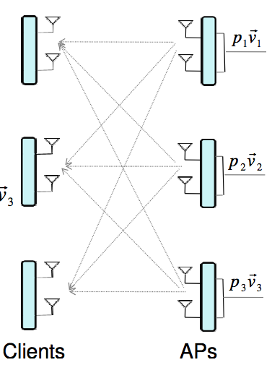
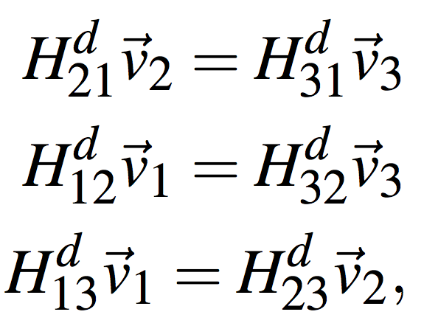
IAC - Downlink
Ethernet
3 Packets/Time

Slide 10
Beyond Two Antennas
If we have M antennas per node, what is the maximum packets/time that can be delivered?
How many APs are needed for this system?

Slide 11
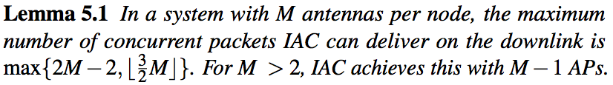
Lemmas

Slide 12
Medium Access Control in IAC
One AP is designated as the leader, which acts as a coordinator.
Time is divided into: Contention Free Period (CFP) and Contention Period (CP)
CFP is when the downlink and uplink transmissions occur, while CP allows the clients to contend to associate with APs.
The leader AP runs a concurrency algorithm, which divides clients with pending traffic into groups of concurrent transmissions (transmission groups). The algorithm also decides which AP serves which client in a transmission group, and the values of the encoding and decoding vectors.
Ethernet

Slide 13
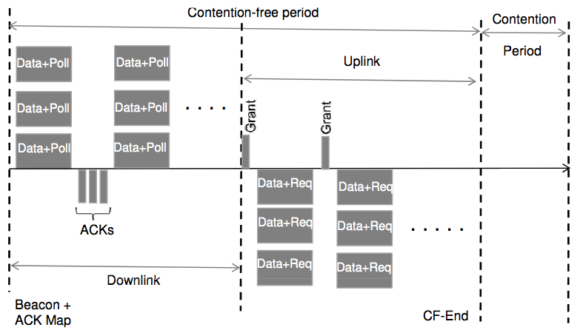
Medium Access Control in IAC (continued)
Downlink:
  Leader AP goes through the list of downlink transmission groups.
  For each group, the leader AP first broadcasts the ids of the clients in the group and their encoding and decoding vectors .
  Concurrent transmissions from the APs begin, followed by the ACKs from the clients.

Slide 14
Medium Access Control in IAC (continued)
Uplink:
  Leader AP goes through the list of uplink transmission groups.
  For each group, the leader AP first broadcasts a “Grant” frame specifying the ids of the clients in the group and their encoding and decoding vectors .
  Concurrent transmissions from the clients begin.
  The APs will notify the leader of their successful receptions, and the leader will combine all the ACKs and broadcast them during the next CFP.

Slide 15
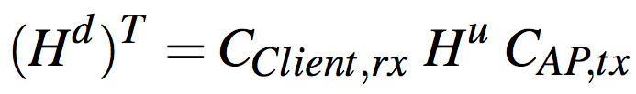
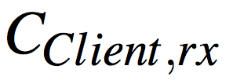
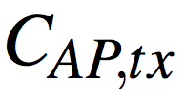
Channel Estimation
The APs estimate and convey the channels to the leader AP via Ethernet.
The first time a client broadcasts an association message, all APs estimate the channel from that client to themselves. The APs continue “tracking” the channel using the client’s ACK and data packets.
The downlink channel is related to the uplink channel via reciprocity, but they are not the same!
IAC uses a calibration method from QUALCOMM’s 802.11n proposal:
Ethernet
and are constant diagonal matrices that describe the extra attenuation and delay observed by the signal in the transmit and receive hardware chains on the client and the AP respectively.

Slide 16
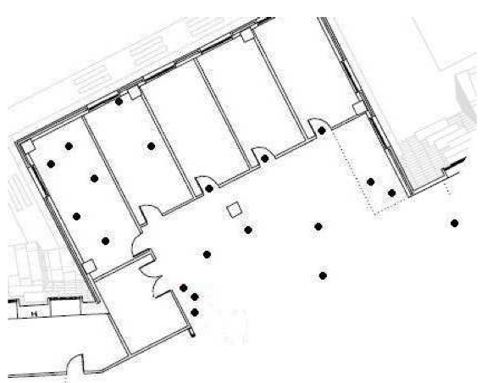
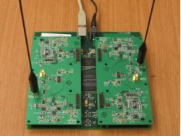
Performance Evaluation
Testbed of 20 MIMO software defined radio nodes.
Each node has two antennas.
All nodes are within radio range of each other.
IAC was compared to 802.11n (which uses point-to-point MIMO)

Slide 17
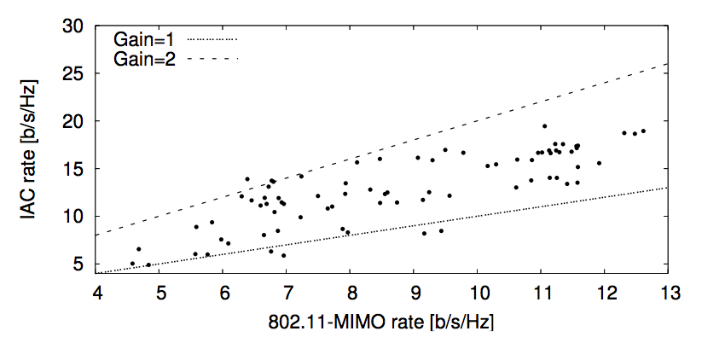
Results-1
2-Client and 2-AP Uplink
Each point is a particular choice of 2 clients and 2 APs.
IAC increases the transfer rate by 1.5x over 802.11n

Slide 18
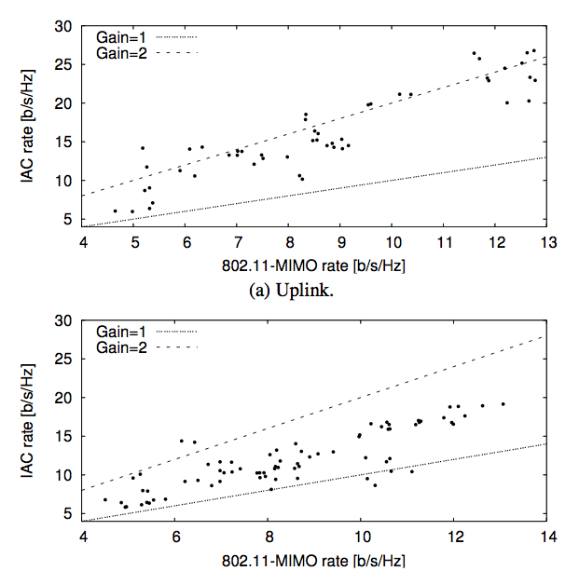
Results-2
3-Client and 3-AP Uplink and Downlink
Each point is a particular choice of 3 clients and 3 APs.
IAC increases the rate by 1.8x on the uplink and 1.4x on the downlink.

Slide 19
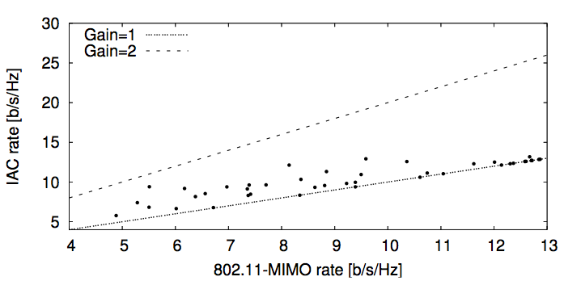

Results-3
1-Client and 2-AP Downlink
In this case, IAC provides a diversity gain over 802.11n because it allows the client to choose between downloading two concurrent packets from one of the two APs, or using both APs concurrently, downloading one packet from each.
Ethernet

Slide 20
Related work
Interference Alignment:
  M. A. Ali, S. A. Motahari, and A. K. Khandani. Communication over MIMO X Channels: Interference Alignment, Decomposition, and Performance Analysis. Tran. on Info. Theory, 2008.
  V. Cadambe and S. Jafar. Interference Alignment and the Degrees of Freedom for the K User Interference Channel. In Trans. on Information Theory, 2008.
Interference Cancellation:
  D. Halperin, T. Anderson, and D. Wetherall. Taking the sting out of carrier sense: Interference Cancellation for wireless LANs. In ACM Mobicom, 2008.
Virtual MIMO:
  C. Huang and S. Jafar. Degrees of Freedom of the MIMO Interference Channel with Cooperation and Cognition. In arxiv: 0803.1733, 2008.

Slide 21
IAC is superior because…
It is the first to combine interference alignment and interference cancellation to achieve higher throughputs.
It is the first to present a system design and an implementation of interference alignment.
IAC’s receivers communicate decoded packets instead of raw received signal samples.

Slide 22
Conclusion
The paper presented IAC, which combines interference alignment and interference cancellation to achiever higher throughputs.
IAC achieves more packets per time slot compared to point-to-point MIMO systems (802.11n), which was confirmed by implementing and evaluating the system.

