Slide 1
Stochastic Geometry and Random Graphs for the analysis and design of Wireless networks
Haenggi et al
EE 360 : 19th February 2014.

Slide 2
Contents
SNR, SINR and geometry
Poisson Point Processes
  Analysing interference and outage
Random Graph models
Continuum percolation and network models
Other applications
  Routing
  Epidemic models

Slide 3
Introduction
SNR metric used to characterize performance
But wireless networks limited by interference – SINR
SINR depends on
  Network geometry – node location
  MAC protocol being used
Uncertainty in the system
  regarding location
  number of users
  channel, etc.

Slide 4
Introduction
Stochastic Geometry – study of system behaviour averaged over many spatial realizations
Random graph models – distance dependence and connectivity of nodes
Techniques applied to study cellular networks, wideband networks, wireless sensor networks, cognitive radio, hierarchical networks and ad hoc networks

Slide 5
Point Processes
Informally – random collection of points in space.
May be simple – points do not occur at the same spot
Stationary – law of the point process invariant by translation
Isotropic – Invariant by rotation
Homogenous – Density of the points common in space.
Important mathematically tractable process : Poisson Point Process (PPP)

Slide 6
Poisson Point Process
Definition : number of events occurring in disjoint subsets of the sample space is Poisson and Independent.
Similar to Poisson process in time – memory less and independent.
Mathematically tractable
Properties:
  Sum of PPPs is a PPP.
  Independent thinning of a PPP is a PPP.
  Displacing points independently is a PPP.
Independent distribution not applicable in all cases – nodes may not be close to one other – other models like Matern process

Slide 7
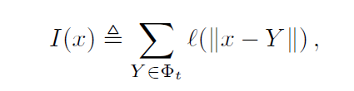
Interference Characterization
Simple path loss model usually chosen for interferer
A subset of the randomly placed users transmit – random thinning, used in Aloha
Points are considered to a homogenous PPP – Interference is a sum of independent random variables – Transform analysis
For finite moments of the interference, path loss exponent > dimensions.
Rayleigh faded systems have finite moments of interference.

Slide 8
Outage and Throughput
Outage occurs when SINR level falls below threshold T.
Resultant expression depends on SNR and previously obtained Interference characterization.
In ALOHA networks, throughput = f(p) = p(1-p)p_{s} (p) must be optimized, p is transmission probability.
Strikes balance between spatial reuse and success probability.
Similar framework for optimizing Area Spectral Efficiency, transmission capacity
Can be used to compare techniques such as spread spectrum, frequency hopping on ad hoc networks.

Slide 9

Random Graph Models
Germ-Grain model:
  Germs are a point process.
  Grains distributed for each germ in an IID set
  Model useful for studying coverage, fraction covered.
Gilbert’s Random Disk model :
  Points are spread according to a PPP.
  Edge connects points if the separating distance less than d.
  Grain here: Disks
Nodes connected if – the grain set on germ overlaps
Continuum percolation – studying connectedness of graph

Slide 10
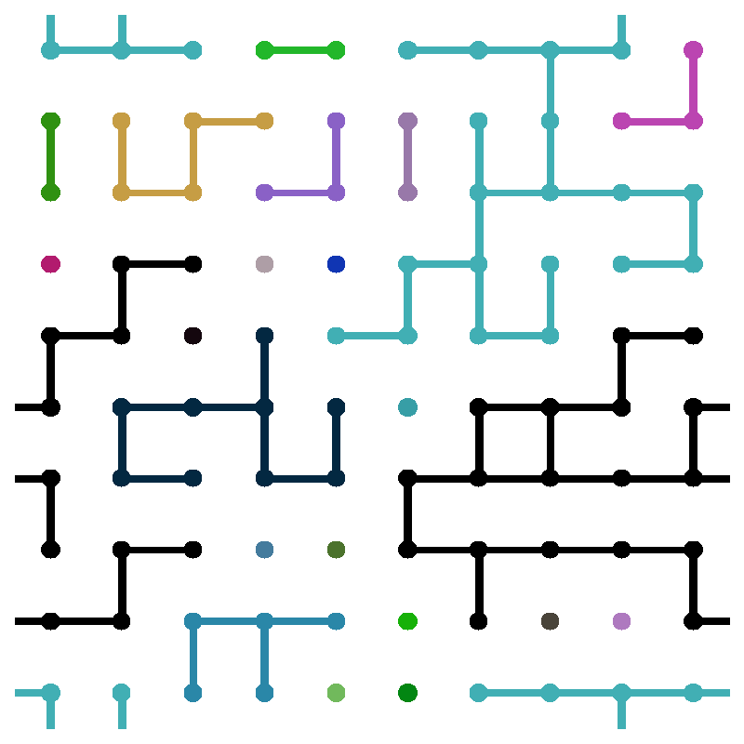
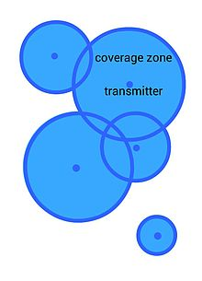
Percolation Theory
http://en.wikipedia.org/wiki/File:BooleanCellCoverage.jpg
http://pages.physics.cornell.edu/~myers/teaching/Compu
tationalMethods/ComputerExercises/Fig/BondPercolation
_10_0.4_1.gif

Slide 11
Percolation Theory
Key Result in Percolation theory in bond percolation in infinite lattice, there exists a phase transition point.
Adjacent nodes are independently connected with probability p_{c}.
For small p_{c}, the probability of getting an infinite component is zero and one for large p_{c}
There is a value of p_{c} (phase transition point) at which this transition occurs.
For Gilbert disk process, the phase transition occurs at the intensity point >1/πr². For values lower, it is subcritical with no component of infinite size.

Slide 12
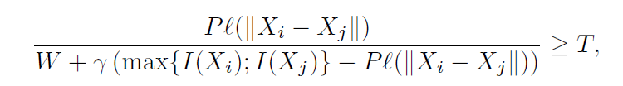
Other Models used in Percolation Theory
If a node is connected to its k nearest neighbours : scale free, independent of intensity of PP.
k>3 for connected component to form.
Random connection model : Adjacent nodes are connected according to an iid distribution –
  models shadowing, fading.
Signal to Interference Ratio Graph (STRIG) : Nodes connected if

Slide 13
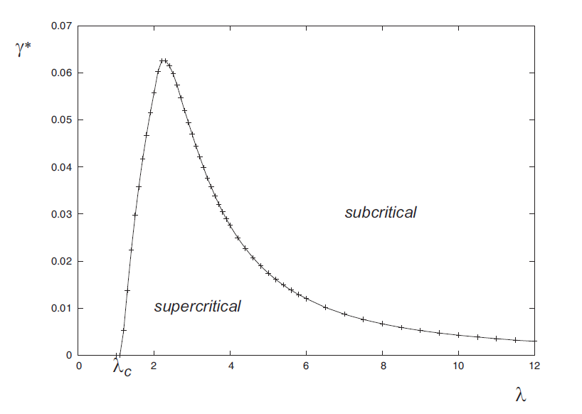
Other Models in Percolation Theory
Finite networks : Connected component size scales as a function of log (n) if previous conditions met.

Slide 14
Application : Routing and Epidemics
Flooding :
  Every user forwards
  Broadcasts reaches all a.s. – Connected component
Gossiping:
  A user who receives forwards with some probability
  Succesful broadcast – thinned PP has connected component
Results can be expanded to include SINR
First passage percolation:
  Studies length of shortest path connecting components
  Studying speed of dynamic model.

Slide 15
Conclusion
Wireless networks limited by interference which depends on network geometry, MAC protocol, uncertain location.
Stochastic Geometry which describes properties averaged over spatial realizations ideal tool to study wireless network performance
Outage probability, interference, Spectral Efficiency characterized
Random Graph models study when the point process is connected answers – what fractions of the nodes covered, minimum density that can be served

