Slide 1
EE360: Lecture 8 Outline
Intro to Ad Hoc Networks
Announcements
  Makeup lecture this Friday, 2/7, 12-1:15pm in Packard 312
  Paper summary 1 due today
  Proposal feedback sent, revision due Monday 2/10
  HW 1 posted, due 2/19
Overview of Ad-hoc Networks
Design Issues
MAC Protocols
Routing
Relay Techniques
Adaptive Techniques
Power Control

Slide 2
Ad-Hoc Networks
Peer-to-peer communications
  No backbone infrastructure or centralized control
Routing can be multihop.
Topology is dynamic.
Fully connected with different link SINRs
Open questions
  Fundamental capacity
  Optimal routing
  Resource allocation (power, rate, spectrum, etc.) to meet QoS
Notes:
-No backbone: nodes must self-configure into a network.
-In principle all nodes can communicate with all other nodes, but multihop routing can reduce the interference associated with direct transmission.
-Topology dynamic since nodes move around and link characteristics change.
-Applications: appliances and entertainment units in the home, community networks that bypass the Internet. Military networks for robust flexible easily-deployed network (every soldier is a node).

Slide 3
Ad-Hoc Network
Design Issues
Ad-hoc networks provide a flexible network infrastructure for many emerging applications.
The capacity of such networks is generally unknown.
Transmission, access, and routing strategies for ad-hoc networks are generally ad-hoc.
Crosslayer design critical and very challenging.
Energy constraints impose interesting design tradeoffs for communication and networking.

Slide 4
Medium Access Control
Centralized access entails significant overhead
Decentralized channel access more common
  Minimize packet collisions and insure channel not wasted
  Collisions entail significant delay
Aloha w/ CSMA/CD have hidden/exposed terminals
802.11 uses four-way handshake
  Creates inefficiencies, especially in multihop setting
Exposed
Terminal
Hidden
Terminal
1
2
3
4
5

Slide 5
Frequency Reuse
More bandwidth-efficient
Distributed methods needed.
Dynamic channel allocation hard for packet data.
Mostly an unsolved problem
CDMA most common
  No overhead required

Slide 6
DS Spread Spectrum Reuse:
Code Assignment
Common spreading code for all nodes
  Collisions occur whenever receiver can “hear” two or more transmissions.
  Near-far effect improves capture.
  Broadcasting easy
Receiver-oriented
  Each receiver assigned a spreading sequence.
  All transmissions to that receiver use the sequence.
  Collisions occur if 2 signals destined for same receiver arrive at same time (can randomize transmission time.)
  Little time needed to synchronize.
  Transmitters must know code of destination receiver
    Complicates route discovery.
    Multiple transmissions for broadcasting.

Slide 7
Transmitter-oriented
  Each transmitter uses a unique spreading sequence
  No collisions
  Receiver must determine sequence of incoming packet
    Complicates route discovery.
    Good broadcasting properties
  Poor acquisition performance
Preamble vs. Data assignment
  Preamble may use common code that contains information about data code
  Data may use specific code
  Advantages of common and specific codes:
    Easy acquisition of preamble
    Few collisions on short preamble
    New transmissions don’t interfere with the data block

Slide 8
Introduction to Routing
Destination
Source
Routing establishes the mechanism by which a packet traverses the network
A “route” is the sequence of relays through which a packet travels from its source to its destination
Many factors dictate the “best” route
Typically uses “store-and-forward” relaying
  Network coding breaks this paradigm

Slide 9
Routing Techniques
Flooding
  Broadcast packet to all neighbors
Point-to-point routing
  Routes follow a sequence of links
  Connection-oriented or connectionless
Table-driven
  Nodes exchange information to develop routing tables
On-Demand Routing
  Routes formed “on-demand”
“A Performance Comparison of Multi-Hop Wireless Ad Hoc Network
Routing Protocols”: Broch, Maltz, Johnson, Hu, Jetcheva, 1998.

Slide 10
Relay nodes in a route
Source
Relay
Destination
Intermediate nodes (relays) in a route help to forward the packet to its final destination (minimize total TX power)
Decode-and-forward (store-and-forward) most common:
  Packet decoded, then re-encoded for transmission
  Removes noise at the expense of complexity
Amplify-and-forward: relay just amplifies received packet
  Also amplifies noise: works poorly for long routes; low SNR.
Compress-and-forward: relay compresses received packet
  Used when Source-relay link good, relay-destination link weak
Often evaluated via capacity analysis

Slide 11
Route dessemination
Route computed at centralized node
  Most efficient route computation.
  Can’t adapt to fast topology changes.
  BW required to collect and desseminate information
Distributed route computation
  Nodes send connectivity information to local nodes.
  Nodes determine routes based on this local information.
  Adapts locally but not globally.
Nodes exchange local routing tables
  Node determines next hop based on some metric.
  Deals well with connectivity dynamics.
  Routing loops common.

Slide 12
Reliability
Packet acknowledgements needed
  May be lost on reverse link
  Should negative ACKs be used.
Combined ARQ and coding
  Retransmissions cause delay
  Coding may reduce data rate
  Balance may be adaptive
Hop-by-hop acknowledgements
  Explicit acknowledgements
  Echo acknowledgements
    Transmitter listens for forwarded packet
    More likely to experience collisions than a short acknowledgement.
  Hop-by-hop or end-to-end or both.

Slide 13
Adaptive Techniques for
Wireless Ad-Hoc Networks
Network is dynamic (links change, nodes move around)
Adaptive techniques can adjust to and exploit variations
Adaptivity can take place at all levels of the protocol stack
Negative interactions between layer adaptation can occur

Slide 14
What to adapt, and to what?
QoS
  Adapts to application needs, network/link conditions, energy/power constraints, …
Routing
  Adapts to topology changes, link changes, user demands, congestion, …
Transmission scheme (power, rate, coding, …)
  Adapts to channel, interference, application requirements, throughput/delay constraints, …
Adapting requires information exchange across
layers and should happen on different time scales

Slide 15
Bottom-Up View:
Link Layer Impact
“Connectivity” determines everything (MAC, routing, etc.)
  Link SINR and the transmit/receive strategy determine connectivity
  Can change connectivity via link adaptation
Link layer techniques (MUD, SIC, smart antennas) can improve MAC and overall capacity by reducing interference
Link layer techniques enable new throughput/delay tradeoffs
  Hierarchical coding removes the effect of burstiness on throughput
  Power control can be used to meet delay constraints

Slide 16
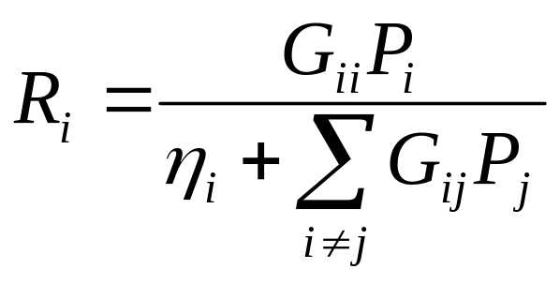
Power Control Adaptation
P_{i}
G_{ii}
G_{ij}
P_{j}
Each node generates independent data.
Source-destination pairs are chosen at random.
Topology is dynamic (link gain G_{ij}s time-varying)
Different link SIRs based on channel gains G_{ij}
Power control used to maintain a target R_{i} value
Notes:
BIG DIFFERENCE BETWEEN AD HOC AND CELLULAR. START OFF WITH THE FOLLOWING SETUP

Slide 17
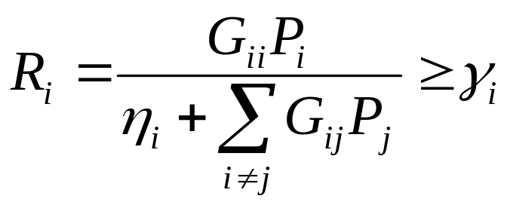
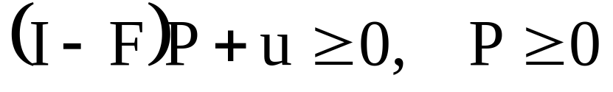
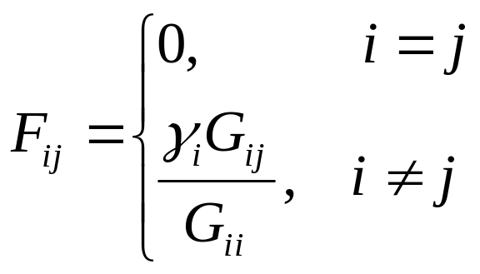
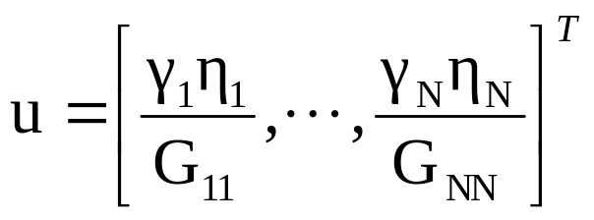
Power Control for Fixed Channels
Seminal work by Foschini/Miljanic [1993]
Assume each node has an SIR constraint
Write the set of constraints in matrix form
Scaled Interferer Gain
Scaled Noise

Slide 18
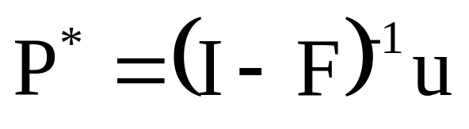
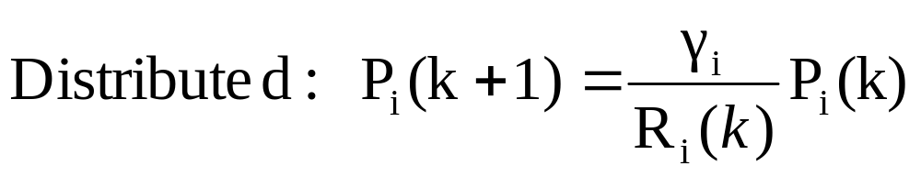
Optimality and Stability
Then if ρ_{F} <1 then ∃ a unique solution to
P* is the global optimal solution
Iterative power control algorithms P→P*

Slide 19
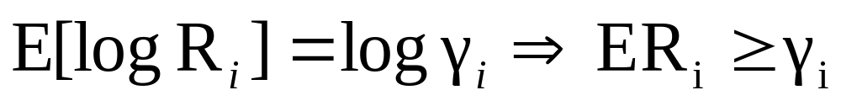
What if the Channel is Random?
Can define performance based on distribution of R_{i}:
  Average SIR
  Outage Probability
  Average BER
The standard F-M algorithm overshoots on average
How to define optimality if network is time-varying?

Slide 20
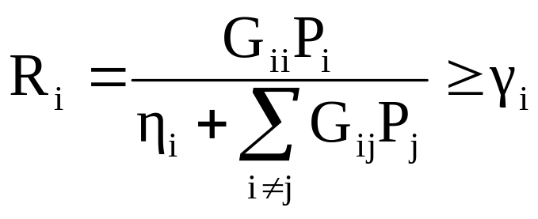
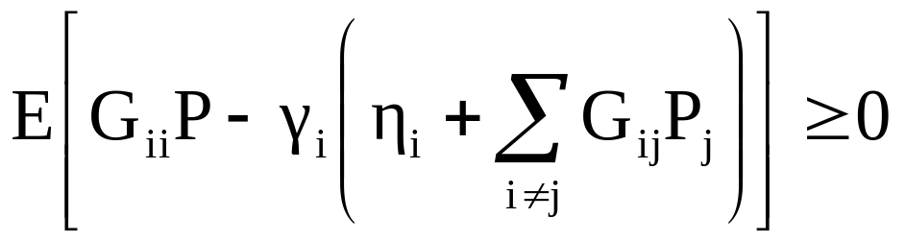
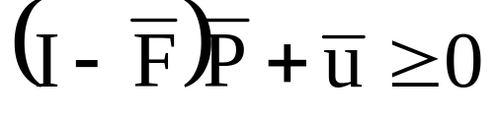
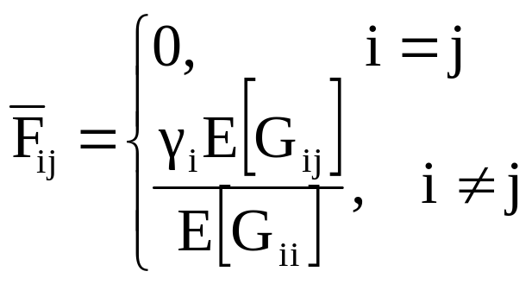
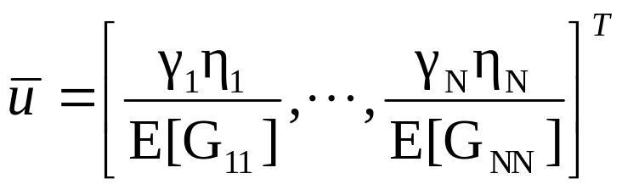
Can Consider A New SIR Constraint
⇐ Original constraint
⇐ Multiply out and take expectations
⇐ Matrix form
Same form as SIR constraint in F-M for fixed channels

Slide 21
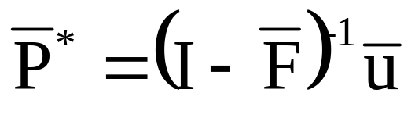
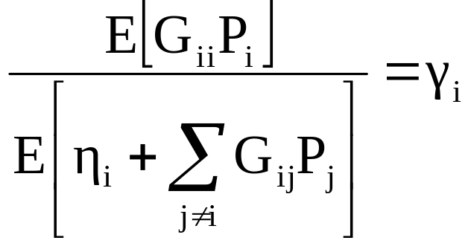
New Criterion for Optimality
If ρ_{F}<1 then exists a global optimal solution
For the SIR constraint
Can find P* in a distributed manner using stochastic approximation (Robbins-Monro)

Slide 22
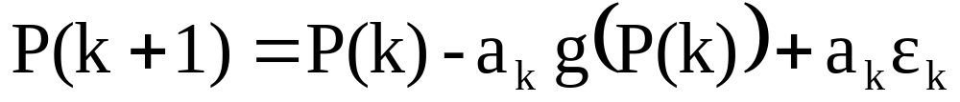
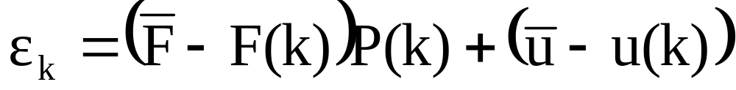
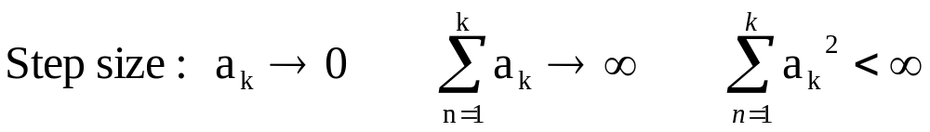
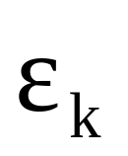
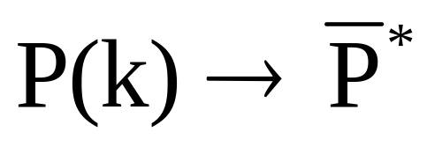
Robbins-Monro algorithm
Where ε_{k} is a noise term
Under appropriate conditions on
Notes:
DISTRIBUTED!!!!!

Slide 23
Admission Control
What happens when a new user powers up?
  More interference added to the system
  The optimal power vector will move
  System may become infeasible
Admission control objectives
  Protect current user’s with a “protection margin”
  Reject the new user if the system is unstable
  Maintain distributed nature of the algorithm
Tracking problem, not an equilibrium problem

Slide 24
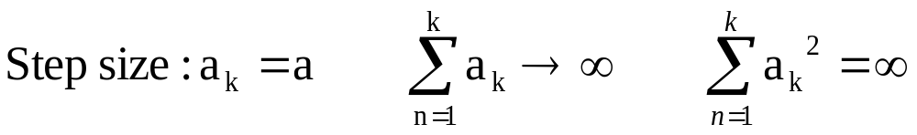
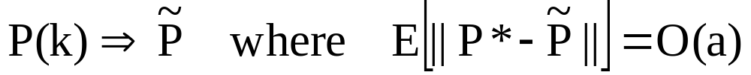
Fixed Step Size Algorithm Properties
Have non-stationary equilibria
  So cannot allow a_{k} → 0
A fixed step size algorithm will not converge to the optimal power allocation
This error is cost of tracking a moving target

Slide 25
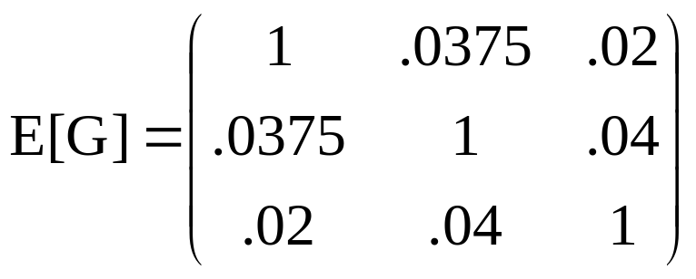
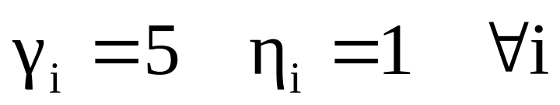
Example: i.i.d. Fading Channel
Suppose the network consists of 3 nodes
Each link in the network is an independent exponential random variable
Note that ρ_{F}=.33 so we should expect this network to be fairly stable

Slide 26
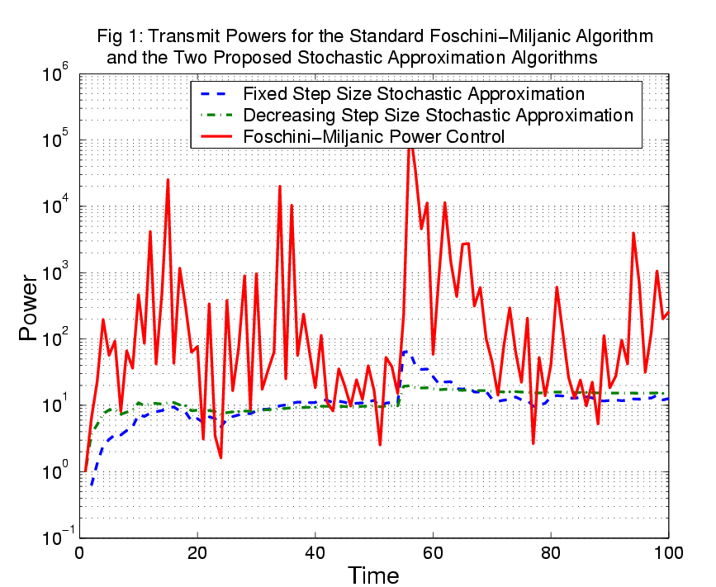

Slide 27
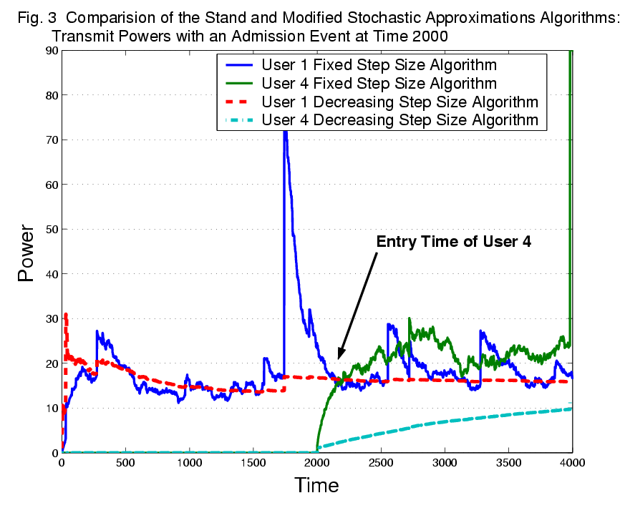

Slide 28
Power Control + …
Power control impacts multiple layers of the protocol stack
Power control affects interference/SINR, which other users react to
Useful to combine power control with other adaptive protocols
  Adaptive routing and/or scheduling (Haleh)
  Adaptive modulation and coding
  Adaptive retransmissions
  End-to-end QoS
  …

Slide 29
Multiuser Adaptation
Receiver
Channel
Traffic
Generator
Data
Buffer
Source
Coder
Channel
Coder
Modulator
(Power)
Cross-Layer Adaptation
Channel interference is responsive to the cross-layer adaptation of each user
Notes:
WHAT IS IT ABOUT MULTI USER THAT MAKES IT HARD!?!?!?! This is the picture I showed earlier describing a single-user system. Recall the two key points I made. First, that all of the randomness in the system comes from the traffic generator and the channel, and second, that the things we control are marked by this box. So the key difference between the single-user and multi-user models is that the channel now falls into this box. Specifically, the interference in the channel now responds to the cross-layer adaptation chosen by each user. Intuitively this should make sense. Suppose I have a two user system and user 1 raises its power. Then the interference observed by user 2 will increase and user 2 will increase power also. So the interference observed by a single user is responsive to that user’s choice of adaptive control. Just looking at the picture this may not seem like a very big deal, I’m just adding in one more box. But the channel is really what drives every problem in wireless communications, and now I’m permitting the interference in the channel to be a controlled stochastic process, which is very different from the single user formulation. As you can imagine, this extension adds in all sorts of difficulties.

Slide 30
Multiuser Problem Formulation
Optimize cross-layer adaptation in a multi-user setting
Users interact through interference
  Creates a “Chicken and Egg” control problem
  Want an optimal and stable equilibrium state and adaptation for the system of users
The key is to find a tractable stochastic process to describe the interference
Notes:
Generically, we would like to solve the same cross-layer adaptation problems I talked about before but now in a multi-user setting. And in this multi-user setting the user interact through the interference that they create. The key issue that pops up here is that this creates a chicken and egg control problem. For each user to figure out what adaptation they should choose, they need to know how the other mobiles in the system will respond. This is random dynamic system evolving over time and the adaptation you choose now affects how other users act in the future. The problem is, in order to figure out how the other users will respond, I need to know what control they are using. But I don’t know the control policy, that’s the point of solving the problem. So you need the interference behavior to solve the problem, and you need to solve the problem to figure out the interference behavior. What we would hope is that there is an equilibrium somewhere, where the optimal control and interference model are consistent. And it is this equilibrium that we’re trying to find. The key is the stochastic process describing the interference.

Slide 31
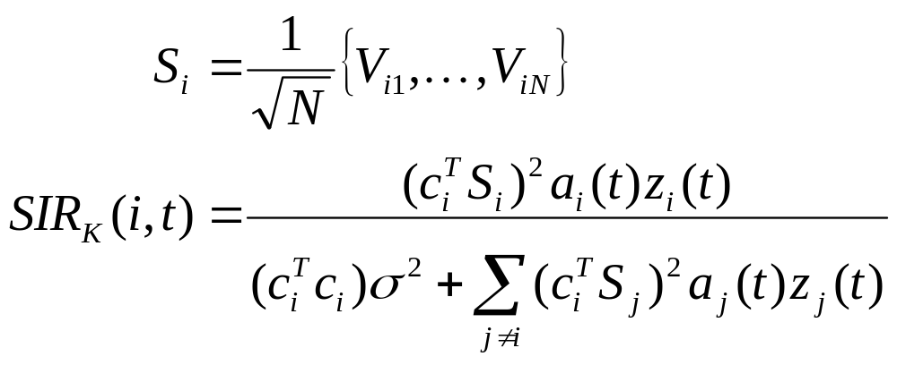
Linear Multi-User Receiver
Assume each of K mobiles has interference reduced by c_{i} (may be via an N-length random spreading sequence)
The attenuation c_{i} takes different values for different structures (MMSE, de-correlator, etc.)
Interference term
Notes:
The component of the system that determines the interference is the structure of the receiver at the basestation. As I mentioned, we will assume each basestation employs a linear multiuse receiver, and this is the equation for the SIR of such a receiver. Assume the system contains K mobiles and that each mobile is assigned a N length random spreading sequence. The meaning of each term isn’t important. The top is user i’s received power, the bottom two terms are the thermal noise and the sum of the effective interference generated by all other users. So based on this receiver structure it’s easy to see how each user’s power affects the SIR of everyone else in the system.

Slide 32
Interference Models
Jointly model the state space of every mobile in the system
  Problem: State space grows exponentially
Assume unresponsive interference
  Avoids the “Chicken and Egg” control issue
  Problem: Unresponsive interference models provide misleading results
Approximations use mean-field approach
  Model aggregate behavior as an average
  Can prove this is optimal in some cases
Distributed Power Control for Time-Varying Wireless Networks: Optimality and Convergence
T. Holliday, N. Bambos, P. W. Glynn, and A. Goldsmith, 2003 Allerton Conference
Notes:
Several authors have proposed solutions to this problem. The most obvious solution is to avoid trying to characterize the interference altogether and just explicitly model the state space of every user in the system. The problem there is that the state space grows exponentially with the number of users, so in a system with just 50 or 60 users the problem is totally intractable. Another idea, and this one is actually VERY common in the literature, is to assume the interference is unresponsive. This gets rid of the chicken and egg problem. However, our work has shown that solving problems using an unresponsive interference model can create misleading results.
Finally, a recent paper has proposed using diffusion approximations for this problem. The problem is that diffusion approximations do not do a good job of capturing delay performance. So while they might work well for capacity problems, they just don’t work in the delay constrained case. We propose a new approach based on wideband limit approximations for CDMA networks.

Slide 33
Summary
Ad-hoc networks provide a flexible network infrastructure for many emerging applications
Commercial ad-hoc networks to date have experienced poor performance: designs are ad-hoc
Design issues traverse all layers of the protocol stack, and cross layer designs are needed
Protocol design in one layer can have unexpected interactions with protocols at other layers.
The dynamic nature of ad-hoc networks indicate that adaptation techniques are necessary and powerful

Slide 34
Today’s presentation
Jeff will present “Principles and Protocols for Power Control in Wireless Ad Hoc Networks”
Authors: Vikas Kawadia and P.R. Kumar
Published in IEEE Journal on Selected Areas in Communications, January 2005

