Slide 1
EE360: Multiuser Wireless Systems and Networks
Lecture 6 Outline
  Announcements
    Student presentation schedule circulated
    Project proposals due today
    Makeup lecture for 2/10 (Friday 2/7 or 2/21, time TBD)
    Makeup lecture for 3/5 needed
  Multiuser Detection in cellular
  MIMO in Cellular
    Diversity versus interference cancellation
    Smart antennas and DAS
  Virtual MIMO and CoMP
  Dynamic Resource Allocation

Slide 2
Presentation Schedule
(talks should be 20-25 min with 5 min for questions)
Ad-Hoc Networks:
  Feb 3: “Principles and Protocols for Power Control in Wireless Ad Hoc Networks” – Presented by Jeff
  Feb. 5: “XORs in the Air: Practical Wireless Network Coding” - Presented by Gerald
  Feb. 10 makeup lecture (likely Feb. 7): “Mobility Increases the Capacity of Ad-hoc Wireless Networks” – Presented by Chris
Wireless Network Design and Analysis
  Feb. 12: "Stochastic geometry and random graphs for the analysis and design of wireless networks” – Presented by Milind
  Feb. 19: ”Interference alignment and cancellation.” – presented by Omid
Cognitive Radio:
  Feb. 26: “Breaking Spectrum Gridlock With Cognitive Radios: An Information Theoretic Perspective” - Presented by Naroa
  March 3: "Multiantenna-assisted spectrum sensing for cognitive radio." - Presented by Christina
Sensor Networks:
  March 5 (to be rescheduled): “Routing techniques in wireless sensor networks: a survey” Presented by Abbas.
  March 10: "Energy-Efficient Communication Protocol for Wireless Microsensor Networks" – presented by Stefan

Slide 3

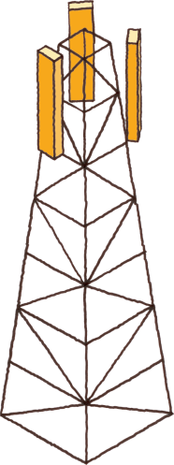

Review of Last Lecture
Small Cells, HetNets, and SoN
  Small cells key to large capacity increases
  Must be deployed in an automated fashion (SoN)
  Resistance from large cell vendors and carriers
Shannon Capacity of Cellular Systems
  Wyner model: Achievable rate region with out-of cell interference captures by propagation parameter α
  Optimal scheme uses TDMA within a cell, treats out-of-cell interference via joint decoding.
Area Spectral Efficiency: A_{e}=ΣR_{i}/(.25D²π) bps/Hz/Km².
  For BER fixed, captures tradeoff between reuse distance and link spectral efficiency (bps/Hz).
  Quantifies increase in ASE due to reduced cell size and reduced reuse distance
SoN
Server
IP Network
X2
X2
X2
X2
Small cell BS
Macrocell BS
8C32810.43-Cimini-7/98

Slide 4
MUD, Smart Antennas and MIMO in Cellular

Slide 5
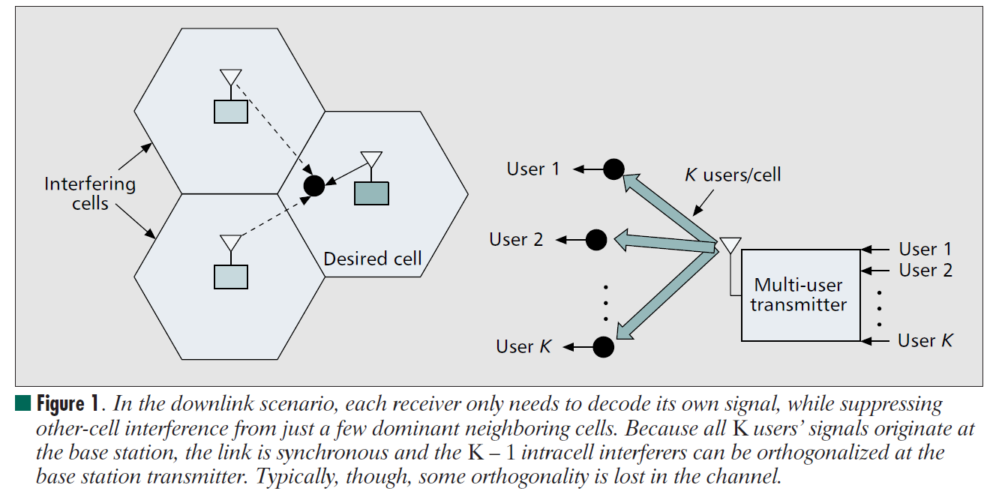
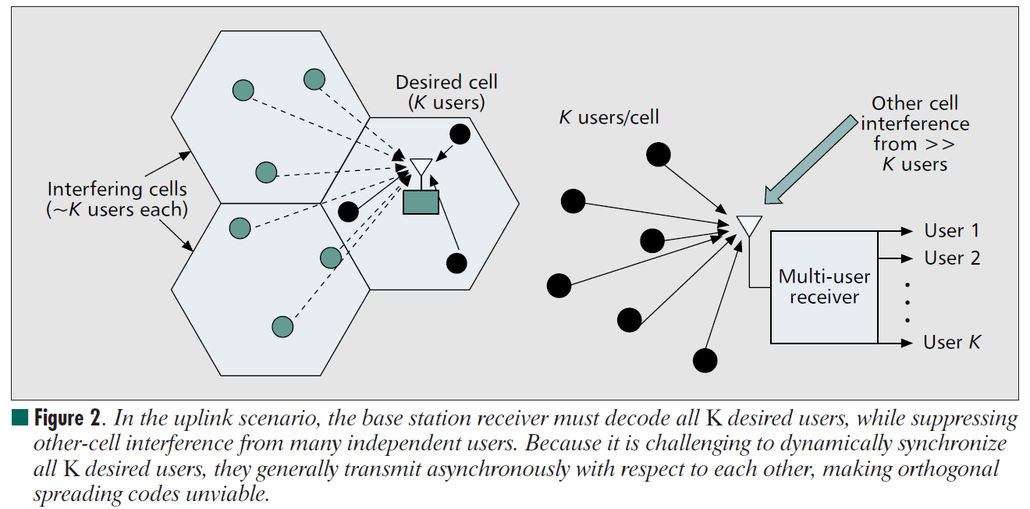
MUD in Cellular
In the uplink scenario, the BS RX must decode all K desired users, while suppressing other-cell interference from many independent users. Because it is challenging to dynamically synchronize all K desired users, they generally transmit asynchronously with respect to each other, making orthogonal
spreading codes unviable.
In the downlink scenario, each RX only needs to decode its own signal, while suppressing other-cell interference from just a few dominant neighboring cells. Because all K users’ signals originate at the base station, the link is synchronous and the K – 1 intracell interferers can be orthogonalized at the base station transmitter. Typically, though, some orthogonality is lost in the channel.

Slide 6
MIMO in Cellular:
Performance Benefits
Antenna gain ⇒ extended battery life, extended range, and higher throughput
Diversity gain ⇒ improved reliability, more robust operation of services
Interference suppression (TXBF) ⇒ improved quality, reliability, and robustness
Multiplexing gain ⇒ higher data rates
Reduced interference to other systems
Optimal use of MIMO in cellular systems, especially
given practical constraints, remains an open problem

Slide 7
Sectorization and
Smart Antennas
5
7
5
2
6
5
1
5
3
4
5
5
120⁰ sectoring reduces interference by one third
Requires base station handoff between sectors
Capacity increase commensurate with shrinking cell size
Smart antennas typically combine sectorization with an intelligent choice of sectors
8C32810.46-Cimini-7/98

Slide 8
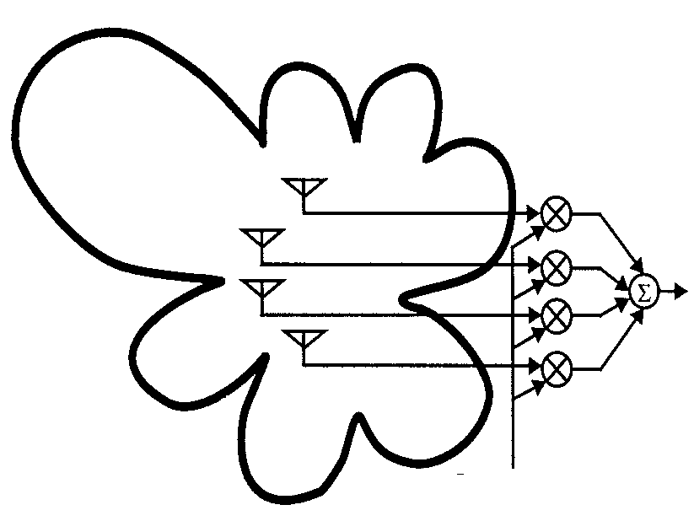
Beam Steering
SIGNAL
INTERFERENCE
SIGNAL OUTPUT
INTERFERENCE
BEAMFORMING
WEIGHTS
Beamforming weights used to place nulls in up to N_{R} directions
  Can also enhance gain in direction of desired signal
  Requires AOA information for signal and interferers

Slide 9


Multiplexing/diversity/interference cancellation tradeoffs
Interference
Stream 2
Stream 1
Spatial multiplexing provides for multiple data streams
TX beamforming and RX diversity provide robustness to fading
TX beamforming and RX nulling cancel interference
  Can also use DSP techniques to remove interference post-detection
Optimal use of antennas in wireless networks unknown

Slide 10

Diversity vs. Interference Cancellation
w_{t1}(t)
w_{r1}(t)
x₁(t)
r₁(t)
x₂(t)
w_{t2}(t)
r₂(t)
w_{r2}(t)
s_{D}(t)
+
y(t)
w_{tT}(t)
w_{rR}(t)
x_{M}(t)
r_{R}(t)
N_{t} transmit antennas
N_{R} receive antennas
Romero and Goldsmith: Performance comparison of MRC and IC
Under transmit diversity, IEEE Trans. Wireless Comm., May 2009

Slide 11
Diversity/IC Tradeoffs
N_{R} antennas at the RX provide N_{R}-fold diversity gain in fading
  Get N_{T}N_{R} diversity gain in MIMO system
Can also be used to null out N_{R} interferers via beam-steering
  Beam steering at TX reduces interference at RX
Antennas can be divided between diversity combining and interference cancellation
Can determine optimal antenna array processing to minimize outage probability

Slide 12
Diversity Combining Techniques
MRC diversity achieves maximum SNR in fading channels.
MRC is suboptimal for maximizing SINR in channels with fading and interference
Optimal Combining (OC) maximizes SINR in both fading and interference
  Requires knowledge of all desired and interferer channel gains at each antenna

Slide 13
SIR Distribution and P_{out}
Distribution of γ obtained using similar analysis as MRC based on MGF techniques.
Leads to closed-form expression for P_{out}.
  Similar in form to that for MRC
Fo L>N, OC with equal average interference powers achieves the same performance as MRC with N −1 fewer interferers.

Slide 14
Performance Analysis for IC
Assume that N antennas perfectly cancel N-1 strongest interferers
  General fading assumed for desired signal
  Rayleigh fading assumed for interferers
Performance impacted by remaining interferers and noise
  Distribution of the residual interference dictated by order statistics

Slide 15
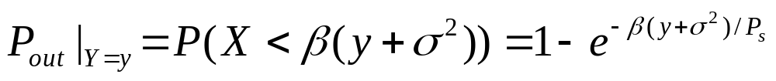
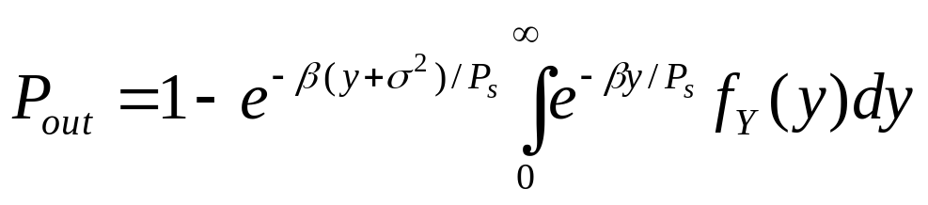
SINR and Outage Probability
The MGF for the interference can be computed in closed form
  pdf is obtained from MGF by differentiation
Can express outage probability in terms of desired signal and interference as
Unconditional P_{out} obtained as
Obtain closed-form expressions for most fading distributions

Slide 16
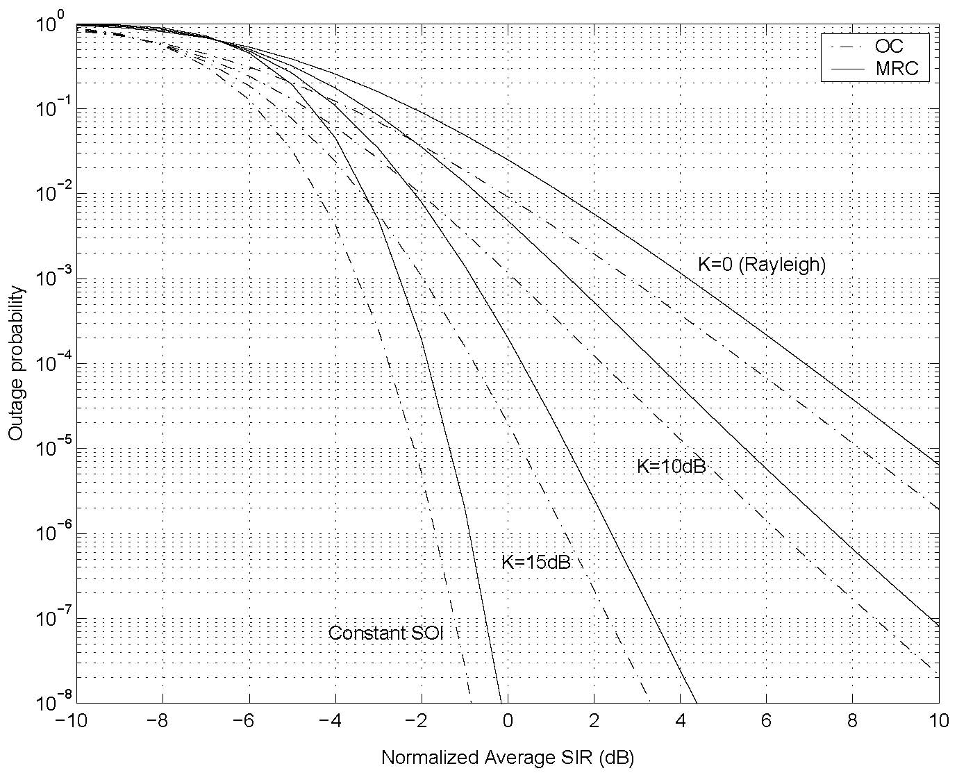
OC vs. MRC for Rician fading

Slide 17
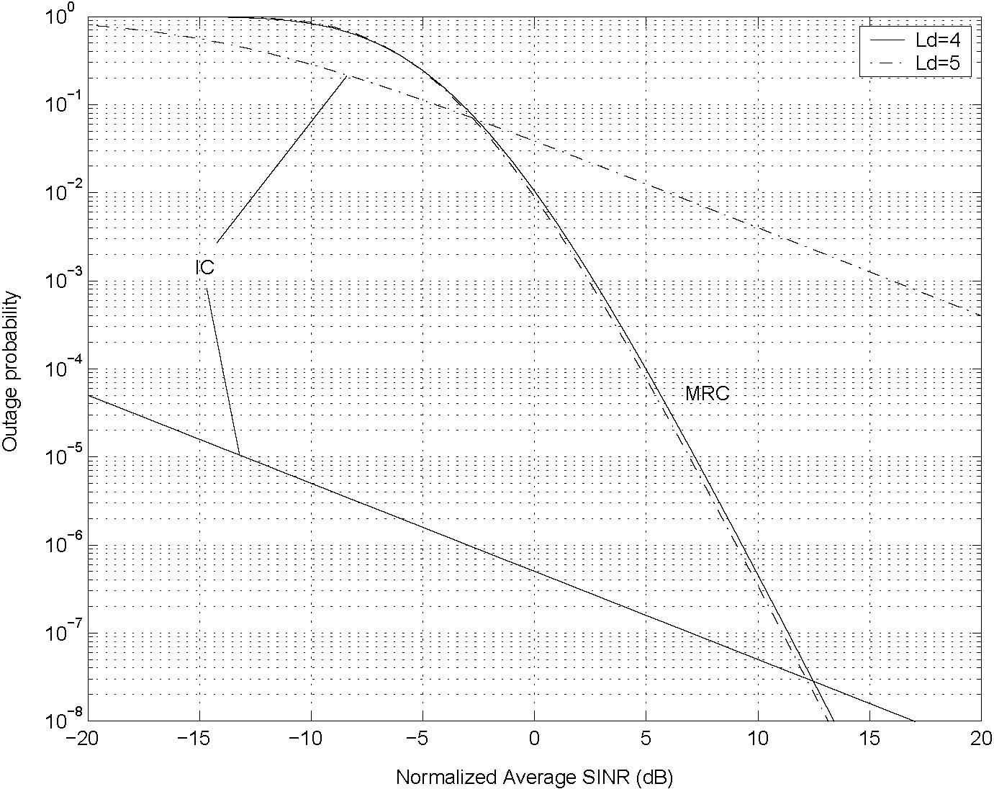
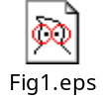
IC vs MRC as function of No. Ints

Slide 18
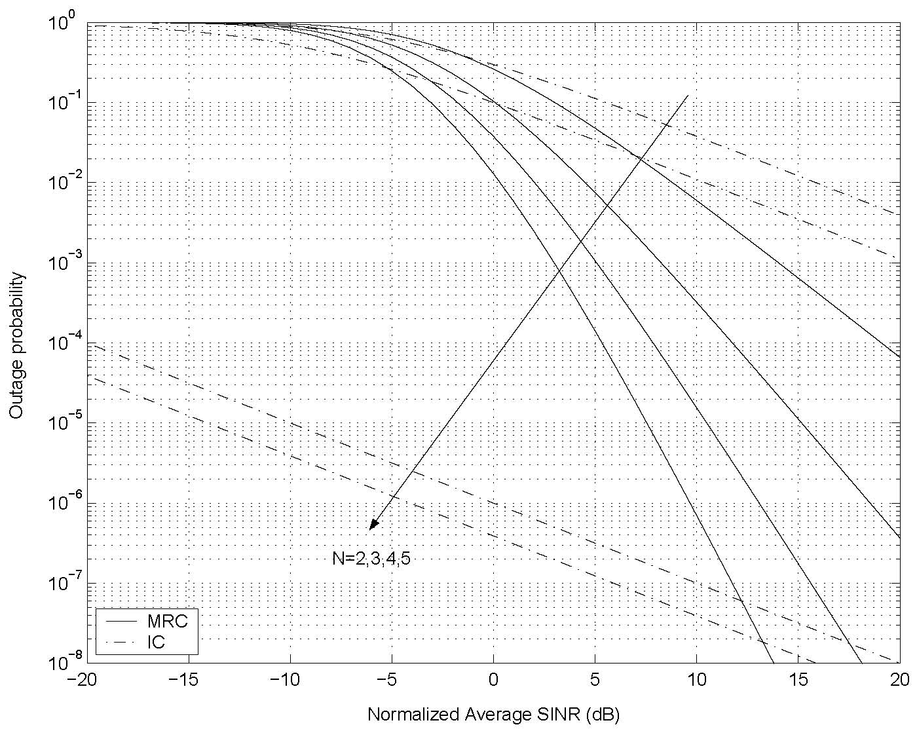
Diversity/IC Tradeoffs

Slide 19
Distributed Antennas in Cellular

Slide 20

Distributed Antennas (DAS) in Cellular
Basic Premise:
  Distribute BS antennas throughout cell
    Rather than just at the center
  Antennas connect to BS through wireless/wireline links
Performance benefits
  Capacity
  Coverage
  Power consumption
DAS

Slide 21
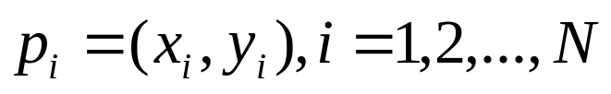
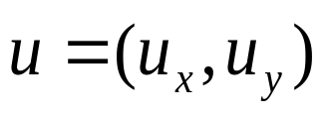

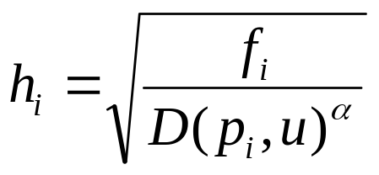
System Model
N distributed single antenna ports located at positions
User is located at
Channel model where h is the channel vector gain:
  D is the distance function in Cartesian plain
  α is the path loss exponent

Slide 22
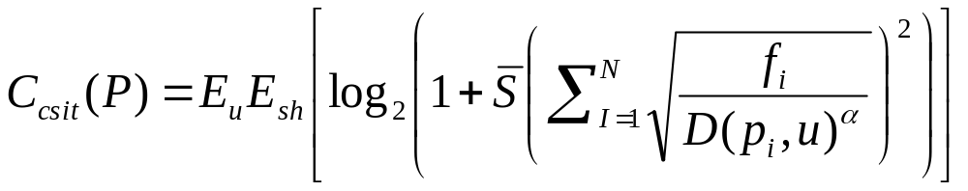
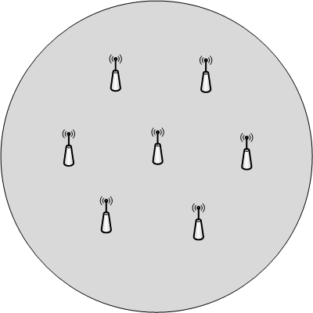
Average Ergodic Rate
Assume full CSIT at BS of gains for all antenna ports
Downlink is a MIMO broadcast channel with full CSIR
Expected rate is
  Average over user location and shadowing
DAS optimization
  Where to place antennas
  Goal: maximize ergodic rate

Slide 23
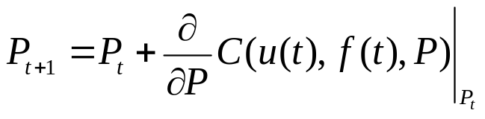
Solve via Stochastic Gradients
Stochastic gradient method to find optimal placement
  Initialize the location of the ports randomly inside the coverage region and set t=0.
  Generate one realization of the shadowing vector f(t) based on the probabilistic model that we have for shadowing
  Generate a random location u(t), based on the geographical distribution of the users inside the cell
  Update the location vector as
  Let t = t +1 and repeat from step 2 until convergence.

Slide 24
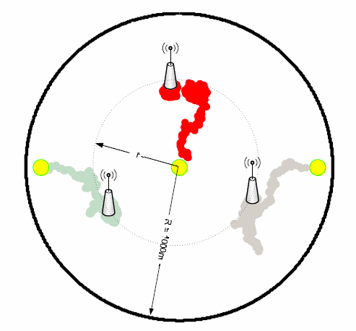
Gradient Trajectory
N = 3 (three nodes)
Circular cell size of radius R = 1000m
Independent log-Normal shadow fading
Path-loss exponent: α=4
Objective to maximize : average ergodic rate with CSIT

Slide 25
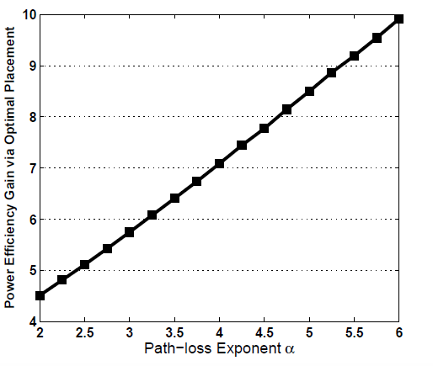
Power efficiency gains
Power gain for optimal placement versus central placement
  Three antennas

Slide 26
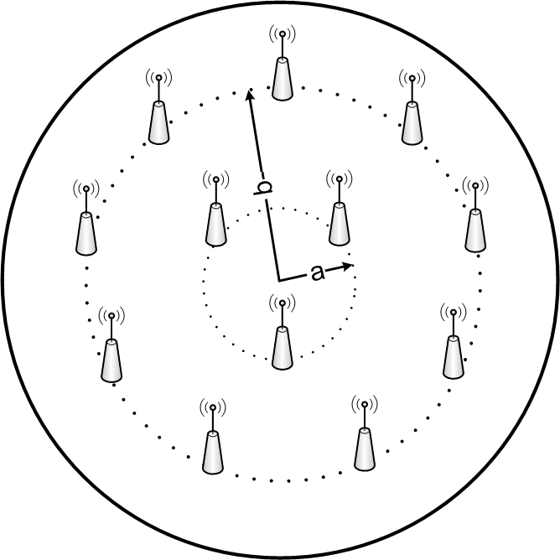
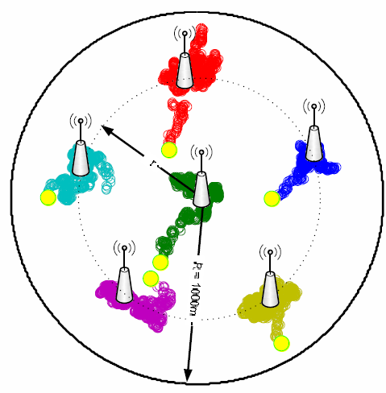
Non-circular layout
For typical path-loss exponents 2<α<6, and for N>5, optimal antenna deployment layout is not circular
N = 12, α = 5
N = 6, α = 5

Slide 27
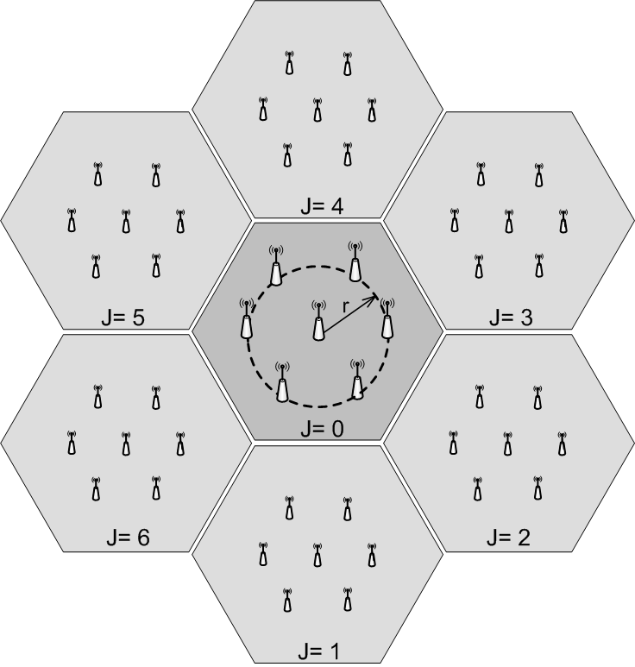
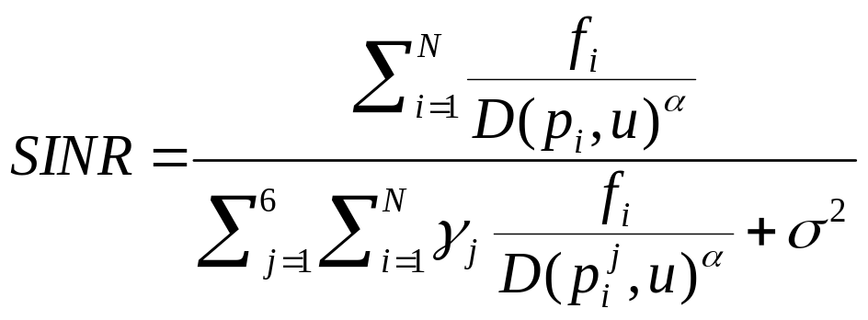

Interference Effect
Impact of intercell interference
is the interference coefficient from cell j
  Autocorrelation of neighboring cell codes for CDMA systems
  Set to 1 for LTE(OFDM) systems with frequency reuse of one.

Slide 28
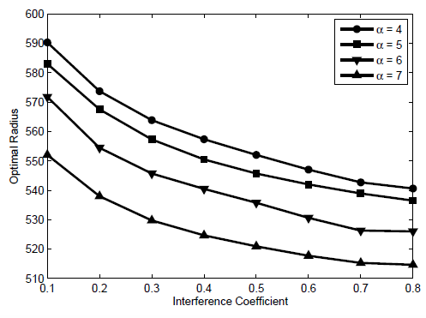
Interference Effect
The optimal layout shrinks towards the center of
the cell as the interference coefficient increases

Slide 29
Power Allocation
Prior results used same fixed power for all nodes
Can jointly optimize power allocation and node placement
Given a sum power constraint on the nodes within a cell, the primal-dual algorithm solves the joint optimization
For N=7 the optimal layout is the same: one node in the center and six nodes in a circle around it.
  Optimal power of nodes around the central node unchanged

Slide 30
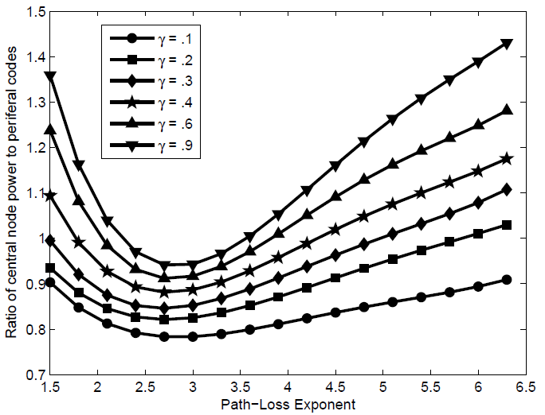
Power Allocation Results
N = 7 nodes
For larger interference and in high path-loss, central node transmits at much higher power than distributed nodes

Slide 31
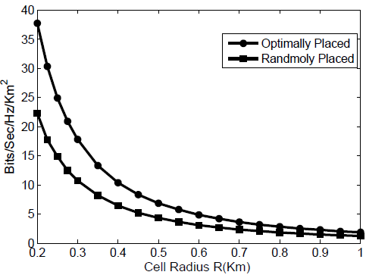
Area Spectral Efficiency
Average user rate/unit bandwidth/unit area (bps/Hz/Km²)
  Captures effect of cell size on spectral efficiency and interference
ASE typically increases as cell size decreases
Optimal placement leads to much higher gains as cell size shrinks vs. random placement

Slide 32
Virtual MIMO and
CoMP in Cellular

Slide 33
Virtual/Network MIMO in Cellular
Many open problems
for next-gen systems
Will gains in practice be
big or incremental; in
capacity or coverage?
Network MIMO: Cooperating BSs form a MIMO array
  Downlink is a MIMO BC, uplink is a MIMO MAC
  Can treat “interference” as known signal (DPC) or noise
  Can cluster cells and cooperate between clusters
Mobiles can cooperate via relaying, virtual MIMO, conferencing, analog network coding, …
Design Issues: CSI, delay, backhaul, complexity

Slide 34
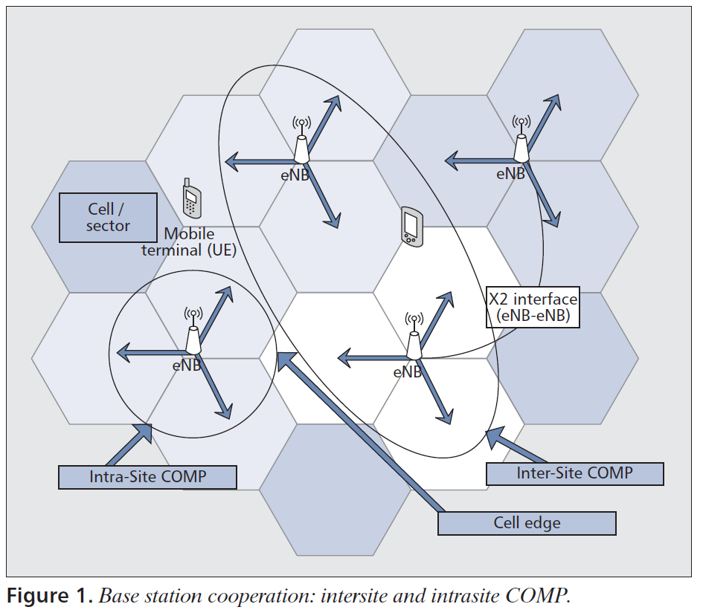
Cooperative Multipoint (CoMP)
Part of LTE Standard
- not yet implemented
"Coordinated multipoint: Concepts, performance, and field trial results" Communications Magazine, IEEE , vol.49, no.2, pp.102-111, February 2011

Slide 35
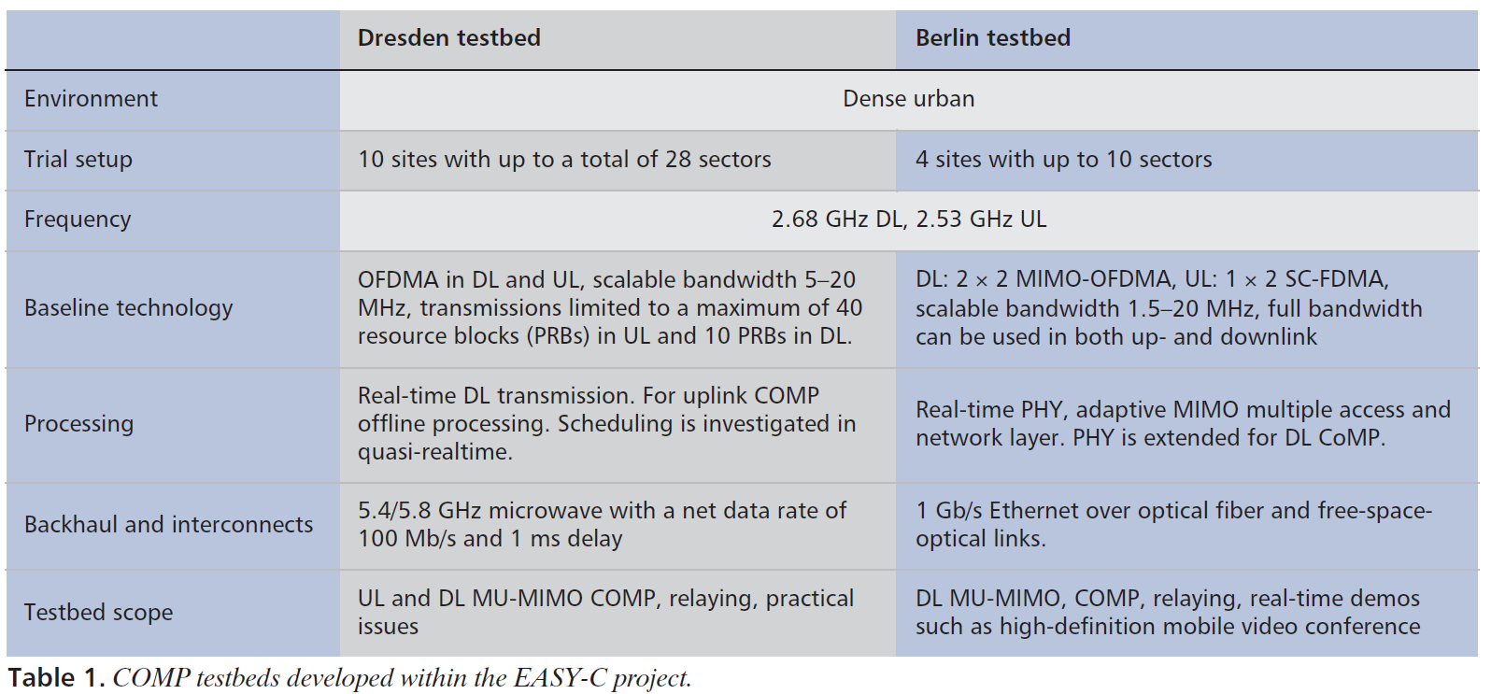
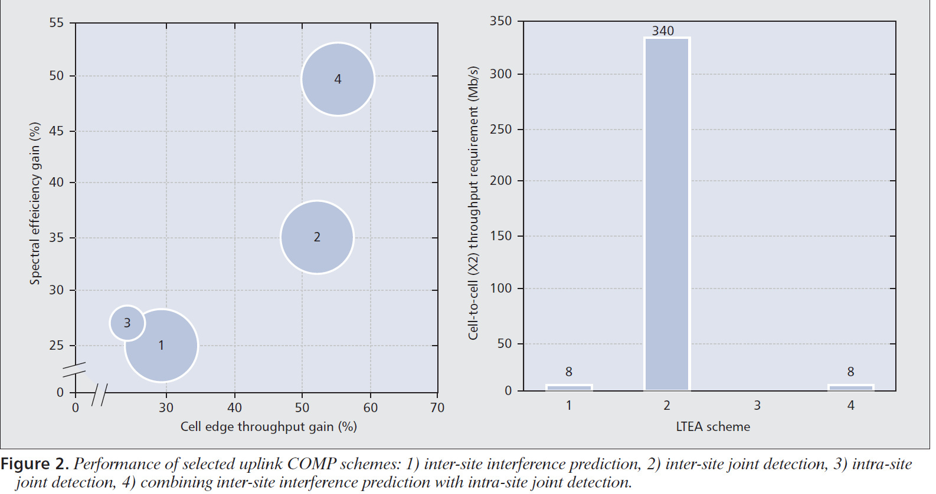

Slide 36
Open design questions
Single Cluster
  Effect of impairments (finite capacity, delay) on the backbone connecting APs:
  Effects of reduced feedback (imperfect CSI) at the APs.
  Performance improvement from cooperation among mobile terminals
  Optimal degrees of freedom allocation
Multiple Clusters
  How many cells should form a cluster?
  How should interference be treated? Cancelled spatially or via DSP?
  How should MIMO and virtual MIMO be utilized: capacity vs. diversity vs interference cancellation tradeoffs

Slide 37
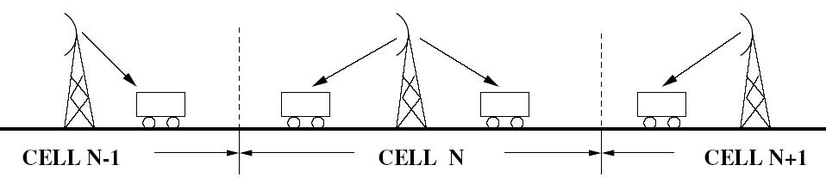
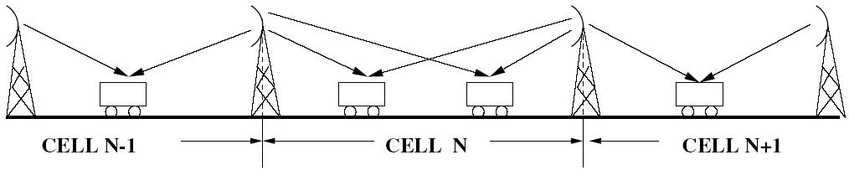
System Model
  Linear cellular array, one-dimensional, downlink, single cell processing
    best models the system along a highway [Wyner 1994]
  Full cooperation leads to fundamental performance limit
  More practical scheme: adjacent base station cooperation

Slide 38
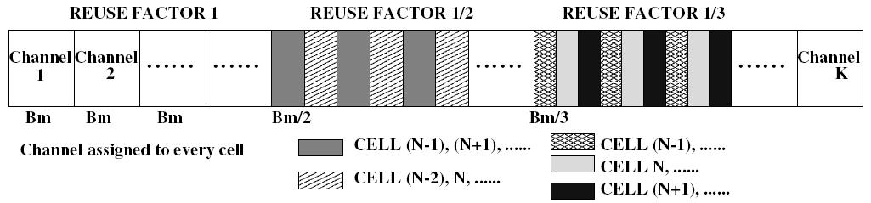
Channel Assignment
  Intra-cell FDMA, K users per cell, total bandwidth in the system K·Bm
  Bandwidth allocated to each user
    maximum bandwidth Bm, corresponding to channel reuse in each cell
    may opt for a fraction of bandwidth, based on channel strength
      increased reuse distance, reduced CCI & possibly higher rate

Slide 39
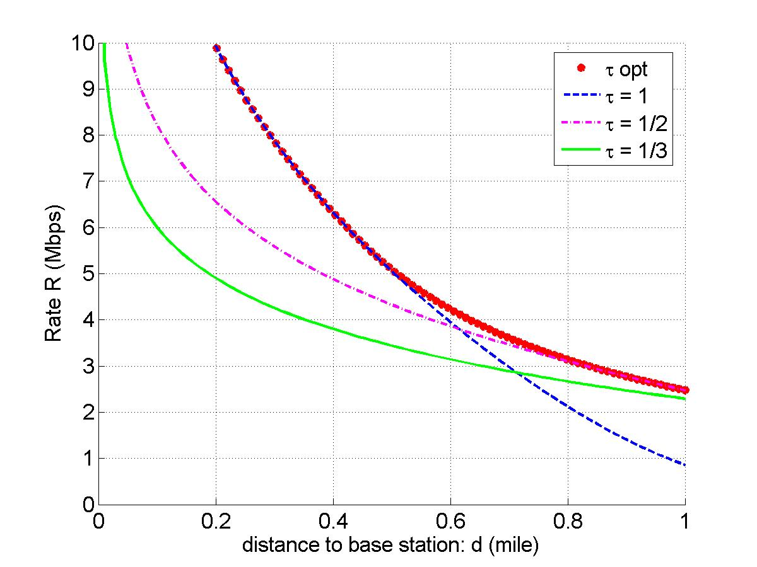


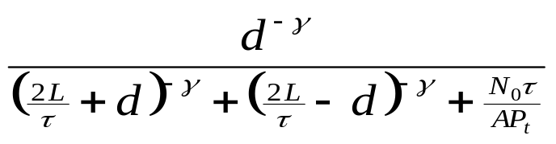

Single Base Station Transmission: AWGN
  Path loss only, receive power
  A: path loss at unit distance
  γ : path-loss exponent
  Receive SINR
  L: cell radius. N0: noise power
  Optimal reuse factor
Observations
  Mobile close to base station -> strong channel, small reuse distance
  Reuse factor changes (1 -> ½) at transition distance dT = 0.62 mile

Slide 40
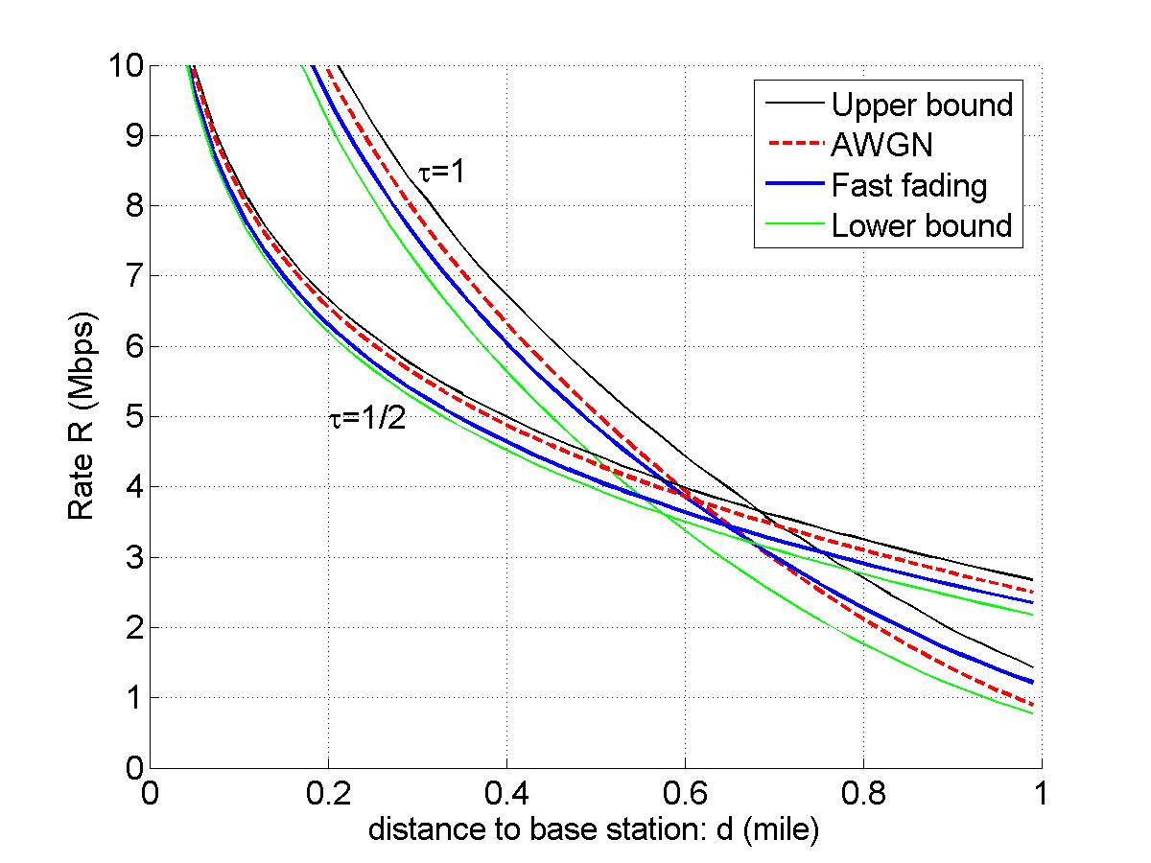


Rayleigh Fast Fading Channel
  Environment with rich scatters
  Applies if channel coherence time shorter than delay constraint
  Receive power
  g: exponentially distributed r.v.
  Optimal reuse factor
  Lower bound: random signal
  Upper bound: random interference
Observations
  AWGN and fast fading yield similar performance
    reuse factor changes (1 -> ½) at transition distance dT = 0.65 mile
  Both “sandwiched” by same upper/lower bounds (small gap in between)

Slide 41
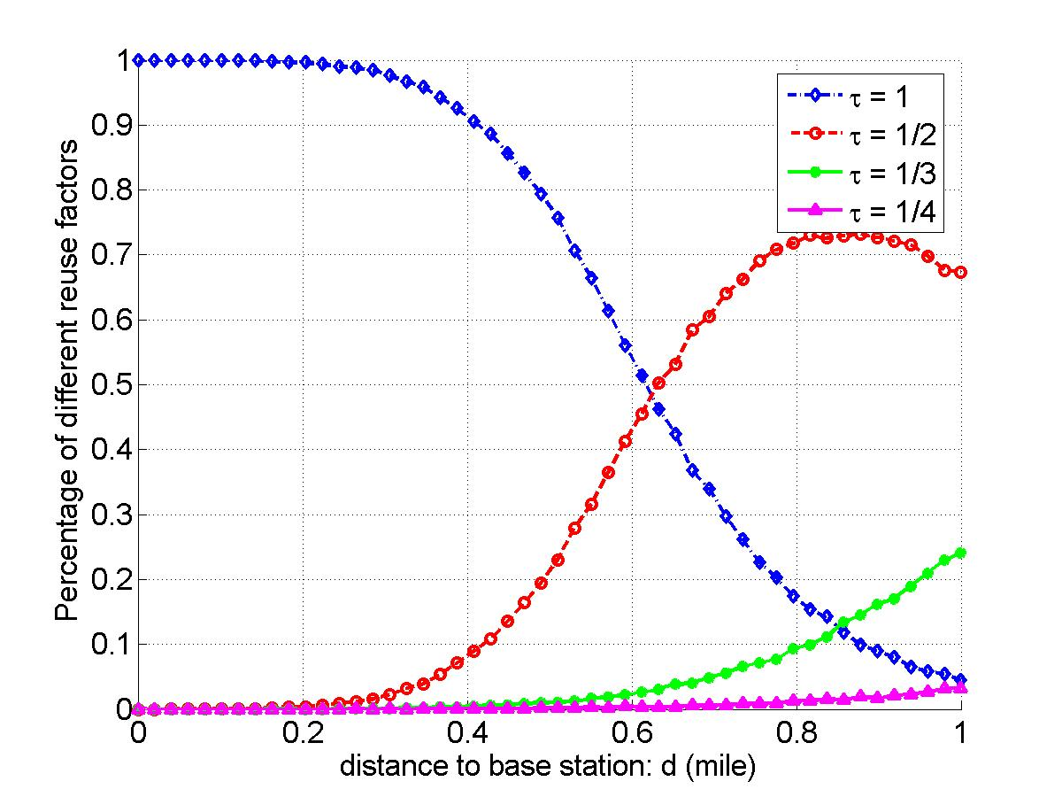

Rayleigh Slow Fading Channel
  Stringent delay constraint, entire codeword falls in one fading state
  Optimal reuse factor
  Compare with AWGN/slow fading:
  optimal reuse factor only depends on distance between mobile and base station
Observations
  Optimal reuse factor random at each distance, also depends on fading
  Larger reuse distance (1/τ > 2) needed when mobiles close to cell edge

Slide 42
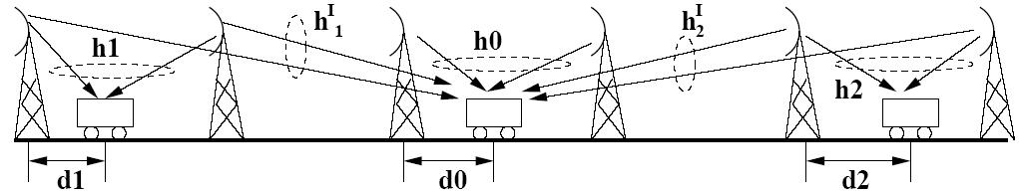
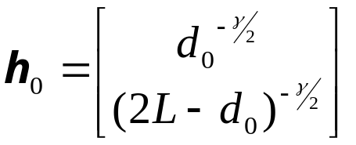
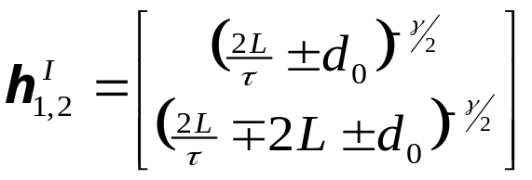
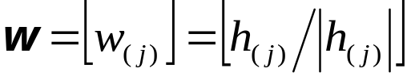
Base Station Cooperation: AWGN
  Adjacent base station cooperation, effectively 2×1 MISO system
  Channel gain vectors: signal interference
  Transmitter beamforming
    optimal for isolated MISO system with per-base power constraint
    suboptimal when interference present
    an initial choice to gain insight into system design

Slide 43
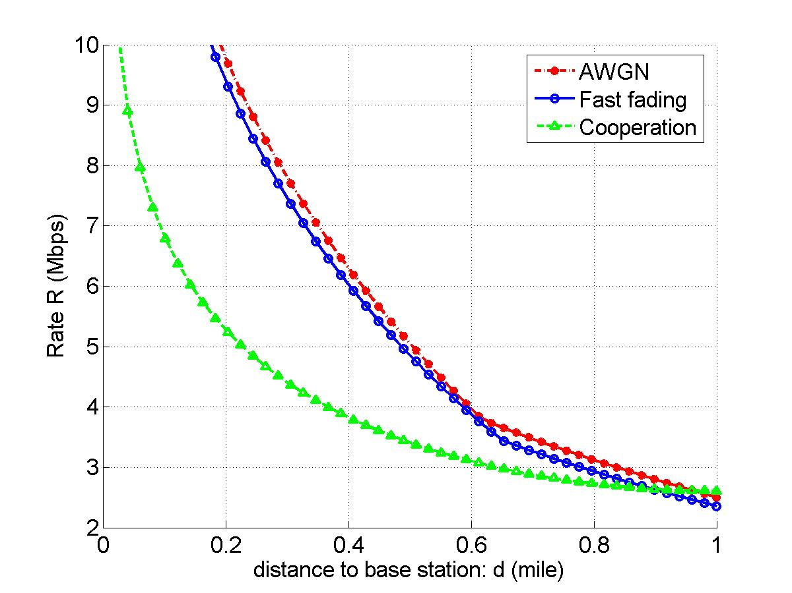
Performance Comparison
  no reuse channel in adjacent cell: to avoid base station serving user and interferer at the same time
  reuse factor ½ optimal at all d: suppressing CCI without overly shrinking the bandwidth allocation
  bandwidth reduction (1-> ½) over-shadows benefit from cooperation
Observations
Advantage of cooperation over single cell transmission: only prominent when users share the channel; limited with intra-cell TD/FD [Liang 06]
Remedy: allow more base stations to cooperate
in the extreme case of full cooperation, channel reuse in every cell

Slide 44
Dynamic Resource Allocation
Allocate resources as user and network conditions change
Resources:
  Channels
  Bandwidth
  Power
  Rate
  Base stations
  Access
Optimization criteria
  Minimize blocking (voice only systems)
  Maximize number of users (multiple classes)
  Maximize “revenue”: utility function
    Subject to some minimum performance for each user
BASE
STATION

Slide 45
Dynamic Channel Allocation
Fixed channel assignments are inefficient
  Channels in unpopulated cells underutilized
  Handoff calls frequently dropped
Channel Borrowing
  A cell may borrow free channels from neighboring cells
  Changes frequency reuse plan
Channel Reservations
  Each cell reserves some channels for handoff calls
  Increases blocking of new calls, but fewer dropped calls
Dynamic Channel Allocation
  Rearrange calls to pack in as many users as possible without violating reuse constraints
  Very high complexity
“DCA is a 2G/4G problem”

Slide 46
Variable Rate and Power
Narrowband systems
  Vary rate and power (and coding)
  Optimal power control not obvious
CDMA systems
  Vary rate and power (and coding)
    Multiple methods to vary rate (VBR, MC, VC)
  Optimal power control not obvious
Optimization criteria
  Maximize throughput/capacity
  Meet different user requirements (rate, SIR, delay, etc.)
  Maximize revenue

Slide 47
Multicarrier CDMA
Multicarrier CDMA combines OFDM and CDMA
Idea is to use DSSS to spread a narrowband signal and then send each chip over a different subcarrier
  DSSS time operations converted to frequency domain
Greatly reduces complexity of SS system
  FFT/IFFT replace synchronization and despreading
More spectrally efficient than CDMA due to the overlapped subcarriers in OFDM
Multiple users assigned different spreading codes
  Similar interference properties as in CDMA

Slide 48
Rate and Power Control in CDMA*
Optimize power and rate adaptation in a CDMA system
  Goal is to minimize transmit power
Each user has a required QoS
  Required effective data rate
*Simultaneous Rate and Power Control in Multirate
Multimedia CDMA Systems,” S. Kandukuri and S. Boyd

Slide 49
System Model: General
Single cell CDMA
Uplink multiple access channel
Different channel gains
System supports multiple rates

Slide 50
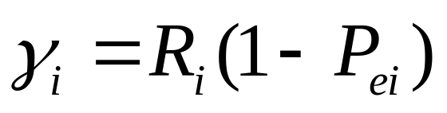
System Model: Parameters
Parameters
  N = number of mobiles
  P_{i} = power transmitted by mobile i
  R_{i} = raw data rate of mobile i
  W = spread bandwidth
QoS requirement of mobile i, _{i}, is the effective data rate

Slide 51
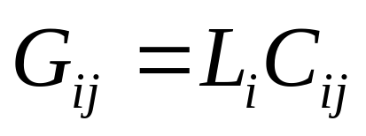
System Model: Interference
Interference between users represented by cross correlations between codes, C_{ij}
Gain of path between mobile i and base station, L_{i}
Total interfering effect of mobile j on mobile i, G_{ij} is

Slide 52
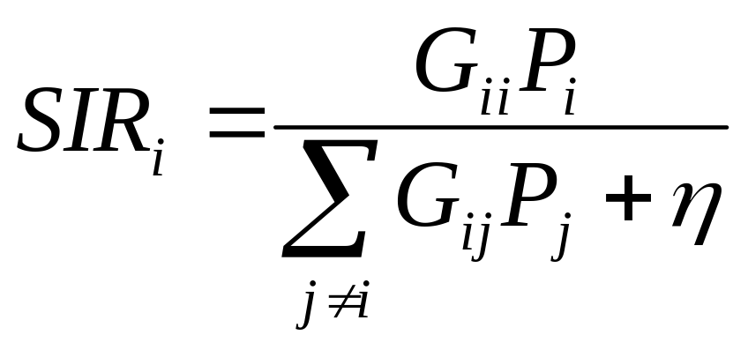
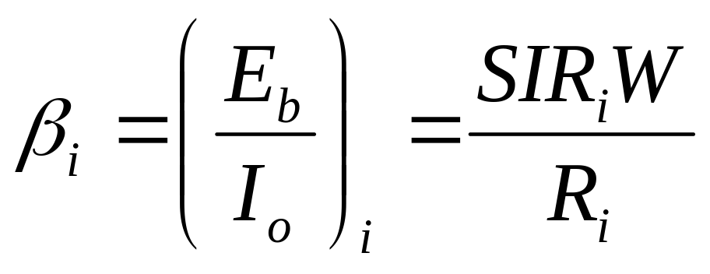
SIR Model (neglect noise)

Slide 53
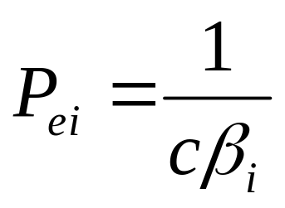
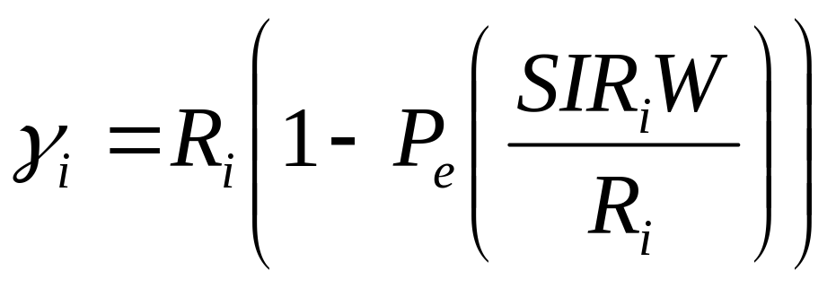
QoS Formula
Probability of error is a function of _{I}
  Formula depends on the modulation scheme
Simplified P_{e} expression
QoS formula

Slide 54
Solution
Objective: Minimize sum of mobile powers subject to QoS requirements of all mobiles
Technique: Geometric programming
  A non-convex optimization problem is cast as a convex optimization problem
Convex optimization
  Objective and constraints are all convex
  Can obtain a global optimum or a proof that the set of specifications is infeasible
  Efficient implementation

Slide 55
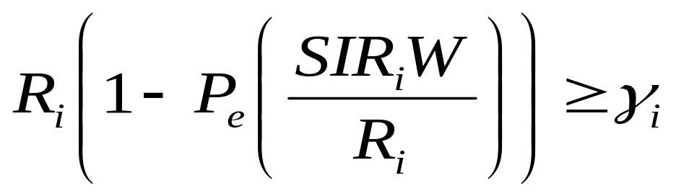
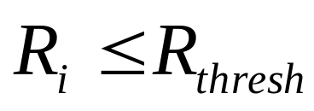

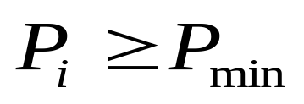
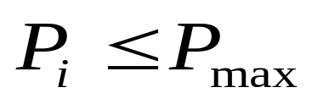
Problem Formulation
Minimize 1^{T}P (sum of powers)
Subject to
Can also add constraints such as

Slide 56

Results
Sum of powers transmitted vs interference

Slide 57

Results
QoS vs. interference

Slide 58
Summary
Smart antennas, MIMO, and multiuser detection have a key role to play in future cellular system design.
Distributed antennas (DAS) leads to large performance gains, especially in energy efficiency
CoMP not so promising, at least in terms of capacity
Adaptive techniques in cellular can improve significantly performance and capacity, especially in LTE
Notes:
Next lecture: ASE, capacity, CoMP, DAS

