Slide 1
EE360: Multiuser Wireless Systems and Networks
Lecture 4 Outline
  Announcements
    Project proposals due 1/27
    Makeup lecture for 2/10 (previous Friday 2/7, time TBD)
  Multiuser Detection
  Multiuser OFDM Techniques
  Cellular System Overview
  Design Considerations
  Standards
  MIMO in Cellular

Slide 2
Review of Last Lecture
Duality connects BC and MAC channels
  Used to obtain capacity of one from the other
Duality and dirty paper coding are used to obtain the capacity of a broadcast MIMO channel.
  MIMO MAC capacity known from general formula
  MIMO BC capacity uses DPC optimized based on duality with MIMO MAC.
  DPC complicated to implement in practice.
ZFBF has similar performance as DPC with much lower complexity.
Spread spectrum superimposes users on top of each other: interference from code cross correlation

Slide 3
Multiuser Detection
Notes:
Lecture 3 ended here

Slide 4
Multiuser Detection
In all CDMA systems and in TD/FD/CD cellular systems, users interfere with each other.
In most of these systems the interference is treated as noise.
  Systems become interference-limited
  Often uses complex mechanisms to minimize impact of interference (power control, smart antennas, etc.)
Multiuser detection exploits the fact that the structure of the interference is known
  Interference can be detected and subtracted out
  Better have a darn good estimate of the interference

Slide 5
MUD System Model
Synchronous Case
y₁+I₁
X
MF 1
s_{c1}(t)
y(t)=
s₁(t)+
s₂(t)+
s₃(t)+
n(t)
y₂+I₂
Multiuser
Detector
X
MF 2
s_{c2}(t)
y₃+I₃
X
MF 3
s_{c3}(t)
Matched filter integrates over a
symbol time and samples

Slide 6
MUD Algorithms
Multiuser
Receivers
Optimal
Suboptimal
MLSE
Linear
Non-linear
Decorrelator
MMSE
Multistage
Decision
Successive
-feedback
interference
cancellation

Slide 7
Optimal Multiuser Detection
Maximum Likelihood Sequence Estimation
  Detect bits of all users simultaneously (2^{M} possibilities)
Matched filter bank followed by the VA (Verdu’86)
  VA uses fact that I_{i}=f(b_{j}, j≠i)
  Complexity still high: (2^{M-1} states)
  In asynchronous case, algorithm extends over 3 bit times
    VA samples MFs in round robin fasion
y₁+I₁
X
MF 1
s_{c1}(t)
Viterbi Algorithm
s₁(t)+s₂(t)+s₃(t)
y₂+I₂
X
MF 2
Searches for ML
bit sequence
s_{c2}(t)
y₃+I₃
X
MF 3
s_{c3}(t)

Slide 8
Suboptimal Detectors
Main goal: reduced complexity
Design tradeoffs
  Near far resistance
  Asynchronous versus synchronous
  Linear versus nonlinear
  Performance versus complexity
  Limitations under practical operating conditions
Common methods
  Decorrelator
  MMSE
  Multistage
  Decision Feedback
  Successive Interference Cancellation

Slide 9
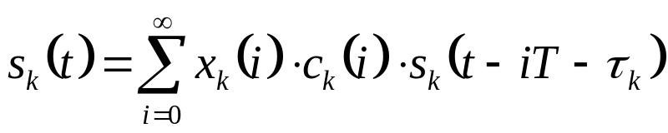
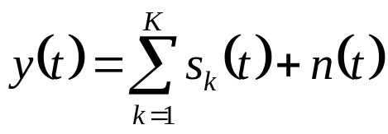
Mathematical Model
Simplified system model (BPSK)
  Baseband signal for the k^{th} user is:
    s_{k}(i) is the i^{th} input symbol of the k^{th} user
    c_{k}(i) is the real, positive channel gain
    s_{k}(t) is the signature waveform containing the PN sequence
    τ_{k} is the transmission delay; for synchronous CDMA, τ_{k}=0 for all users
  Received signal at baseband
    K number of users
    n(t) is the complex AWGN process

Slide 10
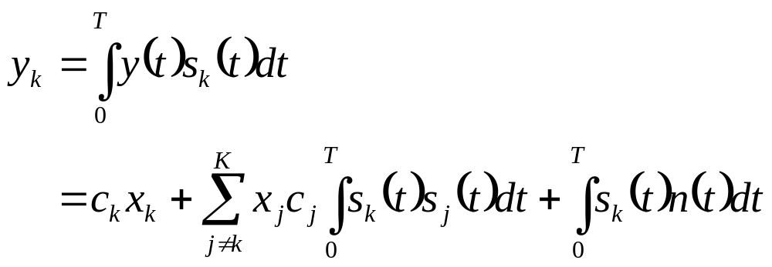
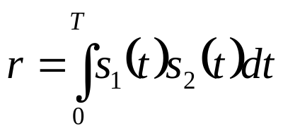
Matched Filter Output
Sampled output of matched filter for the k^{th} user:
  1st term - desired information
  2nd term - MAI
  3rd term - noise
Assume two-user case (K=2), and

Slide 11

Symbol Detection
Outputs of the matched filters are:
Detected symbol for user k:
If user 1 much stronger than user 2 (near/far problem), the MAI rc₁x₁ of user 2 is very large

Slide 12
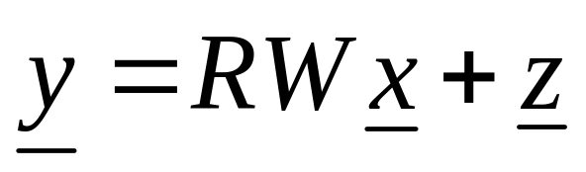
Decorrelator
Matrix representation
  where y=[y₁,y₂,…,y_{K}]^{T}, R and W are KxK matrices
  Components of R are cross-correlations between codes
  W is diagonal with W_{k,k} given by the channel gain c_{k}
  z is a colored Gaussian noise vector
Solve for x by inverting R
Analogous to zero-forcing equalizers for ISI
  Pros: Does not require knowledge of users’ powers
  Cons: Noise enhancement

Slide 13

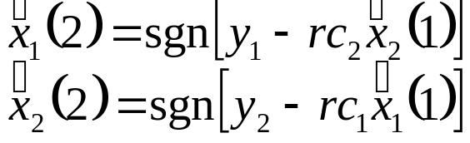
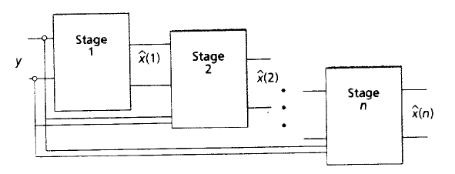
Multistage Detectors
Decisions produced by 1st stage are
2nd stage:
and so on…

Slide 14

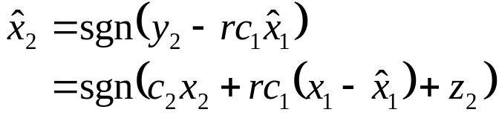
Successive Interference Cancellers
Successively subtract off strongest detected bits
MF output:
Decision made for strongest user:
Subtract this MAI from the weaker user:
  all MAI can be subtracted is user 1 decoded correctly
MAI is reduced and near/far problem alleviated
  Cancelling the strongest signal has the most benefit
  Cancelling the strongest signal is the most reliable cancellation

Slide 15
Parallel Interference Cancellation
Similarly uses all MF outputs
Simultaneously subtracts off all of the users’ signals from all of the others
works better than SIC when all of the users are received with equal strength (e.g. under power control)

Slide 16
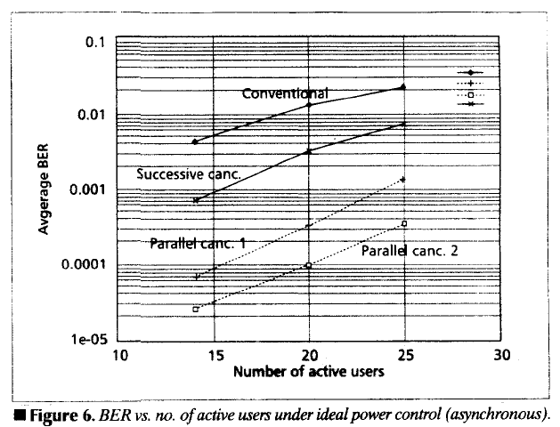
Performance of MUD: AWGN

Slide 17
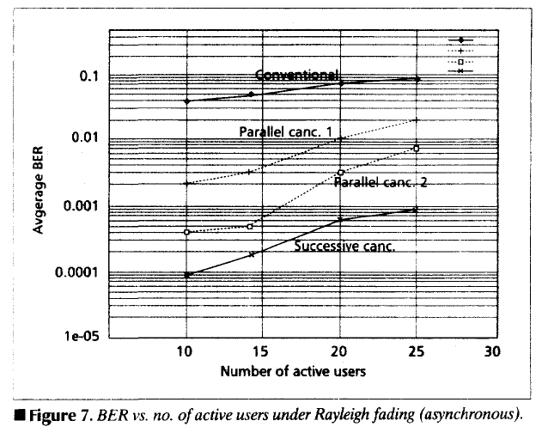
Performance of MUD
Rayleigh Fading

Slide 18
Near-Far Problem and Traditional Power Control
On uplink, users have different channel gains
If all users transmit at same power (P_{i}=P), interference from near user drowns out far user
“Traditional” power control forces each signal to have the same received power
  Channel inversion: P_{i}=P/h_{i}
  Increases interference to other cells
  Decreases capacity
  Degrades performance of successive interference cancellation and MUD
    Can’t get a good estimate of any signal
h₁
h₃
P₃
P₁
h₂
P₂

Slide 19
Near Far Resistance
Received signals are received at different powers
MUDs should be insensitive to near-far problem
Linear receivers typically near-far resistant
  Disparate power in received signal doesn’t affect performance
Nonlinear MUDs must typically take into account the received power of each user
  Optimal power spread for some detectors (Viterbi’92)

Slide 20
Synchronous vs. Asynchronous
Linear MUDs don’t need synchronization
  Basically project received vector onto state space orthogonal to the interferers
  Timing of interference irrelevant
Nonlinear MUDs typically detect interference to subtract it out
  If only detect over a one bit time, users must be synchronous
  Can detect over multiple bit times for asynch. users
    Significantly increases complexity

Slide 21
Channel Estimation (Flat Fading)
Nonlinear MUDs typically require the channel gains of each user
Channel estimates difficult to obtain:
  Channel changing over time
  Must determine channel before MUD, so estimate is made in presence of interferers
Imperfect estimates can significantly degrade detector performance
  Much recent work addressing this issue
  Blind multiuser detectors
    Simultaneously estimate channel and signals

Slide 22
State Space Methods
Antenna techniques can also be used to remove interference (smart antennas)
Combining antennas and MUD in a powerful technique for interference rejection
Optimal joint design remains an open problem, especially in practical scenarios

Slide 23
Multipath Channels
In channels with N multipath components, each interferer creates N interfering signals
  Multipath signals typically asynchronous
  MUD must detect and subtract out N(M-1) signals
Desired signal also has N components, which should be combined via a RAKE.
MUD in multipath greatly increased
Channel estimation a nightmare
Much work has focused on complexity reduction and blind MUD in multipath channels (e.g. Wang/Poor’99)

Slide 24
Summary of MUD
MUD a powerful technique to reduce interference
  Optimal under ideal conditions
  High complexity: hard to implement
  Processing delay a problem for delay-constrained apps
  Degrades in real operating conditions
Much research focused on complexity reduction, practical constraints, and real channels
Smart antennas seem to be more practical and provide greater capacity increase for real systems

Slide 25
Multiuser OFDM Techniques

Slide 26
Multiuser OFDM
MCM/OFDM divides a wideband channel into narrowband subchannels to mitigate ISI
In multiuser systems these subchannels can be allocated among different users
  Orthogonal allocation: Multiuser OFDM (OFDMA)
  Semiorthogonal allocation: Multicarrier CDMA
Adaptive techniques increase the spectral efficiency of the subchannels.
Spatial techniques help to mitigate interference between users

Slide 27
Multicarrier CDMA
Multicarrier CDMA combines OFDM and CDMA
Idea is to use DSSS to spread a narrowband signal and then send each chip over a different subcarrier
  DSSS time operations converted to frequency domain
Greatly reduces complexity of SS system
  FFT/IFFT replace synchronization and despreading
More spectrally efficient than CDMA due to the overlapped subcarriers in OFDM
Multiple users assigned different spreading codes
  Similar interference properties as in CDMA

Slide 28
Multicarrier DS-CDMA
The data is serial-to-parallel converted.
Symbols on each branch spread in time.
Spread signals transmitted via OFDM
Get spreading in both time and frequency
c(t)
S/P convert
...
IFFT
P/S convert
s(t)
c(t)

Slide 29
Cellular System Overview
• Frequencies (or time slots or codes) are reused at spatially-separated locations ⇒ exploits power falloff with distance.
• Base stations perform centralized control functions
(call setup, handoff, routing, etc.)
• Best efficiency obtained with minimum reuse distance
• System capacity is interference-limited.
8C32810.43-Cimini-7/98

Slide 30
Basic Design Considerations
Spectral Sharing
  TD,CD or hybrid (TD/FD)
  Frequency reuse
Reuse Distance
  Distance between cells using the same frequency, timeslot, or code
  Smaller reuse distance packs more users into a given area, but also increases co-channel interference
Cell radius
  Decreasing the cell size increases system capacity, but complicates routing and handoff
Resource allocation: power, BW, etc.

Slide 31
Cellular Evolution: 1G-3G
Japan
Europe
Americas
1st Gen
TACS
NMT/TACS/Other
AMPS
1st Gen
2nd Gen
2nd Gen
PDC
GSM
TDMA
CDMA
3rd Gen
(EDGE in Europe and Asia
outside Japan)
EDGE
WCDMA
3rd Gen
W-CDMA/EDGE
cdma2000 was the initial
standard, which evolved
To WCDMA
Global strategy
based on W-CDMA and EDGE networks,
common IP based network, and dual mode
W-CDMA/EDGE phones.

Slide 32
1-2 G Cellular Design:
Voice Centric
Cellular coverage designed for voice service
  Area outage, e.g. < 10% or < 5%.
  Minimal, but equal, service everywhere.
Cellular systems are designed for voice
  20 ms framing structure
  Strong FEC, interleaving and decoding delays.
Spectral Efficiency
  around 0.04-0.07 bps/Hz/sector
  comparable for TDMA and CDMA

Slide 33
IS-54/IS-136 (TD)
FDD separates uplink and downlink.
Timeslots allocated between different cells.
  FDD separates uplink and downlink.
One of the US standards for digital cellular
  IS-54 in 900 MHz (cellular) band.
  IS-136 in 2 GHz (PCS) band.
IS-54 compatible with US analog system.
  Same frequencies and reuse plan.

Slide 34
GSM (TD with FH)
FDD separates uplink and downlink.
Access is combination of FD,TD, and slow FH
  Total BW divided into 200Khz channels.
  Channels reused in cells based on signal and interference measurements.
  All signals modulated with a FH code.
    FH codes within a cell are orthogonal.
    FH codes in different cells are semi-orthgonal
  FH mitigates frequency-selective fading via coding.
  FH averages interference via the pseudorandom hop pattern

Slide 35
IS-95 (CDMA)
Each user assigned a unique DS spreading code
  Orthogonal codes on the downlink
  Semiorthogonal codes on the uplink
Code is reused in every cell
  No frequency planning needed
  Allows for soft handoff is code not in use in neighboring cell
Power control required due to near-far problem
  Increases interference power of boundary mobiles.

Slide 36
3G Cellular Design:
Voice and Data
Goal (early 90s): A single worldwide air interface
  Yeah, right
Bursty Data => Packet Transmission
  Simultaneous with circuit voice transmisison
Need to “widen the data pipe”:
  384 Kbps outdoors, 1 Mbps indoors.
Need to provide QOS
  Evolve from best effort to statistical or “guaranteed”
Adaptive Techniques
  Rate (spreading, modulation/coding), power, resources, signature sequences, space-time processing, MIMO

Slide 37
3G GSM-Based Systems
EDGE: Packet data with adaptive modulation and coding
8-PSK/GMSK at 271 ksps supports 9.02 to 59.2 kbps per time slot with up to 8 time-slots
Supports peak rates over 384 kbps
IP centric for both voice and data

Slide 38
3G CDMA Approaches
W-CDMA and cdma2000
cdma2000 used a multicarrier overlay for IS-95 compatibility
WCDMA designed for evolution of GSM systems
  Current 3G services based on WCDMA
  Voice, streaming, high-speed data
  Multirate service via variable power and spreading
  Different services can be mixed on a single code for a user
C_{A}
C_{C}
C_{D}

Slide 39
Features of WCDMA
Bandwidth | 5, 10, 20 MHz
Spreading codes | Orthogonal variable spreading factor (OVSF) SF: 4-256
Scrambling codes | DL- Gold sequences. (len-18) UL- Gold/Kasami sequences (len-41)
Data Modulation | DL - QPSK UL - BPSK
Data rates | 144 kbps, 384 kbps, 2 Mbps
Duplexing | FDD

Slide 40
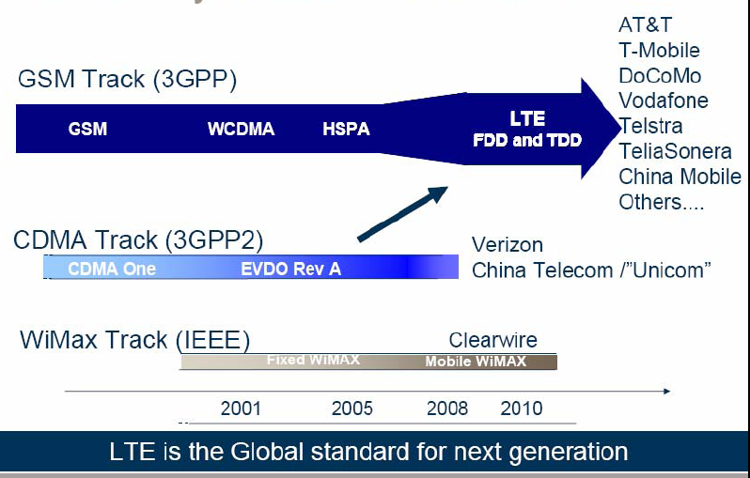
4G Evolution
LTE most recent cellular standard: 200 networks worldwide

Slide 41
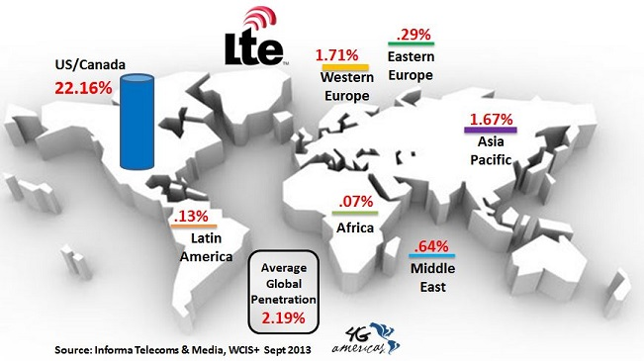
LTE Penetration (Sept. 2013)
Predicted by Ericsson to be 60% by 2018, serving 1 billion phones

Slide 42
Long-Term Evolution (LTE)
OFDM/MIMO
Much higher data rates (50-100 Mbps)
Greater spectral efficiency (bits/s/Hz)
Flexible use of up to 100 MHz of spectrum
Low packet latency (<5ms).
Increased system capacity
Reduced cost-per-bit
Support for multimedia

Slide 43

Rethinking “Cells” in Cellular
How should cellular
systems be designed?
Coop
MIMO
Small
Cell
Relay
Will gains in practice be
big or incremental; in
capacity or coverage?
DAS
Traditional cellular design “interference-limited”
  MIMO/multiuser detection can remove interference
  Cooperating BSs form a MIMO array: what is a cell?
  Relays change cell shape and boundaries
  Distributed antennas move BS towards cell boundary
  Small cells create a cell within a cell
  Mobile relaying, virtual MIMO, analog network coding.

Slide 44
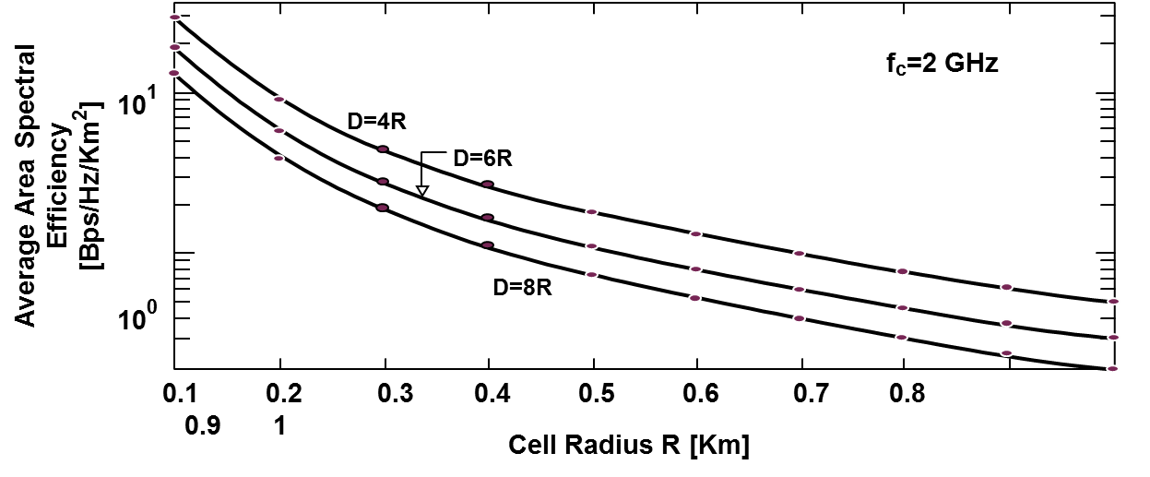
Are small cells the solution to increase cellular system capacity?
Yes, with reuse one and adaptive techniques (Alouini/Goldsmith 1999)
Area Spectral Efficiency
A=.25D²π
S/I increases with reuse distance (increases link capacity).
Tradeoff between reuse distance and link spectral efficiency (bps/Hz).
Area Spectral Efficiency: A_{e}=ΣR_{i}/(.25D²π) bps/Hz/Km².

Slide 45
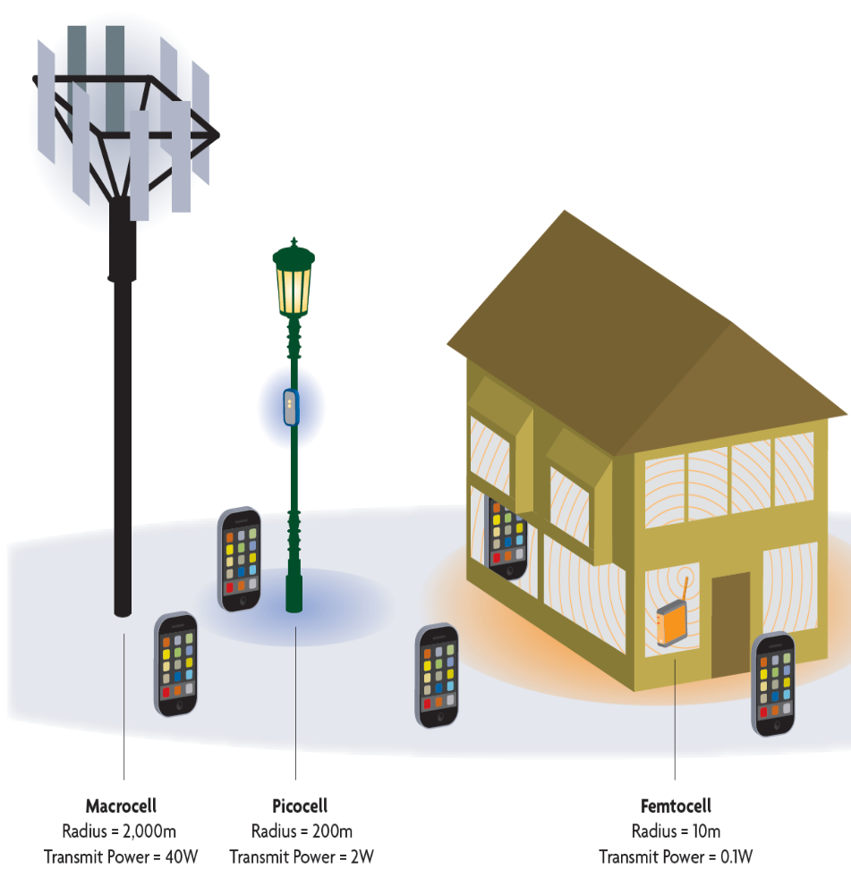

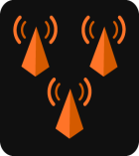





The Future Cellular Network: Hierarchical Architecture
Today’s architecture
3M Macrocells serving 5 billion users
MACRO: solving initial coverage issue, existing network
10x Lower HW COST
PICO: solving street, enterprise & home coverage/capacity issue
10x CAPACITY Improvement
Near 100%
COVERAGE
FEMTO: solving enterprise & home
coverage/capacity issue
Macrocell
Picocell
Femtocell
Managing interference
between cells is hard

Slide 46
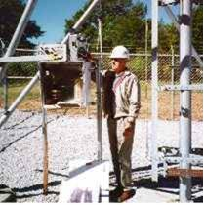
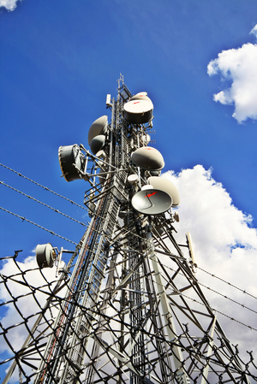
Deployment Challenges
Deploying One Macrocell | Effort (MD – Man Day)
New site verification | 1
On site visit: site details verification | 0.5
On site visit: RF survey | 0.5
New site RF plan | 2
Neighbors, frequency, preamble/scrambling code plan | 0.5
Interference analyses on surrounding sites | 0.5
Capacity analyses | 0.5
Handover analyses | 0.5
Implementation on new node(s) | 0.5
Field measurements and verification | 2
Optimization | 2
Total activities | 7.5 man days
5M Pico base stations in 2015 (ABI)
37.5M Man Days = 103k Man Years
Exorbitant costs
Where to find so many engineers?
Small cell deployments require automated self-configuration via software
Basic premise of self-organizing networks (SoN)

Slide 47

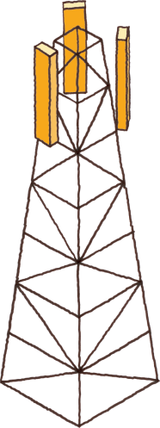

SON for LTE small cells
Mobile Gateway
Or Cloud
Node Installation
Self
Healing
SoN
Server
Initial Measurements
IP Network
SON
Server
Self Configuration
Measurement
Self Optimization
X2
X2
X2
X2
Small cell BS
Macrocell BS

Slide 48
Algorithmic Challenge: Complexity
Optimal channel allocation was NP hard in 2nd-generation (voice) IS-54 systems
Now we have MIMO, multiple frequency bands, hierarchical networks, …
But convex optimization has advanced a lot in the last 20 years
Innovation needed to tame the complexity
Stage 3
Use genetic search to find further improvements by mutating some “genes”

Slide 49
MIMO Techniques in Cellular
How should MIMO be fully used in cellular systems?
Shannon capacity requires dirty paper coding or IC
Network MIMO: Cooperating BSs form an antenna array
  Downlink is a MIMO BC, uplink is a MIMO MAC
  Can treat “interference” as known signal (DPC) or noise
  Shannon capacity will be covered later this week
Multiplexing/diversity/interference cancellation tradeoffs
  Can optimize receiver algorithm to maximize SINR

Slide 50
MIMO in Cellular:
Performance Benefits
Antenna gain ⇒ extended battery life, extended range, and higher throughput
Diversity gain ⇒ improved reliability, more robust operation of services
Interference suppression (TXBF) ⇒ improved quality, reliability, and robustness
Multiplexing gain ⇒ higher data rates
Reduced interference to other systems
Optimal use of MIMO in cellular systems, especially
given practical constraints, remains an open problem

Slide 51
Sectorization and
Smart Antennas
5
7
5
2
6
5
1
5
3
4
5
5
120⁰ sectoring reduces interference by one third
Requires base station handoff between sectors
Capacity increase commensurate with shrinking cell size
Smart antennas typically combine sectorization with an intelligent choice of sectors
8C32810.46-Cimini-7/98

Slide 52
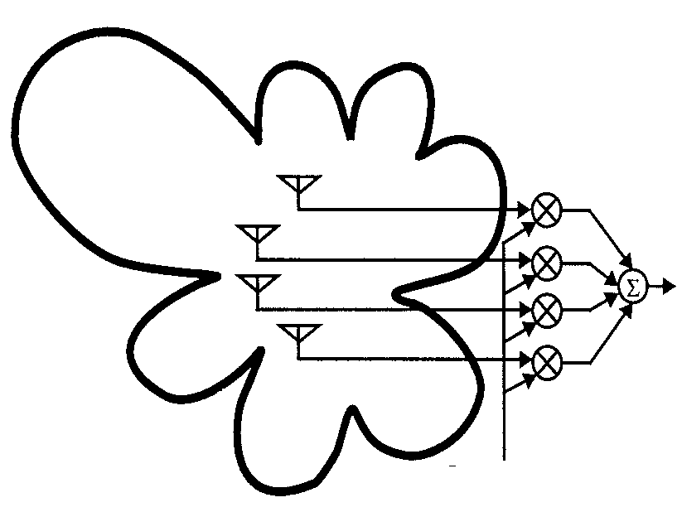
Beam Steering
SIGNAL
INTERFERENCE
SIGNAL OUTPUT
INTERFERENCE
BEAMFORMING
WEIGHTS
Beamforming weights used to place nulls in up to N_{R} directions
  Can also enhance gain in direction of desired signal
  Requires AOA information for signal and interferers

Slide 53
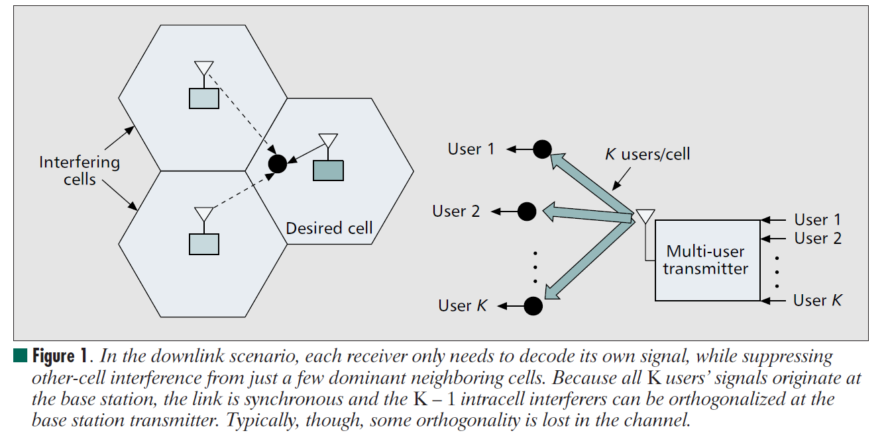
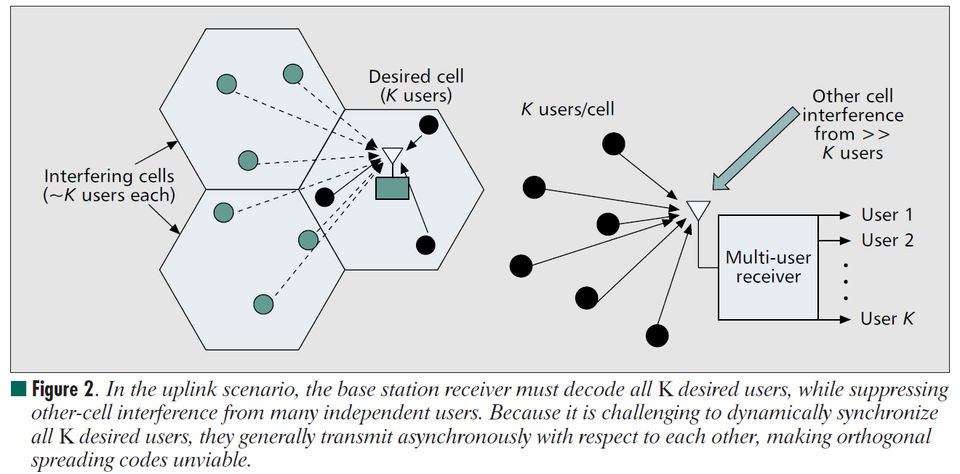
MUD in Cellular
In the uplink scenario, the BS RX must decode all K desired users, while suppressing other-cell interference from many independent users. Because it is challenging to dynamically synchronize all K desired users, they generally transmit asynchronously with respect to each other, making orthogonal
spreading codes unviable.
In the downlink scenario, each RX only needs to decode its own signal, while suppressing other-cell interference from just a few dominant neighboring cells. Because all K users’ signals originate at the base station, the link is synchronous and the K – 1 intracell interferers can be orthogonalized at the base station transmitter. Typically, though, some orthogonality is lost in the channel.

Slide 54
MUD in Cellular
• Goal: decode interfering signals to remove them from desired signal
• Interference cancellation
– decode strongest signal first; subtract it from the remaining signals
– repeat cancellation process on remaining signals
– works best when signals received at very different power levels
• Optimal multiuser detector (Verdu Algorithm)
– cancels interference between users in parallel
– complexity increases exponentially with the number of users
• Other techniques trade off performance and complexity
– decorrelating detector
– decision-feedback detector
– multistage detector
• MUD often requires channel information; can be hard to obtain
7C29822.051-Cimini-9/97

Slide 55
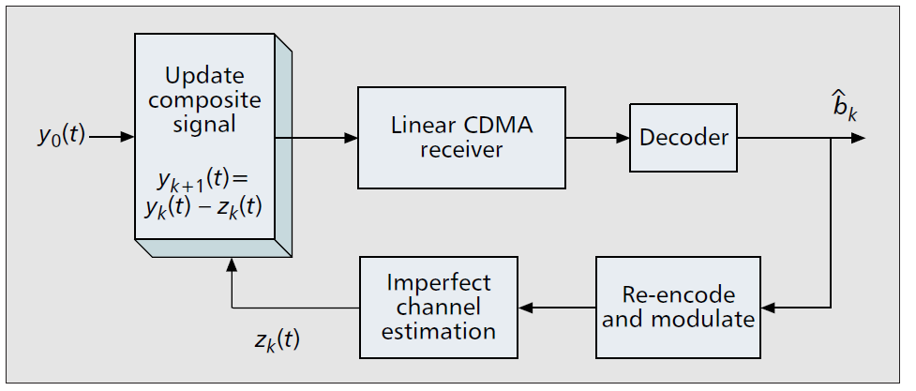
Successive Interference Cancellers
Successively subtract off strongest detected bits
MF output:
Decision made for strongest user:
Subtract this MAI from the weaker user:
  all MAI can be subtracted is user 1 decoded correctly
MAI is reduced and near/far problem alleviated
  Cancelling the strongest signal has the most benefit
  Cancelling the strongest signal is the most reliable cancellation

Slide 56
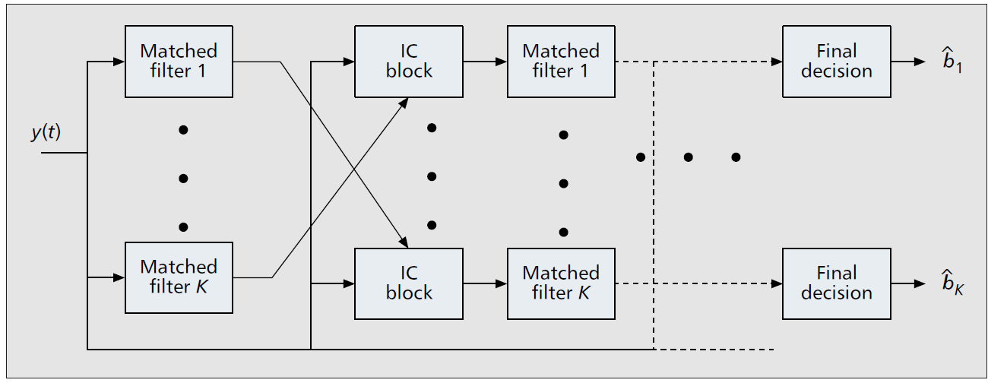
Parallel Interference Cancellation
Similarly uses all MF outputs
Simultaneously subtracts off all of the users’ signals from all of the others
works better than SIC when all of the users are received with equal strength (e.g. under power control)

Slide 57
Performance of MUD: AWGN

Slide 58
Optimal Multiuser Detection
Maximum Likelihood Sequence Estimation
  Detect bits of all users simultaneously (2^{M} possibilities)
Matched filter bank followed by the VA (Verdu’86)
  VA uses fact that I_{i}=f(b_{j}, j≠i)
  Complexity still high: (2^{M-1} states)
  In asynchronous case, algorithm extends over 3 bit times
    VA samples MFs in round robin fasion
y₁+I₁
X
MF 1
s_{c1}(t)
Viterbi Algorithm
s₁(t)+s₂(t)+s₃(t)
y₂+I₂
X
MF 2
Searches for ML
bit sequence
s_{c2}(t)
y₃+I₃
X
MF 3
s_{c3}(t)

Slide 59
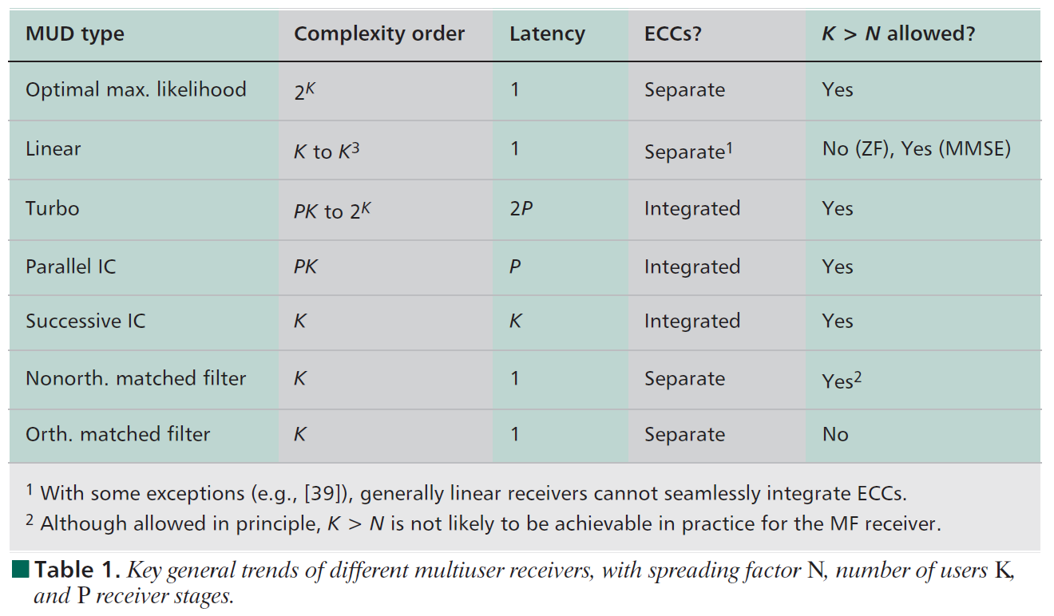
Tradeoffs

Slide 60

Diversity vs. Interference Cancellation
w_{t1}(t)
w_{r1}(t)
x₁(t)
r₁(t)
x₂(t)
w_{t2}(t)
r₂(t)
w_{r2}(t)
s_{D}(t)
+
y(t)
w_{tT}(t)
w_{rR}(t)
x_{M}(t)
r_{R}(t)
N_{t} transmit antennas
N_{R} receive antennas
Romero and Goldsmith: Performance comparison of MRC and IC
Under transmit diversity, IEEE Trans. Wireless Comm., May 2009

Slide 61
Diversity/IC Tradeoffs
N_{R} antennas at the RX provide N_{R}-fold diversity gain in fading
  Get N_{T}N_{R} diversity gain in MIMO system
Can also be used to null out N_{R} interferers via beam-steering
  Beam steering at TX reduces interference at RX
Antennas can be divided between diversity combining and interference cancellation
Can determine optimal antenna array processing to minimize outage probability

Slide 62
Diversity Combining Techniques
MRC diversity achieves maximum SNR in fading channels.
MRC is suboptimal for maximizing SINR in channels with fading and interference
Optimal Combining (OC) maximizes SINR in both fading and interference
  Requires knowledge of all desired and interferer channel gains at each antenna

Slide 63
SIR Distribution and P_{out}
Distribution of γ obtained using similar analysis as MRC based on MGF techniques.
Leads to closed-form expression for P_{out}.
  Similar in form to that for MRC
Fo L>N, OC with equal average interference powers achieves the same performance as MRC with N −1 fewer interferers.

Slide 64
Performance Analysis for IC
Assume that N antennas perfectly cancel N-1 strongest interferers
  General fading assumed for desired signal
  Rayleigh fading assumed for interferers
Performance impacted by remaining interferers and noise
  Distribution of the residual interference dictated by order statistics

Slide 65
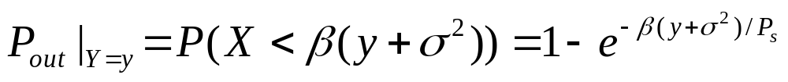
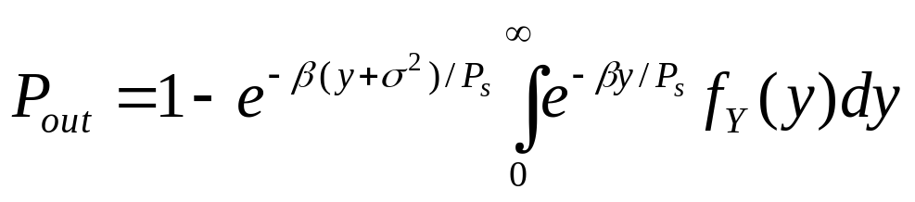
SINR and Outage Probability
The MGF for the interference can be computed in closed form
  pdf is obtained from MGF by differentiation
Can express outage probability in terms of desired signal and interference as
Unconditional P_{out} obtained as
Obtain closed-form expressions for most fading distributions

Slide 66
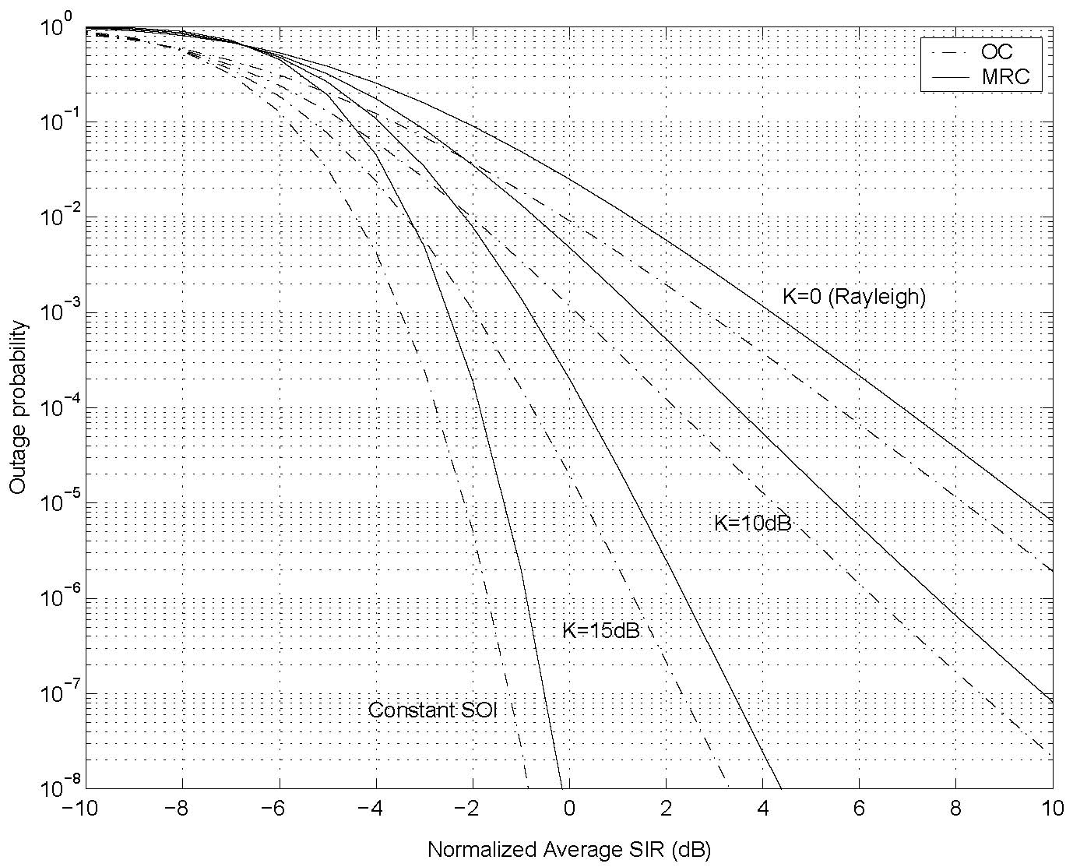
OC vs. MRC for Rician fading

Slide 67
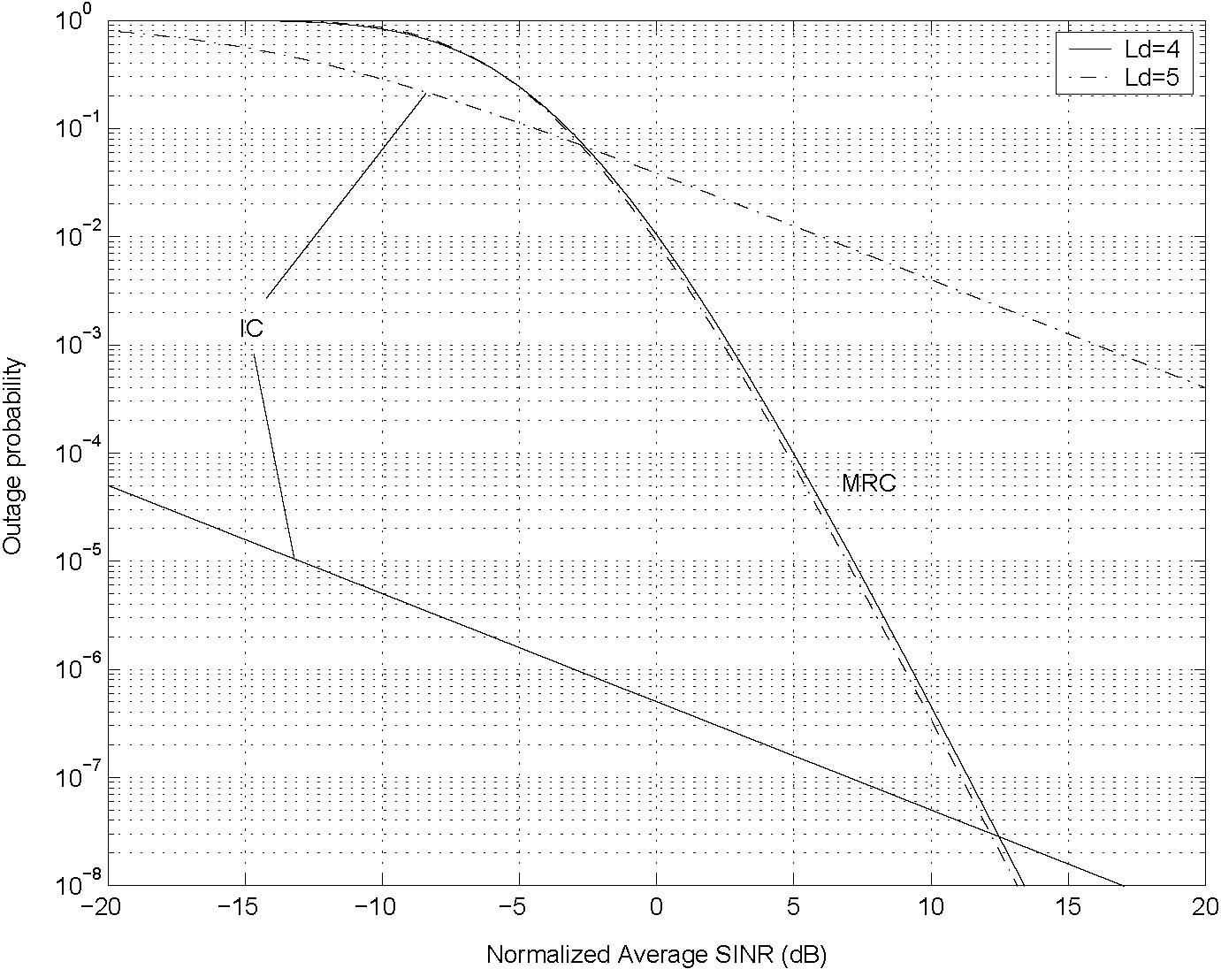
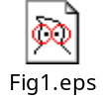
IC vs MRC as function of No. Ints

Slide 68
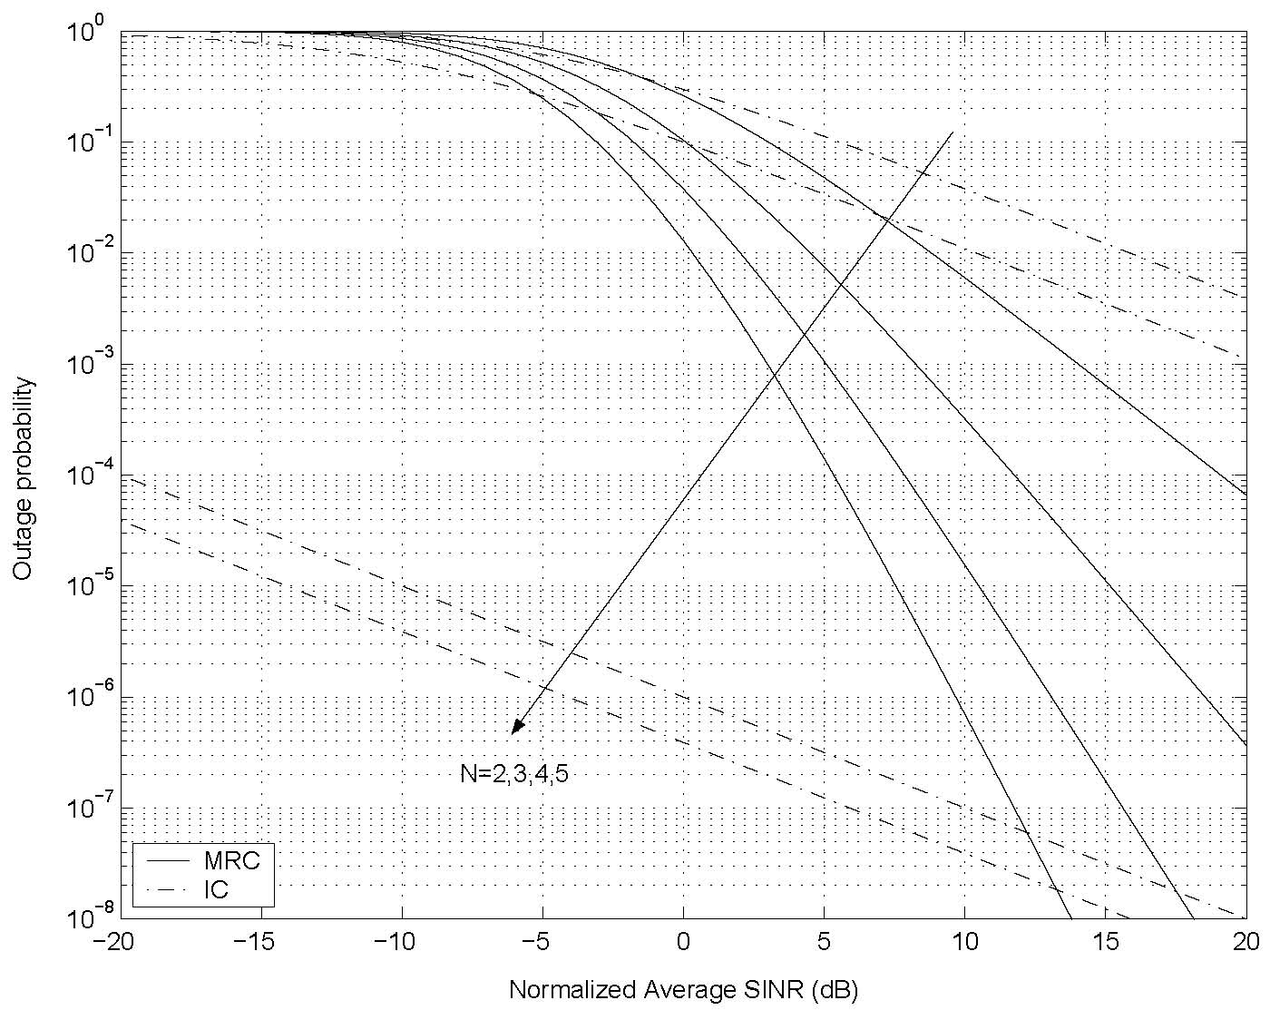
Diversity/IC Tradeoffs

Slide 69
Summary
Multiuser detection removes interference: tradeoffs between complexity and performance
Multiuser OFDM the basis for current cellular and WiFi systems.
Cellular systems have evolved from voice-only to sophisticated high-speed data – bandwidth limited.
HetNets the key to increasing capacity of cellular systems – require automated self-organization (SoN)
Smart antennas, MIMO, and multiuser detection have a key role to play in future cellular system design.

