Slide 1
EE360: Multiuser Wireless Systems and Networks
Lecture 3 Outline
  Announcements
    HW0 due today
    Project proposals due 1/27
    Makeup lecture for 2/10 (previous Friday 2/7 at lunch?)
  Duality between the MAC and the BC
  Capacity of MIMO Multiuser Channels
  Spread Spectrum
  Multiuser Detection
  Multiuser OFDM Techniques

Slide 2
Review of Last Lecture
Deterministic bandwidth sharing via time-division, frequency-division, code-division, space-division, and hybrid techniques.
Shannon capacity gives fundamental data rate limits for multiuser wireless channels
Fading multiuser channels optimize at each channel instance for maximum average rate
Outage capacity has higher (fixed) rates than with no outage.
OFDM is near optimal for broadcast channels with ISI
MAC channels superimpose users on top of each other, use multiuser detection to subtract out interference

Slide 3
Duality between
Broadcast and MAC Channels

Slide 4
Comparison of MAC and BC
P
Differences:
  Shared vs. individual power constraints
  Near-far effect in MAC
Similarities:
  Optimal BC “superposition” coding is also optimal for MAC (sum of Gaussian codewords)
  Both decoders exploit successive decoding and interference cancellation
P₁
P₂

Slide 5
MAC-BC Capacity Regions
MAC capacity region known for many cases
  Convex optimization problem
BC capacity region typically only known for (parallel) degraded channels
  Formulas often not convex
Can we find a connection between the BC and MAC capacity regions?
Duality

Slide 6














Dual Broadcast and MAC Channels
Gaussian BC and MAC with same channel gains
and same noise power at each receiver
x
+
x
+
x
+
x
Broadcast Channel (BC)
Multiple-Access Channel (MAC)

Slide 7
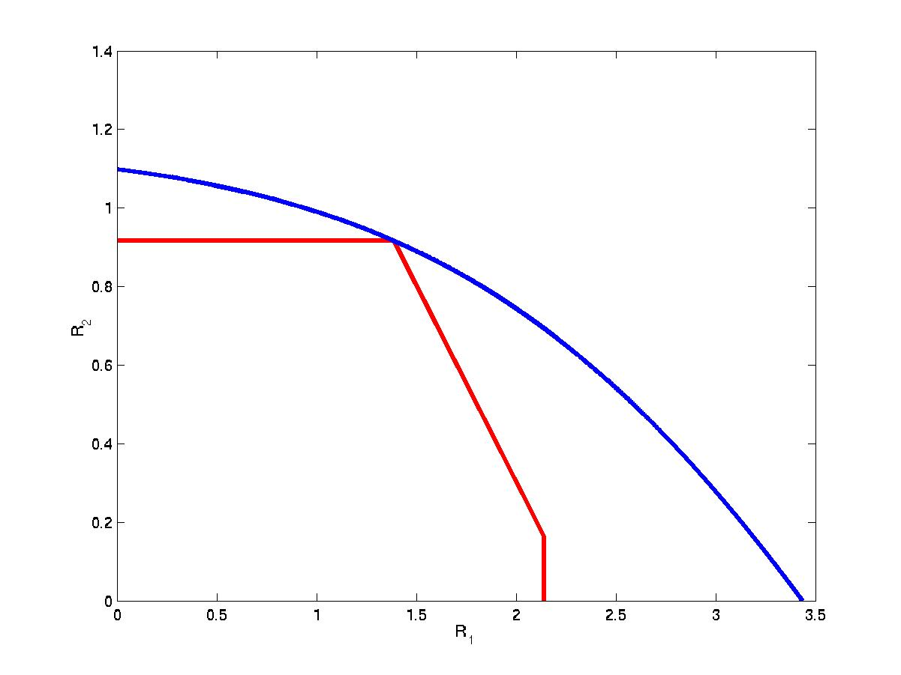

The BC from the MAC
P₁=0.5, P₂=1.5
Blue = BC
Red = MAC
P₁=1, P₂=1
P₁=1.5, P₂=0.5
MAC with sum-power constraint

Slide 8
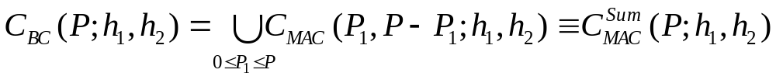

Sum-Power MAC
MAC with sum power constraint
  Power pooled between MAC transmitters
  No transmitter coordination
Same capacity region!
MAC
BC

Slide 9

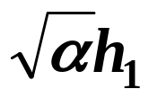
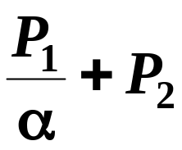


BC to MAC: Channel Scaling
Scale channel gain by √α, power by 1/α
MAC capacity region unaffected by scaling
Scaled MAC capacity region is a subset of the scaled BC capacity region for any α
MAC region inside scaled BC region for any scaling
MAC
+
+
+
BC

Slide 10
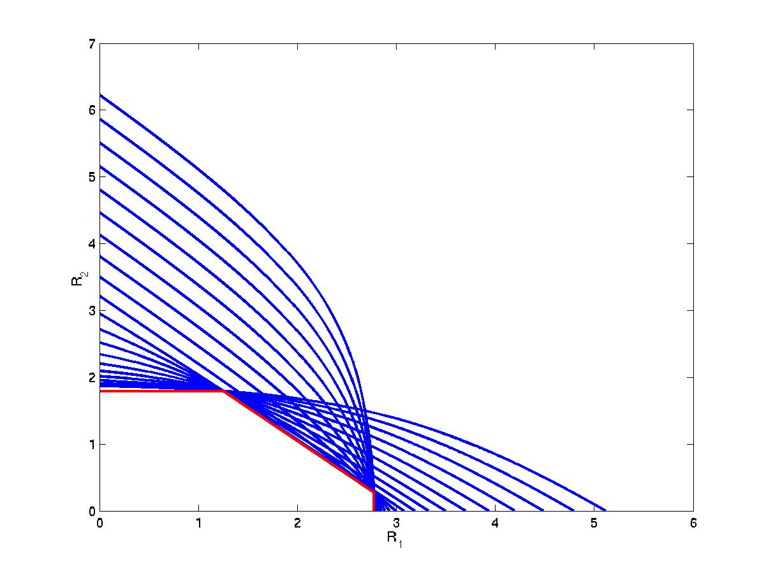

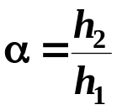

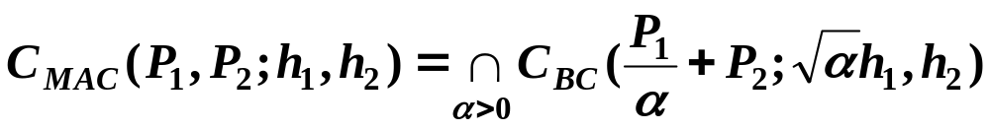
The BC from the MAC
Blue = Scaled BC
Red = MAC

Slide 11
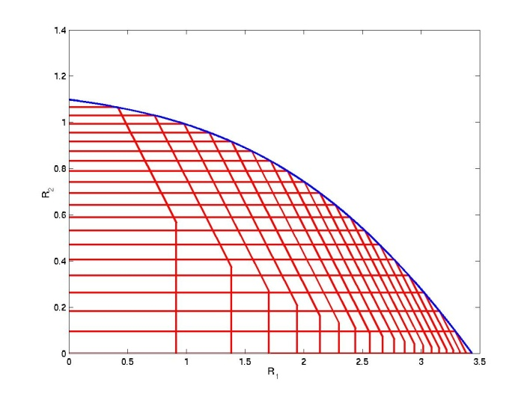

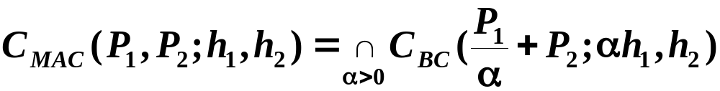
Duality: Constant AWGN Channels
BC in terms of MAC
MAC in terms of BC
What is the relationship between
the optimal transmission strategies?
Notes:
Summary of what we’ve done so far

Slide 12
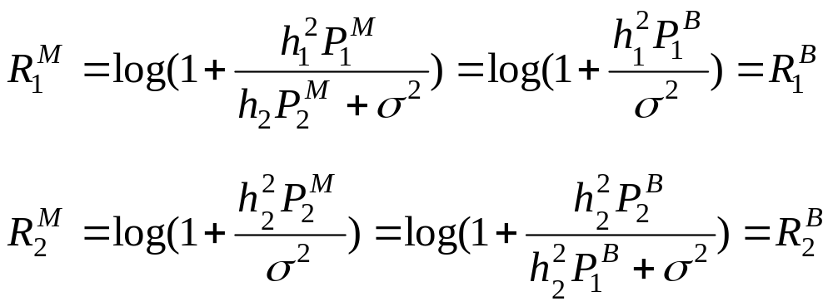
Transmission Strategy Transformations
Equate rates, solve for powers
Opposite decoding order
  Stronger user (User 1) decoded last in BC
  Weaker user (User 2) decoded last in MAC

Slide 13
Duality Applies to Different
Fading Channel Capacities
Ergodic (Shannon) capacity: maximum rate averaged over all fading states.
Zero-outage capacity: maximum rate that can be maintained in all fading states.
Outage capacity: maximum rate that can be maintained in all nonoutage fading states.
Minimum rate capacity: Minimum rate maintained in all states, maximize average rate in excess of minimum
  Explicit transformations between transmission strategies

Slide 14
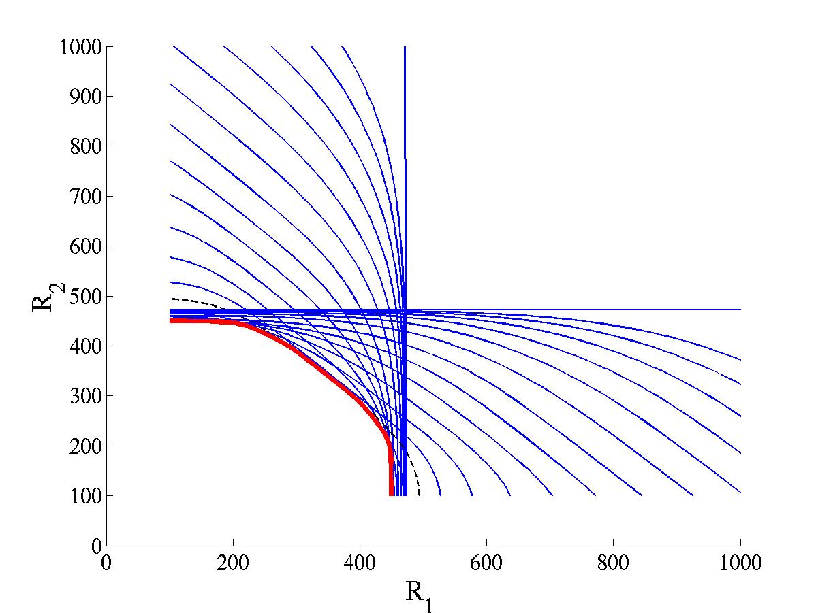
Duality: Minimum Rate Capacity
MAC in terms of BC
Blue = Scaled BC
Red = MAC
  BC region known
  MAC region can only be obtained by duality
What other capacity regions can be obtained by duality?
Broadcast MIMO Channels

Slide 15
Capacity Limits of
Broadcast MIMO Channels

Slide 16


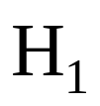




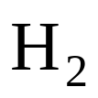

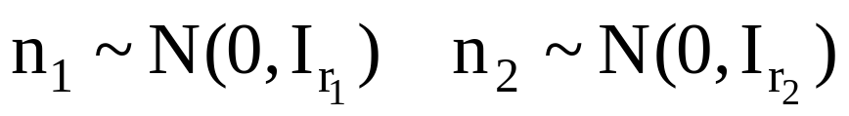
Broadcast MIMO Channel
t≥1 TX antennas
r₁≥1, r₂≥1 RX antennas
Perfect CSI at TX and RX
Non-degraded broadcast channel
Notes:
Channel on the left is the downlink (BC), channel on the right is the uplink (MAC) – notice dual channels have the same channel gains

Slide 17
Dirty Paper Coding (Costa’83)
Basic premise
  If the interference is known, channel capacity same as if there is no interference
  Accomplished by cleverly distributing the writing (codewords) and coloring their ink
  Decoder must know how to read these codewords
Dirty
Paper
Coding
Dirty
Paper
Coding
Clean Channel
Dirty Channel

Slide 18
Modulo Encoding/Decoding
Received signal Y=X+S, -1≤X≤1
  S known to transmitter, not receiver
Modulo operation removes the interference effects
  Set X so that ⎣Y⎦_{[-1,1]}=desired message (e.g. 0.5)
  Receiver demodulates modulo [-1,1]
-1
0
+1
…
…
-7
-5
-3
-1
0
+1
+3
+5
+7
S
X
-1
0
+1

Slide 19
MIMO BC Capacity
Non-degraded broadcast channel
  Receivers not necessarily “better” or “worse” due to multiple transmit/receive antennas
  Capacity region for general case unknown
Pioneering work by Caire/Shamai (Allerton’00):
  Two TX antennas/two RXs (1 antenna each)
  Dirty paper coding/lattice precoding (achievable rate)
    Computationally very complex
  MIMO version of the Sato upper bound
  Upper bound is achievable: capacity known!
Notes:
Caire and Shamai solved the 2 transmit antenna, 2 receiver case with only a single receive antenna – found the achievable region and showed it was optimal at the sum rate point.
We consider the general K-user case, where there are an arbitrary number of transmit antennas and arbitrary number of antennas at each receiver – most general scenario. We will develop a duality between the downlink and uplink and show that the achievable region is sum rate optimal.

Slide 20
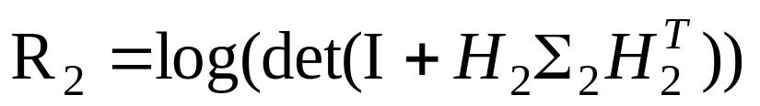
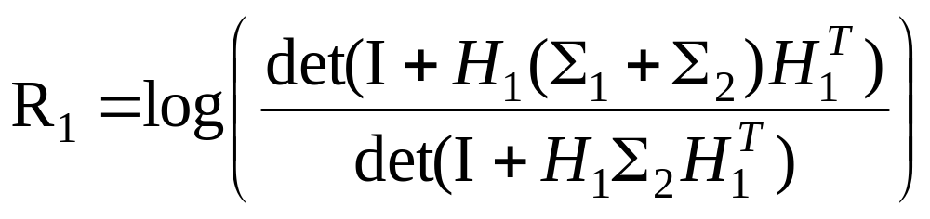
Dirty-Paper Coding (DPC) for MIMO BC
Coding scheme:
  Choose a codeword for user 1
  Treat this codeword as interference to user 2
  Pick signal for User 2 using “pre-coding”
Receiver 2 experiences no interference:
Signal for Receiver 2 interferes with Receiver 1:
Encoding order can be switched
DPC optimization highly complex
Notes:
Can transmit to user 2 as if a single-user channel (I.e. as if user 1 does not exist) due to precoding, dirty paper coding.
Region found by considering all covariance matrices sigma1 and sigma2, subject to a trace constraint (aka power constraint) on the sum of sigma1 and sigma2.
Can also encode in the other order – easily extends to K users.

Slide 21
Does DPC achieve capacity?
DPC yields MIMO BC achievable region.
  We call this the dirty-paper region
Is this region the capacity region?
We use duality, dirty paper coding, and Sato’s upper bound to address this question
First we need MIMO MAC Capacity

Slide 22
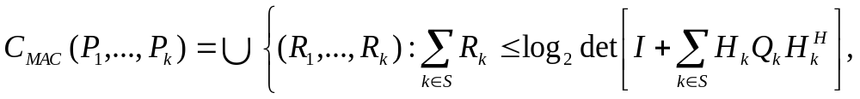
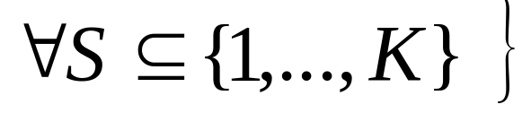
MIMO MAC Capacity
MIMO MAC follows from MAC capacity formula
Basic idea same as single user case
  Pick some subset of users
  The sum of those user rates equals the capacity as if the users pooled their power
Power Allocation and Decoding Order
  Each user has its own power (no power alloc.)
  Decoding order depends on desired rate point
Notes:
Can transmit to user 2 as if a single-user channel (I.e. as if user 1 does not exist) due to precoding, dirty paper coding.
Region found by considering all covariance matrices sigma1 and sigma2, subject to a trace constraint (aka power constraint) on the sum of sigma1 and sigma2.
Can also encode in the other order – easily extends to K users.

Slide 23
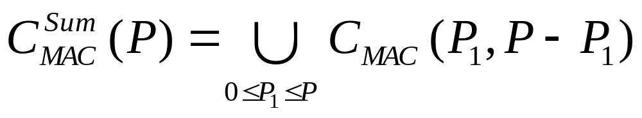
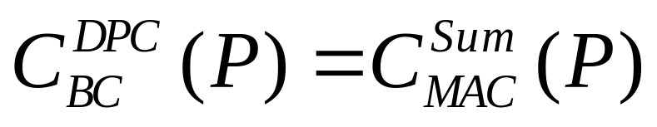
MIMO MAC with sum power
MAC with sum power:
  Transmitters code independently
  Share power
Theorem: Dirty-paper BC region equals the dual sum-power MAC region
P

Slide 24
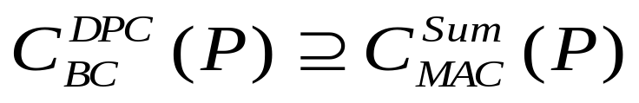
Transformations: MAC to BC
Show any rate achievable in sum-power MAC also achievable with DPC for BC:
  A sum-power MAC strategy for point (R₁,…R_{N}) has a given input covariance matrix and encoding order
  We find the corresponding PSD covariance matrix and encoding order to achieve (R₁,…,R_{N}) with DPC on BC
    The rank-preserving transform “flips the effective channel” and reverses the order
    Side result: beamforming is optimal for BC with 1 Rx antenna at each mobile
DPC BC
Sum MAC
Notes:
Analogy of relationship between powers for scalar case ( now need covariances because have vector signals)
A and B are matrices that represent the interference experiences in the BC and MAC, respectively

Slide 25
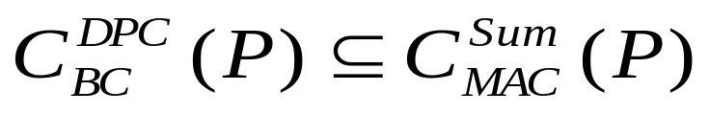
Transformations: BC to MAC
Show any rate achievable with DPC in BC also achievable in sum-power MAC:
  We find transformation between optimal DPC strategy and optimal sum-power MAC strategy
    “Flip the effective channel” and reverse order
DPC BC
Sum MAC
Notes:
Analogy of relationship between powers for scalar case ( now need covariances because have vector signals)
A and B are matrices that represent the interference experiences in the BC and MAC, respectively

Slide 26
Computing the Capacity Region
Hard to compute DPC region (Caire/Shamai’00)
“Easy” to compute the MIMO MAC capacity region
  Obtain DPC region by solving for sum-power MAC and applying the theorem
  Fast iterative algorithms have been developed
  Greatly simplifies calculation of the DPC region and the associated transmit strategy

Slide 27







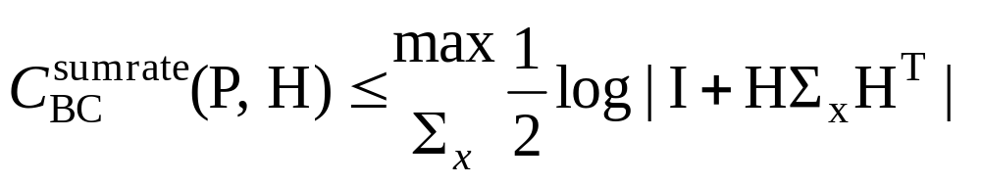
Sato Upper Bound on the
BC Capacity Region
• Based on receiver cooperation
• BC sum rate capacity ≤ Cooperative capacity
+
Joint receiver
+
Notes:
If we allow all receivers to cooperate, the system looks like a single-user multiple-antenna link – clearly the capacity of this link is an upper bound to the sum rate capacity of the BC (where the receivers are not allowed to cooperate)

Slide 28
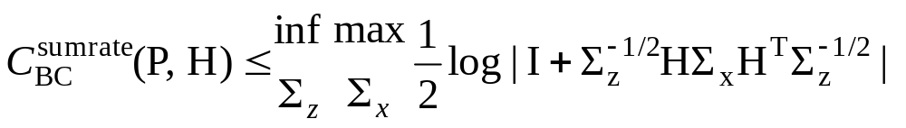
The Sato Bound for MIMO BC
Introduce noise correlation between receivers
BC capacity region unaffected
  Only depends on noise marginals
Tight Bound (Caire/Shamai’00)
  Cooperative capacity with worst-case noise correlation
Explicit formula for worst-case noise covariance
By Lagrangian duality, cooperative BC region equals the sum-rate capacity region of MIMO MAC
Notes:
In fact, we can make this bound much tighter by introducing noise correlation between the different receivers (that doesn’t affect the BC capacity) – Sato upper bound to the BC

Slide 29
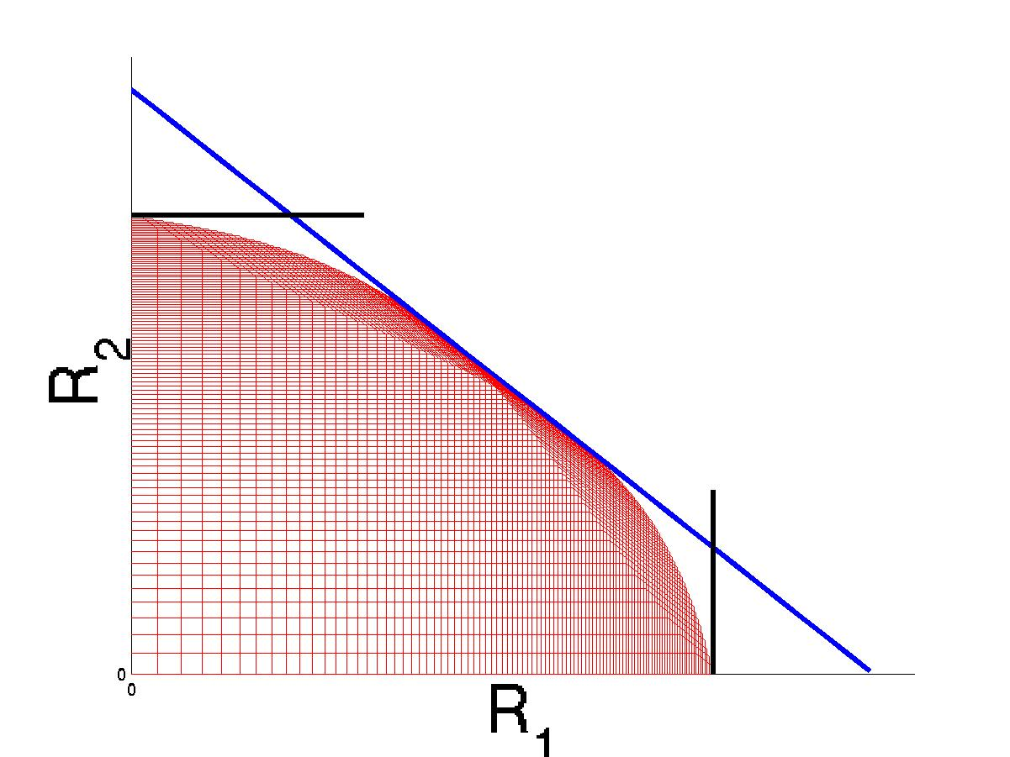
MIMO BC Capacity Bounds
Single User Capacity Bounds
Dirty Paper Achievable Region
BC Sum Rate Point
Sato Upper Bound
Does the DPC region equal the capacity region?
Notes:
Notice that the Sato upper bound is tight (as we proved), and also it is trivial to see that the single-user capacity bounds (i.e. the bounds by considering a single-user channel) are also
Tight – not too much room between achievable region and capacity bounds

Slide 30
Full Capacity Region
DPC gives us an achievable region
Sato bound only touches at sum-rate point
Bergman’s entropy power inequality is not a tight upper bound for nondegraded broadcast channel
A tighter bound was needed to prove DPC optimal
  It had been shown that if Gaussian codes optimal, DPC was optimal, but proving Gaussian optimality was open.
Breakthrough by Weingarten, Steinberg and Shamai
  Introduce notion of enhanced channel, applied Bergman’s converse to it to prove DPC optimal for MIMO BC.

Slide 31
Enhanced Channel Idea
The aligned and degraded BC (AMBC)
  Unity matrix channel, noise innovations process
  Limit of AMBC capacity equals that of MIMO BC
  Eigenvalues of some noise covariances go to infinity
  Total power mapped to covariance matrix constraint
Capacity region of AMBC achieved by Gaussian superposition coding and successive decoding
  Uses entropy power inequality on enhanced channel
  Enhanced channel has less noise variance than original
  Can show that a power allocation exists whereby the enhanced channel rate is inside original capacity region
By appropriate power alignment, capacities equal

Slide 32
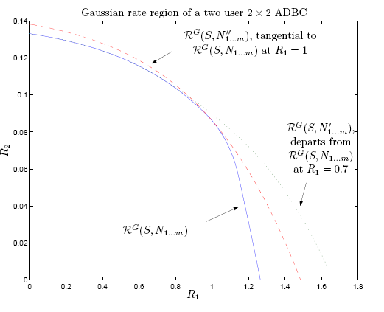
Illustration
Original
Enhanced

Slide 33
Complexity/Performance Tradeoffs
DPC can have much better performance than TDMA (Jindal/Goldsmith’05)
  DPC gain ≤min(M,K) for M TX antennas, K users
  At low SNRs there is no gain
  At high SNRs, DPC gain =max(min(M/N, K),1)
DPC highly complex to implement
Practical techniques that approach the performance of DPC do not yet exist.
Are there alternatives to DPC and TDMA?

Slide 34
Multiuser Diversity via Beamforming

Slide 35
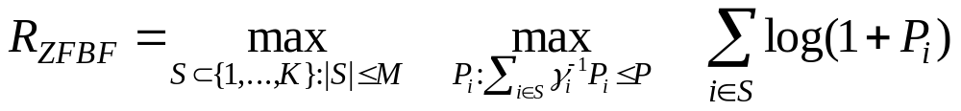



Zero-forcing beamforming (ZFBF)
Channel inversion for up to M users at a time
Sum-rate much higher than TDMA
  Achieves good fraction of DPC sum-rate capacity
Easily implemented
Scheduler
(user selection)
Zero-forcing
beamforming
Joint work with T. Yoo
Notes:
The implementation of ZFBF consists of two stages.
In the first stage, the scheduler selects a subset of users to which the BS intends to transmit.
Then in the second stage, the beamformer inverts the channel. So ZFBF is essentially a channel inversion strategy.

Slide 36
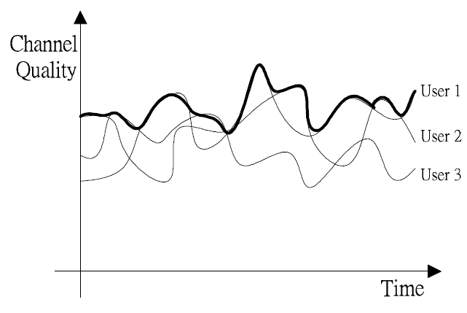


Performance for a large number of users (K>>M)
Multiuser diversity (MUDiv)
  Opportunistic scheduling
Large K
  TDMA
  DPC
What about ZFBF?
Notes:
performances when the number of users is large

Slide 37
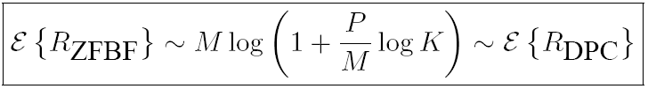
Optimality of ZFBF
Main theorem (ICC’05):
Theorem is due to multiuser diversity
  Higher channel gain (SNR gain of log K)
  Directional diversity
Multiuser diversity simplifies design without sacrificing optimality

Slide 38

Scheduler design: SUG
Optimal user selection requires searches → high complexity when K is large
Need simple algorithm with full MU diversity gain.
  Semi-orthogonal user group (SUG) selection
  Fast suboptimal user search
Algorithm can also incorporate fairness
Scheduler
(SUG Selection)
Zero-forcing
beamforming

Slide 39
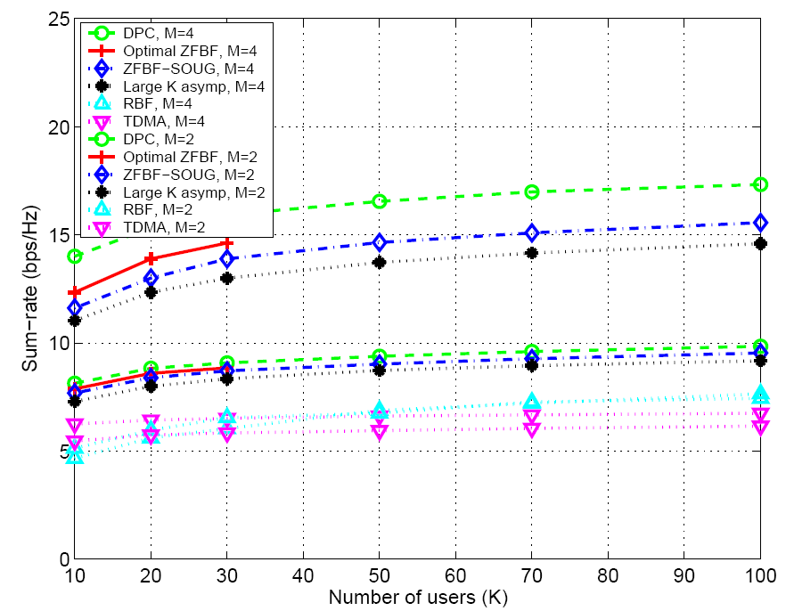
Simulation Results
(Practical K)
DPC (M=4)
ZFBF (M=4)
DPC (M=2)
ZFBF (M=2)
TDMA (M=2,4)
Notes:
RBF=random beamforming

Slide 40
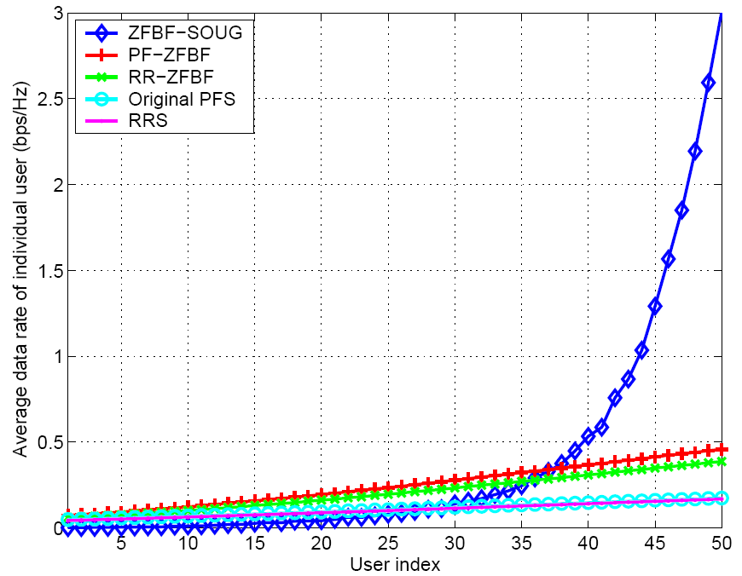
Fairness comparison

Slide 41
Spread Spectrum for
Multiple Access

Slide 42
Spread Spectrum
Multiple Access
Basic Features
  signal spread by a code
  synchronization between pairs of users
  compensation for near-far problem (in MAC channel)
  compression and channel coding
Spreading Mechanisms
  direct sequence multiplication
  frequency hopping
Note: spreading is 2nd modulation (after bits encoded into digital waveform, e.g. BPSK). DS spreading codes are inherently digital.

Slide 43
Direct Sequence
Linear
Modulation.
(PSK,QAM)
d(t)
s(t)
Linear
Demod.
X
Channel
X
Synchronized
SS Modulator
S_{ci}(t)
S_{ci}(t)
SS Demodulator
Chip time T_{c} is N times the symbol time T_{s}.
Bandwidth of s(t) is N+1 times that of d(t).
Channel introduces noise, ISI, narrowband and multiple access interference.
  Spreading has no effect on AWGN noise
  ISI delayed by more than T_{c} reduced by code autocorrelation
  narrowband interference reduced by spreading gain.
  MAC interference reduced by code cross correlation.

Slide 44
BPSK Example
T_{b}
d(t)
T_{c}=T_{b}/10
s_{ci}(t)
s(t)

Slide 45
Spectral Properties
Narrowband
Narrowband
Interference
Filter
Original
Data Signal
Data Signal
with Spreading
ISI
Other
Other
ISI
SS Users
SS Users
Modulated
Receiver
Demodulator
Data
Input
Filtering
8C32810.117-Cimini-7/98

Slide 46
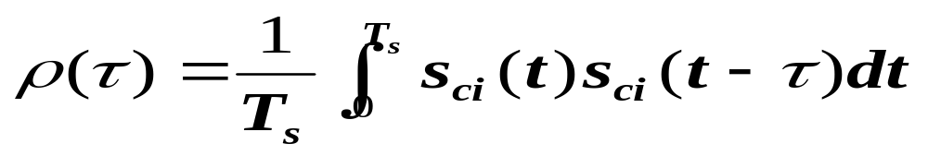
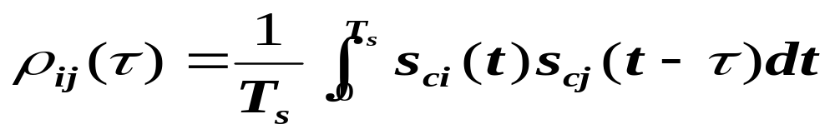
Code Properties
Autocorrelation (ISI rejection, covered in EE359):
Cross Correlation
Good codes have ρ(τ)=δ(τ) and ρ_{ij}(τ)=0 for all τ.
  ρ(τ)=δ(τ) removes ISI
  ρ_{ij}(τ)=0 removes interference between users
  Hard to get these properties simultaneously.

Slide 47
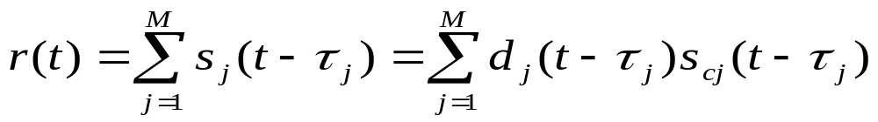
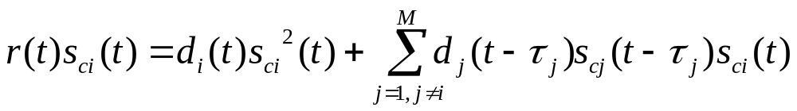
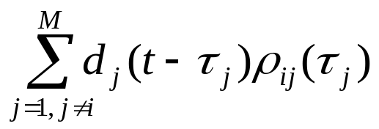
MAC Interference Rejection
Received signal from all users (no multipath):
Received signal after despreading
In the demodulator this signal is integrated over a symbol time, so the second term becomes
  For ρ_{ij}(τ)=0, all MAC interference is rejected.

Slide 48
Walsh-Hadamard Codes
For N chips/bit, can get N orthogonal codes
Bandwidth expansion factor is roughly N.
Roughly equivalent to TD or FD from a capacity standpoint
Multipath destroys code orthogonality.

Slide 49
Semi-Orthogonal Codes
Maximal length feedback shift register sequences have good properties
  In a long sequence, equal # of 1s and 0s.
    No DC component
  A run of length r chips of the same sign will occur 2^{-r}l times in l chips.
    Transitions at chip rate occur often.
  The autocorrelation is small except when τ is approximately zero
    ISI rejection.
  The cross correlation between any two sequences is small (roughly ρ_{ij}=G^{-1/2} , where G=B_{ss}/B_{s})
    Maximizes MAC interference rejection

Slide 50
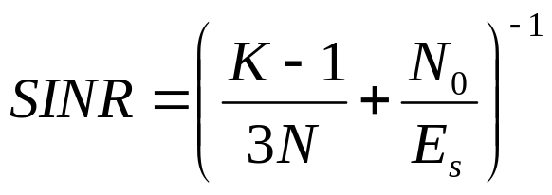
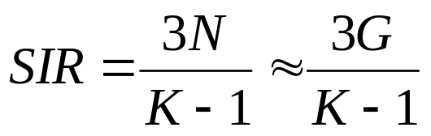
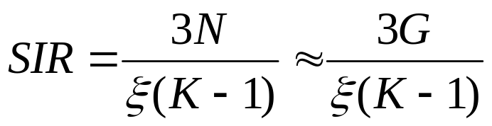
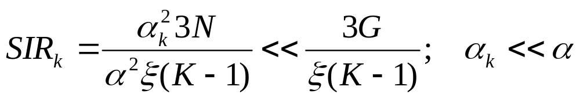
SINR analysis
SINR (for K users, N chips per symbol)
Interference limited systems (same gains)
Interference limited systems (near-far)
Assumes random
spreading codes
Random spreading codes
Nonrandom spreading codes

Slide 51
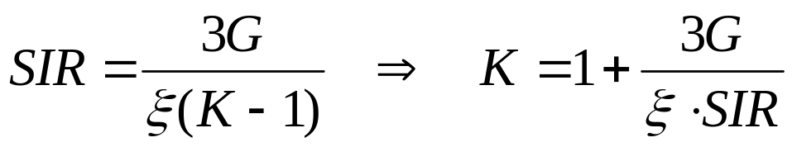
CDMA vs. TD/FD
For a spreading gain of G, can accommodate G TD/FD users in the same bandwidth
  SNR depends on transmit power
In CDMA, number of users is SIR-limited
For SIR≈3/ξ, same number of users in TD/FD as in CDMA
  Fewer users if larger SIR is required
  Different analysis in cellular (Gilhousen et. Al.)

Slide 52
Multiuser Detection

Slide 53
Multiuser Detection
In all CDMA systems and in TD/FD/CD cellular systems, users interfere with each other.
In most of these systems the interference is treated as noise.
  Systems become interference-limited
  Often uses complex mechanisms to minimize impact of interference (power control, smart antennas, etc.)
Multiuser detection exploits the fact that the structure of the interference is known
  Interference can be detected and subtracted out
  Better have a darn good estimate of the interference

Slide 54
MUD System Model
Synchronous Case
y₁+I₁
X
MF 1
s_{c1}(t)
y(t)=
s₁(t)+
s₂(t)+
s₃(t)+
n(t)
y₂+I₂
Multiuser
Detector
X
MF 2
s_{c2}(t)
y₃+I₃
X
MF 3
s_{c3}(t)
Matched filter integrates over a
symbol time and samples

Slide 55
MUD Algorithms
Multiuser
Receivers
Optimal
Suboptimal
MLSE
Linear
Non-linear
Decorrelator
MMSE
Multistage
Decision
Successive
-feedback
interference
cancellation

Slide 56
Optimal Multiuser Detection
Maximum Likelihood Sequence Estimation
  Detect bits of all users simultaneously (2^{M} possibilities)
Matched filter bank followed by the VA (Verdu’86)
  VA uses fact that I_{i}=f(b_{j}, j≠i)
  Complexity still high: (2^{M-1} states)
  In asynchronous case, algorithm extends over 3 bit times
    VA samples MFs in round robin fasion
y₁+I₁
X
MF 1
s_{c1}(t)
Viterbi Algorithm
s₁(t)+s₂(t)+s₃(t)
y₂+I₂
X
MF 2
Searches for ML
bit sequence
s_{c2}(t)
y₃+I₃
X
MF 3
s_{c3}(t)

Slide 57
Suboptimal Detectors
Main goal: reduced complexity
Design tradeoffs
  Near far resistance
  Asynchronous versus synchronous
  Linear versus nonlinear
  Performance versus complexity
  Limitations under practical operating conditions
Common methods
  Decorrelator
  MMSE
  Multistage
  Decision Feedback
  Successive Interference Cancellation

Slide 58
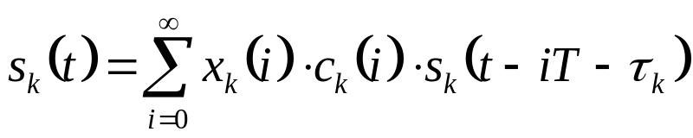
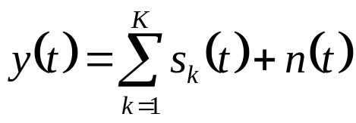
Mathematical Model
Simplified system model (BPSK)
  Baseband signal for the k^{th} user is:
    s_{k}(i) is the i^{th} input symbol of the k^{th} user
    c_{k}(i) is the real, positive channel gain
    s_{k}(t) is the signature waveform containing the PN sequence
    τ_{k} is the transmission delay; for synchronous CDMA, τ_{k}=0 for all users
  Received signal at baseband
    K number of users
    n(t) is the complex AWGN process

Slide 59
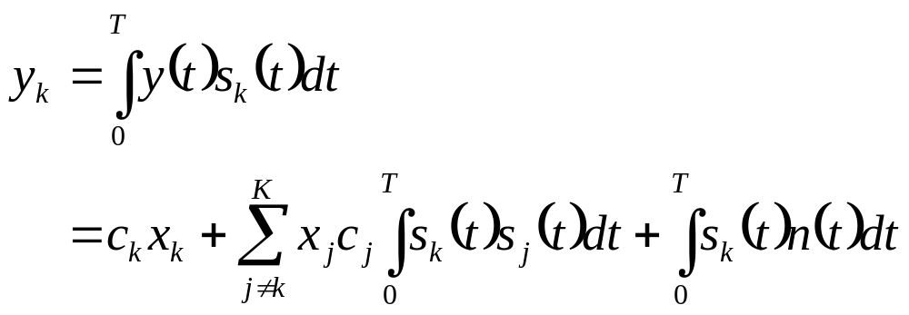
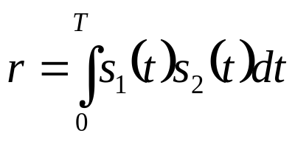
Matched Filter Output
Sampled output of matched filter for the k^{th} user:
  1st term - desired information
  2nd term - MAI
  3rd term - noise
Assume two-user case (K=2), and

Slide 60

Symbol Detection
Outputs of the matched filters are:
Detected symbol for user k:
If user 1 much stronger than user 2 (near/far problem), the MAI rc₁x₁ of user 2 is very large

Slide 61
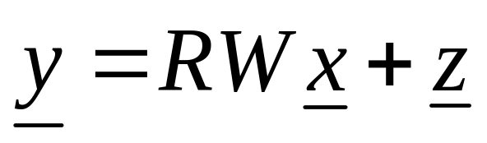
Decorrelator
Matrix representation
  where y=[y₁,y₂,…,y_{K}]^{T}, R and W are KxK matrices
  Components of R are cross-correlations between codes
  W is diagonal with W_{k,k} given by the channel gain c_{k}
  z is a colored Gaussian noise vector
Solve for x by inverting R
Analogous to zero-forcing equalizers for ISI
  Pros: Does not require knowledge of users’ powers
  Cons: Noise enhancement

Slide 62

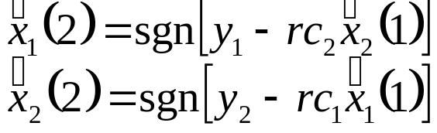
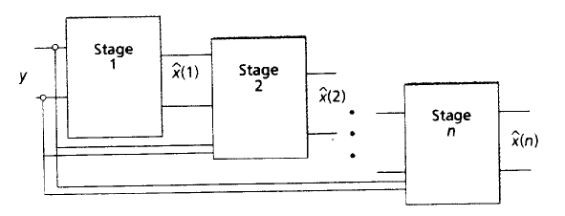
Multistage Detectors
Decisions produced by 1st stage are
2nd stage:
and so on…

Slide 63

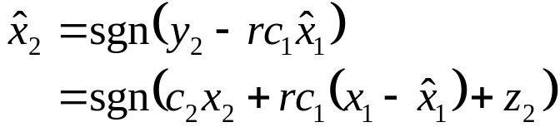
Successive Interference Cancellers
Successively subtract off strongest detected bits
MF output:
Decision made for strongest user:
Subtract this MAI from the weaker user:
  all MAI can be subtracted is user 1 decoded correctly
MAI is reduced and near/far problem alleviated
  Cancelling the strongest signal has the most benefit
  Cancelling the strongest signal is the most reliable cancellation

Slide 64
Parallel Interference Cancellation
Similarly uses all MF outputs
Simultaneously subtracts off all of the users’ signals from all of the others
works better than SIC when all of the users are received with equal strength (e.g. under power control)

Slide 65
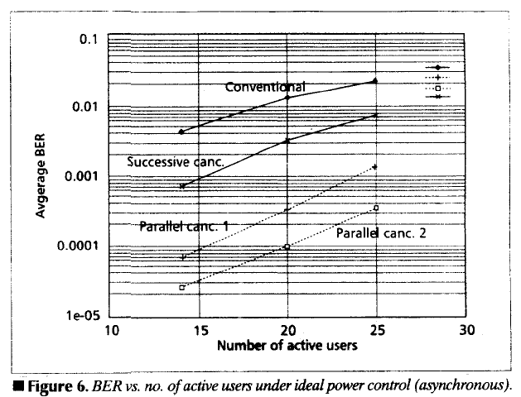
Performance of MUD: AWGN

Slide 66

Performance of MUD
Rayleigh Fading

Slide 67
Near-Far Problem and Traditional Power Control
On uplink, users have different channel gains
If all users transmit at same power (P_{i}=P), interference from near user drowns out far user
“Traditional” power control forces each signal to have the same received power
  Channel inversion: P_{i}=P/h_{i}
  Increases interference to other cells
  Decreases capacity
  Degrades performance of successive interference cancellation and MUD
    Can’t get a good estimate of any signal
h₁
h₃
P₃
P₁
h₂
P₂

Slide 68
Near Far Resistance
Received signals are received at different powers
MUDs should be insensitive to near-far problem
Linear receivers typically near-far resistant
  Disparate power in received signal doesn’t affect performance
Nonlinear MUDs must typically take into account the received power of each user
  Optimal power spread for some detectors (Viterbi’92)

Slide 69
Synchronous vs. Asynchronous
Linear MUDs don’t need synchronization
  Basically project received vector onto state space orthogonal to the interferers
  Timing of interference irrelevant
Nonlinear MUDs typically detect interference to subtract it out
  If only detect over a one bit time, users must be synchronous
  Can detect over multiple bit times for asynch. users
    Significantly increases complexity

Slide 70
Channel Estimation (Flat Fading)
Nonlinear MUDs typically require the channel gains of each user
Channel estimates difficult to obtain:
  Channel changing over time
  Must determine channel before MUD, so estimate is made in presence of interferers
Imperfect estimates can significantly degrade detector performance
  Much recent work addressing this issue
  Blind multiuser detectors
    Simultaneously estimate channel and signals

Slide 71
State Space Methods
Antenna techniques can also be used to remove interference (smart antennas)
Combining antennas and MUD in a powerful technique for interference rejection
Optimal joint design remains an open problem, especially in practical scenarios

Slide 72
Multipath Channels
In channels with N multipath components, each interferer creates N interfering signals
  Multipath signals typically asynchronous
  MUD must detect and subtract out N(M-1) signals
Desired signal also has N components, which should be combined via a RAKE.
MUD in multipath greatly increased
Channel estimation a nightmare
Much work has focused on complexity reduction and blind MUD in multipath channels (e.g. Wang/Poor’99)

Slide 73
Summary of MUD
MUD a powerful technique to reduce interference
  Optimal under ideal conditions
  High complexity: hard to implement
  Processing delay a problem for delay-constrained apps
  Degrades in real operating conditions
Much research focused on complexity reduction, practical constraints, and real channels
Smart antennas seem to be more practical and provide greater capacity increase for real systems

Slide 74
Multiuser OFDM Techniques

Slide 75
Multiuser OFDM
MCM/OFDM divides a wideband channel into narrowband subchannels to mitigate ISI
In multiuser systems these subchannels can be allocated among different users
  Orthogonal allocation: Multiuser OFDM (OFDMA)
  Semiorthogonal allocation: Multicarrier CDMA
Adaptive techniques increase the spectral efficiency of the subchannels.
Spatial techniques help to mitigate interference between users

Slide 76
Multicarrier CDMA
Multicarrier CDMA combines OFDM and CDMA
Idea is to use DSSS to spread a narrowband signal and then send each chip over a different subcarrier
  DSSS time operations converted to frequency domain
Greatly reduces complexity of SS system
  FFT/IFFT replace synchronization and despreading
More spectrally efficient than CDMA due to the overlapped subcarriers in OFDM
Multiple users assigned different spreading codes
  Similar interference properties as in CDMA

Slide 77
Multicarrier DS-CDMA
The data is serial-to-parallel converted.
Symbols on each branch spread in time.
Spread signals transmitted via OFDM
Get spreading in both time and frequency
c(t)
S/P convert
...
IFFT
P/S convert
s(t)
c(t)

Slide 78
Summary
Duality connects BC and MAC channels
  Used to obtain capacity of one from the other
Duality and dirty paper coding are used to obtain the capacity of a broadcast MIMO channel.
MIMO MAC capacity known from general formula, MIMO BC capacity known based on DPC and duality.
  DPC complicated to implement in practice.
  ZFBF has similar performance as DPC with much lower complexity.
Spread spectrum superimposes users on top of each other – interference subtracted via MUD
OFDMA easier multiuser technique than CDMA

