Slide 1
EE360: Lecture 18 Outline
Course Summary
Announcements
  Poster session W 3/12: 4:30pm setup, 4:45 start, pizza@6.
  DiscoverEE days poster session, March 14, 3:30-5:30
  Final project reports due March 17
  Student evaluations open, 10 bonus points for completion
Course Summary
Promising Research Directions

Slide 2
Course Summary

Slide 3

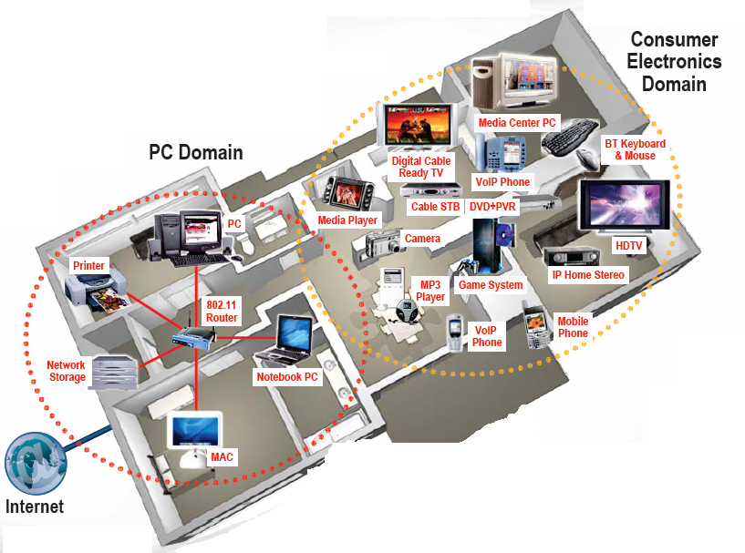





Future Wireless Networks
Ubiquitous Communication Among People and Devices
Next-generation Cellular
Wireless Internet Access
Wireless Multimedia
Sensor Networks
Smart Homes/Spaces
Automated Highways
In-Body Networks
All this and more …

Slide 4
Design Challenges
Wireless channels are a difficult and capacity-limited broadcast communications medium
There is limited spectrum available.
Traffic patterns, user locations, and network conditions are constantly changing
Applications are heterogeneous with hard constraints that must be met by the network
Energy and delay constraints change design principles across all layers of the protocol stack
Many wireless networks, with fragmented coordination and connectivity
Billions of devices coming with the Internet of Things

Slide 5
Wireless Network Design Issues
Multiuser Communications
Multiple and Random Access
Cellular System Design
Ad-Hoc and Cognitive Network Design
Network Optimization
Sensor Network Design
Protocol Layering and Cross-Layer Design
Software-Defined Wireless Networks

Slide 6
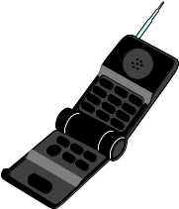

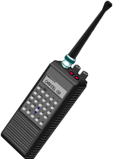
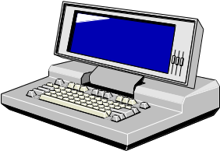
Multiuser Channels:
Uplink and Downlink
Uplink (Multiple Access
Channel or MAC):
Many Transmitters
to One Receiver.
x
R₃
h₃(t)
x
h₂₂(t)
Downlink (Broadcast Channel or BC):
One Transmitter
to Many Receivers.
x
h₂₁(t)
x
h₁(t)
R₂
R₁
Uplink and Downlink typically duplexed in time or frequency

Slide 7
Multiple vs. Random Access
Multiple Access Techniques
  Used to create a dedicated channel for each user
  Orthogonal (TD/FD with no interference) or semi-orthogonal (CD with interference reduced by the code spreading gain) techniques may be used
Random Access
  Assumes dedicated channels wasteful - no dedicated channel assigned to each user
  Users contend for channel when they have data to send
  Very efficient when users rarely active; very inefficient when users have continuous data to send
  Scheduling and hybrid scheduling used to combine benefits of multiple and random access

Slide 8
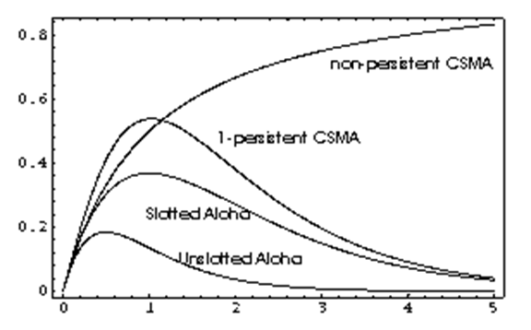
Random Access and Scheduling
RANDOM ACCESS TECHNIQUES
Dedicated channels wasteful for data
  Use statistical multiplexing
Random Access Techniques
  Aloha (Pure and Slotted)
  Carrier sensing
    Typically include collision detection or avoidance
  Poor performance in heavy loading
Reservation protocols
  Resources reserved for short transmissions (overhead)
  Hybrid Methods: Packet-Reservation Multiple Access
Retransmissions used for corrupted data
  Often assumes corruption due to a collision, not channel
7C29822.038-Cimini-9/97

Slide 9
Deterministic Bandwidth Sharing
Code Space
Frequency Division
Time Division
Code Division
  Multiuser Detection
Space (MIMO Systems)
Hybrid Schemes
Time
Frequency
  Code Space
Time
Frequency
Code Space
Time
Frequency
7C29822.033-Cimini-9/97

Slide 10




OFDMA and SDMA
OFDMA
  Implements FD via OFDM
  Different subcarriers assigned to different users
SDMA (space-division multiple access)
  Different spatial dimensions assigned to different users
  Implemented via multiuser beamforming (e.g. zero-force beamforming)
  Benefits from multiuser diversity

Slide 11
Spread Spectrum
Multiple Access
Basic Features
  signal spread by a code
  synchronization between pairs of users
  compensation for near-far problem (in MAC channel)
  compression and channel coding
Spreading Mechanisms
  direct sequence multiplication
  frequency hopping
Note: spreading is 2nd modulation (after bits encoded into digital waveform, e.g. BPSK). DS spreading codes are inherently digital.

Slide 12
Ideal Multiuser Detection
Signal 1
-
=
A/D
Signal 1
Demod
A/D
A/D
A/D
Iterative
Multiuser
Detection
Signal 2
Signal 2
Demod
-
=
Why Not Ubiquitous Today?
Power and A/D Precision

Slide 13
MUD Algorithms
Multiuser
Receivers
Optimal
Suboptimal
MLSE
Linear
Non-linear
Decorrelator
MMSE
Multistage
Decision
Successive
-feedback
interference
cancellation

Slide 14
Near-Far Problem and Traditional Power Control
On uplink, users have different channel gains
If all users transmit at same power (P_{i}=P), interference from near user drowns out far user
“Traditional” power control forces each signal to have the same received power
  Channel inversion: P_{i}=P/h_{i}
  Increases interference to other cells
  Decreases capacity
  Degrades performance of successive interference cancellation and MUD
    Can’t get a good estimate of any signal
h₁
h₃
P₃
P₁
h₂
P₂

Slide 15
Multiuser OFDM
MCM/OFDM divides a wideband channel into narrowband subchannels to mitigate ISI
In multiuser systems these subchannels can be allocated among different users
  Orthogonal allocation: Multiuser OFDM (OFDMA)
  Semiorthogonal allocation: Multicarrier CDMA
Adaptive techniques increase the spectral efficiency of the subchannels.
Spatial techniques help to mitigate interference between users

Slide 16
Multiuser Channel Capacity
Fundamental Limit on Data Rates
Capacity: The set of simultaneously achievable rates {R₁,…,R_{n}}
R₃
R₃
R₂
R₁
R₂
R₁
Main drivers of channel capacity
  Bandwidth and received SINR
  Channel model (fading, ISI)
  Channel knowledge and how it is used
  Number of antennas at TX and RX
Duality connects capacity regions of uplink and downlink

Slide 17
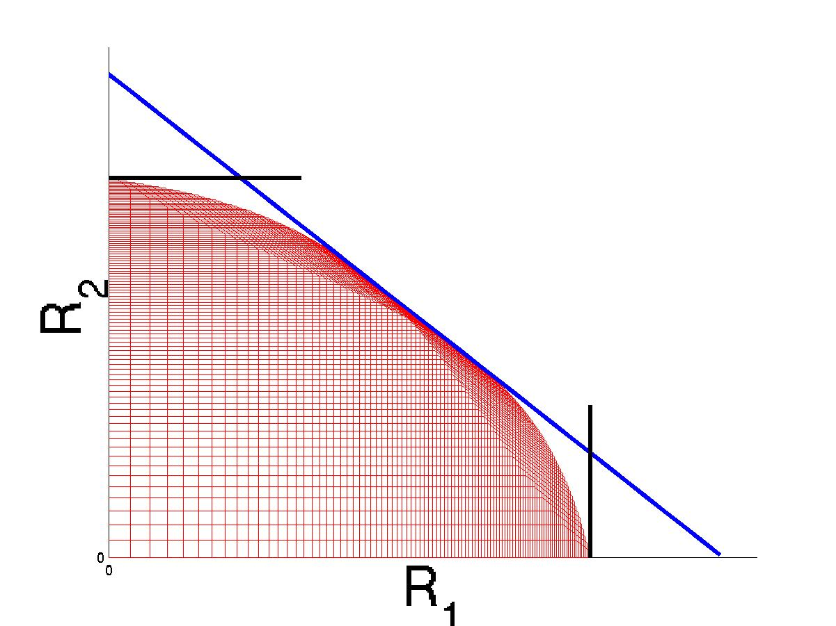
Capacity Results for
Multiuser Channels
Broadcast Channels
  AWGN
  Fading
  ISI
MACs
Duality
MIMO MAC and BC Capacity
Dirty Paper Achievable Region
BC Sum Rate Point
Sato Upper Bound
Single User
Capacity Bounds

Slide 18
Capacity-Achieving Techniques
Structured Coding
  Dirty-paper coding, superposition coding, rate splitting
Interference Cancellation and MUD
Adaptive techniques
  Opportunistic assignment of time, space, frequency to users
  Multiuser diversity
Multuser MIMO, opportunistic beamforming
Duality to reduce complexity of design

Slide 19
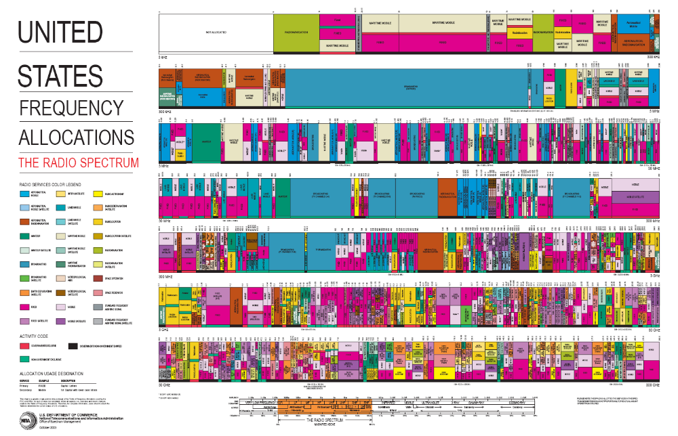
Scarce Wireless Spectrum
$$$
and Expensive

Slide 20

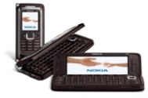
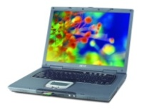
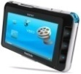
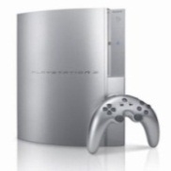

Spectral Reuse
Due to its scarcity, spectrum is reused
In licensed bands
and unlicensed bands
BS
Cellular, Wimax
Wifi, BT, UWB,…
Reuse introduces interference

Slide 21
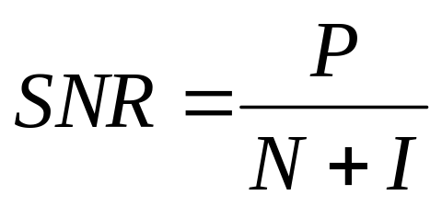
Interference: Friend or Foe?
If treated as noise: Foe
If decodable (MUD): Neither friend nor foe
If exploited via cooperation and cognition: Friend (especially in a network setting)
Increases BER
Reduces capacity

Slide 22
Cellular Systems
Reuse channels to maximize capacity
1G: Analog systems, large frequency reuse, large cells, uniform standard
2G: Digital systems, less reuse (1 for CDMA), smaller cells, multiple standards, evolved to support voice and data (IS-54, IS-95, GSM)
3G: Digital systems, WCDMA competing with GSM evolution.
4G: OFDM/MIMO
BASE
STATION
MTSO

Slide 23
Improving Capacity
Interference averaging
  WCDMA (3G)
Interference cancellation
  Multiuser detection
Interference reduction
  Sectorization, smart antennas, and relaying
  Dynamic resource allocation
  Power control
MIMO techniques
  Space-time processing

Slide 24
Multiuser Detection in Cellular
• Goal: decode interfering signals to remove them from desired signal
• Interference cancellation
– decode strongest signal first; subtract it from the remaining signals
– repeat cancellation process on remaining signals
– works best when signals received at very different power levels
• Optimal multiuser detector (Verdu Algorithm)
– cancels interference between users in parallel
– complexity increases exponentially with the number of users
• Other techniques tradeoff performance and complexity
– decorrelating detector
– decision-feedback detector
– multistage detector
• MUD often requires channel information; can be hard to obtain

Slide 25

Benefits of Relaying in Cellular Systems
Power falls of exponentially with distance
  Relaying extends system range
Can eliminate coverage holes due to shadowing, blockage, etc.
Increases frequency reuse
  Increases network capacity
Virtual Antennas and Cooperation
  Cooperating relays techniques
  May require tight synchronization

Slide 26
Dynamic Resource Allocation
Allocate resources as user and network conditions change
Resources:
  Channels
  Bandwidth
  Power
  Rate
  Base stations
  Access
Optimization criteria
  Minimize blocking (voice only systems)
  Maximize number of users (multiple classes)
  Maximize “revenue”
    Subject to some minimum performance for each user
BASE
STATION
“DCA is a 2G/4G problem”

Slide 27

MIMO Techniques in Cellular
How should MIMO be fully used in cellular systems?
Network MIMO: Cooperating BSs form an antenna array
  Downlink is a MIMO BC, uplink is a MIMO MAC
  Can treat “interference” as known signal (DPC) or noise
Multiplexing/diversity/interference cancellation tradeoffs
  Can optimize receiver algorithm to maximize SINR

Slide 28
MIMO in Cellular:
Performance Benefits
Antenna gain ⇒ extended battery life, extended range, and higher throughput
Diversity gain ⇒ improved reliability, more robust operation of services
Interference suppression (TXBF) ⇒ improved quality, reliability, and robustness
Multiplexing gain ⇒ higher data rates
Reduced interference to other systems

Slide 29
Cooperative Techniques in Cellular
Many open problems
for next-gen systems
Network MIMO: Cooperating BSs form a MIMO array
  Downlink is a MIMO BC, uplink is a MIMO MAC
  Can treat “interference” as known signal (DPC) or noise
  Can cluster cells and cooperate between clusters
  Can also install low-complexity relays
Mobiles can cooperate via relaying, virtual MIMO, conferencing, analog network coding, …

Slide 30
Rethinking “Cells” in Cellular
How should cellular
systems be designed?
Coop
MIMO
Small
Cell
Relay
Will gains in practice be
big or incremental; in
capacity or coverage?
DAS
Traditional cellular design “interference-limited”
  MIMO/multiuser detection can remove interference
  Cooperating BSs form a MIMO array: what is a cell?
  Relays change cell shape and boundaries
  Distributed antennas move BS towards cell boundary
  Small cells create a cell within a cell
  Mobile relaying, virtual MIMO, analog network coding.

Slide 31
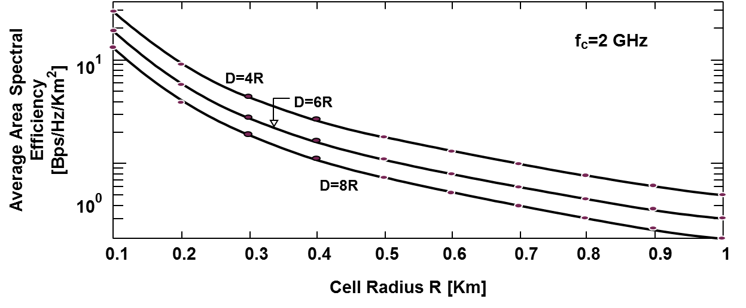
Area Spectral Efficiency
A=.25D²π =
BASE
STATION
S/I increases with reuse distance.
For BER fixed, tradeoff between reuse distance and link spectral efficiency (bps/Hz).
Area Spectral Efficiency: A_{e}=ΣR_{i}/(.25D²π) bps/Hz/Km².

Slide 32
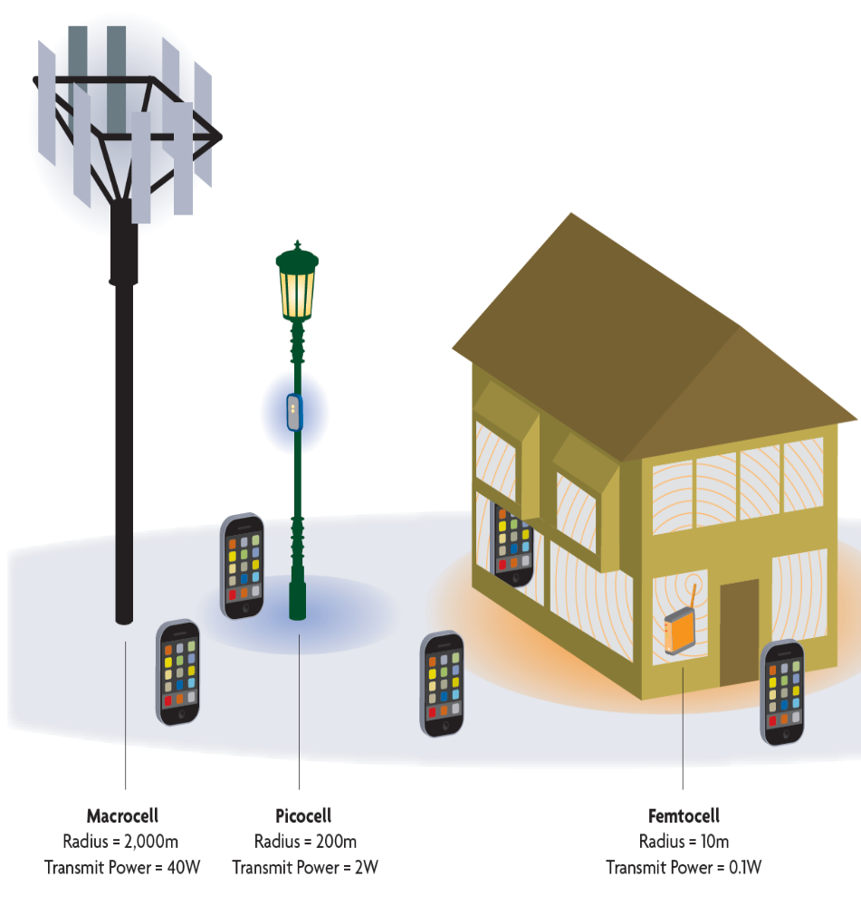

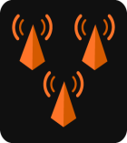





The Future Cellular Network: Hierarchical Architecture
Today’s architecture
3M Macrocells serving 5 billion users
MACRO: solving initial coverage issue, existing network
10x Lower HW COST
PICO: solving street, enterprise & home coverage/capacity issue
10x CAPACITY Improvement
Near 100%
COVERAGE
FEMTO: solving enterprise & home
coverage/capacity issue
Macrocell
Picocell
Femtocell
Managing interference
between cells is hard

Slide 33

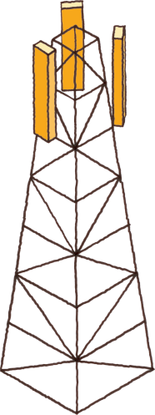

SON for LTE small cells
Mobile Gateway
Or Cloud
Node Installation
Self
Healing
SoN
Server
Initial Measurements
IP Network
SON
Server
Self Configuration
Measurement
Self Optimization
X2
X2
X2
X2
Small cell BS
Macrocell BS

Slide 34
Green” Cellular Networks
How should cellular
systems be redesigned
for minimum energy?
Pico/Femto
Coop
MIMO
Relay
Research indicates that
signicant savings is possible
DAS
Minimize energy at both the mobile and base station via
  New Infrastuctures: cell size, BS placement, DAS, Picos, relays
  New Protocols: Cell Zooming, Coop MIMO, RRM, Scheduling, Sleeping, Relaying
  Low-Power (Green) Radios: Radio Architectures, Modulation, coding, MIMO

Slide 35
Cellular System Capacity
Shannon Capacity
  Shannon capacity does no incorporate reuse distance.
  Wyner capacity: capacity of a TDMA systems with joint base station processing
User Capacity
  Calculates how many users can be supported for a given performance specification.
  Results highly dependent on traffic, voice activity, and propagation models.
  Can be improved through interference reduction techniques.
Area Spectral Efficiency
  Capacity per unit area
In practice, all techniques have roughly the same capacity for voice, but
flexibility of OFDM/MIMO supports more heterogeneous users

Slide 36
Defining Cellular Capacity
Shannon-theoretic definition
  Multiuser channels typically assume user coordination and joint encoding/decoding strategies
  Can an optimal coding strategy be found, or should one be assumed (i.e. TD,FD, or CD)?
  What base station(s) should users talk to?
  What assumptions should be made about base station coordination?
  Should frequency reuse be fixed or optimized?
  Is capacity defined by uplink or downlink?
  Capacity becomes very dependent on propagation model
Practical capacity definitions (rates or users)
  Typically assume a fixed set of system parameters
  Assumptions differ for different systems: comparison hard
  Does not provide a performance upper bound

Slide 37
Approaches to Date
Shannon Capacity
  TDMA systems with joint base station processing
Multicell Capacity
  Rate region per unit area per cell
  Achievable rates determined via Shannon-theoretic analysis or for practical schemes/constraints
  Area spectral efficiency is sum of rates per cell
User Capacity
  Calculates how many users can be supported for a given performance specification.
  Results highly dependent on traffic, voice activity, and propagation models.
  Can be improved through interference reduction techniques. (Gilhousen et. al.)

Slide 38
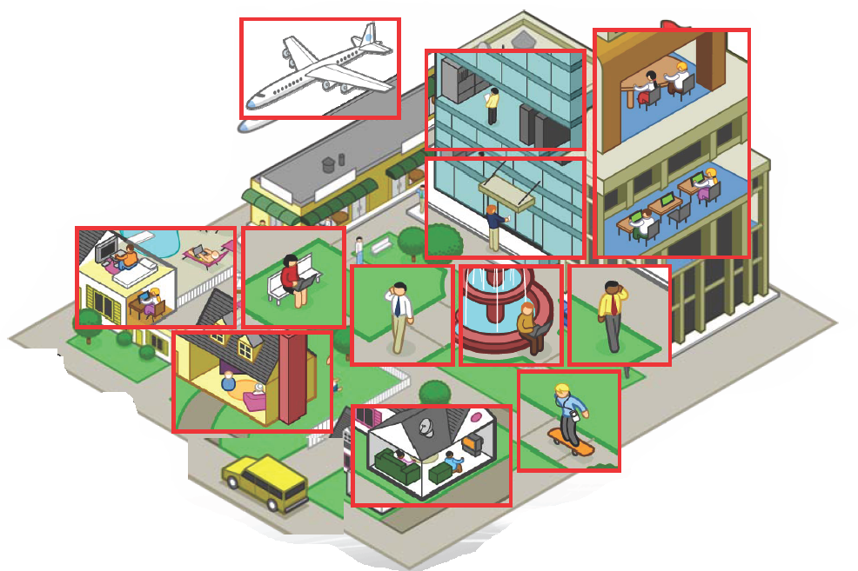
Ad-Hoc/Mesh Networks
ce
Outdoor Mesh
Indoor Mesh

Slide 39
Ad-Hoc Networks
Peer-to-peer communications.
No backbone infrastructure.
Routing can be multihop.
Topology is dynamic.
Fully connected with different link SINRs
Notes:
-No backbone: nodes must self-configure into a network.
-In principle all nodes can communicate with all other nodes, but multihop routing can reduce the interference associated with direct transmission.
-Topology dynamic since nodes move around and link characteristics change.
-Applications: appliances and entertainment units in the home, community networks that bypass the Internet. Military networks for robust flexible easily-deployed network (every soldier is a node).

Slide 40
Design Issues
Link layer design
Channel access and frequency reuse
Reliability
Cooperation and Routing
Adaptive Resource Allocation
Network Capacity
Cross Layer Design
Power/energy management (Sensor Nets)

Slide 41
Routing Techniques
Flooding
  Broadcast packet to all neighbors
Point-to-point routing
  Routes follow a sequence of links
  Connection-oriented or connectionless
Table-driven
  Nodes exchange information to develop routing tables
On-Demand Routing
  Routes formed “on-demand”
Analog Network Coding

Slide 42
Cooperation in Ad-Hoc Networks
Many possible cooperation strategies:
  Virtual MIMO , generalized relaying, interference forwarding, and one-shot/iterative conferencing
Many theoretical and practice issues:
  Overhead, forming groups, dynamics, synch, …

Slide 43
Generalized Relaying
TX1
RX1
X₁
Y₄=X₁+X₂+X₃+Z₄
relay
Y₃=X₁+X₂+Z₃
X₃= f(Y₃)
Analog network coding
Y₅=X₁+X₂+X₃+Z₅
X₂
TX2
RX2
Can forward message and/or interference
  Relay can forward all or part of the messages
    Much room for innovation
  Relay can forward interference
    To help subtract it out

Slide 44
Adaptive Resource Allocation for Wireless Ad-Hoc Networks
Network is dynamic (links change, nodes move around)
Adaptive techniques can adjust to and exploit variations
Adaptivity can take place at all levels of the protocol stack
Negative interactions between layer adaptation can occur
Network optimization techniques (e.g. NUM) often used
Prime candidate for cross-layer design

Slide 45
Ad-Hoc Network Capacity
R₃₄
Capacity
Delay
Upper Bound
Upper Bound
Lower Bound
Lower Bound
R₁₂
Energy
Network capacity in general refers to how much data a network can carry
Multiple definitions
  Shannon capacity: n(n-1)-dimensional region
  Total network throughput (vs. delay)
  User capacity (bps/Hz/user or total no. of users)
  Other dimensions: delay, energy, etc.
Notes:
-No backbone: nodes must self-configure into a network.
-In principle all nodes can communicate with all other nodes, but multihop routing can reduce the interference associated with direct transmission.
-Topology dynamic since nodes move around and link characteristics change.
-Applications: appliances and entertainment units in the home, community networks that bypass the Internet. Military networks for robust flexible easily-deployed network (every soldier is a node).

Slide 46
Network Capacity Results
Multiple access channel (MAC)
Broadcast channel
Relay channel upper/lower bounds
Interference channel
Scaling laws
Achievable rates for small networks

Slide 47
Intelligence beyond Cooperation: Cognition
Cognitive radios can support new wireless users in existing crowded spectrum
  Without degrading performance of existing users
Utilize advanced communication and signal processing techniques
  Coupled with novel spectrum allocation policies
Technology could
  Revolutionize the way spectrum is allocated worldwide
  Provide sufficient bandwidth to support higher quality and higher data rate products and services

Slide 48
Cognitive Radio Paradigms
Underlay
  Cognitive radios constrained to cause minimal interference to noncognitive radios
Interweave
  Cognitive radios find and exploit spectral holes to avoid interfering with noncognitive radios
Overlay
  Cognitive radios overhear and enhance noncognitive radio transmissions
Knowledge
and
Complexity

Slide 49
Underlay Systems
Cognitive radios determine the interference their transmission causes to noncognitive nodes
  Transmit if interference below a given threshold
The interference constraint may be met
  Via wideband signalling to maintain interference below the noise floor (spread spectrum or UWB)
  Via multiple antennas and beamforming
I_{P}
NCR
NCR
CR
CR

Slide 50
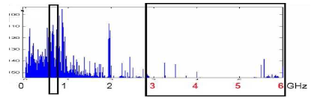
Interweave Systems
Measurements indicate that even crowded spectrum is not used across all time, space, and frequencies
  Original motivation for “cognitive” radios (Mitola’00)
These holes can be used for communication
  Interweave CRs periodically monitor spectrum for holes
  Hole location must be agreed upon between TX and RX
  Hole is then used for opportunistic communication with minimal interference to noncognitive users

Slide 51
Overlay Systems
Cognitive user has knowledge of other user’s message and/or encoding strategy
  Used to help noncognitive transmission
  Used to presubtract noncognitive interference
  Capacity/achievable rates known in some cases
    With and without MIMO nodes
CR
RX1
RX2
NCR

Slide 52

Cellular Systems with Cognitive Relays
Cognitive Relay 1
data
Source
Enhance robustness and capacity via cognitive relays
  Cognitive relays overhear the source messages
  Cognitive relays then cooperate with the transmitter in the transmission of the source messages
  Can relay the message even if transmitter fails due to congestion, etc.
Cognitive Relay 2
Can extend these ideas to MIMO systems

Slide 53
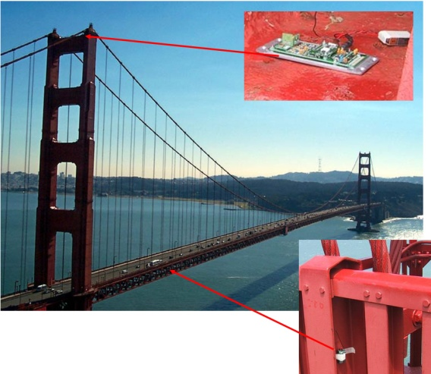
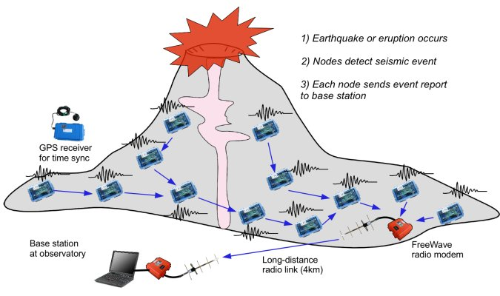
Wireless Sensor and “Green” Networks
Smart homes/buildings
Smart structures
Search and rescue
Homeland security
Event detection
Battlefield surveillance
Energy (transmit and processing) is driving constraint
Data flows to centralized location (joint compression)
Low per-node rates but tens to thousands of nodes
Intelligence is in the network rather than in the devices
Similar ideas can be used to re-architect systems and networks to be green

Slide 54
Energy-Constrained Nodes
Each node can only send a finite number of bits.
  Transmit energy minimized by maximizing bit time
  Circuit energy consumption increases with bit time
  Introduces a delay versus energy tradeoff for each bit
Short-range networks must consider transmit, circuit, and processing energy.
  Sophisticated techniques not necessarily energy-efficient.
  Sleep modes save energy but complicate networking.
Changes everything about the network design:
  Bit allocation must be optimized across all protocols.
  Delay vs. throughput vs. node/network lifetime tradeoffs.
  Optimization of node cooperation.
Notes:
All the sophisticated high-performance communication techniques developed since WW2 may need to be thrown out the window.
By cooperating, nodes can save energy

Slide 55
Cross-Layer Tradeoffs
under Energy Constraints
Hardware
  Models for circuit energy consumption highly variable
  All nodes have transmit, sleep, and transient modes
  Short distance transmissions require TD optimization
Link
  High-level modulation costs transmit energy but saves circuit energy (shorter transmission time)
  Coding costs circuit energy but saves transmit energy
Access
  Transmission time (TD) for all nodes jointly optimized
  Adaptive modulation adds another degree of freedom
Routing:
  Circuit energy costs can preclude multihop routing
Applications, cross-layer design, and in-network processing
  Protocols driven by application reqmts (e.g. directed diffusion)
Notes:
Make this section more about cross layer stuff

Slide 56
Cooperative Compression in Sensor Networks
Source data correlated in space and time
Nodes should cooperate in compression as well as communication and routing
  Joint source/channel/network coding
  What is optimal for cooperative communication:
    Virtual MIMO or relaying?

Slide 57
Crosslayer Design in
Wireless Networks
Application
Network
Access
Link
Hardware
Tradeoffs at all layers of the protocol stack are optimized with respect to end-to-end performance
This performance is dictated by the application
Notes:
Interdisciplinary research, design, and development very challenging, but necessary to meet the requirements of future wireless applications

Slide 58
Software Defined Wireless Networks
Video
Security
Vehicular
Networks
M2M
App layer
Health
Freq.
Allocation
Power
Control
Self
Healing
ICIC
QoS
Opt.
CS
Threshold
SW layer
UNIFIED CONTROL PLANE
Commodity HW
WiFi
Cellular
60 GHz
Cognitive Radio

Slide 59
Promising
Research
Areas

Slide 60
Promising Research Areas
Link Layer
  Wideband air interfaces and dynamic spectrum management
  Practical MIMO techniques (modulation, coding, imperfect CSI)
  mmWave communications
Multiple/Random Access
  Distributed techniques
  Multiuser Detection
  Distributed random access and scheduling
Cellular Systems
  How to use multiple antennas
  Multihop routing
  Cooperation
Ad Hoc Networks
  How to use multiple antennas
  Cross-layer design

Slide 61
Promising Research Areas
Cognitive Radio Networks
  MIMO underlay systems – exploiting null space
  Distributed detection of spectrum holes
  Practice overlay techniques and applications
Sensor networks
  Energy-constrained communication
  Cooperative techniques
Information Theory
  Capacity of ad hoc networks
  Imperfect CSI
  Incorporating delay: Rate distortion theory for networks
  Applications in biology and neuroscience

Slide 62
Reduced-Dimension
Communication System Design
Compressed sensing ideas have found widespread application in signal processing and other areas.
Basic premise of CS: exploit sparsity to approximate a high-dimensional system/signal in a few dimensions.
Can sparsity be exploited to reduce the complexity of communication system design in general

Slide 63
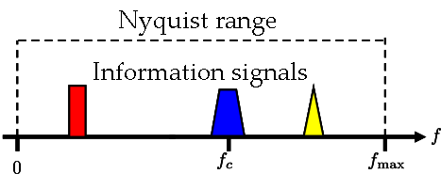
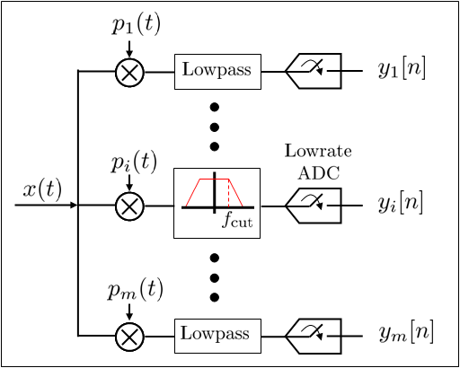
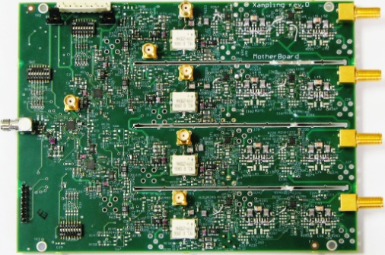
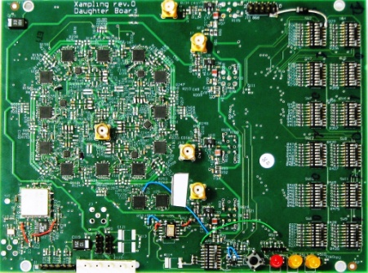
Compressed Sensing
Basic premise is that signals with some sparse structure can be sampled below their Nyquist rate
Determined fundamental capacity limits and optimal transmission for sub-Nyquist sampled channels.
This significantly reduces the burden on the front-end A/D converter, as well as the DSP and storage
Might be key enabler for SD and low-energy radios
  Only for incoming signals “sparse” in time, freq., space, etc.

Slide 64

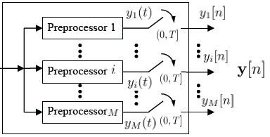






Capacity of Sampled Analog Channels
New Channel
Sampling
Mechanism
(rate f_{s})
  For a given sampling mechanism (i.e. a “new” channel)
    What is the optimal input signal?
    What is the tradeoff between capacity and sampling rate?
  What is the optimal sampling mechanism?
  Extensions to multiuser systems, MIMO, networks,…

Slide 65



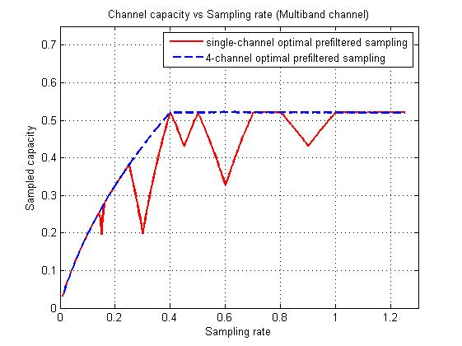
















Joint Optimization of Input and Filter Bank
Selects the m branches with m highest SNR
  Example (Bank of 2 branches)
low
SNR
highest SNR
Capacity monotonic in f_{s}
2nd highest
SNR
low SNR

Slide 66















Sampling with Modulator and Filter Bank
Theorem:
  Bank of Modulator+Filter≅Single Branch ≅ Filter Bank
Theorem
  Optimal among all time-preserving nonuniform sampling techniques of rate f_{s}
zzzzzzzzzz
zzzzzzzzzz
equals

Slide 67
Rethinking “Cells” in Cellular
Coop
MIMO
Picocell/
HetNet
How should future
cellular systems
be designed?
Relay
DAS
Traditional cellular design “interference-limited”
  MIMO/multiuser detection can remove interference
  Cooperating BSs form a MIMO array: what is a cell?
  Relays and distributed antennas change cell shape and boundaries
  Small cells create a cell within a cell (HetNet)
  Mobile cooperation via relaying, virtual MIMO, analog network coding.
  Green cellular requires drastically reduced energy consumption of BSs

Slide 68
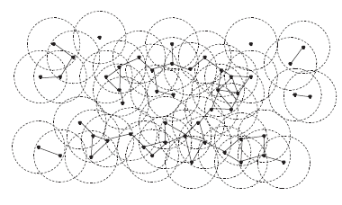
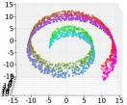
Reduced-Dimension Network Design
Random Network State
Reduced-Dimension
State-Space Representation
Projection
Sparse
Sampling
Approximate
Stochastic Control
and Optimization
Utility estimation
Sampling
and
Learning

Slide 69

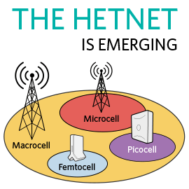




Self-optimization for all wireless networks
TV White Space &
Cognitive Radio
Vehicle networks
Ad-hoc networks
Self-optimizing networks (SoN)

Slide 70

Communication and Control
Automated Vehicles
- Cars/planes/UAVs
- Insect flyers
  Interdisciplinary design approach
    Control requires fast, accurate, and reliable feedback.
    Wireless networks introduce delay and loss
    Need reliable networks and robust controllers
    Mostly open problems
: Many design challenges

Slide 71
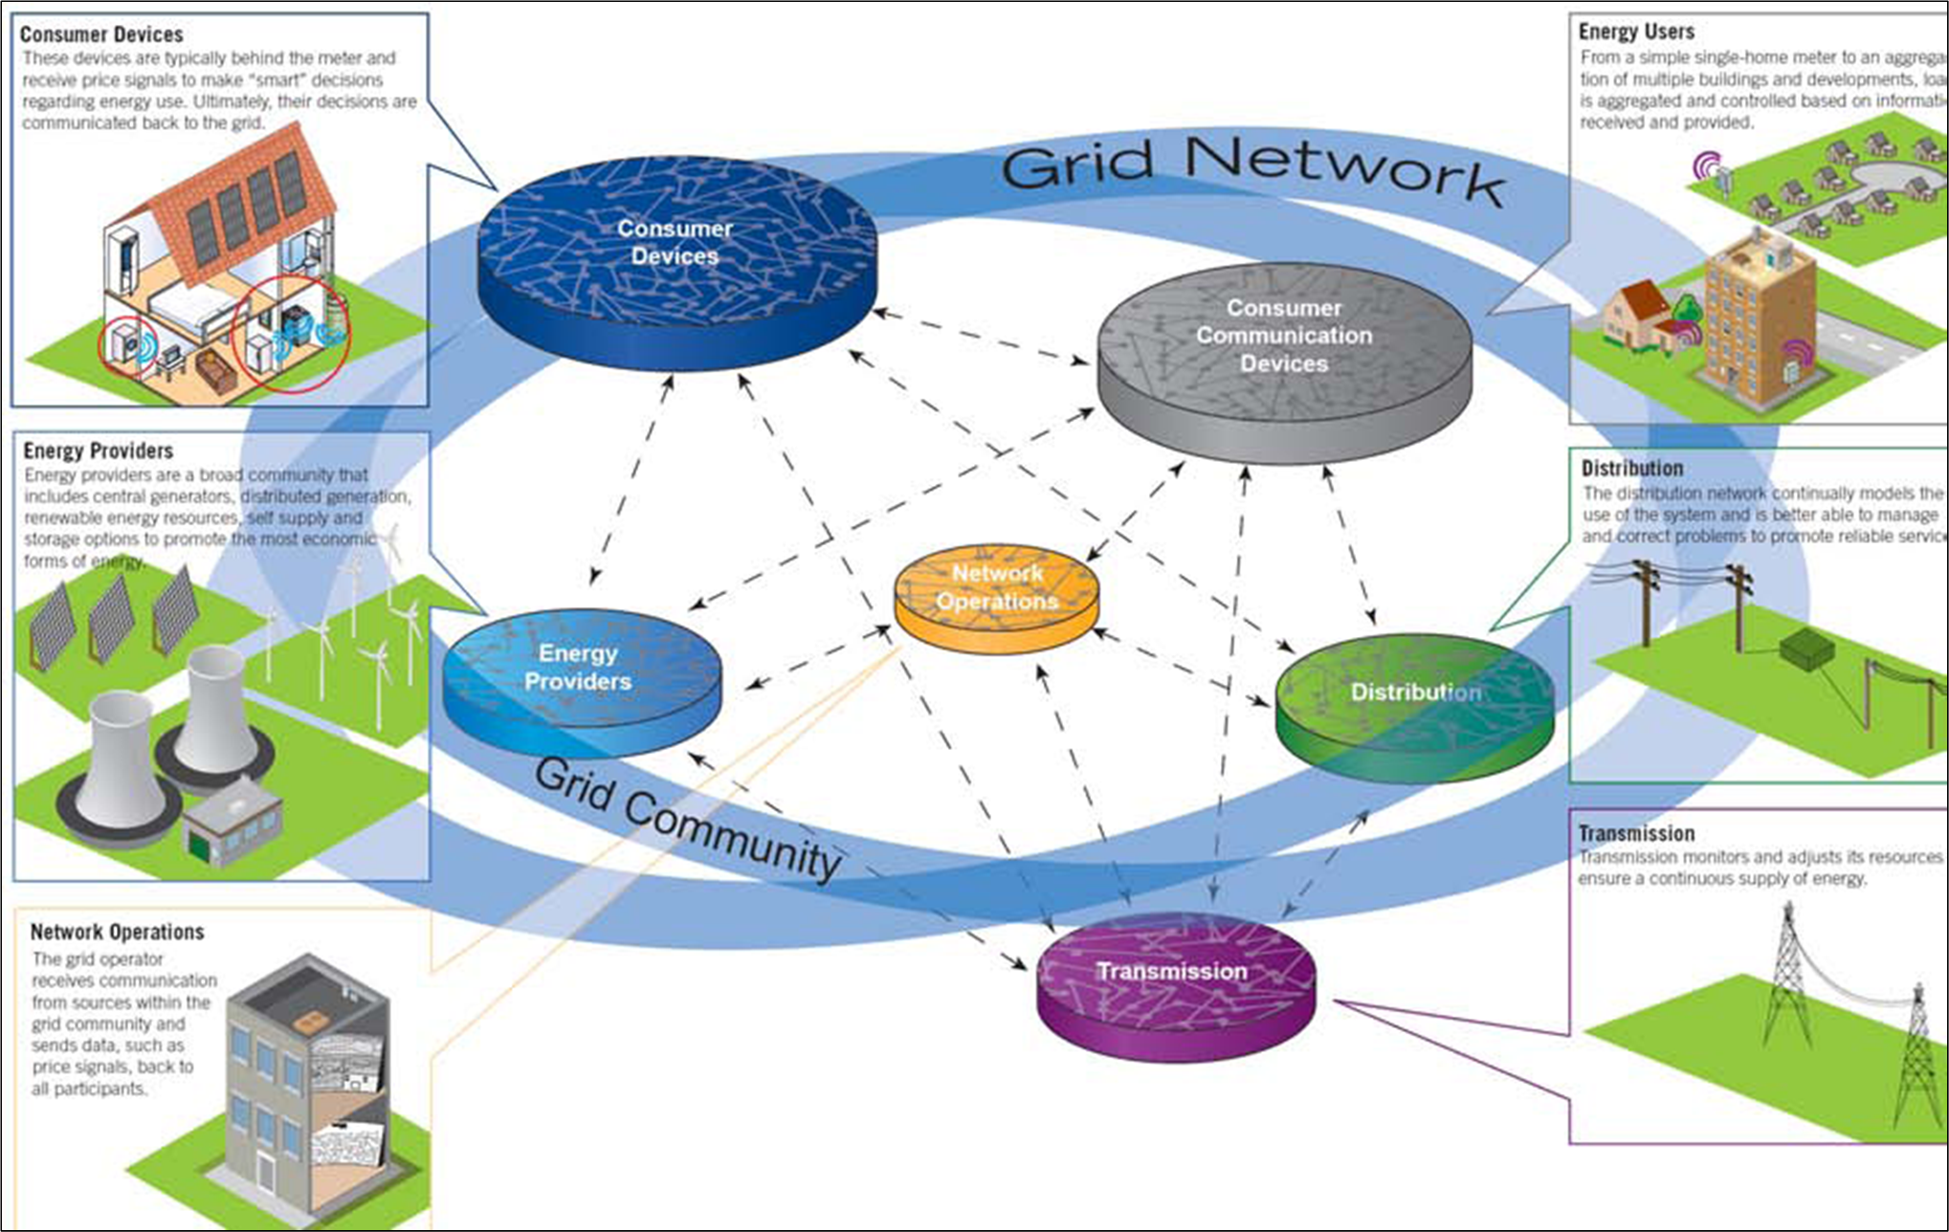
Smart Grids
carbonmetrics.eu

Slide 72
The Smart Grid Design Challenge
Design a unified communications and control system overlay
On top of the existing/emerging power infrastructure
  To provide the right information
  To the right entity (e.g. end-use devices, transmission and distribution systems, energy providers, customers, etc.)
  At the right time
  To take the right action
Control
Communications
Fundamentally change how energy is
stored, delivered, and consumed
Sensing

Slide 73

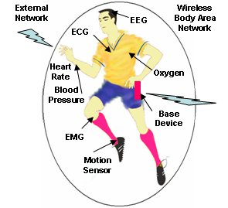
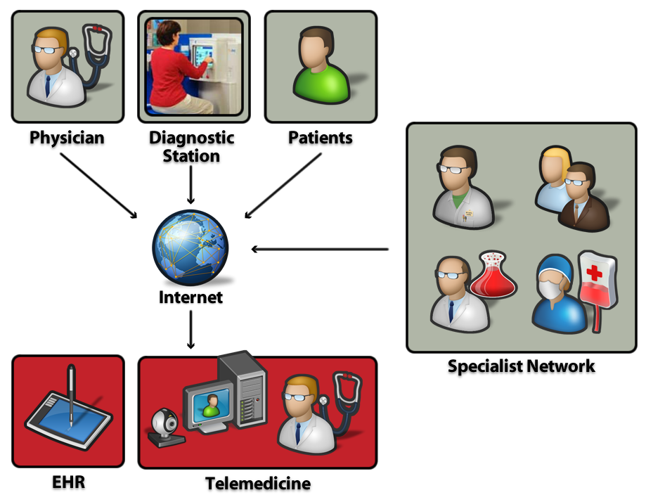
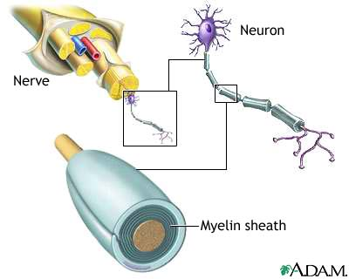
Wireless and Health, Biomedicine and Neuroscience
Body-Area
Networks
Doctor-on-a-chip
Cell phone info repository
Monitoring, remote
intervention and services
The brain as a wireless network
EKG signal reception/modeling
Signal encoding and decoding
Nerve network (re)configuration
Cloud

Slide 74

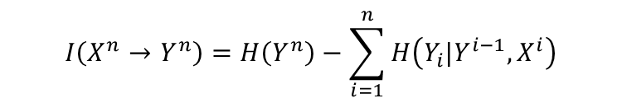
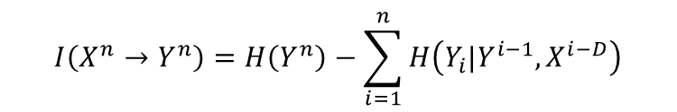
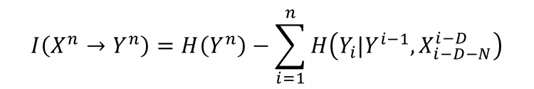
Pathways through the brain
DI inference
Neuron layout
B
A
E
B
A
E
C
D
C
D
$$I\left(X^{n}→Y^{n}\right)=H\left(Y^{n}\right)−\sum_{i=1}^{n}{H\left(Y_{i}|Y^{i−1},X^{i}\right)}$$
DI inference with delay lower bound
Constrained DI inference
B
A
E
B
A
E
C
D
C
D
$$I\left(X^{n}→Y^{n}\right)=H\left(Y^{n}\right)−\sum_{i=1}^{n}{H\left(Y_{i}|Y^{i−1},X^{i−D}\right)}$$
$$I\left(X^{n}→Y^{n}\right)=H\left(Y^{n}\right)−\sum_{i=1}^{n}{H\left(Y_{i}|Y^{i−1},X_{i−D−N}^{i−D}\right)}$$
Directed mutual information and propagation constraints predict connections

Slide 75
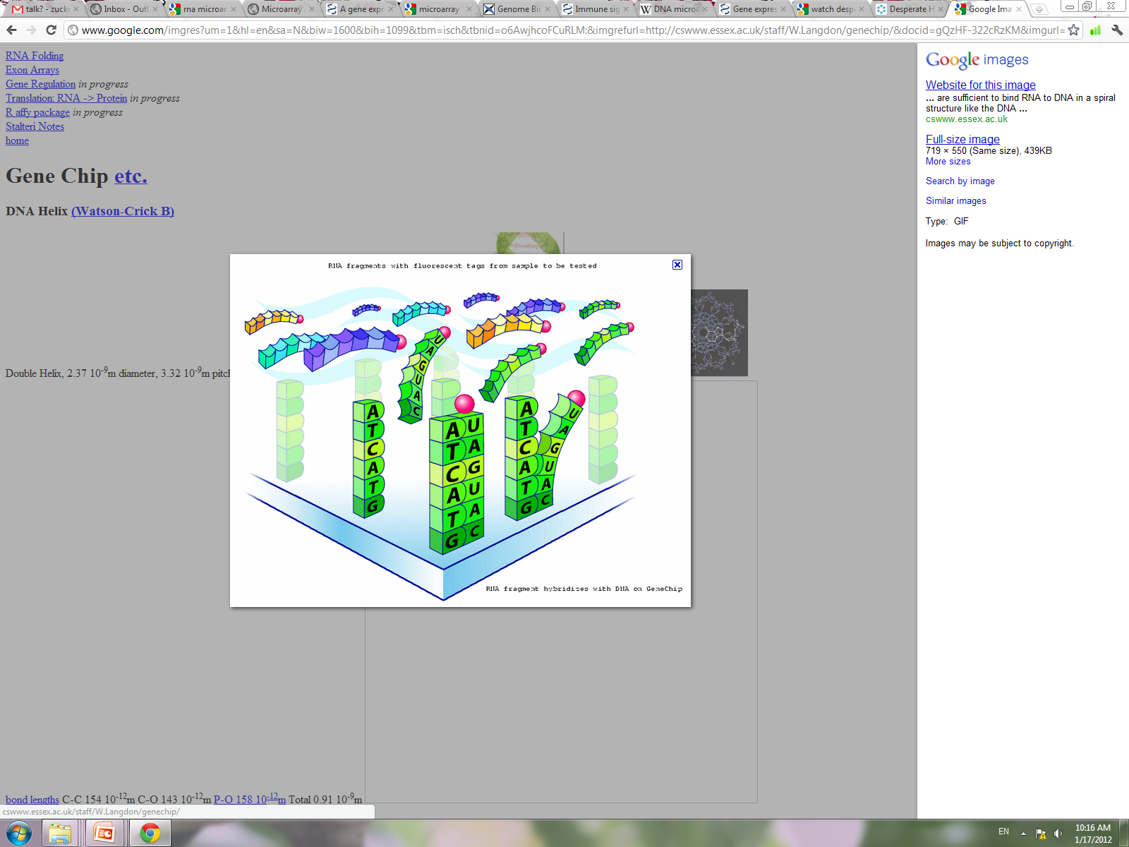
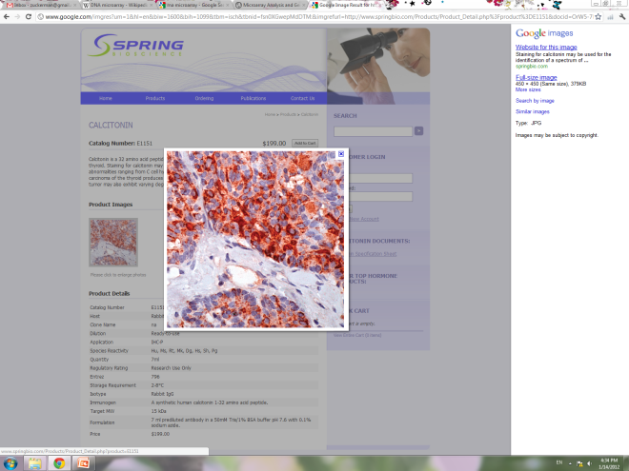
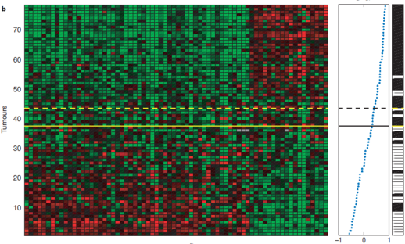
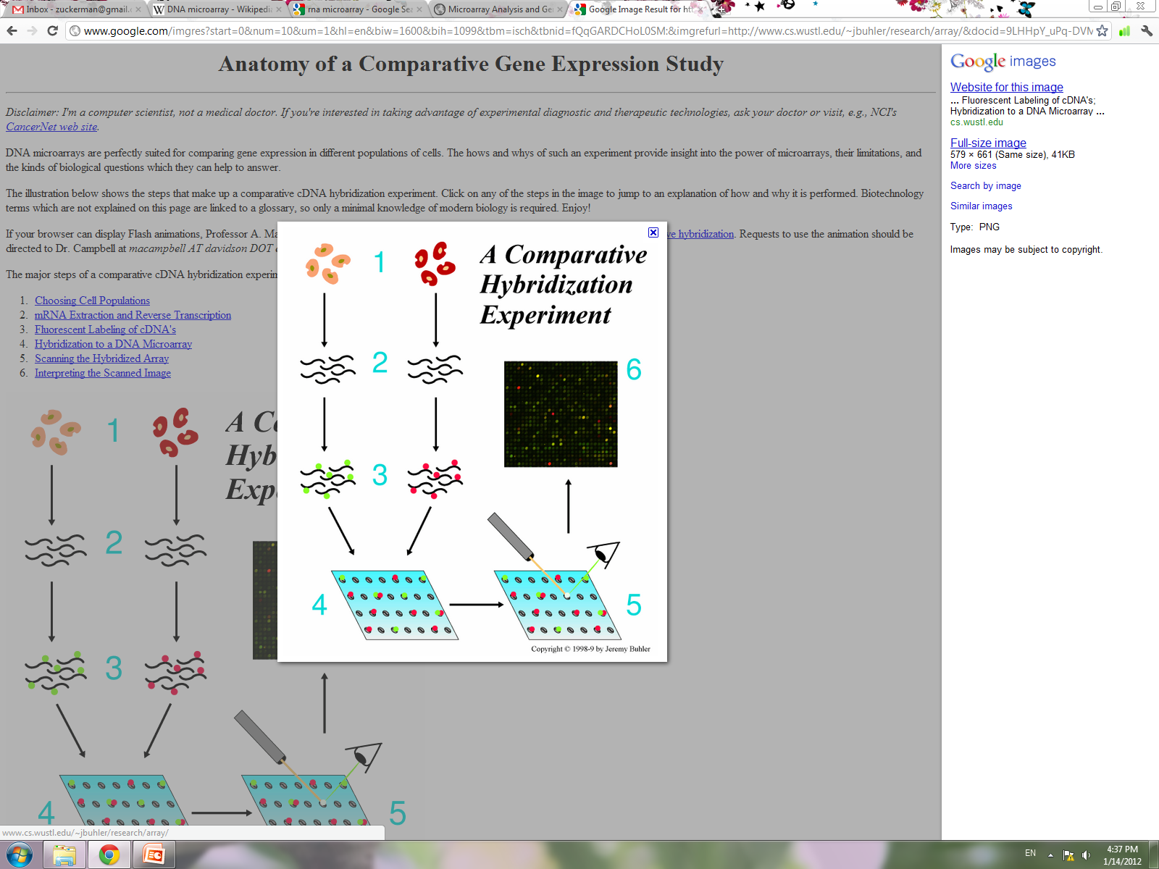
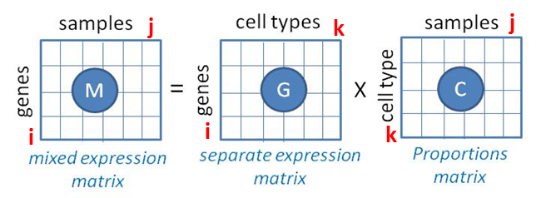

Gene Expression Profiling
70 genes
RNA
extraction
labeling
hybridization
scan
tumor
tissue
Gene expression profiling predicts clinical outcome of breast cancer (Van’t Veer et al., Nature 2002.)
Gene expression measurements: a mix of many cell types
We adapt techniques from hyperspectroscopy assuming “C”, “G” and “k” unknown: better accuracy than all existing methods
Gene Signatures
Cell-type
Proportion
Cell Types
Notes:
Microarrays make use of the DNA characteristic that is can hybridize. Meaning – that A sticks to T and G sticks to C.
How does microarrays work:
A microarray is a chip with a matrix. In each square in the matrix there are many probes that can stick to a specific messenger RNA (that represents an expressed gene). The matrix in the chip represents all human genes, for example.
A tissue (ex. Tumor tissue) is taken, the messenger RNA is extracted from it, labeled and then hybridized onto the microarray chip. If a gene is expressed in the tissue (that is, if there is messenger RNA from that gene), then it sticks to the probes in the square that represent it on the chip, according to the quantity of mRNA that were in the tissue sampled. Then the chip is scanned and sent to image analysis to get the intensity of the binding, and to any additional data analysis.

Slide 76
Summary
Wireless networking is an important research area with many interesting and challenging problems
Many of the research problems span multiple layers of the protocol stack: little to be gained at just the link layer.
Cross-layer design techniques are in their infancy: require a new design framework and new analysis tools.
Hard delay and energy constraints change fundamental design principles of the network.
Software-defined wireless networks an open area for research and innovation

