Slide 1
EE360: Lecture 16 Outline
Sensor Networks and
Energy Efficient Radios
Announcements
  Poster session W 3/12: 4:30pm setup, 4:45 start, pizza@6.
  DiscoverEE days poster session, March 14, 3:30-5:30, signup at http://tinyurl.com/EEposter2014 by today.
  Next HW due March 10
  Final project reports due March 17
Energy-Efficient Cooperative MIMO
Energy-Efficient Multiple Access
Energy-Efficient Routing
Cooperative compression
Green cellular design

Slide 2
Cooperative MIMO
  Nodes close together can cooperatively transmit
    Form a multiple-antenna transmitter
  Nodes close together can cooperatively receive
    Form a multiple-antenna receiver
  MIMO systems have tremendous capacity and diversity advantages

Slide 3
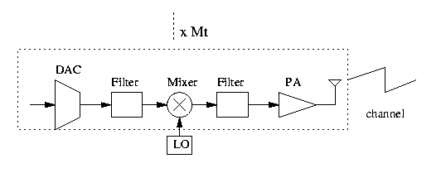
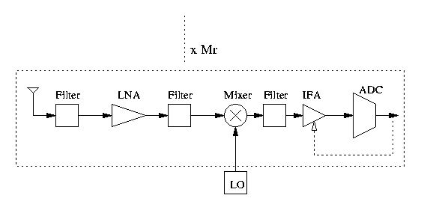
MIMO
Tx:
Rx:

Slide 4
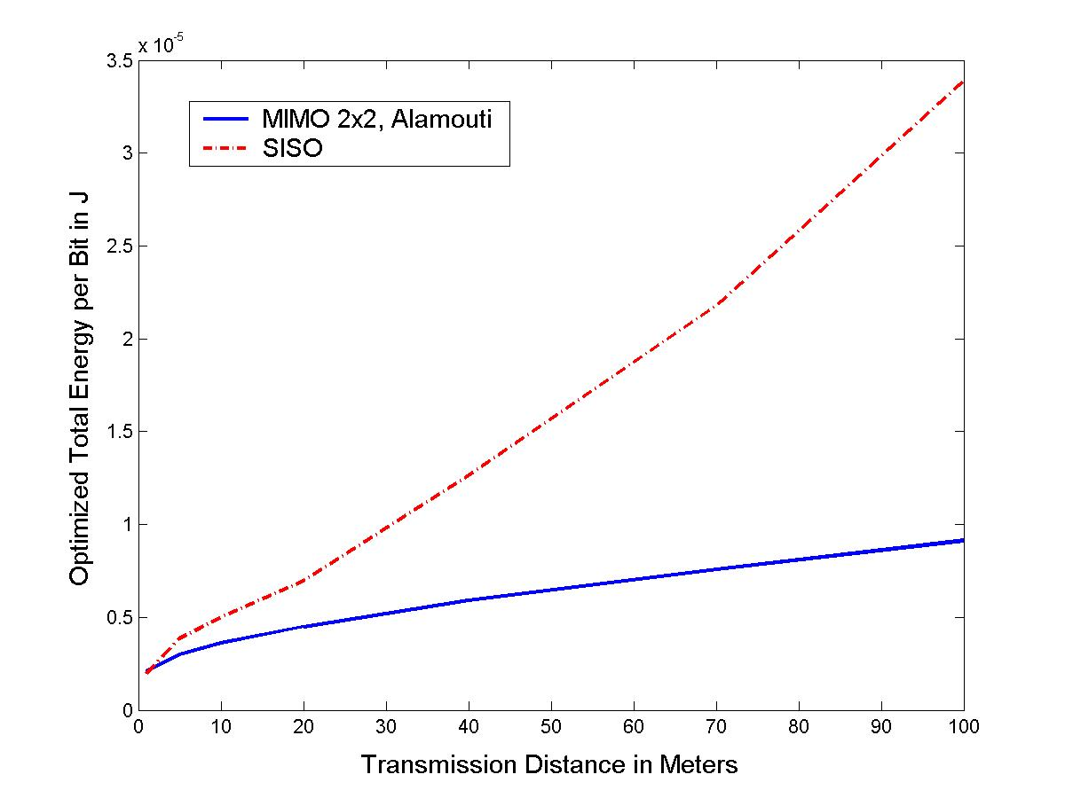
MIMO: optimized constellations
(Energy for cooperation neglected)

Slide 5
Cross-Layer Design with Cooperation
Multihop Routing among Clusters

Slide 6
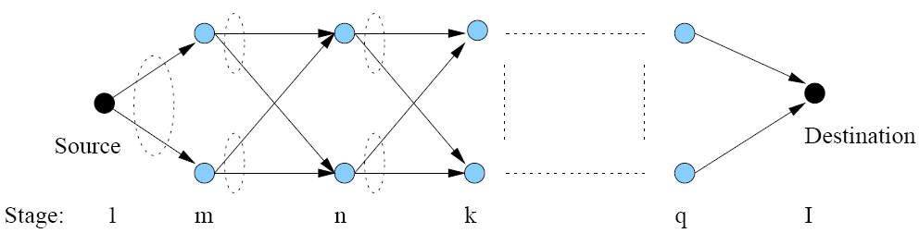
Double String Topology with Alamouti Cooperation
Alamouti 2x1 diversity coding scheme
  At layer j, node i acts as ith antenna
Synchronization required
Local information exchange not required

Slide 7
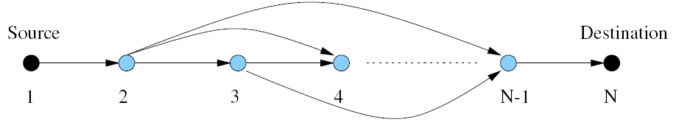
Equivalent Network with Super Nodes
Each super node is a pair of cooperating nodes
We optimize:
  link layer design (constellation size b_{ij})
  MAC (transmission time t_{ij})
  Routing (which hops to use)

Slide 8
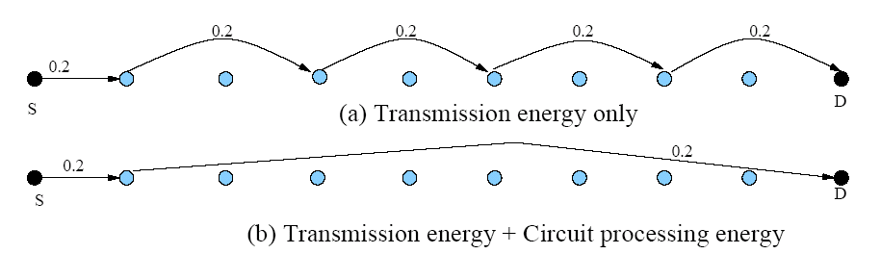
Minimum-energy Routing (cooperative)

Slide 9
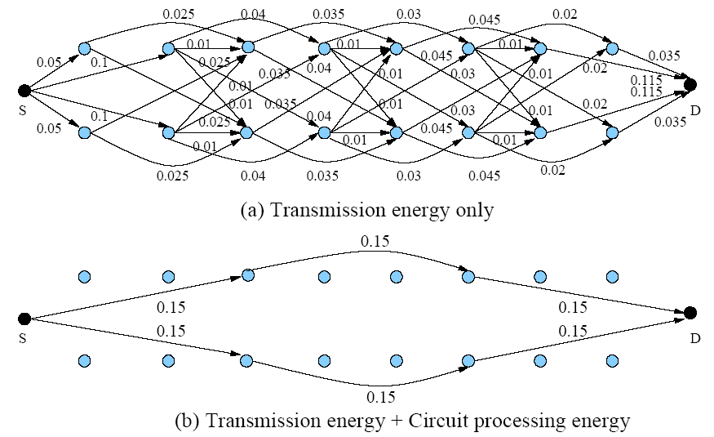
Minimum-energy Routing (non-cooperative)

Slide 10
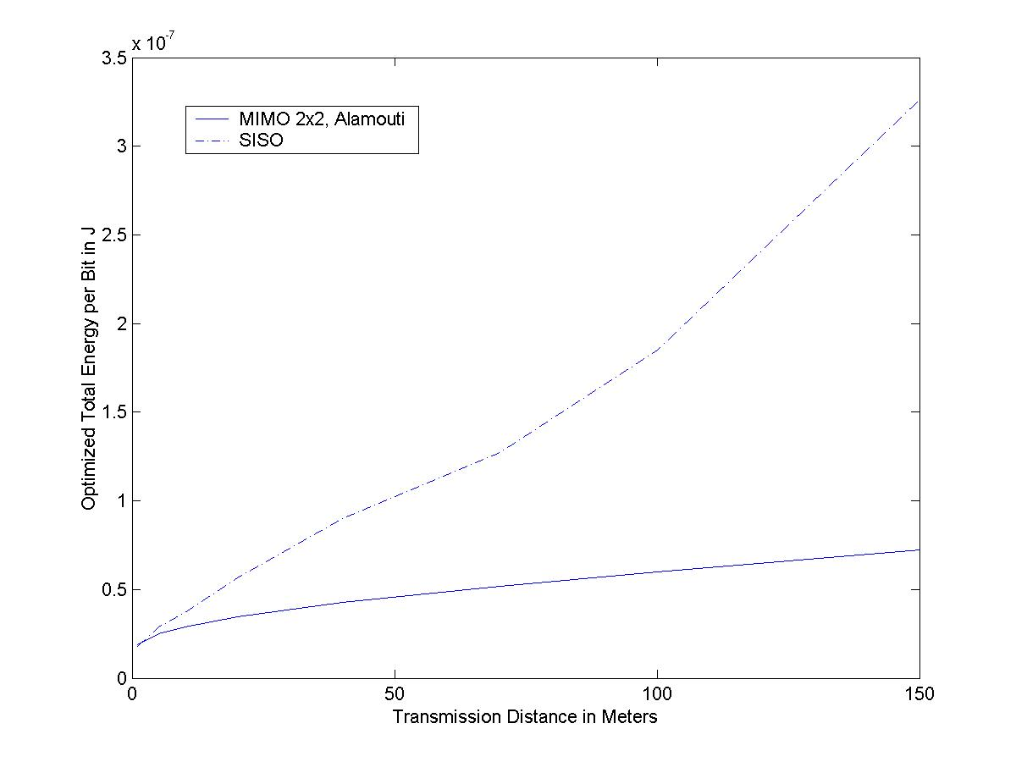
MIMO v.s. SISO
(Constellation Optimized)

Slide 11
Delay/Energy Tradeoff
Packet Delay: transmission delay + deterministic queuing delay
Different ordering of t_{ij}’s results in different delay performance
Define the scheduling delay as total time needed for sink node to receive packets from all nodes
There is fundamental tradeoff between the scheduling delay and total energy consumption

Slide 12
Minimum Delay Scheduling
5
3
4
2!3
1!3
3!4
4!5
2!5
3!5
1
2
T
T
The minimum value for scheduling delay is T (among all the energy-minimizing schedules): T=∑ t_{ij}
Sufficient condition for minimum delay: at each node the outgoing links are scheduled after the incoming links
An algorithm to achieve the sufficient condition exists for a loop-free network with a single hub node
An minimum-delay schedule for the example: {2!3, 1!3, 3!4, 4!5, 2!5, 3!5}

Slide 13

Energy-Delay Optimization
Minimize weighted sum of scheduling delay and energy

Slide 14
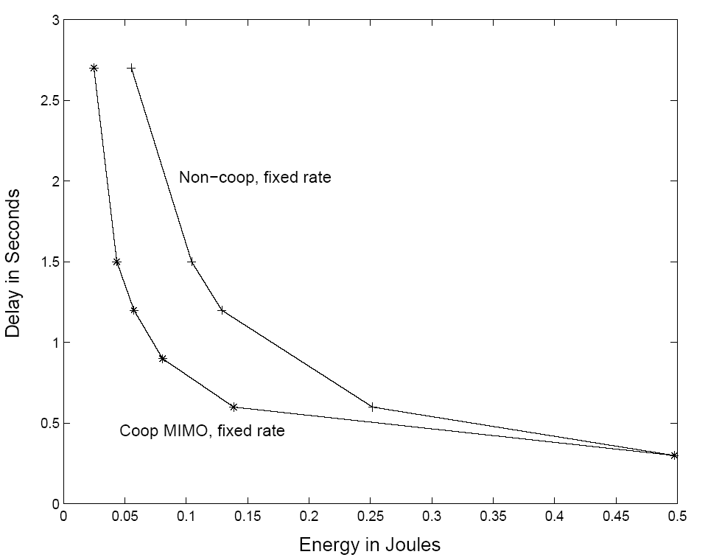
Transmission Energy vs. Delay

Slide 15
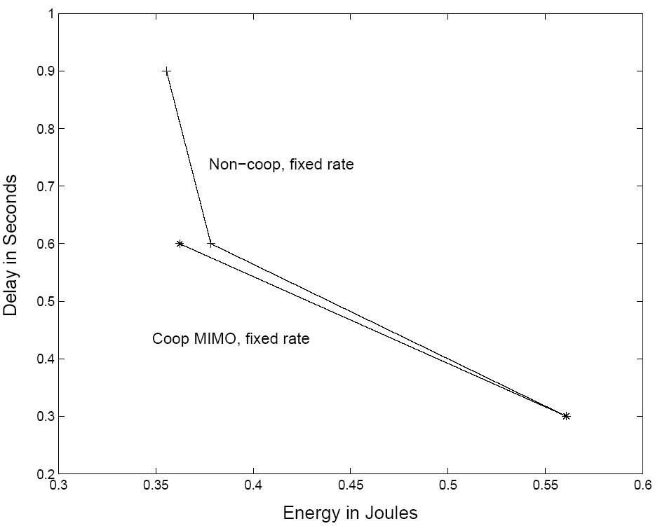
Total Energy vs. Delay

Slide 16
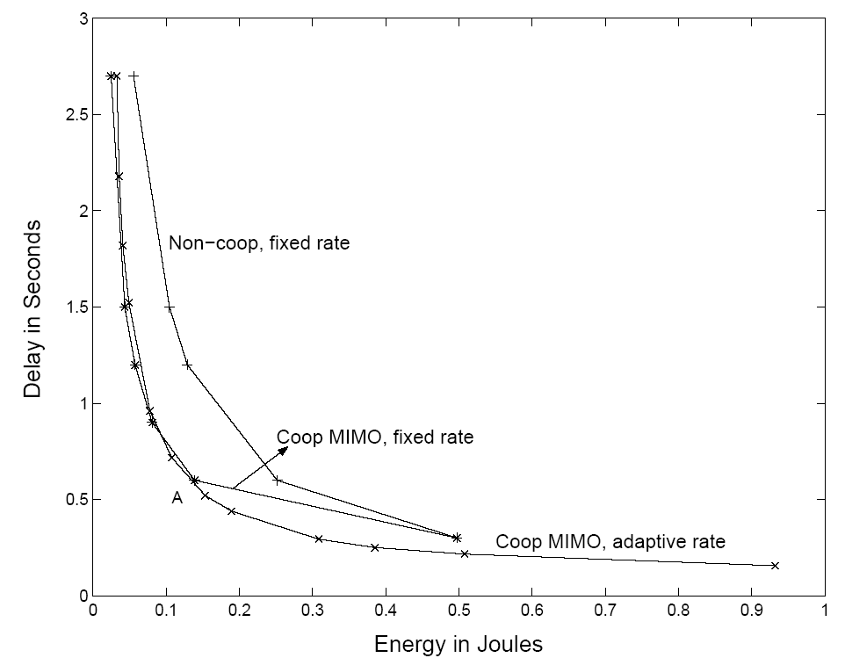
Transmission Energy vs. Delay
(with rate adaptation)

Slide 17
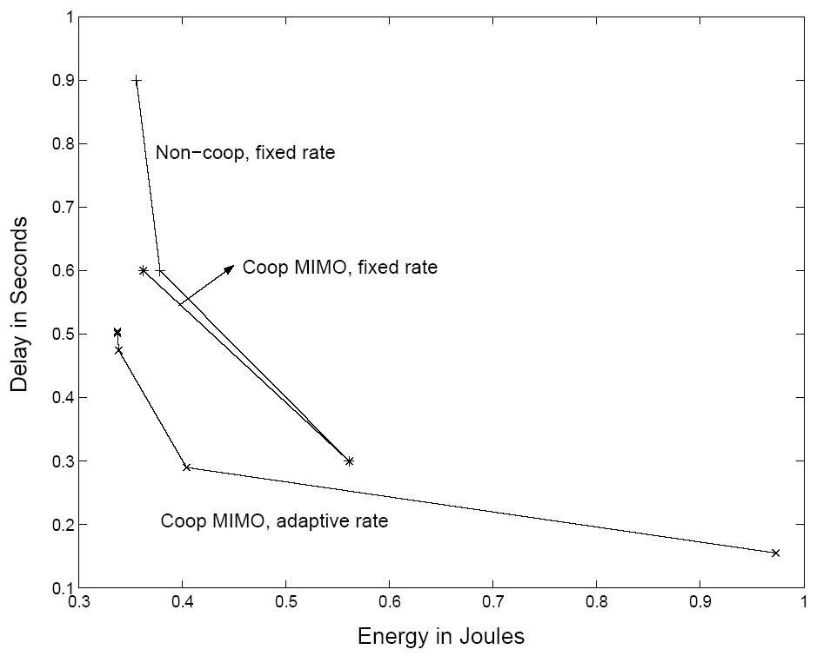
Total Energy vs. Delay
(with rate adaptation)

Slide 18



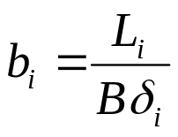
MAC Protocols
Each node has bits to transmit via MQAM
Want to minimize total energy required
TDMA considered, optimizing time slots assignment (or equivalently , where )

Slide 19
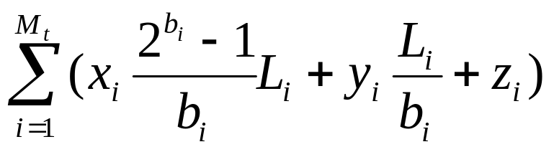
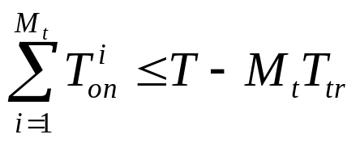
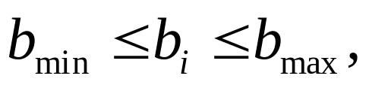
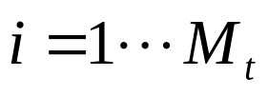
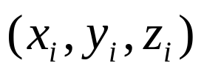
Optimization Model
min
subject to
Where are constants defined by the
hardware and underlying channels

Slide 20
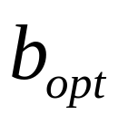
Optimization Algorithm
An integer programming problem (hard)
Relax the problem to a convex one by letting be real-valued
  Achieves lower bound on the required energy
Round up to nearest integer value
  Achieves upper bound on required energy
Can bound energy error
  If error is not acceptable, use branch-and-bound algorithm to better approximate
Notes:
Number of bits to transmit is an integer

Slide 21
Branch and Bound Algorithm
b=1,…,8
b=1,…,4
b=5,…,8
b=1, 2
b=3, 4
b=3
b=4
Divide the original set into subsets, repeat the relaxation method to get the new upper bound and lower bound
If unlucky: defaults to the same as exhaustive search (the division ends up with a complete tree)
Can dramatically reduce computation cost

Slide 22
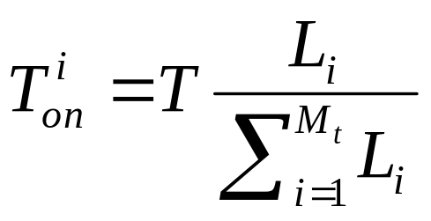
Numerical Results
When all nodes are equally far away from the receiver, analytical solution exists:
General topology: must be solved numerically
  Dramatic energy saving possible
  Up to 70%, compared to uniform TDMA.

Slide 23
Routing Protocols
Energy-efficient routing minimizes energy consumption associated with routing
Multiple techniques have been explored (Abbas will give an overview)
Can pose this as an optimization problem to get an upper bound on performance

Slide 24
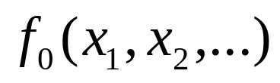
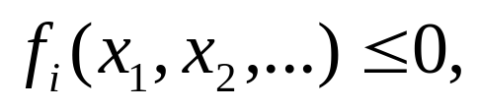

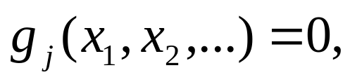

Minimum-Energy Routing
Optimization Model
Min
s.t.
The cost function f₀(.) is energy consumption.
The design variables (x₁,x₂,…) are parameters that affect energy consumption, e.g. transmission time.
f_{i}(x₁,x₂,…)≤0 and g_{j}(x₁,x₂,…)=0 are system constraints, such as a delay or rate constraints.
If not convex, relaxation methods can be used.
Focus on TD systems

Slide 25
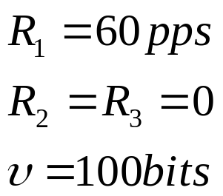
Minimum Energy Routing
Transmission and Circuit Energy
Red: hub node
Blue: relay only
Green: source
0.3
4
3
2
1
(0,0)
(5,0)
(10,0)
(15,0)
Multihop routing may not be optimal when
circuit energy consumption is considered

Slide 26
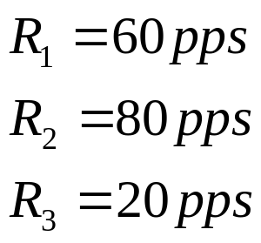
Relay Nodes with
Data to Send
Transmission energy only
0.1
Red: hub node
Green: relay/source
0.085
4
0.185
3
2
0.115
1
(0,0)
(5,0)
(10,0)
(15,0)
0.515
• Optimal routing uses single and multiple hops
• Link adaptation yields additional 70% energy savings

Slide 27
Cooperative Compression
Source data correlated in space and time
Nodes should cooperate in compression as well as communication and routing
  Joint source/channel/network coding

Slide 28
Cooperative Compression and Cross-Layer Design
Intelligent local processing can save power and improve centralized processing
Local processing also affects MAC and routing protocols

Slide 29





Energy-efficient estimation
σ²₁
Sensor 1
g₁
σ²₂
g₂
Sensor 2
Fusion Center
g_{K}
Different observation
quality (known)
σ²_{K}
Different channel
gains (known)
Sensor K
We know little about optimizing this system
  Analog versus digital
  Analog techniques (compression, multiple access)
  Should sensors cooperate in compression/transmission
  Transmit power optimization

Slide 30
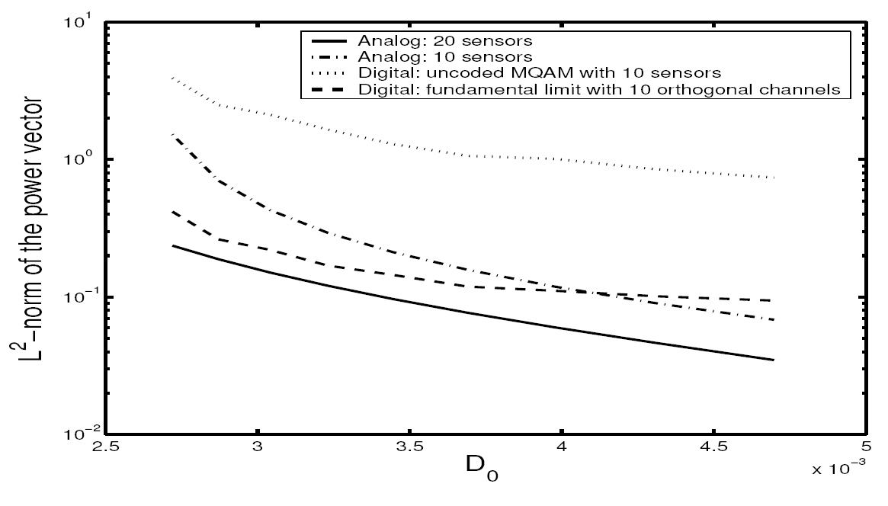
Digital vs. Analog
Notes:
Why doesn’t power associated with the fundamental limit in digital decrease with D_0?

Slide 31

Green” Cellular Networks
Pico/Femto
How should cellular
systems be redesigned
for minimum energy?
Coop
MIMO
Relay
Research indicates that
signicant savings is possible
DAS
Minimize energy at both mobile and base station via
  New Infrastuctures: small cells, BS placement, DAS, relays
  New Protocols: Cell Zooming, Coop MIMO, RRM, Scheduling, Sleeping, Relaying
  Low-Power (Green) Radios: Radio Architectures, Modulation, coding, MIMO

Slide 32
Why Green, why now
The energy consumption of cellular networks is growing rapidly with increasing data rates and numbers of users
Operators are experiencing increasing and volatile costs of energy to run their networks
There is a push for “green” innovation in most sectors of information and communication technology (ICT)
There is a wave of companies, industry consortia and government programs focused on green wireless

Slide 33

CO₂ annual emissions from cellular networks
Base Stations consume ~80% of energy in cellular networks use.
correspond to
25 million
household average yearly consumption
*1Mt CO2 = 2TWh
Energy
~2TWh
~60TWh
~3.5TWh
~10TWh
CO
2
~1Mt
~30Mt
<2Mt
~5Mt
3 billion subscribers
4 million Radio Stations
20,000 Radio Controllers
Other elements

Slide 34
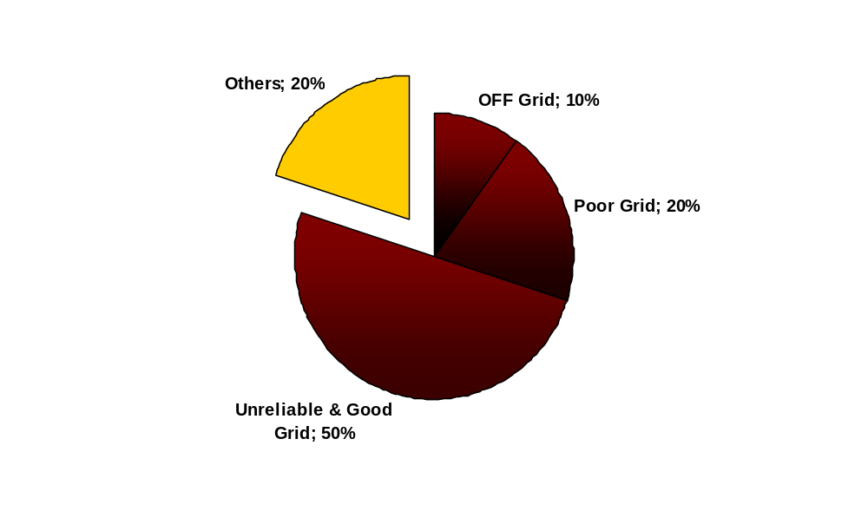

Energy costs are escalating
Typical sites in emerging market countries like India and Africa use Diesel Generators as primary power or backup solution
Diesel:
Main Driver for increase of energy costs and CO2 emissions
Percentage of sites using Diesel Generators in relation to power grid availability (source India)
DG run over 18 h per day
No DG
DG run min. 10 h/day
.…Emerging market energy costs to climb over 70% driven primarily by network expansion but compounded by increased energy cost of between 5% and 10% per annum
DG run 2-6 h/day
DG : Diesel Generator

Slide 35
Leading to reduced profits
Trends:
Exponential growth in data traffic
Number of base stations / area increasing for higher capacity
Revenue growth constrained and dependent on new services
Traffic
Diverging expectations for traffic and revenue growth
Costs
Voice
Data
Revenue
Time
Energy use cannot follow traffic growth without significant increase in energy consumption
  Must reduce energy use per data bit carried
Number of base stations increasing
  Operating power per cell must reduce
Green radio is a key enabler for growth in cellular while at the same time guarding against increased environmental impact
Traffic / revenue curve from “The Mobile Broadband Vision - How to make LTE a success”, Frank Meywerk, Senior Vice President Radio Networks, T-Mobile Germany, LTE World Summit, November 2008, London

Slide 36


Research Consortia
GreenTouch
  Goal: reduce energy consumption in wired/wireless networks by 1000x
  Initiated by Alcatel-Lucent
  Many major carriers and companies involved, also research labs/academia (63 members to date)
  5+ year duration (started Jan. 2010)
  Demonstrated antenna array prototype
Earth
  Goal: 50% reduction in the energy consumption of 4th Generation (4G) mobile wireless communication networks within two-and-a-half years (started Jan. 2010)
  15 partners from 10 countries
  Mix of operators, eqmt makers, academia, ETSI – led by ACLU/Ericsson
Smart 2010, company initiatives (Vodophone, NEC, Ericsson, …)

Slide 37
Enabling Technologies
Infrastucture: Cell size optimization, hierarchical structure, BS/distributed antenna placement, relays
Protocols: Cell Zooming, Cooperative MIMO, Relaying, Radio Resource Management, Scheduling, Sleeping,
Green Radios: Radio architectures, modulation, coding, MIMO

Slide 38
Infrastructure
Cell size optimization
Hierarchical structures
Distributed antenna placement
Relays

Slide 39


Cell Size Optimization
Smaller cells require less TX power at both the BS and mobile
Smaller cells have better capacity and coverage
Smaller cell size puts a higher burden on handoff, backhaul, and infrastructure cost.
Optimized BS placement and multiple antennas can further reduce energy requirements.

Slide 40
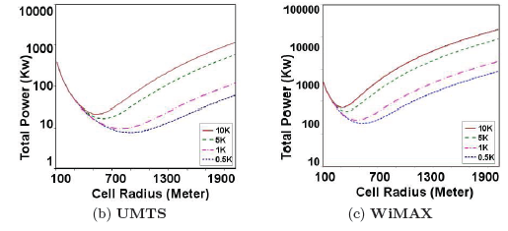
Energy Efficiency vs Cell Size
Small cells reduce required transmit power
But other factors are same as for large cells
  Circuit energy consumption, paging, backhaul, …
Can determine cell power versus radius
  Cell power based on propagation, # users, QoS, etc.
Very large/small cells
are power-inefficienct
Large number of
users -> smaller cells
Number
of Users
Number
of Users
Bhaumik et. al., Green Networking Conference, 2010

Slide 41




Hierarchical Architecture
MACRO: Coverage and high mobility connectivity
Today’s architecture
3M Macro cells serving 5 billion users
Picos and Femtos will be self-organized
How will frequencies be allocated?
How will interference be managed?
How will handoffs occur?
Many challenges
PICO: For street, enterprise & home coverage/capacity
FEMTO: For enterprise & home
coverage/capacity

Slide 42
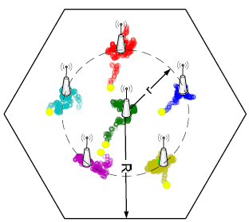
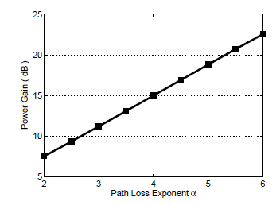
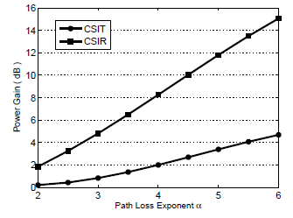
Antenna Placement in DAS
Optimize distributed BS antenna location
Primal/dual optimization framework
Convex; standard solutions apply
For 4+ ports, one moves to the center
Up to 23 dB power gain in downlink
  Gain higher when CSIT not available
6 Ports
3 Ports

Slide 43
Protocols
Cell Zooming
Cooperative MIMO
Relaying
Radio Resource Management
Scheduling
Sleeping

Slide 44
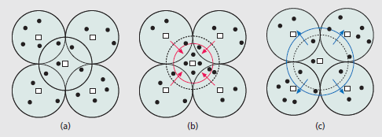
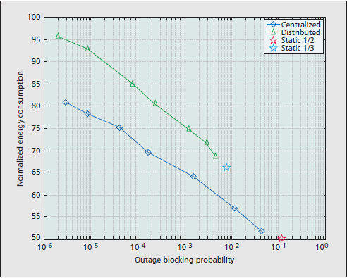
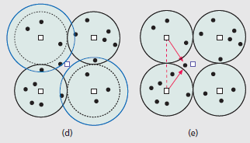
Cell Zooming
Dynamically adjusts cell size (via TX power) based on capacity needs
  Can put central (or other) cells to sleep based on traffic patterns
  Neighbor cells expand or transmit cooperatively to central users
Significant energy savings (~50%)
Work by Zhisheng Niu, Yiqun Wu, Jie Gong, and Zexi Yang

Slide 45
Adding Cooperation and MIMO
Focus of cooperation in
LTE is on capacity increase
Network MIMO: Cooperating BSs form a MIMO array
  MIMO focuses energy in one direction, less TX energy needed
  Can treat “interference” as known signal (MUD) or noise; interference is extremely inefficient in terms of energy
  Can also install low-complexity relays
Mobiles can cooperate via relaying, virtual MIMO, conferencing, analog network coding, …

Slide 46
Summary
Sensor network protocol designs must take into account energy constraints
For large sensor networks, in-network processing and cooperation is essential to preserve energy
Node cooperation can include cooperative compression
Green wireless design applies to infrastructure design of cellular networks as well

Slide 47
Presentation
Routing techniques in wireless sensor networks: a survey
By J.N. Al-Karaki and A.E. Kamal
IEEE Trans. Wireless Communications, Dec. 2004.
Presented by Abbas

