Slide 1
EE360: Lecture 15 Outline
Sensor Networks and
Energy Efficient Radios
Announcements
  2nd paper summary due March 5 (extended by 2 days)
  March 5 lecture moved to March 7, 12-1:15pm, Packard 364
  Poster session W 3/12: 4:30pm setup, 4:45 start, pizza@6.
  Next HW posted by Wed, due March 10
Overview of sensor network applications
Technology thrusts
Energy-Efficient Radios
Energy-Efficient Protocols
Cross-layer design of sensor network protocols

Slide 2




Wireless Sensor Networks
Data Collection and Distributed Control
Hard Energy Constraints
Hard Delay Constraints
Hard Rate Requirements

Slide 3
Application Domains
Home networking: Smart appliances, home security, smart floors, smart buildings
Automotive: Diagnostics, occupant safety, collision avoidance
Industrial automation: Factory automation, hazardous material control
Traffic management: Flow monitoring, collision avoidance
Security: Building/office security, equipment tagging, homeland security
Environmental monitoring: Habitat monitoring, seismic activity, local/global environmental trends, agricultural

Slide 4
Wireless Sensor Networks
Revolutionary technology.
Hard energy, rate, or delay constraints change fundamental design principles
Breakthroughs in devices, circuits, communications, networking, signal processing and crosslayer design needed.
Rich design space for many industrial and commercial applications.

Slide 5
Technology Thrusts
Analog Circuits
Ultra low power
On-chip sensor
Efficient On/Off
MEMS
Miniaturized size
Packaging tech.
Low-cost imaging
System-on-Chip
Integration of sensing, data processing, and communication in a single, portable, disposable device
Wireless
Multi-hop routing
Energy-efficiency
Very low duty cycle
Efficient MAC
Cooperative Comm.
Wireless Sensor Networks
Data Processing
Distributed
Sensor array proc.
Collaborative detection/accuracy improvement
Data fusion
Networking
Self-configuration
Scalable
Multi-network comm.
Distributed routing and scheduling
Applications

Slide 6
Crosslayer Protocol Design in Sensor Networks
Application
Network
Access
Link
Hardware
Protocols should be tailored to the application requirements and constraints of the sensor network
Notes:
Interdisciplinary research, design, and development very challenging, but necessary to meet the requirements of future wireless applications

Slide 7
Energy-Constrained Nodes
Each node can only send a finite number of bits.
  Energy minimized by sending each bit very slowly.
  Introduces a delay versus energy tradeoff for each bit.
Short-range networks must consider both transmit and processing energy.
  Sophisticated techniques not necessarily energy-efficient.
  Sleep modes save energy but complicate networking.
Changes everything about the network design:
  Bit allocation must be optimized across all protocols.
  Delay vs. throughput vs. node/network lifetime tradeoffs.
  Optimization of node cooperation.
Notes:
All the sophisticated high-performance communication techniques developed since WW2 may need to be thrown out the window.
By cooperating, nodes can save energy

Slide 8
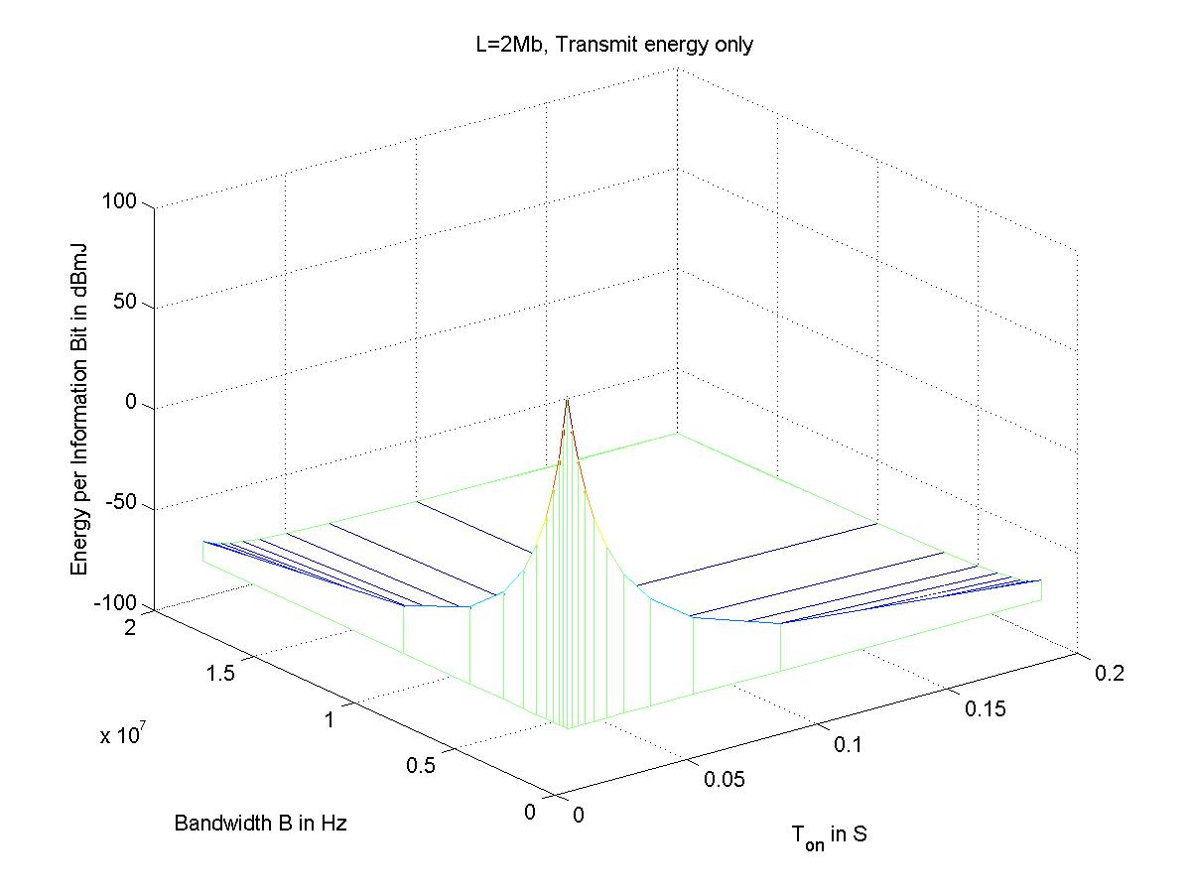
Transmission Energy
Circuit energy can also be significant

Slide 9
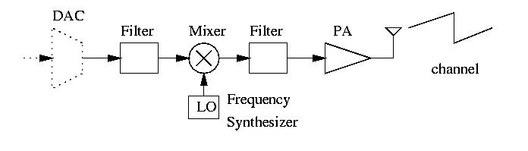
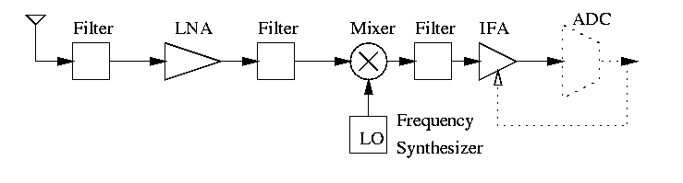
Modulation Optimization
Tx
Rx

Slide 10
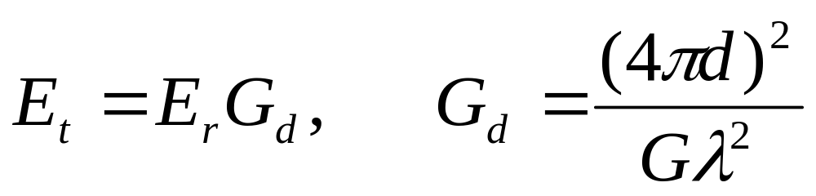
Key Assumptions
Narrow band, i.e. B<<f_{c}
  Power consumption of synthesizer and mixer independent of bandwidth B.
Peak power constraint
L bits to transmit with deadline T and bit error probability P_{b}.
Square-law path loss for AWGN channel

Slide 11
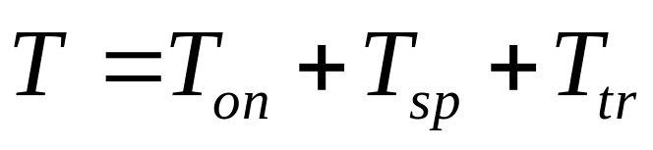
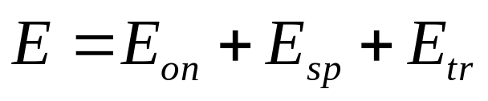
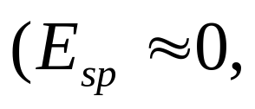
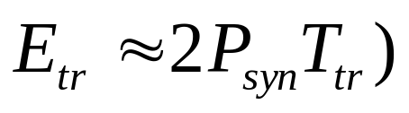
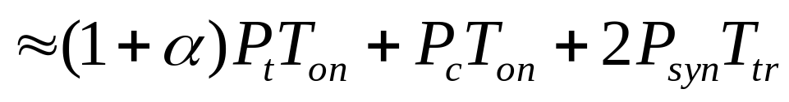
Multi-Mode Operation
Transmit, Sleep, and Transient
Deadline T:
Total Energy:
Transmit
Circuit
Transient Energy
where α is the amplifier efficiency and

Slide 12
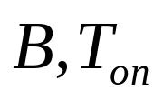
Energy Consumption:
Uncoded
Two Components
  Transmission Energy: Decreases with T_{on} & B.
  Circuit Energy: Increases with T_{on}
Minimizing Energy Consumption
  Finding the optimal pair ( )
  For MQAM, find optimal constellation size (b=log₂M)

Slide 13
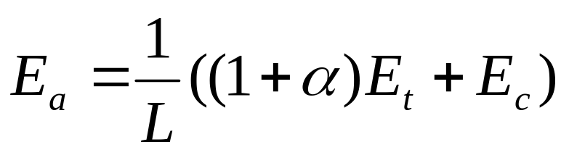
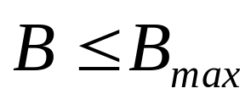
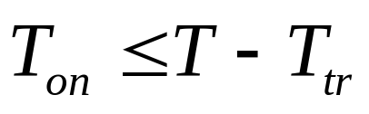
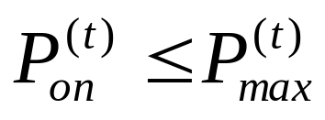
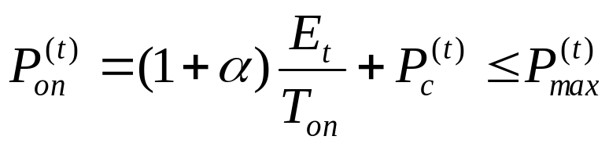
Optimization Model
min
subject to
Where

Slide 14

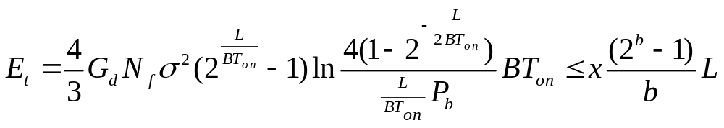
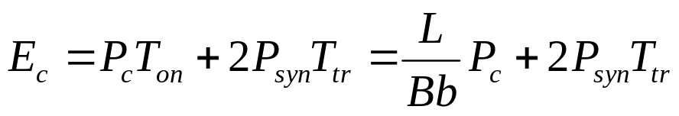
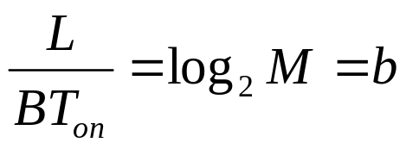
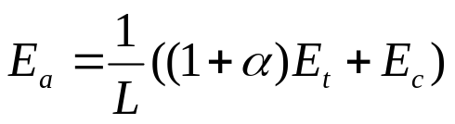





MQAM
MQAM (AWGN), for a given :
Spectral efficiency (b/s/Hz):
min
min
s.t.
s.t.

Slide 15
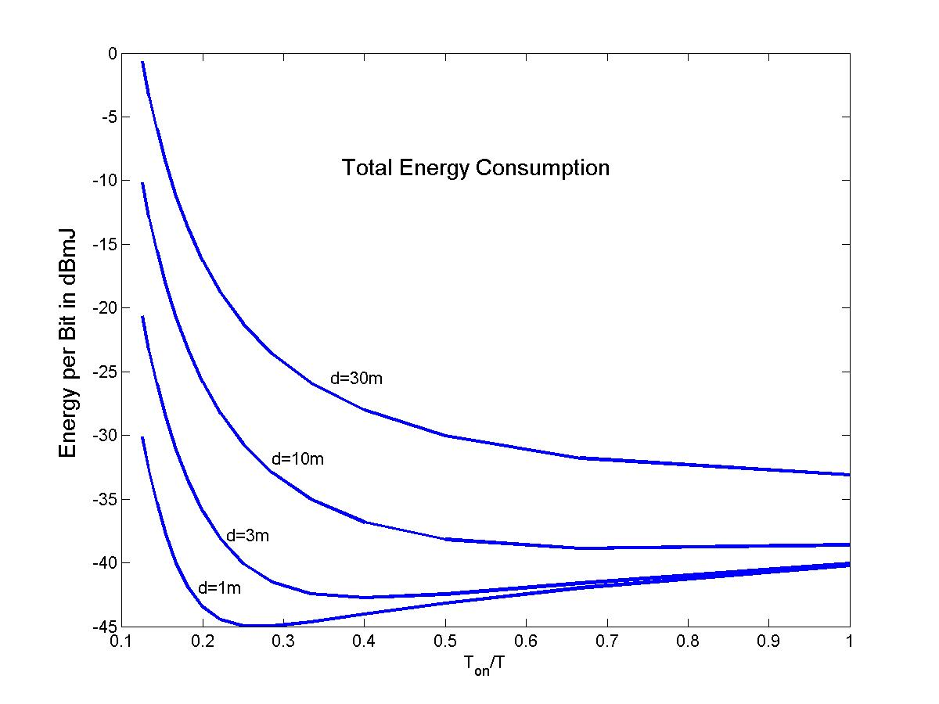
Total Energy (MQAM)

Slide 16
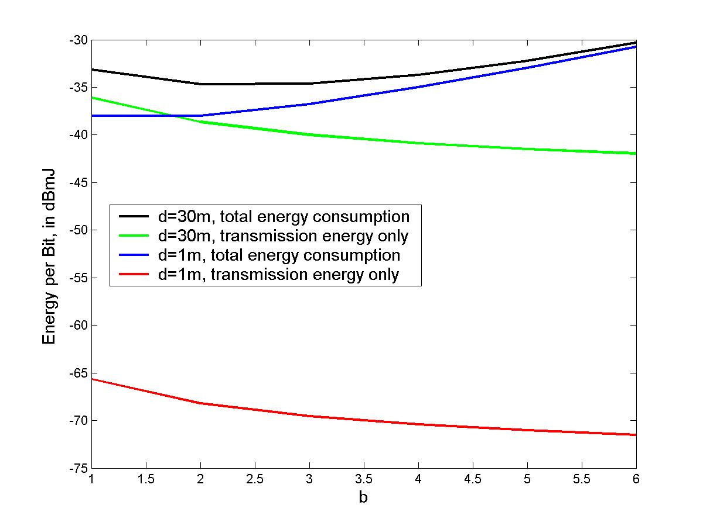
Total Energy (MFSK)
MQAM:
-45dBmJ at 1m
-33dBmJ at 30m

Slide 17
Energy Consumption: Coded
Coding reduces required E_{b}/N₀
Reduced data rate increases T_{on} for block/convolutional codes
Coding requires additional processing
Is coding energy-efficient
If so, how much total energy is saved.

Slide 18
MQAM Optimization
Find BER expression for coded MQAM
  Assume trellis coding with 4.7 dB coding gain
  Yields required E_{b}/N₀
  Depends on constellation size (b_{k})
Find transmit energy for sending L bits in T_{on} sec.
Find circuit energy consumption based on uncoded system and codec model
Optimize T_{on} and b_{k} to minimize energy

Slide 19
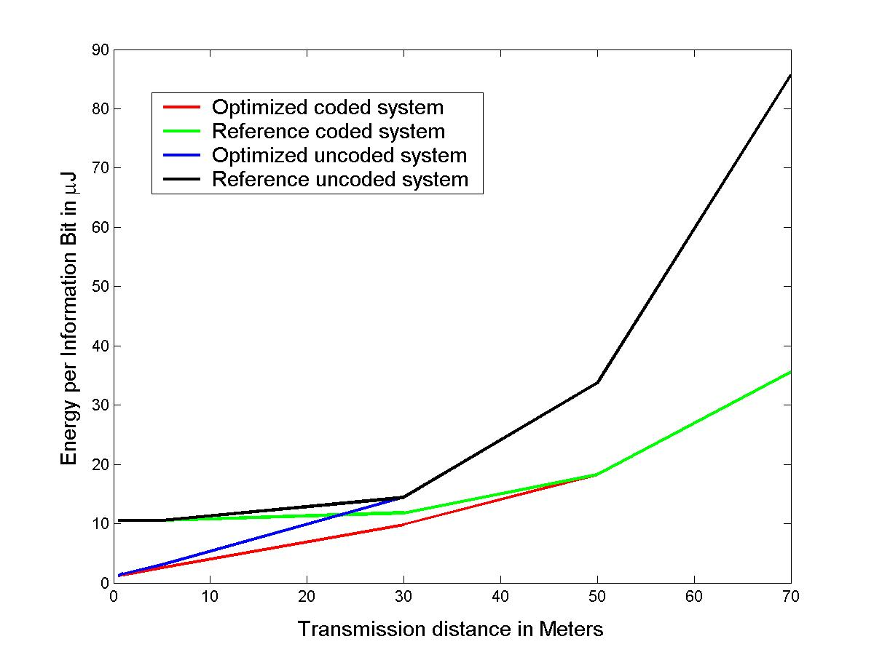
Coded MQAM
Reference system has b_{k}=3 (coded) or 2 (uncoded)
90% savings
at 1 meter.

Slide 20
MFSK Optimization
Find BER expression for uncoded MFSK
  Yields required E_{b}/N₀ (uncoded)
  Depends on b, T_{on} a function of b.
Assume 2/3 CC with 32 states
  Coding gain of 4.2 dB
  Bandwidth expansion of 3/2 (increase T_{on})
Find circuit energy consumption based on uncoded system and codec model
Optimize b to minimize total energy

Slide 21
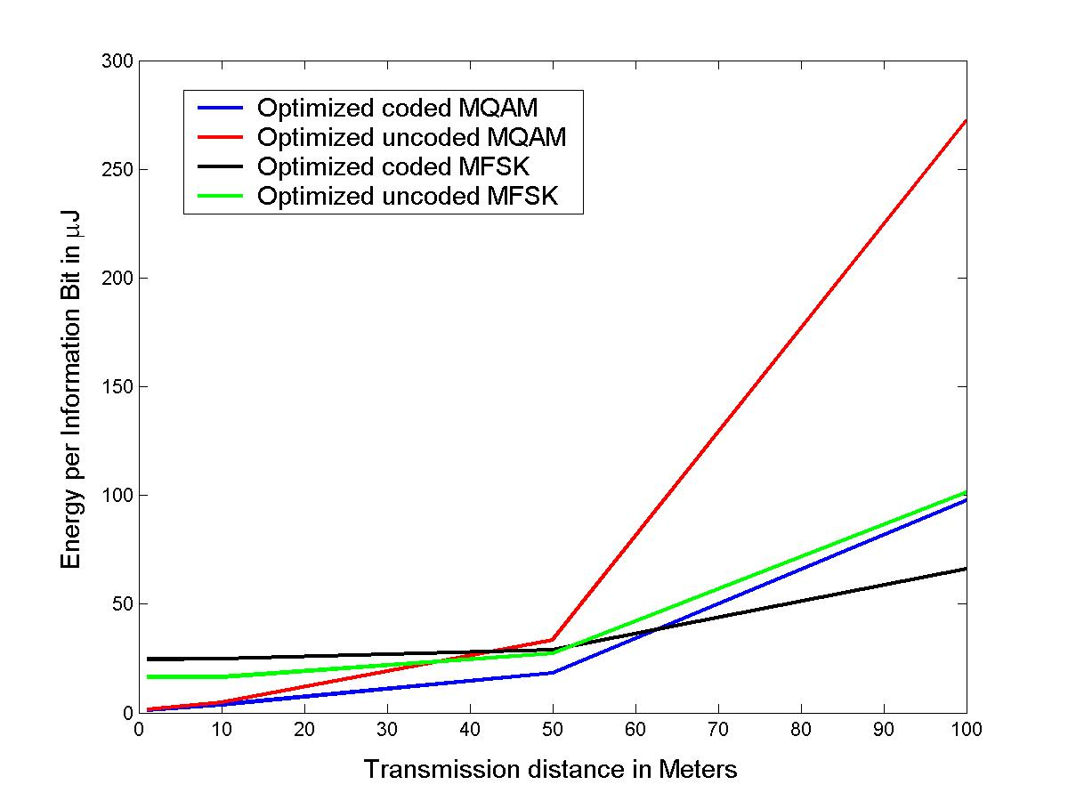
Benefits of Coding

Slide 22
Cooperative MIMO
  Nodes close together can cooperatively transmit
    Form a multiple-antenna transmitter
  Nodes close together can cooperatively receive
    Form a multiple-antenna receiver
  MIMO systems have tremendous capacity and diversity advantages

Slide 23
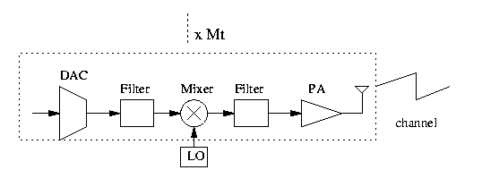
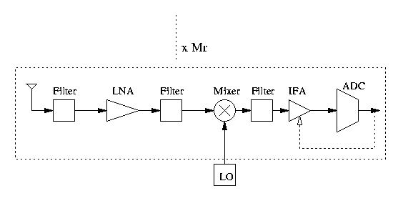
MIMO
Tx:
Rx:

Slide 24
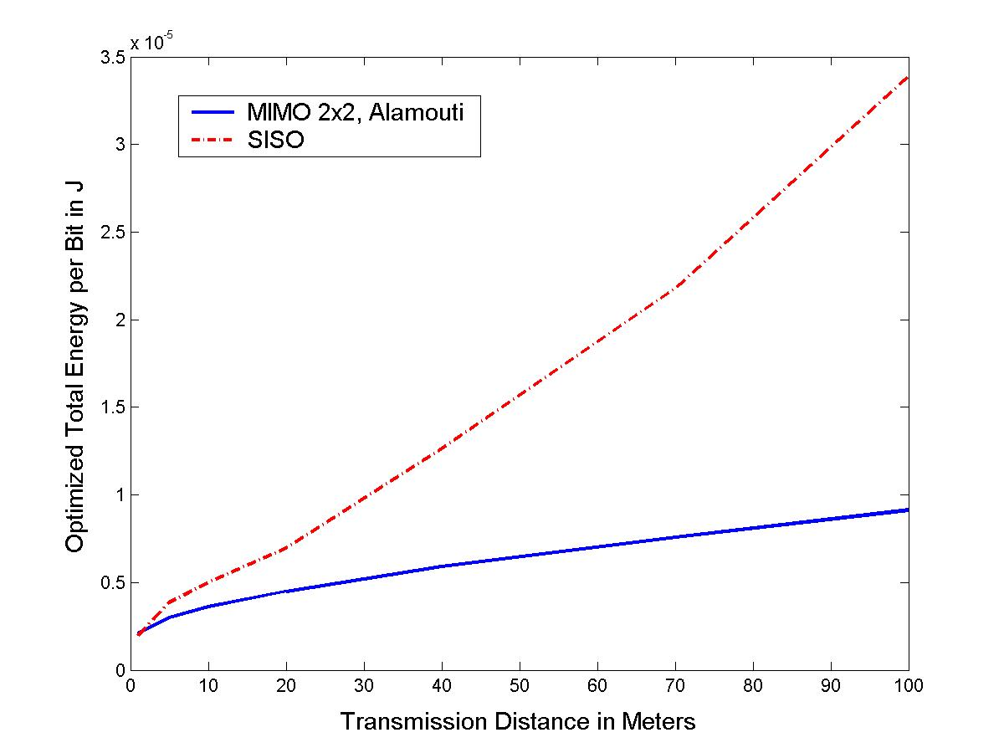
MIMO: optimized constellations
(Energy for cooperation neglected)

Slide 25
Cross-Layer Design with Cooperation
Multihop Routing among Clusters

Slide 26
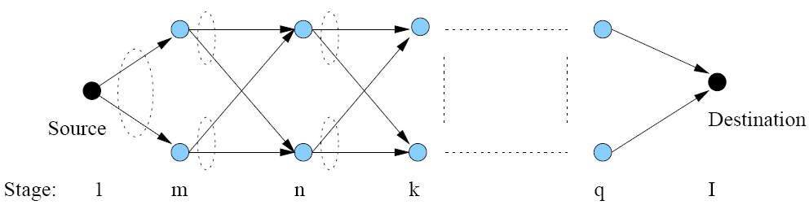
Double String Topology with Alamouti Cooperation
Alamouti 2x1 diversity coding scheme
  At layer j, node i acts as ith antenna
Synchronization required
Local information exchange not required

Slide 27
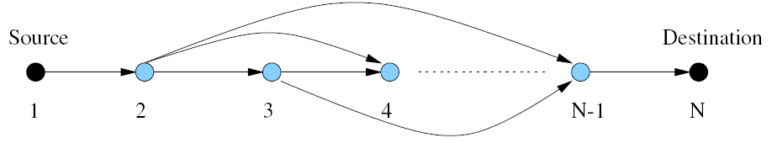
Equivalent Network with Super Nodes
Each super node is a pair of cooperating nodes
We optimize:
  link layer design (constellation size b_{ij})
  MAC (transmission time t_{ij})
  Routing (which hops to use)

Slide 28
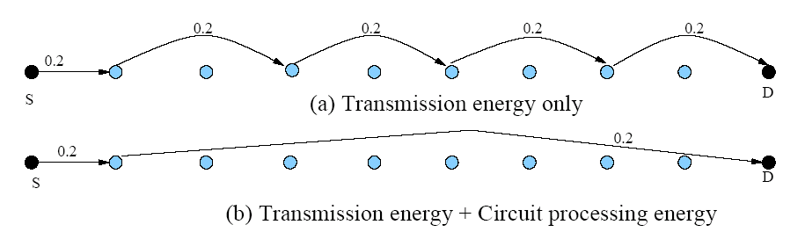
Minimum-energy Routing (cooperative)

Slide 29
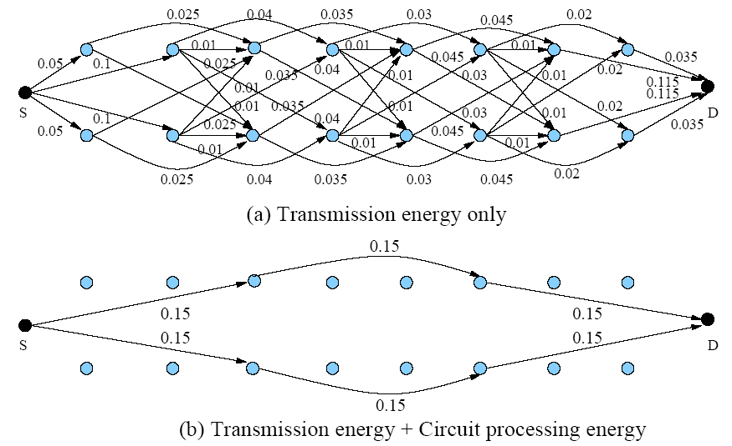
Minimum-energy Routing (non-cooperative)

Slide 30
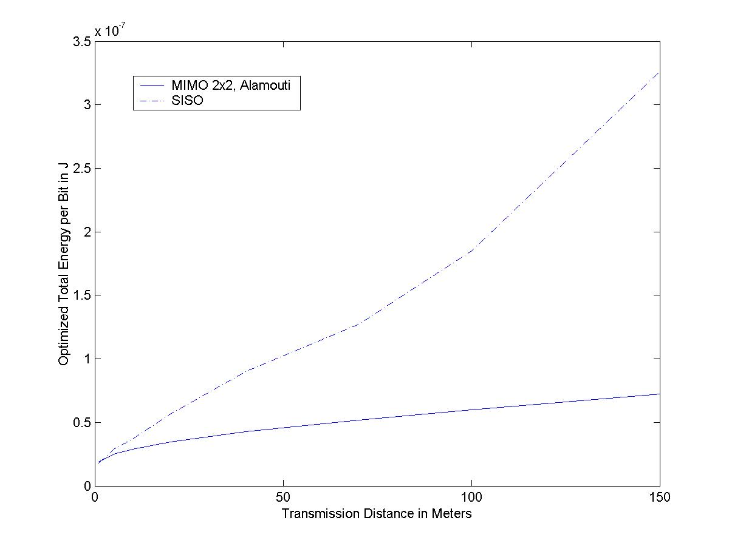
MIMO v.s. SISO
(Constellation Optimized)

Slide 31
Delay/Energy Tradeoff
Packet Delay: transmission delay + deterministic queuing delay
Different ordering of t_{ij}’s results in different delay performance
Define the scheduling delay as total time needed for sink node to receive packets from all nodes
There is fundamental tradeoff between the scheduling delay and total energy consumption

Slide 32
Minimum Delay Scheduling
5
3
4
2!3
1!3
3!4
4!5
2!5
3!5
1
2
T
T
The minimum value for scheduling delay is T (among all the energy-minimizing schedules): T=∑ t_{ij}
Sufficient condition for minimum delay: at each node the outgoing links are scheduled after the incoming links
An algorithm to achieve the sufficient condition exists for a loop-free network with a single hub node
An minimum-delay schedule for the example: {2!3, 1!3, 3!4, 4!5, 2!5, 3!5}

Slide 33

Energy-Delay Optimization
Minimize weighted sum of scheduling delay and energy

Slide 34
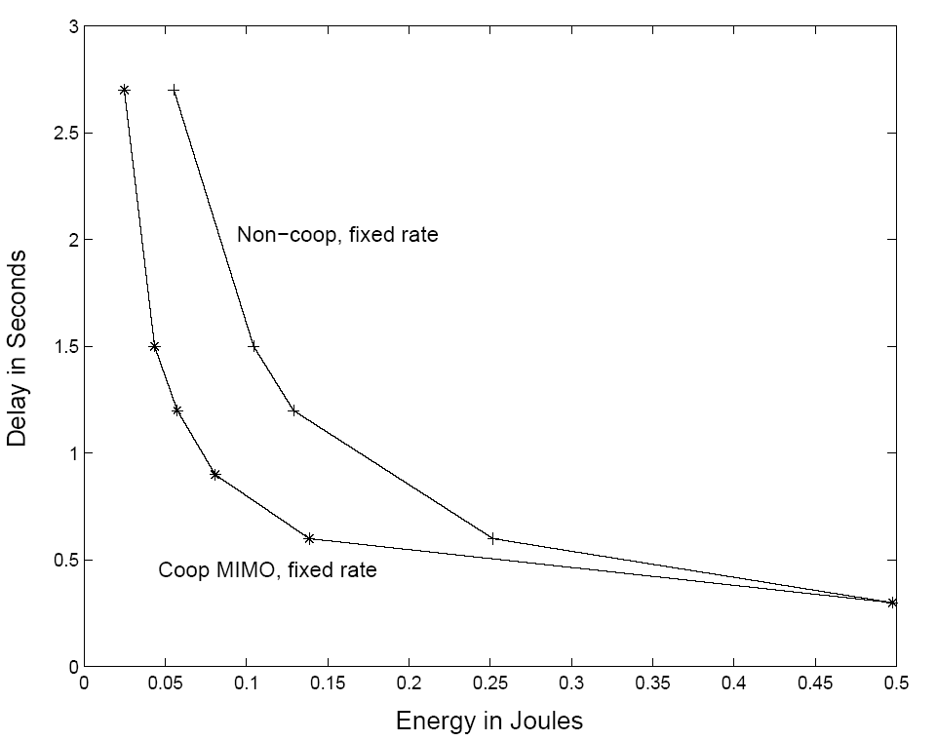
Transmission Energy vs. Delay

Slide 35
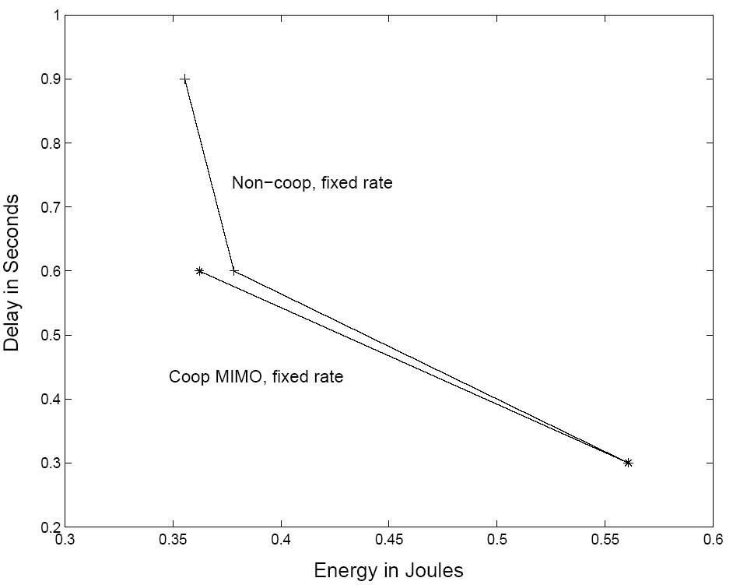
Total Energy vs. Delay

Slide 36
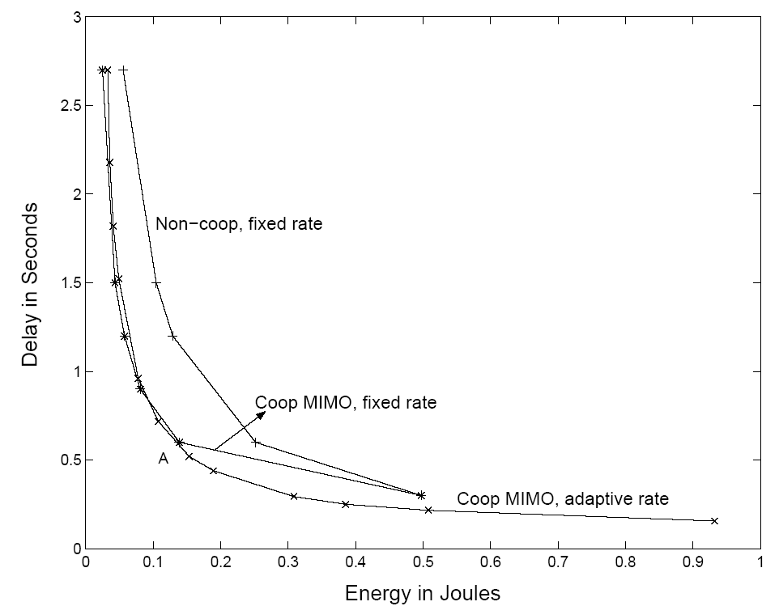
Transmission Energy vs. Delay
(with rate adaptation)

Slide 37
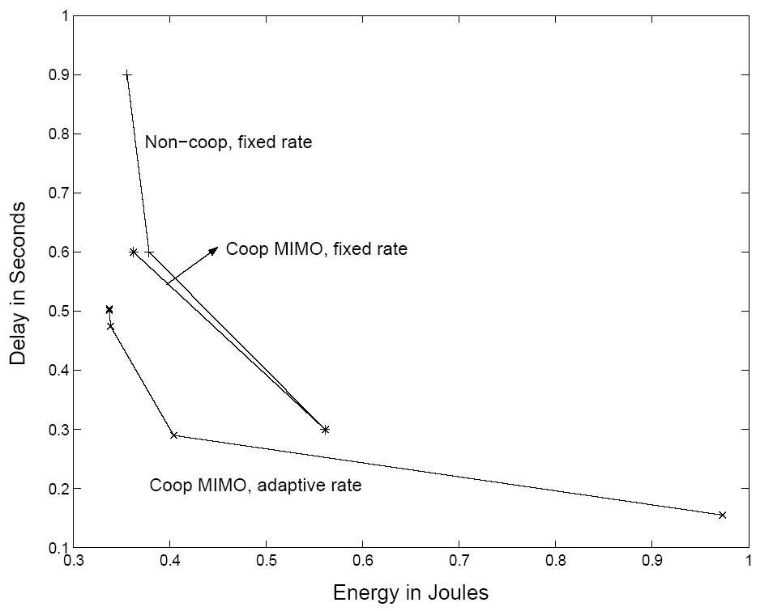
Total Energy vs. Delay
(with rate adaptation)

Slide 38



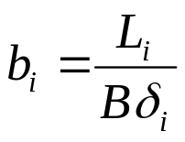
MAC Protocols
Each node has bits to transmit via MQAM
Want to minimize total energy required
TDMA considered, optimizing time slots assignment (or equivalently , where )

Slide 39
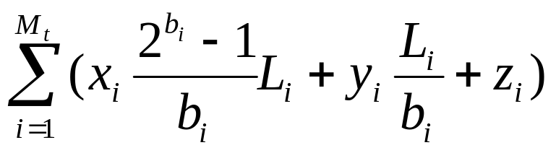
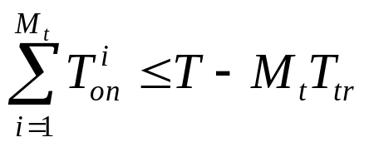
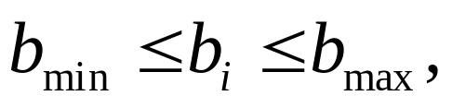
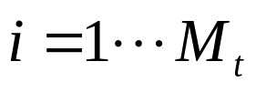
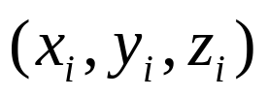
Optimization Model
min
subject to
Where are constants defined by the
hardware and underlying channels

Slide 40
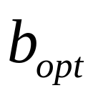
Optimization Algorithm
An integer programming problem (hard)
Relax the problem to a convex one by letting be real-valued
  Achieves lower bound on the required energy
Round up to nearest integer value
  Achieves upper bound on required energy
Can bound energy error
  If error is not acceptable, use branch-and-bound algorithm to better approximate
Notes:
Number of bits to transmit is an integer

Slide 41
Branch and Bound Algorithm
b=1,…,8
b=1,…,4
b=5,…,8
b=1, 2
b=3, 4
b=3
b=4
Divide the original set into subsets, repeat the relaxation method to get the new upper bound and lower bound
If unlucky: defaults to the same as exhaustive search (the division ends up with a complete tree)
Can dramatically reduce computation cost

Slide 42
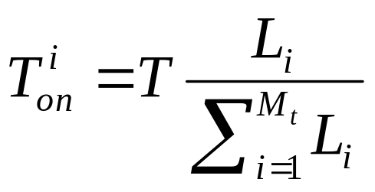
Numerical Results
When all nodes are equally far away from the receiver, analytical solution exists:
General topology: must be solved numerically
  Dramatic energy saving possible
  Up to 70%, compared to uniform TDMA.

Slide 43
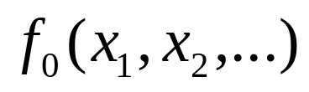
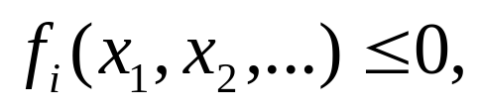

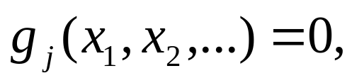

Minimum-Energy Routing
Optimization Model
Min
s.t.
The cost function f₀(.) is energy consumption.
The design variables (x₁,x₂,…) are parameters that affect energy consumption, e.g. transmission time.
f_{i}(x₁,x₂,…)≤0 and g_{j}(x₁,x₂,…)=0 are system constraints, such as a delay or rate constraints.
If not convex, relaxation methods can be used.
Focus on TD systems

Slide 44
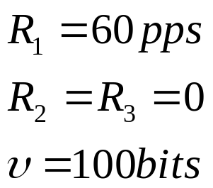
Minimum Energy Routing
Transmission and Circuit Energy
Red: hub node
Blue: relay only
Green: source
0.3
4
3
2
1
(0,0)
(5,0)
(10,0)
(15,0)
Multihop routing may not be optimal when
circuit energy consumption is considered

Slide 45
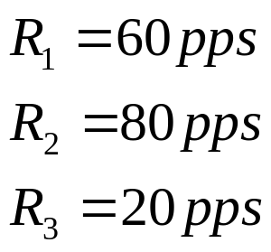
Relay Nodes with
Data to Send
Transmission energy only
0.1
Red: hub node
Green: relay/source
0.085
4
0.185
3
2
0.115
1
(0,0)
(5,0)
(10,0)
(15,0)
0.515
• Optimal routing uses single and multiple hops
• Link adaptation yields additional 70% energy savings

Slide 46
Summary
Protocol designs must take into account energy constraints
Efficient protocols tailored to the application
For large sensor networks, in-network processing and cooperation is essential
Cross-layer design critical

Slide 47
Cognitive radios are also sensor networks

Slide 48
Presentation
Multiantenna-assisted spectrum sensing for cognitive radio.
By Wang, Pu, et al.
Appeared in IEEE Trans. Vehicular Technology, in 2010
Presented by Christina

