Slide 1
EE360: Lecture 13 Outline
Cognitive Radios and their Capacity
Announcements
  March 5 lecture moved to March 7, 12-1:15pm, Packard 364
  Poster session scheduling (90 min): T 3/11: 12pm or 4pm; W 3/12: 4:30pm, F 3/14 12pm or 5pm.
Overlay cognitive radios
Overlay cognitive radios with MIMO
Broadcast channels with cognitive relays
Capacity versus robustness

Slide 2
Overlay Systems
Cognitive user has knowledge of other user’s message and/or encoding strategy
  Used to help noncognitive transmission
  Used to presubtract noncognitive interference
CR
RX1
RX2
NCR

Slide 3
Transmission Strategy “Pieces”
To allow each receiver to
decode part of the other node’s message
⇨ reduces interference
Cooperation
at CR TX
Cooperation
atCR TX
Removes the NCR
interference at the CR RX
Cooperation
at CR TX
Precoding against
interference
at CR TX
Precoding against
interference
at CR TX
To help in sending NCR’s
message to its RX
Rate splitting
Must optimally combine
these approaches
“Achievable Rates in Cognitive Radios” by Devroye, Mitran, Tarokh
Notes:
It is CLEAR that it needs

Slide 4
Results around 2007
a
Wu et.al.
Joviċić et.al.
strong
M.,Y.,K
weak
interference
1
For Gaussian channel with P₁=P₂
1
b
New encoding scheme uses same techniques as previous work:
rate splitting, G-P precoding against interference and cooperation
Differences:
More general scheme than the one that suffices in weak interference
Different binning than the one proposed by [Devroye et.al] and [Jiang et.al.]

Slide 5











Improved Scheme
Transmission for Achievable Rates
The NCR uses single-user encoder
RX1
CR
RX2
The CR uses
- Rate-splitting to allow receiver 2 to decode part of cognitive
user’s message and thus reduce interference at that receiver
- Precoding while treating the codebook for user 2 as
interference to improve rate to its own receiver
- Cooperation to increase rate to receiver 2
NCR
Rate
split
CR
NCR

Slide 6
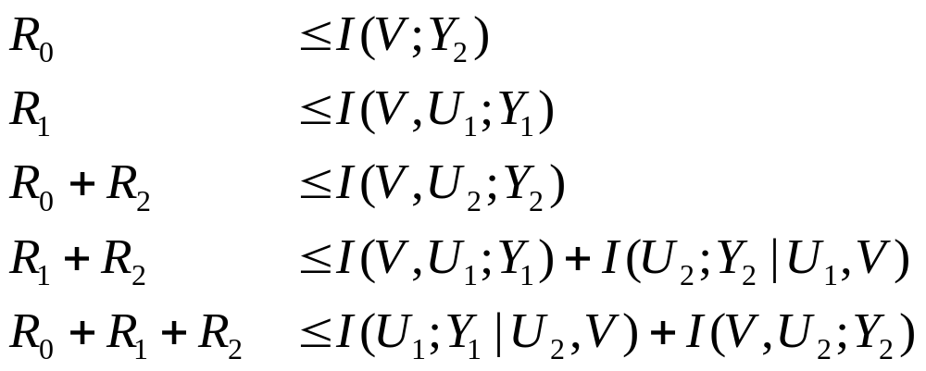
Outer Bound
The set of rate triples (R₀, R₁,R₂ ) satisfying
for input distributions that factor as
For R₂=0, U₂=Ø, and by redefining R₀ as R₂:
outer bound for the IC with full cooperation

Slide 7
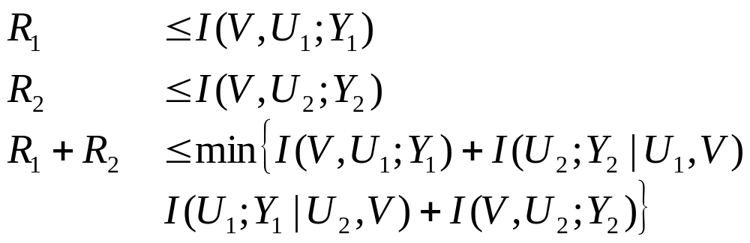
Outer Bound: Full Cooperation
The set of rate triples (R₀, R₁,R₂ ) satisfying
for input distributions that factor as
The exact same form as the Nair-El Gamal outer bound on the broadcast channel capacity
The difference is in the factorization of the input distribution
reflecting the fact that only one-way cooperation is possible

Slide 8
Summary of new technique
Outer bound
Follows from standard approach: invoke Fano’s inequality
Reduces to outer bound for full cooperation for R₂=0
Has to be evaluated for specific channels
Achievable rates: combine
  rate splitting
  precoding against interference at encoder 1
  cooperation at encoder 1
How far are the achievable rates from the outer bound?
Capacity for other regimes?

Slide 9
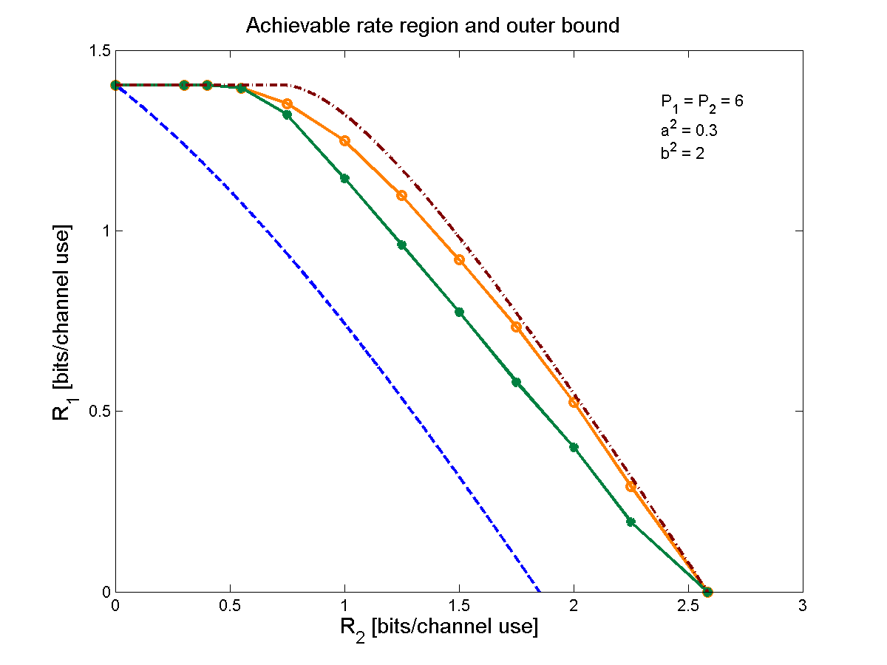
Performance Gains from Cognitive Encoding
  outer bound
  this scheme
  DMT schemes
  CR
  broadcast bound

Slide 10
Insights
CR
RX1
RX2
NCR
Orthogonalizing transmissions is suboptimal
Canceling strong interference is beneficial
Cooperation can be exploited
Rate-splitting can be used for partially canceling interference
Precoding against interference can be exploited

Slide 11
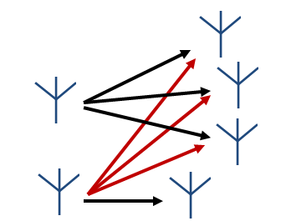
Cognitive MIMO Networks
NCR
NC_{RX}
RX1
NC_{TX}
NC_{RX}
NC_{RX}
RX2
CR
C_{TX}
C_{RX}
Coexistence conditions:
  Noncognitive user unaware of secondary users
  Cognitive user doesn’t impact rate of noncognitive user
Encoding rule for the cognitive encoder:
  Generates codeword for primary user message
  Generates codeword for its message using dirty paper coding
  Two codewords superimposed to form final codeword

Slide 12
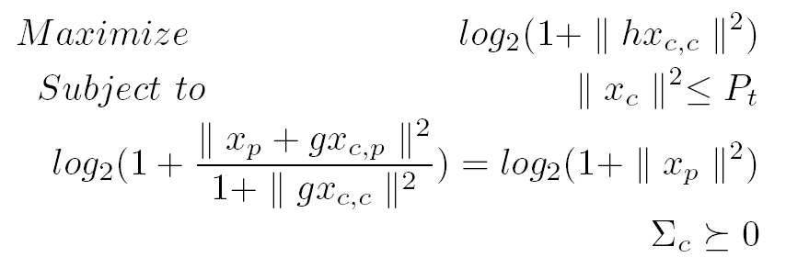
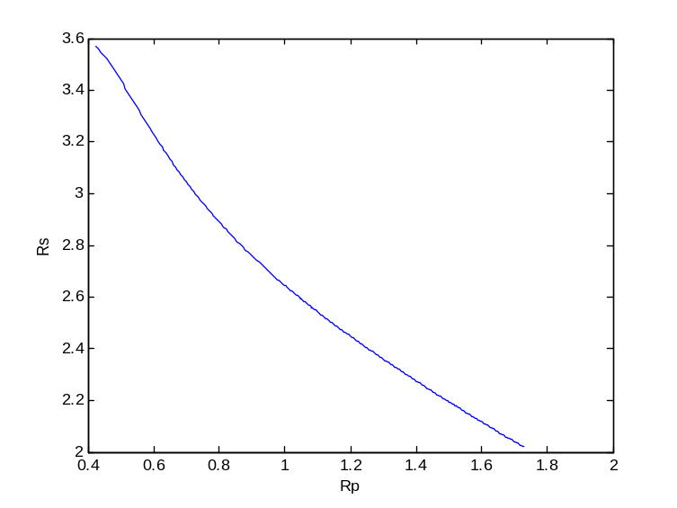
Achievable rates (2 users)
For MISO secondary users, beamforming is optimal
Maximum achievable rate obtained by solving
Closed-form relationship between primary/secondary user rates.

Slide 13
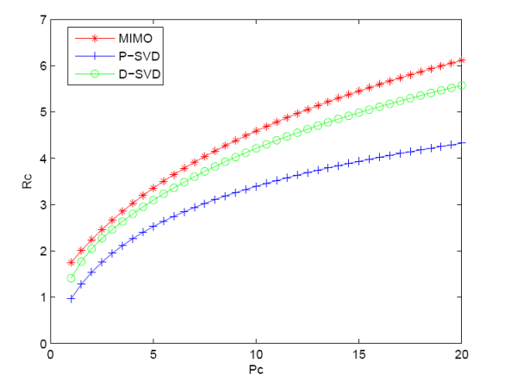
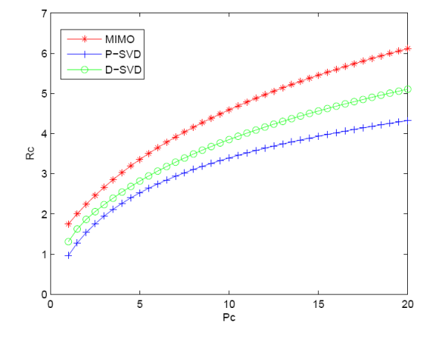


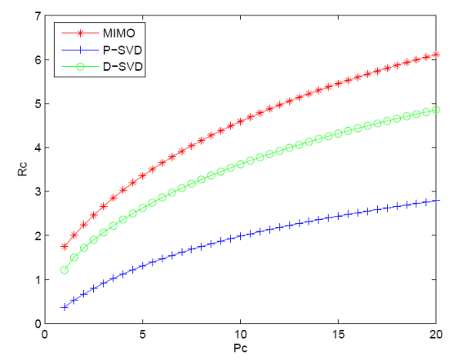
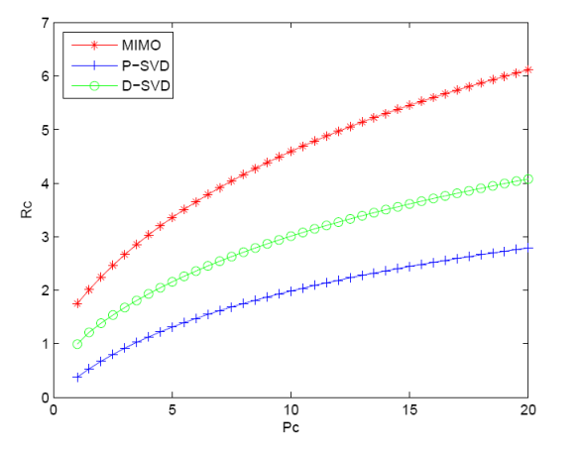


MIMO cognitive users (2 Users)
Propose two (suboptimal) cognitive strategies
D-SVD
Precode based on SVD of cognitive user’s channel
P-SVD
Project cognitive user’s channel onto null space between C_{TX} and NC_{RX}, then perform SVD on projection

Slide 14
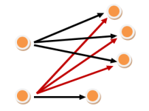
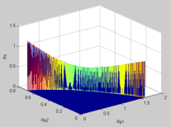
Multi-user Cognitive MIMO Networks
Extend analysis to multiple primary users
Assume each transmitter broadcasts to multiple users
  Primary receivers have one antenna
  Secondary users are MISO.
Main Result:
  With appropriate power allocation among primary receivers, the secondary users achieve their maximum possible rate.
Cognitive MIMO network
with multiple primary users
Achievable rates with
two primary users

Slide 15

Other Overlay Systems
Cognitive relays
Cognitive BSs
Cognitive Relay 1
Cognitive Relay 2

Slide 16
Broadcast Channel with Cognitive Relays (BCCR)
Cognitive Relay 1
Enhance capacity via cognitive relays
  Cognitive relays overhear the source messages
  Cognitive relays then cooperate with the transmitter in the transmission of the source messages
data
Source
Cognitive Relay 2

Slide 17
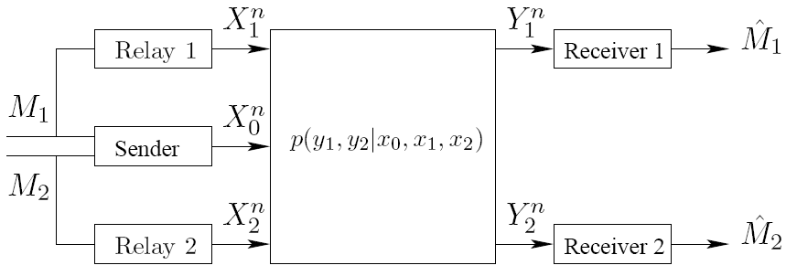
Channel Model
Sender (Base Station) wishes to send two independent messages to two receivers
Messages uniformly generated
Each cognitive relay knows only one of the messages to send

Slide 18
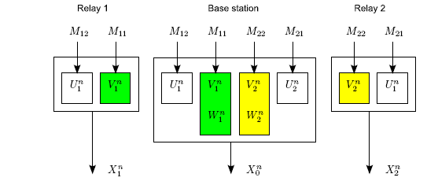
Coding Scheme for the BCCR
Each message split into two parts: common and private
Cognitive relays cooperate with the base station to transmit the respective common messages
Each private message encoded with two layers
    Inner layer exposed to the respective relay
    Outer layer pre-codes for interference (GGP coding)

Slide 19
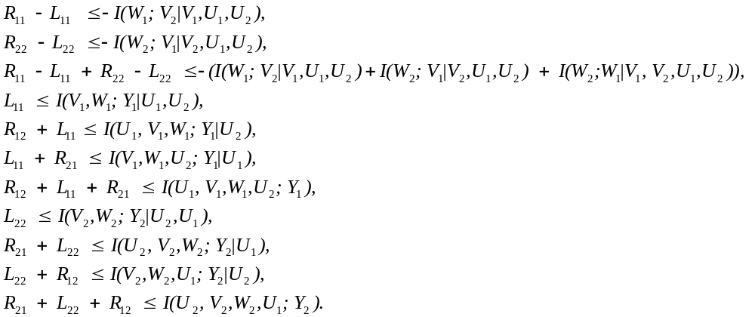
Achievable Rate Region
Joint probability distribution
Achievable rate region: all rates (R₁₂+R₁₁,R₂₁+R₂₂) s.t.

Slide 20
Generality of the Result
Without the cognitive relays
  BCCR reduces to a generic BC
  Correspondingly, rate region reduces to Marton’s region for the BC (best region to date for the BCs)
Without the base station
  BCCR reduces to an IC
  Correspondingly, rate region reduces to the Han-Kobayashi Region for the IC (best region for ICs)

Slide 21
Improved Robustness
Without cognitive relays
  When base station is gone, the entire transmission is dead
With cognitive relays
  When base station is gone, cognitive relays can pick up the role of base station, and the ongoing transmission continues
  Cognitive relays and the receivers form an interference channel
Source
data

Slide 22
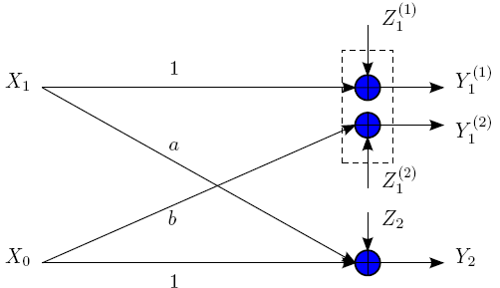
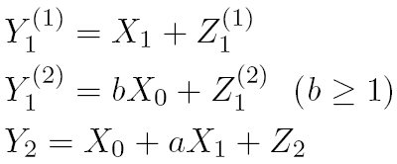
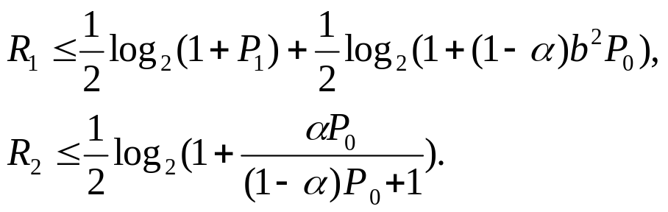
A Numerical Example
Special Gaussian configuration with a single cognitive relay,
Rate region for this special case (obtained from region for BCCR)

Slide 23
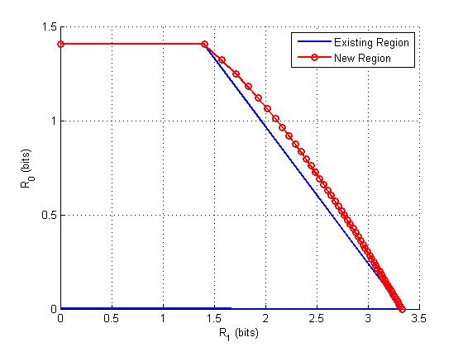
A Numerical Example
No existing rate region can be specialized to this region for the example except [Sridharan et al’08]
This rate region also demonstrates strict improvement over one of the best known region for the cognitive radio channel ([Jiang-Xin’08] and [Maric et al’08])
Channel parameters:
a = 0.5, b = 1.5;
P₁ = 6, P₂ = 6;

Slide 24
Overlay Challenges
Complexity of transmission and detection
Obtaining information about channel, other user’s messages, etc.
Full-duplex vs. half duplex
Synchronization
And many more …

Slide 25
Summary
Overlay techniques substantially increase capacity
Can be applied to many types of systems
  Cognitive networks
  Ad hoc networks
  Cellular systems
  Hybrid systems
Uses all “tricks” from BC, MAC, interference channels
More details on channel capacity in tutorial paper (to be presented) and Chapter 2 of “Principles of Cognitive Radio”: to be posted
Very interesting to reduce these ideas to practice: much room for innovation

Slide 26
Student Presentation
“Blind Null Space Learning”
By Alexandros Manolakos

