Slide 1
EE360: Lecture 13 Outline
Cognitive Radios and their Capacity
Announcements
  Progress reports due today, HW 2 posted
  March 5 lecture moved to March 7, 12-1:15pm, Packard 364
  Poster session scheduling (90 min): T 3/11: 12pm or 4pm; W 3/12: 4:30pm, F 3/14 12pm or 5pm.
Introduction to cognitive radios
Underlay cognitive radios
  Spread spectrum
  MIMO
Interweave cognitive radios
Overlay cognitive radios
Next lecture: practical cognitive radio techniques

Slide 2
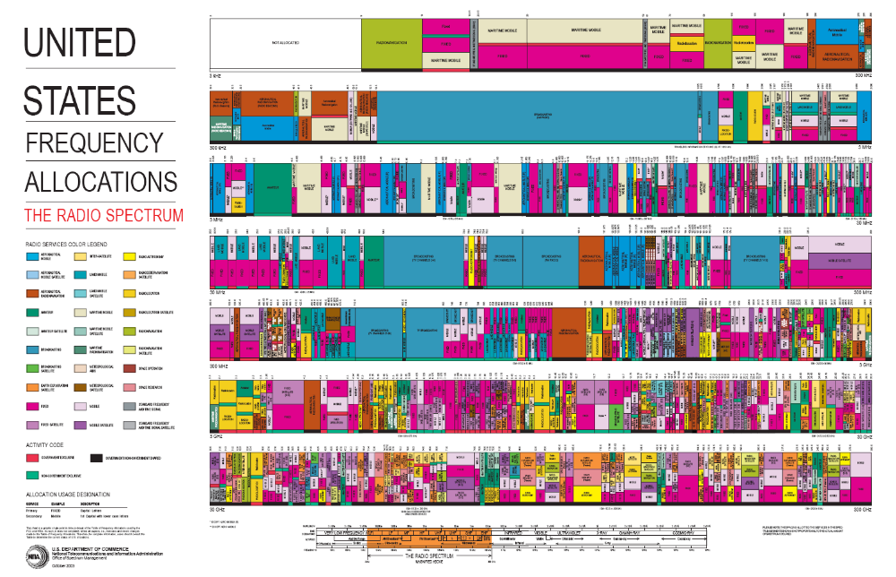
CR Motivation
Scarce Wireless Spectrum
$$$
and Expensive

Slide 3
Cognition Radio Introduction
Cognitive radios can support new wireless users in existing crowded spectrum
  Without degrading performance of existing users
Utilize advanced communication and signal processing techniques
  Coupled with novel spectrum allocation policies
Technology could
  Revolutionize the way spectrum is allocated worldwide
  Provide sufficient bandwidth to support higher quality and higher data rate products and services

Slide 4
What is a Cognitive Radio?
Cognitive radios (CRs) intelligently exploit
available side information about the
Channel conditions
Activity
Codebooks
Messages
of other nodes with which they share the spectrum

Slide 5
Cognitive Radio Paradigms
Underlay
  Cognitive radios constrained to cause minimal interference to noncognitive radios
Interweave
  Cognitive radios find and exploit spectral holes to avoid interfering with noncognitive radios
Overlay
  Cognitive radios overhear and enhance noncognitive radio transmissions
Knowledge
and
Complexity

Slide 6
Underlay Systems
Cognitive radios determine the interference their transmission causes to noncognitive nodes
  Transmit if interference below a given threshold
The interference constraint may be met
  Via wideband signalling to maintain interference below the noise floor (spread spectrum or UWB)
  Via multiple antennas and beamforming
I_{P}
NCR
NCR
CR
CR

Slide 7
Underlay Challenges
Measurement challenges
  Measuring interference at primary receiver
  Measuring direction of primary node for beamsteering
Policy challenges
  Underlays typically coexist with licensed users
  Licensed users paid $$$ for their spectrum
    Licensed users don’t want underlays
    Insist on very stringent interference constraints
    Severely limits underlay capabilities and applications

Slide 8
Ultrawideband Radio (UWB)
Uses 7.5 Ghz of “free spectrum” (underlay)
UWB is an impulse radio: sends pulses of tens of picoseconds(10⁻¹²) to nanoseconds (10⁻⁹)
  Duty cycle of only a fraction of a percent
A carrier is not necessarily needed
Uses a lot of bandwidth (GHz)
High data rates, up to 500 Mbps, very low power
Multipath highly resolvable: good and bad
Failed to achieve commercial success

Slide 9
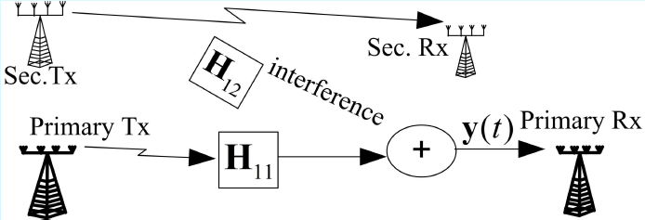
Null-Space Learning in MIMO CR Networks
Performance of CRs suffers from interference constraint
In MIMO systems, secondary users can utilize the null space of the primary user’s channel without interfering
Challenge is for CR to learn and then transmit within the null space of the H₁₂ matrix
Can develop blind null-space learning algorithms based on simple energy measurements with fast convergence
  Guest lecture by Alexandros Manolakos on this Wednesday

Slide 10
Capacity of Underlay Systems
The capacity region of an underlay system must capture rates for both primary and cognitive users
If there are no constraints on the cognitive users, this reduces to the capacity region of the network
Constraints on cognitive users translate to constraints on their transmission
  For example, reduced power, null-space transmission, etc.
Capacity region depends on how interference is treated at both the primary and cognitive receivers

Slide 11

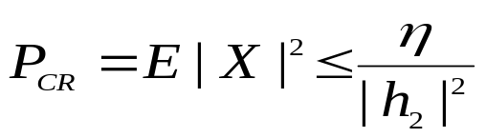
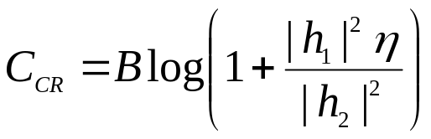
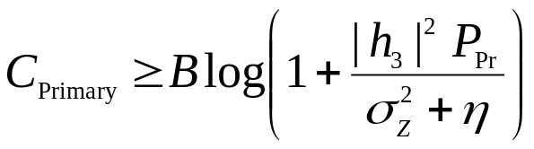
Example: 2 user network
X
h₁
CR
X
RX1
h₂
X’
Y=h₂X
RX2
Y_{tot}=h₂X+h₃X’+Z
Primary
h₃
Interference caused by CR to RX2: Y=hX
Assume an interference constraint at RX2 of η:
This translates to a power constraint at the CR transmitter
Capacities:
Ideas can be extended to larger networks/other constraints

Slide 12
Summary of Underlay MIMO Systems
Null-space learning in MIMO systems can be exploited for cognitive radios
Blind Jacobi techniques provide fast convergence with very limited information
These ideas may also be applied to white space radios

Slide 13
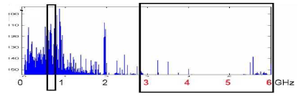
Interweave Systems:
Avoid interference
Measurements indicate that even crowded spectrum is not used across all time, space, and frequencies
  Original motivation for “cognitive” radios (Mitola’00)
These holes can be used for communication
  Interweave CRs periodically monitor spectrum for holes
  Hole location must be agreed upon between TX and RX
  Hole is then used for opportunistic communication with minimal interference to noncognitive users

Slide 14
Interweave Challenges
Spectral hole locations change dynamically
  Need wideband agile receivers with fast sensing
    Compresses sensing can play a role here
  Spectrum must be sensed periodically
  TX and RX must coordinate to find common holes
  Hard to guarantee bandwidth
Detecting and avoiding active users is challenging
  Fading and shadowing cause false hole detection
  Random interference can lead to false active user detection
Policy challenges
  Licensed users hate interweave even more than underlay
  Interweave advocates must outmaneuver incumbents

Slide 15
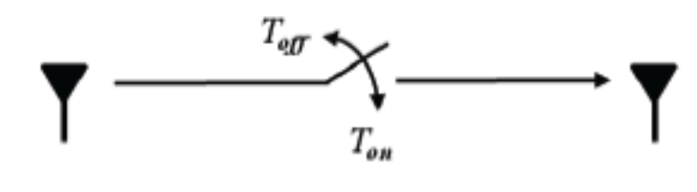
Capacity of Interweave Channels
Capacity of CR depends on what white spaces are available and how accurately they are detected
Can model availability of white spaces via an on-off channel
Ergodic and outage capacity depend on probability of T_{off}/T_{on}
Misdetection leads to 2-state channel (with/without interference). Use capacity analysis for 2-state channels

Slide 16
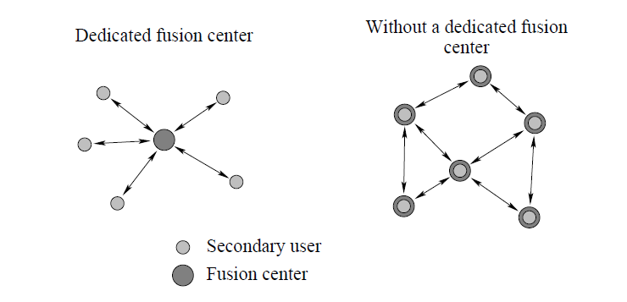
White Space Detection
White space detection can be done by a single sensor or multiple sensors
With multiple sensors, detection can be distributed or done by a central fusion center
Known techniques for centralized or distributed detection can be applied

Slide 17
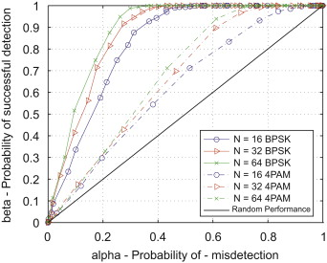
Detection Errors
Missed detection of primary user activity causes interference to primary users.
False detection of primary user activity (false alarm) misses spectrum opportunities
There is typically a tradeoff between these two (conservative vs. aggressive)

Slide 18
Overlay Systems
Cognitive user has knowledge of other user’s message and/or encoding strategy
  Used to help noncognitive transmission
  Used to presubtract noncognitive interference
CR
RX1
RX2
NCR

Slide 19
Transmission Strategy “Pieces”
To allow each receiver to
decode part of the other node’s message
⇨ reduces interference
Cooperation
at CR TX
Cooperation
atCR TX
Removes the NCR
interference at the CR RX
Cooperation
at CR TX
Precoding against
interference
at CR TX
Precoding against
interference
at CR TX
To help in sending NCR’s
message to its RX
Rate splitting
Must optimally combine
these approaches
“Achievable Rates in Cognitive Radios” by Devroye, Mitran, Tarokh
Notes:
It is CLEAR that it needs

Slide 20
Results around 2007
a
Wu et.al.
Joviċić et.al.
strong
M.,Y.,K
weak
interference
1
For Gaussian channel with P₁=P₂
1
b
New encoding scheme uses same techniques as previous work:
rate splitting, G-P precoding against interference and cooperation
Differences:
More general scheme than the one that suffices in weak interference
Different binning than the one proposed by [Devroye et.al] and [Jiang et.al.]

Slide 21











Improved Scheme
Transmission for Achievable Rates
The NCR uses single-user encoder
RX1
CR
RX2
The CR uses
- Rate-splitting to allow receiver 2 to decode part of cognitive
user’s message and thus reduce interference at that receiver
- Precoding while treating the codebook for user 2 as
interference to improve rate to its own receiver
- Cooperation to increase rate to receiver 2
NCR
Rate
split
CR
NCR

Slide 22
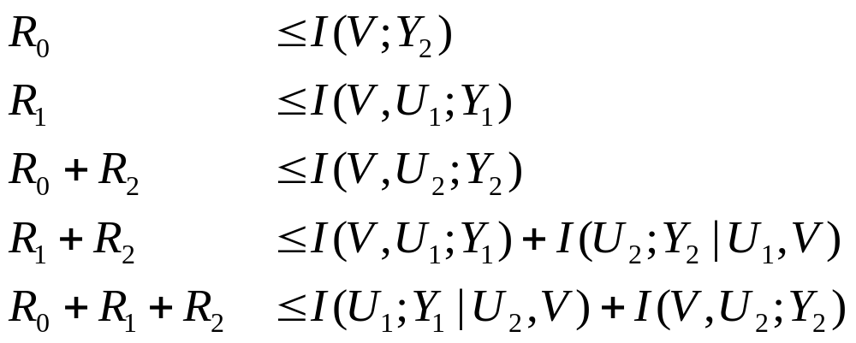
Outer Bound
The set of rate triples (R₀, R₁,R₂ ) satisfying
for input distributions that factor as
For R₂=0, U₂=Ø, and by redefining R₀ as R₂:
outer bound for the IC with full cooperation

Slide 23
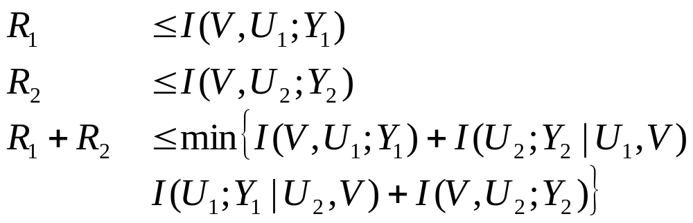
Outer Bound: Full Cooperation
The set of rate triples (R₀, R₁,R₂ ) satisfying
for input distributions that factor as
The exact same form as the Nair-El Gamal outer bound on the broadcast channel capacity
The difference is in the factorization of the input distribution
reflecting the fact that only one-way cooperation is possible

Slide 24
Summary of new technique
Outer bound
Follows from standard approach: invoke Fano’s inequality
Reduces to outer bound for full cooperation for R₂=0
Has to be evaluated for specific channels
Achievable rates: combine
  rate splitting
  precoding against interference at encoder 1
  cooperation at encoder 1
How far are the achievable rates from the outer bound?
Capacity for other regimes?

Slide 25
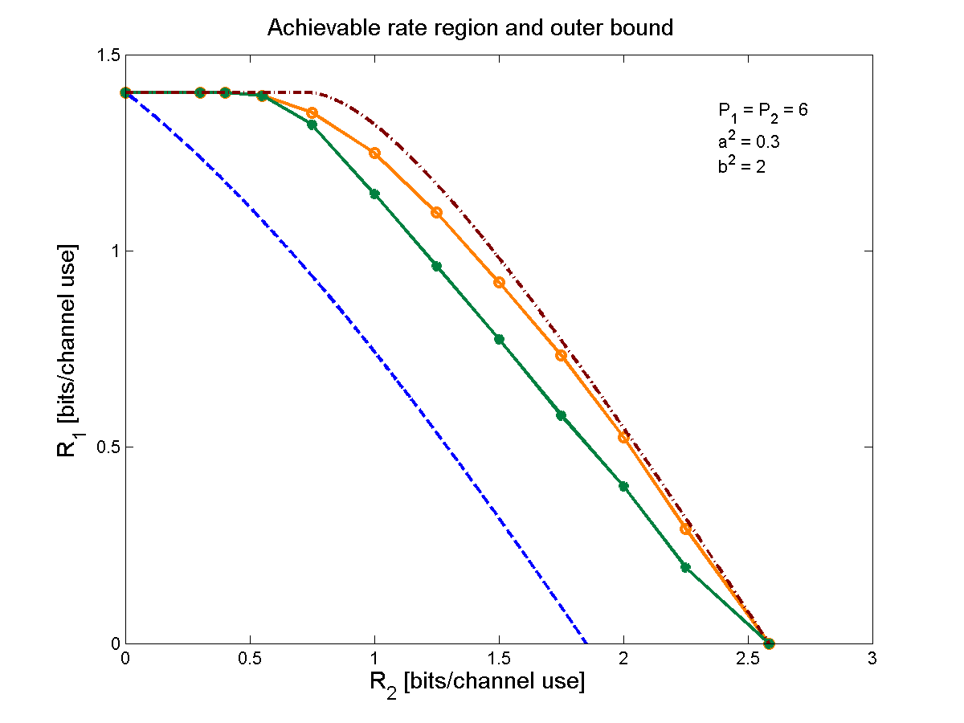
Performance Gains from Cognitive Encoding
  outer bound
  this scheme
  DMT schemes
  CR
  broadcast bound

Slide 26
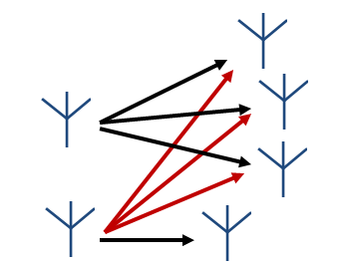
Cognitive MIMO Networks
NCR
NC_{RX}
RX1
NC_{TX}
NC_{RX}
NC_{RX}
RX2
CR
C_{TX}
C_{RX}
Coexistence conditions:
  Noncognitive user unaware of secondary users
  Cognitive user doesn’t impact rate of noncognitive user
Encoding rule for the cognitive encoder:
  Generates codeword for primary user message
  Generates codeword for its message using dirty paper coding
  Two codewords superimposed to form final codeword

Slide 27
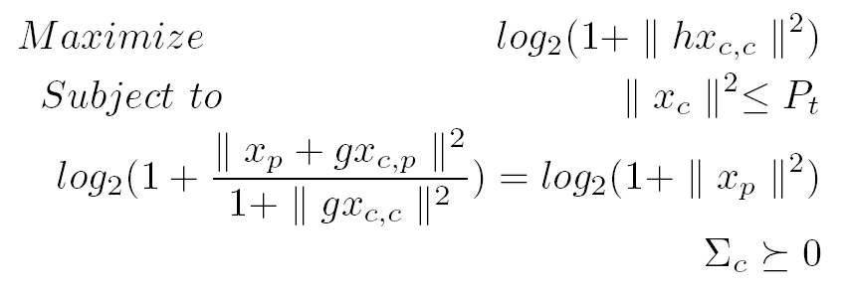
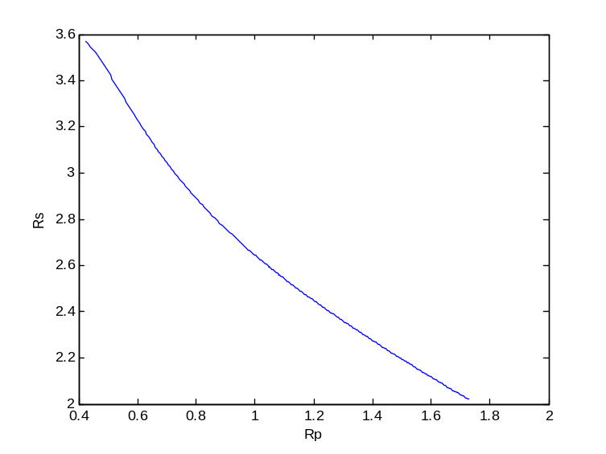
Achievable rates (2 users)
For MISO secondary users, beamforming is optimal
Maximum achievable rate obtained by solving
Closed-form relationship between primary/secondary user rates.

Slide 28
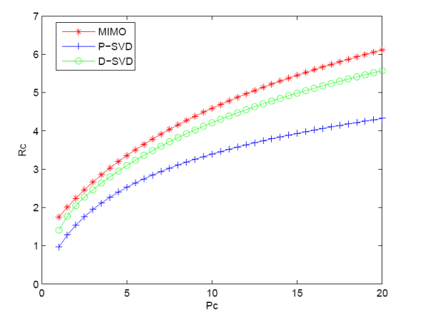
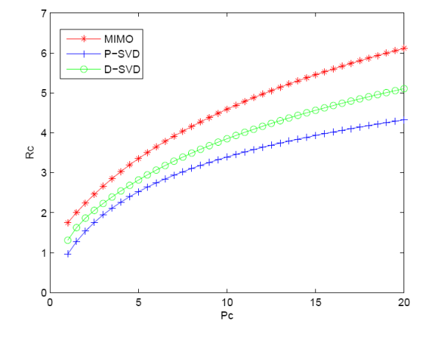


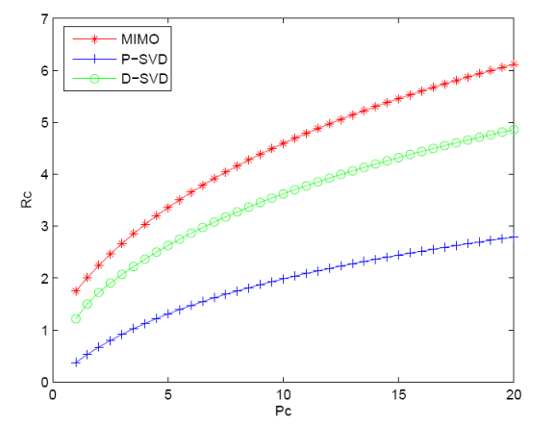
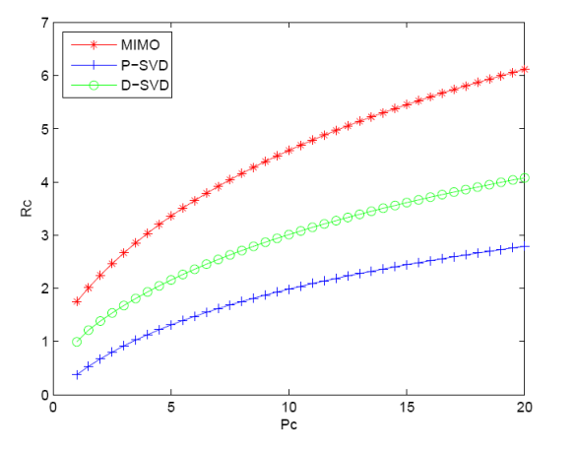


MIMO cognitive users (2 Users)
Propose two (suboptimal) cognitive strategies
D-SVD
Precode based on SVD of cognitive user’s channel
P-SVD
Project cognitive user’s channel onto null space between C_{TX} and NC_{RX}, then perform SVD on projection

Slide 29
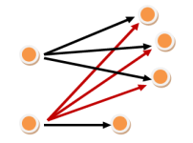
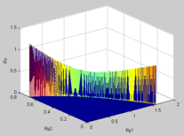
Multi-user Cognitive MIMO Networks
Extend analysis to multiple primary users
Assume each transmitter broadcasts to multiple users
  Primary receivers have one antenna
  Secondary users are MISO.
Main Result:
  With appropriate power allocation among primary receivers, the secondary users achieve their maximum possible rate.
Cognitive MIMO network
with multiple primary users
Achievable rates with
two primary users

Slide 30

Other Overlay Systems
Cognitive relays
Cognitive BSs
Cognitive Relay 1
Cognitive Relay 2

Slide 31
Broadcast Channel with Cognitive Relays (BCCR)
Cognitive Relay 1
Enhance capacity via cognitive relays
  Cognitive relays overhear the source messages
  Cognitive relays then cooperate with the transmitter in the transmission of the source messages
data
Source
Cognitive Relay 2

Slide 32
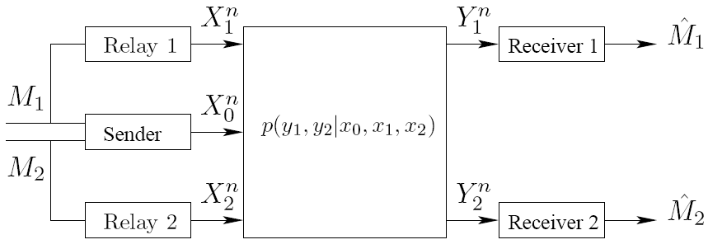
Channel Model
Sender (Base Station) wishes to send two independent messages to two receivers
Messages uniformly generated
Each cognitive relay knows only one of the messages to send

Slide 33
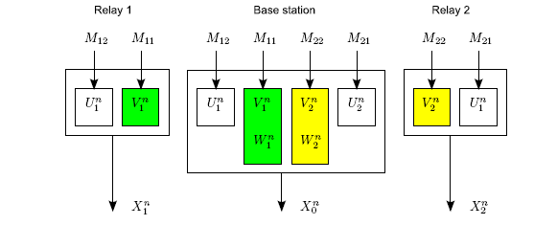
Coding Scheme for the BCCR
Each message split into two parts: common and private
Cognitive relays cooperate with the base station to transmit the respective common messages
Each private message encoded with two layers
    Inner layer exposed to the respective relay
    Outer layer pre-codes for interference (GGP coding)

Slide 34
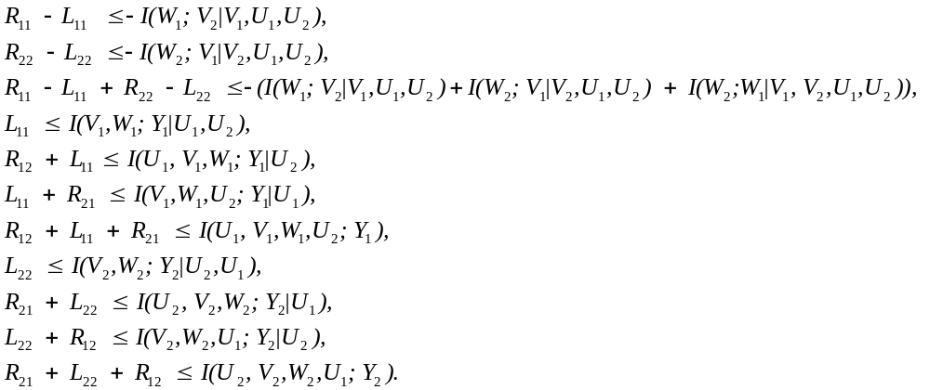
Achievable Rate Region
Joint probability distribution
Achievable rate region: all rates (R₁₂+R₁₁,R₂₁+R₂₂) s.t.

Slide 35
Generality of the Result
Without the cognitive relays
  BCCR reduces to a generic BC
  Correspondingly, rate region reduces to Marton’s region for the BC (best region to date for the BCs)
Without the base station
  BCCR reduces to an IC
  Correspondingly, rate region reduces to the Han-Kobayashi Region for the IC (best region for ICs)

Slide 36
Improved Robustness
Without cognitive relays
  When base station is gone, the entire transmission is dead
With cognitive relays
  When base station is gone, cognitive relays can pick up the role of base station, and the ongoing transmission continues
  Cognitive relays and the receivers form an interference channel
Source
data

Slide 37
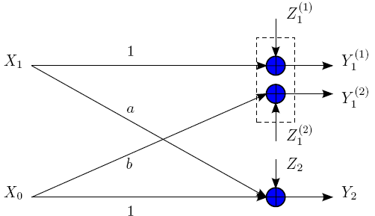
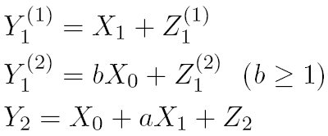
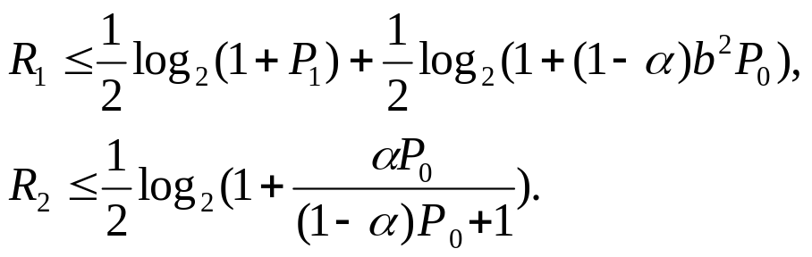
A Numerical Example
Special Gaussian configuration with a single cognitive relay,
Rate region for this special case (obtained from region for BCCR)

Slide 38
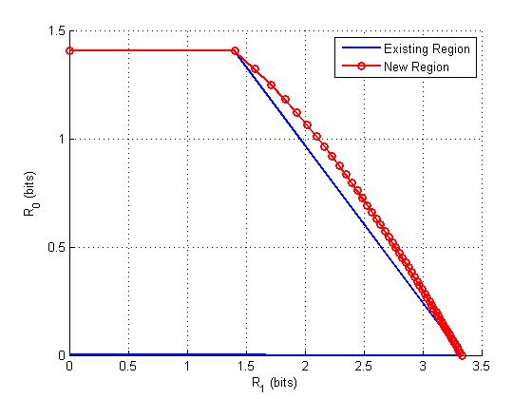
A Numerical Example
No existing rate region can be specialized to this region for the example except [Sridharan et al’08]
This rate region also demonstrates strict improvement over one of the best known region for the cognitive radio channel ([Jiang-Xin’08] and [Maric et al’08])
Channel parameters:
a = 0.5, b = 1.5;
P₁ = 6, P₂ = 6;

Slide 39
Overlay Challenges
Complexity of transmission and detection
Obtaining information about channel, other user’s messages, etc.
Full-duplex vs. half duplex
Synchronization
And many more …

Slide 40
Summary
Wireless spectrum is scarce: cognitive radios hold promise to alleviate spectrum shortage
Interference constraints have hindered the performance of underlay systems
  Exploiting the spatial dimension compelling
Interweave CRs find and exploit free spectrum:
  Primary users concerned about interference
Overlay techniques substantially increase capacity
  Can be applied to many types of systems
  uses all “tricks” from BC, MAC, interference channels
More details on channel capacity in tutorial paper (to be presented) and Chapter 2 of “Principles of Cognitive Radio”: to be posted
Very interesting to reduce these ideas to practice: much room for innovation

Slide 41
Student Presentation
“Breaking Spectrum Gridlock With Cognitive Radios: An Information Theoretic Perspective”
By Andrea Goldsmith, Syed Ali Jafar, Ivana Maric and Sudhir Snirivasa
Appeared in Proceedings of the IEEE, May 2009
Presented by Naroa

