Slide 1
EE360: Lecture 12 Outline
Ad-Hoc Network Optimization and Analysis, Cognitive Radios
Announcements
  HW 1 due today
  Progress reports due Feb. 24
Network Utility Maximization
New Analysis Tools
Consummating Unions: Control and Networks
Introduction to cognitive radios
Underlay cognitive radios
  Spread spectrum
  MIMO
Interweave cognitive radios
  Basic premise
  Spectrum sensing

Slide 2
Approaches to Cross-Layer
Resource Allocation*
Network
Optimization
Dynamic
Programming
Network Utility
Maximization
Distributed
Optimization
Game
Theory
State Space
Reduction
Wireless NUM
Multiperiod NUM
Distributed
Algorithms
Mechanism Design
Stackelberg Games
Nash Equilibrium
*Much prior work is for wired/static networks

Slide 3
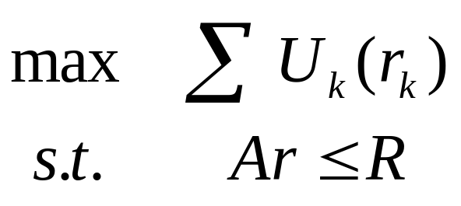
Network Utility Maximization
Maximizes a network utility function
Assumes
  Steady state
  Reliable links
  Fixed link capacities
Dynamics are only in the queues
flow k
routing
Fixed link capacity
U₁(r₁)
R_{i}
U₂(r₂)
R_{j}
U_{n}(r_{n})
Notes:
1 NUM views network protocols as optimization algorithms
2 Underlying problem is…
2.1 max the sum of the utilities
2.2 sum of the flows across a link cannot exceed the capacity of the link

Slide 4
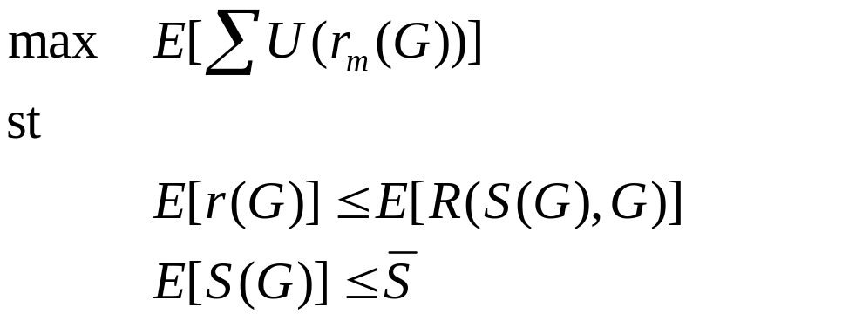
Wireless NUM
Extends NUM to random environments
Network operation as stochastic optimization algorithm
user
video
Upper
Layers
Physical
Layer
Upper
Layers
Upper
Layers
Physical
Layer
Physical
Layer
Upper
Layers
Upper
Layers
Physical
Layer
Physical
Layer
Stolyar, Neely, et. al.
Notes:
The highlighted points are the keys
Dwell on rate/rel/delay tradeoffs

Slide 5
WNUM Policies
Control network resources
Inputs:
  Random network channel information G^{k}
  Network parameters
  Other policies
Outputs:
  Control parameters
  Optimized performance, that
  Meet constraints
Channel sample driven policies
Notes:
The policies are functions or algorithms
The inputs are channel state and other parameters set by the network operator
The lagrange multipliers are Markov

Slide 6



Example: NUM and
Adaptive Modulation
Policies
  Information rate
  Tx power
  Tx Rate
  Tx code rate
Policy adapts to
  Changing channel conditions
  Packet backlog
  Historical power usage
Data
Data
Data
Upper
Layers
Upper
Layers
Buffer
Buffer
Physical
Layer
Physical
Layer
Block codes used
Notes:
Simplest model for illustration of concepts:
Multiple users over a single link
Each is buffered before going over the link
The link uses block codes at rate 0<code rate<1
System adjusts code rate, power, and tx rate to maximize user satisfaction

Slide 7
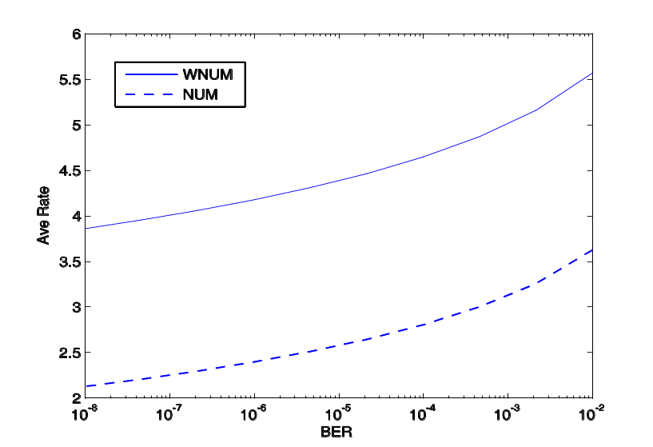
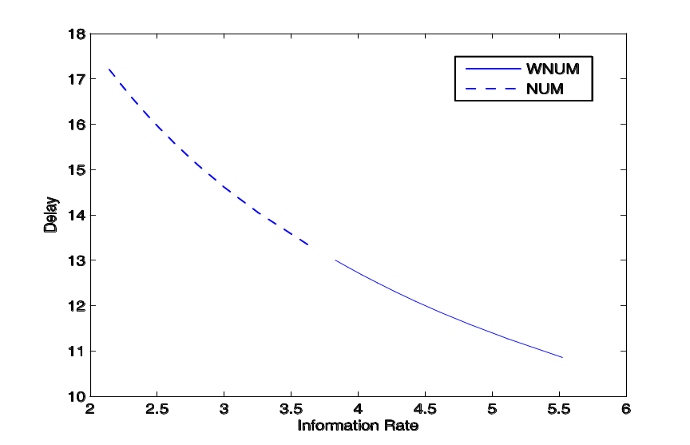
Rate-Delay-Reliability
Policy Results
Notes:
WNUM –with no codes used- offers superior performance.
The rate delay curve illustrates this best.

Slide 8
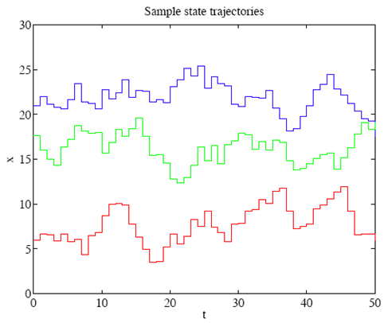
Beyond WNUM
WNUM Limitations
  Adapts to channel and network dynamics
  Cross-layer optimization
  Limited to elastic traffic flows
Multi-period NUM extends WNUM
  Multi-period resource (e.g., flow rate, power) allocation
  Resources (e.g., link capacities, channel states) vary randomly
  Maximize utility (or minimize cost) that reflects different weights (priorities), desired/required target levels, and averaging time scales for different flows
  Traffic can have defined start and stop times
  Traffic QoS metrics can Be met
General capacity regions can be incorporated
Much work by Stephen Boyd and his students

Slide 9
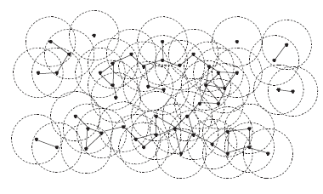
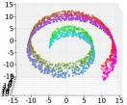
Reduced-Dimension Stochastic Control
Random Network Evolution
Changes
Stochastic
Control
Stochastic Optimization
Resource Management
Reduced-State
Sampling and
Learning

Slide 10
Game theory
Coordinating user actions in a large ad-hoc network can be infeasible
Distributed control difficult to derive and computationally complex
Game theory provides a new paradigm
  Users act to “win” game or reach an equilibrium
  Users heterogeneous and non-cooperative
  Local competition can yield optimal outcomes
  Dynamics impact equilibrium and outcome
  Adaptation via game theory

Slide 11
New Analysis Tools:
Large System Limits and
Stochastic Geometry
As system dimensions go to infinity, results from random matrix theory can be used, e.g.
  MIMO systems with large number of transmit and receive antennas
  Analysis of CDMA systems with large spreading factors and a large number of users
  Ad hoc networks with a large number of nodes (scaling laws)
Stochastic geometry (Milind’s presentation)
  Wireless networks are limited by interference.
  Interference depends on system design and environment
  Stochastic Geometry is an analysis tool based on random graph models averaged over multiple spatial realizations
  Has been used to determine SINR distributions, outage probability, and spectral efficiency in ad-hoc/cellular networks

Slide 12
Connections
Multihop networks with
imperfect feedback
Controller
Transmitter/
Controller
Channel
Feedback
Channel
System
Receiver/
System
Feedback channels
and stochastic control
Controller
System
Distributed Control with
imperfect feedback

Slide 13
Limitations in theory of ad hoc networks today
Wireless
Information
Theory
Wireless
Network
Theory
B. Hajek and A. Ephremides, “Information theory and communications
networks: An unconsummated union,” IEEE Trans. Inf. Theory, Oct. 1998.
Optimization
Theory
  Shannon capacity pessimistic for wireless channels and intractable for large networks
  Large body of wireless (and wired) network theory that is ad-hoc, lacks a basis in fundamentals, and lacks an objective success criteria.
  Little cross-disciplinary work spanning these fields
  Optimization techniques applied to given network models, which rarely take into account fundamental network capacity or dynamics
Notes:
Control theory here is not blue, the success criteria is not blue since can’t solve problems that don’t fit the math

Slide 14
Consummating Unions
Wireless
Information
Theory
Wireless
Network
Theory
Menage a Trois
Optimization
Game Theory,…
When capacity is not the only metric, a new theory is needed to deal with nonasymptopia (i.e. delay, random traffic) and application requirements
  Shannon theory generally breaks down when delay, error, or user/traffic dynamics must be considered
Fundamental limits are needed outside asymptotic regimes
Optimization, game theory, and other techniques provide the missing link
Notes:
Bob’s comments:
Wireless information theory has attacked too many problems
Control and optimization has been too focused on the math, and not on problems that don’t fit the math.

Slide 15
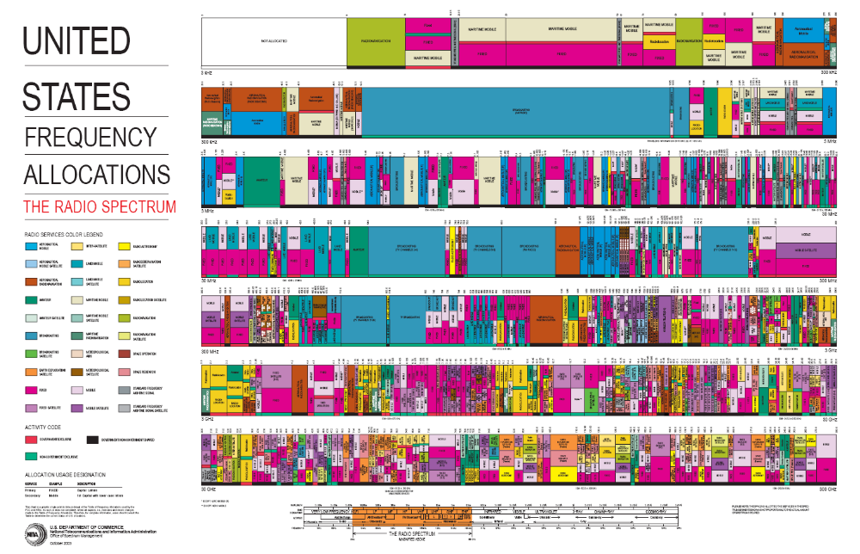
CR Motivation
Scarce Wireless Spectrum
$$$
and Expensive

Slide 16
Cognition Radio Introduction
Cognitive radios can support new wireless users in existing crowded spectrum
  Without degrading performance of existing users
Utilize advanced communication and signal processing techniques
  Coupled with novel spectrum allocation policies
Technology could
  Revolutionize the way spectrum is allocated worldwide
  Provide sufficient bandwidth to support higher quality and higher data rate products and services

Slide 17
What is a Cognitive Radio?
Cognitive radios (CRs) intelligently exploit
available side information about the
Channel conditions
Activity
Codebooks
Messages
of other nodes with which they share the spectrum

Slide 18
Cognitive Radio Paradigms
Underlay
  Cognitive radios constrained to cause minimal interference to noncognitive radios
Interweave
  Cognitive radios find and exploit spectral holes to avoid interfering with noncognitive radios
Overlay
  Cognitive radios overhear and enhance noncognitive radio transmissions
Knowledge
and
Complexity

Slide 19
Underlay Systems
Cognitive radios determine the interference their transmission causes to noncognitive nodes
  Transmit if interference below a given threshold
The interference constraint may be met
  Via wideband signalling to maintain interference below the noise floor (spread spectrum or UWB)
  Via multiple antennas and beamforming
I_{P}
NCR
NCR
CR
CR

Slide 20
Underlay Challenges
Measurement challenges
  Measuring interference at primary receiver
  Measuring direction of primary node for beamsteering
Policy challenges
  Underlays typically coexist with licensed users
  Licensed users paid $$$ for their spectrum
    Licensed users don’t want underlays
    Insist on very stringent interference constraints
    Severely limits underlay capabilities and applications

Slide 21
Ultrawideband Radio (UWB)
Uses 7.5 Ghz of “free spectrum” (underlay)
UWB is an impulse radio: sends pulses of tens of picoseconds(10⁻¹²) to nanoseconds (10⁻⁹)
  Duty cycle of only a fraction of a percent
A carrier is not necessarily needed
Uses a lot of bandwidth (GHz)
High data rates, up to 500 Mbps, very low power
Multipath highly resolvable: good and bad
Failed to achieve commercial success

Slide 22
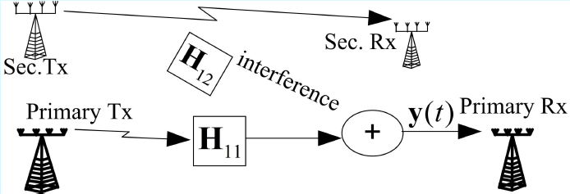
Null-Space Learning in MIMO CR Networks
Performance of CRs suffers from interference constraint
In MIMO systems, secondary users can utilize the null space of the primary user’s channel without interfering
Challenge is for CR to learn and then transmit within the null space of the H₁₂ matrix
We develop blind null-space learning algorithms based on simple energy measurements with fast convergence

Slide 23
Problem Statement
Consider a single primary user, User 1
Objective: Learn null space null(H_{1j}), j≠1 with minimal burden on the primary user
Propose two schemes:
  Passive primary user scheme: Primay user oblivious to secondary system
  Active primary user scheme: Minimal cooperation (no handshake or synchronization). Faster learning time.

Slide 24
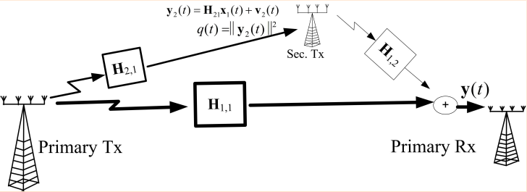
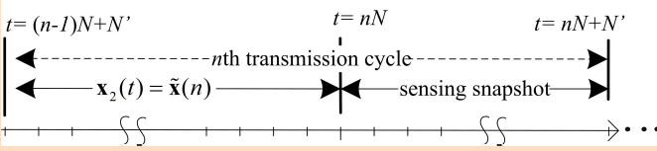
System Setup
Note: q(t) can be any monotonic function of y₂(t)
Energy is easily measurable at secondary transmitter

Slide 25
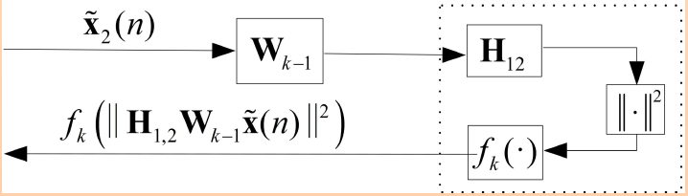

Learning Process
The SU’s learns the null space of H₁₂ by inserting a series of input symbols and measuring q(n)=f_{k}(⋅).
The only information that can be extracted is whether q(n) increases or decreases
Is this sufficient to learn the null space of H₁₂?

Slide 26
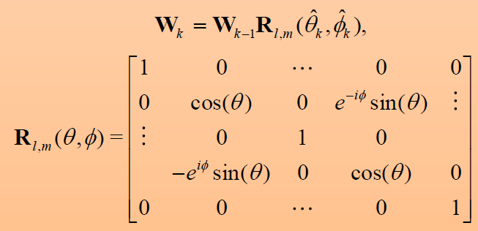
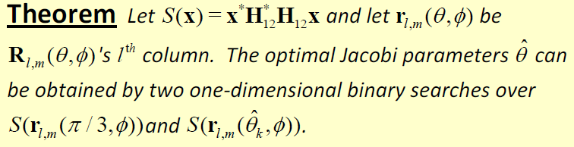
Yes!
The problem is equivalent to a blind Jacobi EVD decomposition
  The theorem ensures that Jacobi can be carried out by a blind 2D optimization in which every local minimum is a global minimum.

Slide 27
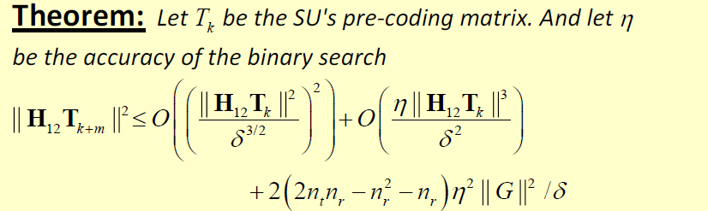
Can Bound Search Accuracy
More relaxed constraints on PU interference leads to better performance of the secondary user
This technique requires no cooperation with PU
If PU transmits its interference plus noise power, can speed up convergence significantly
The proposed learning technique also provides a novel spatial division multiple access mechanism

Slide 28
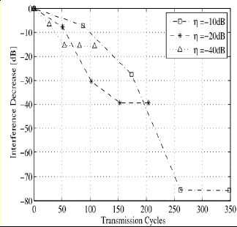
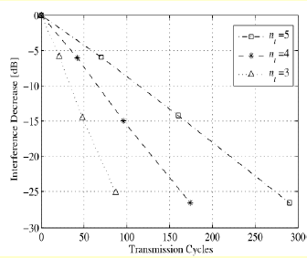
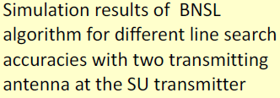
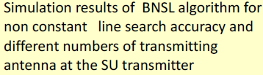
Performance

Slide 29
Summary of Underlay MIMO Systems
Null-space learning in MIMO systems can be exploited for cognitive radios
Blind Jacobi techniques provide fast convergence with very limited information
These ideas may also be applied to white space radios

Slide 30
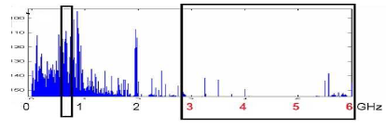
Interweave Systems:
Avoid interference
Measurements indicate that even crowded spectrum is not used across all time, space, and frequencies
  Original motivation for “cognitive” radios (Mitola’00)
These holes can be used for communication
  Interweave CRs periodically monitor spectrum for holes
  Hole location must be agreed upon between TX and RX
  Hole is then used for opportunistic communication with minimal interference to noncognitive users

Slide 31
Interweave Challenges
Spectral hole locations change dynamically
  Need wideband agile receivers with fast sensing
    Compresses sensing can play a role here
  Spectrum must be sensed periodically
  TX and RX must coordinate to find common holes
  Hard to guarantee bandwidth
Detecting and avoiding active users is challenging
  Fading and shadowing cause false hole detection
  Random interference can lead to false active user detection
Policy challenges
  Licensed users hate interweave even more than underlay
  Interweave advocates must outmaneuver incumbents

Slide 32
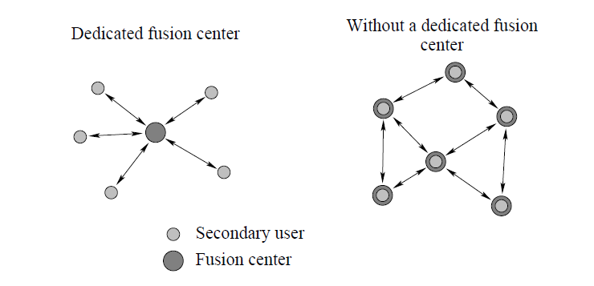
White Space Detection
White space detection can be done by a single sensor or multiple sensors
With multiple sensors, detection can be distributed or done by a central fusion center
Known techniques for centralized or distributed detection can be applied

Slide 33
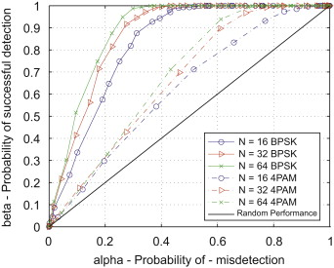
Detection Errors
Missed detection of primary user activity causes interference to primary users.
False detection of primary user activity (false alarm) misses spectrum opportunities
There is typically a tradeoff between these two (conservative vs. aggressive)

Slide 34
Summary
Techniques outside traditional communications theory needed to optimize ad-hoc networks
Wireless spectrum is scarce: cognitive radios hold promise to alleviate spectrum shortage
Interference constraints have hindered the performance of underlay systems
  Exploiting the spatial dimension compelling
Interweave CRs find and exploit free spectrum:
  Primary users concerned about interference
Much room for innovation

Slide 35
Student Presentation
"Stochastic geometry and random graphs for the analysis and design of wireless networks"
By Haenggi, Andrews, Baccelli, Dousse, and Franceschetti,
Appeared in J. Selected Areas in Communications, September 2009.
Presented by Milind

