Slide 1
EE360: Lecture 11 Outline
Cross-Layer Design and CR
Announcements
  HW 1 due Feb. 19
  Progress reports due Feb. 24
Interference alignment
Feedback
MIMO in ad-hoc networks
Cross layer design in ad hoc networks
Consummating the union between network and information theory

Slide 2

Interference Alignment
Addresses the number of interference-free signaling dimensions in an interference channel
Based on our orthogonal analysis earlier, it would appear that resources need to be divided evenly, so only 2BT/N dimensions available
Jafar and Cadambe showed that by aligning interference, 2BT/2 dimensions are available
Everyone gets half the cake!

Slide 3
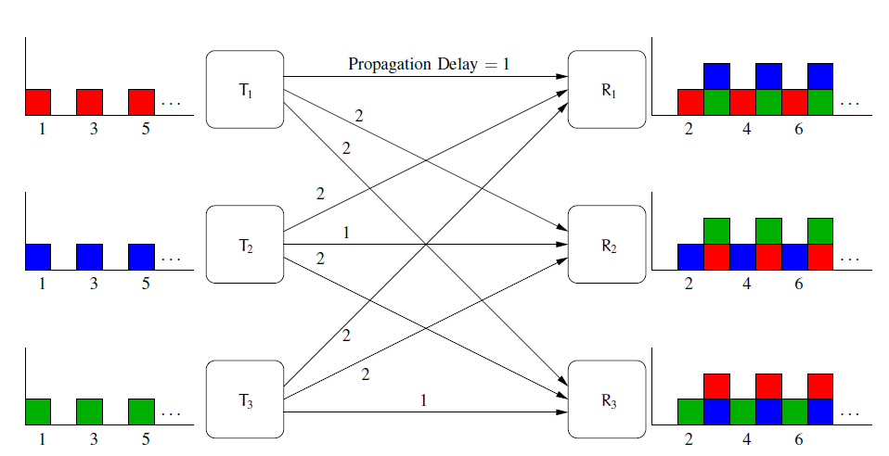
Basic Premise
For any number of TXs and RXs, each TX can transmit half the time and be received without any interference
  Assume different delay for each transmitter-receiver pair
  Delay odd when message from TX i desired by RX j; even otherwise.
  Each TX transmits during odd time slots and is silent at other times.
  All interference is aligned in even time slots.

Slide 4
Extensions
Multipath channels
Fading channels
MIMO channels
Cellular systems
Imperfect channel knowledge
…

Slide 5
Feedback in Networks
Feedback in ptp links
  Does not increase capacity
  Ensures reliable transmission
  Reduces complexity; adds delay
  Used to share CSI
Types of feedback in networks
  Output feedback
  CSI
  Acknowledgements
  Network/traffic information
  Something else
What is the network metric to be improved by feedback?
  Capacity, delay, …
Noisy/Compressed

Slide 6
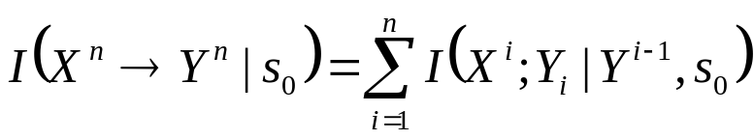
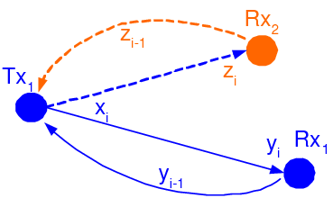
Capacity and Feedback
Feedback does not increase capacity of ptp memoryless channels
  Reduces complexity of optimal transmission scheme
  Drives error to zero faster
Capacity of ptp channels under feedback largely unknown
  E.g. for channels with memory; finite rate and/or noisy feedback
  Feedback introduces a new metric: directed mutual information
Multiuser channel capacity with FB largely unknown
  Feedback introduces cooperation
  RX cooperation in the BC
  TX cooperation in the MAC
Capacity of multihop networks unknown with/without feedback
But ARQ is ubiquitious in practice
  Works well on finite-rate noisy feedback channels
  Reduces end-to-end delay
How to explore optimal use of feedback in networks
T_{X2}
R_{X}
T_{X1}

Slide 7
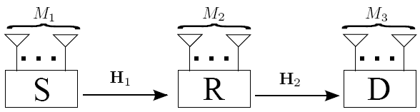
MIMO in Ad-Hoc Networks
Antennas can be used for multiplexing, diversity, or interference cancellation
  Cancel M-1 interferers with M antennas
What metric or tradeoff should be optimized?
  Throughput, diversity, delay, …

Slide 8
Diversity-Multiplexing-Delay Tradeoffs for MIMO Multihop Networks with ARQ
ARQ
Multiplexing
Beamforming
ARQ
H1
H2
Error Prone
Low P_{e}
MIMO used to increase data rate or robustness
Multihop relays used for coverage extension
ARQ protocol:
  Can be viewed as 1 bit feedback, or time diversity,
  Retransmission causes delay (can design ARQ to control delay)
Diversity multiplexing (delay) tradeoff - DMT/DMDT
  Tradeoff between robustness, throughput, and delay

Slide 9
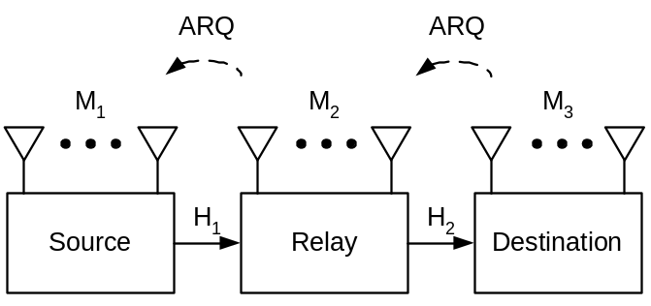
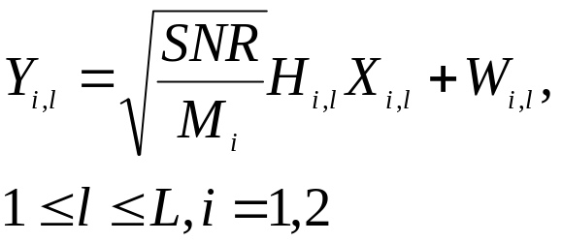


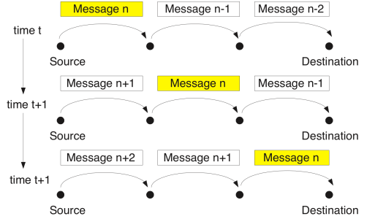

MIMO Multihop Model
Multihop model
  Two models for channel variations
    Long-term static:
    Short-term static: constant or varies/block:
Relay model: delay-and-forward
  Full-duplex (FDD) or half-duplex (using TDD)

Slide 10
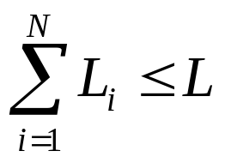


Multihop ARQ Protocols
Fixed ARQ: fixed window size
  Maximum allowed ARQ round for ith hop satisfies
Adaptive ARQ: adaptive window size
  Fixed Block Length (FBL) (block-based feedback, easy synchronization)
  Variable Block Length (VBL) (real time feedback)
Block 1
ARQ round 1
Block 1
ARQ round 2
Block 1
ARQ round 3
Block 2
ARQ round 1
Block 2
ARQ round 2
Receiver has enough
Information to decode
Block 1
ARQ round 1
Block 1
ARQ round 2
Block 1
round 3
Block 2
ARQ round 1
Block 2
ARQ round 2
Receiver has enough
Information to decode

Slide 11
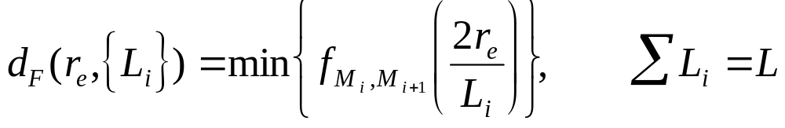
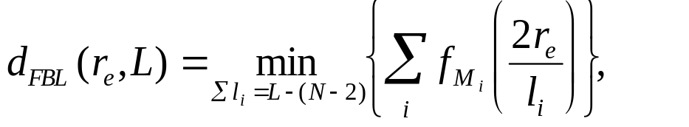
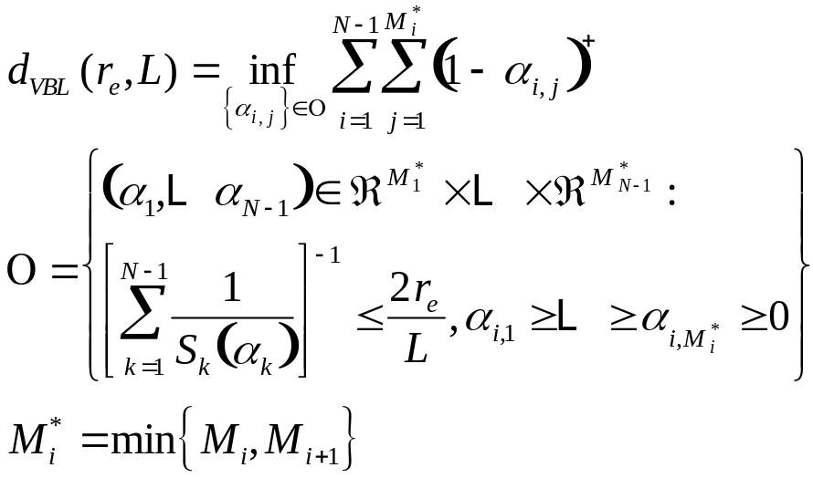
Asymptotic DMDT: long-term static channel
Performance limited by the weakest link
Fixed ARQ Allocation
Adaptive FBL
Adaptive VBL: close form solution in some special cases
Optimal ARQ equalizes link performance
Adaptive ARQ: this equalizing optimization is done automatically

Slide 12
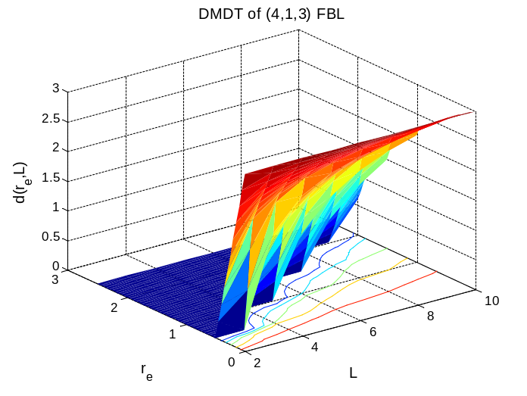
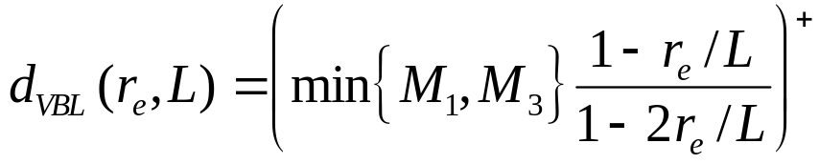
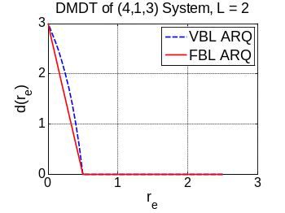
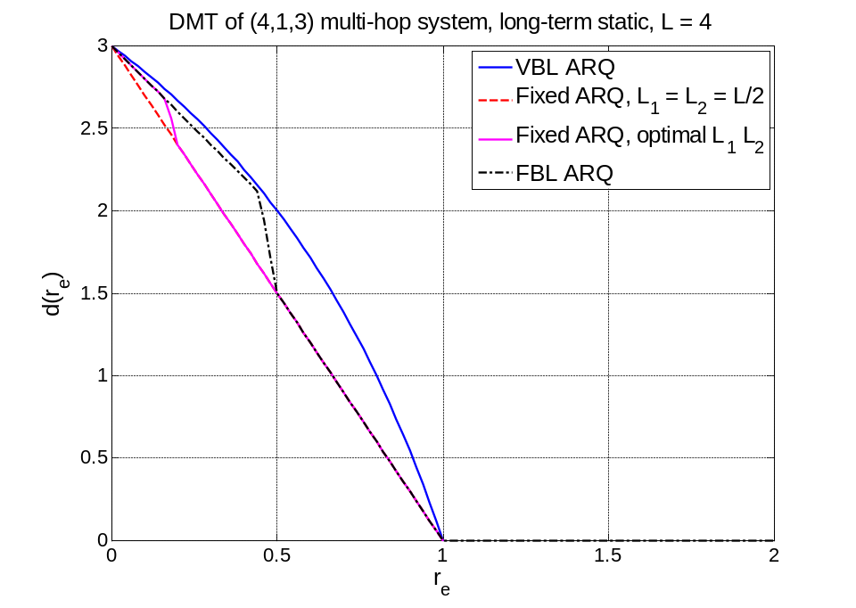
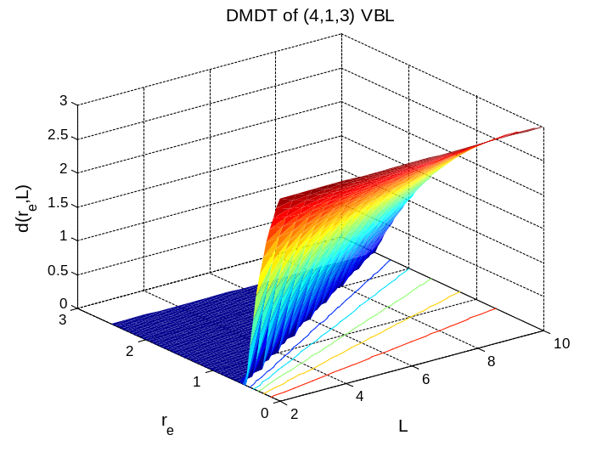
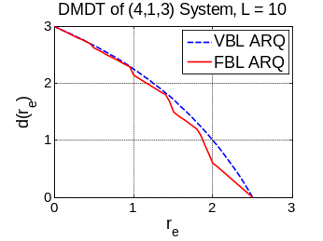
Example: (4, 1, 3) network
Long term static channel
Half duplexing

Slide 13
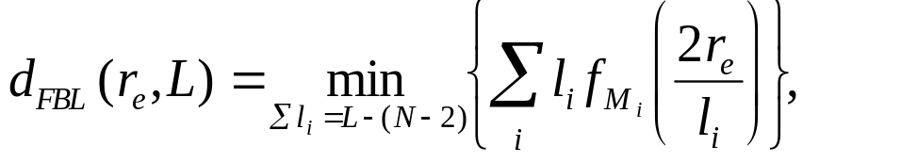
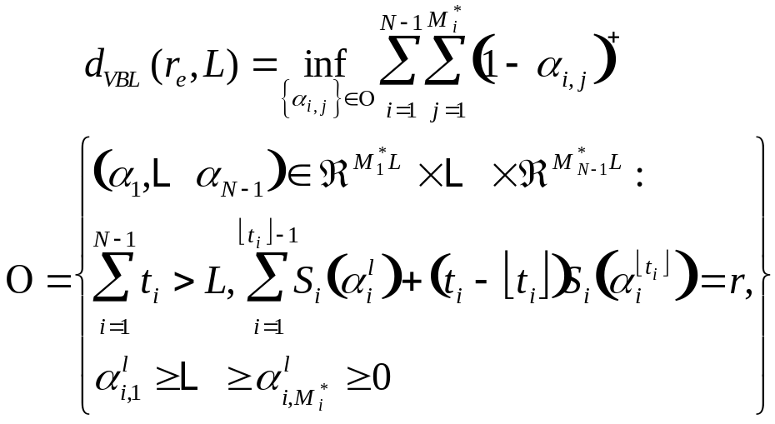
Asymptotic DMDT: Short-term static channel
Gain by a factor due to time diversity of channel variation
Adaptive ARQ: FBL
Adaptive ARQ VBL: optimization problem, no closed form solution
More variables: more degree-of-freedom due to time diversity
Performance limited by the weakest link
Optimal ARQ equalizes the link performance

Slide 14
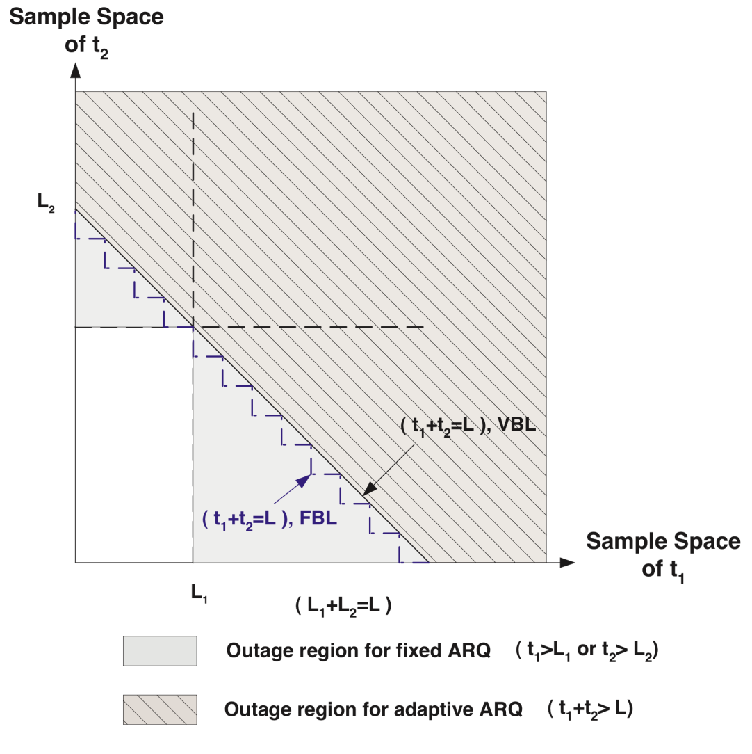
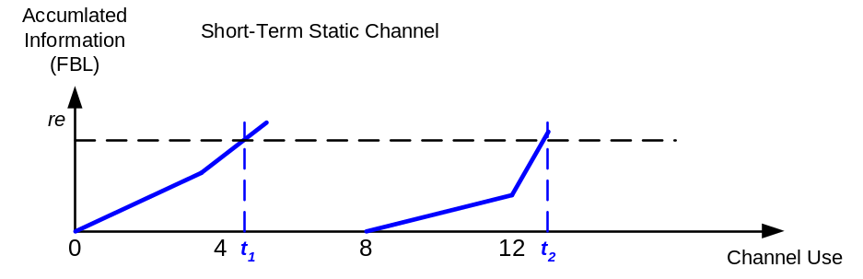
Asymptotic DMDT Optimality
Theorem: VBL ARQ achieves the optimal DMDT in MIMO multihop relay networks in long-term and short-term static channels.
Proved by cut-set bound
An intuitive explanation by
stopping times: VBL ARQ has
the smaller outage regions among
multihop ARQ protocols

Slide 15
Is a capacity region all we need to design networks?
Yes, if the application and network design can be decoupled
Application metric: f(C,D,E):
(C*,D*,E*)=arg max f(C,D,E)
Capacity
(C*,D*,E*)
Delay
If application and network design are
coupled, then cross-layer design needed
Energy

Slide 16
Crosslayer Design in Ad-Hoc Wireless Networks
Application
Network
Access
Link
Hardware
Substantial gains in throughput, efficiency, and end-to-end performance from cross-layer design
Notes:
Interdisciplinary research, design, and development very challenging, but necessary to meet the requirements of future wireless applications

Slide 17
Why a crosslayer design?
The technical challenges of future mobile networks cannot be met with a layered design approach.
QoS cannot be provided unless it is supported across all layers of the network.
  The application must adapt to the underlying channel and network characteristics.
  The network and link must adapt to the application requirements
Interactions across network layers must be understood and exploited.

Slide 18
Delay/Throughput/Robustness across Multiple Layers
B
A
Multiple routes through the network can be used for multiplexing or reduced delay/loss
Application can use single-description or multiple description codes
Can optimize optimal operating point for these tradeoffs to minimize distortion

Slide 19
Cross-layer protocol design for real-time media
Loss-resilient
source coding
and packetization
Application layer
Rate-distortion preamble
Congestion-distortion
optimized
scheduling
Transport layer
Congestion-distortion
optimized
routing
Traffic flows
Network layer
Capacity
assignment
for multiple service
classes
Link capacities
MAC layer
Link state information
Adaptive
link layer
techniques
Joint with T. Yoo, E. Setton,
X. Zhu, and B. Girod
Link layer

Slide 20
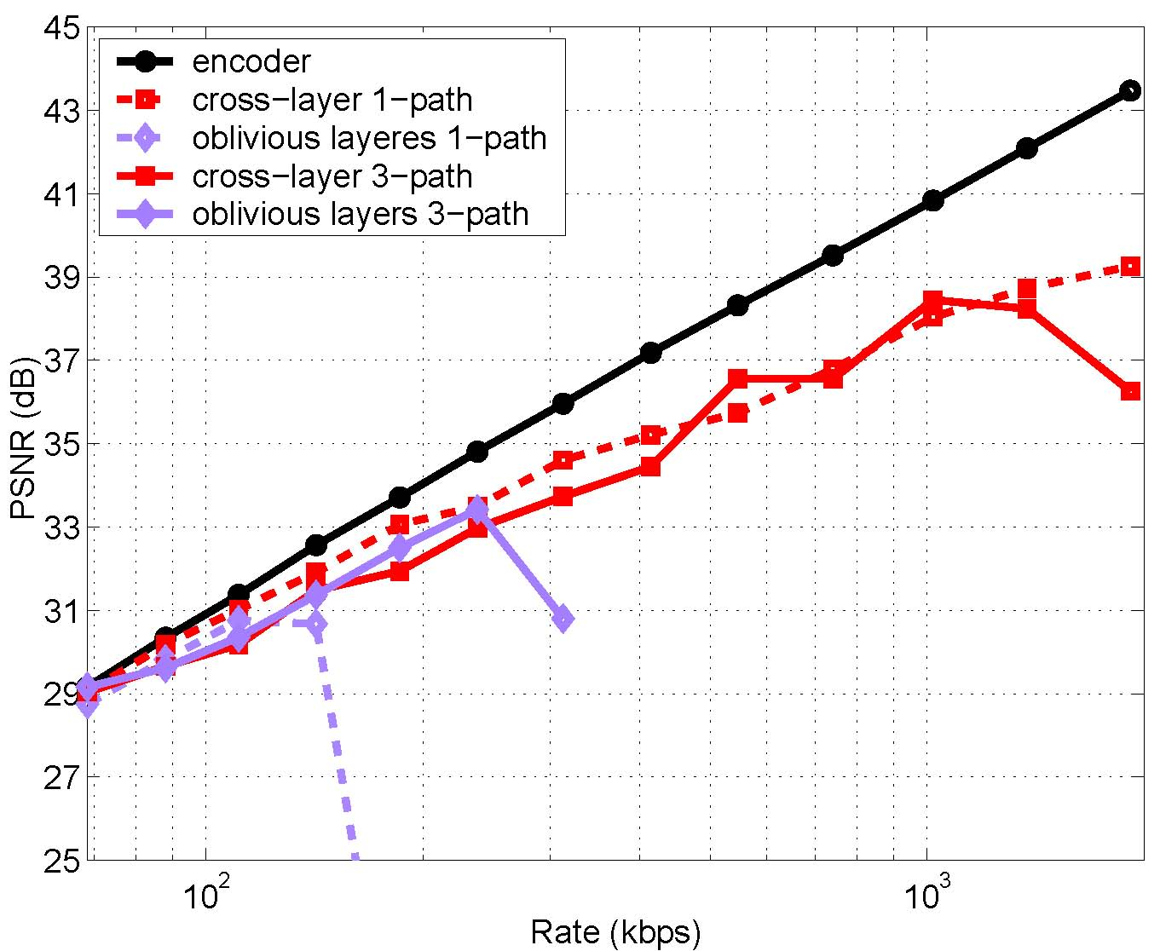
Video streaming performance
s
5 dB
3-fold increase
100
1000
(logarithmic scale)

Slide 21
Approaches to Cross-Layer
Resource Allocation*
Network
Optimization
Dynamic
Programming
Network Utility
Maximization
Distributed
Optimization
Game
Theory
State Space
Reduction
Wireless NUM
Multiperiod NUM
Distributed
Algorithms
Mechanism Design
Stackelberg Games
Nash Equilibrium
*Much prior work is for wired/static networks

Slide 22
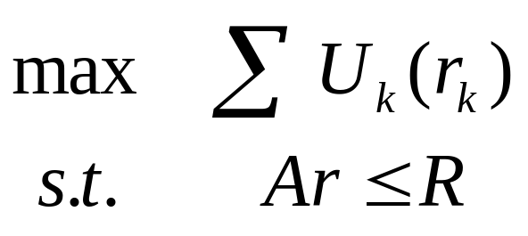
Network Utility Maximization
Maximizes a network utility function
Assumes
  Steady state
  Reliable links
  Fixed link capacities
Dynamics are only in the queues
flow k
routing
Fixed link capacity
U₁(r₁)
R_{i}
U₂(r₂)
R_{j}
U_{n}(r_{n})
Notes:
1 NUM views network protocols as optimization algorithms
2 Underlying problem is…
2.1 max the sum of the utilities
2.2 sum of the flows across a link cannot exceed the capacity of the link

Slide 23
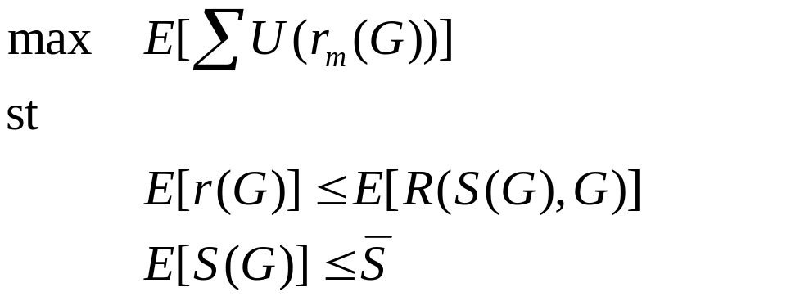
Wireless NUM
Extends NUM to random environments
Network operation as stochastic optimization algorithm
user
video
Upper
Layers
Physical
Layer
Upper
Layers
Upper
Layers
Physical
Layer
Physical
Layer
Upper
Layers
Upper
Layers
Physical
Layer
Physical
Layer
Stolyar, Neely, et. al.
Notes:
The highlighted points are the keys
Dwell on rate/rel/delay tradeoffs

Slide 24
WNUM Policies
Control network resources
Inputs:
  Random network channel information G^{k}
  Network parameters
  Other policies
Outputs:
  Control parameters
  Optimized performance, that
  Meet constraints
Channel sample driven policies
Notes:
The policies are functions or algorithms
The inputs are channel state and other parameters set by the network operator
The lagrange multipliers are Markov

Slide 25



Example: NUM and
Adaptive Modulation
Policies
  Information rate
  Tx power
  Tx Rate
  Tx code rate
Policy adapts to
  Changing channel conditions
  Packet backlog
  Historical power usage
Data
Data
Data
Upper
Layers
Upper
Layers
Buffer
Buffer
Physical
Layer
Physical
Layer
Block codes used
Notes:
Simplest model for illustration of concepts:
Multiple users over a single link
Each is buffered before going over the link
The link uses block codes at rate 0<code rate<1
System adjusts code rate, power, and tx rate to maximize user satisfaction

Slide 26
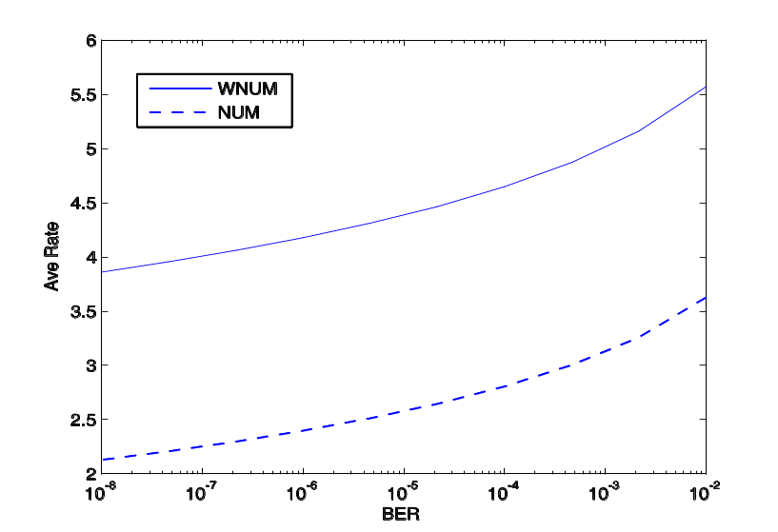
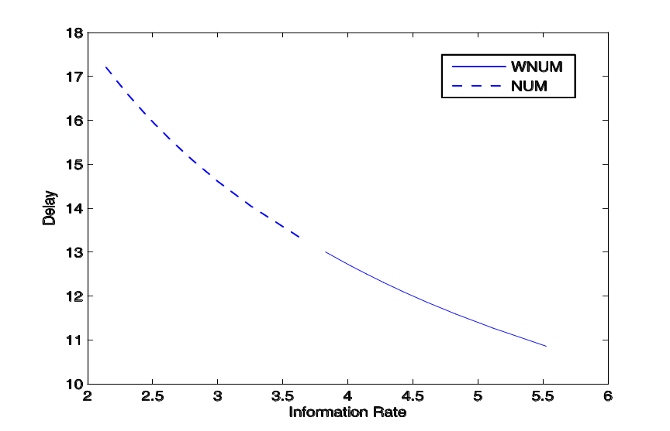
Rate-Delay-Reliability
Policy Results
Notes:
WNUM –with no codes used- offers superior performance.
The rate delay curve illustrates this best.

Slide 27
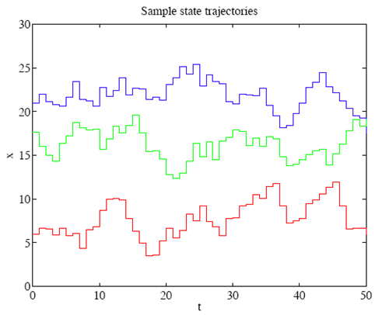
Beyond WNUM
WNUM Limitations
  Adapts to channel and network dynamics
  Cross-layer optimization
  Limited to elastic traffic flows
Multi-period NUM extends WNUM
  Multi-period resource (e.g., flow rate, power) allocation
  Resources (e.g., link capacities, channel states) vary randomly
  Maximize utility (or minimize cost) that reflects different weights (priorities), desired/required target levels, and averaging time scales for different flows
  Traffic can have defined start and stop times
  Traffic QoS metrics can Be met
General capacity regions can be incorporated
Much work by Stephen Boyd and his students

Slide 28
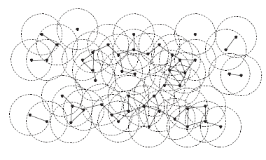
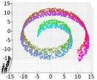
Reduced-Dimension Stochastic Control
Random Network Evolution
Changes
Stochastic
Control
Stochastic Optimization
Resource Management
Reduced-State
Sampling and
Learning

Slide 29
Game theory
Coordinating user actions in a large ad-hoc network can be infeasible
Distributed control difficult to derive and computationally complex
Game theory provides a new paradigm
  Users act to “win” game or reach an equilibrium
  Users heterogeneous and non-cooperative
  Local competition can yield optimal outcomes
  Dynamics impact equilibrium and outcome
  Adaptation via game theory

Slide 30
Connections
Multihop networks with
imperfect feedback
Controller
Transmitter/
Controller
Channel
Feedback
Channel
System
Receiver/
System
Feedback channels
and stochastic control
Controller
System
Distributed Control with
imperfect feedback

Slide 31
Limitations in theory of ad hoc networks today
Wireless
Information
Theory
Wireless
Network
Theory
B. Hajek and A. Ephremides, “Information theory and communications
networks: An unconsummated union,” IEEE Trans. Inf. Theory, Oct. 1998.
Optimization
Theory
  Shannon capacity pessimistic for wireless channels and intractable for large networks
  Large body of wireless (and wired) network theory that is ad-hoc, lacks a basis in fundamentals, and lacks an objective success criteria.
  Little cross-disciplinary work spanning these fields
  Optimization techniques applied to given network models, which rarely take into account fundamental network capacity or dynamics
Notes:
Control theory here is not blue, the success criteria is not blue since can’t solve problems that don’t fit the math

Slide 32
Consummating Unions
Wireless
Information
Theory
Wireless
Network
Theory
Menage a Trois
Optimization
Game Theory,…
When capacity is not the only metric, a new theory is needed to deal with nonasymptopia (i.e. delay, random traffic) and application requirements
  Shannon theory generally breaks down when delay, error, or user/traffic dynamics must be considered
Fundamental limits are needed outside asymptotic regimes
Optimization, game theory, and other techniques provide the missing link
Notes:
Bob’s comments:
Wireless information theory has attacked too many problems
Control and optimization has been too focused on the math, and not on problems that don’t fit the math.

Slide 33
Summary
Interference avoidance a great method for everyone getting “half the cake”
Feedback in networks poorly understood
MIMO provides multiplexing, diversity, and interference reduction tradeoffs
Cross-layer design can be powerful, but can be detrimental if done wrong
Techniques outside traditional communications theory needed to optimize ad-hoc networks

Slide 34
Student Presentation
Interference alignment and cancellation.”
By S. Gollakota, S. Perli, and D. Katabi.
Appeared in ACM SIGCOMM Computer Communication Review. Vol. 39. No. 4. 2009.
Presented by Omid

