Slide 1
EE360: Lecture 10 Outline
Capacity and Optimization of Ad Hoc Nets
Announcements
  Revised proposals due Monday
  HW 1 posted, due Feb. 19
  Lecture Wed will start at 9:15 (15 min early)
Definition of ad hoc network capacity
Capacity regions
Scaling laws and extensions
Achievable rate regions
Cross layer design
Network Utility Maximization

Slide 2
Ad-Hoc Network Capacity
Fundamental limits on the maximum possible rates between all possible node pairs with vanishing probability of error
Independent of transmission and reception strategies (modulation, coding, routing, etc.)
Dependent on propagation, node capabilities (e.g. MIMO), transmit power, noise, etc
Notes:
-No backbone: nodes must self-configure into a network.
-In principle all nodes can communicate with all other nodes, but multihop routing can reduce the interference associated with direct transmission.
-Topology dynamic since nodes move around and link characteristics change.
-Applications: appliances and entertainment units in the home, community networks that bypass the Internet. Military networks for robust flexible easily-deployed network (every soldier is a node).

Slide 3
Network Capacity:
What is it?
R₃₄
n(n-1)-dimensional region
  Rates between all node pairs
  Upper/lower bounds
    Lower bounds achievable
    Upper bounds hard
Other possible axes
  Energy and delay
Upper Bound
Lower Bound
TX1
R₁₂
RX2
Capacity
Delay
TX3
Upper Bound
RX4
Lower Bound
Energy

Slide 4
Fundamental Network Capacity
The Shangri-La of Information Theory
Much progress in finding the capacity limits of wireless single and multiuser channels
Limited understanding about the capacity limits of wireless networks, even for simple models
System assumptions such as constrained energy and delay may require new capacity definitions
Is this elusive goal the right thing to pursue?
Shangri-La is synonymous with any earthly paradise;
a permanently happy land, isolated from the outside world

Slide 5

Some capacity questions
How to parameterize the region
  Power/bandwidth
  Channel models and CSI
  Outage probability
  Security/robustness
Defining capacity in terms of asymptotically small error and infinite delay has been highly enabling
  Has also been limiting
    Cause of unconsummated union in networks and IT
  What is the alternative?

Slide 6
Network Capacity Results
Multiple access channel (MAC)
Broadcast channel
Relay channel upper/lower bounds
Strong interference channel
Scaling laws
Achievable rates for small networks
Gallager
Cover & Bergmans
Cover &
El Gamal
Sato, Han &
Kobayashi
Gupta & Kumar

Slide 7
Capacity for Large Networks
(Gupta/Kumar’00)
Make some simplifications and ask for less
  Each node has only a single destination
  All n nodes create traffic for their desired destination at a uniform rate λ
  Capacity (throughput) is maximum nλ that can be supported by the network (1 dimensional)
Throughput of random networks
  Network topology/packet destinations random.
  Throughput nλ is random: characterized by its distribution as a function of network size n.
Find scaling laws for C(n)=λ as n →∞.

Slide 8
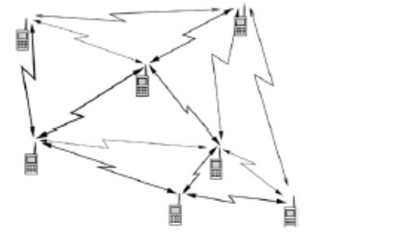
Network Models
Dense networks
  Area is fixed and the density of nodes increases.
  Interference limited.
Extended networks
  Density is fixed and the area increases.
  coverage limited.
  Power limitation come into play

Slide 9
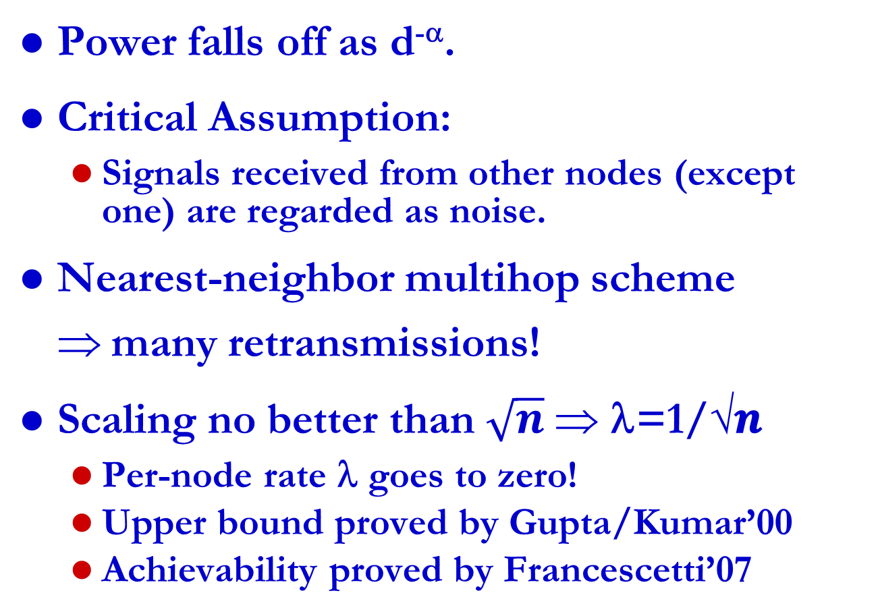
Dense Network Results
(area of network fixed)
Power falls off as d^{-α}.
Critical Assumption:
  Signals received from other nodes (except one) are regarded as noise.
Nearest-neighbor multihop scheme $$many retransmissions!
Scaling no better than $\sqrt{n} $ λ=1/√𝒏
  Per-node rate λ goes to zero!
  Upper bound proved by Gupta/Kumar’00
  Achievability proved by Francescetti’07

Slide 10
Scaling Law Extensions (Dense Networks)
Fixed network topologies (Gupta/Kumar’01)
  Similar throughput bounds as random networks
Mobility in the network (Grossglauser/Tse’01):
  Mobiles pass message to neighboring nodes, eventually neighbor gets close to destination and forwards message
  Per-node throughput constant, aggregate throughput of order n, delay of order n.
  Chris’s presentation
Throughput/delay tradeoffs
  Piecewise linear model for throughput-delay tradeoff (ElGamal et. al’04, Toumpis/Goldsmith’04)
  Finite delay requires throughput penalty.
Achievable rates with multiuser coding/decoding (GK’03)
  Per-node throughput (bit-meters/sec) constant, aggregate infinite.
S
D

Slide 11
Extended Networks
Xie and Kumar [3] addressed the question of scaling laws for the extended networks.
If α > 6, nearest neighbor multihopping is optimal.
  Many subsequent works relaxed the path loss condition down to α > 4 and obtained the same optimal scheme.
What about 2 ≤ α ≤ 4?
  Is nearest neighbor multihop scheme optimal?
  No!!!!
  Intuition: For α ≤ 4 the network is interference limited! Looks like a dense network.

Slide 12

Hierarchical Cooperation in
Large Networks (Ozgur et. al.)
Dense network model
Flat fading channels
  No multipath effects
  Line of sight type environment
The channel gains are known to all the nodes.
Far-Field Assumptions
Path loss and random phase.
Scaling is on the order of log n
  Per-node throughput increases with n!!!

Slide 13
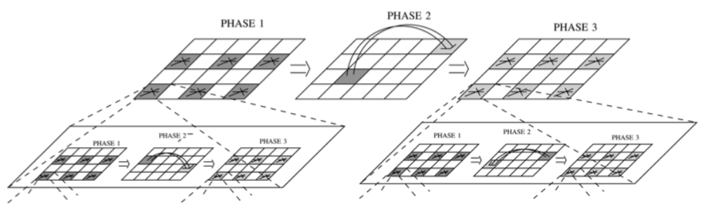
Achievable Scheme
Phase 1: local nodes form clusters, distribute bits within a cluster; concurrent transmissions
Phase 2: Virtual MIMO used to transmit bits between clusters: non-concurrent transmissions
Phase 3: Nodes quantize their received data and exchange within cluster; concurrent transmissions

Slide 14
Ad Hoc Network
Achievable Rate Regions
All achievable rate vectors between nodes
  Lower bounds Shannon capacity
An n(n-1) dimensional convex polyhedron
  Each dimension defines (net) rate from one node to each of the others
  Time-division strategy
  Link rates adapt to link SINR
  Optimal MAC via centralized scheduling
  Optimal routing
Yields performance bounds
  Evaluate existing protocols
  Develop new protocols
3
2
5
1
4

Slide 15
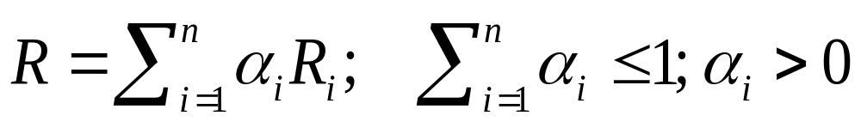
Achievable Rates
Achievable rate
vectors achieved
by time division
Capacity region
is convex hull of
all rate matrices
A matrix R belongs to the capacity region if there are rate matrices R₁, R₂, R₃ ,…, R_{n} such that
Linear programming problem:
  Need clever techniques to reduce complexity
  Power control, fading, etc., easily incorporated
  Region boundary achieved with optimal routing

Slide 16
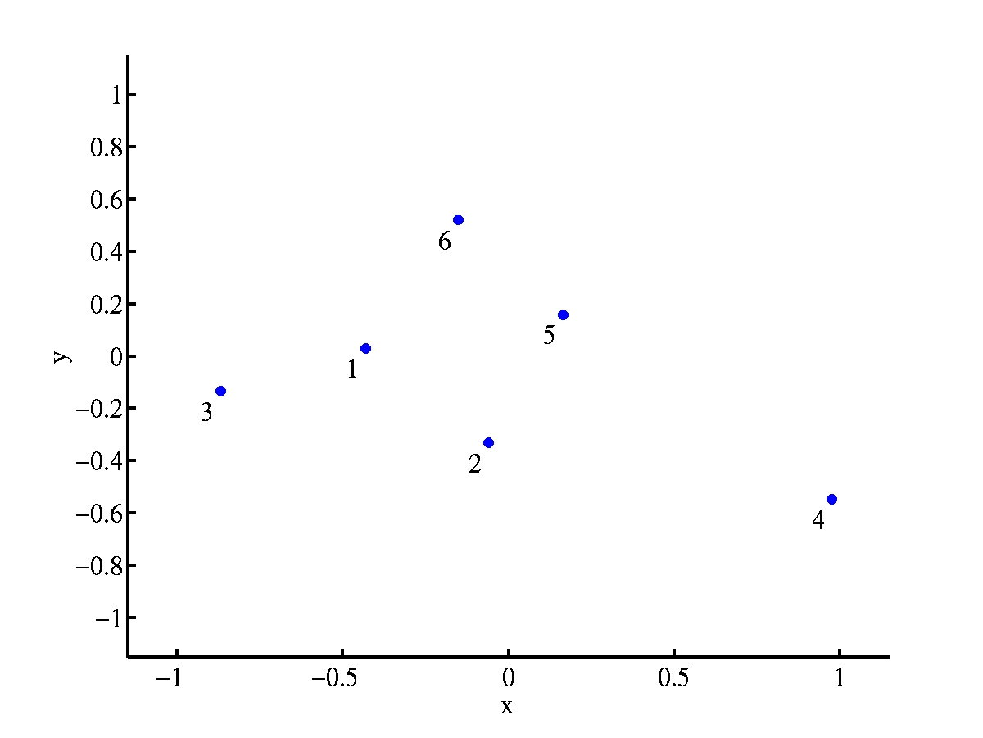
Example: Six Node Network
Capacity region is 30-dimensional

Slide 17
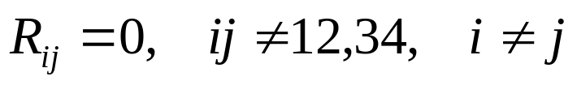
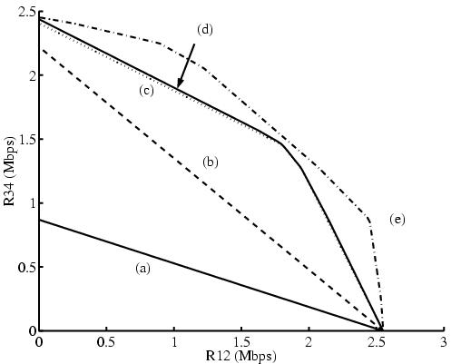
Capacity Region Slice
(6 Node Network)
(a): Single hop, no simultaneous
transmissions.
(b): Multihop, no simultaneous
transmissions.
(c): Multihop, simultaneous
transmissions.
(d): Adding power control
(e): Successive interference
cancellation, no power
control.
Multiple
hops
Spatial
reuse
SIC
Extensions:
- Capacity vs. network size
- Capacity vs. topology
- Fading and mobility
- Multihop cellular

Slide 18
Is a capacity region all we need to design networks?
Yes, if the application and network design can be decoupled
Application metric: f(C,D,E):
(C*,D*,E*)=arg max f(C,D,E)
Capacity
(C*,D*,E*)
Delay
If application and network design are
coupled, then cross-layer design needed
Energy

Slide 19
Crosslayer Design in Ad-Hoc Wireless Networks
Application
Network
Access
Link
Hardware
Substantial gains in throughput, efficiency, and end-to-end performance from cross-layer design
Notes:
Interdisciplinary research, design, and development very challenging, but necessary to meet the requirements of future wireless applications

Slide 20
Why a crosslayer design?
The technical challenges of future mobile networks cannot be met with a layered design approach.
QoS cannot be provided unless it is supported across all layers of the network.
  The application must adapt to the underlying channel and network characteristics.
  The network and link must adapt to the application requirements
Interactions across network layers must be understood and exploited.

Slide 21
Delay/Throughput/Robustness across Multiple Layers
B
A
Multiple routes through the network can be used for multiplexing or reduced delay/loss
Application can use single-description or multiple description codes
Can optimize optimal operating point for these tradeoffs to minimize distortion

Slide 22
Cross-layer protocol design for real-time media
Loss-resilient
source coding
and packetization
Application layer
Rate-distortion preamble
Congestion-distortion
optimized
scheduling
Transport layer
Congestion-distortion
optimized
routing
Traffic flows
Network layer
Capacity
assignment
for multiple service
classes
Link capacities
MAC layer
Link state information
Adaptive
link layer
techniques
Joint with T. Yoo, E. Setton,
X. Zhu, and B. Girod
Link layer

Slide 23
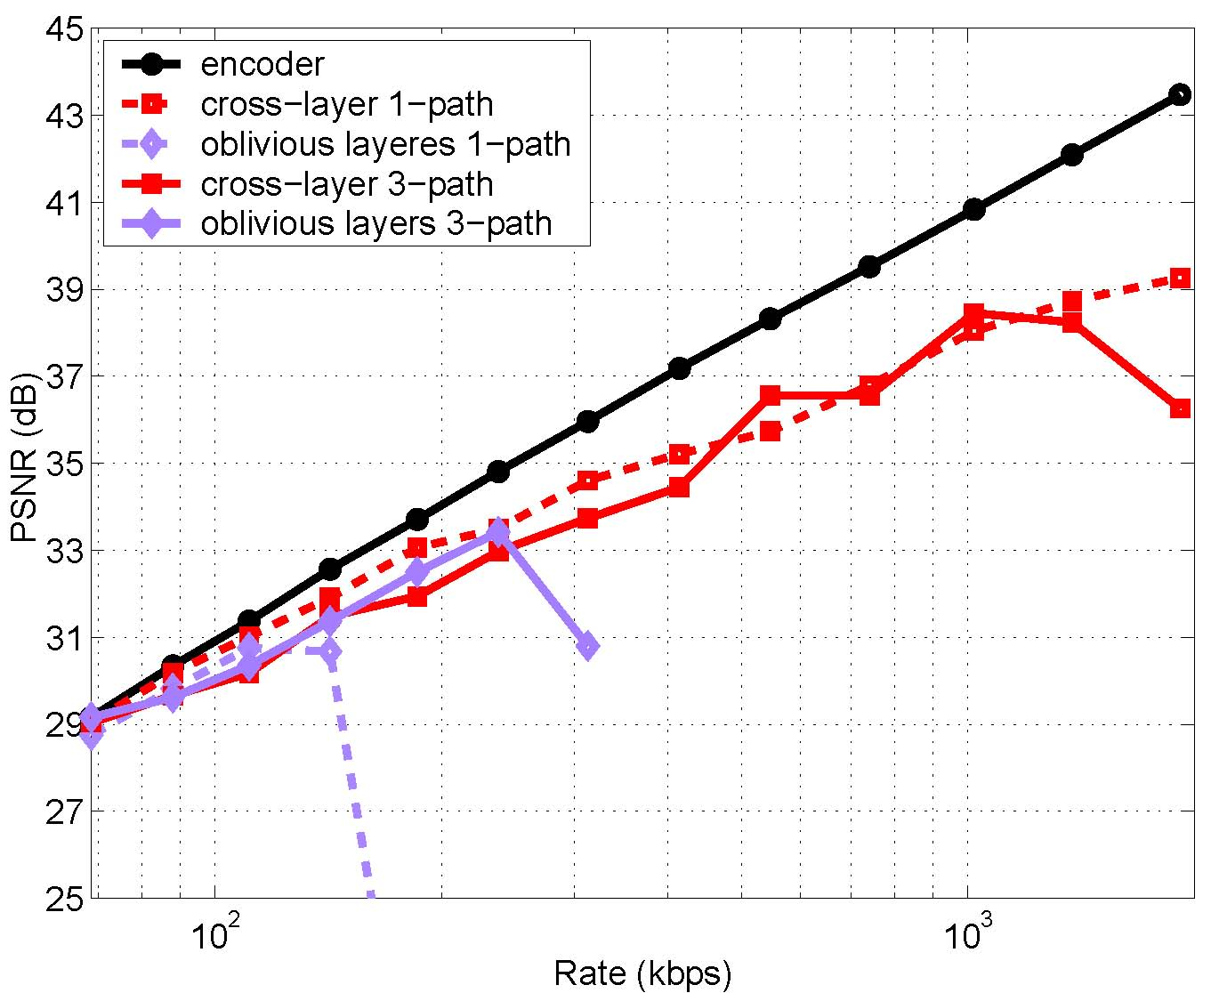
Video streaming performance
s
5 dB
3-fold increase
100
1000
(logarithmic scale)

Slide 24
Approaches to Cross-Layer
Resource Allocation*
Network
Optimization
Dynamic
Programming
Network Utility
Maximization
Distributed
Optimization
Game
Theory
State Space
Reduction
Wireless NUM
Multiperiod NUM
Distributed
Algorithms
Mechanism Design
Stackelberg Games
Nash Equilibrium
*Much prior work is for wired/static networks

Slide 25
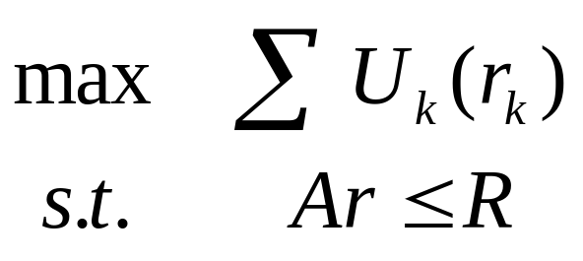
Network Utility Maximization
Maximizes a network utility function
Assumes
  Steady state
  Reliable links
  Fixed link capacities
Dynamics are only in the queues
flow k
routing
Fixed link capacity
U₁(r₁)
R_{i}
U₂(r₂)
R_{j}
U_{n}(r_{n})
Notes:
1 NUM views network protocols as optimization algorithms
2 Underlying problem is…
2.1 max the sum of the utilities
2.2 sum of the flows across a link cannot exceed the capacity of the link

Slide 26
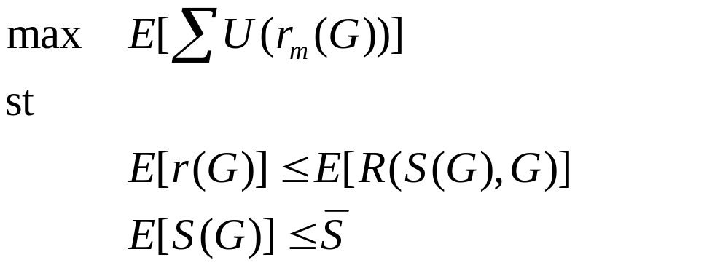
Wireless NUM
Extends NUM to random environments
Network operation as stochastic optimization algorithm
user
video
Upper
Layers
Physical
Layer
Upper
Layers
Upper
Layers
Physical
Layer
Physical
Layer
Upper
Layers
Upper
Layers
Physical
Layer
Physical
Layer
Stolyar, Neely, et. al.
Notes:
The highlighted points are the keys
Dwell on rate/rel/delay tradeoffs

Slide 27
WNUM Policies
Control network resources
Inputs:
  Random network channel information G^{k}
  Network parameters
  Other policies
Outputs:
  Control parameters
  Optimized performance, that
  Meet constraints
Channel sample driven policies
Notes:
The policies are functions or algorithms
The inputs are channel state and other parameters set by the network operator
The lagrange multipliers are Markov

Slide 28



Example: NUM and
Adaptive Modulation
Policies
  Information rate
  Tx power
  Tx Rate
  Tx code rate
Policy adapts to
  Changing channel conditions
  Packet backlog
  Historical power usage
Data
Data
Data
Upper
Layers
Upper
Layers
Buffer
Buffer
Physical
Layer
Physical
Layer
Block codes used
Notes:
Simplest model for illustration of concepts:
Multiple users over a single link
Each is buffered before going over the link
The link uses block codes at rate 0<code rate<1
System adjusts code rate, power, and tx rate to maximize user satisfaction

Slide 29
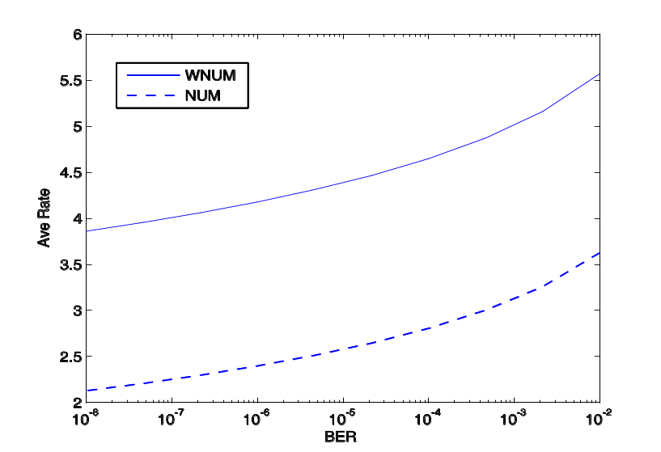
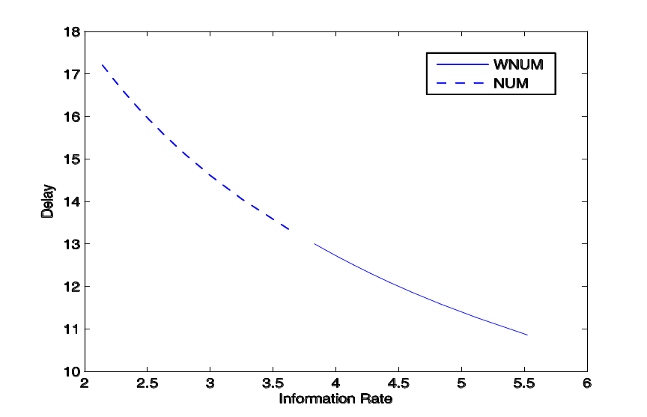
Rate-Delay-Reliability
Policy Results
Notes:
WNUM –with no codes used- offers superior performance.
The rate delay curve illustrates this best.

Slide 30
Game theory
Coordinating user actions in a large ad-hoc network can be infeasible
Distributed control difficult to derive and computationally complex
Game theory provides a new paradigm
  Users act to “win” game or reach an equilibrium
  Users heterogeneous and non-cooperative
  Local competition can yield optimal outcomes
  Dynamics impact equilibrium and outcome
  Adaptation via game theory

Slide 31
Limitations in theory of ad hoc networks today
Wireless
Information
Theory
Wireless
Network
Theory
B. Hajek and A. Ephremides, “Information theory and communications
networks: An unconsummated union,” IEEE Trans. Inf. Theory, Oct. 1998.
Optimization
Theory
  Shannon capacity pessimistic for wireless channels and intractable for large networks
  Large body of wireless (and wired) network theory that is ad-hoc, lacks a basis in fundamentals, and lacks an objective success criteria.
  Little cross-disciplinary work spanning these fields
  Optimization techniques applied to given network models, which rarely take into account fundamental network capacity or dynamics
Notes:
Control theory here is not blue, the success criteria is not blue since can’t solve problems that don’t fit the math

Slide 32
Consummating Unions
Wireless
Information
Theory
Wireless
Network
Theory
Menage a Trois
Optimization
Game Theory,…
When capacity is not the only metric, a new theory is needed to deal with nonasymptopia (i.e. delay, random traffic) and application requirements
  Shannon theory generally breaks down when delay, error, or user/traffic dynamics must be considered
Fundamental limits are needed outside asymptotic regimes
Optimization, game theory, and other techniques provide the missing link
Notes:
Bob’s comments:
Wireless information theory has attacked too many problems
Control and optimization has been too focused on the math, and not on problems that don’t fit the math.

Slide 33
Summary
Capacity of wireless ad hoc networks largely unknown, even for simple canonical models.
Scaling laws, degrees of freedom (interference alignment) and other approximations promising
Capacity not the only metric of interest
Cross layer design requires new tools such as optimization and game theory
Consummating unions in ad-hoc networks a great topic of research

Slide 34
Presentation
“Mobility Increases the Capacity of Ad-hoc Wireless Networks”
Authors: Grossglauser and Tse.
Appeared in IEEE INFOCOM 2001
  journal version in ACM/IEEE Trans. Networking
Presented by Chris

