Slide 1
Paper Presentation by Jeff Mounzer
Principles and Protocols for Power Control in Wireless Ad Hoc Networks
Authors: Vikas Kawadia and P.R. Kumar
Published in:
IEEE Journal on Selected Areas in Communications, January 2005

Slide 2
Presentation Outline
Motivation for studying power control
Power control and the protocol stack
Design considerations for power control at the network layer
The COMPOW and CLUSTERPOW protocols
Performance evaluation results
Concluding thoughts

Slide 3
Excerpt from 802.11 Standard (2012)
10.8.6 Adaptation of the transmit power
“A STA may use any criteria, and in particular any path loss and link margin estimates, to dynamically adapt the transmit power for transmissions of an MPDU to another STA. The adaptation methods or criteria are beyond the scope of this standard.”

Slide 4
Why is power control interesting?
It impacts every aspect of wireless network performance
  Physical layer
  MAC layer
  Network layer
  Even transport layer
We don’t know how to do it yet
  We don’t even know what layer it should belong to (if any at all)

Slide 5
Power Control & the Protocol Stack
Transmit power affects SINR
  Affects the physical layer
Transmit power causes interference for others
  Affects the MAC layer
Transmit power determines transmission range
  Affects the network layer
* And all of these indirectly affect the transport layer via congestion

Slide 6
Power Control at the MAC Layer
Extensive literature in this space
Foschini-Miljanic algorithm is classic example
Many flavors (e.g., interference as noise, with interference cancellation, centralized, decentralized, single channel, multiple channels…)

Slide 7
Is cross-layer design worth it?
These authors advise caution
  Once layering is broken, can no longer design protocols in isolation
  Cross-layer design can create loops
  Some interactions can’t be foreseen
  “Law of unintended consequences”
Many others: yes!
  Since power control so clearly cuts across multiple layers of the protocol stack, significant performance gains are possible (theoretically)

Slide 8
Power Control at the Network Layer
Central argument of this paper is that power control should be at the network layer
Why?
  Leaving power control at MAC layer does not give routing protocol ability to determine optimal next hop

Slide 9
Power Control at the Network Layer
General approaches
  Topology control
    Power control timescale is much slower than routing update timescale
  Energy efficiency & “power-aware” routing
    Optimize energy consumption (sleeping, etc.)
    Determine routing by associating power-based metrics with routing protocols
This paper explores per-packet power control at the network layer to maximize spatial reuse

Slide 10
Design Principles for Network Layer Power Control
“To increase network capacity, it is optimal to reduce the transmit power level.”
Transmissions cause interference
Area of interference proportional to r², while relaying burden (# hops) proportional to (1/r)
  Implies that reducing transmit power increases capacity, as long as network stays connected

Slide 11
Design Principles for Network Layer Power Control
“Reducing the transmit power level reduces average contention at MAC layer.”
Net radio traffic in contention range is proportional to r, so we want to minimize r

Slide 12
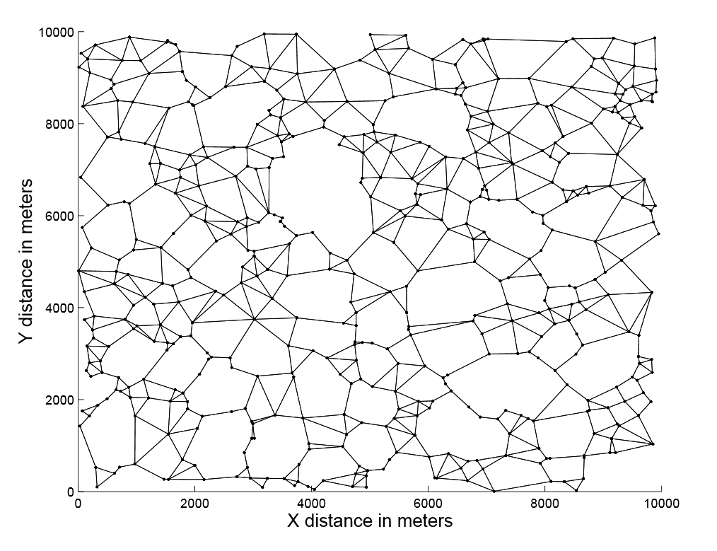
Design Principles for Network Layer Power Control
“Using low power levels is broadly commensurate with energy-efficient routing for commonly used inverse power law path loss models”
Power optimal route between any pair of nodes can be chosen to be planar

Slide 13
Design Principles for Network Layer Power Control
“When the traffic load in the network is high, a lower power level gives lower end-to-end delay, while under low load a higher power gives lower delay.”
At each hop, a packet experiences processing delay, propagation delay, and queuing delay
Processing delay grows ~ linearly in # of hops, therefore is inversely proportional to transmit range (higher power is better)
Queuing delay depends on accessibility of medium (lower power is better)

Slide 14
COMPOW Protocol
Optimization objectives:
  Choose common power level
  Set power level equal to lowest value which keeps network connected
Advantages
  Bidirectionality of links (so MAC and network layers work properly)
  Under homogeneous spatial distribution, common power level does not decrease capacity by too much
Architecture
  Each node builds multiple independent routing tables, one for each admissible power level
  Through communication between nodes, lowest common power level for connectivity is determined via these routing tables

Slide 15
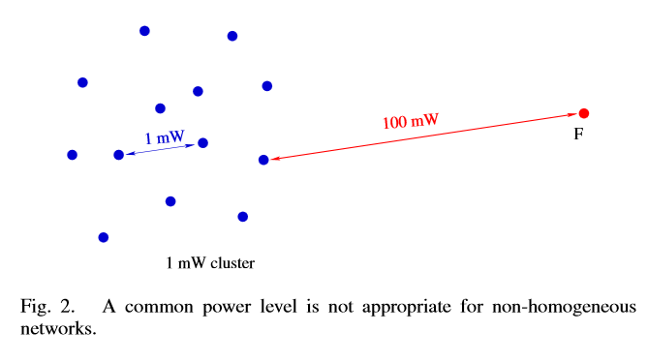
Problem with COMPOW

Slide 16
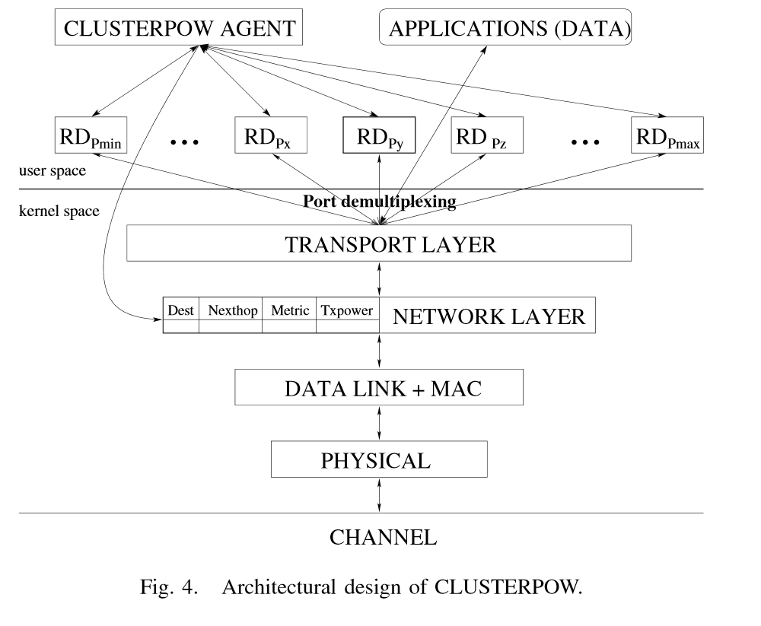
CLUSTERPOW
Same concept of maintaining a routing table at each transmit power level
If a node further downstream knows how to reach the destination using a lower power level, then it uses that level for forwarding the packet
Loops prevented by not allowing power to increase

Slide 17
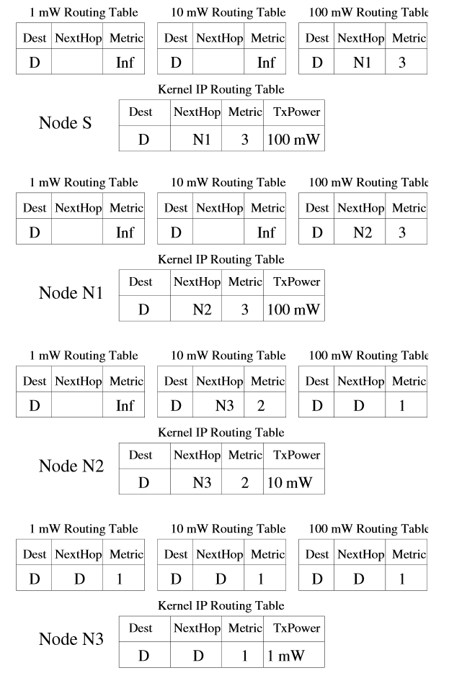
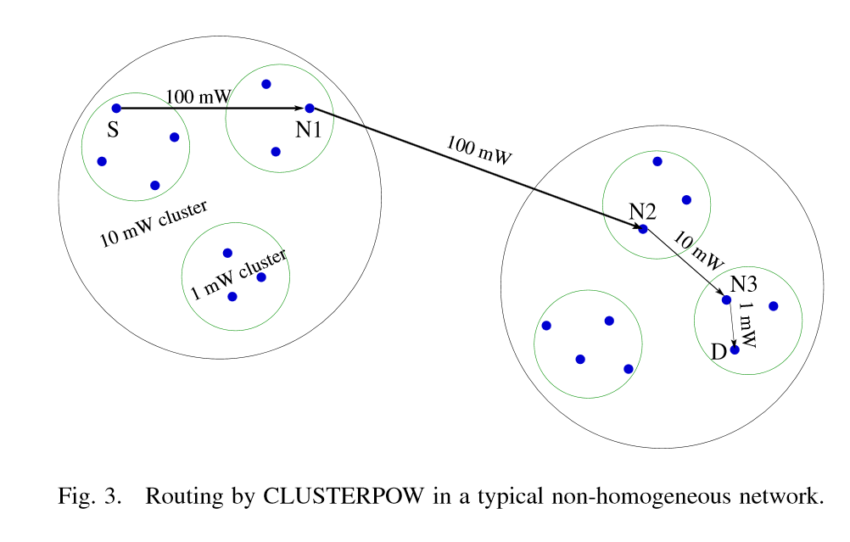
CLUSTERPOW Example

Slide 18
CLUSTERPOW Properties
Provides implicit/adaptive/distributed clustering through transmit power (no centralized control or cluster-head required)
Can be used with any routing protocol
Is provably loop-free
*Source code is available online.

Slide 19
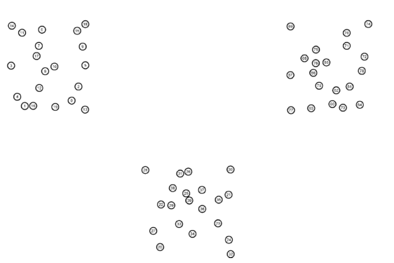
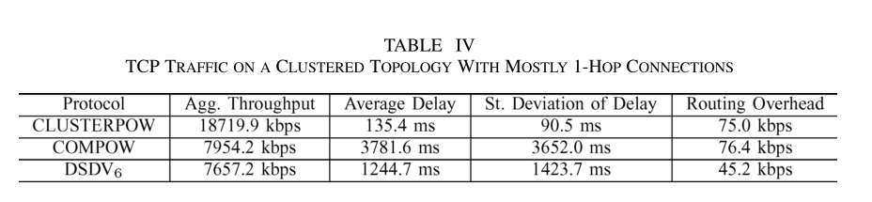
Performance of COMPOW and CLUSTERPOW
Simulated via NS2 (code available online)

Slide 20
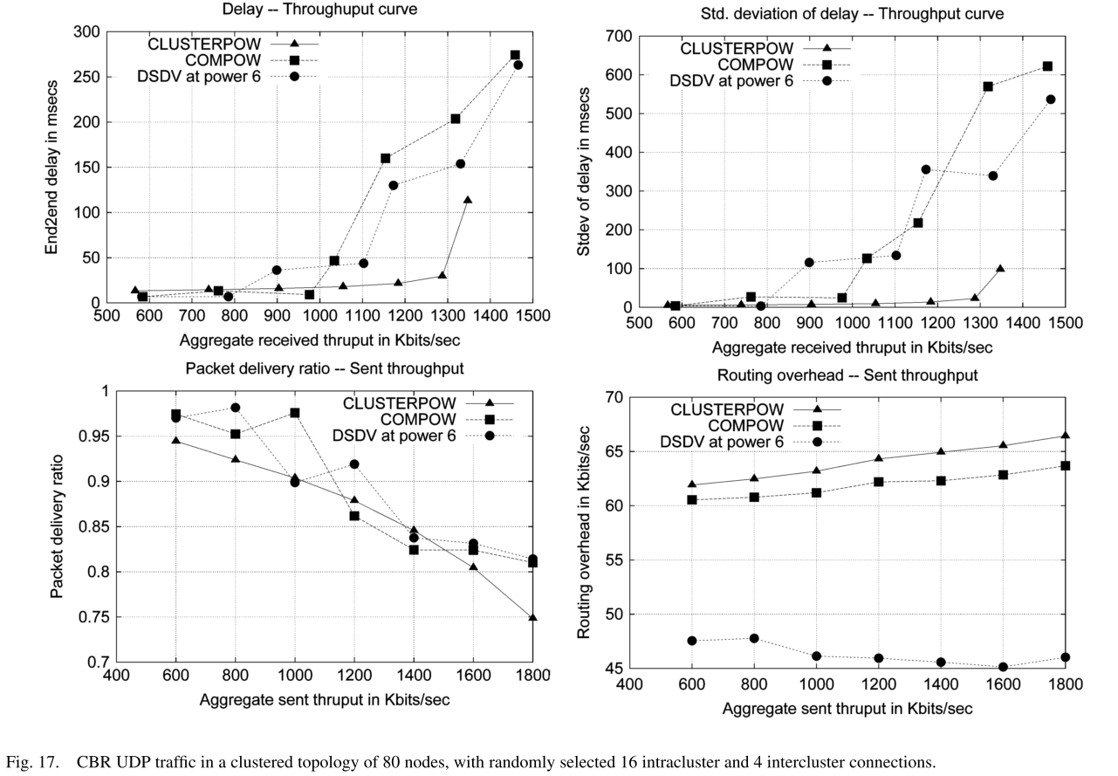
Performance of COMPOW and CLUSTERPOW

Slide 21
Additional Protocols
Tunneled CLUSTERPOW: Reduces transmit power compared to CLUSTERPOW, requires additional overhead
MINPOW: Globally optimizes total energy consumption (through essentially distributed Bellman-Ford)
LOADPOW: Adapts transmit power to network load – uses higher transmit power when load is low, and lowers power as load increases. Has elements of a MAC-layer protocol.

Slide 22
Some Unresolved Issues
How do these algorithms interact with the MAC layer?
  Probably not very well…
Latency increases with large number of hops
Adapting these power control algorithms to network load
  LOADPOW is a first step
Experimental performance evaluations not possible due to hardware limitations, even though software architectures were designed

Slide 23
Summary
Power control affects the physical, data link, and network layers in different ways
  So where should it be situated? The answer appears to be “it depends.”
If situated at network layer, power control should generally aim for low power that maintains connectivity
COMPOW, CLUSTERPOW, etc., have nice properties for ad hoc networks and can improve their performance

Slide 24
Appendix A: Link Bidirectionality
Different power levels can create unidirectional links
Bidirectionality assumed in definition of “neighbor” in many routing protocols, like Bellman-Ford
MAC protocols like 802.11 implicitly rely on bidirectionality
Many protocols employ route reversals

Slide 25
Additional References
S. Narayanaswamy et al., “Power control in ad hoc networks: theory, architecture, algorithm, and implementation of the COMPOW protocol,” Proc. Eur. Wireless Conf., pp. 156-162, 2002.
V. Kawadia and P.R. Kumar, “Power control and clustering in ad hoc networks,” Proc. IEEE INFOCOM, pp. 459-469, 2003.
V. Kawadia and P.R. Kumar, “A cautionary perspective on cross-layer design,” IEEE Wireless Communications Magazine., 2003.

