Slide 1

Multiantenna-Assisted Spectrum Sensing for Cognitive Radio
Wang, Pu, et al. Vehicular Technology, IEEE Transactions on 59.4 (2010): 1791-1800
Christina Apatow
Stanford University EE360
Professor Andrea Goldsmith

Slide 2
Presentation Outline
Introduction
    Spectrum Sensing Cognitive Radio
    Single Antenna Detectors
System Model
Performance Analysis
Concluding thoughts

Slide 3

Introduction
The Importance of This Research
Previous work
Notes:
----- Meeting Notes (3/3/14 07:51) -----
Before we get started would you expect spectrum sensing to be part of:
underlay/interweave/overlay?

Slide 4
Spectrum Sensing Cognitive Radio
The most critical function of cognitive radio
Consider the radio frequency spectrum
    Spectrum is (…still…) scarce
    Utilization rate of licensed spectrum in U.S. is 15-85% at any time/location
Detect and utilize unused spectrum (“white space”) for noninvasive opportunistic channel access
Applications
    Emergency network solutions
    Vehicular communications
    Increase transmission rates and distances
Notes:
-CR techniques in general increase system capacity
-With proper power allocation by the primary users the secondary users can reach max achievable rates

Slide 5
Power
Frequency
Time
Spectrum Holes!
Spectrum Occupied by Primary Users

Slide 6
Single Antenna Detection
Matched Filter Detection
    Requires knowledge of primary user (e.g. modulation type, pulse shaping, synchronization info)
    Requires that secondary CR user has a receiver for every primary user
Cyclostationary Feature Detection
    Must know cyclic frequencies of primary signals
    Computationally Complex
Energy Detection
    No information of primary user signal
    Must have accurate noise variance to set test threshold
    Sensitive to estimation accuracy of noise → subject to error (e.g. environmental, interference)
Notes:
Much of previous work has been using single antenna detection
Energy Detection is preferred because it doesn’t require any knowledge of primary user signal
--Robust to unknown channels

Slide 7
The Limiting Factor
Estimation of Noise Variance
Notes:
Much of previous work has been using single antenna detection
Energy Detection is preferred because it doesn’t require any knowledge of primary user signal
--Robust to unknown channels

Slide 8
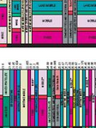
System Model
Multiantenna Cognitive radio

Slide 9
Multiantenna System Model
Single PU Signal to Detect
Primary User
MISO Secondary User
No longer require TX signal or noise variance knowledge
Notes:
Mitigate issues stemming from estimation of noise variance
-hope to exploit signal structure (rank 1 covariance matrix)

Slide 10
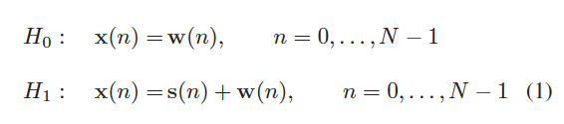
Spectrum Sensing Problem
Formulated according to simple binary hypothesis test:
Where,
x(n) → MISO baseband equivalent of nth sample
s(n) → nth sample of primary user signal seen at RX
w(n) → complex Gaussian noise independent of s(n), unknown noise variance
Notes:
H_0 → hypothesis that there exists only noise and no signal
H_1 → both noise and signal

Slide 11

Generalized Likelihood Ratio Test
Notes:
As implied in name- take ratio of likelyhood functions of H1 over H2
X → [x(0), x(1), …x(N-1)]
h → covariance matrix
Sigma → noise variance

Slide 12



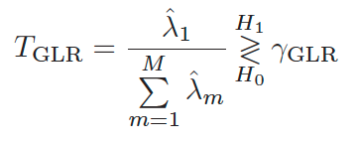
Generalized Likelihood Ratio Test for Spectrum Sensing
ML estimates
    MISO channel coefficient
    Noise variance
Yield GLRT Statistic:
Notes:
This statistic is a Ratio of largest eigenvalue to the sum of eigenvalues of the sample covariance matrix
Gamma_GLR is the threshold determined from a given probability of false alarm

Slide 13

Performance Analysis
Comparison between various Multiantenna-Assisted Spectrum Sensing Models

Slide 14

Simulation Comparables
ED-U
    Multichannel case
    “U” → Noise uncertainty
MME
    GLRT scheme based on known noise variance
    Replaces noise variance by smallest eigenvalue of the sample covariance matrix
AGM
    Computes eigenvalues of a sample covariance matrix
    Compares to threshold from probability of false alarm
Notes:
ED-U- energy detection with uncertainty
MME- Maximum to Minimum Eigenvalue Ratio Detector
AGM – Arithmetic to Geometric mean (Under rank 1, reduces to MME detector)
Computes eigenvalues of a sample covariance matrix
Compares to threshold from probability of false alarm

Slide 15
Simulation Assumptions
Independent BPSK
M = 4
Primary User
MISO Secondary User
Probability of false alarm, P_{f} =0.01
Covariance matrix for receiving signal is rank 1
Independent Rayleigh fading channels
Notes:
Mitigate issues stemming from estimation of noise variance
-hope to exploit signal structure (rank 1 covariance matrix)

Slide 16
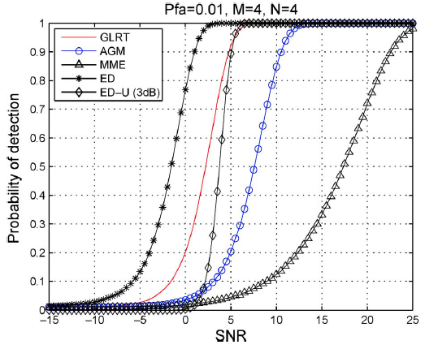
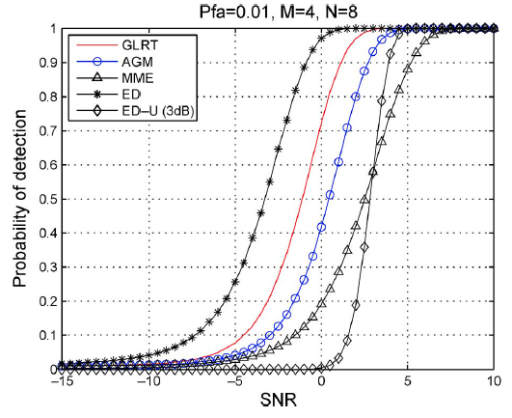
Performance Comparison of Detection Methods
With less samples, GLRT is significantly better
Notes:
ED-U- energy detection with uncertainty
MME- Maximum to Minimum Eigenvalue Ratio Detector
GLRT scheme based on known noise variance
Replaces noise variance by smallest eigenvalue of the sample covariance matrix
AGM – Arithmetic to Geometric mean (Under rank 1, reduces to MME detector)
Computes eigenvalues of a sample covariance matrix
Compares to threshold from probability of false alarm

Slide 17
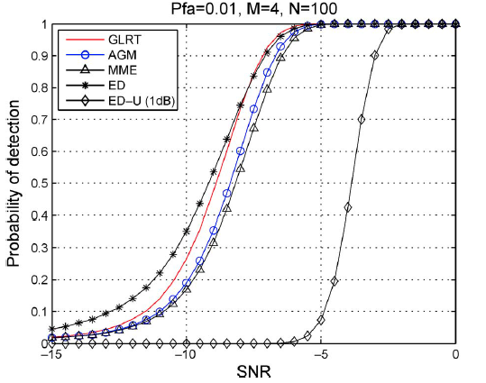
Performance Comparison of Detection Methods
GLRT has marginal performance gain with N=100 samples

Slide 18
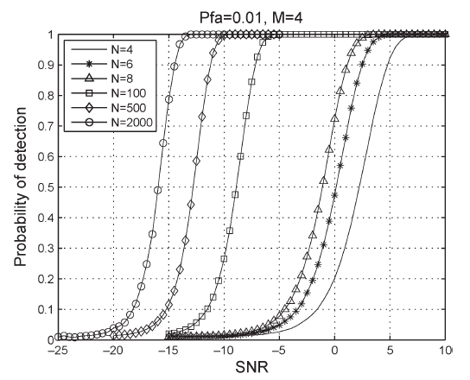
Investigating Impact of Number of Samples, N
As expected, probability of detection increases with N
Notes:
This statistic is a Ratio of largest eigenvalue to the sum of eigenvalues of the sample covariance matrix
Gamma_GLR is the threshold determined from a given probability of false alarm

Slide 19
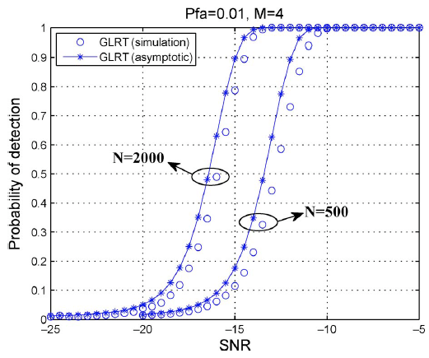
Asymptotic vs Simulated Performance of GLRT
Asymptotic results provide close prediction of detection performance of GLRT
Notes:
Considered the asymptotic distribution of the log-GLRT statistic in terms of a central chi-square distribution
With 2M-1 degrees of freedom

Slide 20

Conclusions
Moving forward

Slide 21
Conclusions
GLRT provides better performance than all other methods for every case of N samples
    Significantly better for less samples
  Model can reduce number of samples required or improve performance with a fixed number of samples

Slide 22
Future Work
Determine a model for general covariance matrix rank
Investigate channels that vary quickly w.r.t. sample time

Slide 23
Questions?

