Slide 1
EE360 presentation
On “Mobility Increases the Capacity of Ad-hoc Wireless Networks”
By Matthias Grossglauser, David Tse
IEEE INFOCOM 2001
Chris Lee
02/07/2014

Slide 2
Presentation Outlines
Main Ideas
Model and Assumptions
Analysis Summary
Simulations
Contributions
Thoughts

Slide 3
Main Ideas: in fixed ad-hoc network
Previous study for a fixed ad-hoc network shows, long-range direct communication of user pairs is infeasible due to interference
  Most communication has to occur between nearest neighbors
  Each packet going through many relay nodes before reaching destination.
  Too much traffic carried by node are relay traffic, the actual useful throughput per user pair is small
  (Gupta & Kumar, IEEE Trans. Inf. Theory, March 2000)

Slide 4
Main Idea: Mobile ad-hoc network
Strategy 1: Transmit only when close to each other (no relay)
  Problem is fraction of time two nodes are near is too low
Strategy 2: Distribute the packet to as many neighbors as potential relay, but relay only once.
  Since there are many relay nodes, probability that at least one node is close is high
  Shown that average long-term throughput per pair can be kept constant even when n increases
  Suitable for application tolerate long end-to-end delays

Slide 5

Model and Assumptions
n nodes lying in a open disk, and are mobile
location of ith user is uniform, stationary, ergodic, independent and identically distributed
each node is a source for one session, a destination for another session.
each node has infinite buffers for relay.

Slide 6
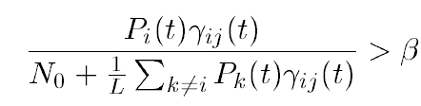

Model and Assumptions – cont.
Each node i transmit data at rate R to node j if
Beta: SIR requirement
Channel gain assumed as
Alpha: parameter greater than 2

Slide 7
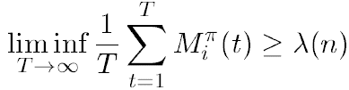
Model and Assumptions – cont.
At any time t, a scheduler chooses which nodes will be senders, and the power level Pi(t) for these senders.
Objective of scheduler is to ensure a high long-term throughput.
Will say a long-term throughput is feasible if there is a policy pi such that
M is the number of source node i packets that destination d(i) receives at t under policy pi.

Slide 8
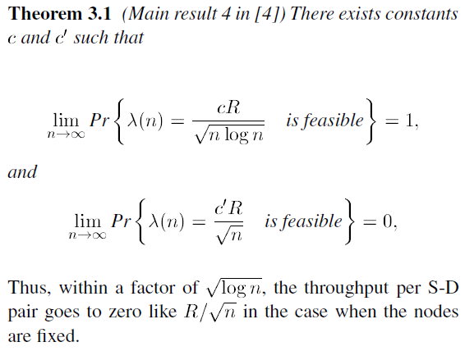
Analysis Summary – (1) fixed ad-hoc

Slide 9
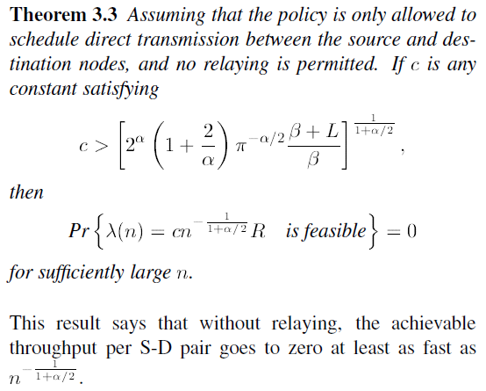
Analysis Summary – (2) mobile ad-hoc with no relay

Slide 10


Analysis Setup- (3) mobile ad-hoc with one relay

Slide 11
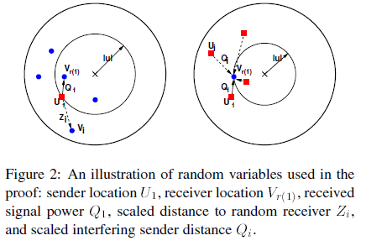

Analysis Setup- (3) mobile ad-hoc with one relay

Slide 12


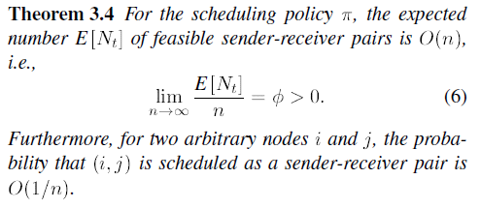
Analysis Summary- (3) mobile ad-hoc with one relay

Slide 13
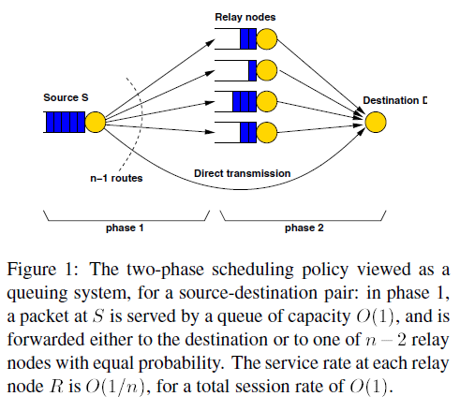

Analysis Setup- (3) mobile ad-hoc with one relay

Slide 14
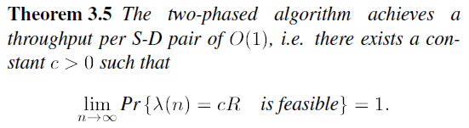
Analysis Setup- (3) mobile ad-hoc with one relay

Slide 15
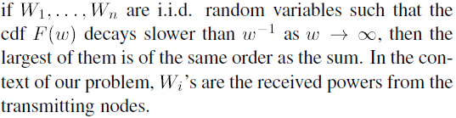
Analysis Summary - (3) mobile ad-hoc with one relay
Analysis shows we can have O(n) concurrent nearest neighbor transmission, and probability of success of any specific send-receive pair is equal at O(1/n), thus maintaining the same throughput as n increases is possible, O(1)
The reason that we can have O(n) concurrent nearest neighbor transmission, is that the receive power at the nearest neighbor is of the same order as the total interference from O(n) number of interferers.

Slide 16
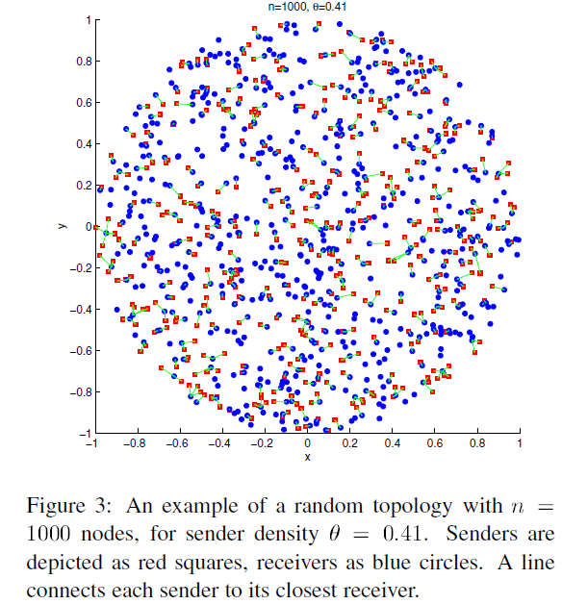
Simulations – one topology

Slide 17
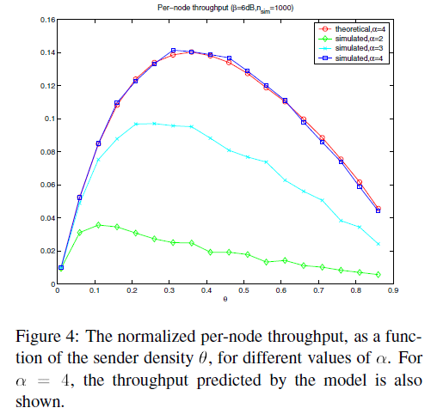
Simulations
Theta too small, did not exploit full spatial channel re-use; too large, interference too dominant

Slide 18
Contributions
Dissected the necessary ingredients and proposed a viable strategy balancing interference and relay loading
Established the theoretical limit

Slide 19
Thoughts
Uniform distribution
Requiring enough nodes
Infinite buffer
Long end-to-end delays

