Slide 1
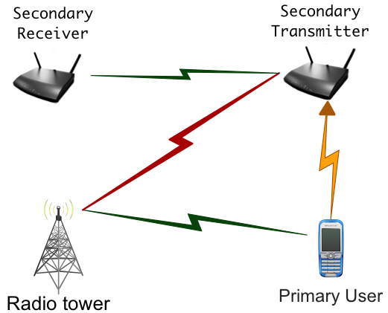


Null Space Learning in MIMO Systems
Alexandros Manolakos
Wireless Systems Laboratory
Electrical Engineering, Stanford University
Joint work with: Yair Noam and Andrea Goldsmith

Slide 2
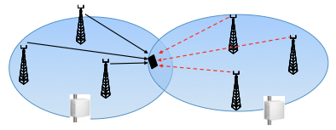
Outline
  Underlay Cognitive Radios & CoMP
Null Space Learning in Underlay MIMO Cognitive radios
  System Model
  Null Space Acquisition
  Null Space Tracking
Null Space Coherence Time
Null Space Learning in Cooperative Multipoint Networks
  System Model
  Null Space Acquisition (Homework)
  Null Space Tracking (Not in this tak)

Slide 3
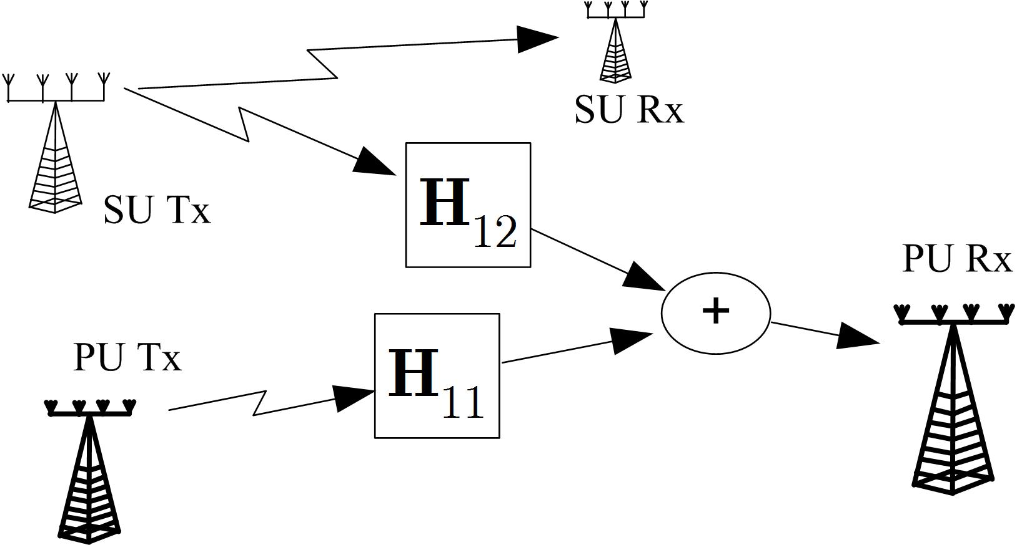
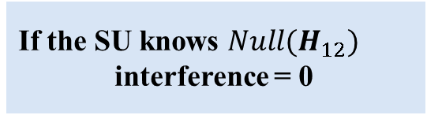
Underlay MIMO Cognitive Radios
  How to obtain the null space without cooperation
data
If the SU knows $Null(H_{12})$
interference = 0
Unlicensed user
interference
Licensed user
The Problem:
  How to obtain the null space without cooperation
Solution:
  The SU learns the null space blindly, without any cooperation, by listening the energy of the PU signal.
Compatible with current wireless systems.

Slide 4

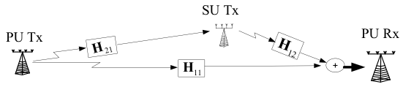
Underlay MIMO Cognitive Radios
One Transmission Cycle (TC)
Power Control
The SU-Tx choses intelligently the messages x(t)
The PU-Rx notifies PU-Tx to change its Transmit Power
The variation in the Transmit Power of the PU-Tx is sensed by the SU-Tx.
The SU-Tx chooses the next message x(t) based only on the increase or decrease of the sensed power from the PU-TX.
The whole process is only based on energy measurements

Slide 5
Underlay MIMO Cognitive Radios
Learning = Acquisition & Tracking
Power Control
Two Phases:
  Acquisition Phase:
    Iterative Algorithm
    The only information needed between iterations is where interference increased or decreased.
  Tracking Phase:
    The SU-Tx searches “around” the outdated version of the precoding matrix to find a new one.
    Allows simultaneous transmission of information to the SU-RX.

Slide 6
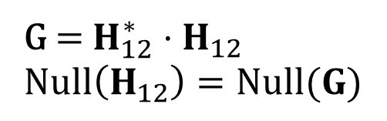
Underlay MIMO Cognitive Radios
Learning = Acquisition & Tracking
Power Control
Main Assumption : SU-Tx has more antennas than the PU-Rx, i.e. $N_{t}>N_{r}$ .
G = $H_{12}^{∗}{⋅H}_{12}$
$Null\left(H_{12}\right)=Null(G)$

Slide 7
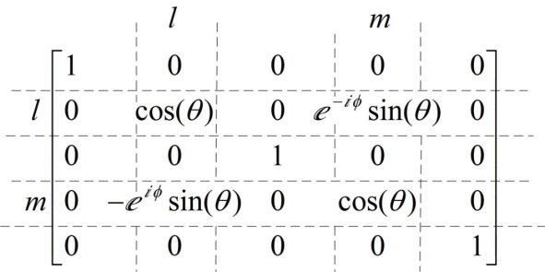

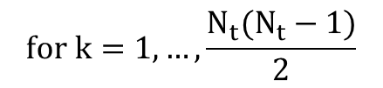



Cyclic Jacobi Technique (CJT)
Technique for Eigenvalue Decomposition
$$Calculates the EVD G=WΛW^{H} via a simple iteravite algorithm:$$
$$Set W_{0}=I$$
$$for k=1,…, \frac{{N_{t}(N}_{t}−1)}{2}$$
$W_{k+1}=W_{k}R_{l_{k},m_{k}}\left({\hat{θ}}_{k}, {\hat{ϕ}}_{k}\right)$
where
$R_{l_{k},m_{k}}\left({\hat{θ}}_{k}, {\hat{ϕ}}_{k}\right) is a rotation matrix$
${\hat{θ}}_{k}, {\hat{ϕ}}_{k} are chosen to zero {\hat{G}=W}_{k+1}G{W_{k+1}}_{}^{H} {\left(l_{k+1},m_{k+1}\right)}^{′}s entry.$
How can the SU-Tx eliminate the $\left(l_{k},m_{k}\right)$ entry of $G$ without knowing $G$?

Slide 8
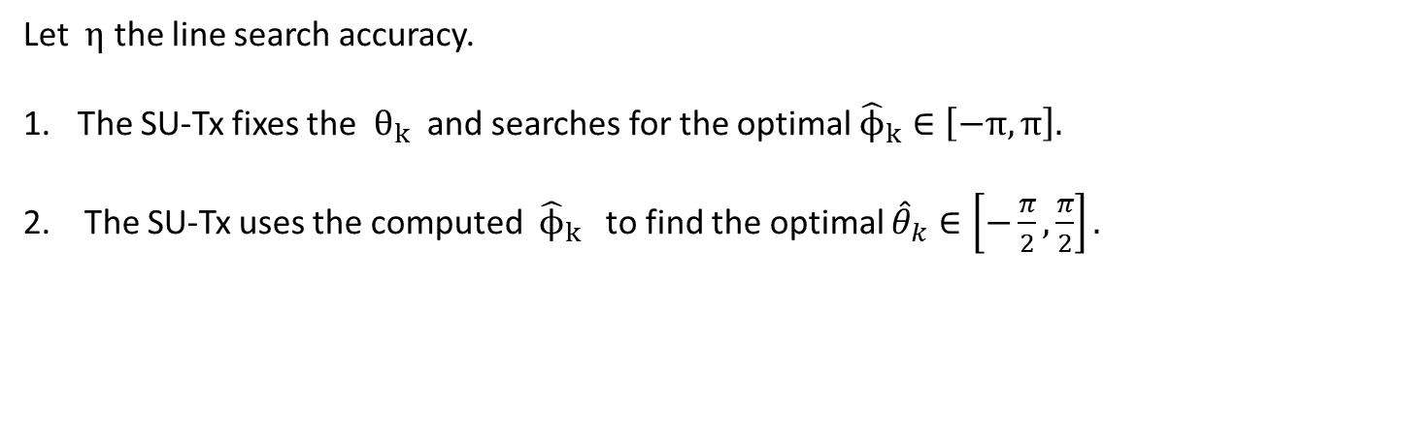
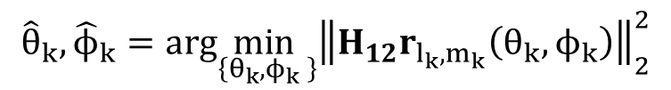
Blind Jacobi Step
Only Binary Comparisons
How can the SU-Tx eliminate the $\left(l_{k},m_{k}\right)$ entry of $G$ without knowing G?
$The values of{ \hat{θ}}_{k},{\hat{ϕ}}_{k}$ are given by:
$${\hat{θ}}_{k},{\hat{ϕ}}_{k}=arg\min_{\left\{θ_{k},ϕ_{k} \right\}}{\left\|H_{12}r_{l_{k},m_{k}}\left(θ_{k},ϕ_{k}\right)\right\|}_{2}^{2}$$
…this optimization can be done with a sequence of two line searches.
Each line search is based only on “binary comparisons”.
Let $η$ the line search accuracy.
The SU-Tx fixes the ${ θ}_{k}$ and searches for the optimal ${\hat{ϕ}}_{k}∈\left[−π,π\right].$
  2. The SU-Tx uses the computed ${\hat{ϕ}}_{k}$ to find the optimal ${\hat{θ}}_{k}∈\left[−\frac{π}{2},\frac{π}{2}\right].$

Slide 9
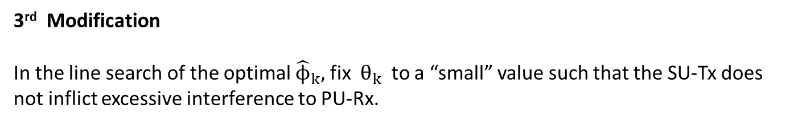
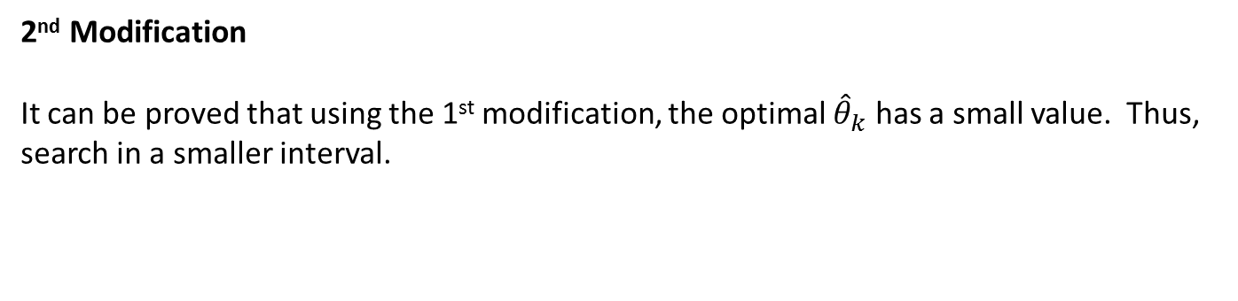
Modifications for the Tracking Algorithm
Main idea of the Tracking algorithm
1st Modification
When starting a new adaptation, do not start from the identity matrix, but from the outdated null space.
2nd Modification
It can be proved that using the 1st modification, the optimal ${\hat{θ}}_{k}$ has a small value. Thus, search in a smaller interval.
3rd Modification
In the line search of the optimal ${\hat{ϕ}}_{k},$ fix ${ θ}_{k}$ to a “small” value such that the SU-Tx does not inflict excessive interference to PU-Rx.

Slide 10

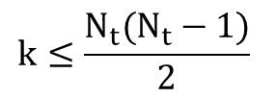







Overview of the BNST Algorithm
$$\tilde{W}\left(t\right), θ_{max},\tilde{θ},η$$
$$\tilde{W}\left(t\right), θ_{max},\tilde{θ},η$$
$$k=1$$
$$k≤\frac{N_{t}(N_{t}−1)}{2}$$
Yes
Search$\left(\tilde{W}\left(t\right)r_{l_{k},m_{k}}\left(\tilde{θ},ϕ\right),π\right)$
No
Search$\left(\tilde{W}\left(t\right)r_{l_{k},m_{k}}\left(θ,\hat{ϕ}\right),θ_{max} \right)$
$\tilde{W}\left(t+T\right)=$ $\tilde{W}\left(t\right)$
$\tilde{W}\left(t+T\right)=$ $\tilde{W}\left(t\right)⋅R_{l_{k},m_{k}}(\hat{θ},\hat{ϕ})$
$$k=k+1$$

Slide 11
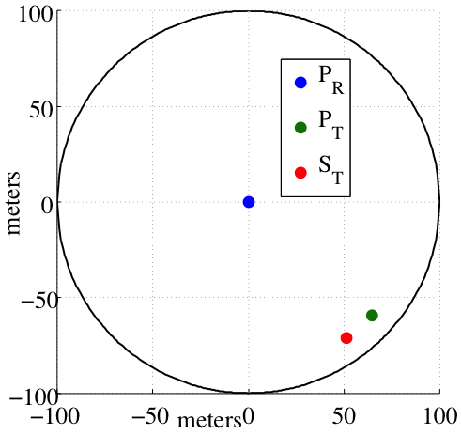
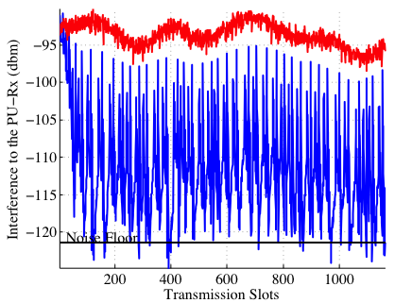
Example
Secondary transmitter (SU-Tx) performs the Null Space Algorithm.
  Red Curve: The Interference at the primary receiver (PU-Rx) without Null Space Learning.
  Blue Curve: The Interference at the PU-Rx with Null Space Learning.
  All channels have Independent Rician Fading with maximum Doppler frequency of 3 Hz and K-factor of 6. Two antennas in S_{T} and one antenna in P_{R}.

Slide 12
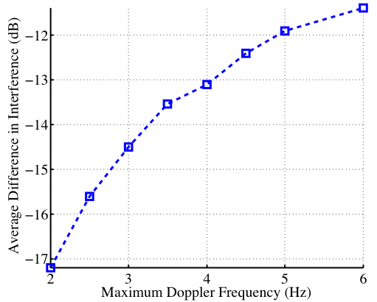
Example
Secondary transmitter (S_{T}) performs the Null Space Algorithm.
  Blue Curve: Average Interference reduction at the PU-Rx as a function of the maximum Doppler frequency.
  All channels have Independent Rician Fading with K-factor of 3. Two antennas in S_{T} and one antenna in P_{R}.

Slide 13
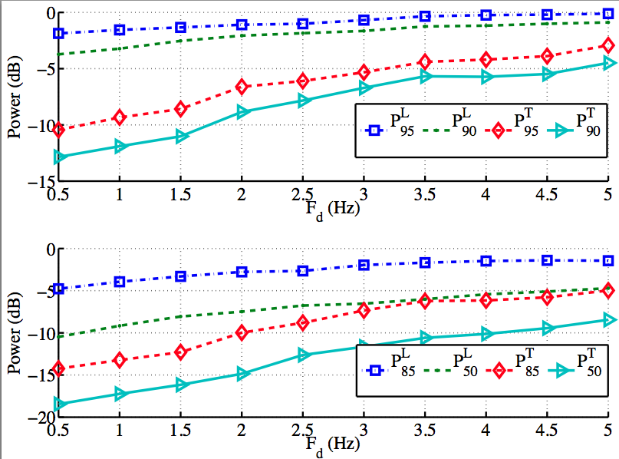
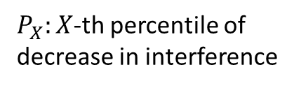

Acquisition vs Tracking
Tracking meets the Peak Interference constraints
Acquisition
Tracking
$$N_{t}=2, N_{r}=1$$
$P_{X}:X$-th percentile of decrease in interference

Slide 14
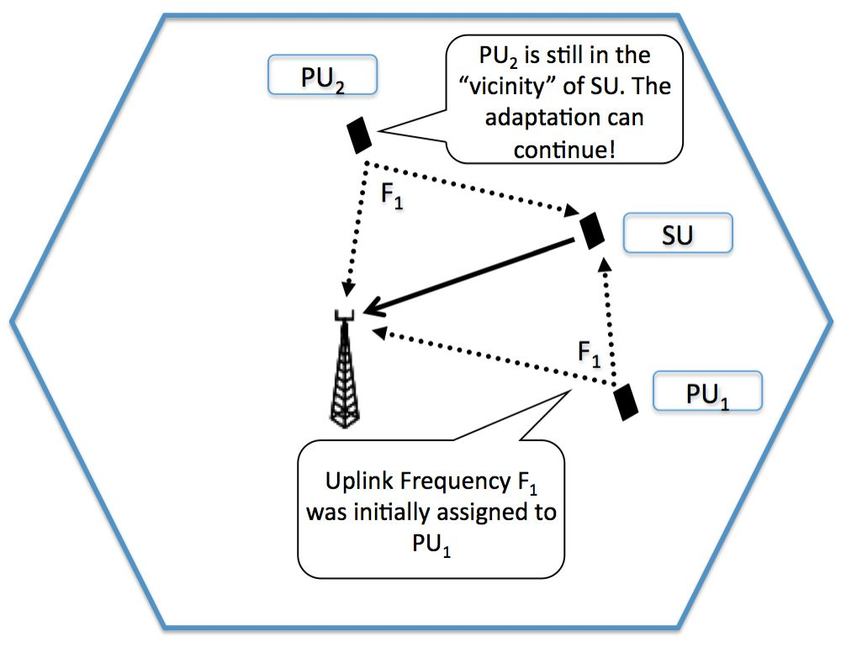
What if the PU-Rx changes Frequency?
The algorithm could still continue!
If the new user that transmits in the frequency that the SU-Tx adapts, then the adaptation will not be severely affected.

Slide 15
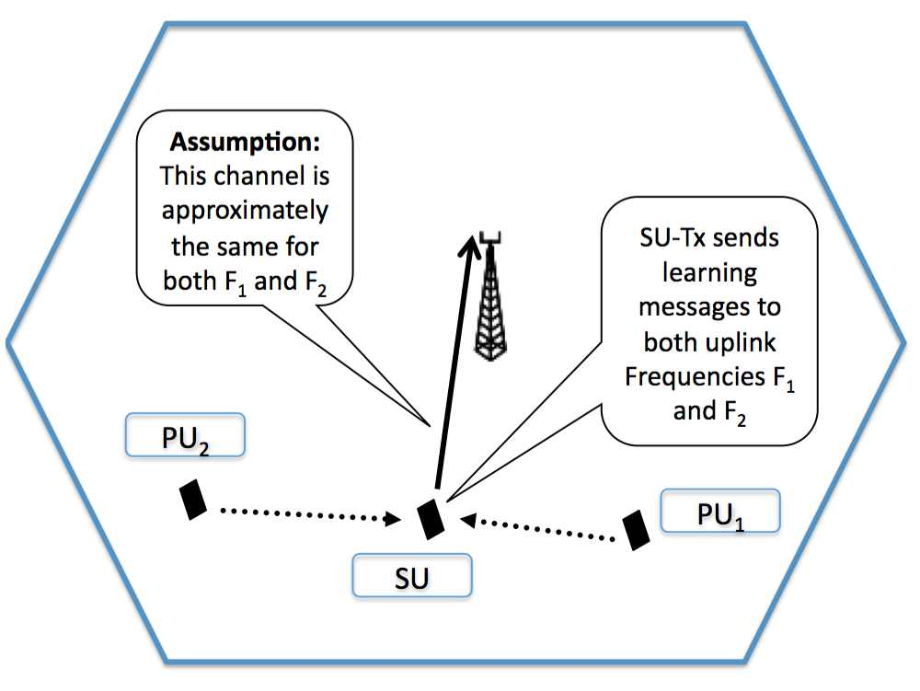
Parallel Jacobi Technique
Future Research direction
Jacobi Method can be implemented in parallel
The SU-Tx can send different learning signals to two or more frequencies.
Assumption:
Interference channels are approximately the same for different uplink frequencies.

Slide 16
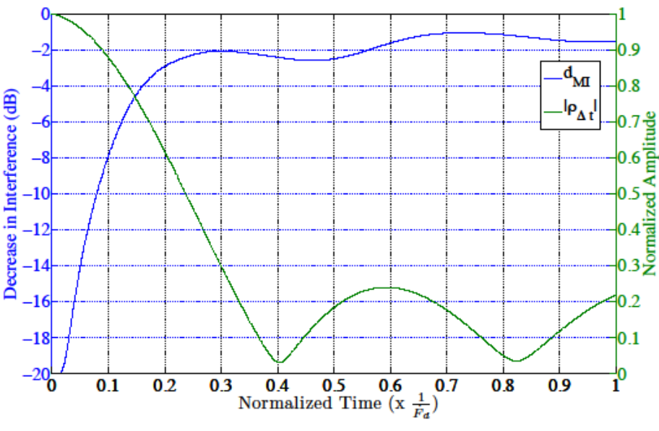

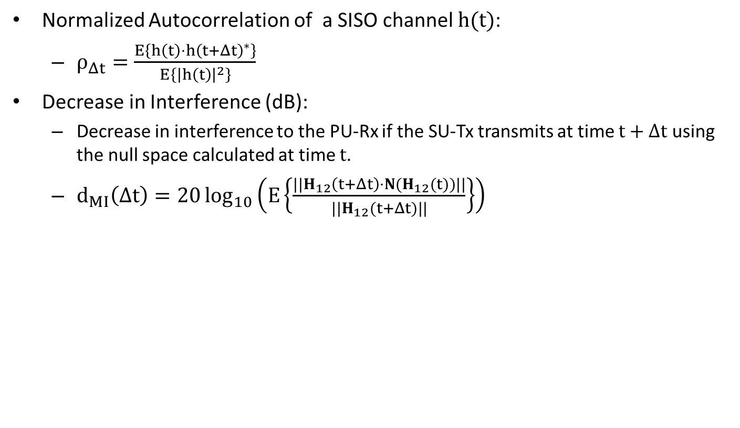
Null Space Coherence Time
Null Space changes “faster” than the channel
Normalized Autocorrelation of a SISO channel $h(t)$:
  $ρ_{Δt}=\frac{E\left\{h\left(t\right)⋅h{\left(t+Δt\right)}^{∗}\right\}}{E\left\{{\left|h\left(t\right)\right|}^{2}\right\}}$
Decrease in Interference (dB):
  Decrease in interference to the PU-Rx if the SU-Tx transmits at time $t+Δt$ using the null space calculated at time $t$.
  $d_{MI}\left(Δt\right)=20\log_{10}\left(E\left\{\frac{||H_{12}\left(t+Δt\right)⋅N(H_{12}(t))||}{||H_{12}(t+Δt)||}\right\}\right)$
Independent Rayleigh Fading using the Clarke’s model with $F_{d}=6.5 Hz.$
The null space changes faster than expected!

Slide 17
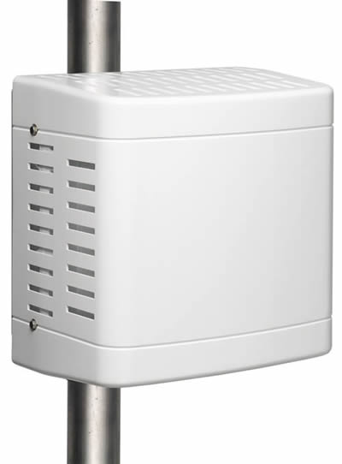
Cooperative Multipoint Networks
CoMP bottleneck: Out-of-Group Interference
eNodeB
eNodeB
Cooperative Multipoint (CoMP) has recently emerged as an important feature of LTE-A.
  CSI is typically available only inside a BSG.
  Out-of-Group interference (OGI)
poor spectral efficiency

Slide 18
One Transmission Cycle (TC)
The eNodeB forwards the interference level
BSG₁
BSG₂
UE
eNodeB
eNodeB
BSG₂ transmits a learning signal for T_{FB} seconds.
UE feeds back q(t) to BSG₁
UE calculates q(t)
BSG₁ sends q(t) to BSG₂

Slide 19
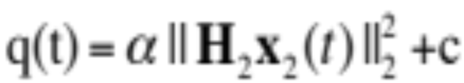
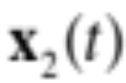



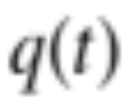


Interference Feedback
Affine function of the interference
Interference Level:
Examples
  Noise plus interference level
  SINR level
  Total received power
Interference
Computation
, c: constant during the learning process

Slide 20
Conclusions
Null Space learning in Underlay MIMO Cognitive Radios
  Cyclic Jacobi Technique and Modifications
  Only based on binary comparisons of Energy measurements
Null Space Coherence Time
  Smaller than the channel coherence time
Null Space learning in Cooperative Multipoint Networks
  The terminals only sense the interference levels
  Algorithmic complexity is on the side of the Base Stations.
Many new research directions

Slide 21

Questions?
Thank You

Slide 22





System Model
Similar System Model as before
Out of Group Interference
UE
eNodeB
eNodeB
Inter-group Communication
BSG₁
BSG₂
The received signal at UE₁:
The antennas of BSG₂ and UE₁.

Slide 23
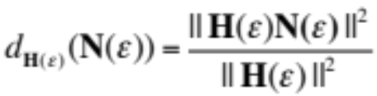
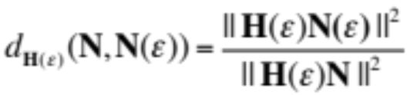

Simulation Scenarios
Independent Rayleigh Fading with Doppler Frequency F_{d} Hz.
(N_{T},N_{R})={ (6,2) , (8,1) }.
T_{FB} = 1 msec
Average OGI is 15 dB more than the noise floor.
Two performance measures
  Average decrease of the worst case interference compared to the case of no null space learning.
  Average decrease of the worst case interference before and after one algorithm sweep.
  where denotes the spectral norm.

Slide 24
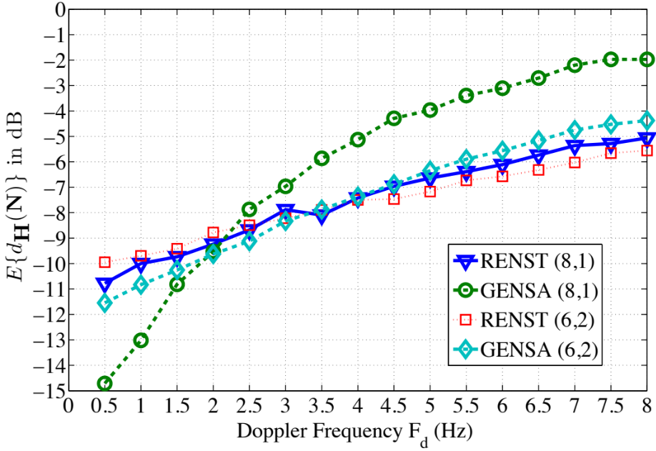
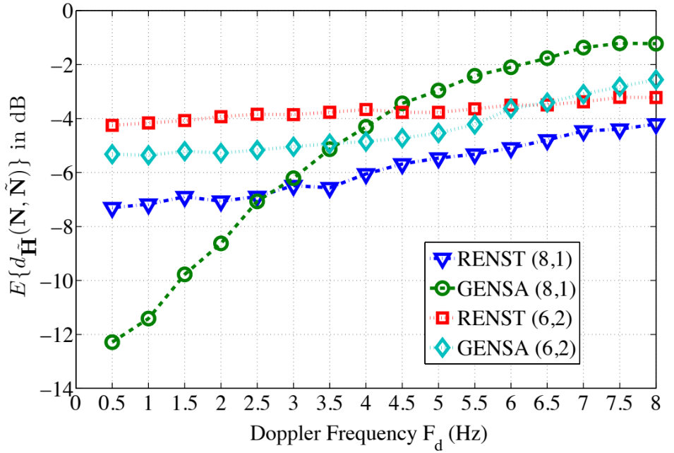
Simulation Results
  Worst case interference reduction
  Relative worst case Interference reduction
Tracking is more robust in channel variations primarily because it is faster.
  N_{T}=8, N_{R} = 1, Tracking needs 64% less TCs than learning
  N_{T}=6, N_{R} = 2, Tracking needs 32% less TCs than learning
Tracking allows for Interference control during learning

Slide 25
Modified Cyclic Jacobi Technique (CJT)
Main idea of the Acquisition algorithm
$$Calculates the EVD G=WΛW^{H} via a simple iterative algorithm:$$
$$Set W_{0}=I$$
$$for k=1,…, \frac{{N_{t}(N}_{t}−1)}{2}$$
$W_{k+1}=W_{k}R_{l_{k},m_{k}}\left({\hat{θ}}_{k}, {\hat{ϕ}}_{k}\right)$
where
$R_{l_{k},m_{k}}\left({\hat{θ}}_{k}, {\hat{ϕ}}_{k}\right) is a rotation matrix$
${\hat{θ}}_{k}, {\hat{ϕ}}_{k} are chosen to zero {\hat{G}=W}_{k+1}G{W_{k+1}}_{}^{H} {\left(l_{k+1},m_{k+1}\right)}^{′}s entry.$
How can the SU-Tx eliminate the $\left(l_{k},m_{k}\right)$ entry of $\hat{G}$ without knowing $\hat{G}$?
$${\hat{θ}}_{k},{\hat{ϕ}}_{k}=arg\min_{\left\{θ_{k},ϕ_{k} \right\}}{\left\|H_{12}r_{l_{k},m_{k}}\left(θ_{k},ϕ_{k}\right)\right\|}_{2}^{2}$$
…this optimization can be done with a sequence of two line searches.
Each line search is based only on “binary comparisons”.

Slide 26
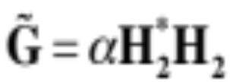
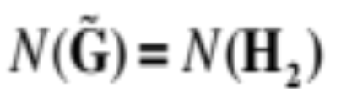




The Acquisition Algorithm
Linear System of Equations
Define
Observe
Perform as many measurements as the elements in
  TC complexity
Each TC gives a linear constraint over
the elements of
Learning is sufficient to learn (but not necessary…)

