Slide 1

ATHENA SHIRAVI, ZOYA GARG, ESHA GUPTA
A4: Concept Video
RESEARCH, STORYBOARD, CONCEPT VIDEO

Slide 2



Team Cybele
Athena Shiravi
B.A. Econ
B.S. CS
HCI Coterm
Esha Gupta
B.S. SymSys
B.A. IR
Zoya Garg
B.S. CS
B.A. Classics

Slide 3
SOLUTION
RESEARCH
Roadmap
STORY
IMPLICATIONS
VIDEO

Slide 4
We Pivoted...
Here’s what’s staying the same

Slide 5
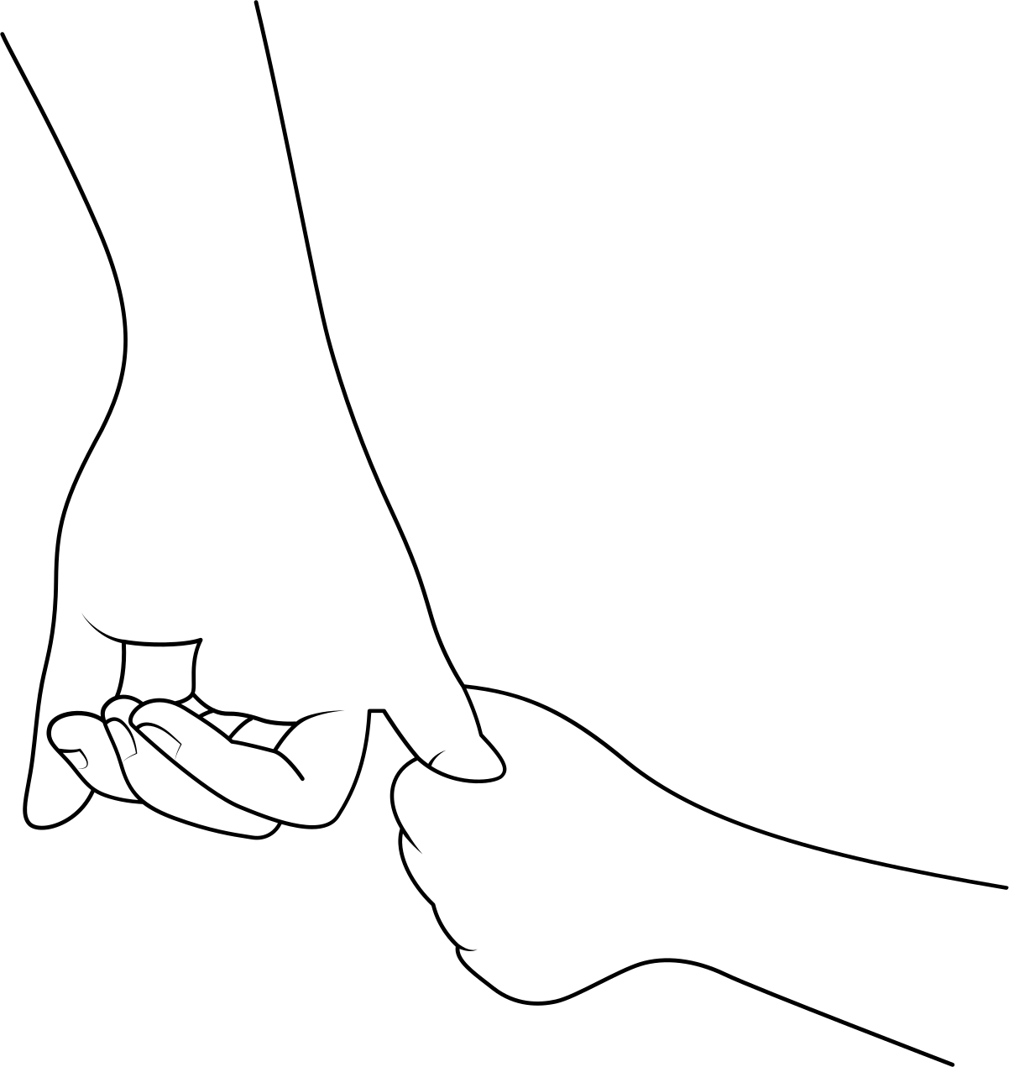
OUR PROBLEM SPACE
Working Moms
Working moms experience mental health challenges as they navigate career demands and family responsibilities, often without adequate support systems

Slide 6
OUR PROBLEM SPACE
Shared art has historically built community and helped people heal.

Slide 7
OUR PROBLEM SPACE
Shared art has historically built community and helped people heal.
(but we aren’t drawing roses anymore)

Slide 8
We Pivoted...
Here’s what’s different

Slide 9
Moms often experience moments of isolation or mental fatigue throughout the day.
Our Solution:
MUSE

Slide 10
Moms often experience moments of isolation or mental fatigue throughout the day.
An interactive, online mural to doodle on with their loved ones offers them a playful, creative outlet to express themselves and connect with others.
Our Solution:
MUSE

Slide 11
Moms often experience moments of isolation or mental fatigue throughout the day.
An interactive, online mural to doodle on with their loved ones offers them a playful, creative outlet to express themselves and connect with others.
This helps foster a sense of community and mental well-being.
Our Solution:
MUSE

Slide 12
MARKET RESEARCH
Who’s Working on This?

Slide 13
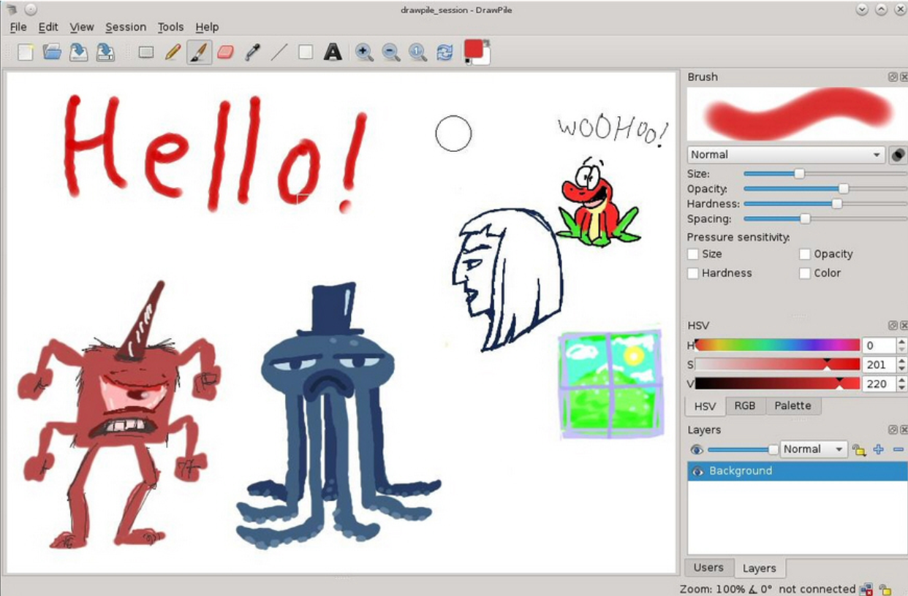
MARKET RESEARCH
DRAWPILE
PROS: EXPANSIVE TOOLSET TO USE FOR DRAWINGS
CONS: YOU HAVE DOWNLOAD SOFTWARE TO USE, OUTDATED AI, BUILT FOR ADVANCED ARTISTS

Slide 14
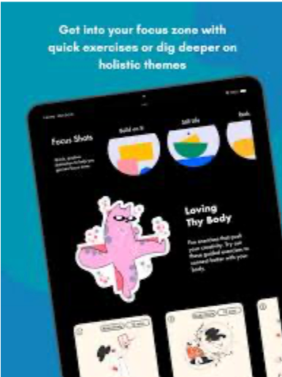
MARKET RESEARCH
GROODLES
PROS: ART THERAPY EXERCISES FROM THE GROUND UP
CONS: RESTRICTIVE DESIGNS

Slide 15

MARKET RESEARCH
HAPPYCOLOR
PROS: COLOR BY NUMBERS MINDFULNESS APP (20K USERS ALREADY)
CONS: NO COLLABORATIVE COMPONENT

Slide 16
IMPLICATIONS
What does this mean,
in practice?

Slide 17
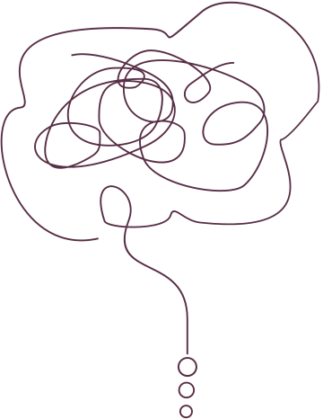
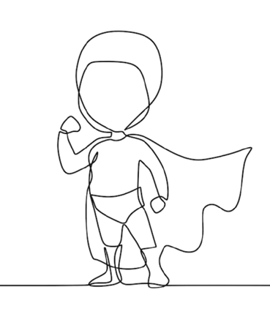
IMPLICATIONS
Our Tarot Cards
THE FORGOTTEN
Who’s left out?
THE SUPERUSER
What about your most dedicated users?

Slide 18
IMPLICATIONS
We’re neglecting moms without regular internet access, with low digital literacy, and moms with special needs.
THE FORGOTTEN
Who’s left out?

Slide 19
IMPLICATIONS
We’re neglecting moms without regular internet access, with low digital literacy, and moms with special needs.
Value Tension: between providing a creative outlet for moms and ensuring inclusivity and accessibility
THE FORGOTTEN
Who’s left out?

Slide 20
IMPLICATIONS
We’re neglecting moms without regular internet access, with low digital literacy, and moms with special needs.
Value Tension: between providing a creative outlet for moms and ensuring inclusivity and accessibility
Design Considerations:
features like voice control, high-contrast mode, or tactile feedback for users with impairments
THE FORGOTTEN
Who’s left out?

Slide 21
IMPLICATIONS
We’re neglecting moms without regular internet access, with low digital literacy, and moms with special needs.
Value Tension: between providing a creative outlet for moms and ensuring inclusivity and accessibility
Design Considerations:
features like voice control, high-contrast mode, or tactile feedback for users with impairments
Provide user-friendly interfaces, and support systems to ensure moms with lower digital literacy can participate
THE FORGOTTEN
Who’s left out?

Slide 22
IMPLICATIONS
Overuse can lead to dependency or reinforcing negative coping mechanisms -- moms may over-rely on the app and neglect offline care
THE SUPERUSER
What about your most dedicated users?

Slide 23
IMPLICATIONS
Overuse can lead to dependency or reinforcing negative coping mechanisms -- moms may over-rely on the app and neglect offline care
Value tension: between promoting regular creative expression and encouraging over-reliance
THE SUPERUSER
What about your most dedicated users?

Slide 24
IMPLICATIONS
Overuse can lead to dependency or reinforcing negative coping mechanisms -- moms may over-rely on the app and neglect offline care
Value tension: between promoting regular creative expression and encouraging over-reliance
Design Considerations:
Implement usage tracking features & gentle nudges
THE SUPERUSER
What about your most dedicated users?

Slide 25
IMPLICATIONS
Overuse can lead to dependency or reinforcing negative coping mechanisms -- moms may over-rely on the app and neglect offline care
Value tension: between promoting regular creative expression and encouraging over-reliance
Design Considerations:
Implement usage tracking features & gentle nudges
Offer suggestions for off-line community building experiences as well (eg. art shows with friends)
THE SUPERUSER
What about your most dedicated users?

Slide 26

STAKEHOLDERS & ETHICAL IMPLICATIONS
DIRECT STAKEHOLDERS
INDIRECT STAKEHOLDERS
ETHICAL IMPLICATIONS
  Moms: Users who doodle and collaborate, benefiting from creative expression and community support
  App Developers: Maintain the app, ensuring a smooth and user-friendly experience
  Mental Health Professionals: May recommend the app for emotional well-being and creative therapy
  Children and Family Members: Indirectly benefit from the moms' improved emotional well-being.
  Third-Party Services: Cloud providers or platforms hosting or sharing the collaborative boards.
  Researchers: Study insights on art therapy and digital health solutions from the app.
  Risk of over-reliance
  Privacy concerns
  Addictive design
  Data concern
  Ethical need for informed consent

Slide 27
STAKEHOLDERS & ETHICAL IMPLICATIONS
DIRECT STAKEHOLDERS
INDIRECT STAKEHOLDERS
ETHICAL IMPLICATIONS
  Moms: Users who doodle and collaborate, benefiting from creative expression and community support
  App Developers: Maintain the app, ensuring a smooth and user-friendly experience
  Mental Health Professionals: May recommend the app for emotional well-being and creative therapy
  Children and Family Members: Indirectly benefit from the moms' improved emotional well-being.
  Third-Party Services: Cloud providers or platforms hosting or sharing the collaborative boards.
  Researchers: Study insights on art therapy and digital health solutions from the app.
  Risk of over-reliance
  Privacy concerns
  Addictive design
  Data concern
  Ethical need for informed consent

Slide 28
STAKEHOLDERS & ETHICAL IMPLICATIONS
DIRECT STAKEHOLDERS
INDIRECT STAKEHOLDERS
ETHICAL IMPLICATIONS
  Moms: Users who doodle and collaborate, benefiting from creative expression and community support
  App Developers: Maintain the app, ensuring a smooth and user-friendly experience
  Mental Health Professionals: May recommend the app for emotional well-being and creative therapy
  Children and Family Members: Indirectly benefit from the moms' improved emotional well-being.
  Third-Party Services: Cloud providers or platforms hosting or sharing the collaborative boards.
  Researchers: Study insights on art therapy and digital health solutions from the app.
  Risk of over-reliance
  Privacy concerns
  Addictive design
  Data concern
  Ethical need for informed consent

Slide 29
IMPLICATIONS
Task Breakdown

Slide 30
3-5 TASKS
DOODLE
COLLAB
SHARE
THERAPY
SIMPLE
MODERATE
COMPLEX
COMPLEX
Opens the app, selects a doodle template or blank canvas, and draws something to express her emotions.
Invites another mom to co-create a real-time doodle, adding elements that reflect shared emotions.
Uploads a finished doodle to a shared board where other moms can comment, react, and provide support or feedback.
Participates in a guided doodle therapy session with prompts, contributing to a collaborative board shared with other moms for reflection.

Slide 31
3-5 TASKS
DOODLE
COLLAB
SHARE
THERAPY
SIMPLE
MODERATE
COMPLEX
COMPLEX
Opens the app, selects a doodle template or blank canvas, and draws something to express her emotions.
Invites another mom to co-create a real-time doodle, adding elements that reflect shared emotions.
Uploads a finished doodle to a shared board where other moms can comment, react, and provide support or feedback.
Participates in a guided doodle therapy session with prompts, contributing to a collaborative board shared with other moms for reflection.

Slide 32
3-5 TASKS
DOODLE
COLLAB
SHARE
THERAPY
SIMPLE
MODERATE
COMPLEX
COMPLEX
Opens the app, selects a doodle template or blank canvas, and draws something to express her emotions.
Invites another mom to co-create a real-time doodle, adding elements that reflect shared emotions.
Uploads a finished doodle to a shared board where other moms can comment, react, and provide support or feedback.
Participates in a guided doodle therapy session with prompts, contributing to a collaborative board shared with other moms for reflection.

Slide 33
3-5 TASKS
DOODLE
COLLAB
SHARE
THERAPY
SIMPLE
MODERATE
COMPLEX
COMPLEX
Opens the app, selects a doodle template or blank canvas, and draws something to express her emotions.
Invites another mom to co-create a real-time doodle, adding elements that reflect shared emotions.
Uploads a finished doodle to a shared board where other moms can comment, react, and provide support or feedback.
Participates in a guided doodle therapy session with prompts, contributing to a collaborative board shared with other moms for reflection.

Slide 34
3-5 TASKS
0:54
0:29
0:48
1:17
DOODLE
COLLAB
SHARE
THERAPY
SIMPLE
MODERATE
COMPLEX
COMPLEX
Opens the app, selects a doodle template or blank canvas, and draws something to express her emotions.
Invites another mom to co-create a real-time doodle, adding elements that reflect shared emotions.
Uploads a finished doodle to a shared board where other moms can comment, react, and provide support or feedback.
Participates in a guided doodle therapy session with prompts, contributing to a collaborative board shared with other moms for reflection.

Slide 35
https://youtu.be/G2HT2ToRvf8
CONCEPT VIDEO

Slide 36
Appendix

Slide 37
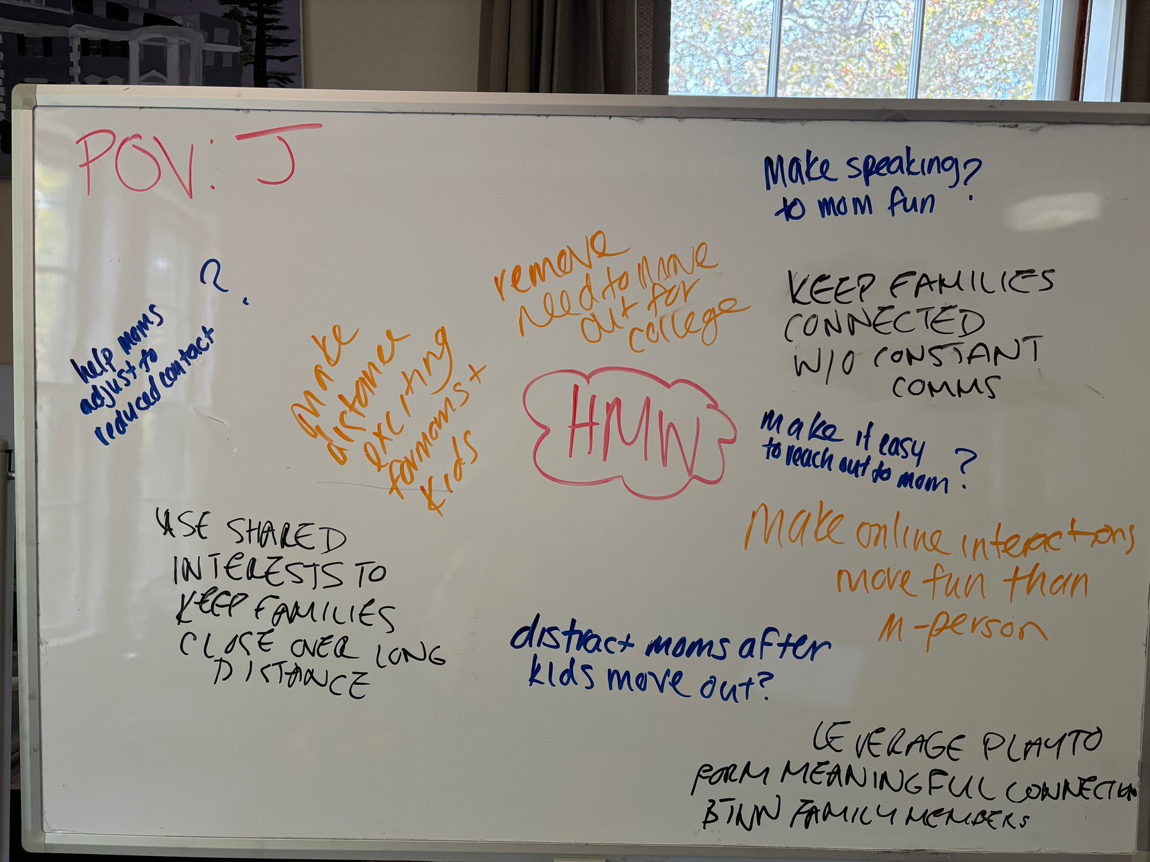
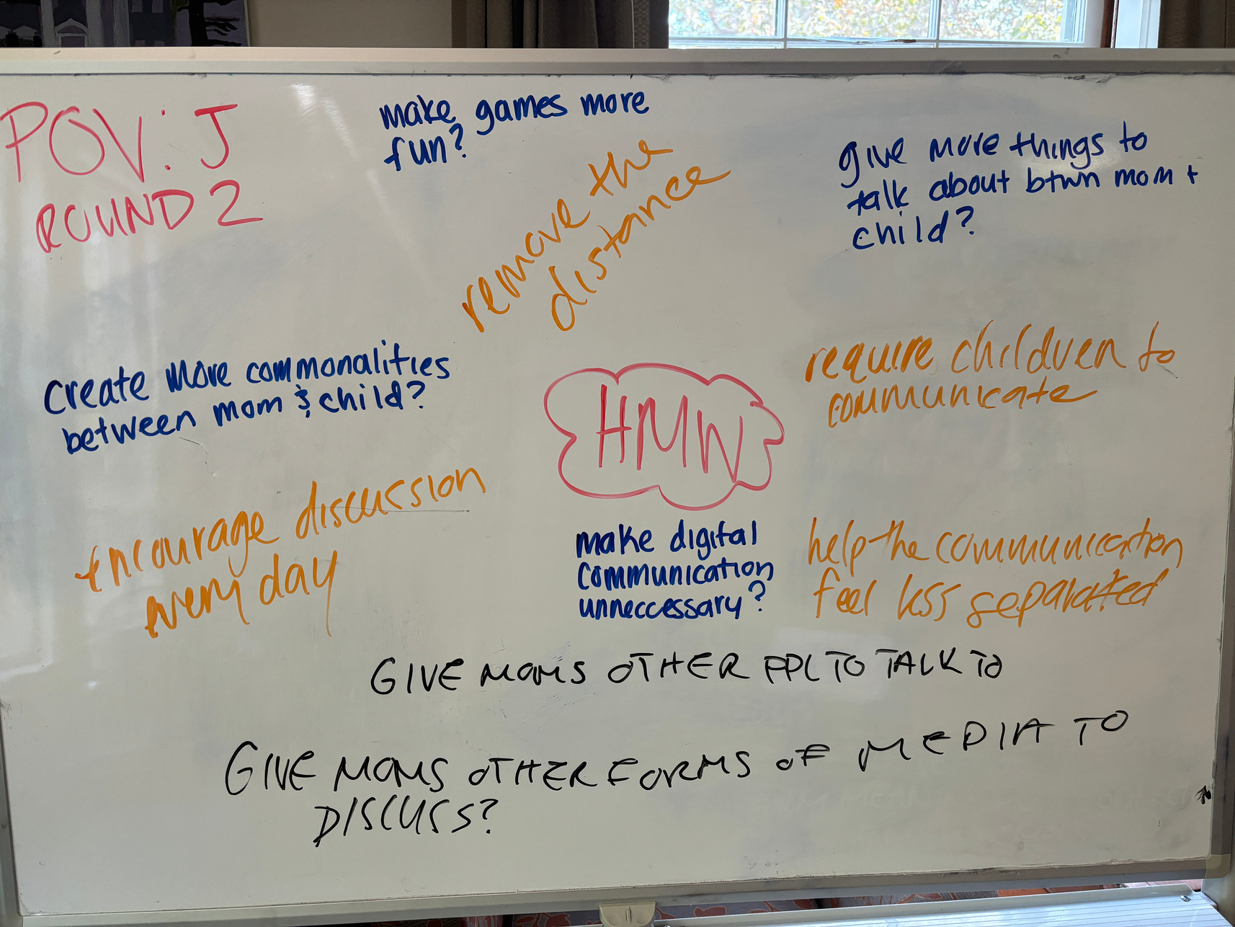
APPENDIX
STORYBOARD ITERATIONS

Slide 38
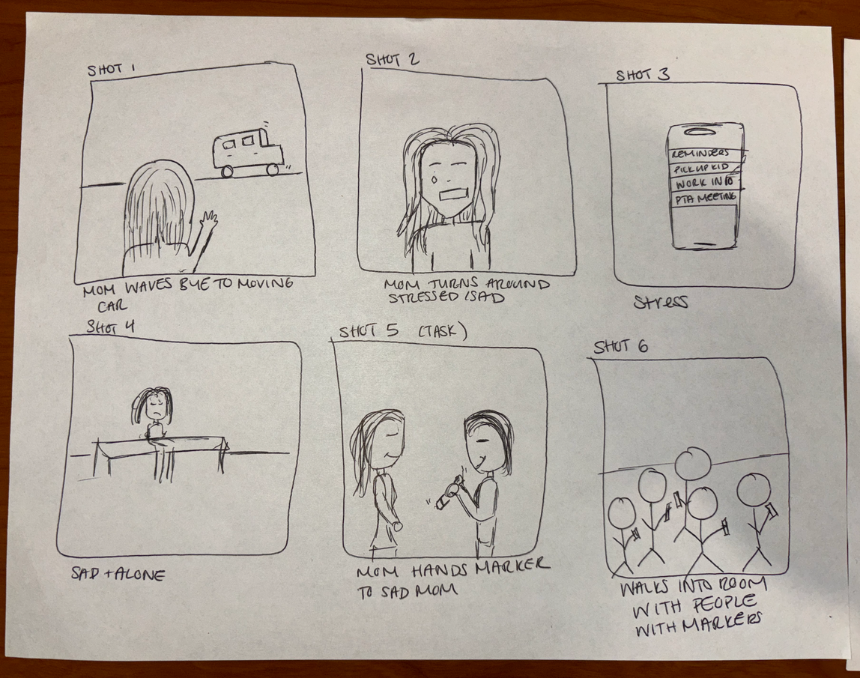
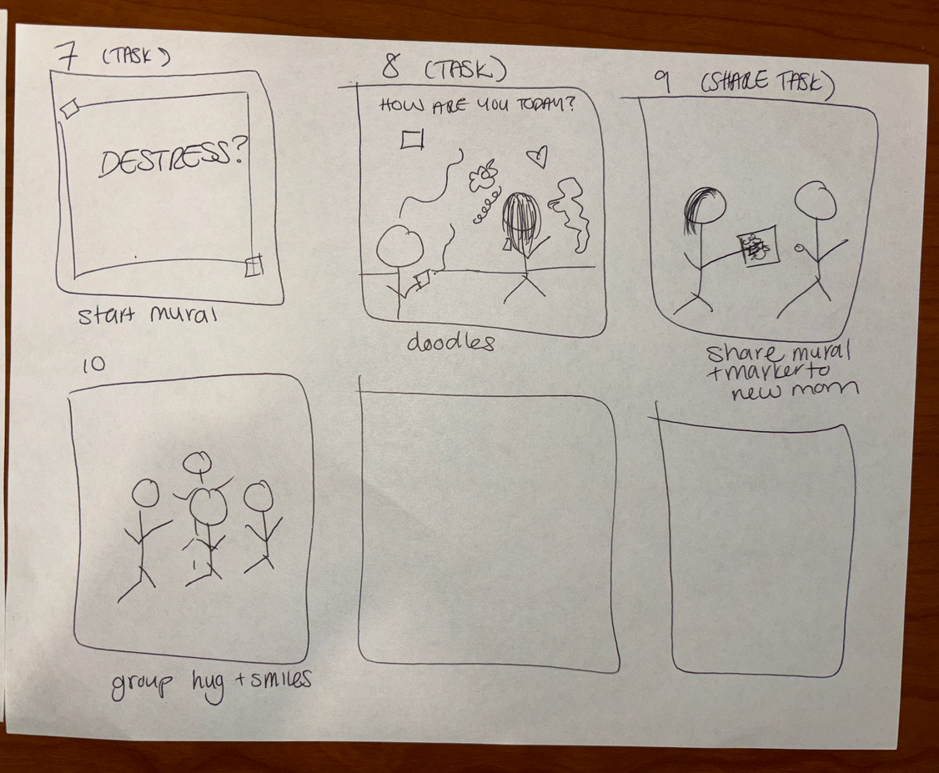

Slide 39
