Slide 1
Collabrio Low-Fi Prototyping
Alexander, Armita, Cate, Manas

Slide 2

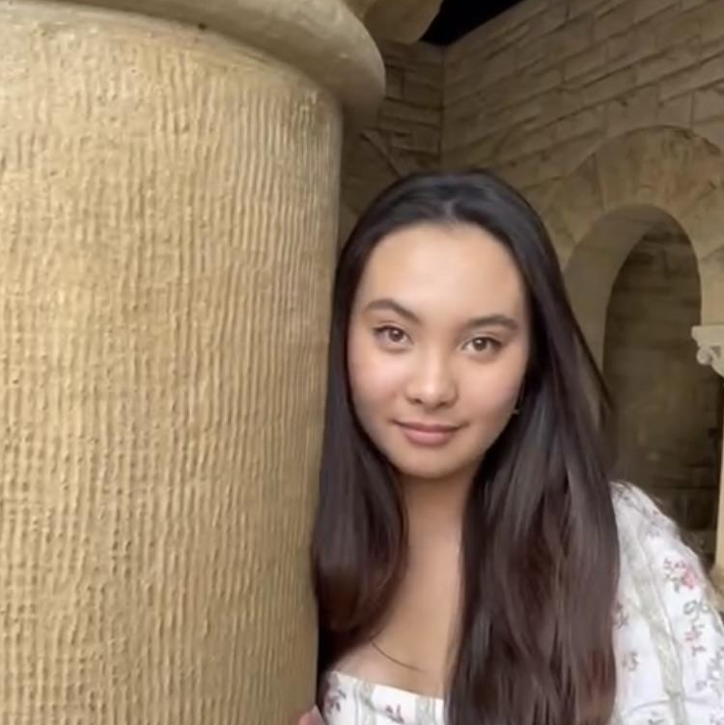


The Collabrio Team
Alexander Belfiore
Armita Hosseini
Cate Celio
Manas Khadka

Slide 3
A platform where an employer’s network is used to match them with freelance collaborators for long-term project partnerships.
Value Proposition

Slide 4

Problem and Solution
Problem: It is very hard to find people outside of one’s typical network when you have a specific need
Primary User: Freelancers
Solution: Collabrio aims to connect people with those outside of their typical network in order to work on collaborative projects and form and maintain professional relationships

Slide 5
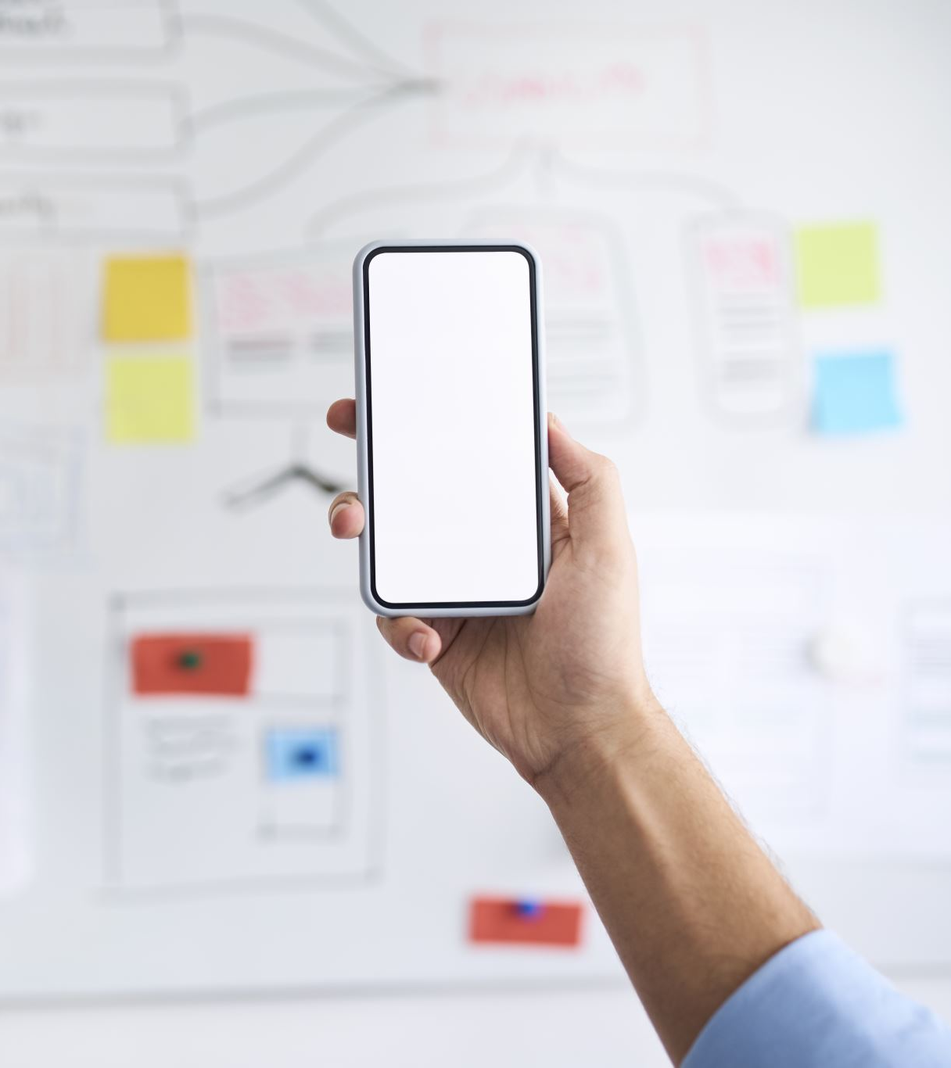
Presentation Outline
Choosing an Interface & Storyboarding
Low-Fi Prototyping
Test Results & Discussion

Slide 6
Choosing an Interface & Storyboarding

Slide 7
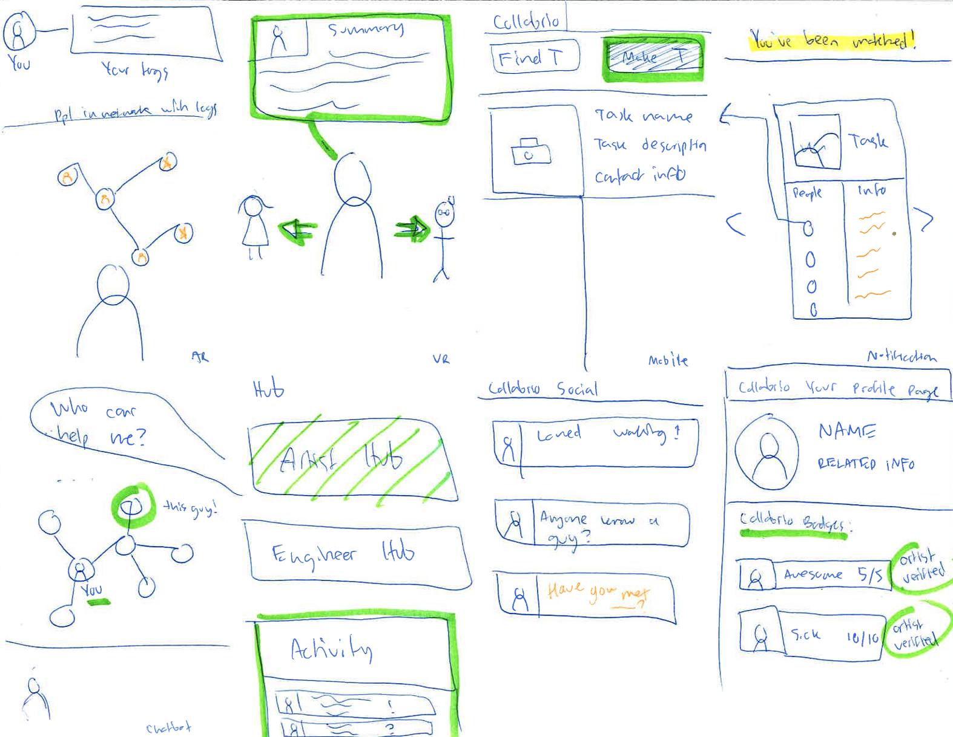
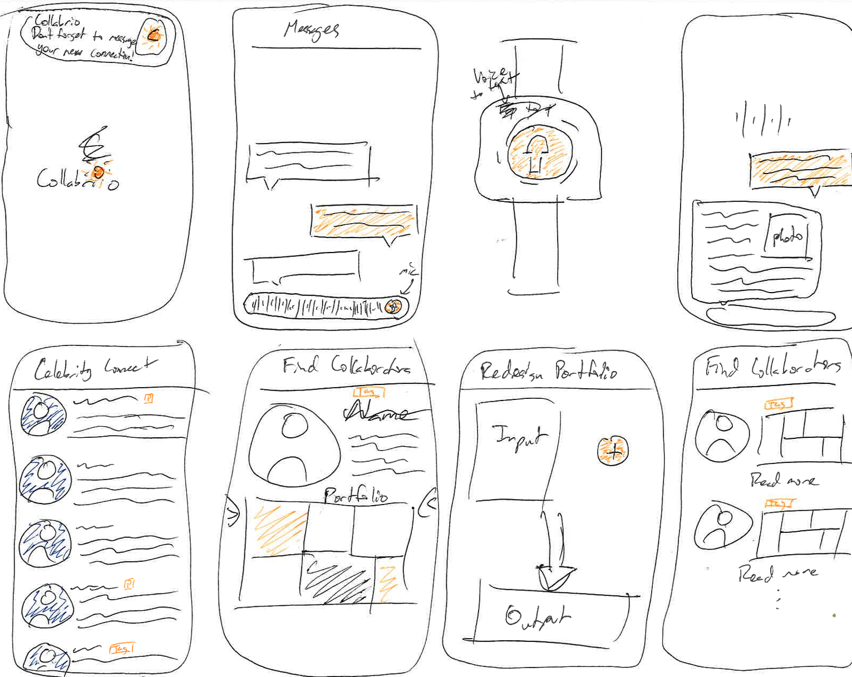
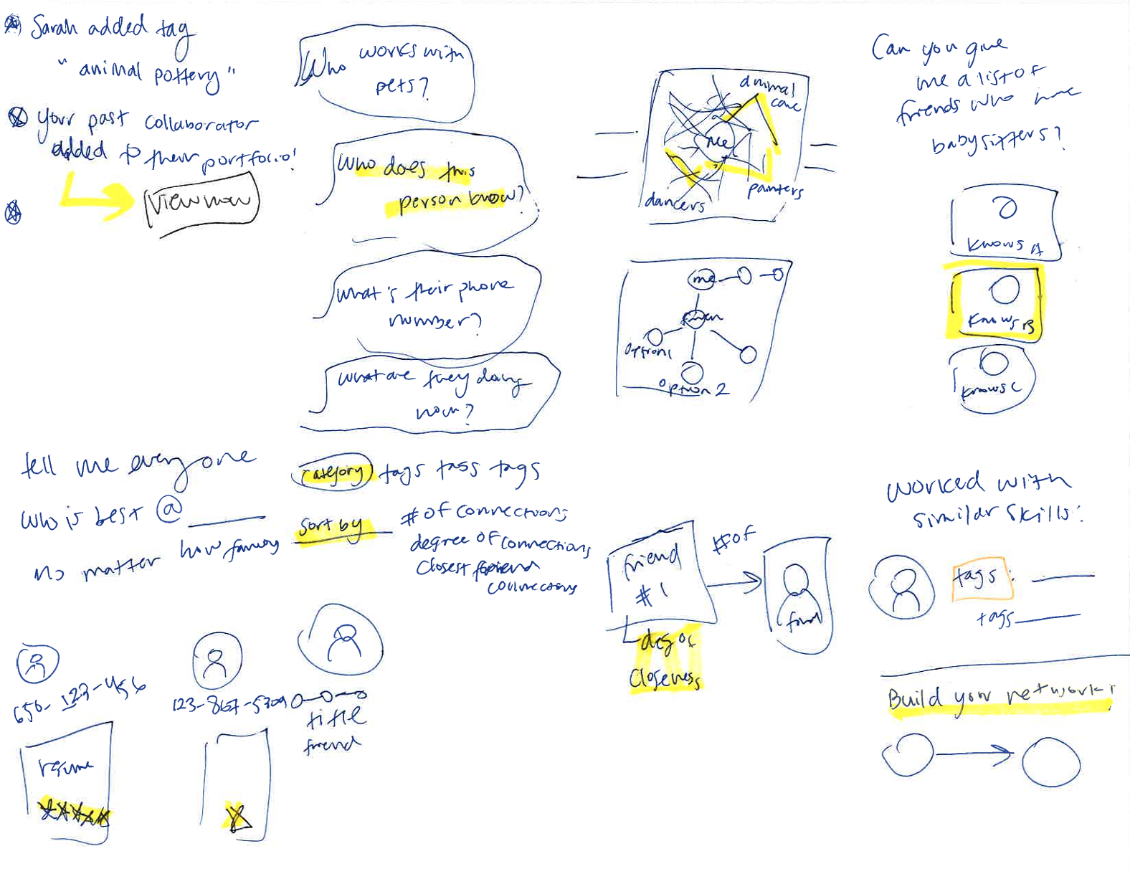
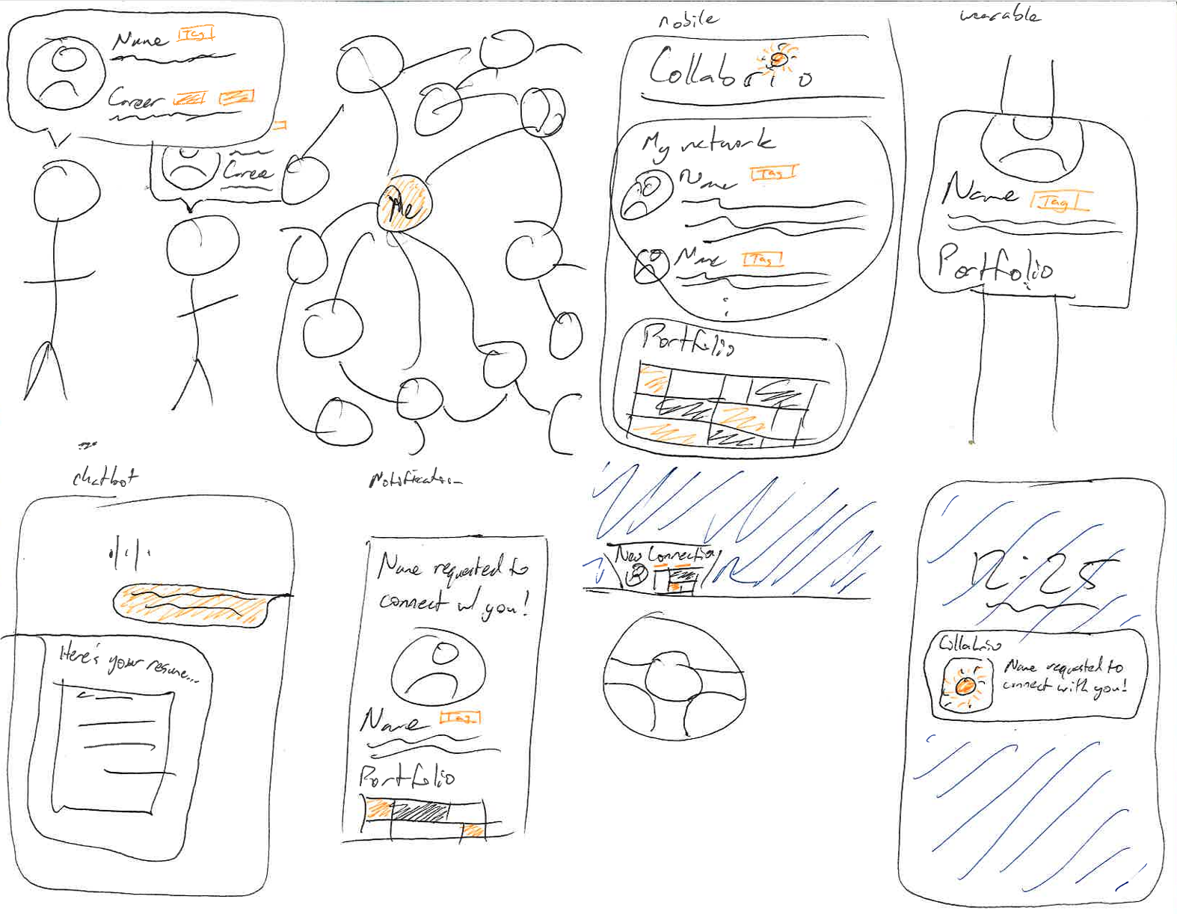

Slide 8
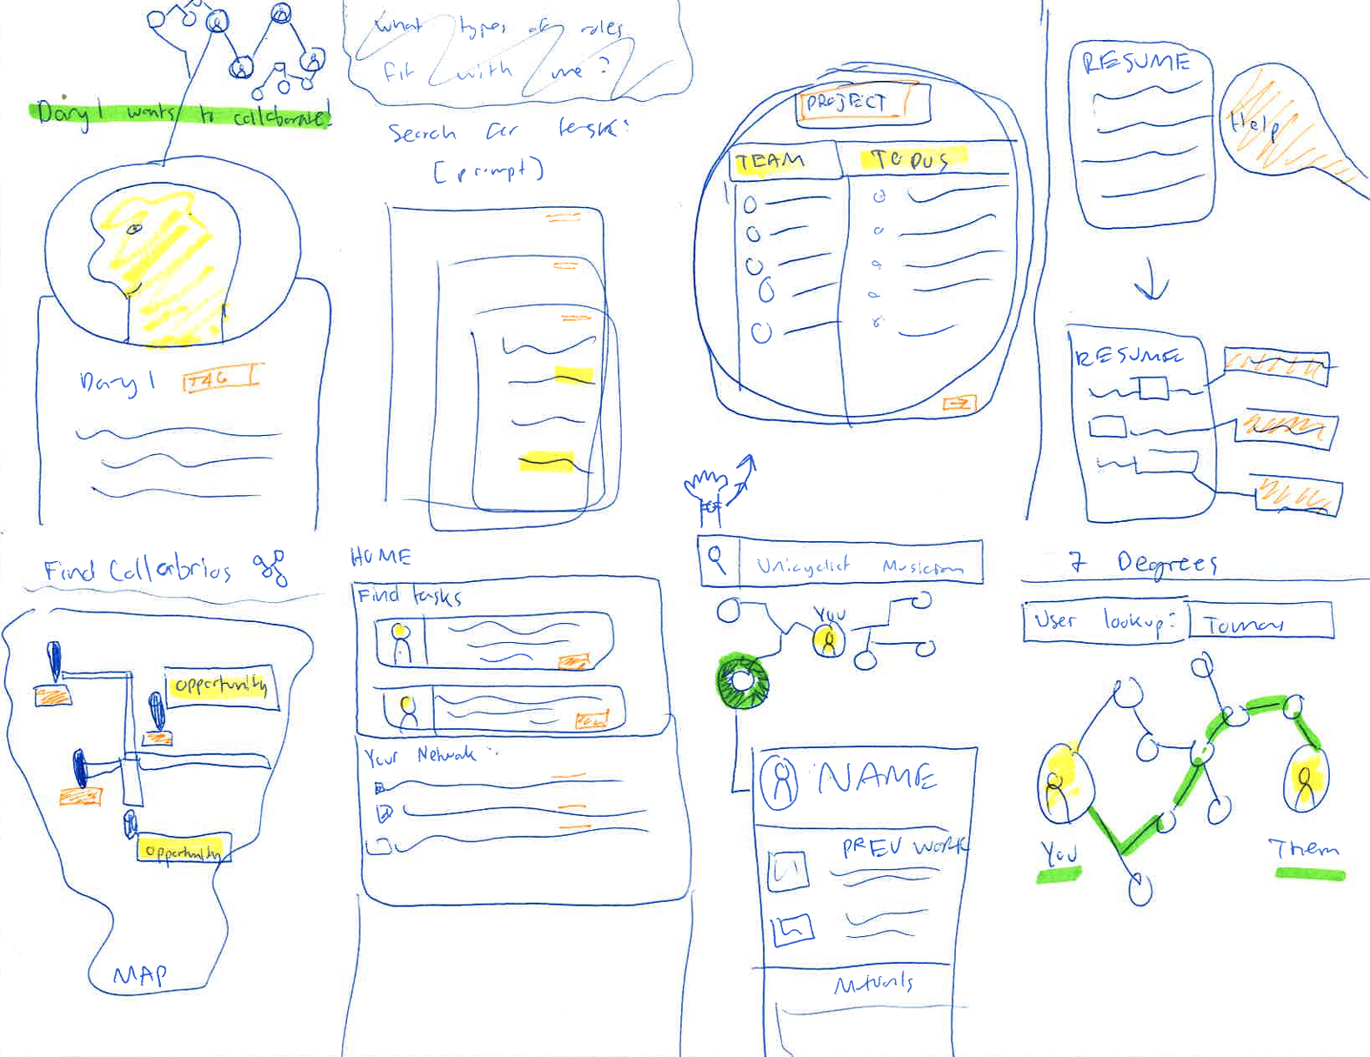
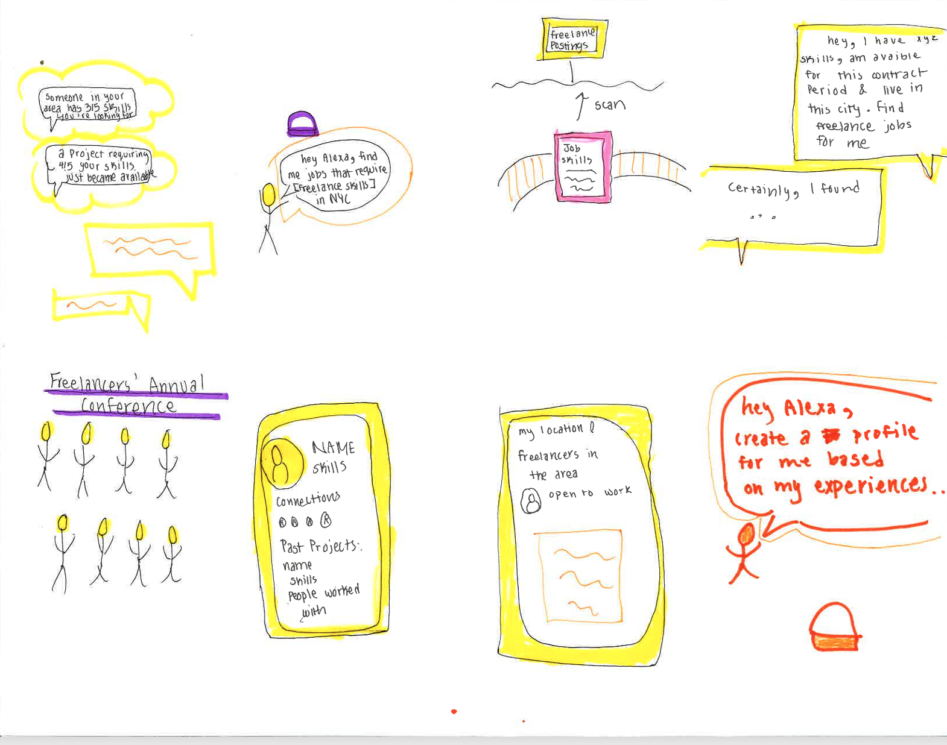
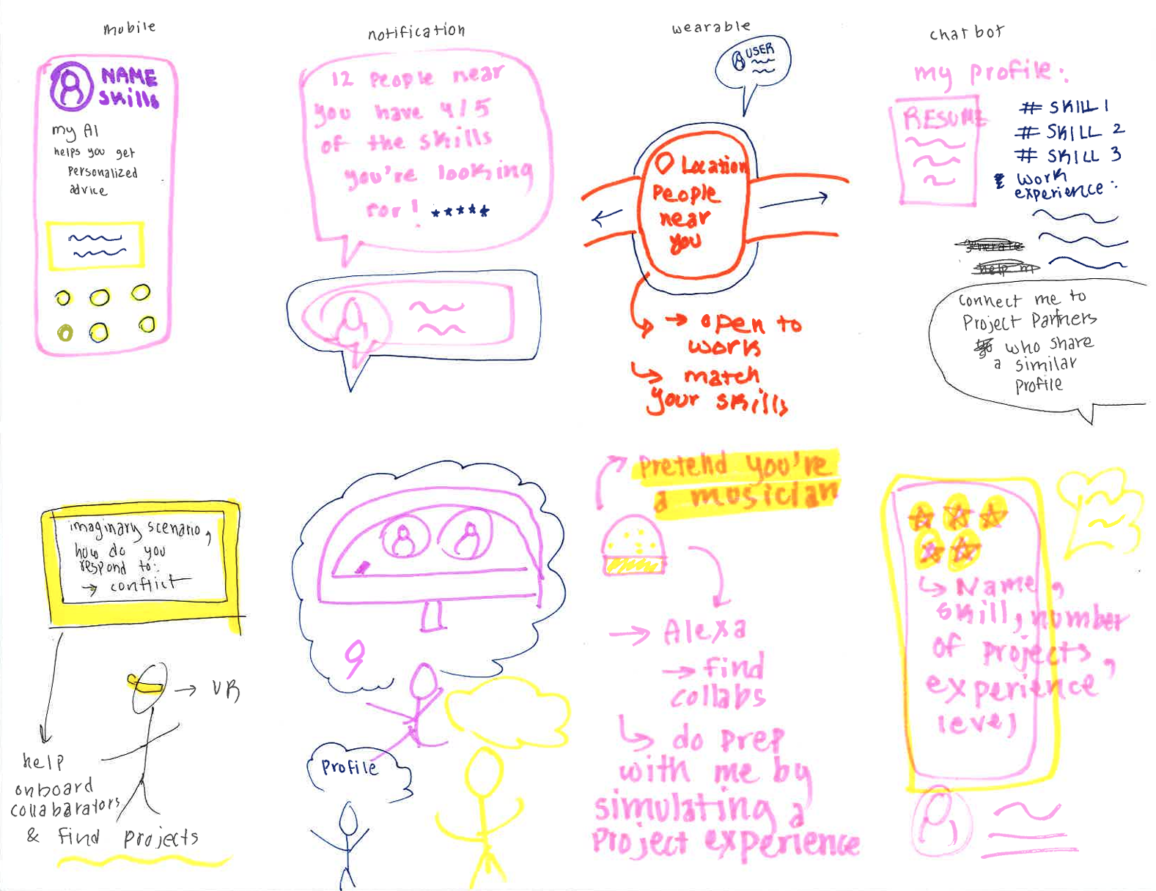
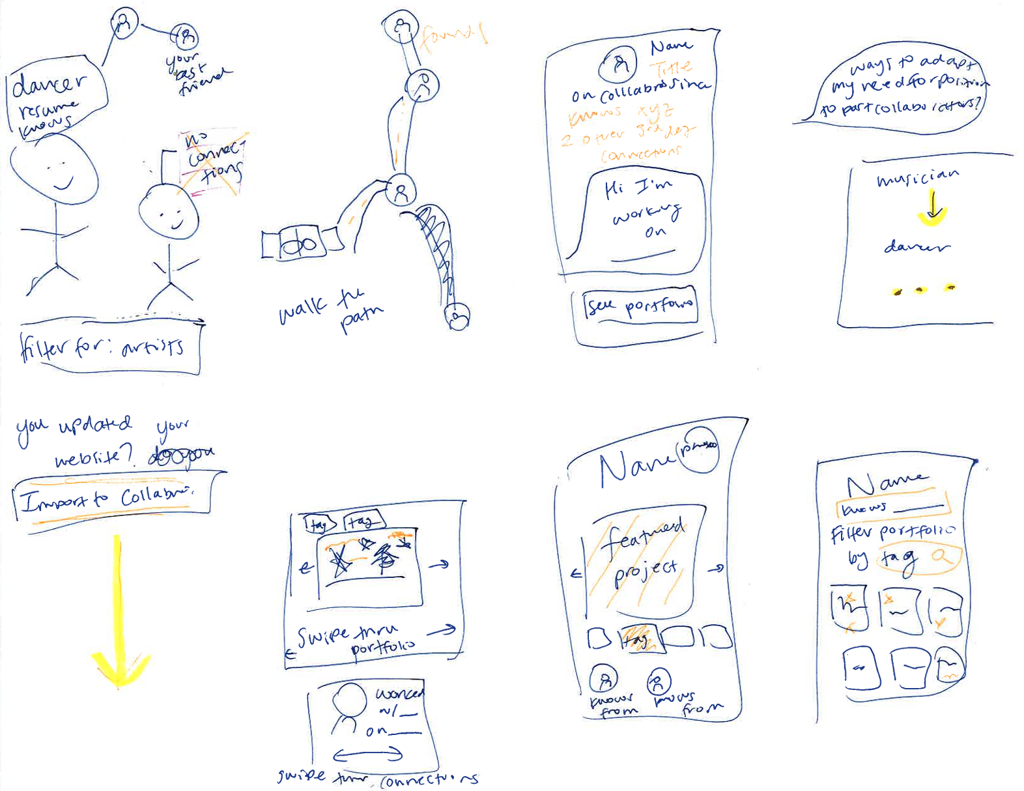

Slide 9
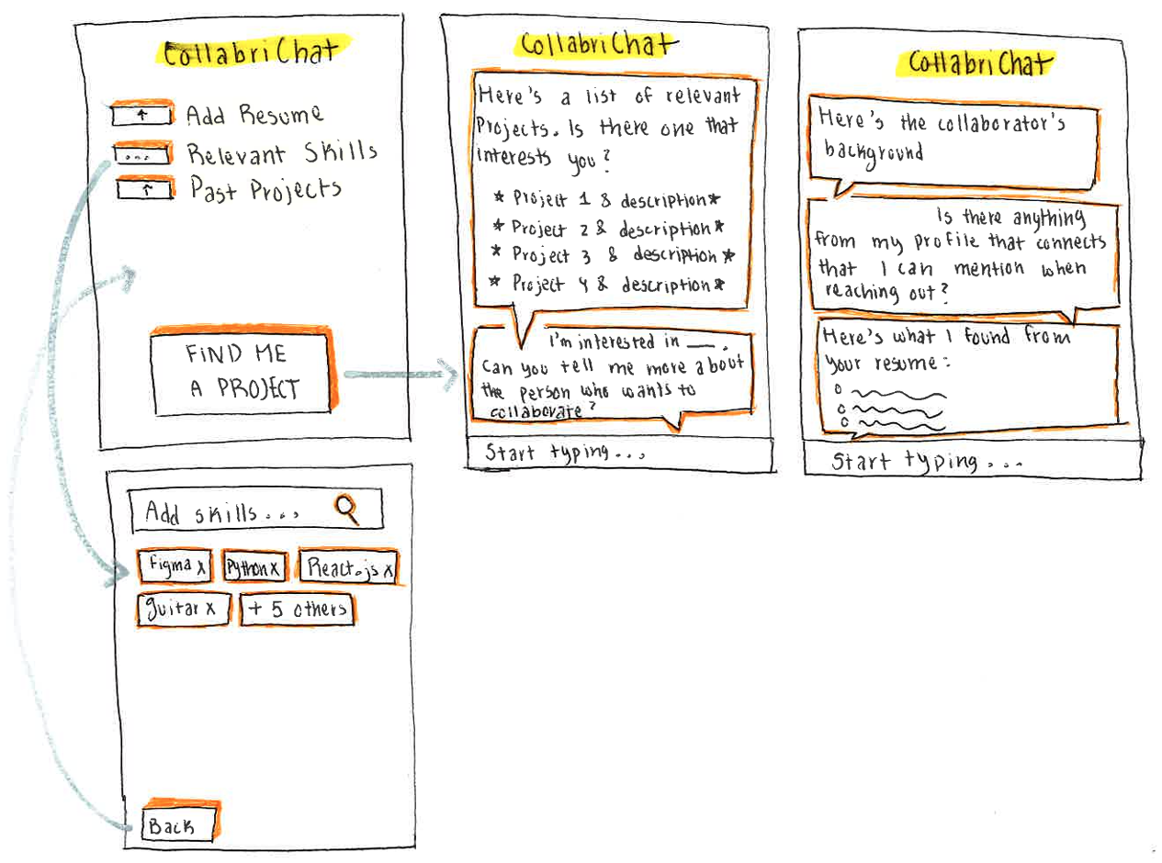
Realization: CollabriChat

Slide 10



Pros & Cons: CollabriChat
Pro: Interactive and highly personalized due to AI
Pro: Tailors your resume for a certain collaborator
Con: Very text heavy screens

Slide 11
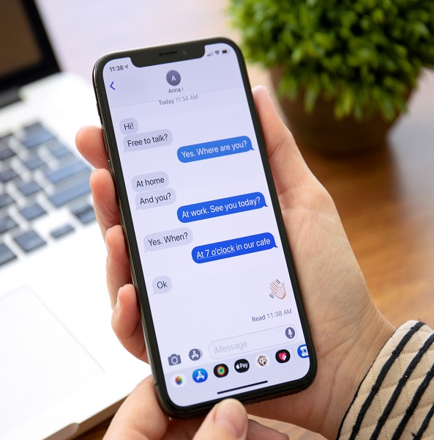
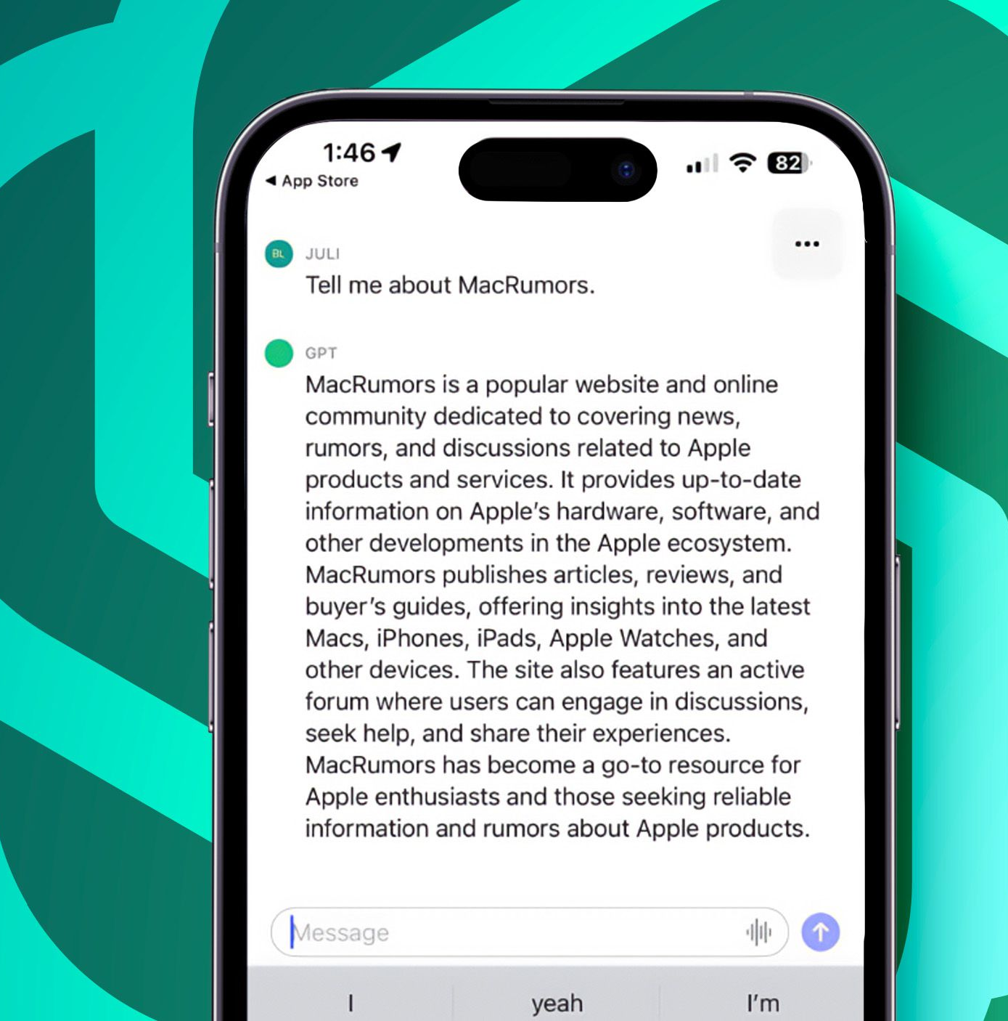

Slide 12
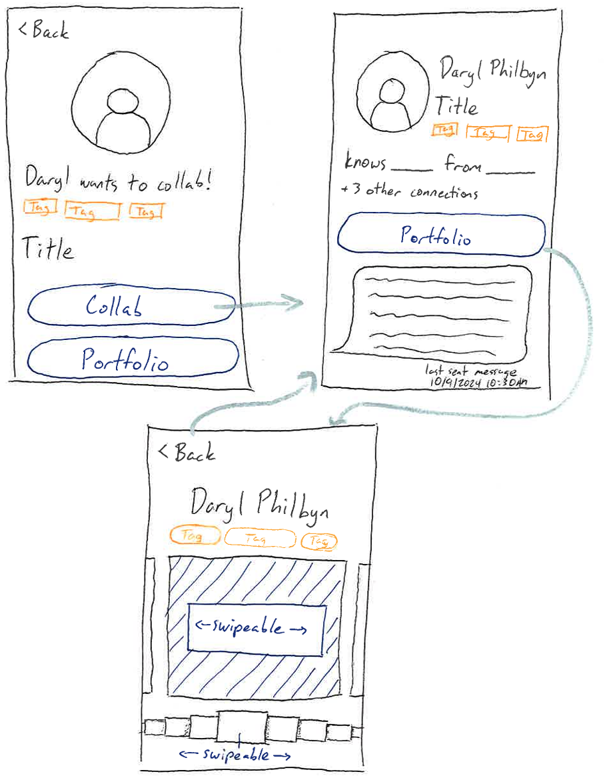
Realization: Profile View

Slide 13



Pros & Cons: Profile View
Pro: Easy to navigate
Pro: Simultaneously focuses on portfolio and network
Con: Notification takes up whole screen

Slide 14
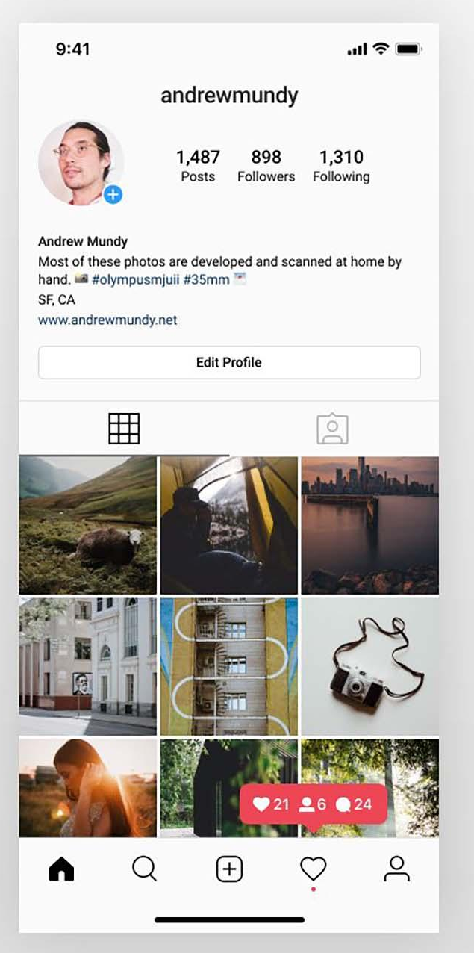
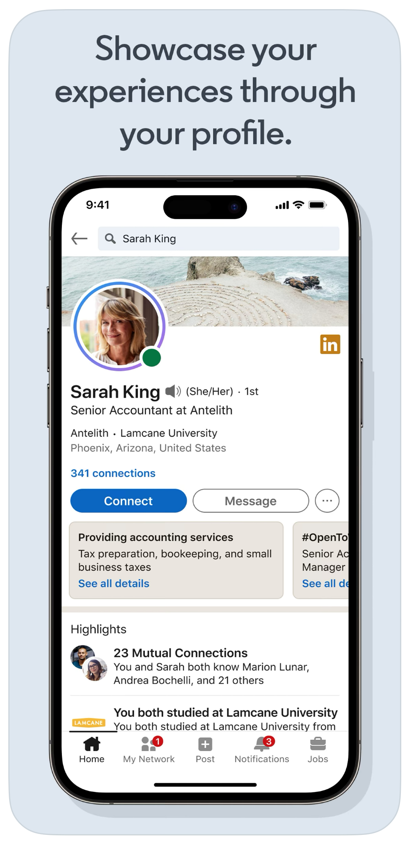

Slide 15
Low-Fi Prototyping

Slide 16
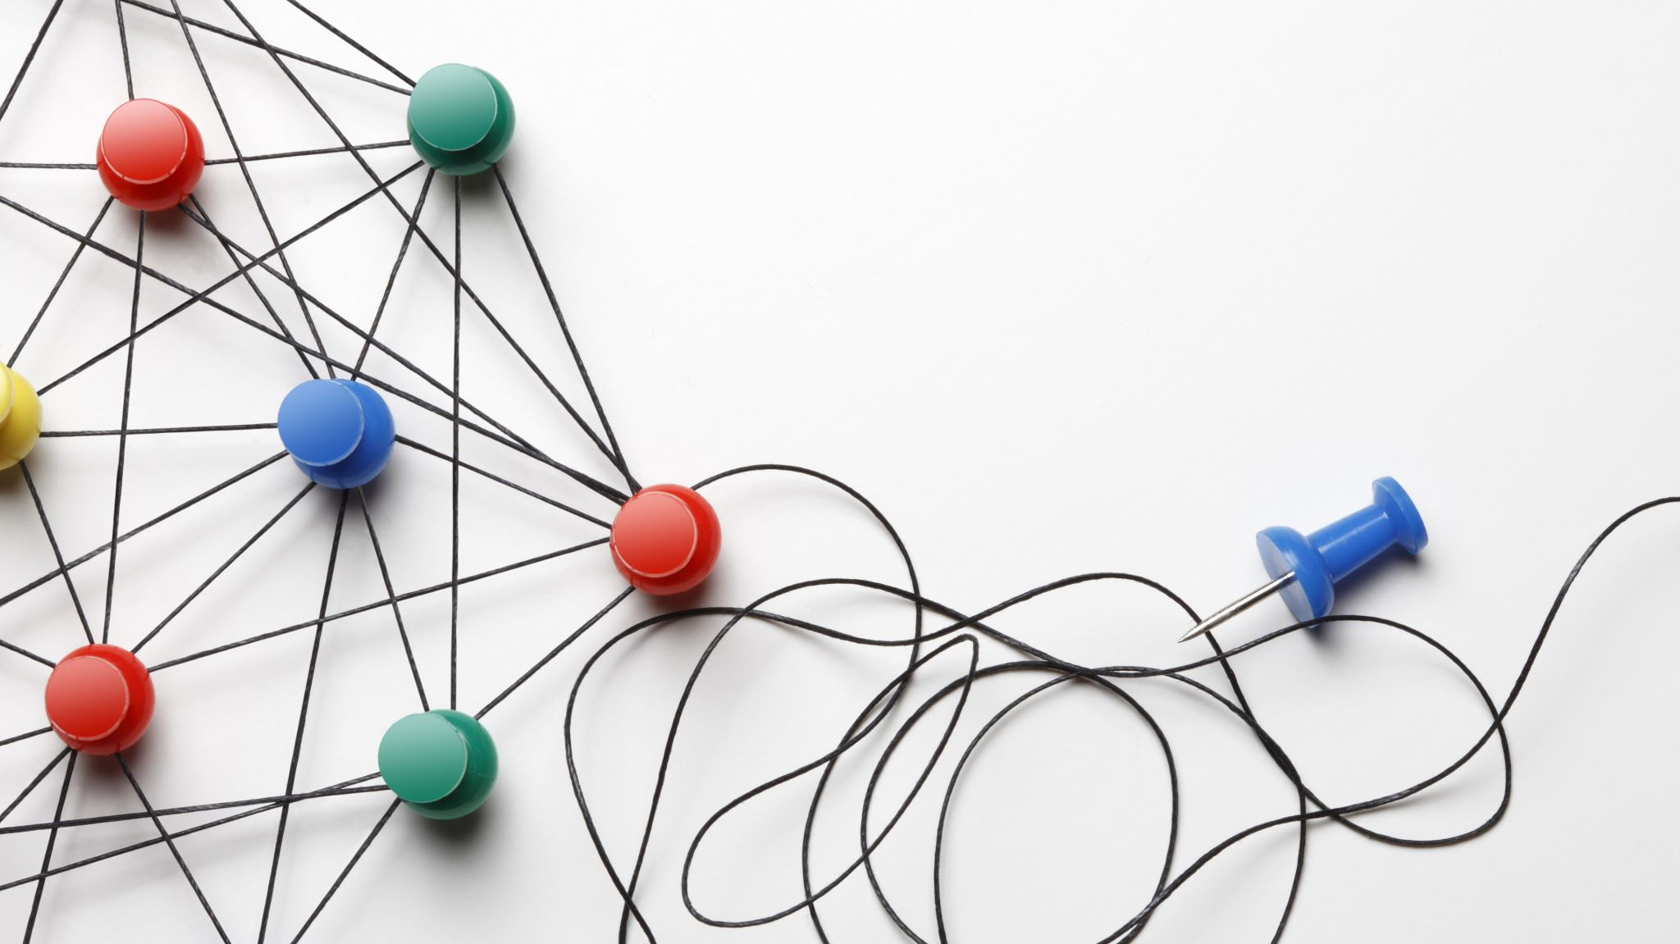
Simple Task
Find someone from your extended network for a specific project

Slide 17
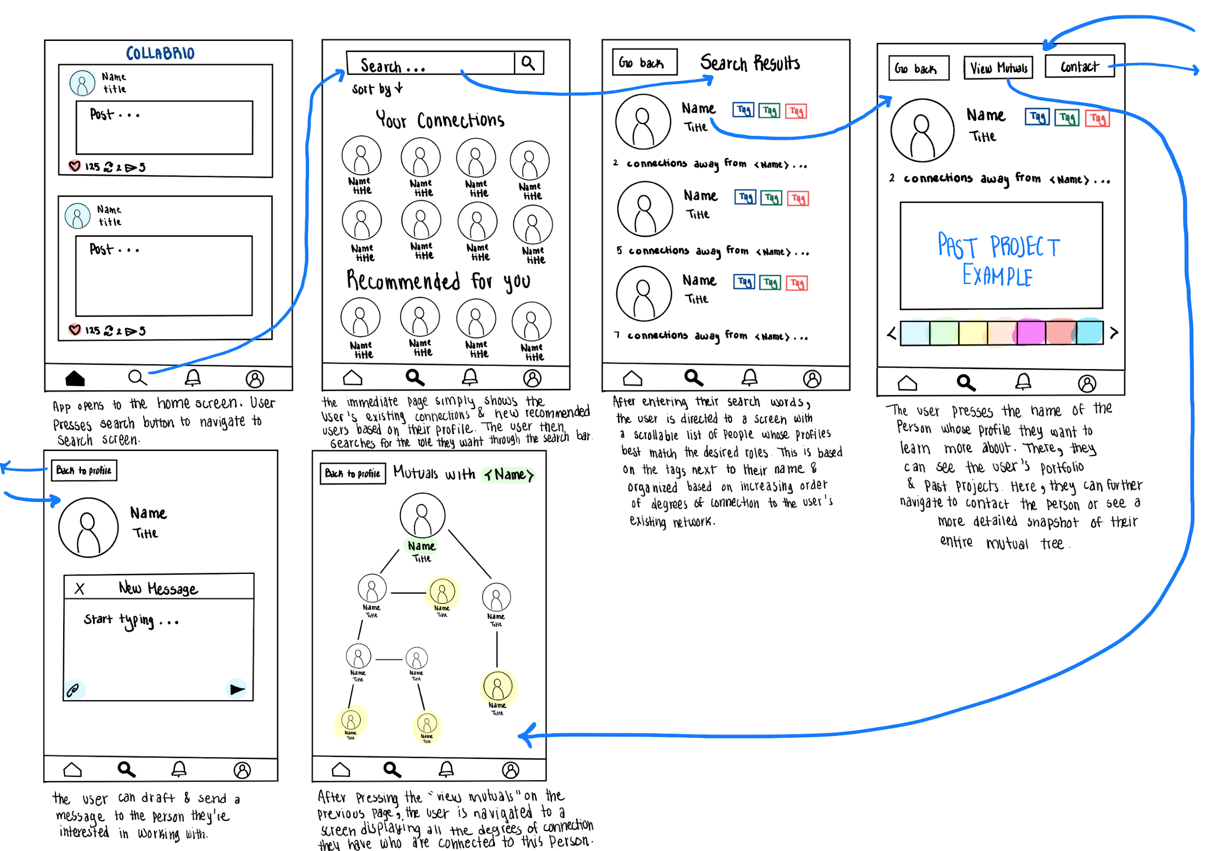

Slide 18

Moderate Task
Share the project you worked on

Slide 19
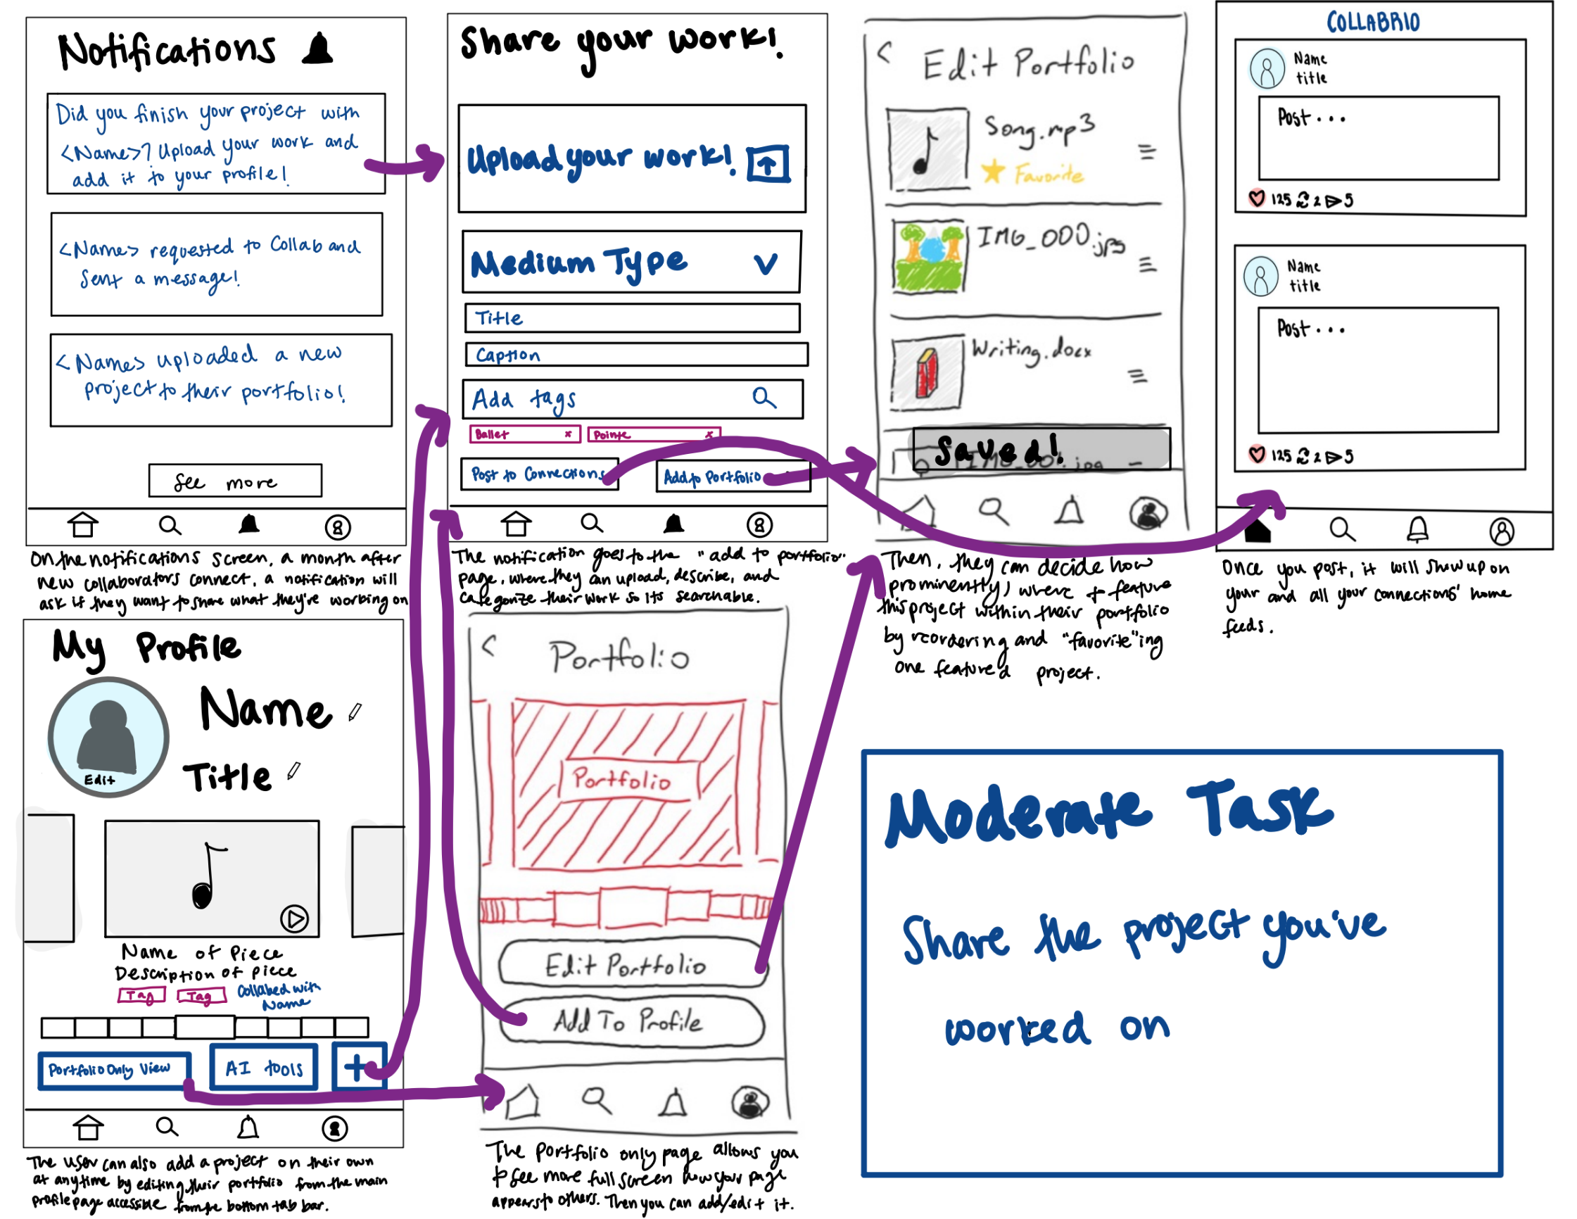

Slide 20
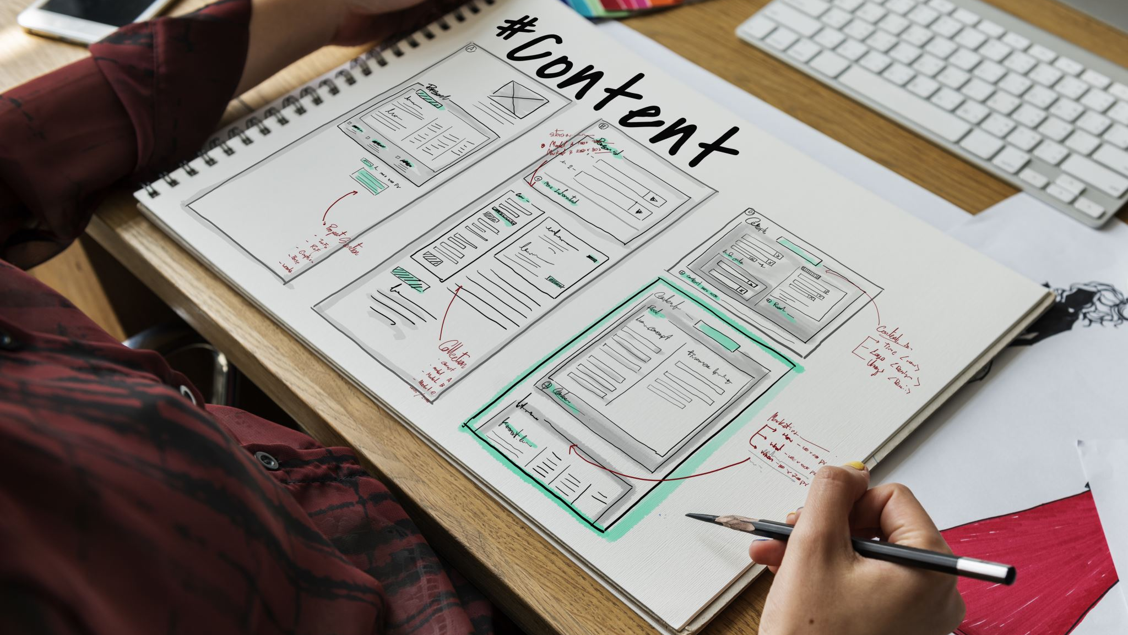
Complex Task
Organize your portfolio and profile with AI

Slide 21
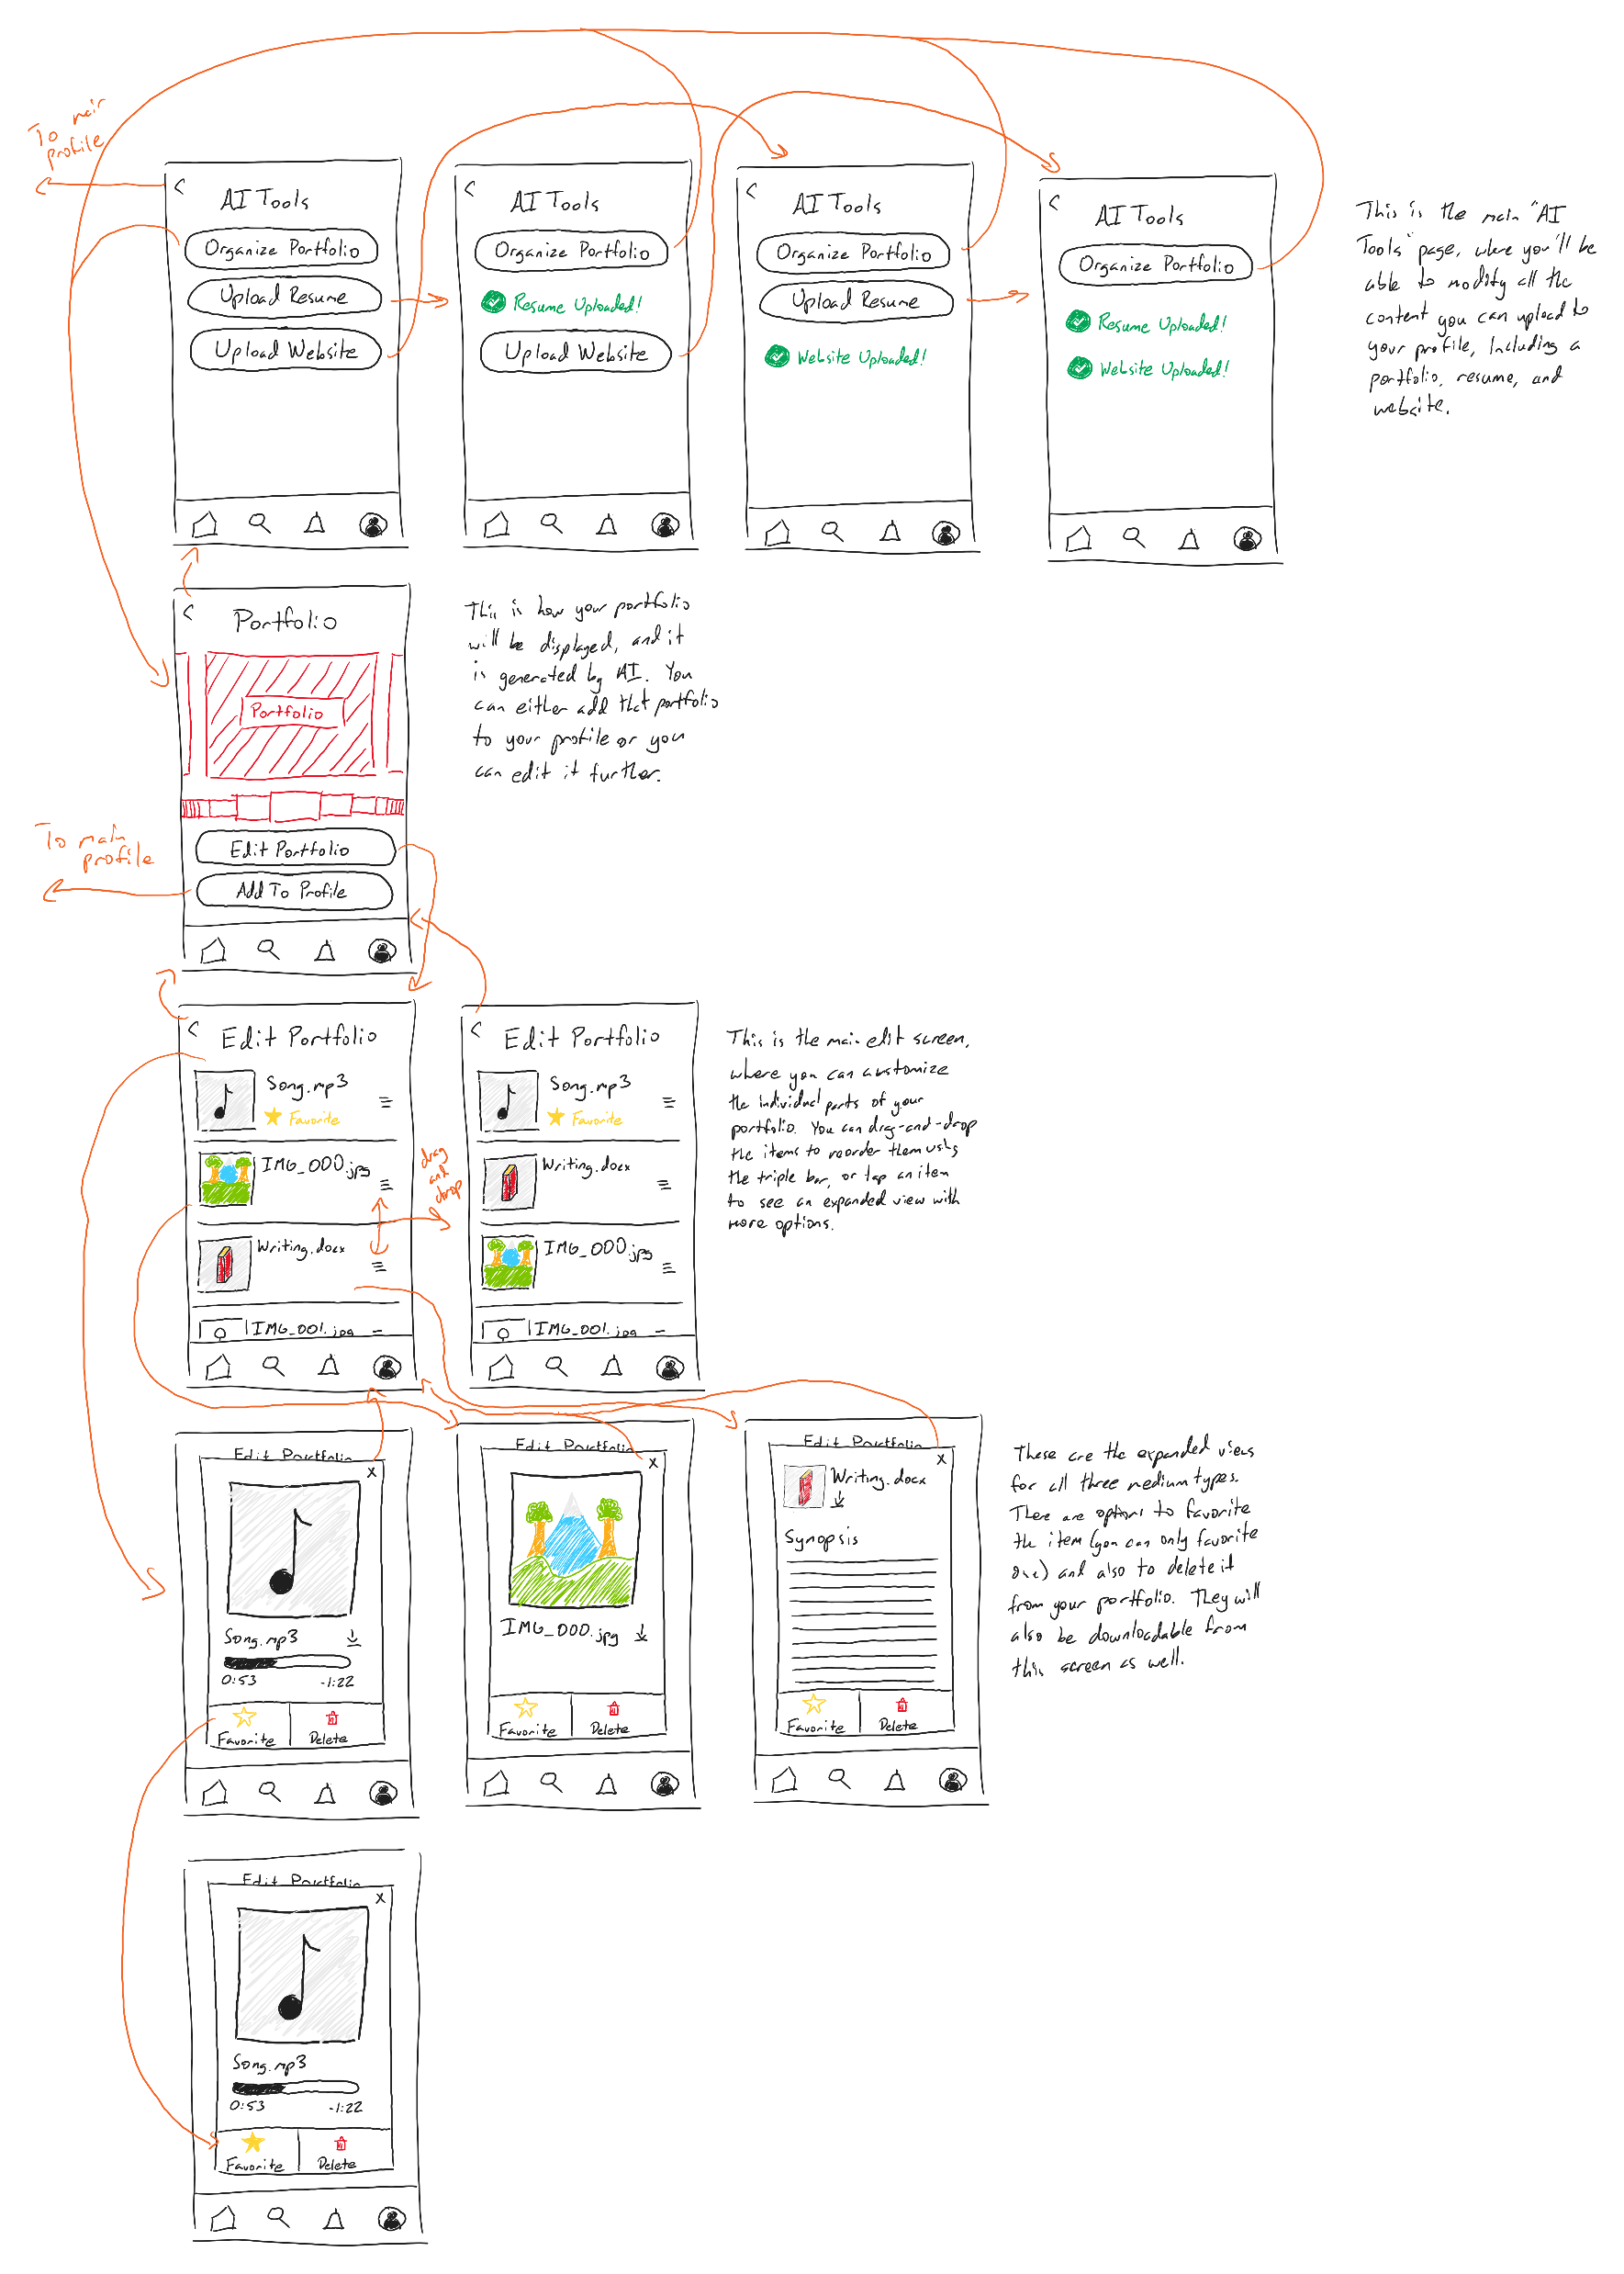

Slide 24
Test Results & Discussion

Slide 25



Testing Methodology
Participants were all Stanford alumni in town for alumni week
Introduced ourselves as Stanford CS students looking for subjects willing to test our UI design
Tracked how often they “took a wrong step” in completing a task
Notes:
Participants were all Stanford alumni in town for alumni week
Approached all of them in/around main quad/oval area
Introduced ourselves as Stanford CS students looking for subjects willing to test our UI design
Gave short rundown of the purpose of our app

Slide 26
Test Results: Simple Task
No interest in the connections tree (View Mutuals button)
The contact button was not an obvious next step
Search section was easily understood and navigable

Slide 27
Test Results: Moderate Task
Unclear how to reach “Share Your Work” screen
Lots of steps required to upload—maybe too many
Notifications screen was basically never used
“Share your Work” screen was intuitive

Slide 28
Test Results: Complex Task
Confusion between “AI Tools” and “Organize Portfolio”
Not a ton of activity interacting with individual media
Confusion on what the AI-generated portfolio is

Slide 29
Takeaways
Alter or remove notifications page, connections tree
Need to redo/improve a couple of screen transitions (Portfolio View)
Some of our app-specific terms are unclear (“AI Tools”)
A couple of places where there’s too much work required from the user to complete a task (“Share your Work”)
Contact button in profile view needs to be more obvious

Slide 30
Appendix

Slide 31
CollabriChat Pros & Cons
Pros:
Helps you compile all your relevant info in one place for quick access
Interactive and highly personalized due to AI
Giving talking points to reach out to people makes it less intimidating
Tailors your resume for a certain collaborator
Guides user through the onboarding process in an accessible way
Cons:
Very text heavy screens
Hard to implement
Static screen
Not a lot of activities to do
Not super dynamic / tasks all look the same

Slide 32
Profile View Pros & Cons
Pros:
Tags help organize
Buttons and other features are very clear
Not a lot of clutter, everything is nicely laid out
Easy to navigate
Portfolio images take up large amount of screen
  Easily navigable
Able to message people to pitch your ideas
Simultaneously focuses on portfolio and network
Allows you to filter portfolio and focus on tags you are most interested in
Cons:
Notification takes up whole screen
The screens to display the other images are not large enough
Maybe doesn’t feature your network enough in other screens (immediate in notification)
Tag buttons are kinda small
Last sent message maybe isn’t most relevant piece of information?

Slide 33
Script
[INTRO]: We are Stanford students working on a computer science project for our class. Do you have five minutes to help us test a paper prototype of our mobile app?
  Great! Could you please sign this quick consent form?
  Before we get into the demo, here’s some background info on our app.
  We are creating a platform where a user’s network is used to match them with freelance collaborators for long-term projects. We want to empower people on their professional, collaborative journeys.
Give Example of Prototype Usage
  I’ll show you how to interact with the paper prototype as well as the types of things we’re looking for you to say out loud
  “Ok so I think this is the home screen right now”
  “I know I want to search, I’ll press this magnifying glass to search”
  “Ok, this keyboard came up, let me just type something and press enter”
  Ok awesome these are the people that came up
  It’s really helpful to us when we understand what you’re thinking about as you do the demo; please try and speak through your thought process!
SIMPLE TASK: Find someone from your extended network for a specific project
MODERATE TASK: You have a previous project that you’ve finished. Share the project you worked on!
COMPLEX TASK: Organize your portfolio and profile with AI
ENDING: Thanks for participating!

Slide 34
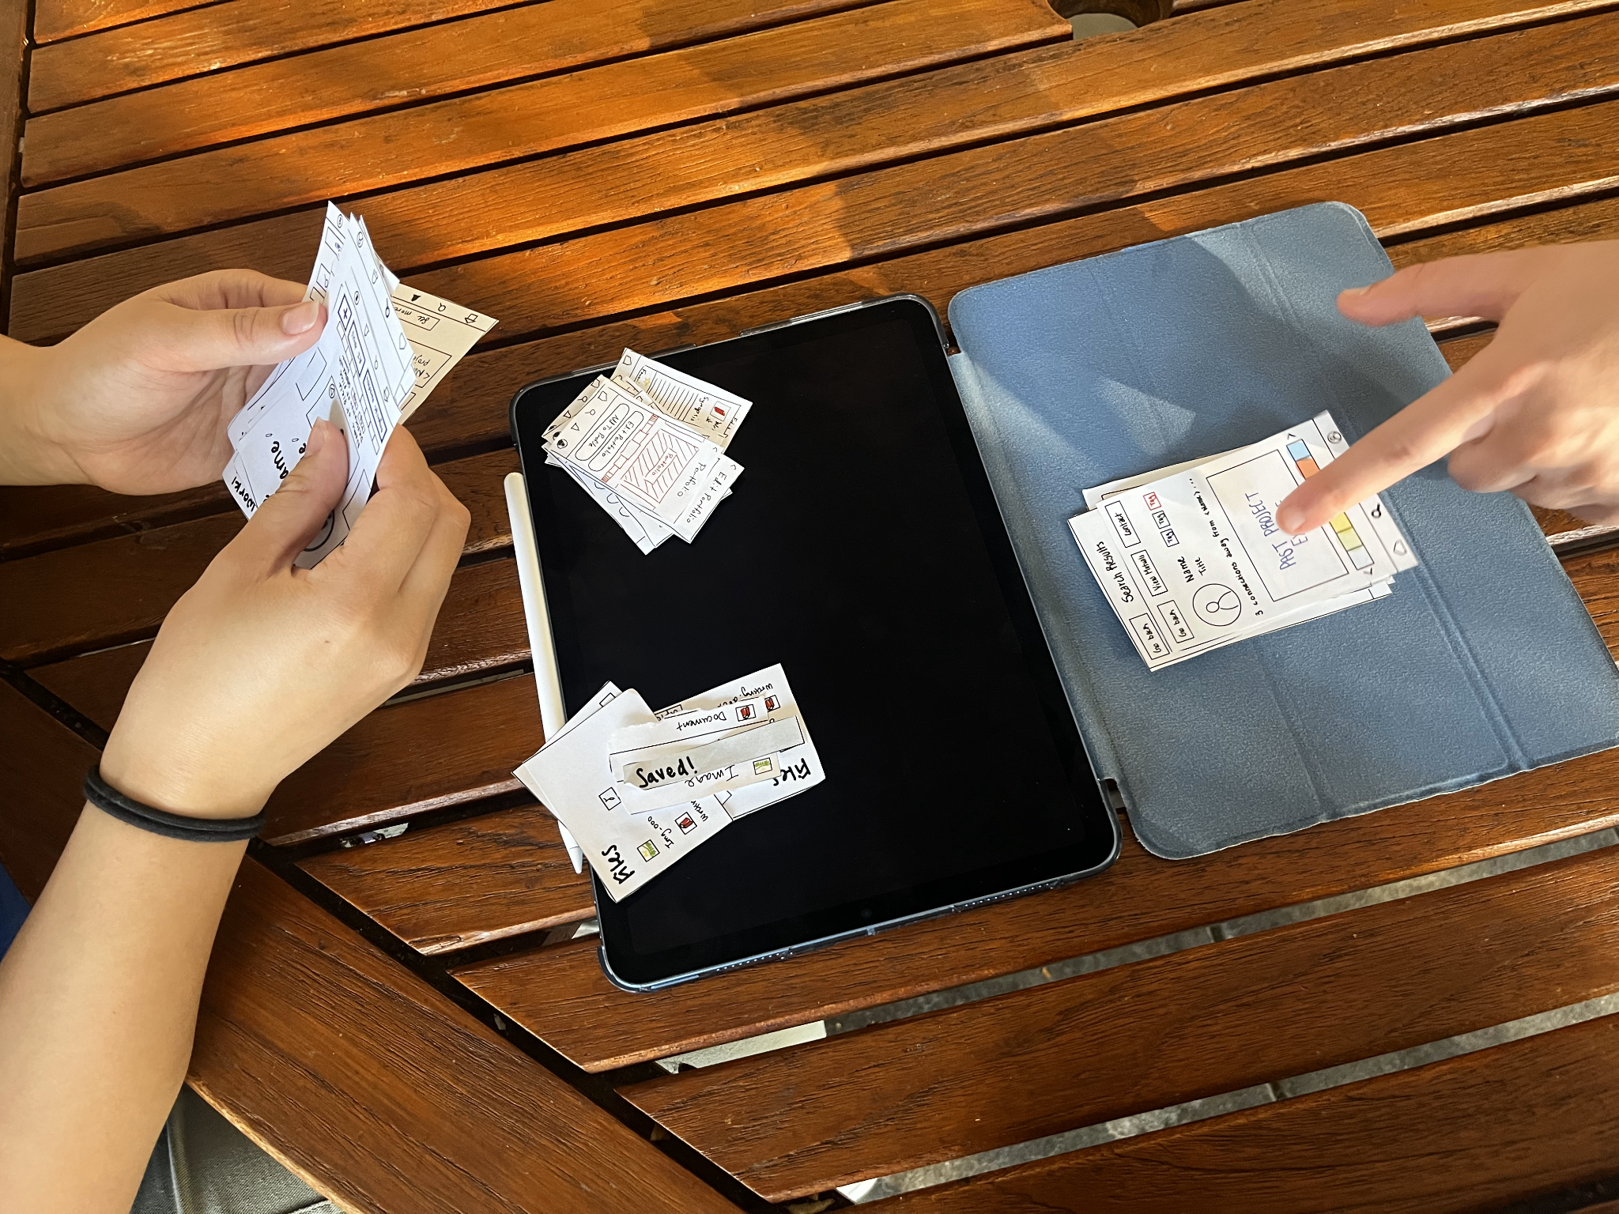
Interview Photo

