Slide 1
Interactive Medium-Fi Prototype
Team TuneTribe

Slide 2
Table of contents
01
06
02
07
03
04
05
Overview
Task Flows
Values in Design
Prototype
Tasks
Usability
Revisions

Slide 3
01
Overview

Slide 4
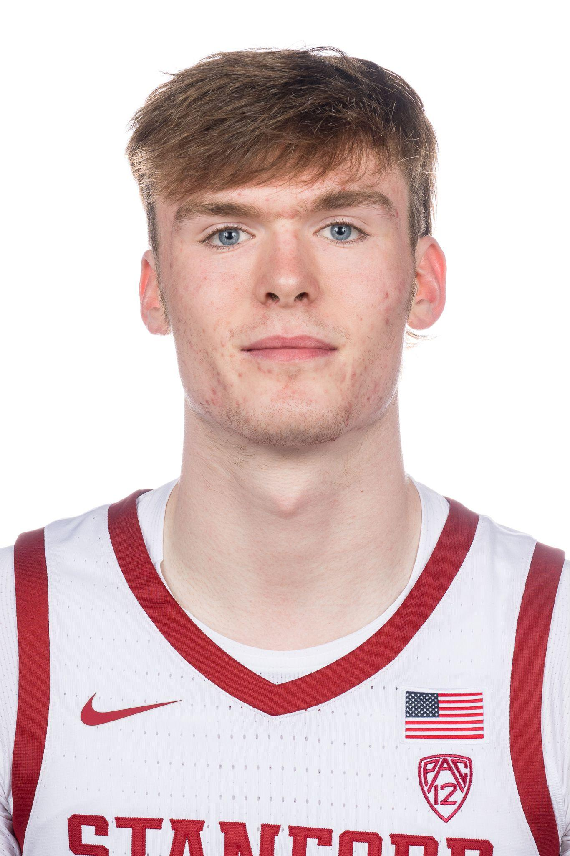
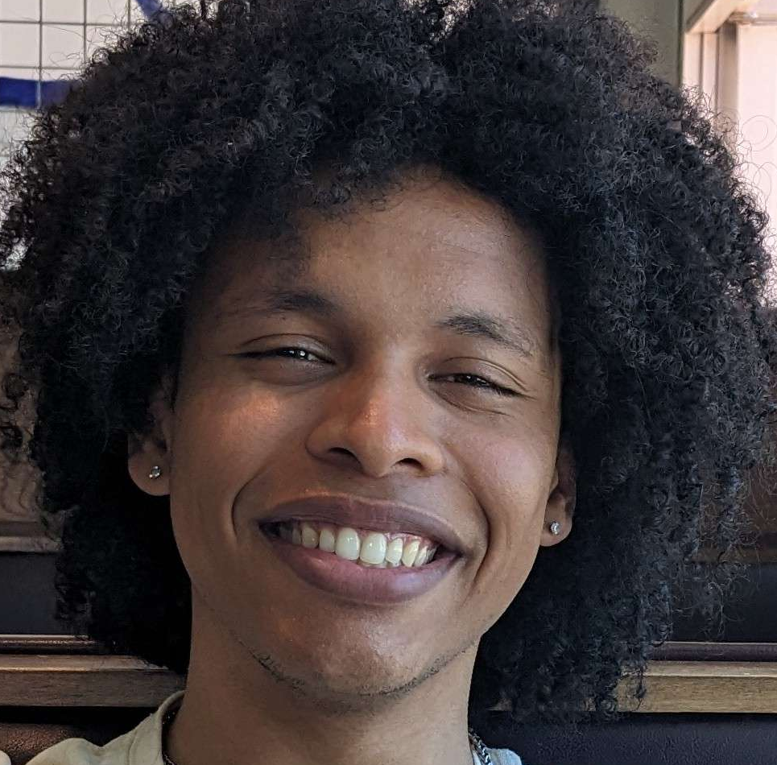
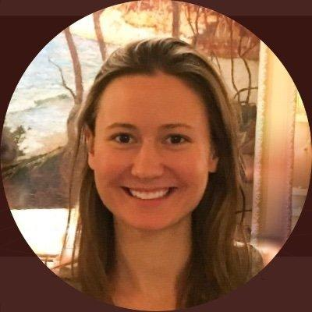
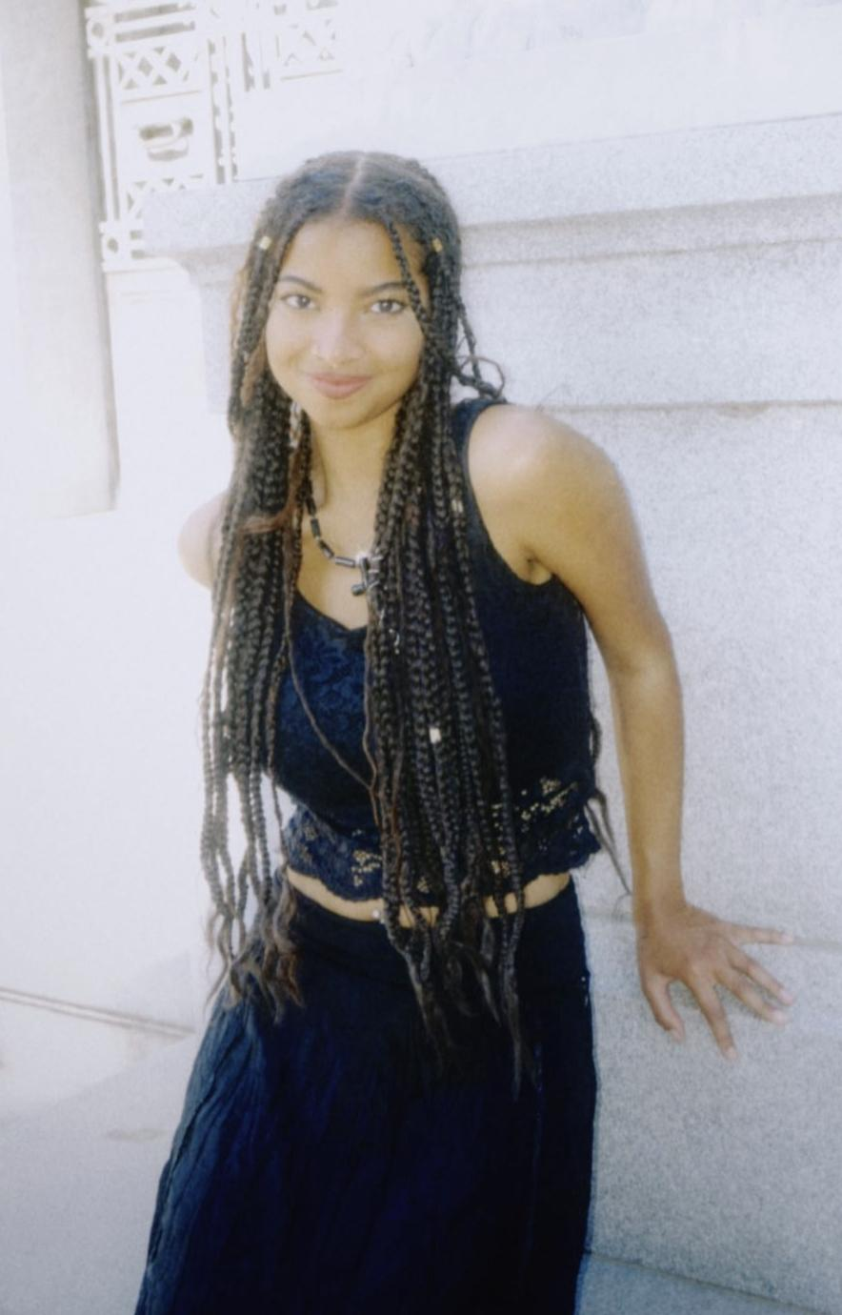
Team
Max
Steven
Lizi
Gracielly

Slide 5
TuneTribe
Find the Beat of Your Community
Discover Live Local Events
Connect with New People Over Music
Promote Your Music in Your Community

Slide 6
Live music events are desirable, but difficult to discover
Events are deeply about the experience with people, yet
few live event apps target connection between them
Promoting for free, local, small events without a marketing budget is hard!
Problem
Notes:
Problem: From our needfinding,
– Live music events are highly desirable, but difficult to discover spontaneously without help
– Live events are often more about the experience and people than the music itself, yet few apps target connection
– Promoting for free and small events within a local community is expensive and difficult to do without time / marketing budget

Slide 7
Centralized & Community-First Space
Promotion Regardless of Price, Type, or Size
Personalized & Incentivised
Integration with Social & Music Apps
Solution
Notes:
Solutions:
- Centralized community-first space for live music lovers with support for promotion of artists’ events regardless of their size, type, price, or skill level
- Personalized connection suggestions based on music tastes and event check ins to find new concert buddies
- FUN through gamification of event attendance / check ins
- Integration NOT duplication of features in existing popular social media & music apps (messaging, directions, playing content, data sources for events)

Slide 8
02
Values in Design

Slide 9
Values
Discovery
Community
Intuitiveness
We seek to emphasize discovery of both music venues and artists, enabling users to go outside their comfort zone.
Our app encourages users to interact with other users and expand their community in the crowd at shows.
A simplified and streamlined UI lets our users simply and efficiently use our core features.
Notes:
Discoverability: We wanted to stay true to our original core value we derived from needfinding of making it easy to discover small local venues. To emphasize this we made the discovery page our core feature. With both a discovery page that displays shows and allows for sorting by genre, distance, and price, along with our “BeatMap”, a heatmap of local small events happening now near your location that have icons scaled by their audience size.
Community: We also wanted to still commit to our value of finding communities and people to connect with. To do this we implemented the ability to view other users and their interests as well as communicate with them through the app. We also incorporated the ability to include community events in our “events” tab that are not simply concerts but still may bring local communities together.
Intuitiveness was another value we kept in mind while designing, we received good feedback from the lo-fi prototype on what parts of our app were confusing and made changes to make the app more intuitive to use and a better user experience. For instance we made event creating much simpler and easier for users by streamlining it and making the UI clearer.

Slide 10
Value-Aligned Features
Discovery
Community
Intuitiveness
Discover tab highlights a “BeatMap” for ease of finding new local events. All tabs include search & filter options for ease of curated results for delight.
Users can connect & interact via personalized recommendation generated from profile preferences & checkins.
Simplified all task flows & made UI easy to understand with clear symbols & names.
Notes:
Discoverability: We wanted to stay true to our original core value we derived from needfinding of making it easy to discover small local venues. To emphasize this we made the discovery page our core feature. With both a discovery page that displays shows and allows for sorting by genre, distance, and price, along with our “BeatMap”, a heatmap of local small events happening now near your location that have icons scaled by their audience size.
Community: We also wanted to still commit to our value of finding communities and people to connect with. To do this we implemented the ability to view other users and their interests as well as communicate with them through the app. We also incorporated the ability to include community events in our “events” tab that are not simply concerts but still may bring local communities together.
Intuitiveness was another value we kept in mind while designing, we received good feedback from the lo-fi prototype on what parts of our app were confusing and made changes to make the app more intuitive to use and a better user experience. For instance we made event creating much simpler and easier for users by streamlining it and making the UI clearer.

Slide 11
Values in Conflict
Discovery & Community
Community & Intuitiveness
Users may want to discover events while traveling or in areas outside their local community. We fully support other locations for event searches.
Community means many different things to different people. Enabling a broad range of filters can include some features which cater directly to the needs of some groups but not to others.

Slide 12
03
Tasks

Slide 13
Tasks
Simple
Discovering a live local event
Medium
Sharing an event with a friend
Complex
Promoting an event as an artist
* No changes from A5

Slide 14
04
Usability Goals

Slide 15
Usability Goals & Key Measurements
Learnability
Timed Performance of Key Tasks
Pleasing
User Survey
Notes:
Learnability: Timed Performance of Simple, Moderate, and Complex Tasks Decreases On Subsequent Iterations (2nd or 3rd session performance)
Pleasing: Questionnaire after completion of usability testing on whether or not the experience was desirable, pleasing, fun

Slide 16
Usability Progress
Pleasing
Learnability
Renamed Community & Connect tabs to Friends & Events for discoverability & direct mapping to task flows
Streamlined event creation task to be more intuitive by embedding within Events tab
Used large & familiar PLUS button for new live event creation
Incorporated search bars & filters in response to user requests for more powerful & specific event discoverability
Added gamified features to user profiles such as awards & points for event check ins to make the experience fun

Slide 17
05
Revised Sketches

Slide 18
Revised Interface Sketch #1
How should we organize content in our app for ease of navigability?
Key Question
“I’m not sure where I’d go to create an event… Maybe here? Or here?”
Feedback

Slide 19
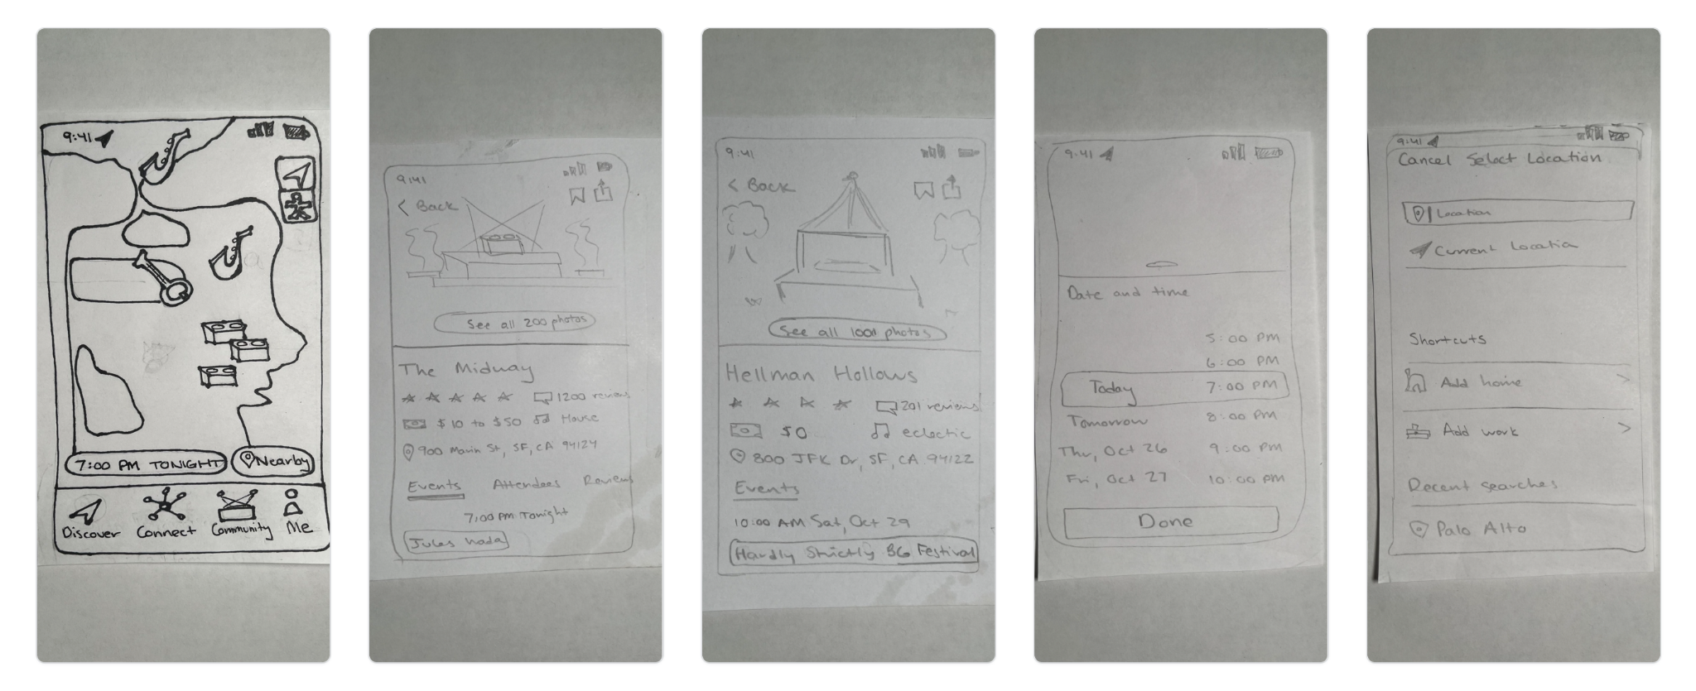
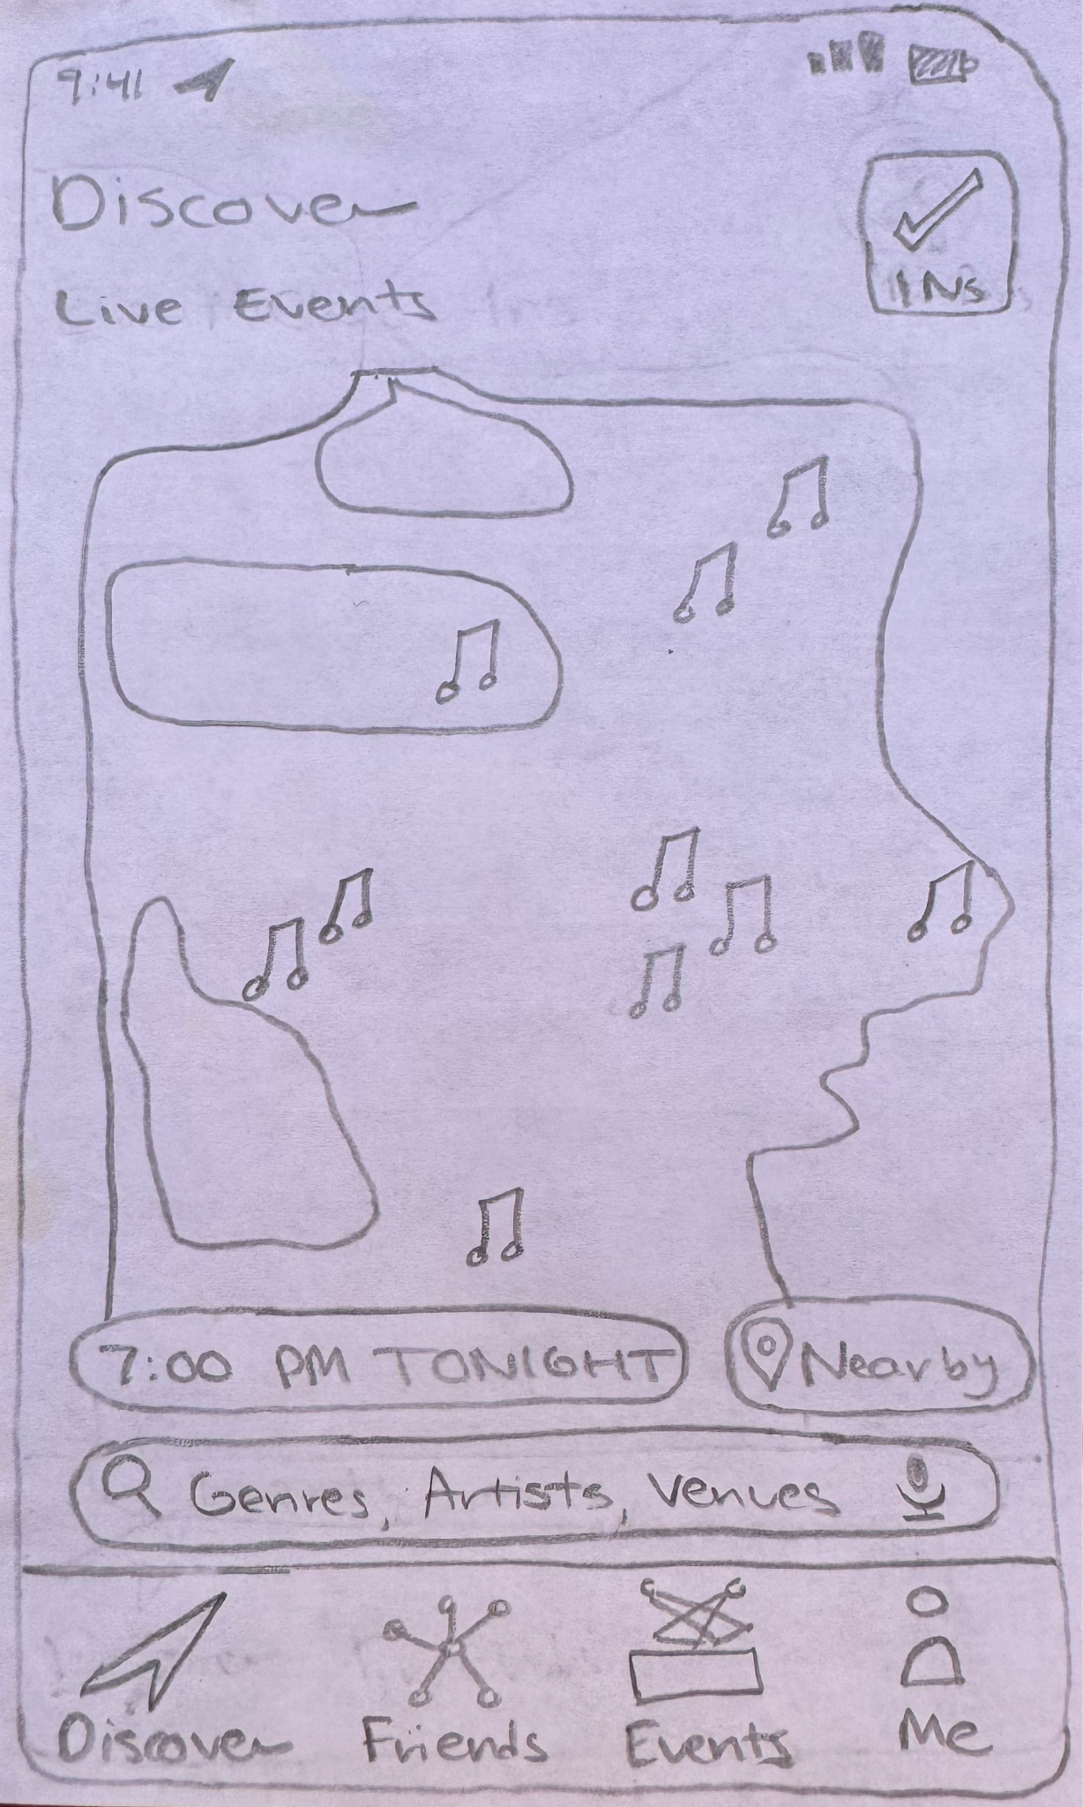
Revised Interface Sketch #1
Rebranding Connect & Community tabs to Friends & Events for navigability
Headings for visibility
Users struggled navigating to the right tabs for moderate & complex tasks
Directly improves discoverability & learnability through clear navigation hierarchy of moderate & complex tasks
* No impact on user satisfaction
Original
Revised

Slide 20
Revised Interface Sketch #2
How can event creation be made intuitive to encourage promotion on our platform?
Key Question
“I wouldn’t have guessed that artists would find this under their Profile.”
Feedback

Slide 21
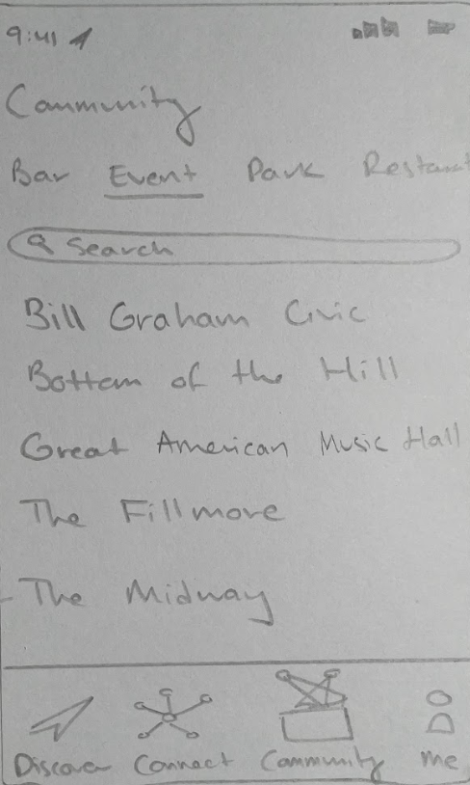
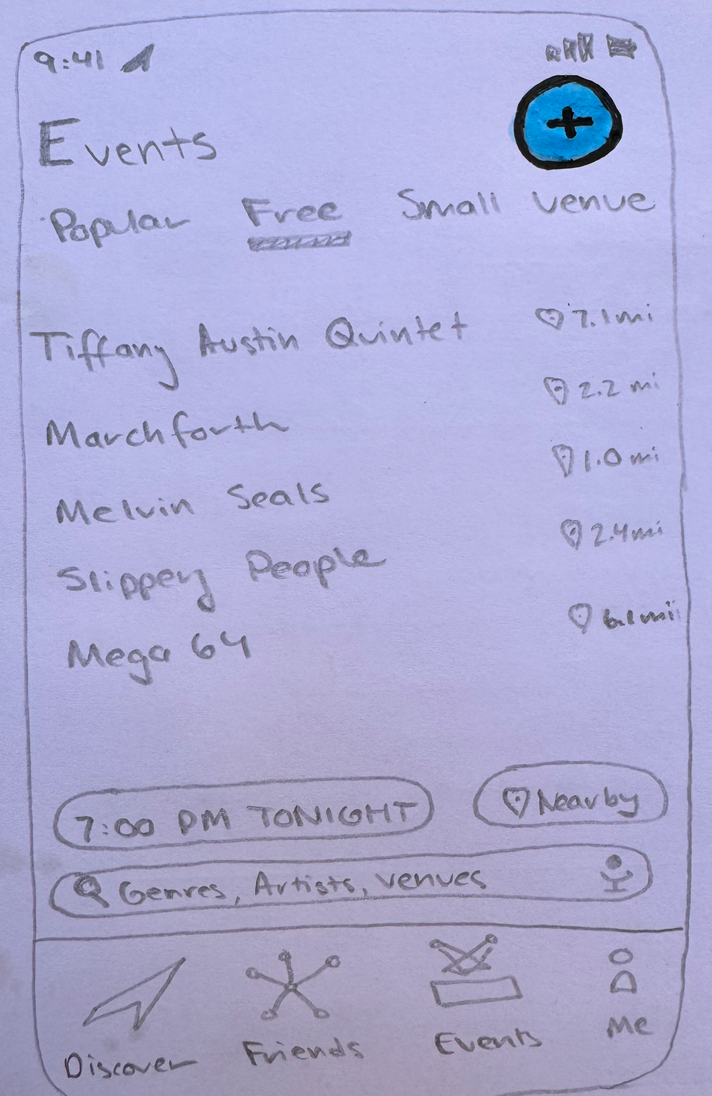
Revised Interface Sketch #2
New large PLUS button with accent color for visibility on new dedicated Events tab
Users struggled discovering how to create new live events
Directly improves discoverability & learnability through easy to find & tap button on intuitively named tab
* No impact on user satisfaction
Original
Revised

Slide 22
Revised Interface Sketch #3
How can live music event discovery be personalized to user preferences?
Key Question
“I really like the Discover view though I’d love if I could search for artists or genres that I like”
Feedback

Slide 23
Revised Interface Sketch #3
Incorporated search for flexibility of finding live events that users want in map
Users requested the ability to query for types of live events they care about
Improves satisfaction through directly addressing feature requests received from users during TuneTribe usability testing
Directly improves flexibility & discoverability of live music events via genre, artist, or venue that users want
Original
Revised

Slide 24
06
Task Flows

Slide 25
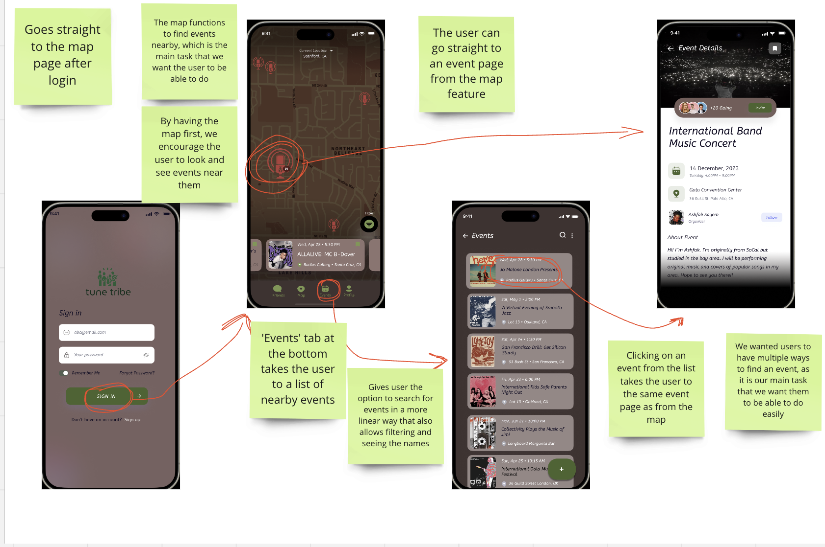
Task Flow 1: Discovering an Event (Simple)
Notes:
Solutions:
- Centralized community-first space for live music lovers with support for promotion of artists’ events regardless of their size, type, price, or skill level
- Personalized connection suggestions based on music tastes and event check ins to find new concert buddies
- FUN through gamification of event attendance / check ins
- Integration NOT duplication of features in existing popular social media & music apps (messaging, directions, playing content, data sources for events)

Slide 26
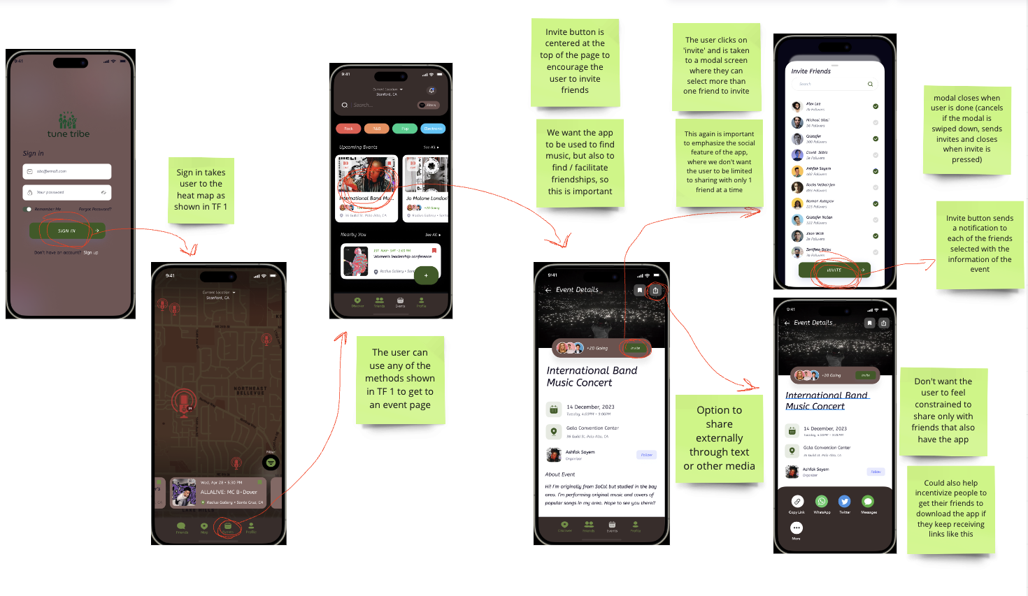
Task Flow 2: Sharing event with friend (moderate)
Notes:
Solutions:
- Centralized community-first space for live music lovers with support for promotion of artists’ events regardless of their size, type, price, or skill level
- Personalized connection suggestions based on music tastes and event check ins to find new concert buddies
- FUN through gamification of event attendance / check ins
- Integration NOT duplication of features in existing popular social media & music apps (messaging, directions, playing content, data sources for events)

Slide 27
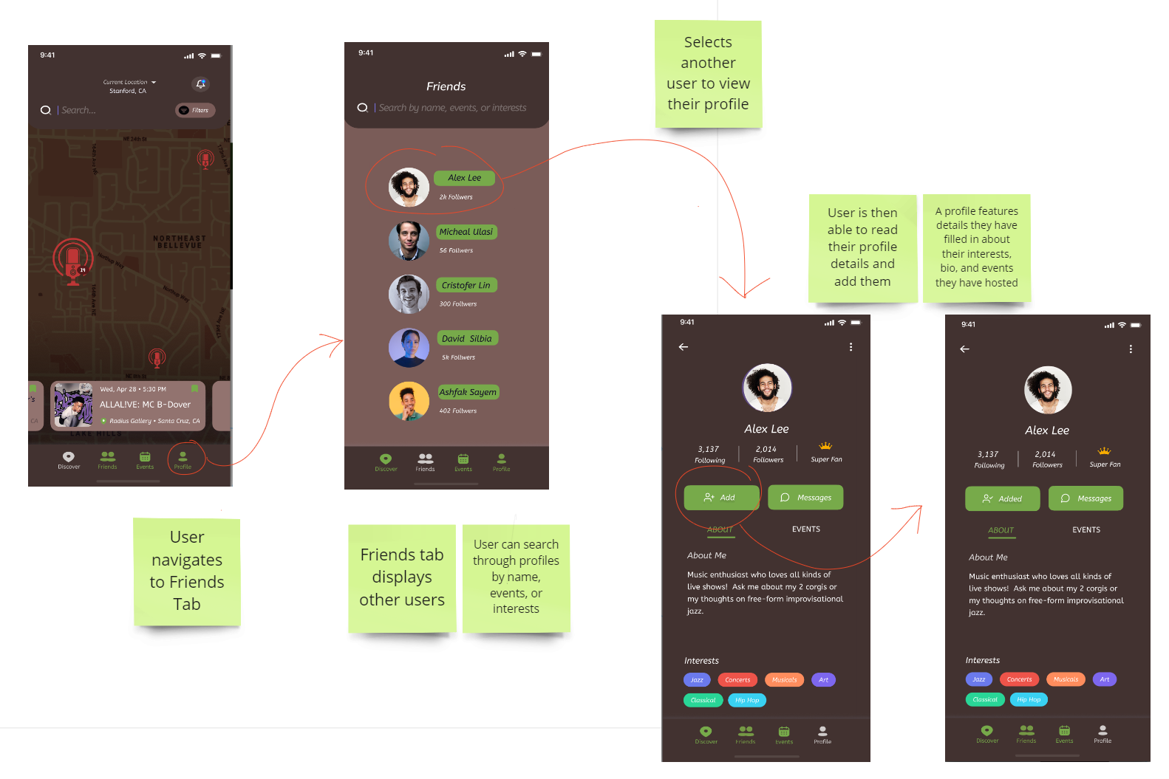
Task Flow 3: Adding Another User (moderate)
Notes:
Solutions:
- Centralized community-first space for live music lovers with support for promotion of artists’ events regardless of their size, type, price, or skill level
- Personalized connection suggestions based on music tastes and event check ins to find new concert buddies
- FUN through gamification of event attendance / check ins
- Integration NOT duplication of features in existing popular social media & music apps (messaging, directions, playing content, data sources for events)

Slide 28
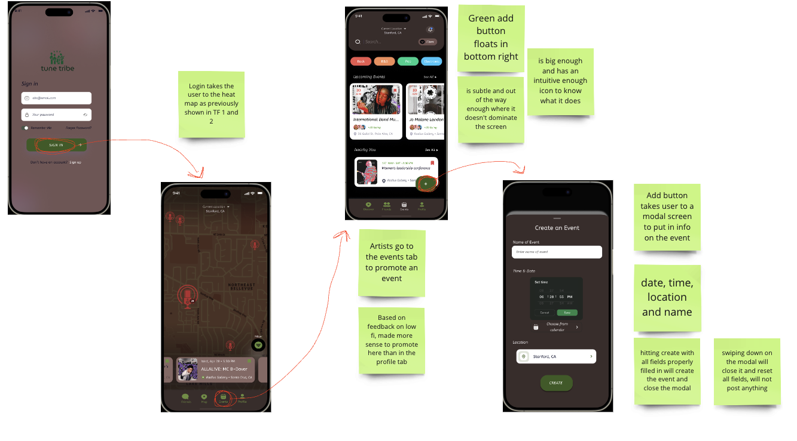
Task Flow 4: Promoting an event (complex)
Notes:
Solutions:
- Centralized community-first space for live music lovers with support for promotion of artists’ events regardless of their size, type, price, or skill level
- Personalized connection suggestions based on music tastes and event check ins to find new concert buddies
- FUN through gamification of event attendance / check ins
- Integration NOT duplication of features in existing popular social media & music apps (messaging, directions, playing content, data sources for events)

Slide 29
07
Prototype Implementation

Slide 30
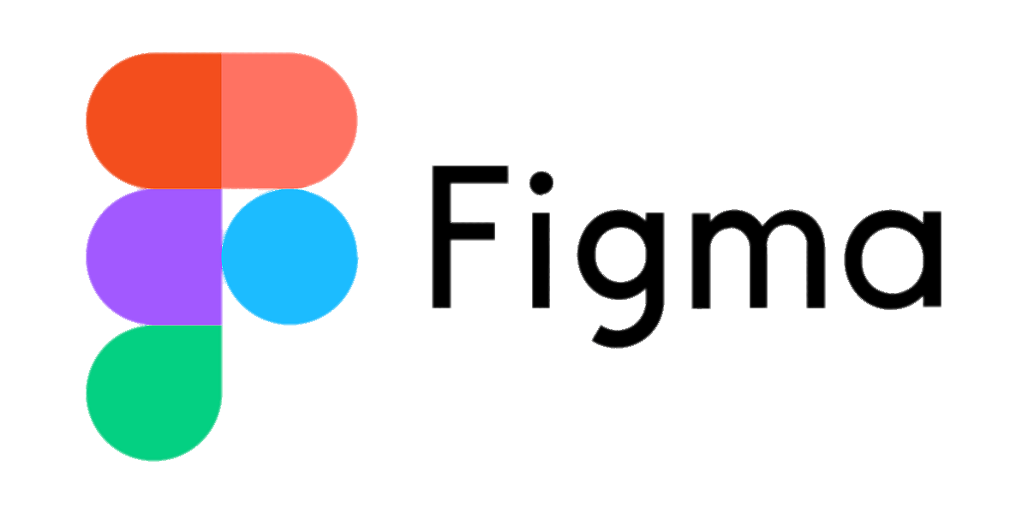

Tools Used
Cons
Pros
 | UI packages Features like smart animate that made prototype come to life Customizable | “After Delay” feature would be disabled at times & there was no way for the user to understand why Elements get lost easily in frames with many elements
 | Able to download designs as PNGs Wide variety of elements and fonts | Not enough features to build a prototype – just small designs

Slide 31
Limitations & Trade-offs
3rd Party Streaming App Linking
In-app Navigation
Gamifying the Experience
Building a navigation app like Google Maps requires more capability than what Figma offers
Gamifying the app would need more data and users
Users fill out personal info instead
Notes:
Q: What did we have to leave out of this prototype? Why?

Slide 32
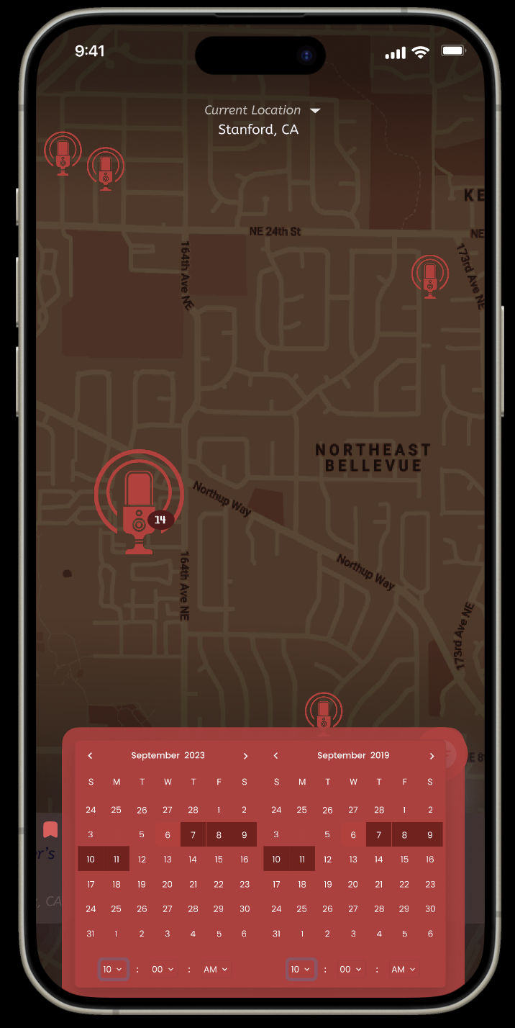
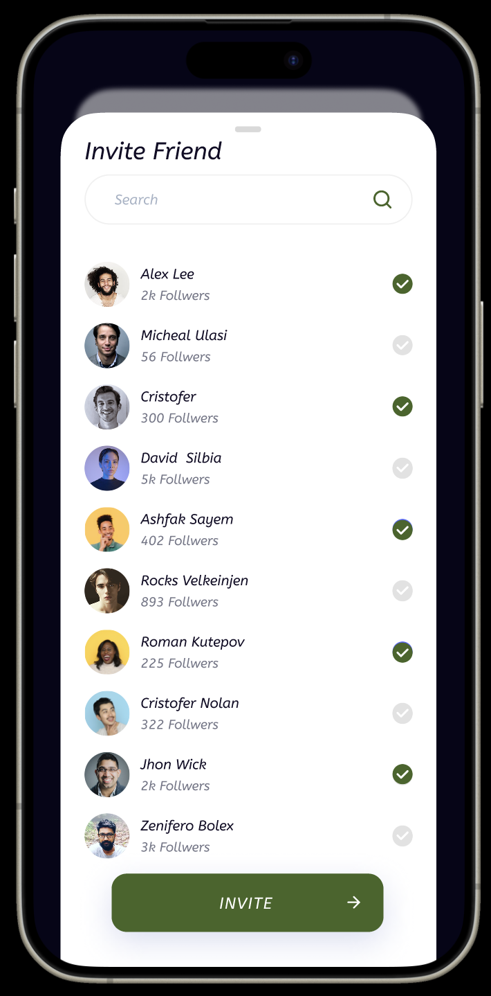
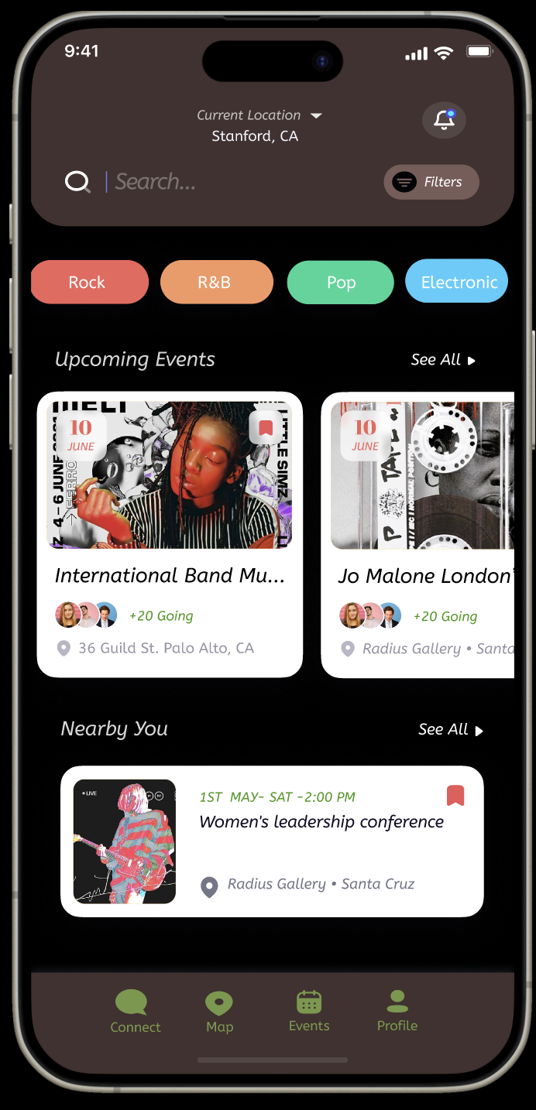
Wizard-of-Oz features
Map
Friend Event Invitation
Filtering Events
Map pre-loaded with a set location and fake events
Filtering events leads to same selection of events
Fake users to act as friends in invite screen

Slide 33
Wizard-of-Oz features
Map
Why?
Since the app has no users and hence no one to upload events, there is no data available on events in the area, so to still give users an understanding of the “Beatmap” feature we added our own fake events.

Slide 34
Wizard-of-Oz features
Friend Event Invitation
Why?
As mentioned previously, the prototype has no user data, so we had to create our own to act as friends to give the user an idea of how the friends feature would work.

Slide 35
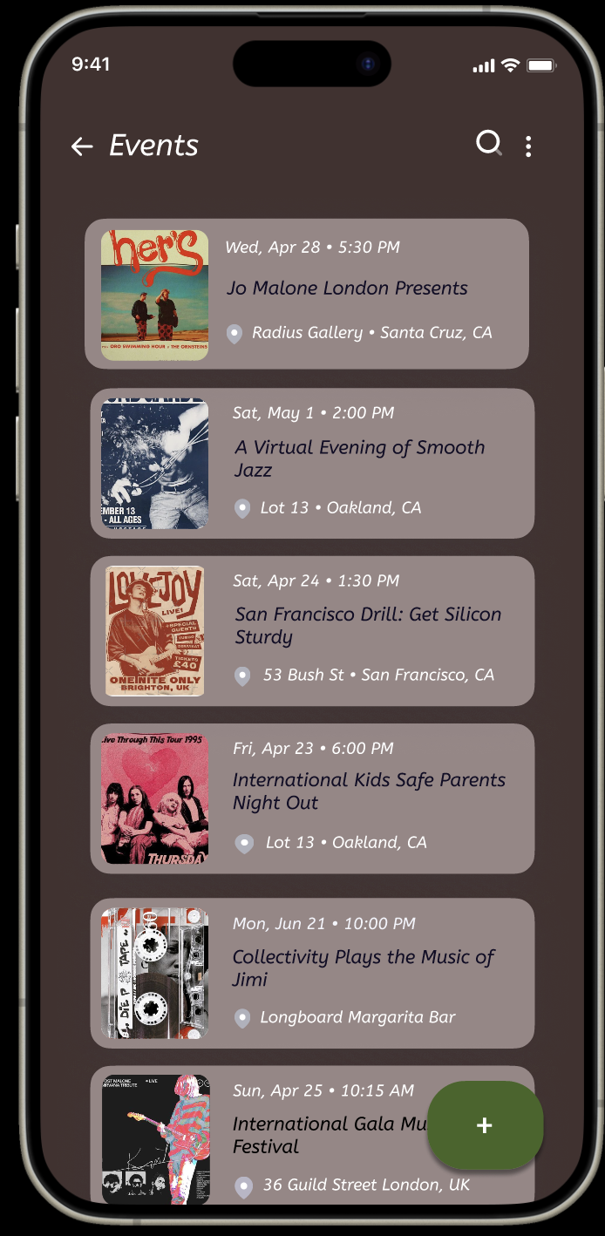
Wizard-of-Oz features
Filtering Events
Why?
To avoid having to create a large amount of fake events for each genre the user is only shown the same selection of events, yet the view still changes to communicate to the user that sorting the events changes the display.

Slide 36
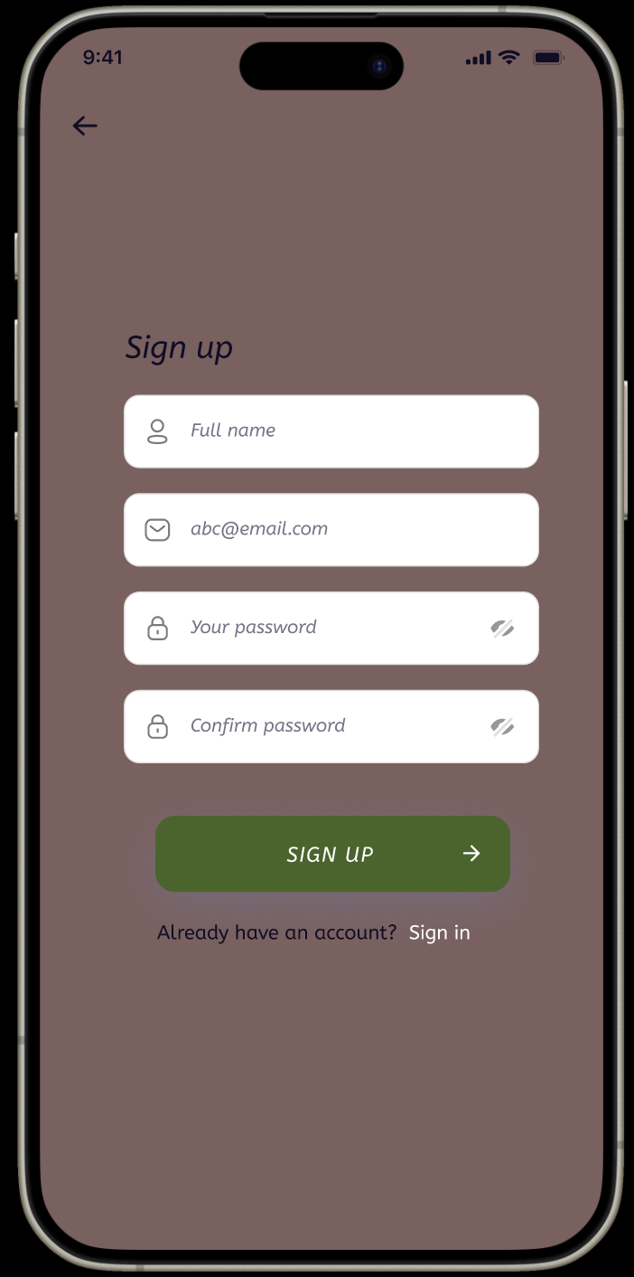
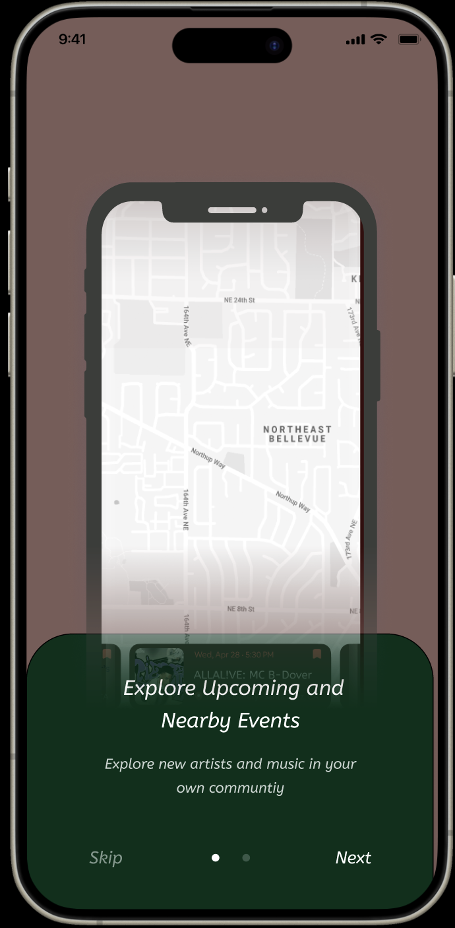
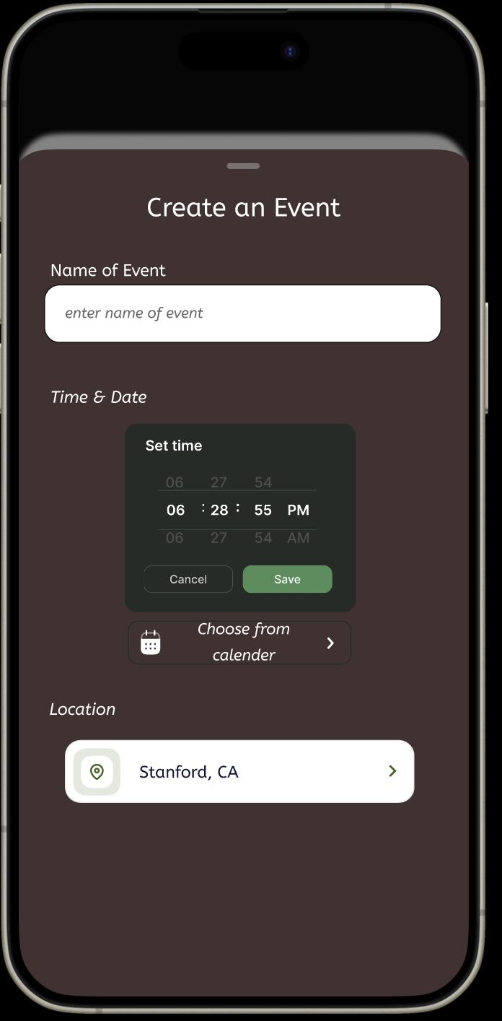
Hard-coded features
Profile Creation
Onboarding
Events Page + Creation
User’s profile info is preset
Before starting app, contextual info is provided
Event creation page has preset inputs

Slide 37
Appendix

Slide 38
Revised Lo-Fi Sketches
Link to Lo-Fi Sketches on Drive

Slide 39
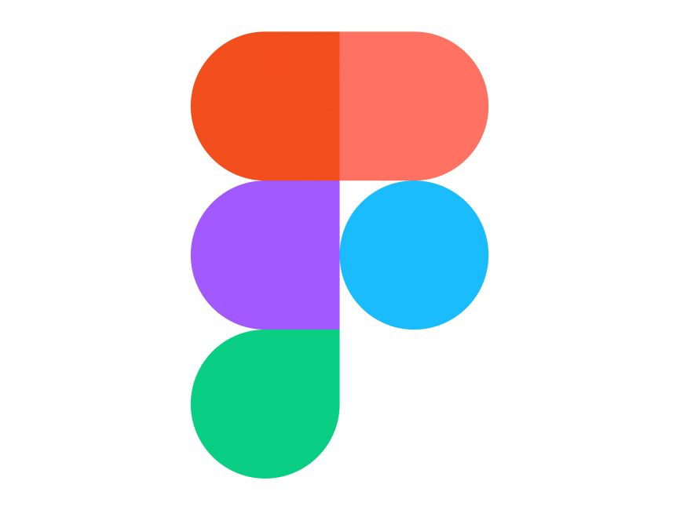
Medium-Fi Prototype
Link to Figma Prototype

Slide 40

Readme
Link to Readme on Drive

Slide 41
Other Slides Due Monday

Slide 42
Table of contents
01
02
03
04
Overview
Values in Design
Tasks
Task Flow #1

Slide 43
Backup Slides
(in case we change
the layout)

Slide 44
A6: Interactive Medium-Fi Prototype
Checkpoint: Friday 11/3
A6
TuneTribe

Slide 45
TuneTribe Team
Max
Steven
Lizi
Gracielly

Slide 46
TuneTribe
Due Friday 11/3
Title, value prop
Notes:
TuneTribe seeks to connect people in their community using music

Slide 47
TuneTribe
Due Friday 11/3
Problem/solution overview

Slide 48
Values in Design
Due Friday 11/3
Discoverability: We wanted to stay true to our original core value we derived from needfinding of making it easy to discover small local venues. To emphasize this we made the discovery page our core feature. With both a discovery page that displays shows and allows for sorting by genre, distance, and price, along with our “BeatMap”, a heatmap of local small events happening now near your location that have icons scaled by their audience size.
Community: We also wanted to still commit to our value of finding communities and people to connect with. To do this we implemented the ability to view other users and their interests as well as communicate with them through the app. We also incorporated the ability to include community events in our “events” tab that are not simply concerts but still may bring local communities together.
Intuitiveness was another value we kept in mind while designing, we received good feedback from the lo-fi prototype on what parts of our app were confusing and made changes to make the app more intuitive to use and a better user experience. For instance we made event creating much simpler and easier for users by streamlining it and making the UI clearer.

Slide 49
Usability Goals & Key Measurements
TODO: Monday
2 usability goals and 2 key measurements identified in Assignment 5
How is your product progressing towards hitting these goals?

Slide 50
Tasks
Due Friday 11/3
Labeled simple, moderate, or complex
Note any changes you made from the tasks in Assignment 5

Slide 51
Revised Interface Sketches
Major changes – 3 biggest changes between original and revised sketches
How will these changes aid in progressing forward with your usability goals?
Rationale based on low-fi testing results, studio feedback, user needs, etc.
Before and after comparisons
If you have more than 3 changes you want to show, add the rest to the appendix

Slide 52
Revised Interface Sketches: #1
Rebranding of Connect and Community tabs to Friends and Events for clear navigability
Clear heading for visibility
Users struggled with moderate & complex tasks
Targeting increased discoverability and learnability
Original
Revised

Slide 53
Medium-Fi Task Flows
TODO: Monday
Task Flow for Task 2
Annotated screenshots from your medium-fi prototype (arrows indicating transitions, relevant labeling, captioning, etc.)

Slide 54
Medium-Fi Task Flows
TODO: Monday
Task Flow for Task 3
Annotated screenshots from your medium-fi prototype (arrows indicating transitions, relevant labeling, captioning, etc.)

Slide 55
Medium-Fi Task Flows
TODO: Monday
Task Flow for Task 4
Annotated screenshots from your medium-fi prototype (arrows indicating transitions, relevant labeling, captioning, etc.)

Slide 56
Revised Interface Sketches: #3
TODO: Monday
TODO: Monday
TODO: Monday
Original
Revised

Slide 57
Revised Interface Sketches: #2
TODO: Monday
TODO: Monday
TODO: Monday
Original
Revised

Slide 58
Medium-Fi Prototype
Link to Figma Prototype

Slide 59
README
Link to README

