Slide 1


A8: Interactive High-Fi Prototype
By: Ananya N, Ayana G, Anthony C, Felix Z
CS 147, FALL 2025 ~ 11.20.25, THURSDAY

Slide 2
Content overview
1. Project title & value proposition
4. Heuristic evaluation results
2. Team
5. Major UI & product revisions
3. Problem/solution overview
6. Prototype implementation

Slide 3
Content overview
1. Project title & value proposition
4. Heuristic evaluation results
2. Team
5. Major UI & product revisions
3. Problem/solution overview
6. Prototype implementation

Slide 4
Gentle nudges, real progress.

Slide 5
Content overview
1. Project title & value proposition
4. Heuristic evaluation results
2. Team
5. Major UI & product revisions
3. Problem/solution overview
6. Prototype implementation

Slide 6

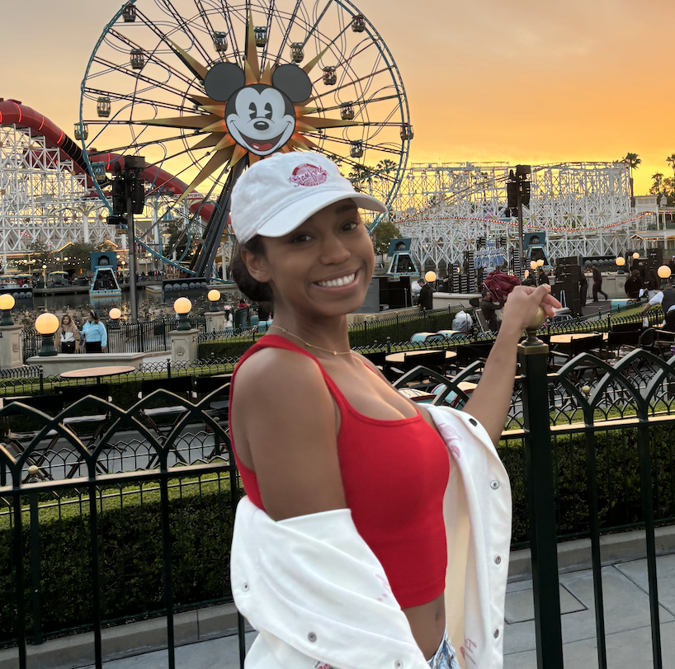
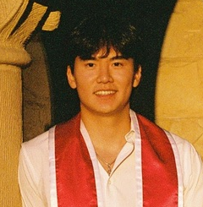
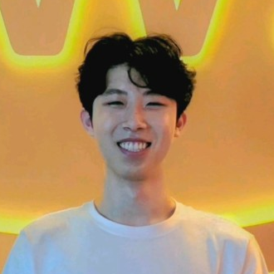
Our team
Ananya N.
Ayana G.
Anthony C.
Felix Z.
DESIGN/DEV
DESIGN/DEV
DESIGN/DEV
DESIGN/DEV

Slide 7
Content overview
1. Project title & value proposition
4. Heuristic evaluation results
2. Team
5. Major UI & product revisions
3. Problem/solution overview
6. Prototype implementation

Slide 8
Facing the challenges of ADHD learners:
PROBLEM/SOLUTION OVERVIEW
01
02
03
04
HYPERFOCUS
HYPOFOCUS
TACKLING OVERWHELMING GOALS
CREATING PRODUCTIVE WORK ENVIRONMENTS
Paying too much attention to smaller details, forgetting the bigger picture
Getting easily distracted or sidetracked
Managing the feasibility of an assignment or project
Working with others, having some form of body-doubling
01
02
03
04
REFLECTION CHECK-INS…
TIMED SESSIONS…
TASK BREAKDOWN…
A STUDY COMPANION…
… to help refocus and start fresh
… to keep learners on track and committed
… to formulate a work plan that walks the learner through smaller steps
… to provide an artificial presence

Slide 9
Content overview
1. Project title & value proposition
4. Heuristic evaluation results
2. Team
5. Major UI & product revisions
3. Problem/solution overview
6. Prototype implementation

Slide 10
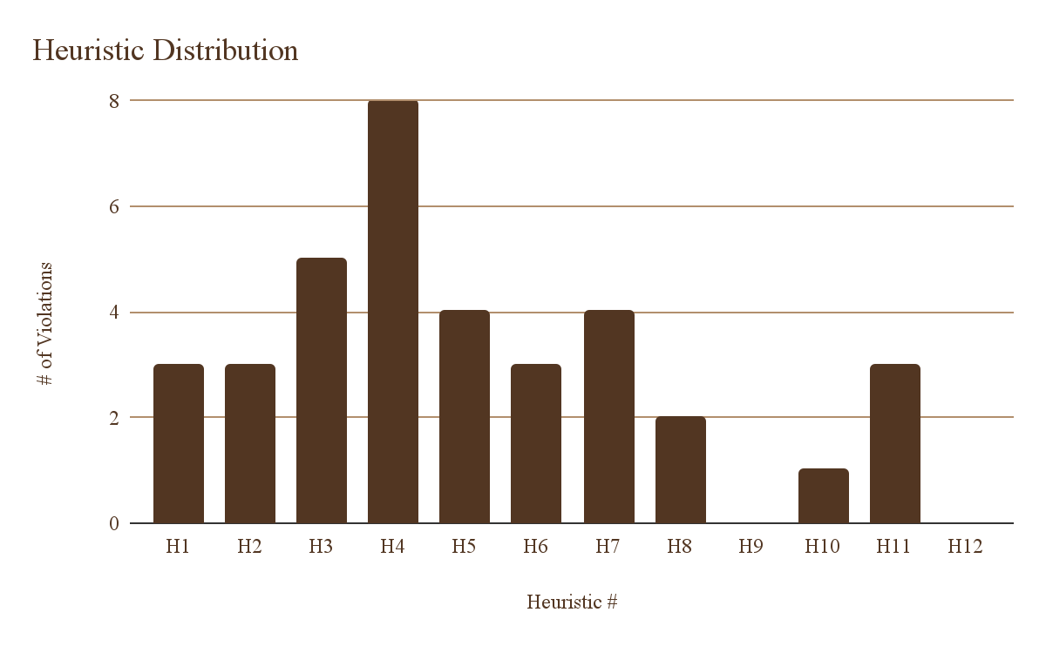
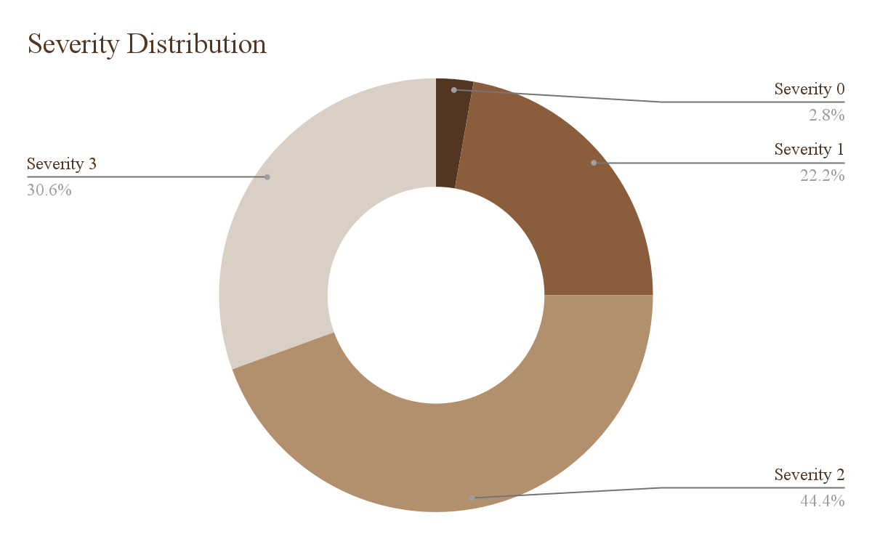
HEURISTIC EVALUATION SUMMARY
total violations: … 36
severity 3 & 4 violations: … 5
most common severity: … 2
most common heuristic: … H4 (Consistency & Standards)
severity 0: … 1
severity 1: … 8
severity 2: … 16
severity 3: … 11
severity 4: … 0
( 1 )
( 11 )
( 8 )
( 16 )

Slide 11
Our values are accommodation and flexibility.
HEURISTIC EVALUATION SUMMARY
REVISION PLAN (FOCUSING ON SEVERITY 3 VIOLATIONS):
Pull back from “Nice-To-Have” features for now – collaboration, calendar, friends & groups
(problems 1 & 7)
Set aside Figma-related violations – prototyping errors will be fixed in the full implementation
(problems 6, 13, 18 & 30)
Providing a safety net/confirmation for users wanting to delete all manually-entered/AI-generated tasks for a goal plan before continuing with the action.
Giving the user an option to enter their own tasks as well as providing AI-supported offerings. Also offering streamlined method to start a session without having multiple tasks
Offering options to view a countdown timer on the screen during work sessions as well as reminders of time remaining at various logical intervals.
Keeping buttons consistent across all task flows and screens
Notes:
Safety net to edit tasks and goal plan
Enter own plan

Slide 12
Content overview
1. Project title & value proposition
4. Heuristic evaluation results
2. Team
5. Major UI & product revisions
3. Problem/solution overview
6. Prototype implementation

Slide 13
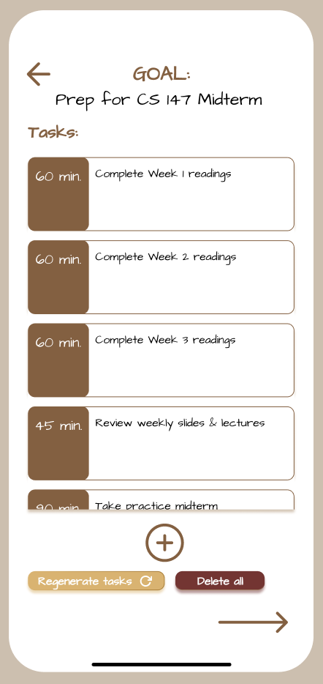
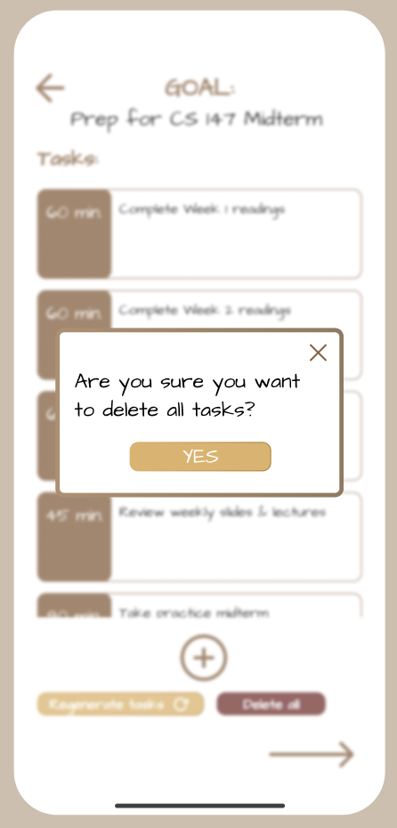
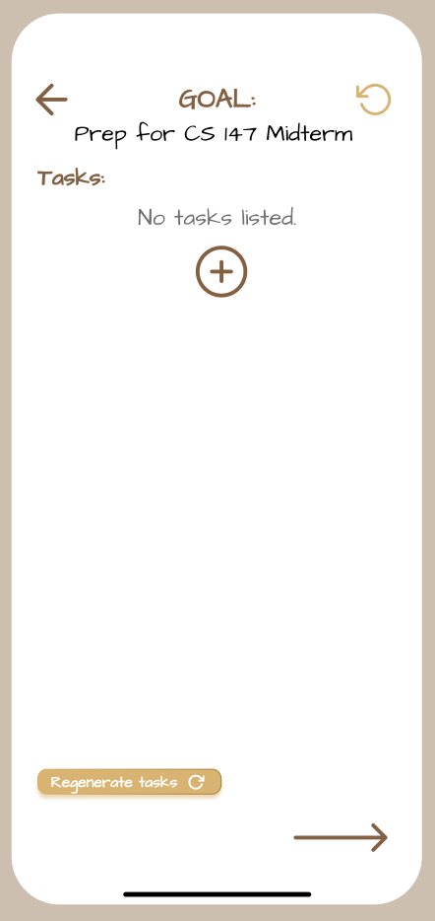
1. ‘Delete All’ confirmation/safety net
UI & PRODUCT REVISIONS
1
Extra check provides reassurance
Avoids added step of “undoing” if selected by accident
Temporarily pauses deletion of all task edits
1
Added confirmation modal
USABILITY GOALS: ROBUSTNESS, SAFETY

Slide 14
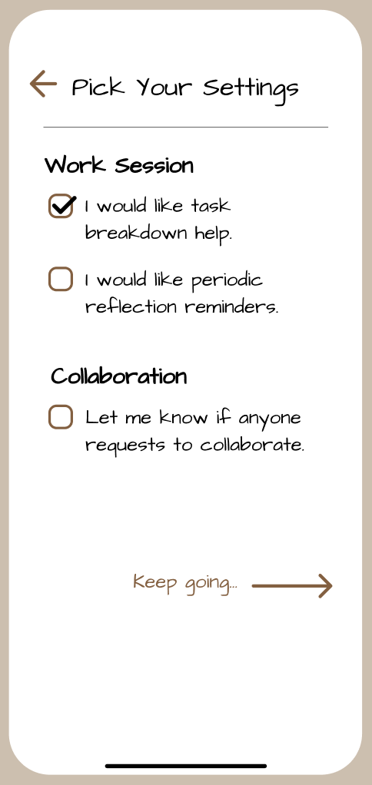
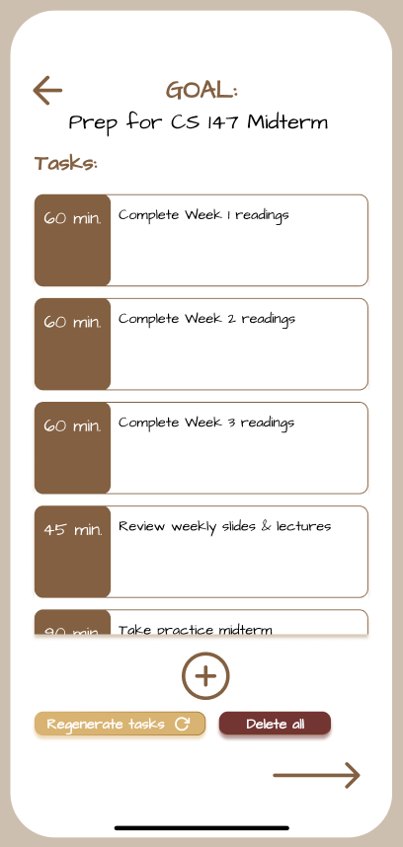
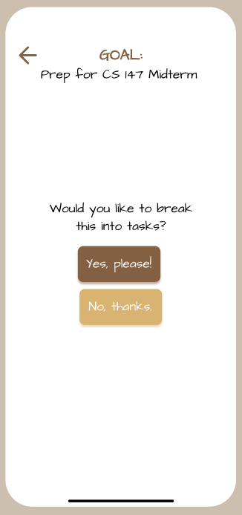
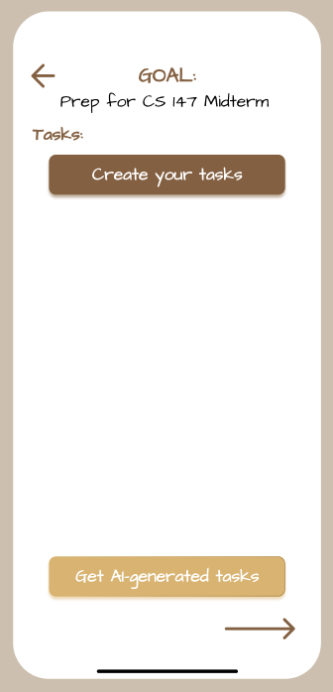
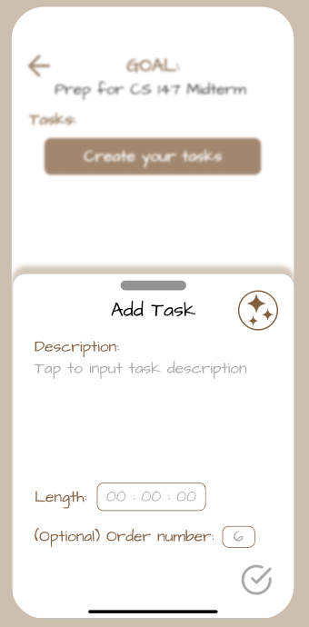
2. Manually enter tasks
1
&
2
Manual and AI-assisted task creation options available
UI & PRODUCT REVISIONS
3
Task-specific AI help
(manual vs. AI are not mutually exclusive)
Users may choose to request AI help in generating tasks or provide their own, from an assignment handout or personal plan
Refined AI help at all times, but manual control prioritized
1
3
2
USABILITY GOALS: FLEXIBILITY, USER CONTROL & FREEDOM

Slide 15
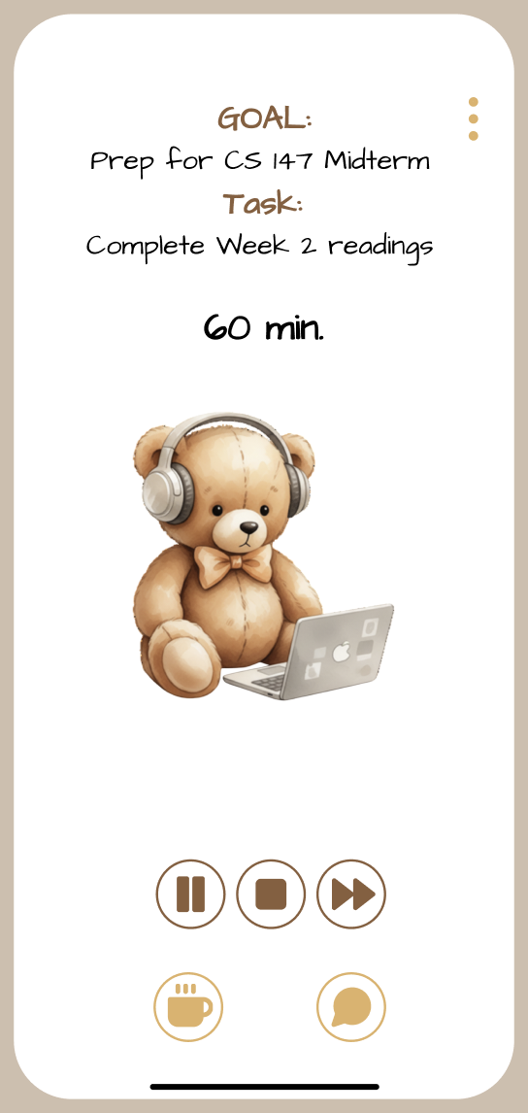
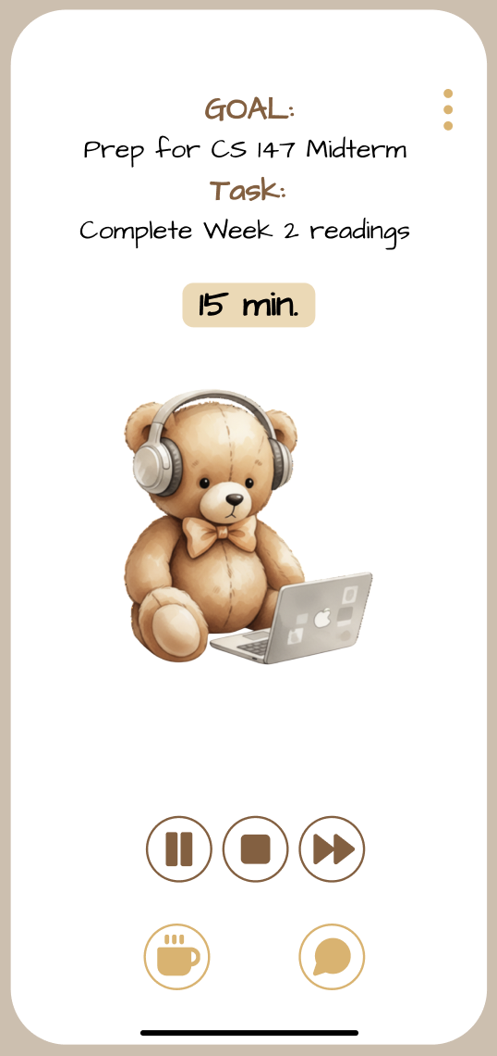

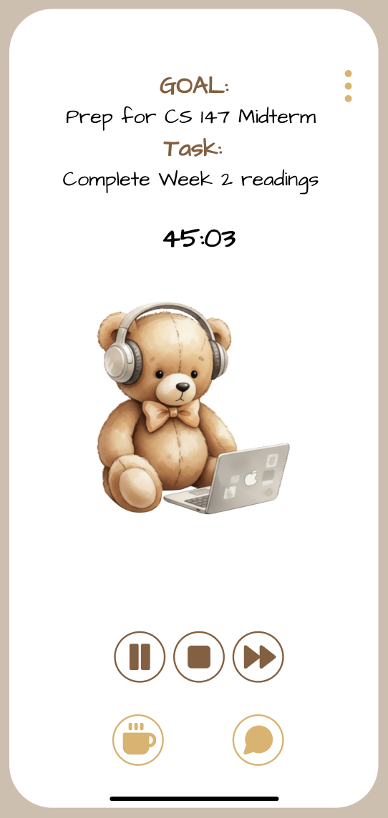
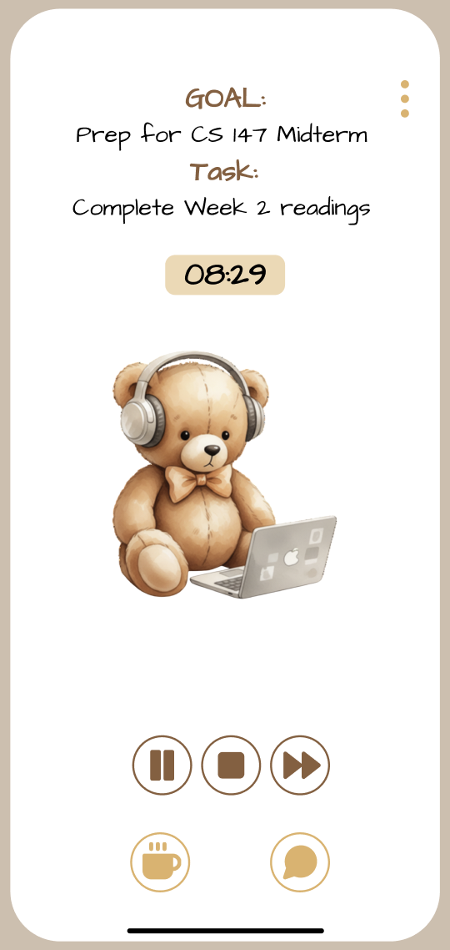
3. Visible countdown timer
1
UI & PRODUCT REVISIONS
Tap to toggle between BTS timer and real-time countdown
Caters to a variety of users: those who would like more constant visual feedback AND those who prefer a background time tracker
Simplistic, minimal, & logical effort to alter settings
1
USABILITY GOALS: UTILITY, FLEXIBILITY

Slide 16
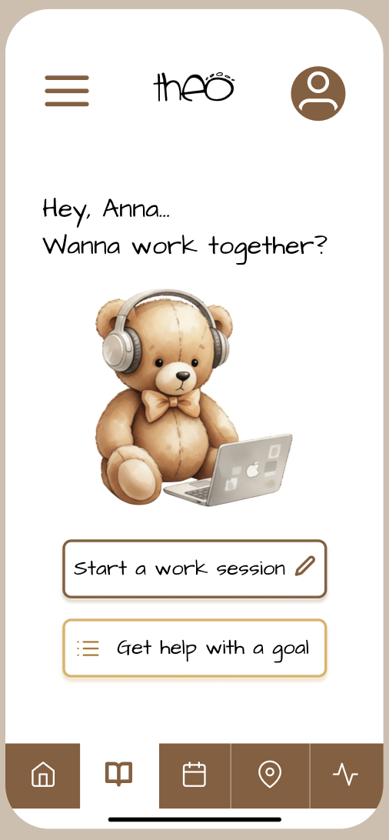
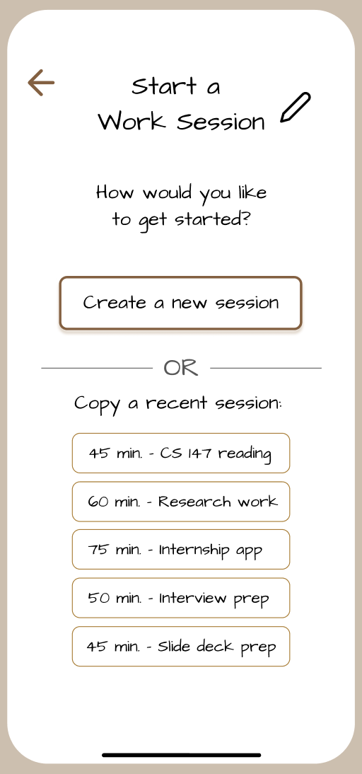
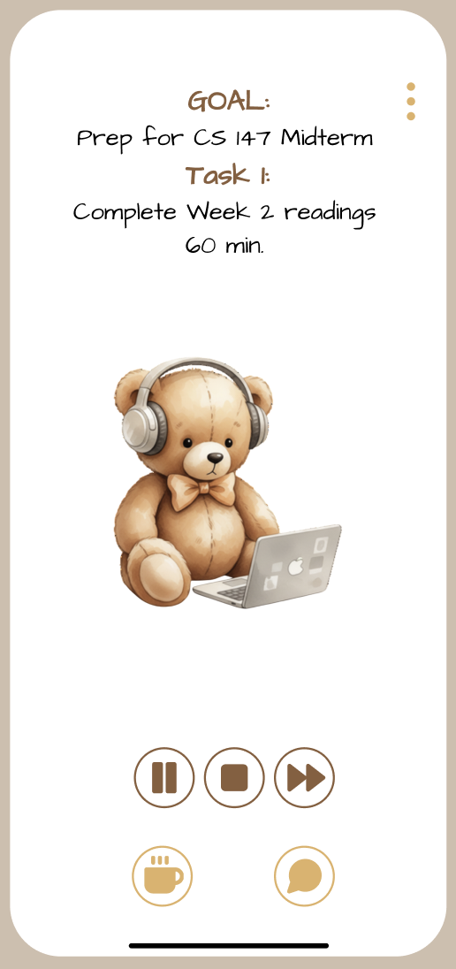
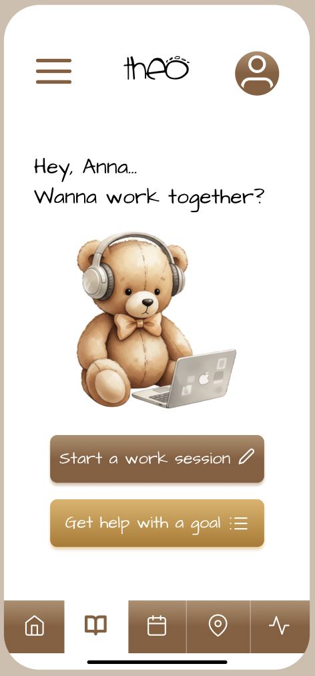
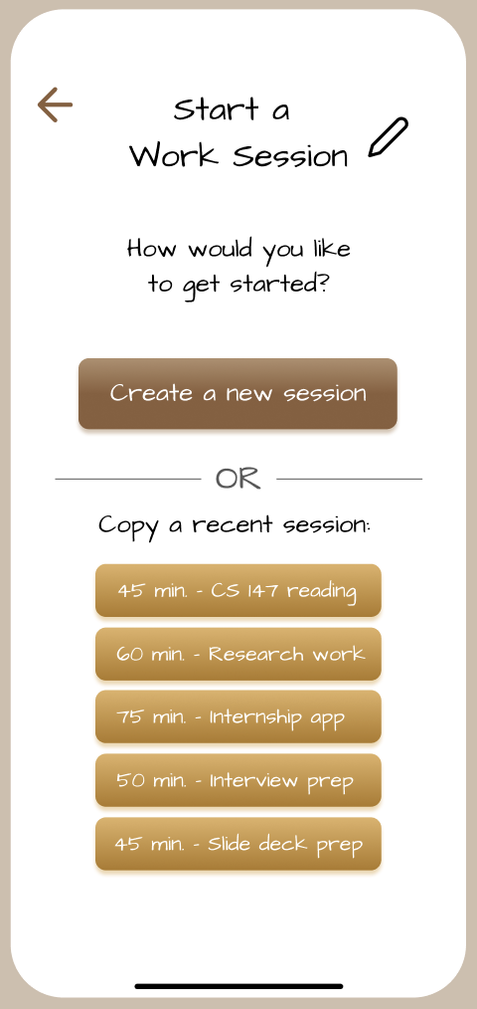
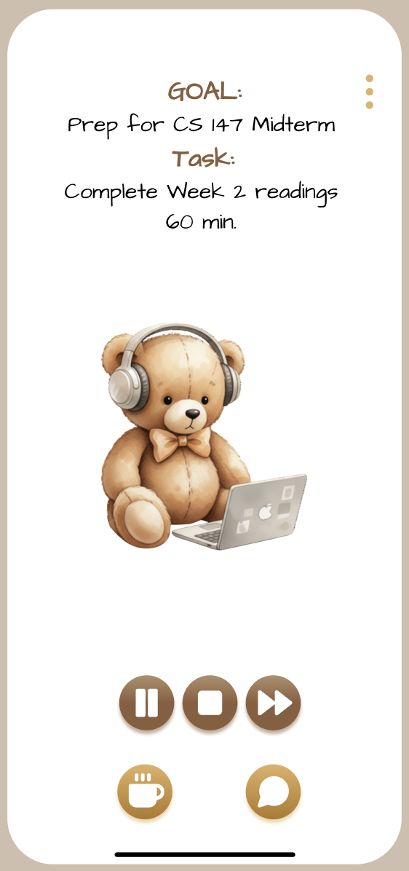
4. Standardizing ‘clickables’
UI & PRODUCT REVISIONS
3
1
4
Makes buttons more salient, gives them volume/substance
Single template for all buttons and icons for easy recognition
2
3
1
USABILITY GOALS: CONSISTENCY
4
2

Slide 17

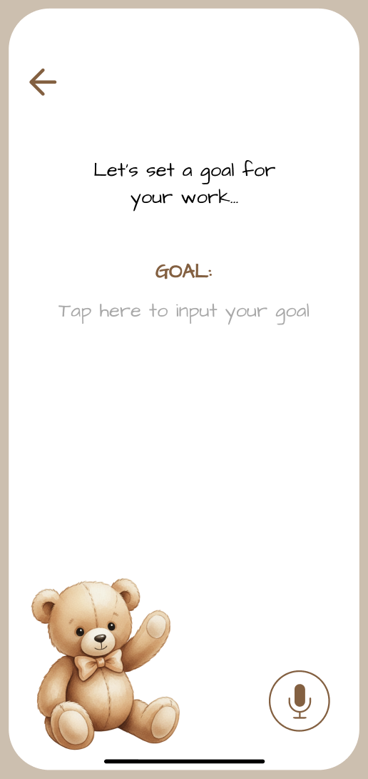
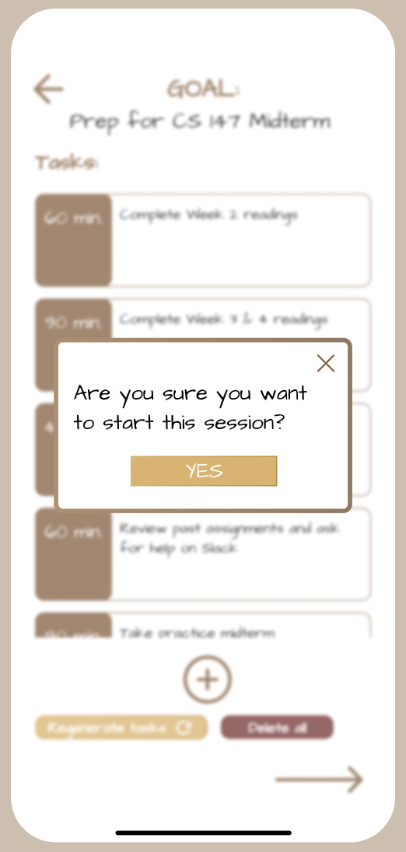
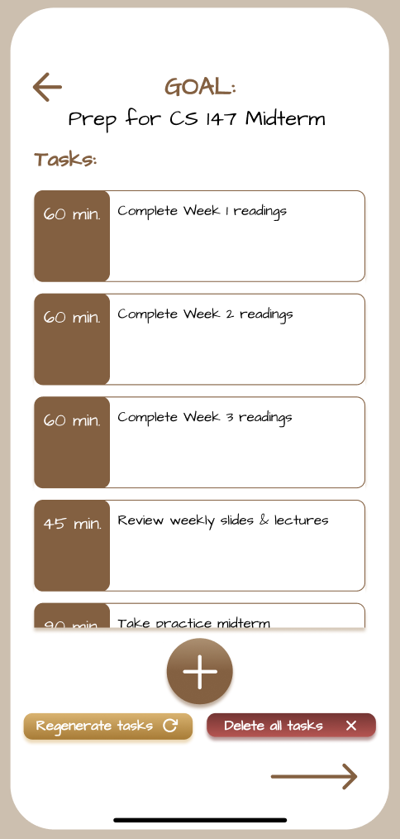
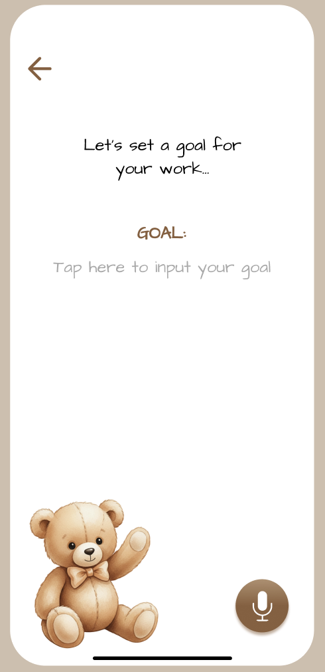
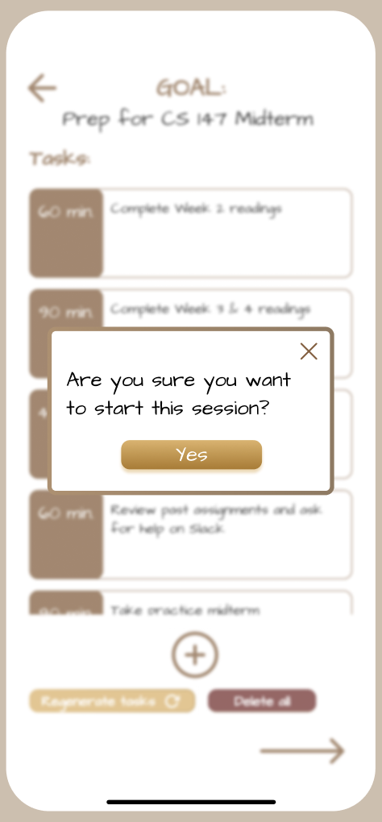
UI & PRODUCT REVISIONS
4. STANDARDIZING “CLICKABLES” - CONT.
4
1
3
Icon images all filled with white strokes
Buttons all use the same letter case format
Buttons all use gradient fill
Buttons all have consistent corner radius, icons are all circular
2
4
1
3
2

Slide 18
Content overview
1. Project title & value proposition
4. Heuristic evaluation results
2. Team
5. Major UI & product revisions
3. Problem/solution overview
6. Prototype implementation

Slide 19
Here’s where our prototype stands as of this moment…
Framework/Tools
AI Integration & Use
HI-FI PROTOTYPE IMPLEMENTATION
JavaScript/React Native/TypeScript ~ functionality
Supabase backend ~ data storage
Github ~ collaborative version control
Gemini-generated visuals of teddy bears
AI code review
Wizard of Oz Techniques
Hard-Coded Items
Implemented Features
Tab navigation
Design system components
Beginning a basic work session with no extra addendums (goal breakdown, reflections, etc.)
None. Most “smart” components are hardcoded or local-only at the moment.
We have a few hardcoded features since our login/account creation is under construction.
Tasks
Goals (internally stored)
Username

Slide 20
Unimplemented Features:
Issues/Questions:
Moving Forward → Task Lead
HI-FI PROTOTYPE IMPLEMENTATION (CONT.)
Goal breakdown feature (manual & AI-assisted) → Top priority! (11/24)
Session archive → top nice-to-have for record-keeping (11/29)
Goals vs. work sessions → Second highest priority, can be merged with Feature (1) (11/26-27)
(opt.) Collaboration/geographic locator → if we have time… (12/01)
None at the moment, we will be sure to ask if anything comes up!
Login/register + Supabase reintegration → Felix
Goal breakdown → Felix/Anthony
Reflections → Ayana
Session archive → Ananya
AI integration → Felix/Anthony

Slide 21
Demo Time!

Slide 22


Slide 23
Thank you.
Questions?

