Slide 1
MARKET RESEARCH & CONCEPT VIDEO
2025
October
by Ananya, Ayana, Anthony, & Felix

Slide 2
CONTENTS
01. Project name and value proposition
02. Problem/solution overview
03. Market research
04. Values in design
05. Tasks
06. Storyboards and concept video

Slide 3
CONTENTS
01. Project name and value proposition
02. Problem/solution overview
03. Market research
04. Values in design
05. Tasks
06. Storyboards and concept video

Slide 4
PROJECT AND VALUE PROPOSITION
🧸 Theo: Gentle nudges. Real progress.
We named our project ‘Theo’ to evoke the sense of a trusted companion. Just as a teddy (Teddy → Theodore → Theo) bear provides the comfort of an imaginary friend, Theo acts as a supportive study buddy, offering structure, encouragement, and reflection. This mirrors the effect of body doubling in a friendly, approachable form reminiscent of childhood.

Slide 5
CONTENTS
01. Project name and value proposition
02. Problem/solution overview
03. Market research
04. Values in design
05. Tasks
06. Storyboards and concept video

Slide 6
PROBLEM OVERVIEW
I waste time on insignificant details, but I can’t stop myself.
It is hard for me to notice that I'm hungry or that I need to stand up or that I need to go to the bathroom.
Geodude (A1 interviewee)
Kadabra (A1 interviewee)
Learners with ADHD often rely on external accountability to stay focused and take breaks. But most digital tools assume self-discipline, leaving them inconsistent, burnt out, or stuck in hyperfocus on low-priority tasks.
“
“

Slide 7
SOLUTION OVERVIEW
A digital study companion that provides structured sessions, gentle encouragement, distraction management, and reflective prompts, simulating the grounding effect of a supportive presence while keeping users in control of their work.
🧸

Slide 8
CONTENTS
01. Project name and value proposition
02. Problem/solution overview
03. Market research
04. Values in design
05. Tasks
06. Storyboards and concept video

Slide 9
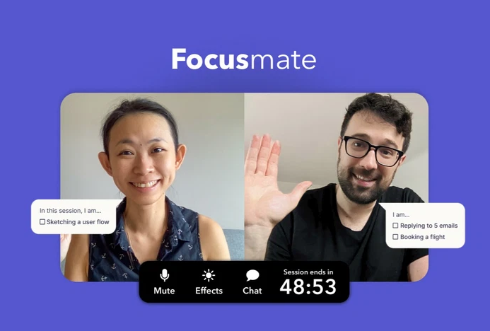
FOCUSMATE
Similarities: External accountability, structured work sessions, presence/body doubling to reduce distractions.
Differences: Focusmate uses live partners and timed sessions; Theo uses an AI buddy. Focusmate users can choose to talk to their partner and reflect/set goals, but this is not built-in.
Focusmate works best for socially motivated users who are okay with live sessions; Theo must be flexible, supportive, and non-intrusive while providing reflection and adaptive feedback to reduce reliance on live partners and to support those who may benefit from body-doubling without social pressure.
Focusmate lets users schedule live, timed work sessions with a partner. It includes features like session reminders and goal-setting at the start of each session.

Slide 10

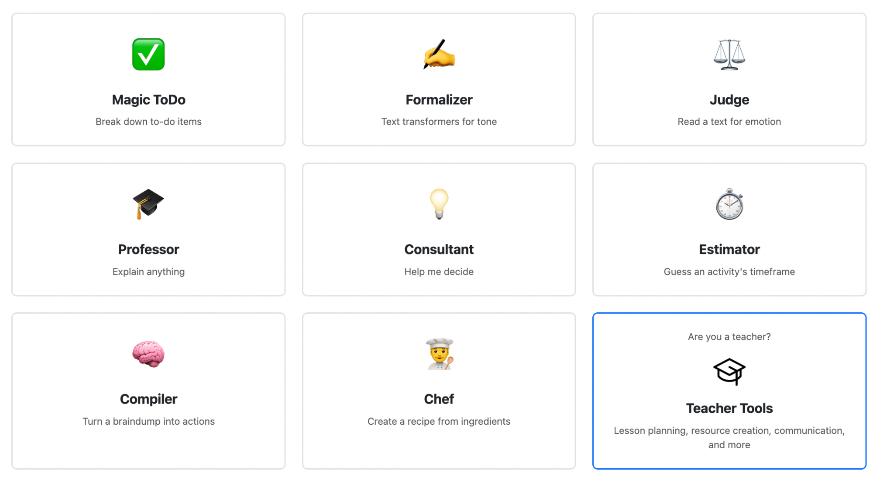
GOBLIN TOOLS
Similarities: Both support executive functioning through structured guidance, adaptive feedback, and tools that externalize mental effort.
Differences: Theo also incorporates presence (body doubling) and distraction tracking, whereas Goblin Tools emphasizes individual task management rather than focus sessions or relational interaction.
Implications: Goblin Tools demonstrates the value of AI scaffolding for neurodivergent users, but Theo must extend this beyond static task support toward relational accountability to provide a sense of being accompanied, encouraged, and guided in real time.
Goblin Tools is a suite of simple, AI-powered tools designed to support neurodivergent people with executive function challenges. It includes features like task breakdown, tone checking, meal planning, and prioritization.

Slide 11
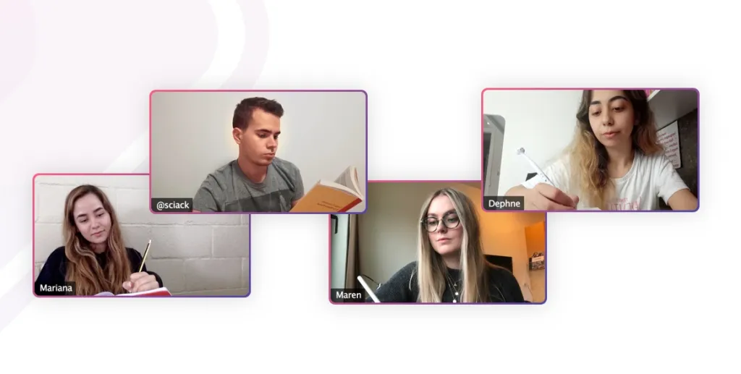

STUDYSTREAM
Similarities: Both provide external accountability through structured focus sessions and a shared sense of presence to reduce distractions and sustain motivation.
Differences: StudyStream uses live video rooms where users study alongside others, while Theo uses an AI companion to create a sense of presence.
Implications: StudyStream shows that co-presence can effectively enhance focus, suggesting that Theo can build on this principle by offering a more flexible, personalized version that doesn’t require live interaction.
A 24/7 virtual co-working platform where users join live video rooms with others studying silently. It replicates a library-like environment to promote accountability through presence and community.

Slide 12
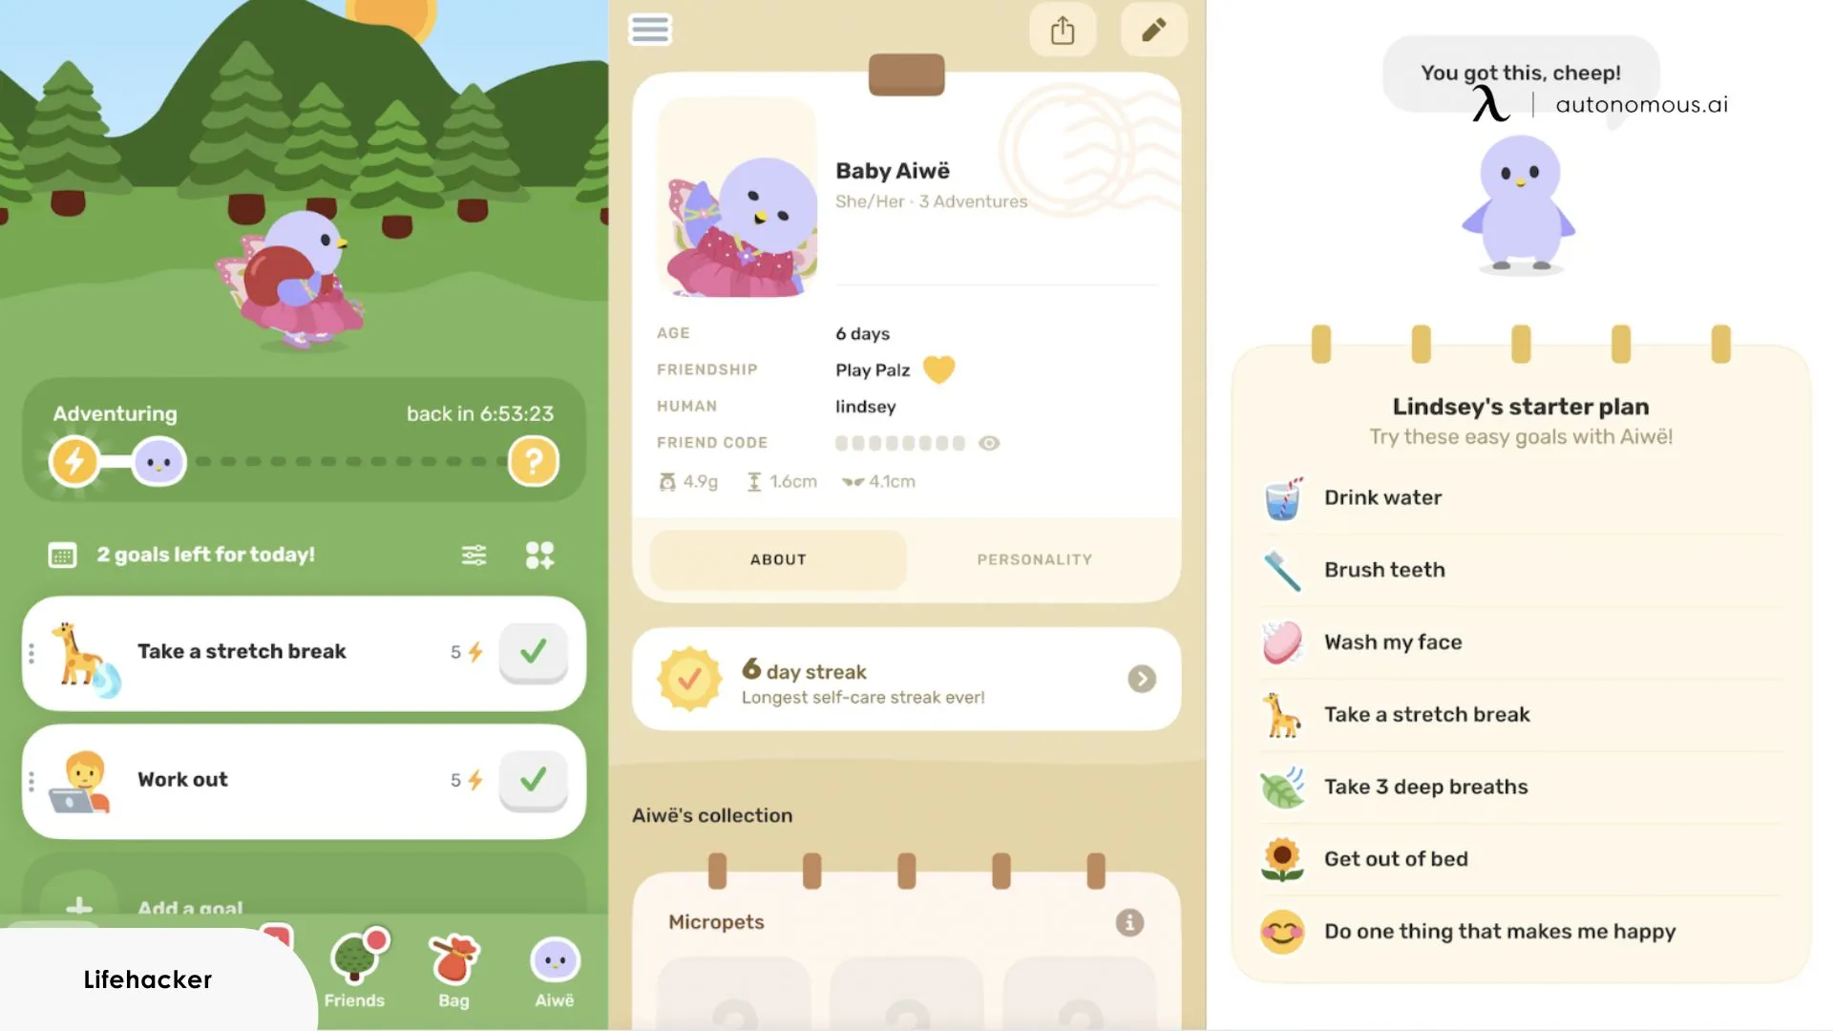
FINCH
Similarities: Both provide external accountability through regular check-ins, reflection and goal tracking
Differences: While Finch uses a companion bird to provide structure to everyday living, the focus is on mental health and well-being rather than studying and productivity
Implications: Finch illustrates that a virtual companion could improve well-being, suggesting that Theo can build on this principle by offering emotionally supportive and structured productivity sessions.
The Finch app is a mobile application designed for self-care and mental well-being that uses a virtual pet to gamify habit tracking and goal setting. It replicates a body-doubling to promote accountability through presence and supportive reminders.

Slide 13

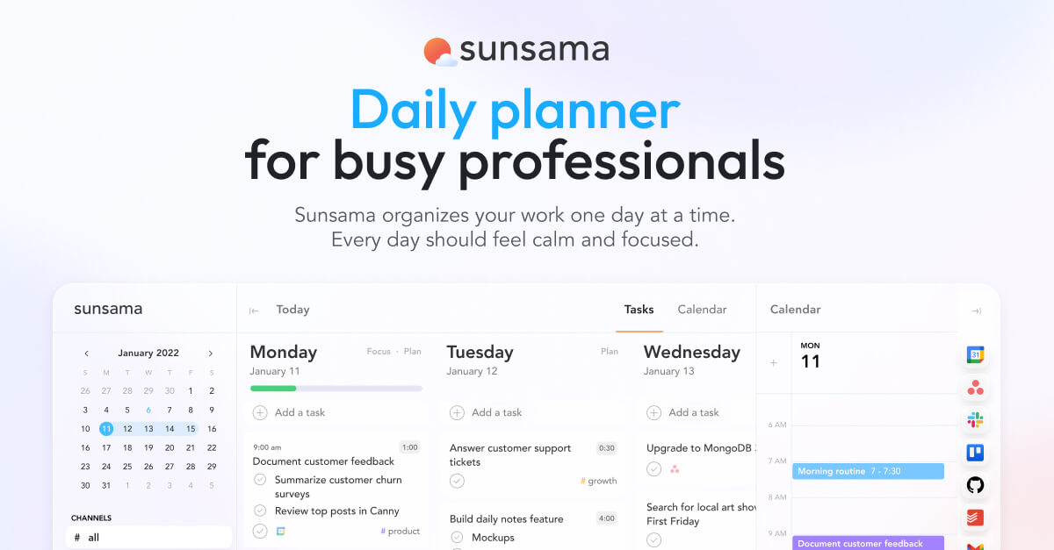
SUNSAMA
Similarities: Both provide task management and reflection features to track and update progress
Differences: While Sunsama provides many features that are helpful for ADHD learners, it largely acts as a scheduling tool whereas we hope to work body-doubling into our design to provide a sense of a real companion working alongside the learner.
Implications: Sunsama is a very close competitor to Theo, and reinforces the observations and analysis we previously found with our interviews. Theo can further develop this by taking on the role of a close friend and advisor, to be a place of emotional as well as academic and social comfort.
The Sunsama app is a desktop (and mobile) application designed as a daily and weekly planner with included guidance. It provides task breakdown and dynamic action updating capabilities.

Slide 14

LOFIGIRL
Similarities: Both use ambient sense of companionship/body doubling
Differences: LofiGirl is heavily reliant on the audio aspect and users can create a sense of community through YouTube livestream comments. We’re unsure at this point about Theo’s audio capabilities.
Implications: Lofi Girl highlights the emotional comfort and focus benefits of a calm, consistent presence, but Theo must build on this by transforming passive ambiance into active, personalized support without losing the soothing, nonjudgmental tone users value.
Lofi Girl is a YouTube channel and livestream that plays continuous lo-fi hip-hop music paired with a looping animation of a girl studying.

Slide 15
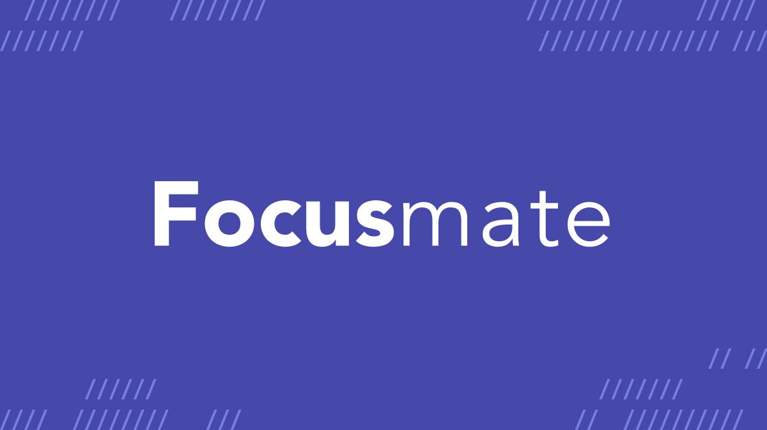


COMPARISON MATRIX
Body doubling / presence | ✅ | ❌ | ✅ | ✅ | ❌ | ✅
Reflection & feedback | ❌ | ✅ | ❌ | ✅ | ✅ | ❌
Distraction blocking | ❌ | ❌ | ❌ | ❌ | ✅ | ❌
Task breakdown | ❌ | ✅ | ✅ | ❌ | ✅ | ❌
Timed sessions | ✅ | ❌ | ✅ (if desired) | ❌ | ✅ | ❌
Personalization / adaptivity | ❌ | ❌ | ❌ | ✅ | ✅ | ❌

Slide 16
CONTENTS
01. Project name and value proposition
02. Problem/solution overview
03. Market research
04. Values in design
05. Tasks
06. Storyboards and concept video

Slide 17
STAKEHOLDERS
DIRECT
INDIRECT
Users (primarily students with ADHD)
Parents/guardians may set up/monitor use
Parents, guardians, or partners
Educational institutions and educators
Disability support services or academic coaches

Slide 18
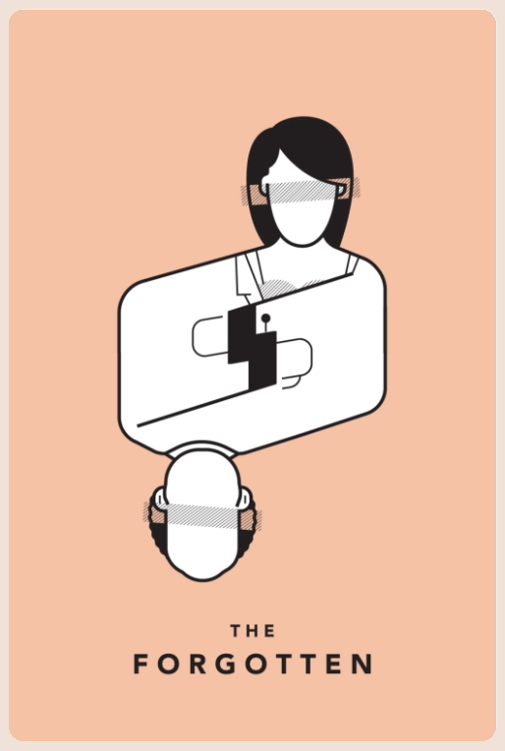
ETHICAL IMPLICATIONS
#1: THE FORGOTTEN
#1
#2
#3
Individuals who struggle with structured work sessions or who might take a while to find their flow states could find Theo to be an excuse for distraction rather than a tool for focus.
Individuals who have limited accessibility to a stable internet connection or devices through which to access Theo would find difficulty using the app on a regular basis.
Individuals who reject the “gamification” or cozy aesthetics would likely reject Theo.
On reflection, there may be ways we could incorporate increased customizability to reduce the gamified quality of assistance to minimize #3, as well as work to make Theo more dynamically supportive to different work habits, including those listed in #1.

Slide 19

ETHICAL IMPLICATIONS
#2: THE
SERVICE DOG
#1
#2
Theo could provide support to ADHD learners who are reluctant to disclose their learning disabilities to technology, since it is usable by other learners beyond the ADHD bubble.
Individuals who are less inclined to ask for help in person or do not have access to mentors or guides in their fields of study could use Theo to bridge this gap.
On reflection, it will be crucial to uphold #1 that minimal sensitive information is requested from users in order for Theo to be effective.
Theo should be a tool that provides necessary support while encouraging that users seek out opportunities for human interaction and guidance as well – in this way, Theo may be a disposable, stepping-stone tool.

Slide 20
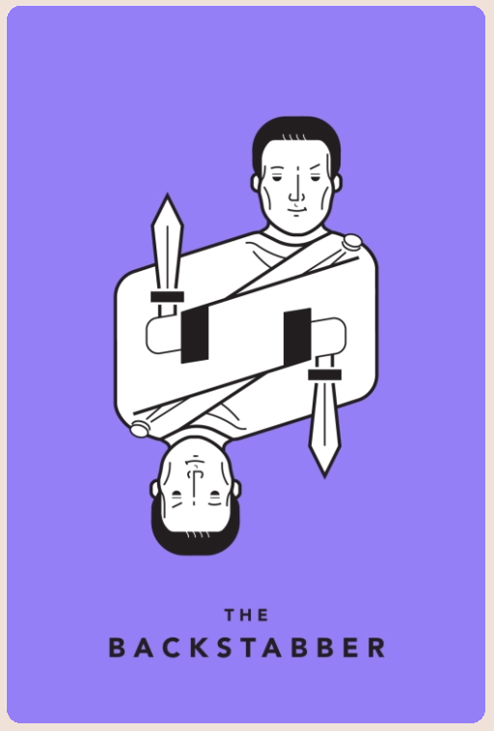
ETHICAL IMPLICATIONS
#3: THE
BACKSTABBER
#1
#2
Users could feel unsafe if they were asked to identify themselves as having a specific (learning) disability for fear of surveillance, or if this information were leaked somehow to others/organizations with unauthorized access.
Theo itself should act as a feedback tool for users to reflect upon the quality of their work session and the efficacy of the study buddy structure.
On reflection, Theo should provide users with personalized feedback tools built into the chat platform that permit the chatbot to adapt to the specific needs of the user, as well as periodically pool insights and suggestions from users to develop platform-wide improvements that are more general to aid with #2.

Slide 21
CONTENTS
01. Project name and value proposition
02. Problem/solution overview
03. Market research
04. Values in design
05. Tasks
06. Storyboards and concept video

Slide 22
SIMPLE TASK
MODERATE TASK
COMPLEX TASK
Start a simple work session with a companion
Break down a larger goal into smaller milestones
Actively reflect on progress and goal at hand while working
Timestamp: 00:21
Timestamp: 00:30
Timestamp: 0:48
From our interviews, we found that simply getting started on achieving an overwhelming goal can be difficult. So, we expect this feature to be important, but not as common as starting a session.
This is a task we expect all users to want to do (have some form of body-doubling) and is the basis of our solution.
This requires more steps on the user’s end beyond simply starting a session. We do not expect all users to do this, but hyperfocusing without reflection was a pain point from our interviews.

Slide 23
CONTENTS
01. Project name and value proposition
02. Problem/solution overview
03. Market research
04. Values in design
05. Tasks
06. Storyboards and concept video

Slide 24
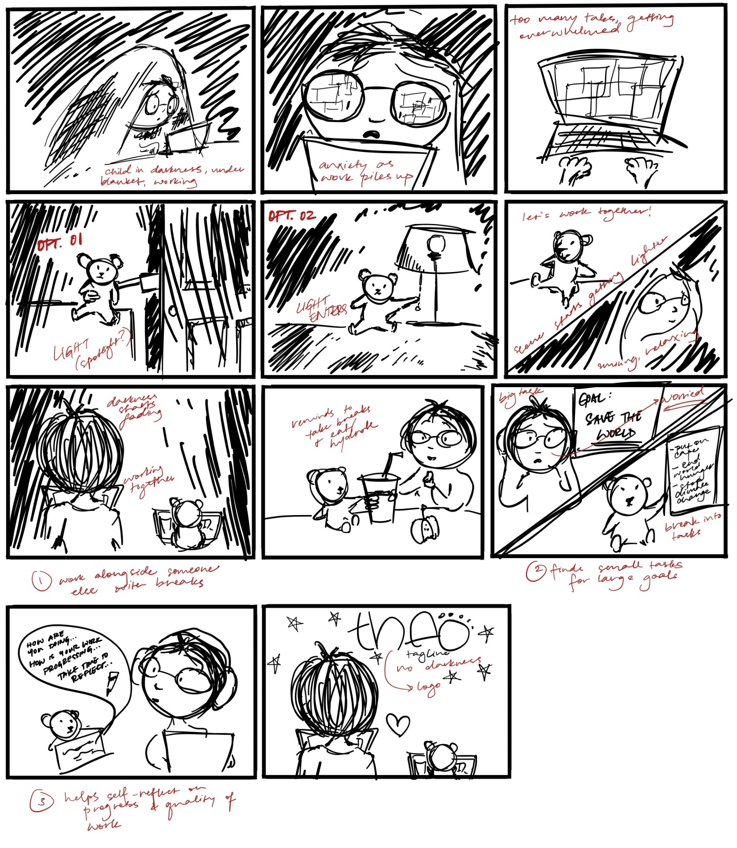
STORY
BOARD

Slide 25
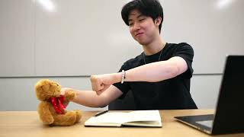
CONCEPT VIDEO

Slide 26
THANK YOU!

Slide 27
APPENDIX

Slide 28
MORE ABOUT OUR SOLUTION
Structure as Accountability
Reflection as Regulation
Presence as Support
Insight #1
Insight #2
Insight #3
Many ADHD learners benefit from external structure but still want to feel in control of how that structure shows up. They crave accountability that supports autonomy rather than pressure.
When users lose focus or drift, they often need small moments of reflection to reconnect with purpose and track progress. These check-ins help prevent burnout and build self-awareness.
For many, focus thrives on a sense of social presence. This external grounding helps manage attention and emotional regulation.
The Start Session flow creates a mindful transition into work, prompting users to set a focus goal and duration before beginning. Scheduling and Notifications let users plan sessions in advance and receive timely reminders–reinforcing consistency while respecting their preferred rhythm of work and rest.
The Mid-Session Reflection prompts users to briefly assess their focus level, energy, and distractions, helping them reorient rather than spiral. The Session Summary compiles these reflections into a concise overview that visualizes patterns over time, highlighting what environments, times, or soundscapes best support sustained attention.
The Study Buddy offers gentle encouragement and adaptive check-ins, while the Distraction Blocker and Tracker helps reduce temptations and log focus lapses. Together, they create a calm sense of accountability without pressure or surveillance.

