Slide 1
A2 Presentation
Additional Needfinding, POVs, HMWs, Brainstorming &
Experience Prototypes
Thursday, October 9th, 2025

Slide 2
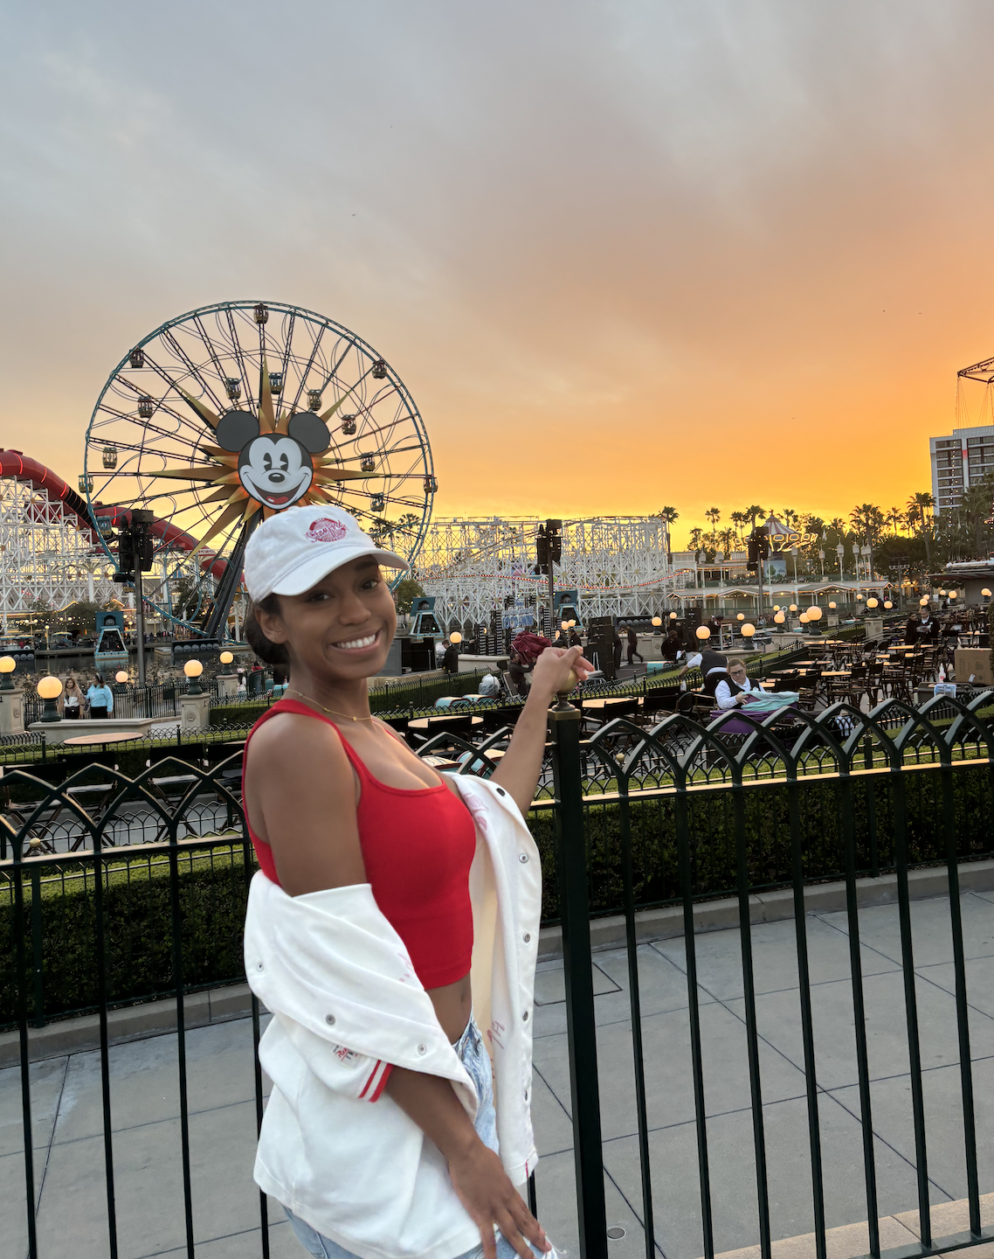
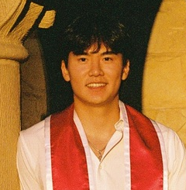
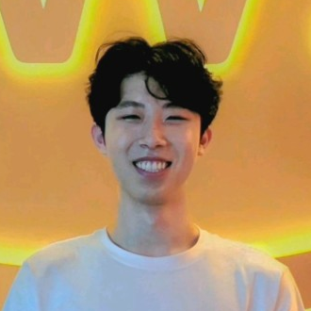
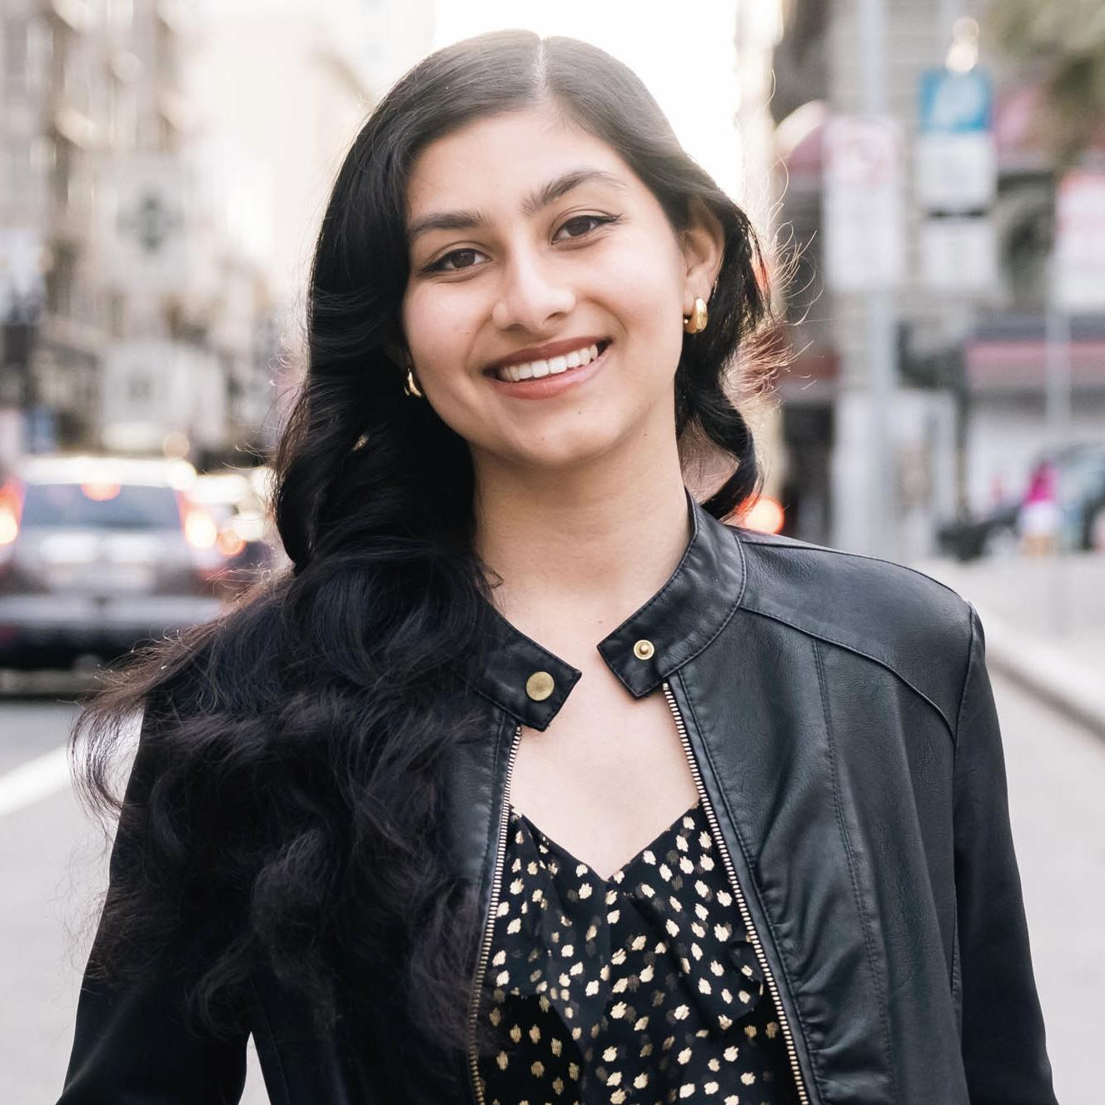
Meet the team!
Ananya N.
Ayana G.
Anthony C.
Felix Z

Slide 3
initial
Our domain
Learners with ADHD

Slide 4
refined
Our domain
Learners with ADHD who need structured support during study sessions

Slide 5
Agenda
Additional needfinding
POVs and HMWs
Solutions
Experience prototypes
Next steps

Slide 6
Agenda
Additional needfinding
POVs and HMWs
Solutions
Experience prototypes
Next steps

Slide 7
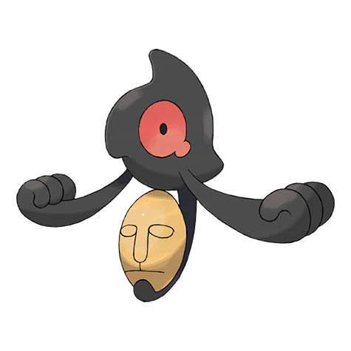
Yamask
A 24-year-old PhD student in Biology
Interviewed by Ayana, Notes by Ayana + HeyMarvin
01
02
Validating thought process is important
Relies on repetition
Doing the same task in different notebooks (physical and digital) helps with his retention
When his advisor acknowledges how work is done, he feels more grounded and confident in his progress

Slide 8
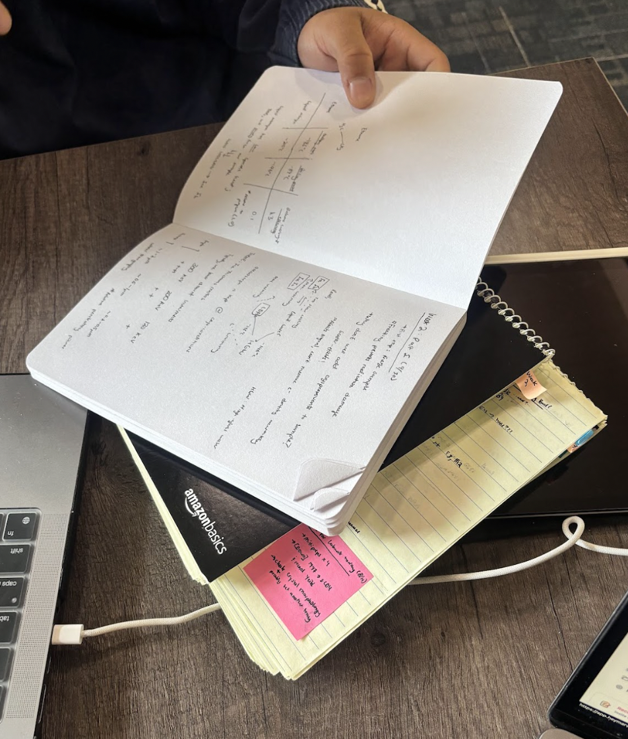
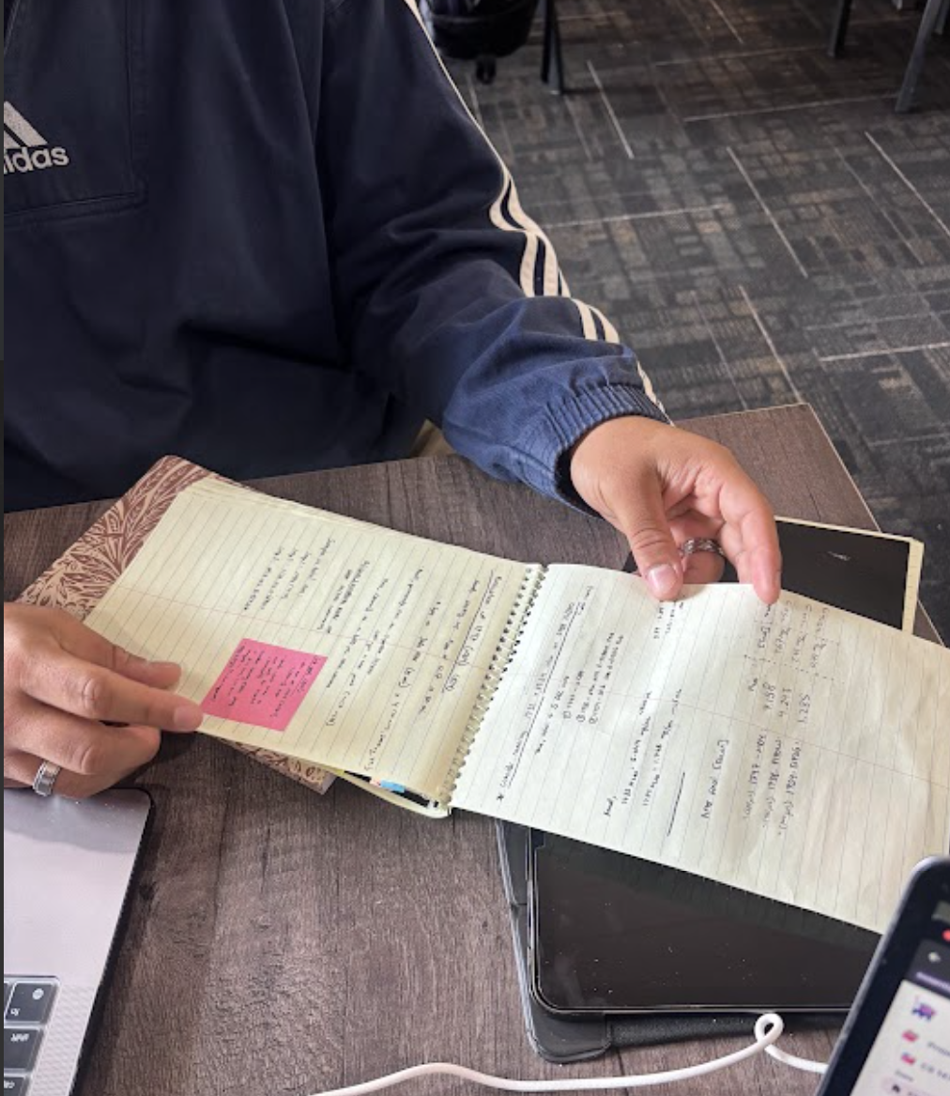
Three notebooks he carries around with him: one for lab, one for “messy” work, and one for “refined” work
💡He spends a lot of time on his thought process and approach

Slide 9
Yamask
A 24-year-old PhD student in Biology
Interviewed by Ayana, Notes by Ayana + HeyMarvin
01
02
Validating thought process is important
Relies on repetition
Doing the same task in different notebooks (physical and digital) helps with his retention
When his advisor acknowledges how work is done, he feels more grounded and confident in his progress
💡He needs feedback that recognizes effort, process, and incremental progress—not only final results—to feel secure in his trajectory

Slide 10

Cyndaquil
A 20-year-old undergraduate in Statistics
Interviewed by Felix, notes by Felix + HeyMarvin
01
02
Human presence to combat anxiety
Urgency is a must
Too much urgency creates anxiety, which in turn can be soothed with human presence.
She will intentionally procrastinate to increase motivation with urgency
💡She needs accessible forms of social or emotional grounding to counterbalance the anxiety that comes with time pressure.
03
Relies on reminders
She doesn’t use a calendar at all, instead relying on external reminders from friends.

Slide 11
Agenda
Additional needfinding
POVs and HMWs
Solutions
Experience prototypes
Next steps

Slide 12

Initial POV
Revised POV #1
We met a 56-year-old husband with ADHD who spends most of his workday on his laptop.
We were surprised to learn that even though he recognizes when he’s hyperfocused on trivial work tasks, he can’t redirect himself without his wife stepping in.
We wonder if this means that what he is working on in a given moment doesn’t reflect his true goals or values.
It would be game-changing to help him reflect while in hyperfocus mode.
We wonder if this means the repeated experience of losing control leaves him feeling frustrated or dependent, undermining his confidence in managing his own attention.
It would be game-changing to help him reclaim control in the moment to recognize when his attention drifts and consciously realign with what matters most.

Slide 13
Initial POV
Revised POV
✓
Deeper emotional insight about powerlessness and dependence on external cues
“Game-changing” statement moved from a broad reflection idea to a clear, action-oriented yet open-ended opportunity
We met a 56-year-old leadership consultant who was diagnosed with ADHD later in life.
We were surprised to learn that even though he recognizes when he’s hyperfocused on trivial tasks, he can’t redirect himself without someone else stepping in.
We wonder if this means that what he is working on in a given moment doesn’t reflect his true goals or values.
It would be game-changing to help him reflect while in hyperfocus mode.
We wonder if this means he feels capable of recognizing his patterns but powerless to act on them without external intervention.
It would be game-changing to help him reclaim control in the moment to recognize when his attention drifts and consciously realign with what matters most.
✓

Slide 14
Initial POV
Revised POV #2
We met a freelance graphic designer with ADHD.
We were surprised to learn that hyperfocus seems to be as big of a problem as lack of focus.
We wonder if this means she believes losing control of her focus is central.
It would be game-changing to help her better regulate her focus.
We met A freelance graphic designer with ADHD who mainly interacts with her husband and her dog most days.
We were surprised to learn that she uses her service dog’s needs to trigger her own self-care (eating, going to the bathroom etc.).
We wonder if this means she struggles to balance her need for external stimuli/structure with her need to feel independent.
It would be game-changing to create supportive rhythms that help her feel anchored and cared for while still giving her agency, even in solitude.

Slide 15
Initial POV
Revised POV
✓
We met A freelance graphic designer with ADHD who mainly interacts with her husband and her dog most days.
We were surprised to learn that she uses her service dog’s needs to trigger her own self-care (eating, going to the bathroom etc.).
We wonder if this means external, ambient cues are powerful scaffolds for initiating tasks, transitions and self-maintenance for her.
It would be game-changing to provide low-friction cueing that simulates body-doubling and initiate routine self-care on unavoidable micro-events.
Deeper insight and understanding about how she regulates (external cues) versus a general focus issue
“Game-changing” statement shifts from a vague goal (“help her regulate her focus”) to a targeted design direction
We met a freelance graphic designer with ADHD.
We were surprised to learn that hyperfocus seems to be as big of a problem as lack of focus.
We wonder if this means she believes losing control of her focus is central.
It would be game-changing to help her better regulate her focus.
✓

Slide 16
From additional needfinding interview
POV #3
We met a CMU student with ADHD and anxiety who studies best and experiences significantly less burnout when other people are around.
We were surprised to learn that she focuses better when there’s a small group of people nearby having an unrelated conversation than when she’s watching or listening to a TV show. Quiet feels too empty, and TV feels too scripted.
We wonder if this means she craves the subtle comfort of human presence; ambient signs of life that make her feel safe, grounded, and less alone with her thoughts.
It would be game-changing to offer ways for her to tap into that shared energy of “working alongside,” wherever she is.

Slide 17
POV #1
POV #2
POV #3
56-year-old knows when he’s stuck in hyperfocus, but can’t break free without someone else (his wife) to pull him out.
💡HMW remind people of their “why” in the middle of their work?
Freelance graphic designer relies on her dog’s routine to take care of herself, showing how powerful external cues can be for daily functioning.
💡HMW use external cues to spark self-care?
Student thrives when real, unpredictable human chatter fills the background, suggesting genuine social presence keeps her grounded and focused.
💡HMW bring the grounding energy of social presence into solo work?
Notes:
POV #1 (HMWs):
HMW turn his moments of awareness into a cue for action rather than frustration?
HMW externalize his self-awareness in a tangible way (like a visual, auditory, or social cue)?
HMW give him tools to self-intervene without disrupting his flow?
HMW help him shift from passive recognition to active self-regulation?
HMW support him in aligning attention with his goals in real time?
HMW replicate the accountability of an external reminder through self-generated systems?
HMW create adaptive, context-aware signals that nudge him to check his priorities?
HMW allow him to design his own “intervention triggers”?
HMW reframe breaks as part of the work, not as interruptions?
HMW mirror the role of a supportive partner, but while fostering independence?
POV #2 (HMWs):
HMW turn dog cues into self-care reminders?
HMW offer body-doubling when she’s alone?
HMW use household sounds as task-switch cues?
HMW link pet mealtimes to her meals?
HMW provide predictable “company” and body-doubling?
HMW place nudges where she commonly lacks the initiation energy?
HMW sync gentle nudges with her partner’s routine?
HMW map dog walks/feeds to meals or water breaks?
HMW make breaks feel short, valid, and finished?
HMW show tiny wins whenever a cue is followed?
POV #3 (HMWs):
HMW recreate the benefits of background conversation and/or body doubling?
HMW use mild social presence to lower anxiety linked to solitary work?
HMW test whether ambient human speech supports sustained attention?
HMW examine how predictable vs spontaneous background sound affects focus quality?
HMW investigate whether social audio can substitute for co-working environments?
HMW embed or simulate social cues that prompt task engagement?
HMW find features of live human noise (tone, rhythm) that improve regulation?
HMW embed or simulate external cues that prompt refocusing or breaking hyperfocus?
HMW provide low-effort access to social presence during independent work?
HMW use distributed social attention (knowing others are working, even if async) to simulate or mimic the effects of body doubling?

Slide 18
Agenda
Additional needfinding
POVs and HMWs
Solutions
Experience prototypes
Next steps

Slide 19
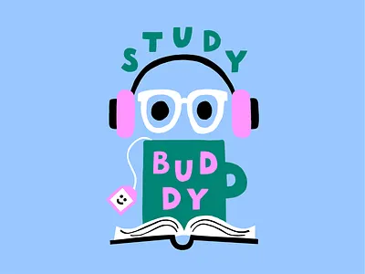
Solution #1:
Check-in moments for reflection and reminders for breaks
An AI study-buddy that aids in setting the structure of a productive work session: identifying goals and steps to achieve the goal, determining the time spent on the task(s) at hand, including and enforcing periodic breaks for resetting and re-energizing
Reflection for retention
HMW remind people of their “why” in the middle of their work?
Reminders for personal care
Focus encouragement and support

Slide 20
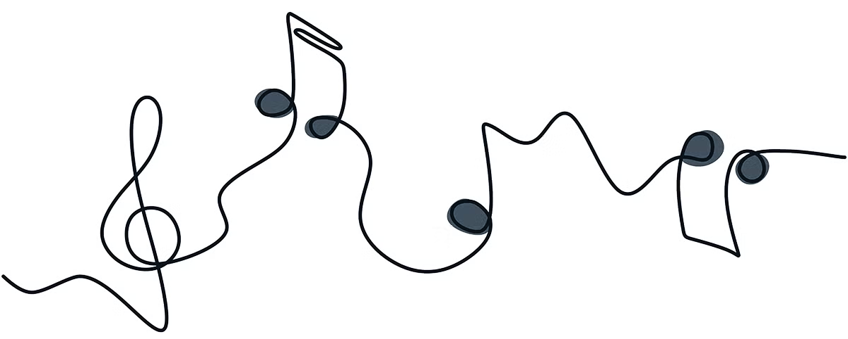
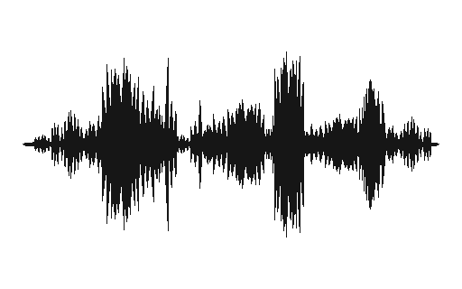
Solution #2:
AI Soundscapes for Focus
Curating sound environments to reduce stress using grounding techniques while working
Tasks should be urgent (INCUP) for ADHD motivation
HMW bring the grounding energy of social presence into solo work?
Work to reduce related anxiety and stress from tasks

Slide 21
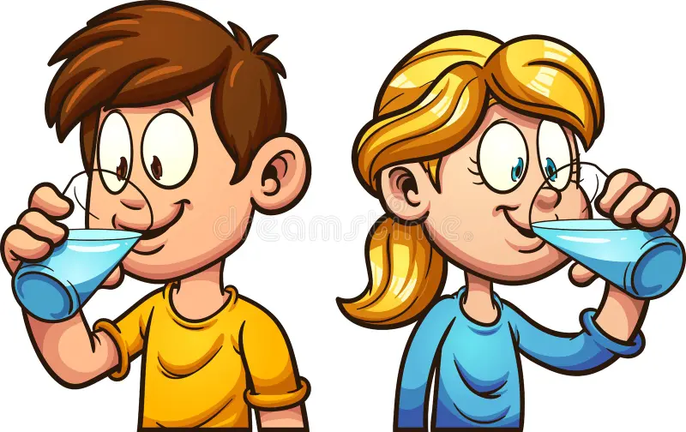
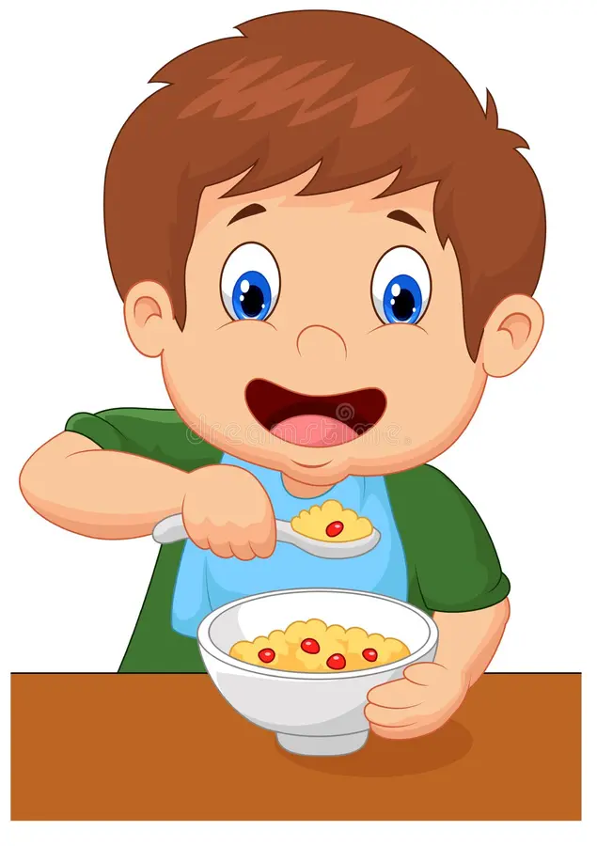
Solution #3:
AI Animal Companion for Body-Doubling
An animal character that uses body-doubling techniques to encourage users to take breaks and take care of biological needs
Reminders to drink water
Eat Regularly
HMW use external cues to spark self-care?

Slide 22
Agenda
Additional needfinding
POVs and HMWs
Solutions
Experience prototypes
Next steps

Slide 23
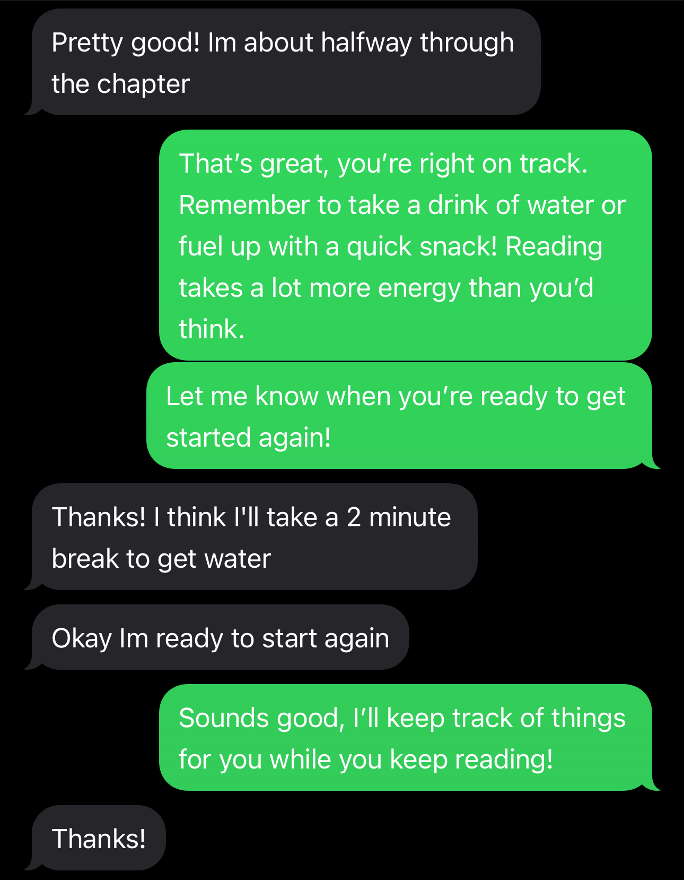
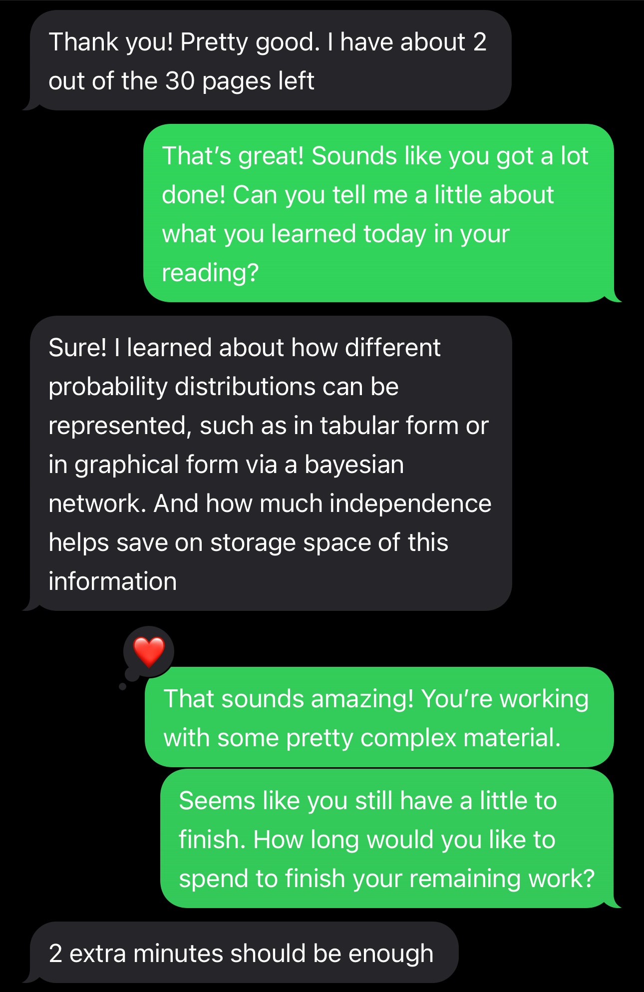
Experience prototype #1
Critical assumption tested
Users struggle with ensuring that they are satisfied with the quality of a work session.
(Hyperfocus, distracted easily, or lack of attention to personal/natural needs)
Participant
CS Coterm student with ADHD recruited for their acknowledgement of struggling with both hyperfocus and attention deficiency
Prototype description
Participant planned a one-hour work session
I behaved like a text-based chatbot that established:
  goals (read 30 pages)
  time length (1 hour)
  intermittent breaks for hydrating, fueling, etc. & reflections of work
Final reflection completed to solidify:
  retention
  affirmation
  next steps/future work sessions & goals
Screenshots from the prototype
Notes:
Why this assumption was chosen:
Other assumptions that were considered:

Slide 24
Experience prototype #1
Results
✅ What worked: Enjoyed the interactivity and motivation to stay focused, was pleasantly surprised by post-work reflection, appreciated reminder to take breaks
👎 What didn’t work: Would have preferred more interaction with visuals, a stronger personality from the “chatbot”
💡New learnings: Reflections and check-ins keep learners accountable
🔎Was the assumption valid? Yes, since the prototype catered to both forms of struggle
➡️ What does it mean for your work going forward? Find ways to make the interaction more personable, develop stronger motivations and advanced communication or encouragement
Critical assumption tested
Subtitle
Prototype description
Breaks can either refresh focus or hijack attention. Structuring them to be restorative and finite is key.
Participants
Who are they? How were they recruited? Why are they relevant?

Slide 25
Experience prototype #1
Ethics
Usability: Focus is keeping users on track, study buddy should feel personable and provide gentle encouragement & kind feedback
Accessibility: Auditory provisions combat visual barriers, colorful notifications combat auditory barriers
Privacy: May be considerations for ensuring unnecessary sensitive information (identification of learning disabilities) is not leaked or stored
Persuasion: All settings should be customizable and all interaction occurs with AI study buddy
Focus: Could potentially be distracting, but this might be the intention to prevent hyperfocus
User involvement: User may offer feedback to study buddy following each work session to improve future productivity
Sustainability & Society: Fully digital interface, not posing risk to environment or society (assuming privacy is protected)
Critical assumption tested
Subtitle
Prototype description
Breaks can either refresh focus or hijack attention. Structuring them to be restorative and finite is key.
Participants
Who are they? How were they recruited? Why are they relevant?

Slide 26
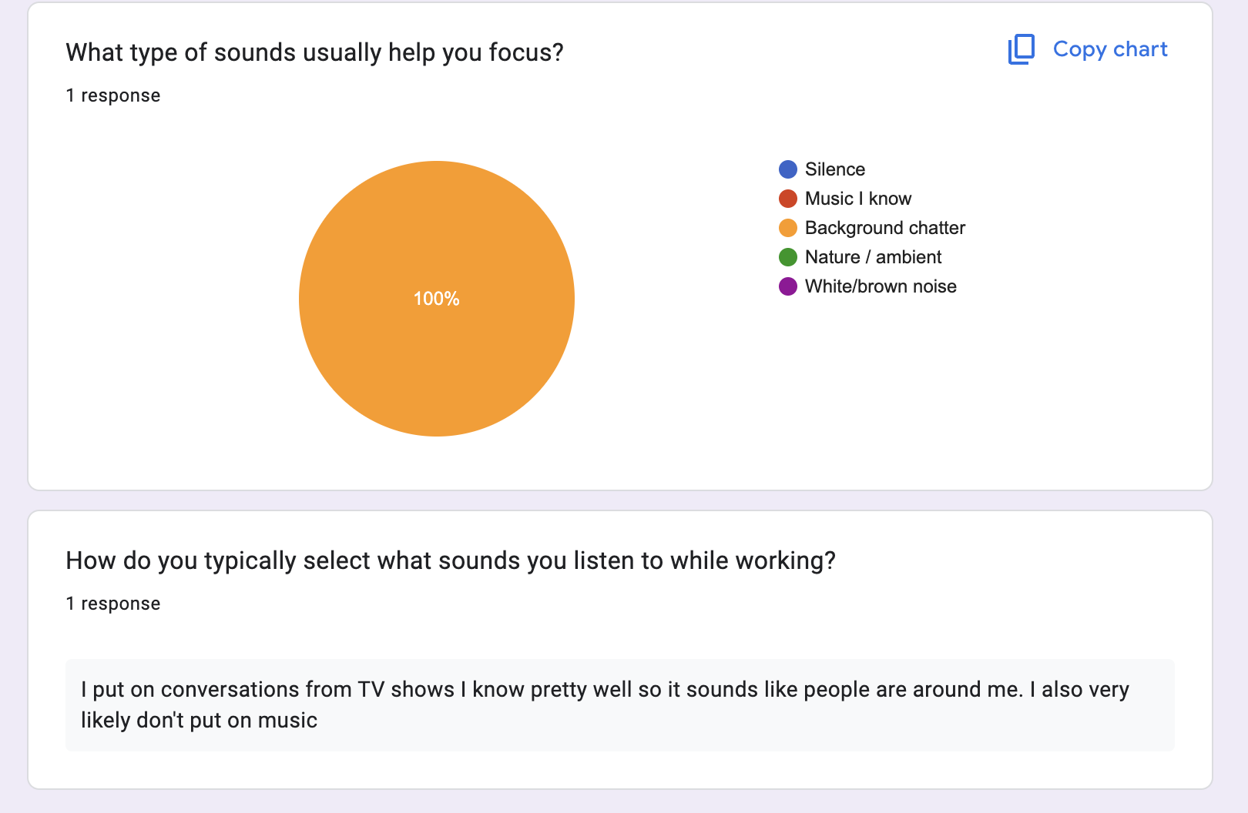
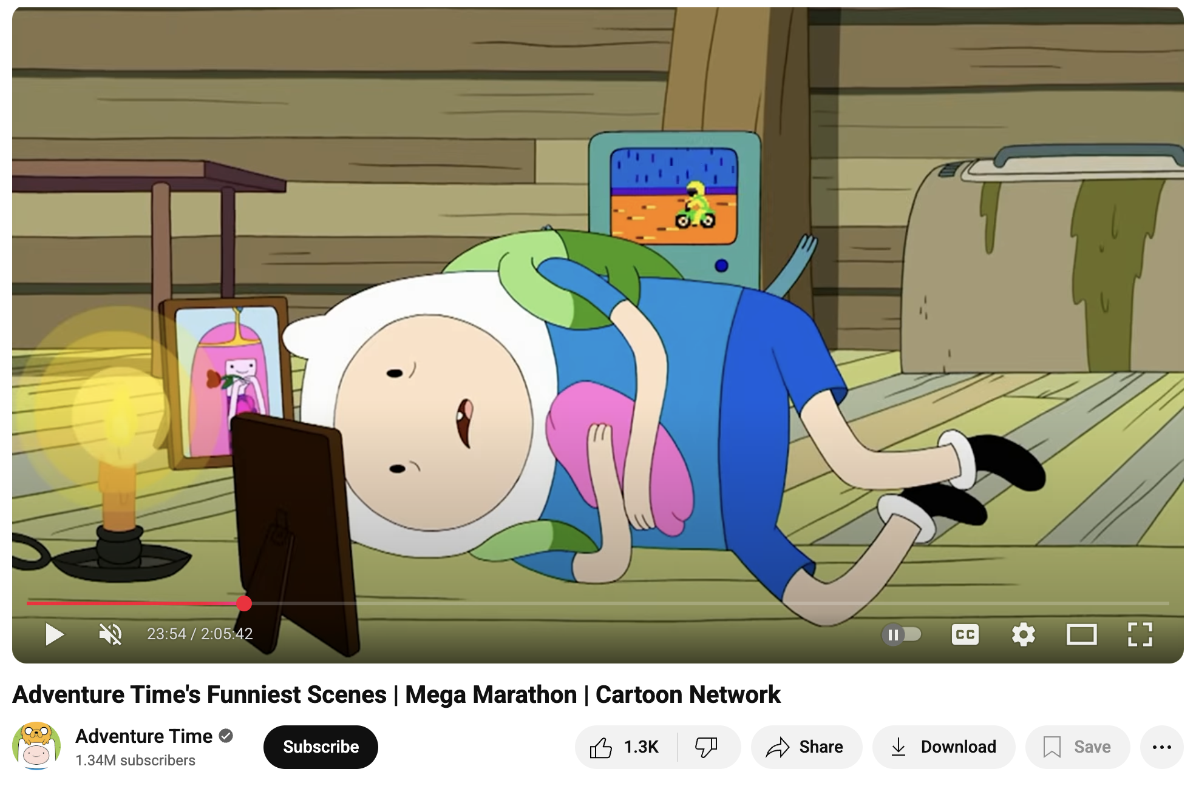
Experience prototype #2
The survey used to select the audio
Critical assumption tested
Users will feel comfortable relinquishing control over their sound environment to something or someone else.
Participant
A masters’ student in CS with ADHD, we met through a previous participant
Prototype description
Short Google Form about typical listening preferences
I selected a video for him to listen to
Zoom 30-minute work session, during which he used the curated sound while I observed
Debriefed the experience
The audio selected for the participant
Notes:
Critical assumption tested
Users will feel comfortable relinquishing control over their sound environment to something or someone else.
Prototype description
Participant filled out a short Google Form about his typical listening preferences while working. Based on his response, I selected a video for them to listen to. We then met on Zoom for a 30-minute work session, during which they used the curated sound while I observed their focus and reactions. We then spent five minutes debriefing.
Participant
A masters’ student in CS with ADHD we met through a previous participant who also enjoys background chatter to focus.
Why we chose this assumption
In our interviews, several participants emphasized how intentionally they curate their environments to support focus, including the sounds around them. For example, Kadabra listens to the same song on repeat while working and has specific playlists for different tasks. Many also expressed a need to control external factors and to have predictability, since they often feel less in control of their own attention. This makes it essential to test whether users would feel comfortable relinquishing some control of their sound environment to an external system.
Other assumptions we considered
Users would feel comfortable with AI-generated or synthetic background chatter.
Users would find new soundscapes motivating rather than distracting.
Users would trust that the system can learn and adapt to their preferences over time.
The AI can adapt to different study settings.

Slide 27
Experience prototype #2
Results
✅ What worked: Initially focused and engaged, liked chaotic, conversational energy, preferred dynamic noise over silence
👎 What didn’t work: Got distracted by references, tuned into dialogue instead of task, repeated phrases and mimicked sounds
💡New learnings: Unfamiliar audio increases curiosity → distraction, “neutral” chatter sustains focus better than content-heavy shows
🔎Was the assumption valid? Felt excited about getting a novel audio (so, yes!)
➡️ What does it mean for your work going forward? Prototype ambient “non-plot” chatter
Critical assumption tested
Users will feel comfortable relinquishing control over their sound environment to something or someone else.
Prototype description
Participant filled out a short Google Form about his typical listening preferences while working. Based on his response, I selected a video for them to listen to. We then met on Zoom for a 30-minute work session, during which they used the curated sound while I observed their focus and reactions. We then spent five minutes debriefing.
Participants
A masters’ student in CS with ADHD we met through a previous participant who also enjoys background chatter to focus.

Slide 28
Experience prototype #2
Ethics
Usability: Audio customizes itself based on user preferences, does not require much learning to be able to use
Accessibility: Inaccessible to learners with auditory impairments
Privacy: Does not require any personal information to function
Persuasion: All settings can be adjusted based on user’s liking
Focus: Intended to help create white noise to stay focused, but could result in distraction based on presence of audio or audio content being heard/played
User involvement: User can adjust all aspects of their audio
Sustainability & Society: Fully digital, no environmental detriment
Critical assumption tested
Users will feel comfortable relinquishing control over their sound environment to something or someone else.
Prototype description
Participant filled out a short Google Form about his typical listening preferences while working. Based on his response, I selected a video for them to listen to. We then met on Zoom for a 30-minute work session, during which they used the curated sound while I observed their focus and reactions. We then spent five minutes debriefing.
Participants
A masters’ student in CS with ADHD we met through a previous participant who also enjoys background chatter to focus.

Slide 29

Experience prototype #3
Critical assumption tested
Individuals with ADHD prefer to take cues from others to remind themselves to complete simple but necessary tasks (snacking, hydrating, going to the bathroom) when in a zone of hyperfocus.
Participant
Junior with ADHD double-majoring in German and Comparative Literature
Prototype description
Tested 3 different study strategies (alone, with other person, AI companion)
Texted AI-generated images of sloth drinking water and going to bathroom
Debriefed the experience
Generated by Gemini

Slide 30
Experience prototype #1
Results
✅ What worked: Found the AI companion engaging and paid attention to it
👎 What didn’t work: Got distracted by the AI generated images and lost focus
💡New learnings: Digital body-doubling is effective at enforcing routine
🔎Was the assumption valid? Kind-of. Even though the AI companion was engaging, didn’t feel particularly connected to it
➡️ What does it mean for your work going forward? Prototype an interactive companion to boost connection
Critical assumption tested
Subtitle
Prototype description
Breaks can either refresh focus or hijack attention. Structuring them to be restorative and finite is key.
Participants
Who are they? How were they recruited? Why are they relevant?
Notes:
Why this assumption was chosen:
Other assumptions that were considered:

Slide 31
Experience prototype #1
Ethics
Usability: Creates a memorable companion that users can form an attachment with
Accessibility: Provisions could be made for individuals with auditory barriers, visual stimulation of phone screen activation could startle some users
Privacy: Does not require sensitive information to function
Persuasion: No choices are necessary, user interacts with interface like another person
Focus: Intended to remind user to take breaks during moments of hyperfocus, but could lead to user being distracted purely by phone usage
User involvement: User can alter their digital animal companion to their preferences
Sustainability & Society: Fully digital interface, no environmental detriment
Critical assumption tested
Subtitle
Prototype description
Breaks can either refresh focus or hijack attention. Structuring them to be restorative and finite is key.
Participants
Who are they? How were they recruited? Why are they relevant?
Notes:
Why this assumption was chosen:
Other assumptions that were considered:

Slide 32
Agenda
Additional needfinding
POVs and HMWs
Solutions
Experience prototypes
Next steps

Slide 33
Next steps
Solution #1: Check-in moments for reflection and reminders for breaks

Slide 34
Ethical Considerations
Usability: Buddy feels motivating, settings are customizable, work–break system supports real focus
Accessibility: Simple, low-stimulation interface, minimal visuals and effects
Privacy: No collection of sensitive or personal data, no references to medical or disability status
Persuasion & Transparency: Clearly explain purpose before first use, remind users not to share personal details, set boundaries for healthy user–AI interaction

Slide 35
Ethical Considerations
Focus: Minimal interaction to reduce screen distractions, buddy helps enforce schedule consistency
User Involvement: Encourage short feedback after each session, use feedback to refine buddy’s tone and pacing over time
Sustainability & Society: Fully digital system with minimal resource use, prevents harmful or exploitative use, alerts users if behavior risks harm to others or the environment

Slide 36
Service
Who We Cater To:
Learners who struggle with hyperfocus or inattention
Learners who struggle to ask for help
Learners who thrive with gentle reminders
Who We Might Be Excluding:
Individuals who strain in more structured environments
Individuals with limited tech literacy or limited access

Slide 37
Thank you!
Questions?

Slide 38
Appendix

Slide 39
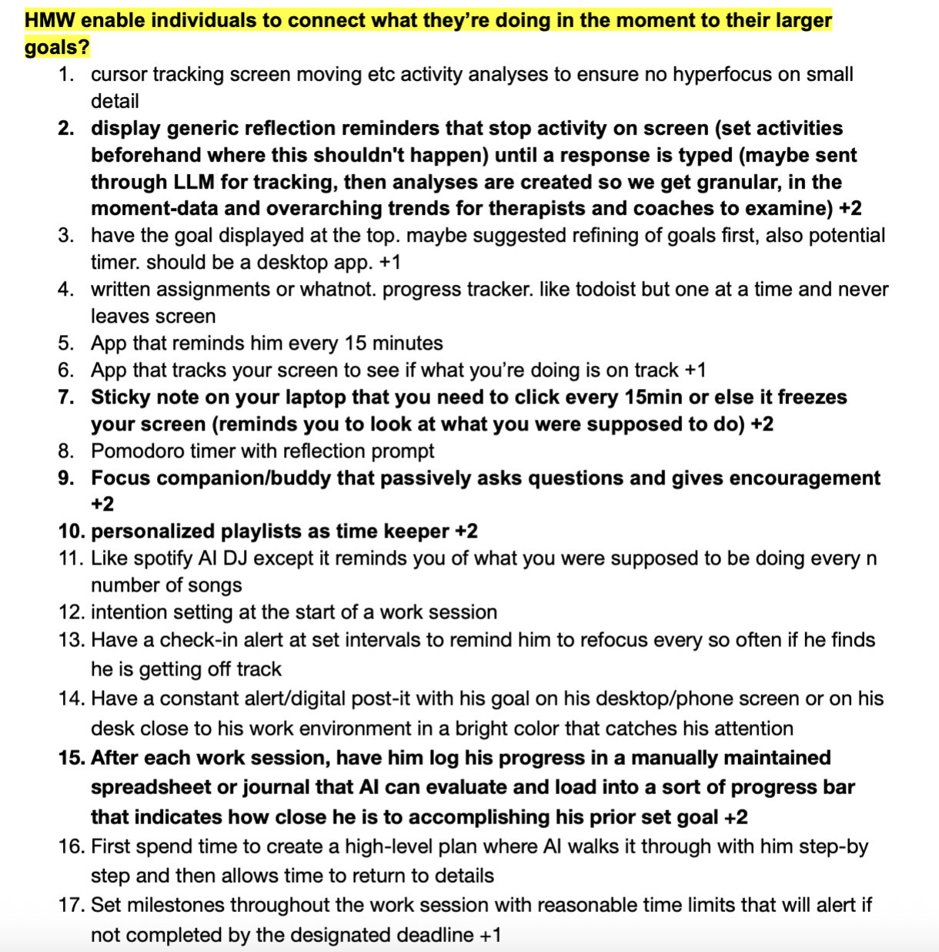
Brainstorming Process
Focus HMW
Preferred solutions
Compilation of brainstormed solutions

Slide 40
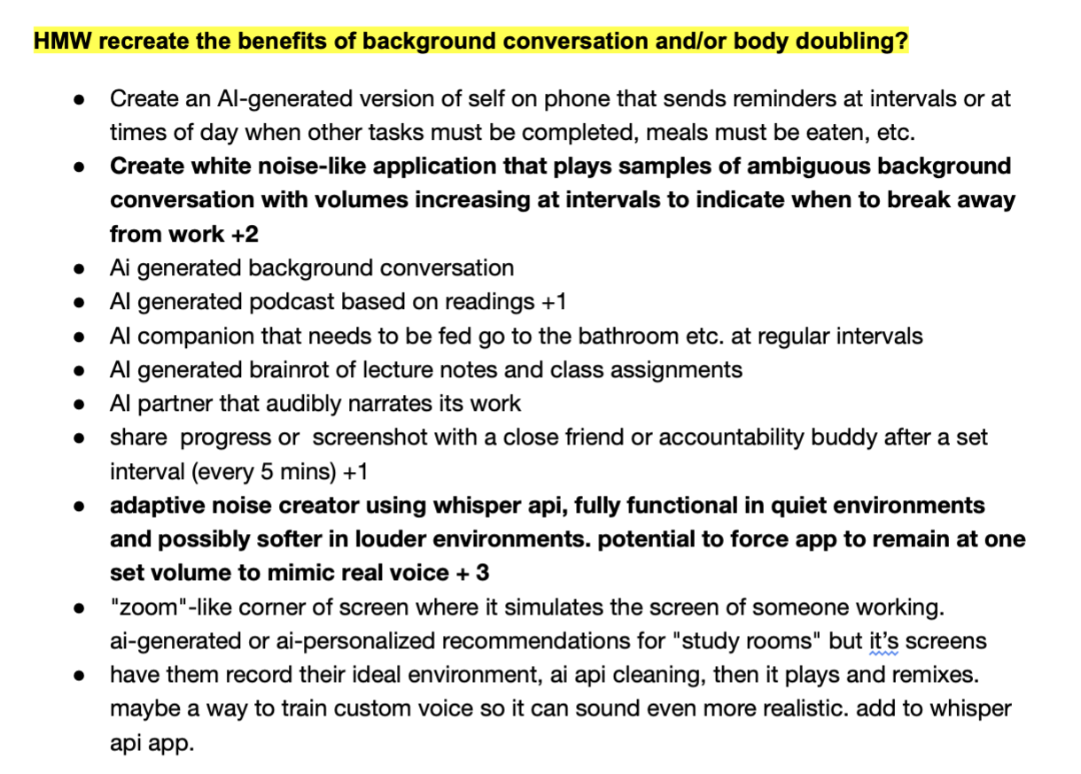
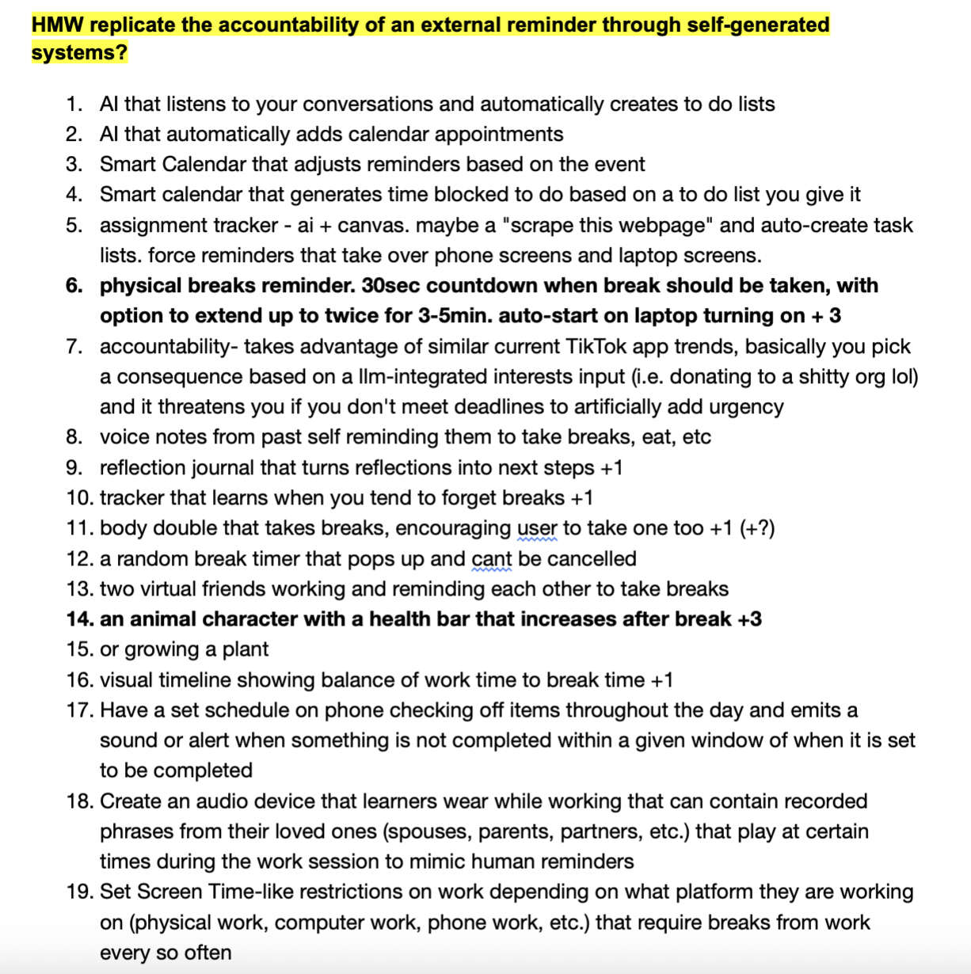
Brainstorming Process (cont.)

Slide 41
Experience prototype #2 artifacts
https://drive.google.com/drive/folders/1DXsuKVPi8z1Ru08eqnQiynB-8garz2R8?usp=sharing (only accessible to members of our team folder + teaching staff)

Slide 42
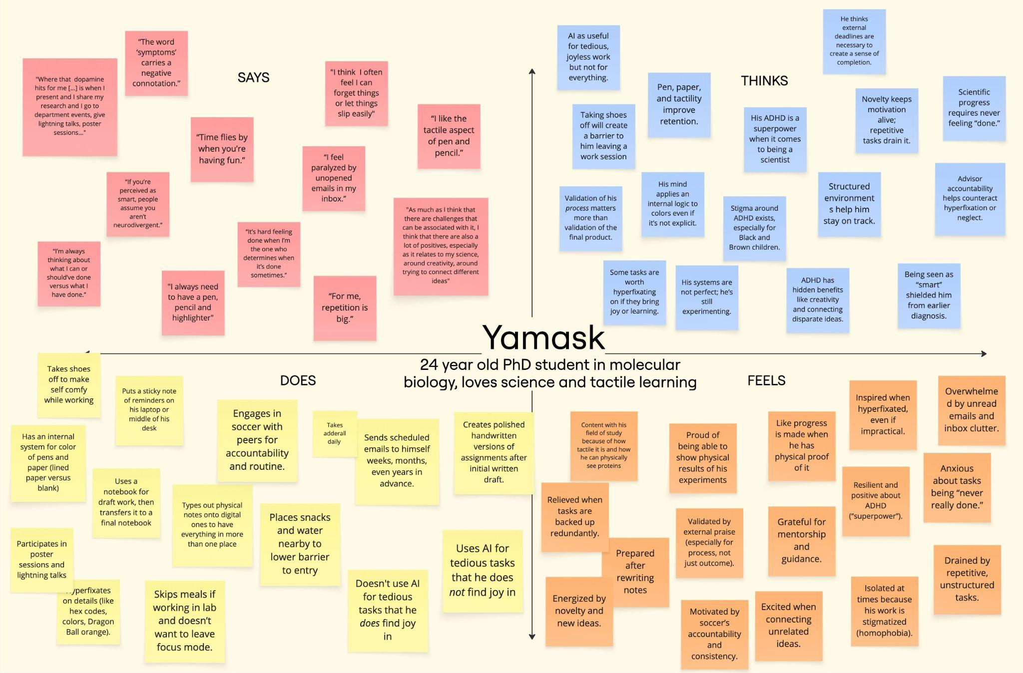
Additional needfinding interview #1

Slide 43
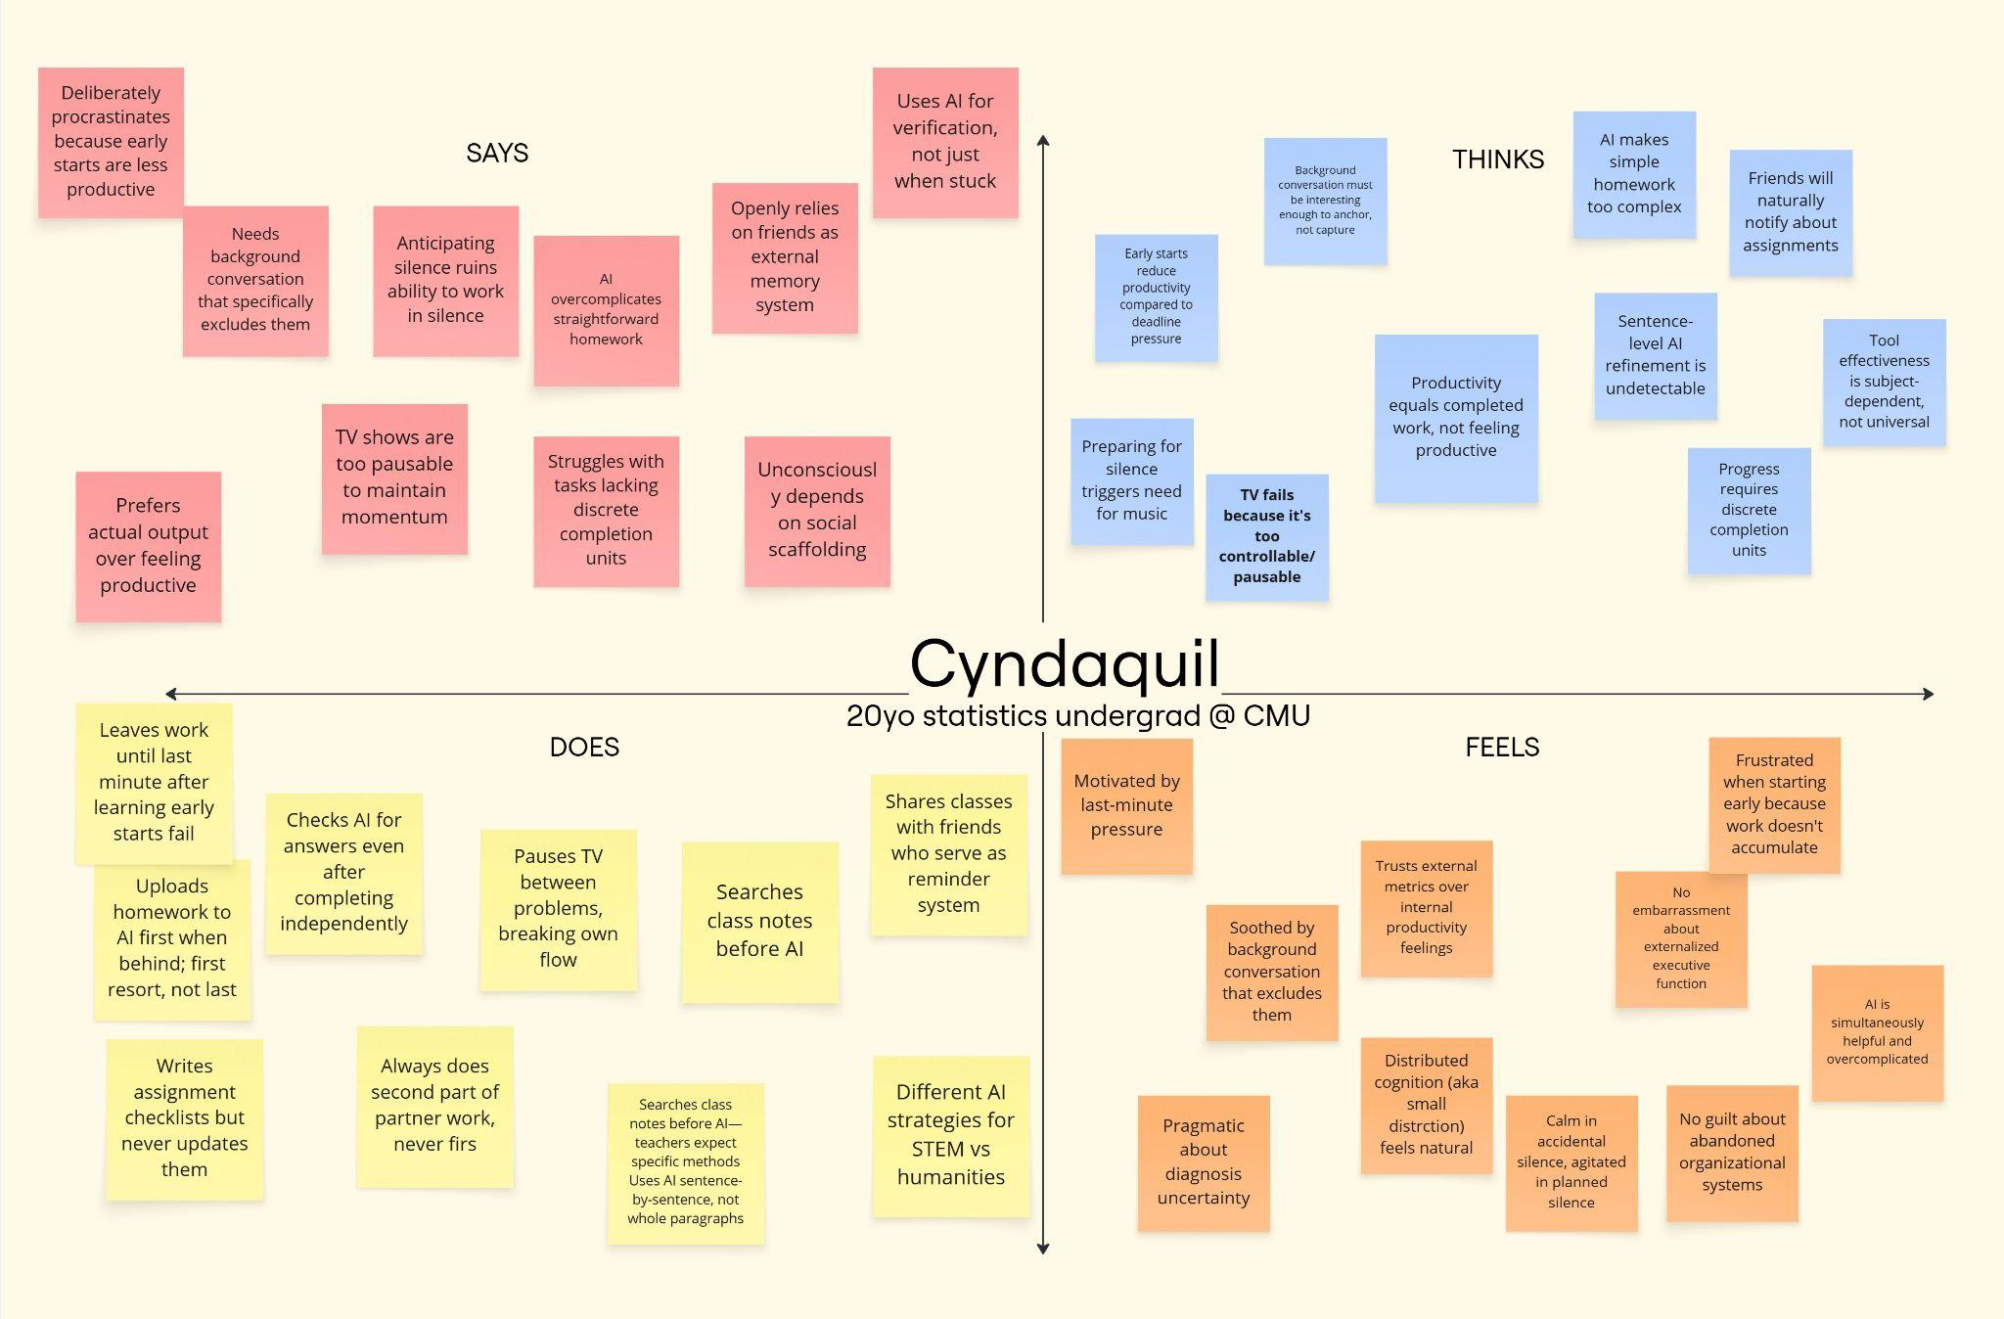
Additional needfinding interview #2

