Slide 1
RememberAll
A1: Needfinding

Slide 2
Today, we’ll cover…
01
03
02
04
Introduction
Empathy Maps
Meet the Team!
Let’s dive deeper…
Interviews
Moving towards A2 →
Meet our recruits!
Some preliminary insights

Slide 3
Intro
01
Who we are, and what we’re focusing on

Slide 4
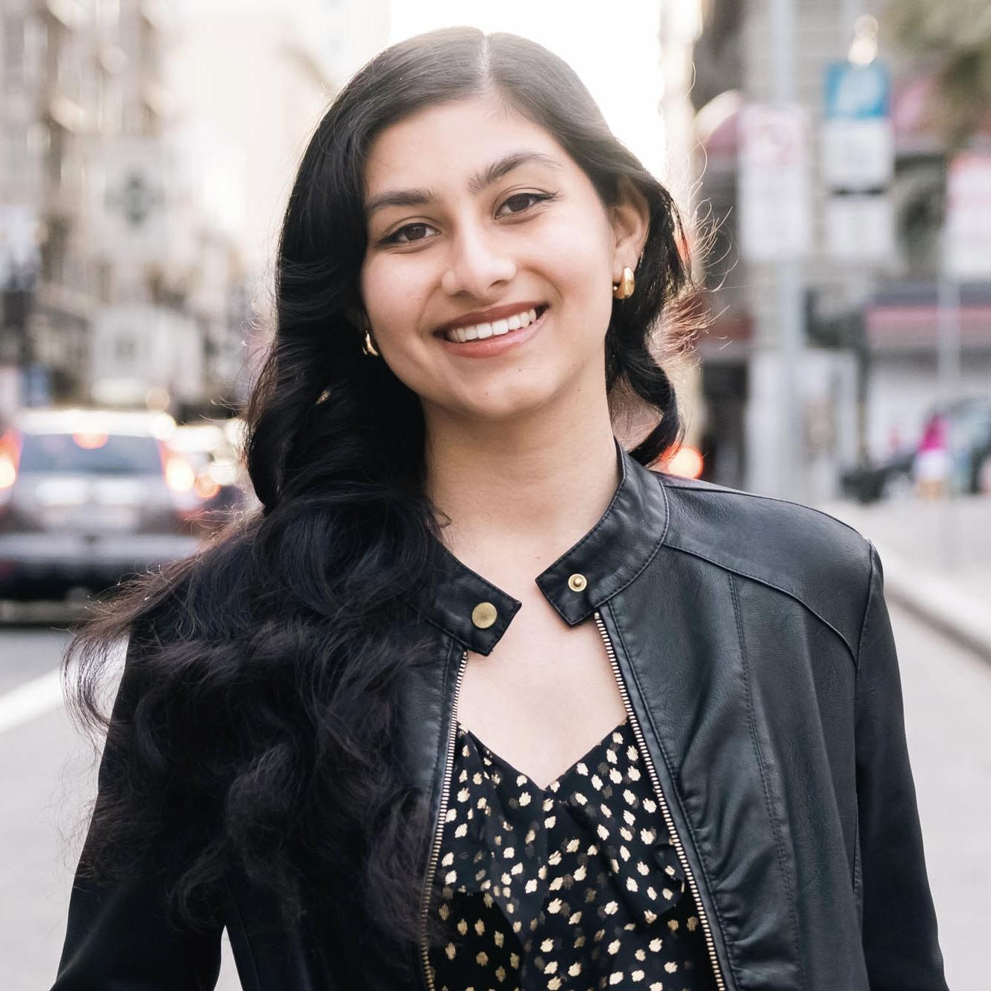
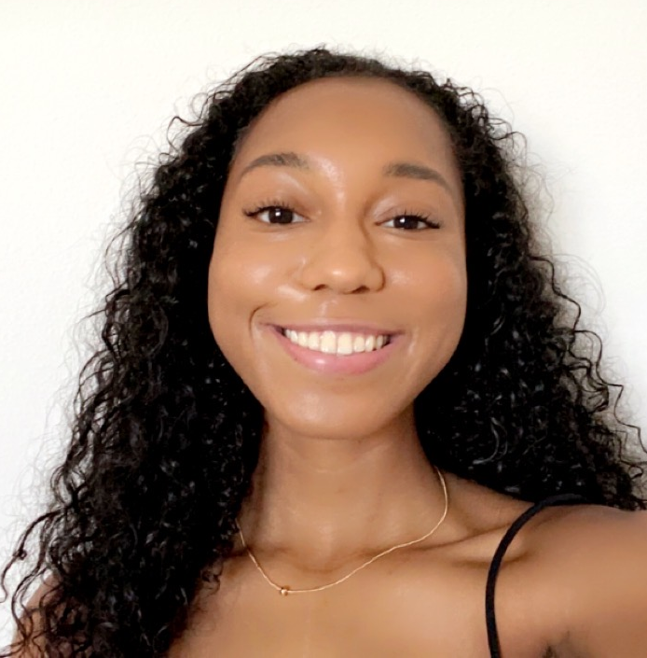
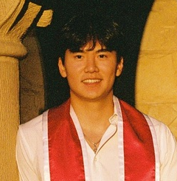
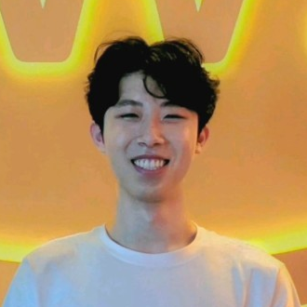
Meet the Team!
Ananya Navale
Ayana Griffin
Anthony Chu
Felix Zhan

Slide 5
Where could we make an actual impact?
Who are underserved learners?
Who already has some tech literacy?

Slide 6
Our Domain:
Neurodivergent learners who use technology on a daily basis, specifically diagnosed with ADHD.

Slide 7
Interviews
02
Participants, extreme users, what we asked, and what we found out

Slide 8
Our participants
01
03
02
04
3 high school students
2 domain experts
Connection to SF high school with program for learning disabilities
Who work with students with ADHD daily
1 early in career learner
1 adult learner
Recently in school, but now does not have the structure school provides
Longer, more nuanced relationship with ADHD

Slide 9
Our participants
Why were they chosen? More focus on learners in school, but not losing other perspectives. Used connections to schools to recruit.
Why are they appropriate? All 5 non-domain experts have ADHD and use technology as a part of their daily routine with school or work. All consider themselves to be learners.
How were they recruited/compensated? Existing connections with an ADHD researcher, a dorm RF, and Stanford’s CTL. Offering college advice to the high school interviewees.
01
03
02
04
3 high school students
2 domain experts
Connection to SF high school with program for learning disabilities
Who work with students with ADHD daily
1 early in career learner
1 adult learner
Recently in school, but now does not have the structure school provides
Longer, more nuanced relationship with ADHD

Slide 10

01
03
02
04
Their high school
Their workplace
3 high school students
2 domain experts
1 early career learner
1 adult learner
Common space in Palo Alto
His home

Slide 11
We asked…
Typical day and the work they do
Interactions with technology and AI
Learning habits and struggles with ADHD
Keeping track of tasks and assignments
Learning preferences

Slide 12
Extreme user
High school students
56 year old learner
Age

Slide 13
Extreme user
Although our focus is school-aged learners, we interviewed an adult with long-term ADHD experience to gain insight into strategies, struggles, and social challenges shaped by a time when diagnoses were less common.
High school students
56 year old learner
Age

Slide 14




Selected Participants
Let’s take a closer look at each person →

Slide 15
“Geodude”
56 y.o. leadership consultant
program director
Resident Fellow at Stanford
Interviewed by Ayana, notes by Ayana
Apparatus: HeyMarvin (transcript), Google Docs

Slide 16
“Squirtle”
HS Junior with ADHD
cross country runner/rower
interested in pursuing clinical psychology
Interviewed by Felix, notes by Ananya
Apparatus: Phone video recording, Google Docs

Slide 17
“Kadabra”
26 y.o. early career freelance graphic designer
service dog mom
diagnosed with ADHD after losing the structure of school
Interviewed by Ayana, notes by Anthony
Apparatus: HeyMarvin (transcript), Google Docs

Slide 18
“Hariyama”
HS Senior at with ADHD/dyslexia
soccer and flag football player
interested in pursuing psychology
Interviewed by Ananya, notes by Felix
Apparatus: Video recording, Google Docs

Slide 19
~ Hariyama
~ Squirtle
~ Geodude
~ Kadabra
“I’ve always been a kinesthetic learner…
I became more open-minded to learn more about how certain things work.”
“They wouldn’t encourage me to ask my teachers for help… I was struggling to the point where I would fail grades.”
“It’s usually [my partner], Patti, who will say, ‘You’ve been on that task for eight hours —have you eaten?’ And I’ll be like, ‘Oh, no, I have to eat.’”
“I live by lists. I have an entire notion wiki of all of the projects I'm working on.”

Slide 20
Surprises
Rather than a single preferred tool type (digital or physical), each participant curated a unique combination of digital and physical systems for different aspects of their work.
Many dislike directly being told what to do, but experience greater productivity and success with external structure.
Learners often know exactly when they’re hyperfocused, even if it takes an external prompt to break the cycle.
Notes:
For example,

Slide 21
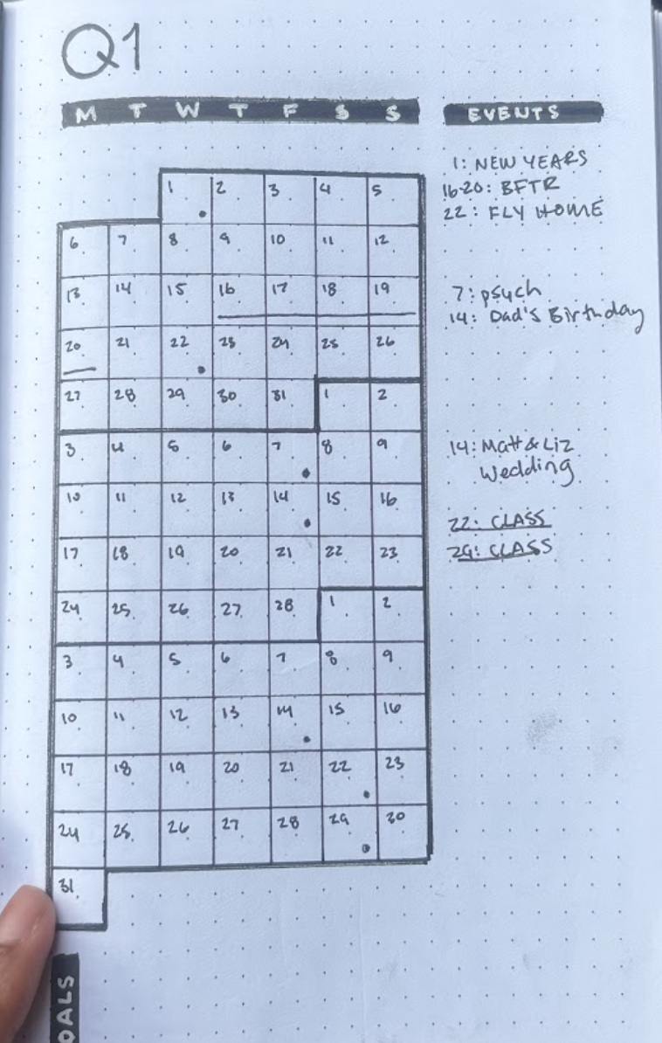
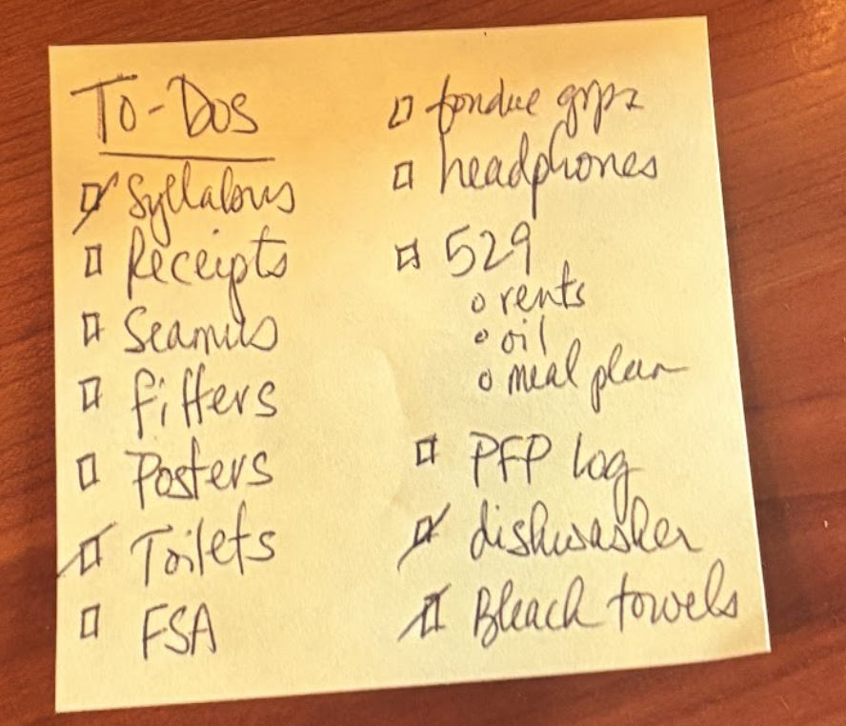
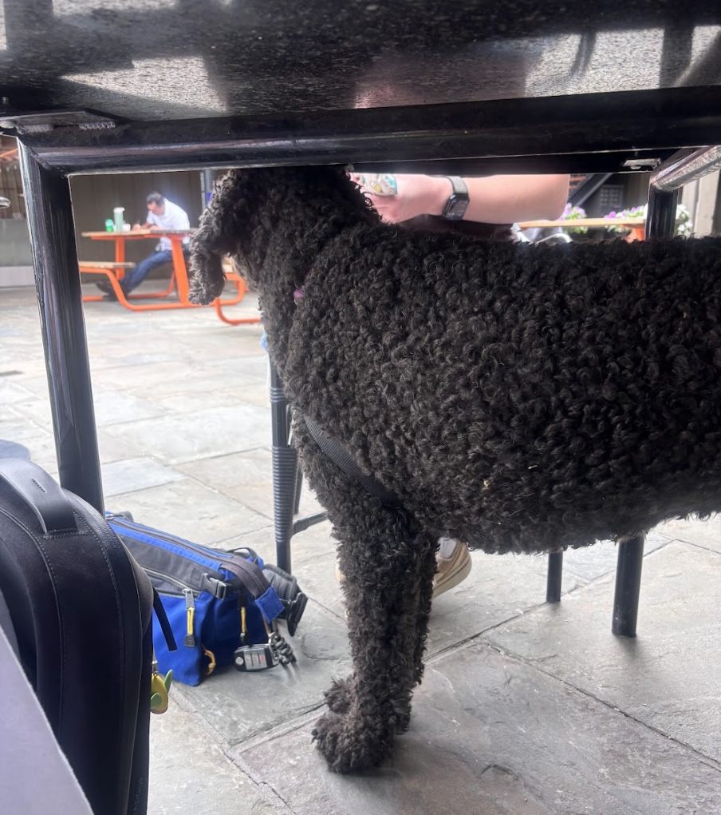
Geodude’s daily sticky note
Kadabra’s dog, Percy, who serves as a reminder for her to take breaks and eat
Kadabra’s QI calendar

Slide 22
Tensions
Parents influence whether students feel AI and supports are “valid” versus “too much help.”
Students juggling many different activities express overwhelm, needing planning to balance coaching with other commitments.
Some view support program as crucial, while others avoid it due to potential stigma from having accommodations.

Slide 23
Empathy Maps
03
Let’s map it all out!

Slide 24
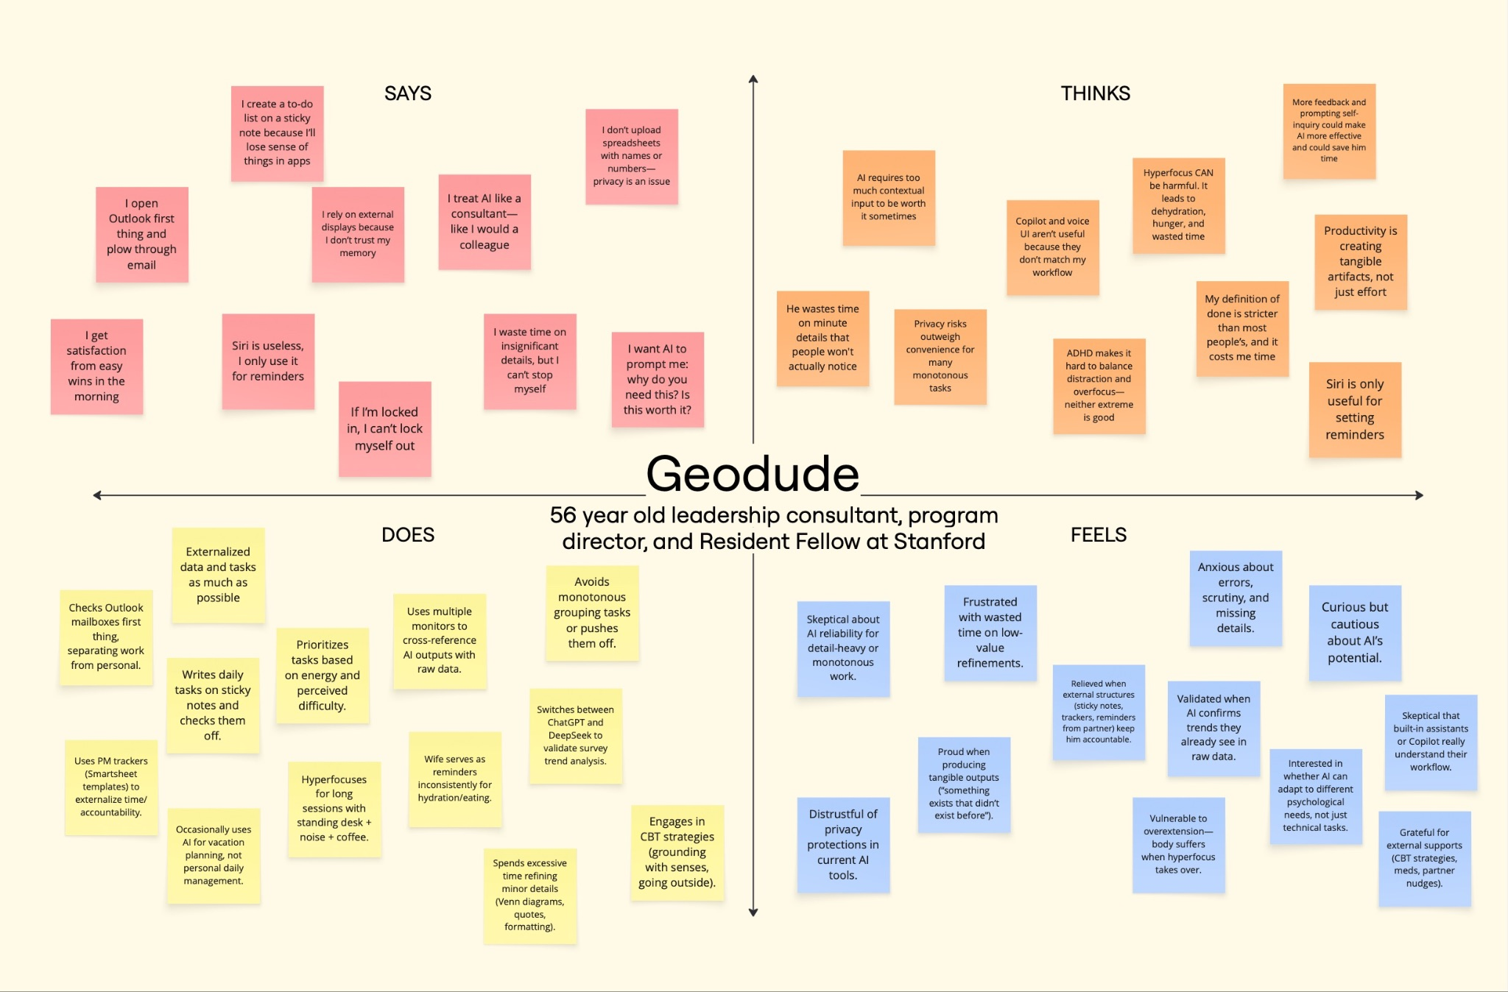

Slide 25
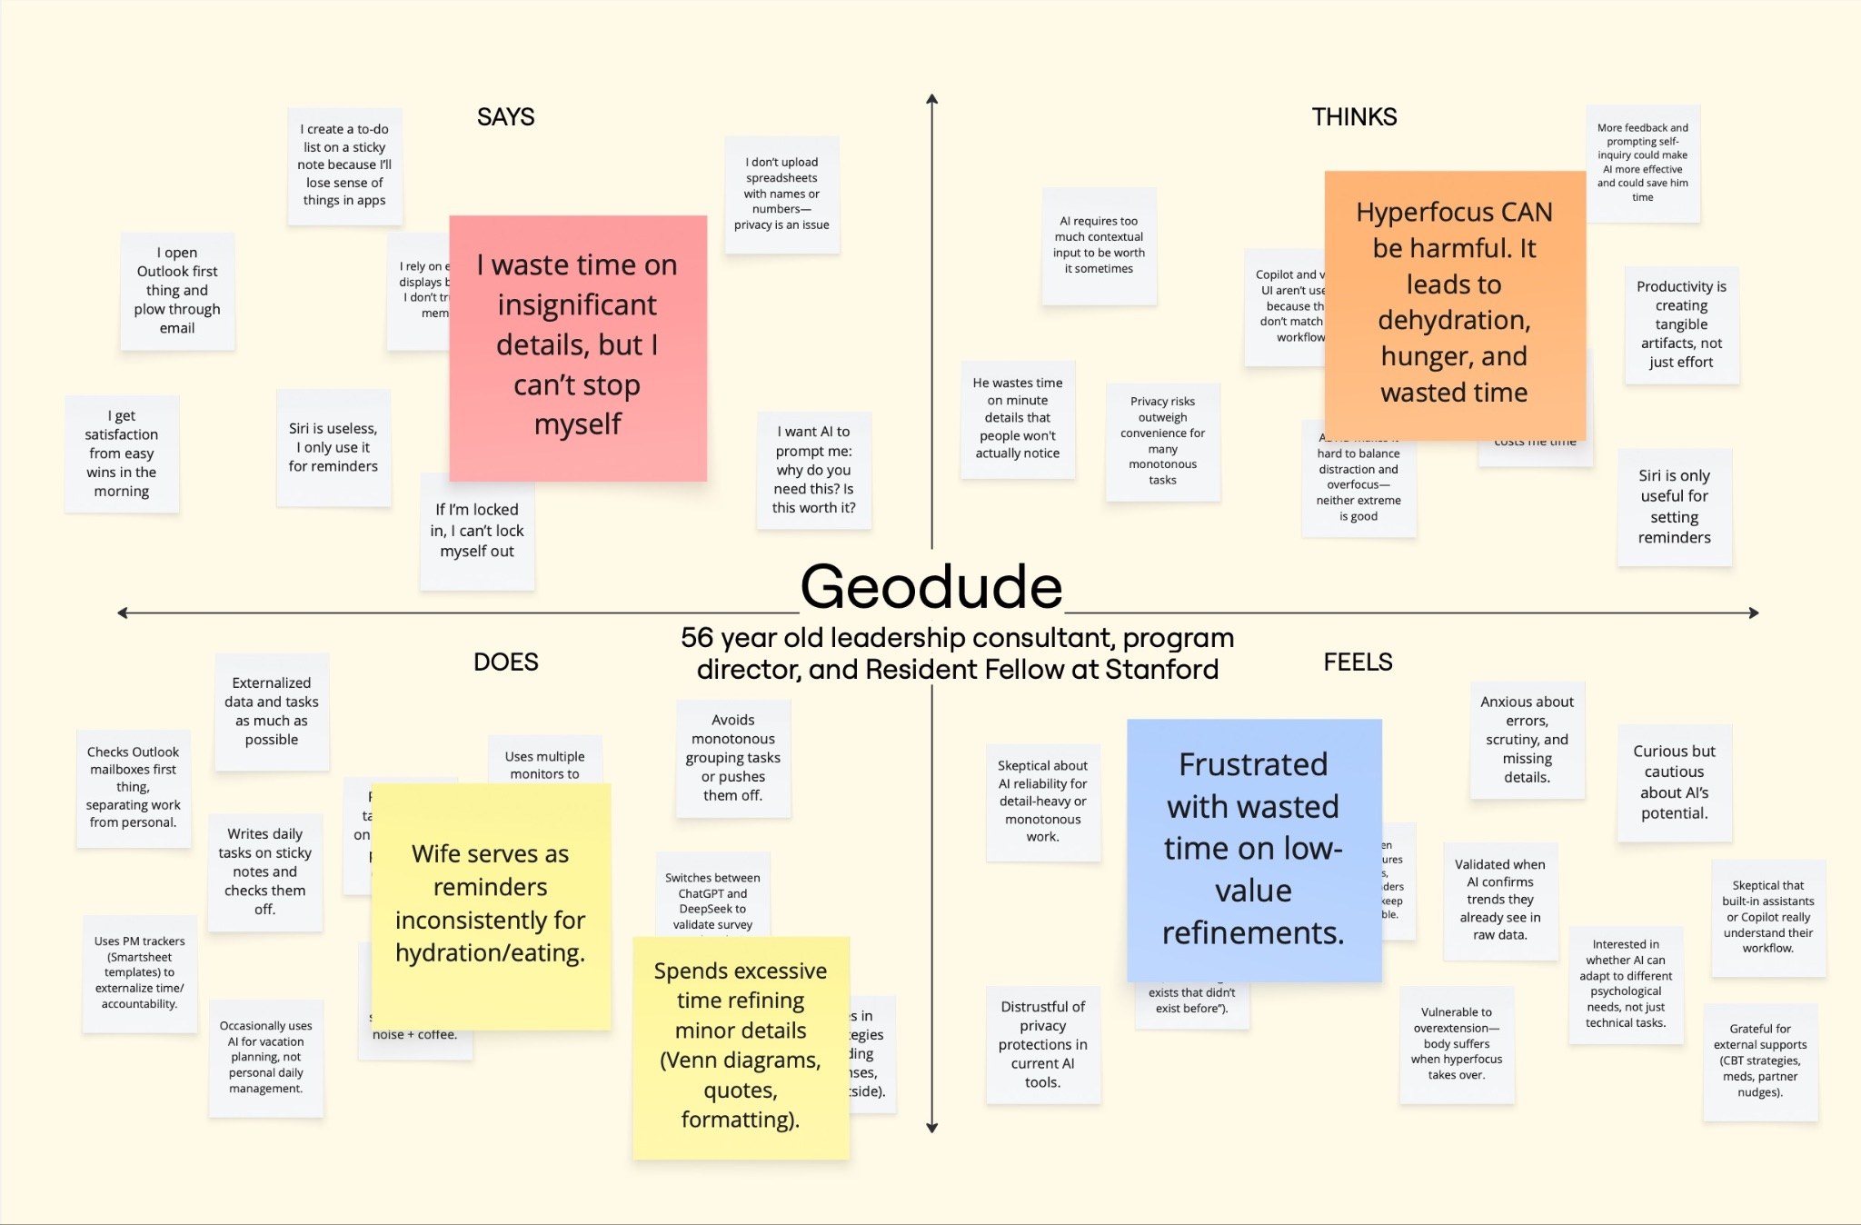

Slide 26
Insight
People can become stuck in hyperfocus, losing track of time and neglecting basic needs. They rely on external reminders.
Need!
People want ways to stay aware of when focus is no longer serving their priorities.

Slide 27
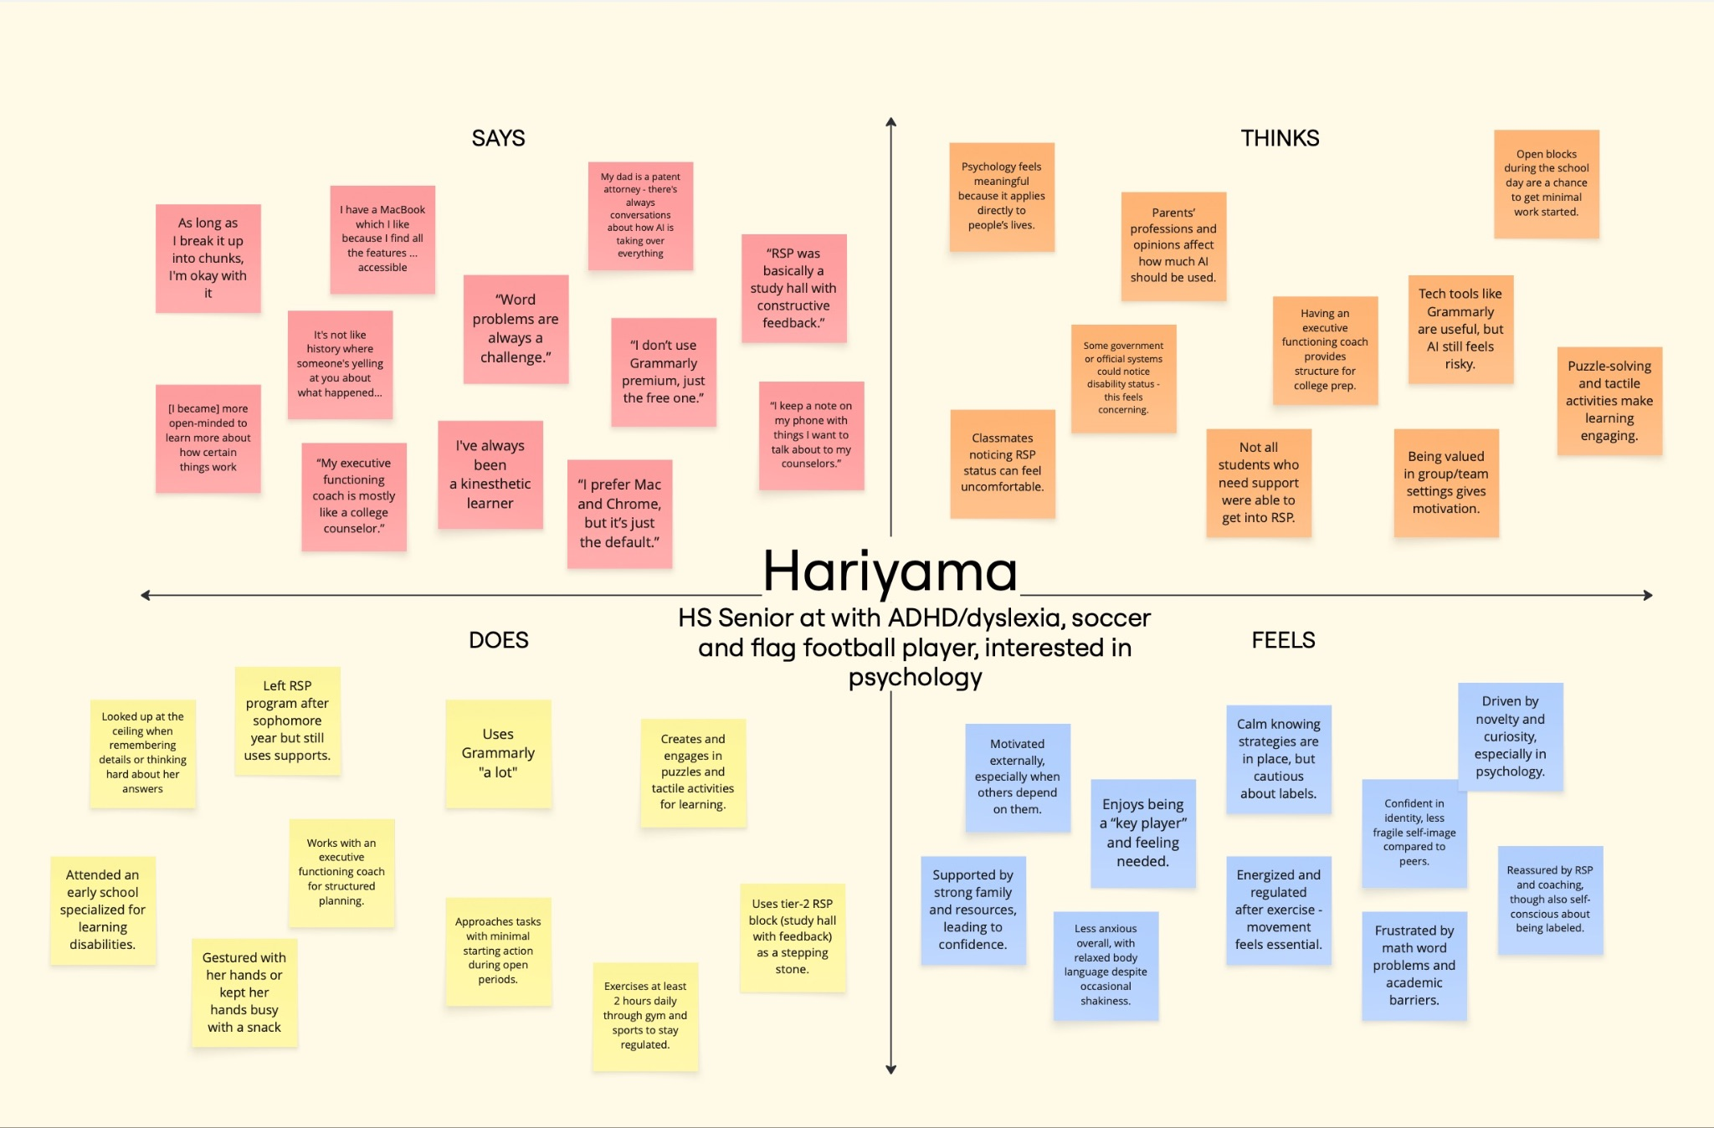

Slide 28
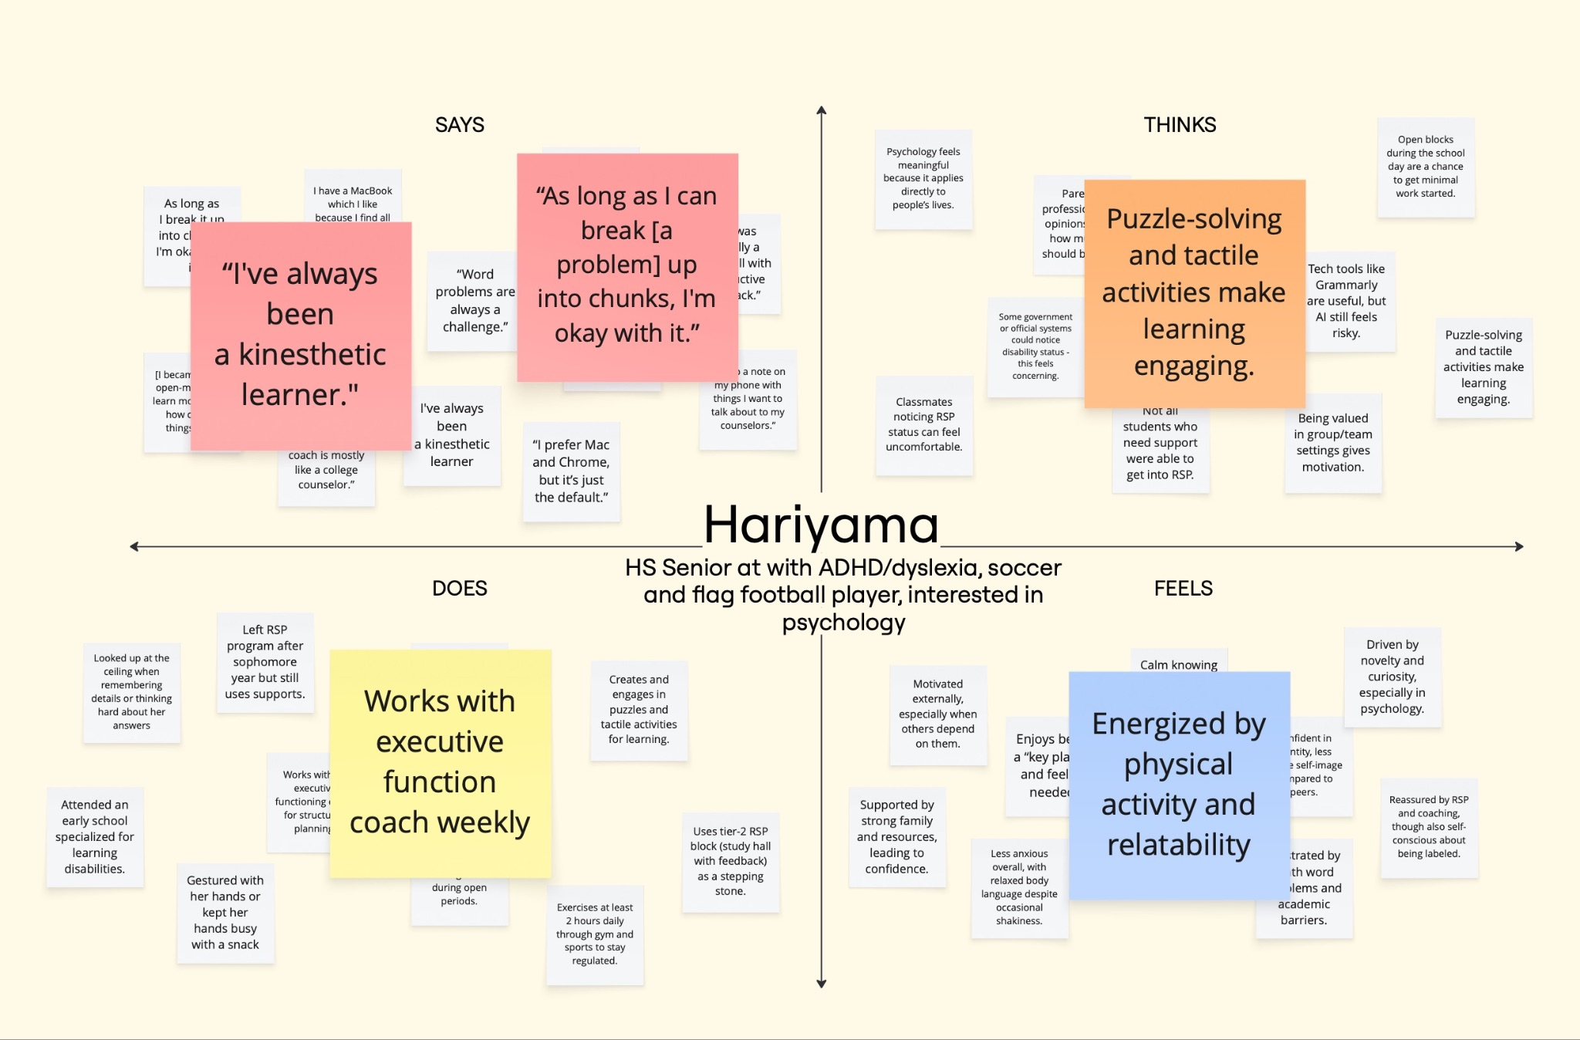

Slide 29
Insight
Some benefit from tactile, audio, and visual components in their learning. Motivation is also strengthened when they feel valued.
Need!
Learners want tools that integrate multiple senses while also affirming their sense of value and belonging.

Slide 30
Summary
04
Our key takeaways and next steps

Slide 31
Key findings
01
02
03
Externalization
Structure
Control
Many externalize their mental load through digital and physical tools
Many dislike direct instruction, but experience greater productivity and success with structure and gentle reminders
Participants feel their thoughts are uncontrollable, so they seek control in other areas

Slide 32
A1 → A2
Continue to extract key pain points: hyperfocus, externalization habits, reliance on external prompts for self-care
Generalize insights from individual stories to broader user behaviors and needs

Slide 33
Appendix
05
More fun stuff!

Slide 34
A note on extreme users
While we classified our 56-year-old participant as our extreme user, all five interviewees (not counting the domain experts) can be considered extreme in different ways. The three high school students each have at least one learning disability in addition to ADHD, the 26-year-old has POTS and is out of school, and the 56-year-old has long-term lived experience. We chose this range to capture diverse perspectives, all with ADHD as the common thread.

Slide 35
Links!
Interview materials (access limited for participant privacy)
  Includes more photos, interview audios, and transcripts
Miro board (empathy maps)
HeyMarvin (used for transcripts of some interviews)

Slide 36
List of team member roles for all interviews
Interview #1 (MT): Felix (interviewer) and Ayana (notetaker)
Interview #2 (KMM): Ayana (interviewer) and Anthony (notetaker)
Interview #3 (GB): Ayana (interviewer and notetaker)
Interview #4 (NO): Ananya (interviewer) and Anthony (notetaker)
Interview #5 (SL): Ananya (interviewer) and Anthony (notetaker)
Interview #6 (HW): Ananya (interviewer) and Felix (notetaker)
Interview #7 (SH): Felix (interviewer) and Ananya (notetaker)

Slide 37
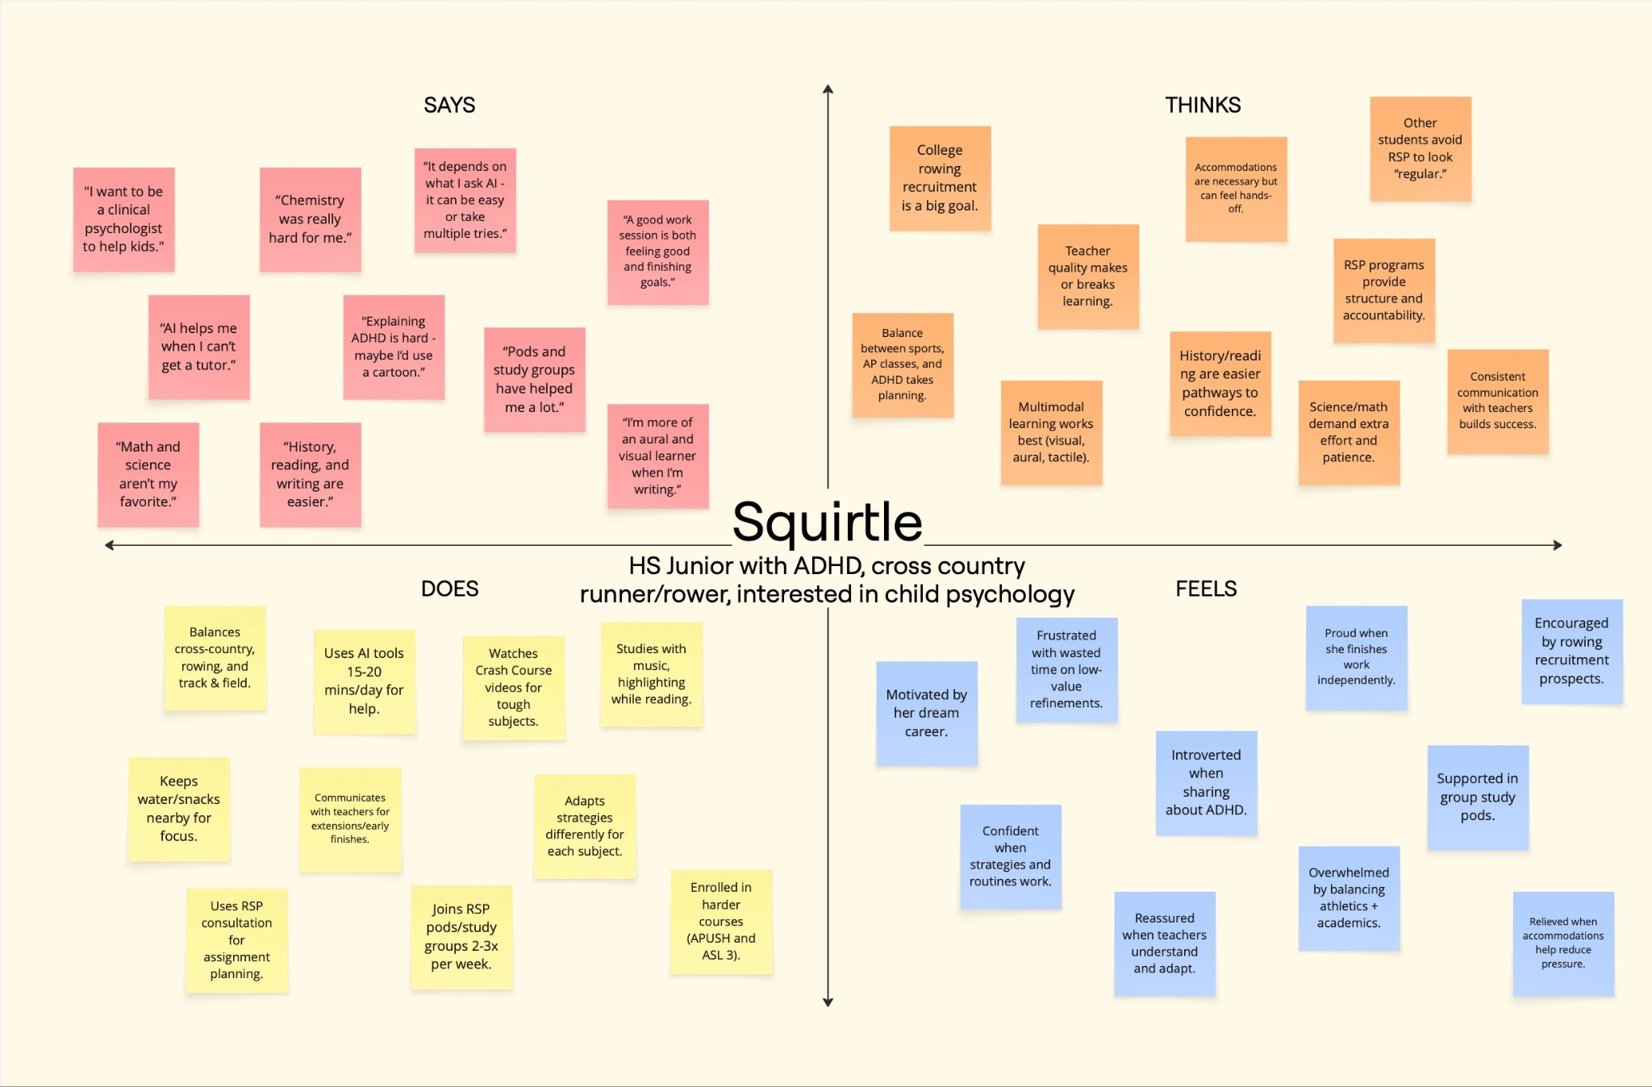

Slide 38
