Slide 1
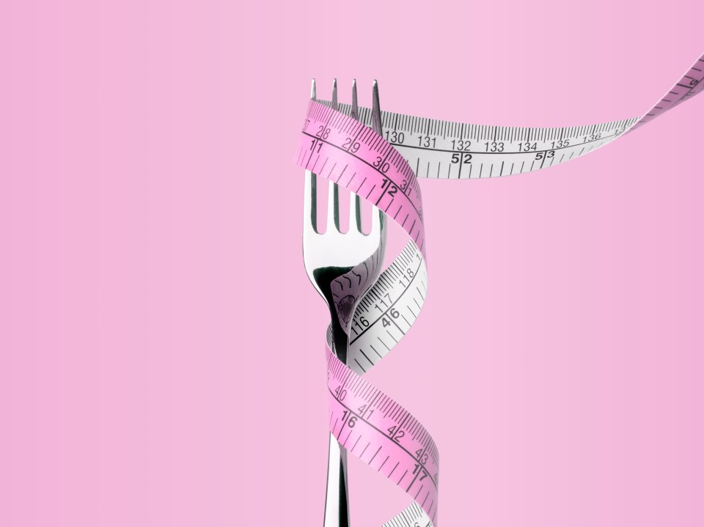
HEALING RELATIONSHIPS WITH FOOD
A02: Additional Needfinding
Notes:
Hi everyone, my name is Jade, thank you all for being here today.

Slide 2




MEET JJYC
JASMINE X.
YUJEN L.
JADE C.
CLARE L.
Psychology & CS ‘27
Symbolic Systems ‘27
Symbolic Systems ‘27
Design ‘28
Notes:
Before we begin, we wanted to reintroduce ourselves, we are the JJYC and my team members Jasmine, Yujen, and Clare

Slide 3
LAST WEEK…
Domain: Eating Disorders
No Struggle with Food and Body Image
Some Struggle with Food and Body Image
Sub-clinical Eating Disorder
Diagnosed Eating Disorder
Noticeable ED symptoms and behaviors, but without a formal diagnosis.
Clinically diagnosed and currently seeking or receiving treatment.
Healthy, balanced relationship with food and body.
Occasional or mild eating disorder related thoughts and behaviors.
Notes:
Recalling from last week, our initial domain of Eating Disorders that included the entire spectrum of relationships with food. Based on the interviews from last week, we realized that many people struggle with food, even without ever seeking professional treatment. This helped us narrow our problem space…

Slide 4
THIS WEEK…
Domain: Eating Disorders
No Struggle with Food and Body Image
Some Struggle with Food and Body Image
Sub-clinical Eating Disorder
Diagnosed Eating Disorder
Clinically diagnosed and currently seeking or receiving treatment.
Healthy, balanced relationship with food and body.
Noticeable ED symptoms and behaviors, but without a formal diagnosis.
Occasional or mild eating disorder related thoughts and behaviors.
Notes:
…to focus more on those who struggle with food but have not yet seeked treatment. This middle-zone population are often invisible in formal care but still live with guilt and anxiety around food.

Slide 5
ADDITIONAL INTERVIEWS
Notes:
To help us gain a better understanding about this scope, we decided to interview two more people.

Slide 6
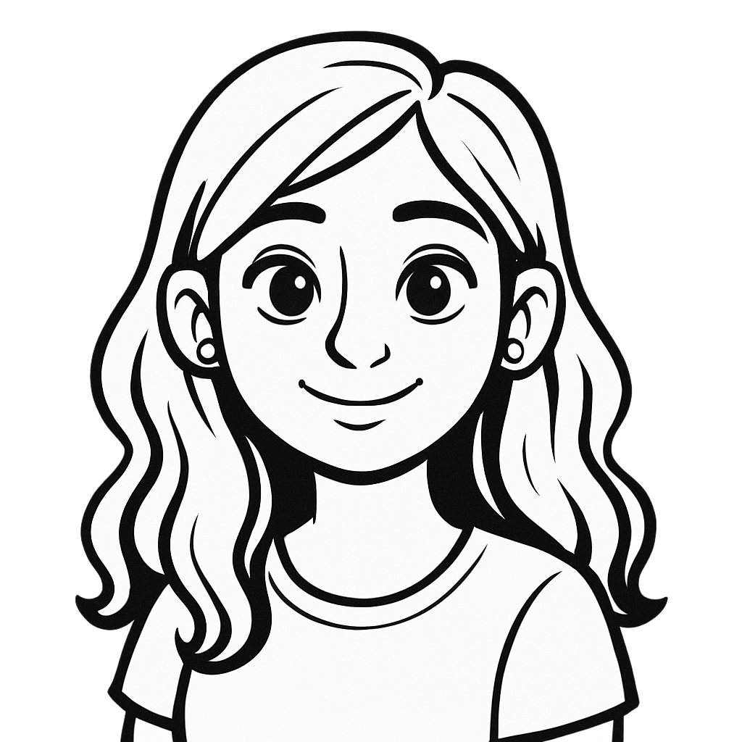
MEET VIOLET
College student from Australia.
Struggled with food & body image during high school before being diagnosed with anorexia.
Lived with food struggles alone before anyone intervened.
Interview conducted via Zoom by Jasmine & Clare.
Notes:
We first talked to Violet through Zoom, who is a college student from Australia who began struggling with food and body image during high school, several years before actually receiving an official diagnosis of anorexia in 2020. She talked about living with these struggles by herself long before anyone intervened.

Slide 7
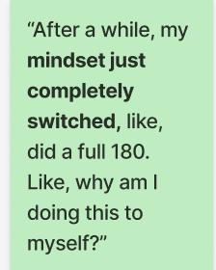
KEY INSIGHTS
Surprising Action: Chose to recover on her own through a personal mindset shift.
Key Observation: Prefers control over external help. Spent years in the in-between space (struggle was real but invisible to others)
Key Insight: Readiness for recovery doesn’t always align with external interventions.
Notes:
“What really surprised us about her interview was how much of her recovery was self-directed. Even when she had access to professional support, she didn’t rely on it — she talked about how her mindset ‘just completely switched.’ She spent years in that in-between space where the struggle was real but invisible to others. This showed us that for many people, readiness to change is internal, and doesn’t always line up with external support systems.”
What was surprising about her interview was that she managed her relationship with food privately (through control and restriction), and even after she had access to professional support, her actual recovery was self-directed. She talked about wanting to get better privately, and how her “mindset just completely switched”. She didn’t lean on this external support, and what mattered to her was the internal readiness and internal control. What really stood out to us is how long she lived in that in-between space, where the struggle was real but invisible to others. This revealed a key insight for us: many people experience years of private struggle, and their readiness for change doesn’t always align with external systems of support.
Recovery whenever she is ready at her own pace.

Slide 8
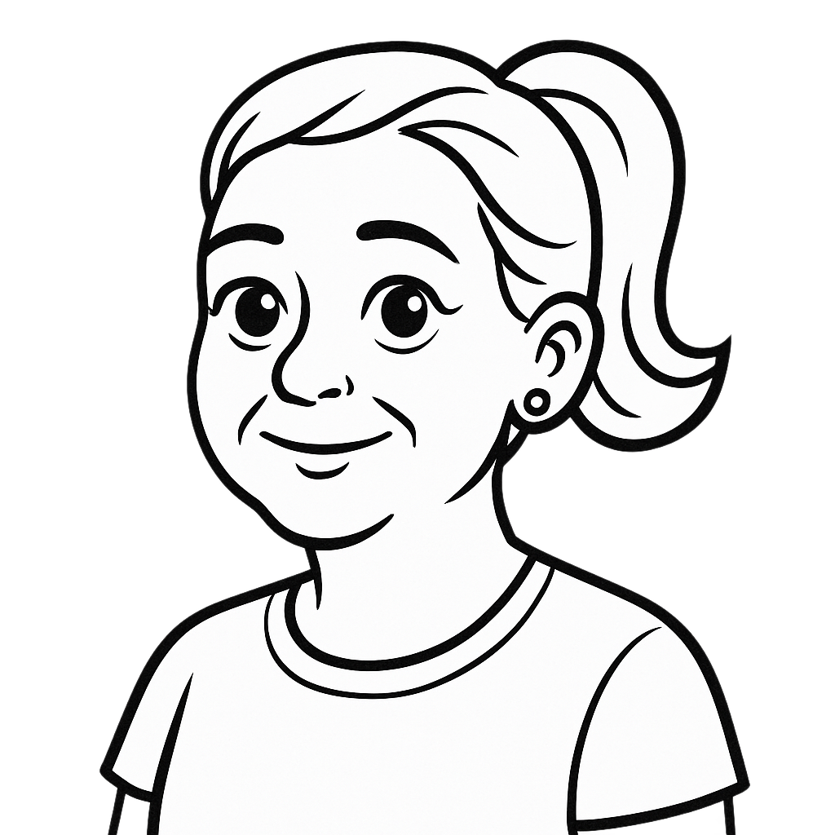
MEET CLARISSE
43 year old from the Bay Area
Lived with struggles in silence for 7 years before seeking help.
Masked behaviors from friends and family.
Current recovery coach.
Interview conducted at Phil’s Coffee by Jade & Jasmine.
Notes:
We also interviewed Clarisse! She is a 43 year old from the Bay Area who lived with an eating disorder for 7 years before seeking help where she hid her behaviors from friends and family. She is now a recovery coach for ED. We interviewed her in person at Phil’s Coffee in Cupertino

Slide 9
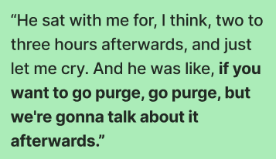
KEY INSIGHTS
Surprising Action: In and out of treatment centers. Masking recovery to comply.
Key Observation: Relational safety, not clinical control, shaped recovery.
Key Insight: Recovery relies less on rules and compliance, but instead, more on trust and emotional safety.
Notes:
“What really surprised us about Clarisse was that even after going through treatment multiple times and being hospitalized seven times, real change didn’t happen in those settings. She actually faked recovery through compliance. The turning point came when someone simply sat with her and held emotional space — no pressure to change, no fixing. That moment of emotional trust and agency mattered more than strict treatment rules, showing us how powerful feeling safe and in control can be in recovery.”
What surprised us about Clarisse was that she was in and out of treatments and was even hospitalized 7 times after she got out of the first treatment center, where she faked her recovery through compliancy. At these centers, she didn’t create real change, and the turning point for her was when someone simply sat with her and held emotional space for her without demanding behavior change or trying to fix her. We found that for her, recovery wasn’t abou being controlled by these strict rules that treatment centers often use, but instead on emotional trust, feeling safe, and self reflections where she had her own agency throughout the recovery process.
Importance of holding space and having a personal autonomy.
Unconventional Methods: Breaking the norms, having to follow the strict rules didnt help with recovery.
Holding up the mirror.

Slide 10
POV, HMW’S & SOLUTIONS
Notes:
From these interviews, we were able to come up with Three POV’s and How Might We’s for them as well.

Slide 11
SANDRA’S POV: FIRST DRAFT
We met a college sophomore who struggles with restrictive eating and body image concerns.
We were surprised to notice that she recognizes the importance of her support network but she doesn’t lean on it.
  More details about the tension?
We wonder if that means that she views her struggles as a person burden rather than something she can share with others.
  Why does she feel like a burden?
It would be game-changing to create spaces where people can open up about their experiences without fear of judgement or burdening their friends.
  What makes a space safe?
Notes:
Let’s start off with one of the interviews from last week. During last week’s studio, we created our first draft of Sandra’s POV. However, we noticed some gaps, where we felt that there needed to have more details about the tension described, explaining why felt like a burden, and defining what made a space safe. Using this, we wrote our new and improved POV.

Slide 12
SANDRA’S POV
We met a sophomore at Azusa University who hasn’t been officially diagnosed with an eating disorder, but struggles with restrictive eating patterns and body image concerns.
We were surprised to notice that she felt that her friends helped her recovery process, yet she doesn’t reach out and relies mostly on herself because she doesn’t want to feel like a “burden” to others.
We were wondering if this means that she is highly self-conscious about her condition and thinks that others would view her differently or more negatively if she is always "bothering" them with her condition, especially when she's not "sick enough" to warrant serious help.
It would be game-changing to have safe communities or support networks that are reflective of individual experiences that allow people to reach out without fear of judgment or burden.

Slide 13
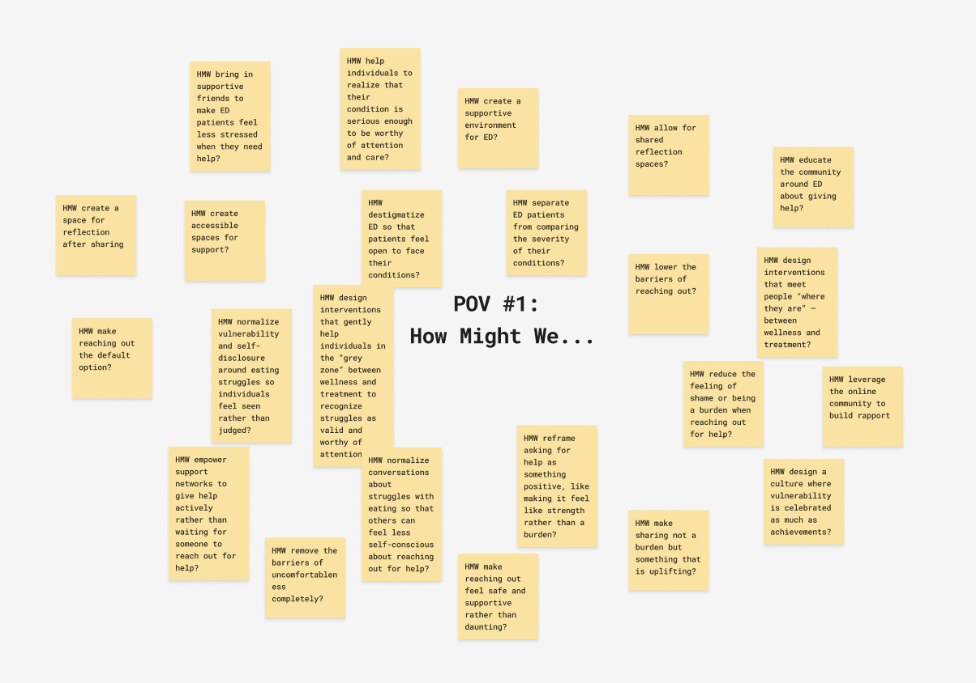
Notes:
From this, we brainstormed a bunch of how might we’s, and decided on

Slide 14
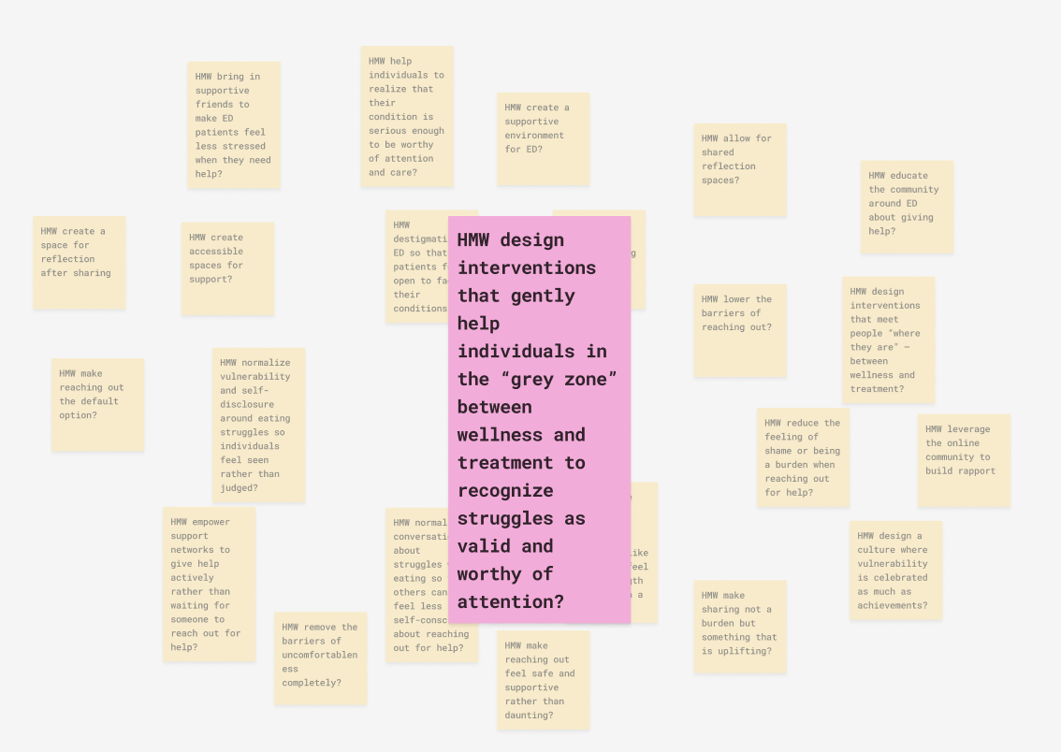
Notes:
The finalized one, which is… Now, our solution?

Slide 15
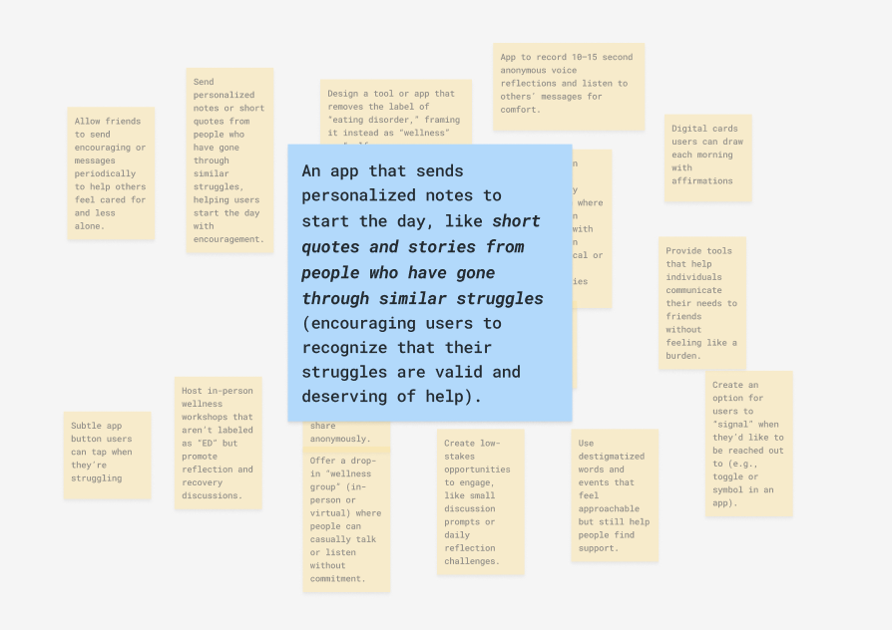
SOLUTION

Slide 16
VIOLET’S POV
We met a 21-year-old woman living in Melbourne who has been officially diagnosed and treated in outpatient settings for anorexia nervosa since 2020.
We were surprised to notice that, despite receiving professional support, her recovery journey was largely self-directed , shaped more by an internal “mindset switch” than by external help from doctors or parents.
We wonder if this means that meaningful recovery depends less on access to formal treatment, and more on fostering the intrinsic motivation and readiness for change that drive self-initiated healing.
It would be game-changing to reimagine healing approaches that center on cultivating this inner motivation, emphasizing personal readiness as an essential foundation for improving one's relationship with food and body.
Notes:
Next up, we have

Slide 17
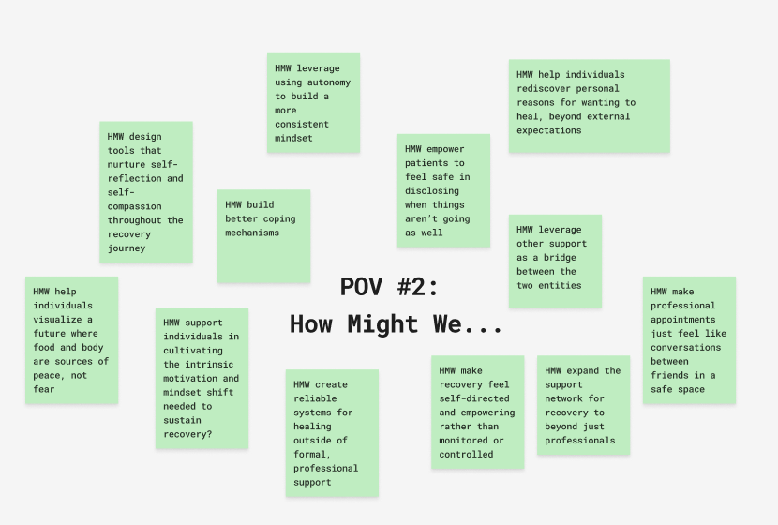
Notes:
Within these How Might We’s,

Slide 18
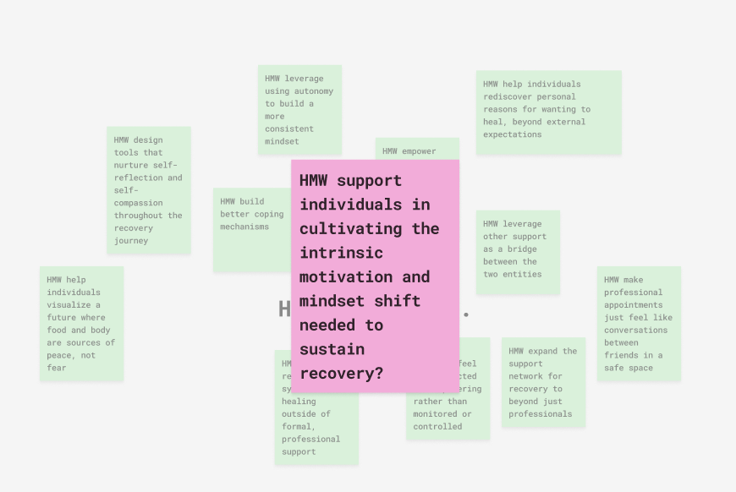
Notes:
We decided on

Slide 19
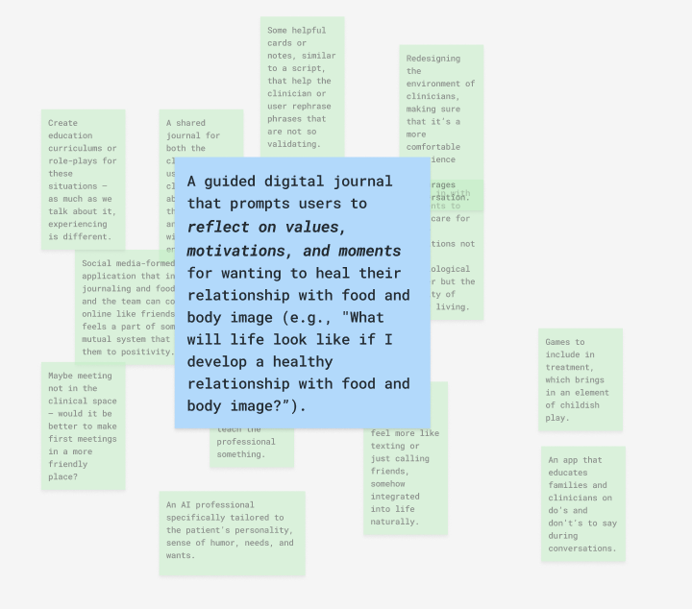
SOLUTION
Notes:
With our solution being

Slide 20
CLARISSE’S POV
We met a 43-year-old woman living in the Bay Area who had lived with an eating disorder for over a decade, had gone through repeated hospitalizations and residential stays, and is now using her lived experience to support others as a recovery coach.
We were surprised to notice that her most healing experiences were not ones where she was told what to do, but rather when she was given the freedom to make choices herself, even harmful ones, while others held space for her emotions and supported her through the outcomes.
We wonder if this means that the process of recovery depends less on rigid rules and compliance, and more on personal autonomy, where one feels trusted to guide their own journey with empathetic/compassionate support around them.
It would be game-changing to have healing approaches that prioritize personal autonomy and emotional safety over strict authoritarian control.

Slide 21
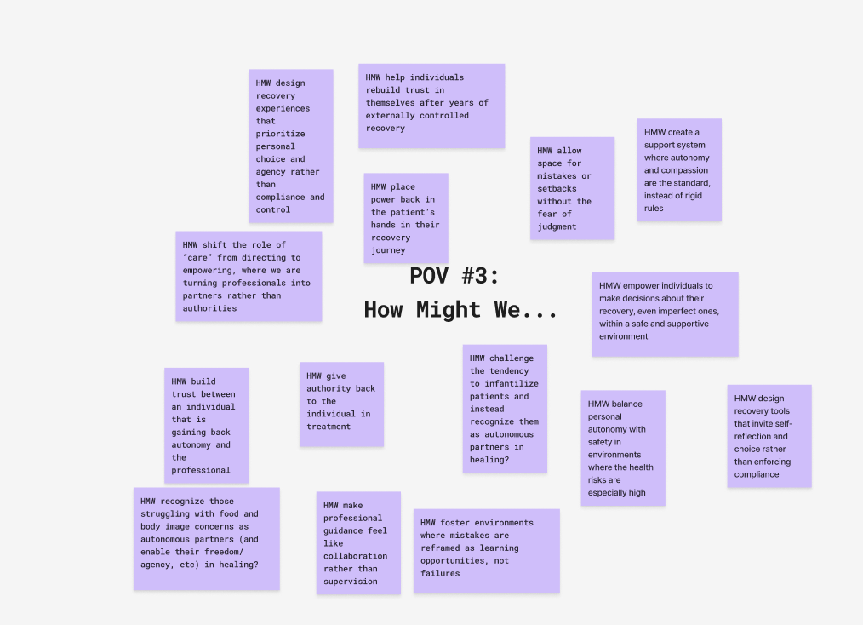
Notes:
From this, we brainstormed a bunch of how might we’s, and decided on

Slide 22
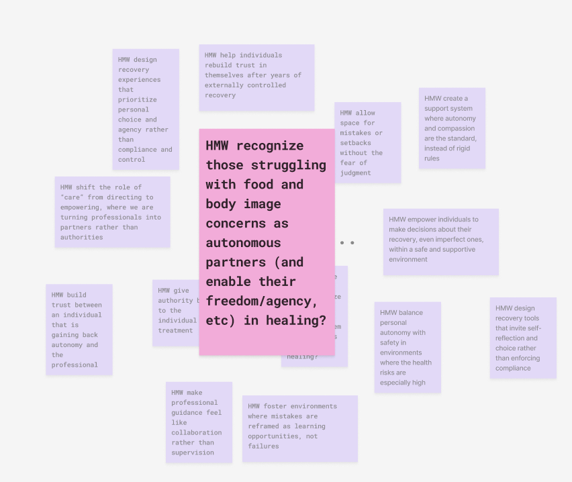
Notes:
The finalized one, which is…

Slide 23
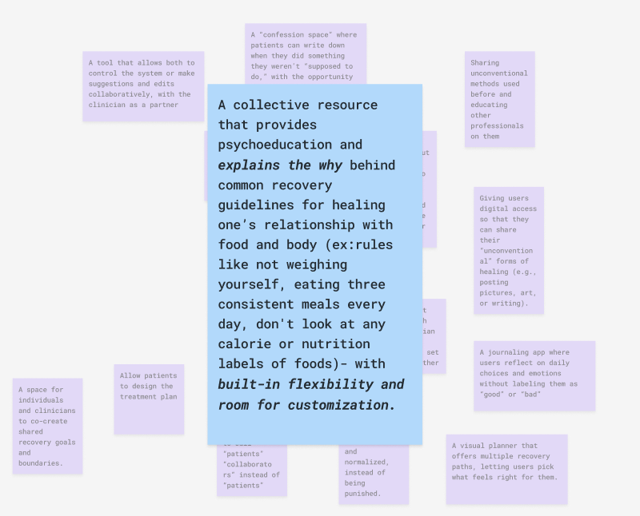
SOLUTION
Notes:
With our solution being

Slide 24
EXPERIENCE PROTOTYPES
Notes:
WIth these solutions in mind

Slide 25
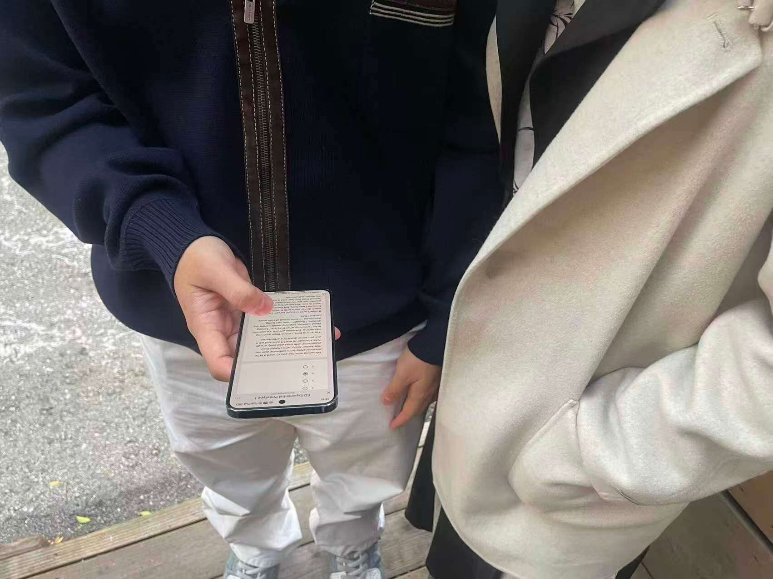
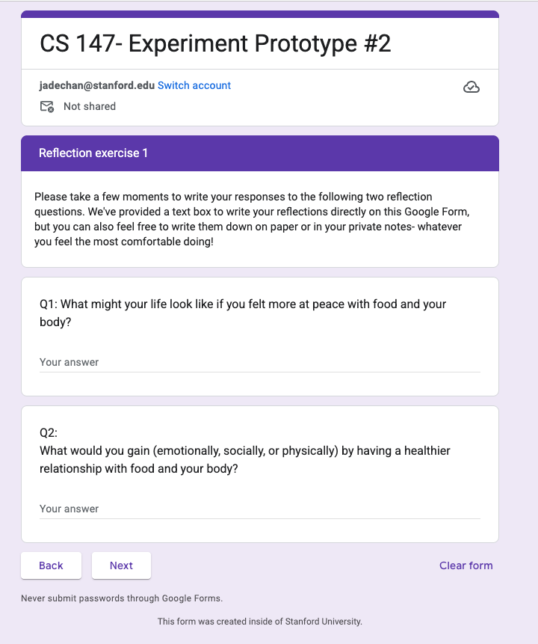
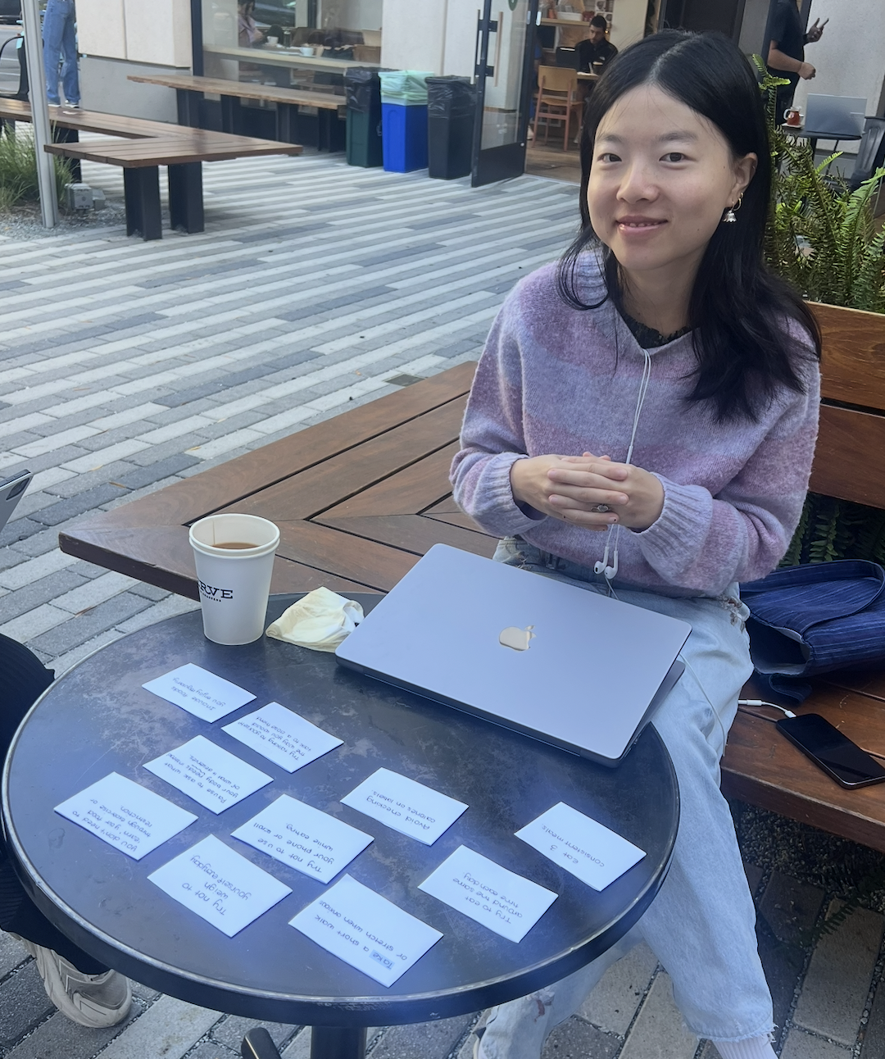
THREE EXPERIENCES
Add picture of #1
Add picture of #2
Add picture of #3
Story Sharing
Motivation Framing
Blind Rule Cards
Notes:
We identified key assumptions and tested it through three experience prototypes. `

Slide 26
01
Story Sharing Experience
Testing the assumption that stories from others will foster connection, validation, and hope, rather than triggering harmful social comparison or reinforcing the belief that one’s struggles are ‘not serious enough.

Slide 27
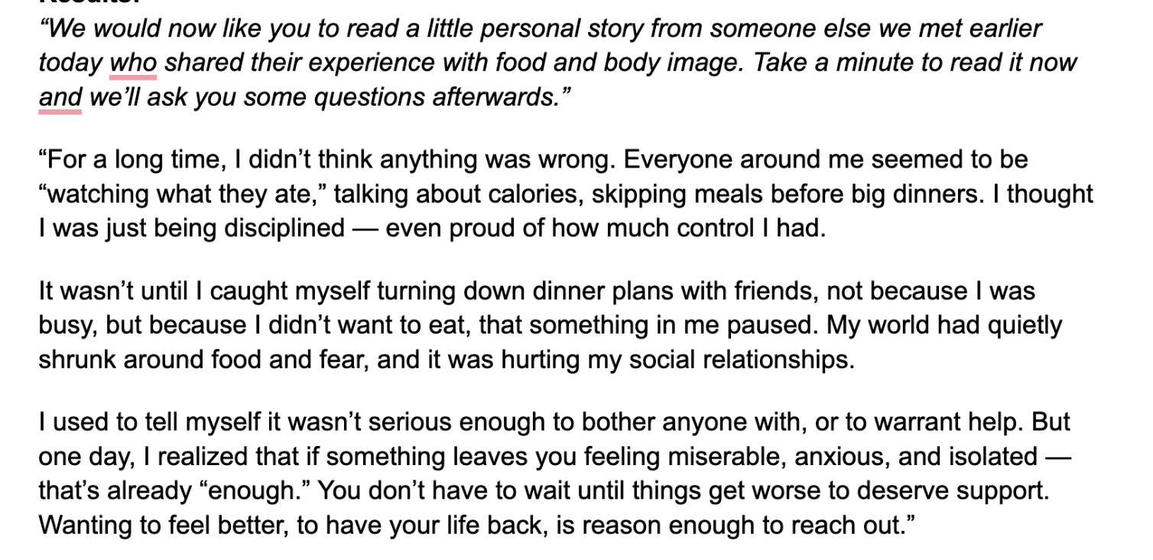
THE EXPERIENCE
3 Participants (19 - 22 years old): Restaurant line at Cotogna
Prescreening Question: Do you have complicated feelings or sometimes struggle with food or body image?
Answer some questions from a scale of 1 - 5.
Read a short narrative about someone realizing their struggles were “enough” to deserve help.
Answer same questions post-story.
With an additional open-ended question:
“How did reading this make you feel?”
Notes:
We recruited three participants ranging from ages 19 to 22 at the restaurant line at Cotogna. Just to preface, for ALL THREE experiments, we did ask the prescreening question to make sure that they had any complicated feelings or struggles with food or body image. They first answered baseline questions on willingness to act or talk about their relationship with food and body image.
Then, they read a short story written by a peer who shared their lived experience.
Finally, they reflected on how the story made them feel and re-rated their willingness to take action or confide in others.”

Slide 28
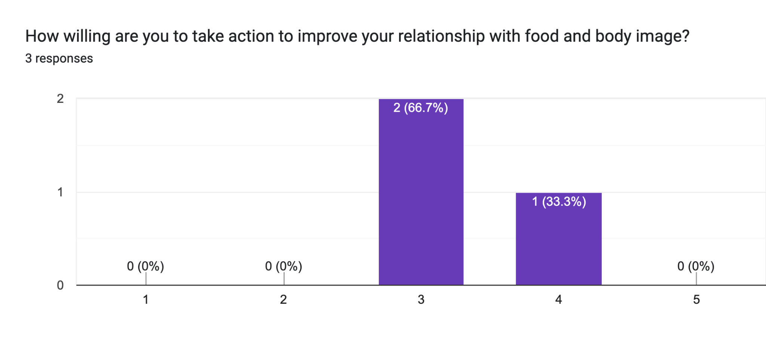
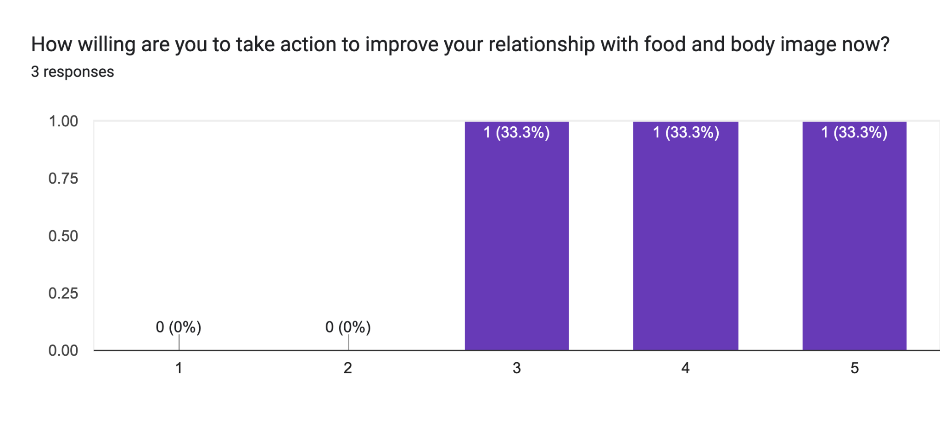
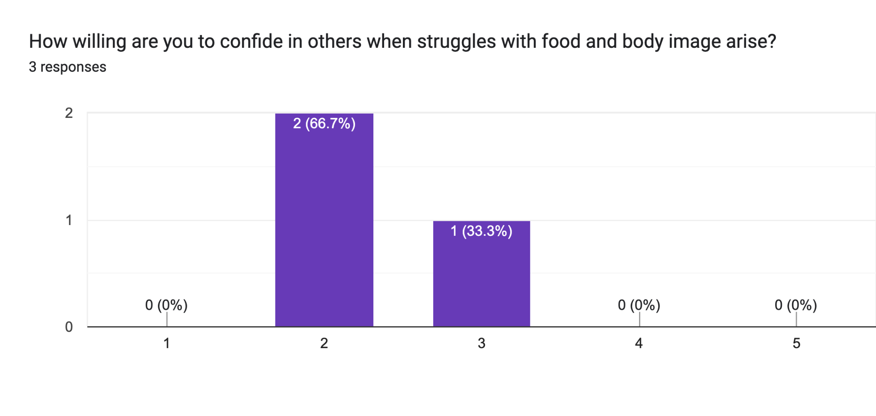
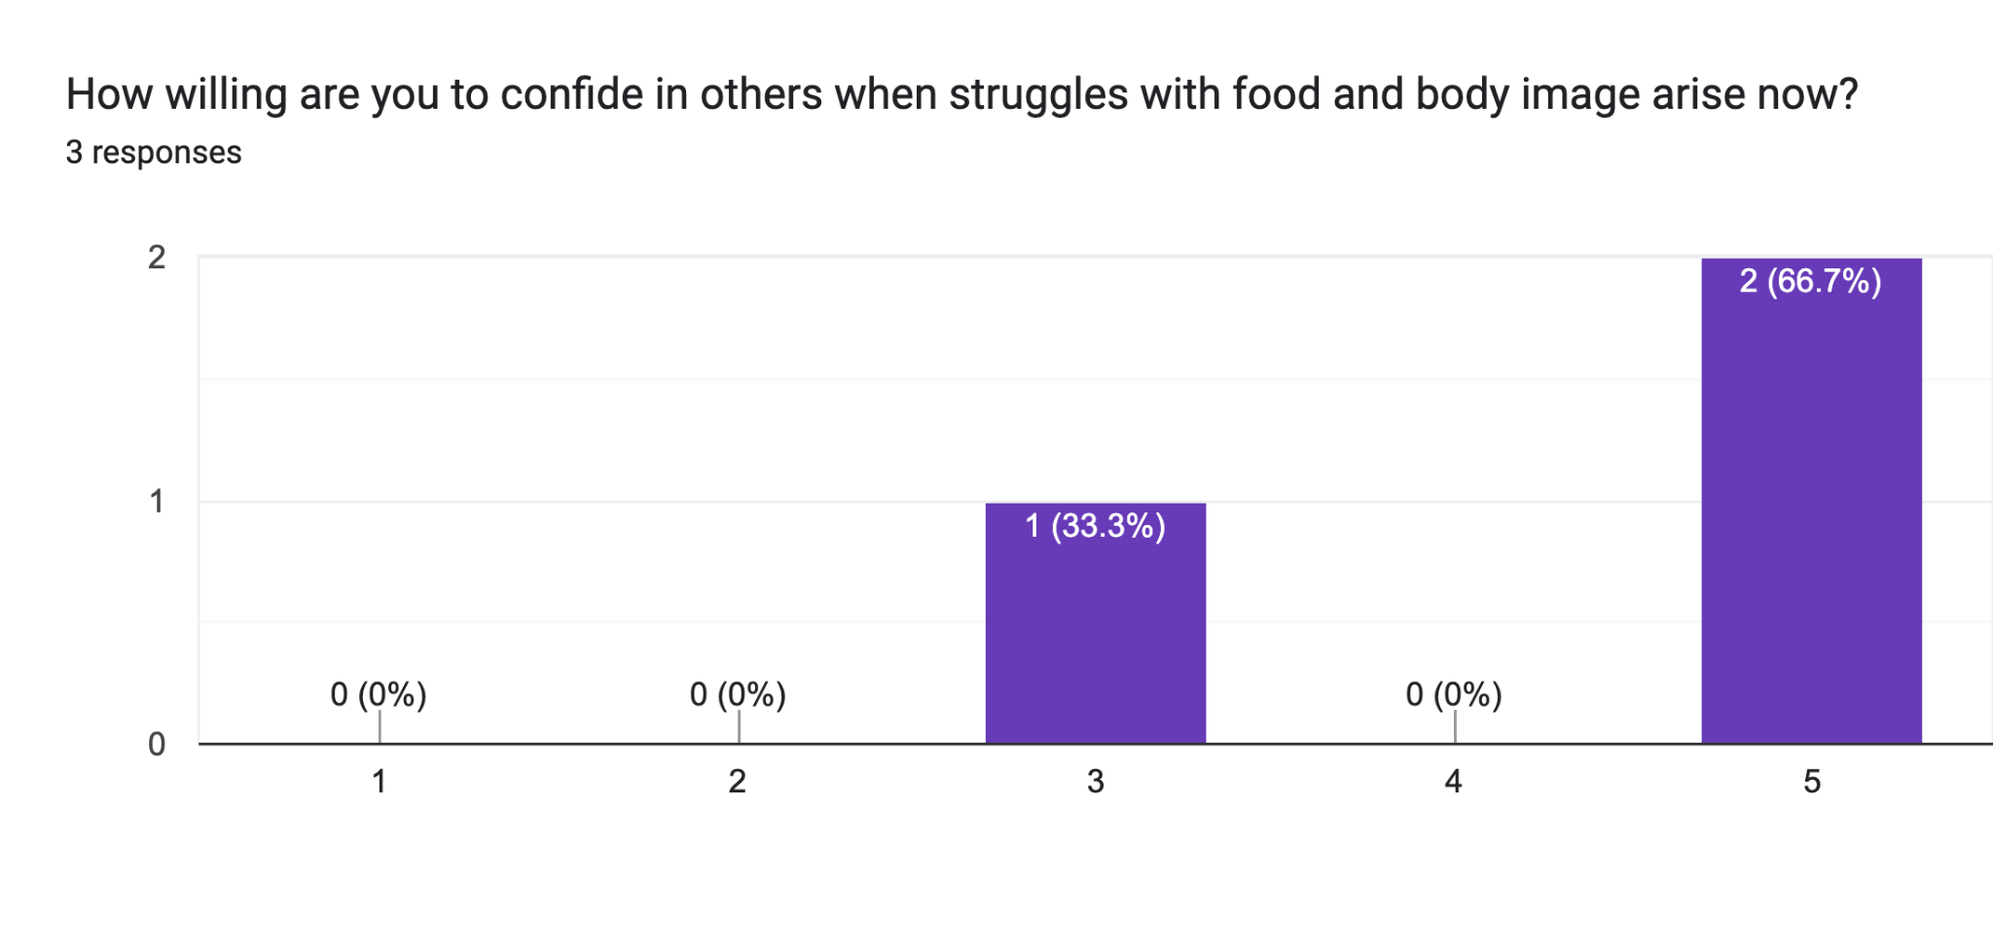
Pre-Story
Post-Story

Slide 29
RESULTS
What Worked:
Participants related the story to their own lives.
Increased willingness to act & confide.
Emotional resonance without judgment.
“I went through a period of binge eating back in high school”
“It feels like eating disorders affects a lot more aspects of life than just concept of meals”
What Didn’t Work:
Some wanted more personal depth or variety.
New Insight:
Stories can spark self-awareness and emotional connection, especially when framed as nonjudgmental and relatable.
Notes:
“What really stood out here is how people projected their own experiences onto the story. After reading, most participants rated their willingness to take action and confide higher than before.
What didn’t work was that because we only had one story available, it wouldn’t be an exact match to their personal experiences.
A new insight from this was that stories can spark self-awareness and emotion connection, if it’s framed in a safe, nonjudgmental way.”
From these quotes from the open ended responses, we see that it mirrors the story provided and shows the power of storytelling to invite reflection without pressure. After reading, most participants rated their willingness to take action and confide higher than before.

Slide 30
RESULTS
What Worked:
Participants related the story to their own lives.
Increased willingness to act & confide.
Emotional resonance without judgment.
“I went through a period of binge eating back in high school”
“It feels like eating disorders affects a lot more aspects of life than just concept of meals”
What Didn’t Work:
Some wanted more personal depth or variety.
✅ Assumption Outcome: Validated
New Insight:
Stories can spark self-awareness and emotion connection, especially when framed as nonjudgmental and relatable.
Notes:
And this validates our first assumption.

Slide 31
02
Motivation Framing Experience
Testing the assumption that people are more motivated towards this mindset shift when the reflection prompts are framed around future gains and personal values.
Notes:
For the second prototype, we are testing the assumption that people are more motivated to shift their mindset when the reflections are framed around future gains and personal values.

Slide 32
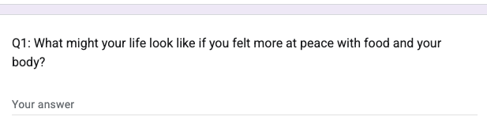
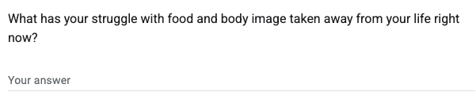
THE EXPERIENCE
6 Participants (18 - 29 years old): Online via Google Forms
Pre Screening Question
Answer hope-based reflection prompt: Rating their levels of motivations, hopefulness, self-compassion, & emotional safety.
Answer loss-based reflection prompt: Filling out the same rating questions.
Answer open-ended questions:
Which reflection felt more motivating or empowering to you?
Which felt heavier or more difficult?
Did either reflection make you think differently about your relationship with food or body image?
Notes:
We recruited 6 participants online through a google form and were asked to answer both hope and loss-based reflection prompts, and then filled out a survey after each one, and answered some open-ended questions

Slide 33
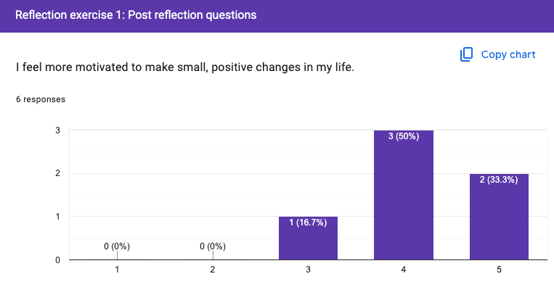
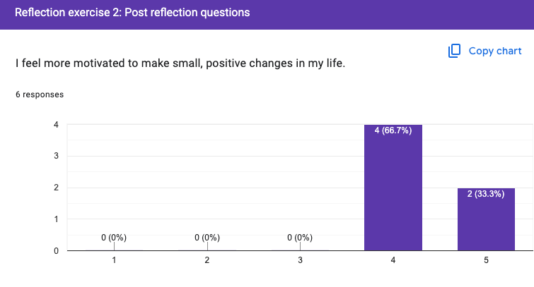
RESULTS
What Worked:
Both frames felt emotionally safe (4.67 / 5).
Hope framing described as “gentle,” “encouraging,” “easier to start with.”
What Didn’t Work:
Motivation was higher for loss (4.3) compared to hope (4.17)
Some participants found loss prompts emotionally heavy.
Loss framing could be overwhelming without support.
Notes:
What worked was that both felt emotionally safe.
Hope framing was consistently described as ‘gentle,’ ‘encouraging, making it easier for people to engage.
What didnt work was that motivation for change was higher for loss, HOWEVER, it was emotionally hard for them to go through the loss prompts and could be overwhelming without support.
‘made me realize how much I’ve lost.’ That kind of emotional depth is what likely pushed the motivation scores up.A few people described the loss reflection as ‘bringing up a lot’ and said they’d need more support to do that kind of reflection regularly.

Slide 34
RESULTS
❌ Assumption Outcome: NOT Validated
Key Insight:
Hope framing lowers the barrier to entry, while loss framing may be powerful for those who are ready to go deeper.
Notes:
So our original assumption was not supported by the data. But the insight is valuable:
Hope framing lowers the barrier to entry, while loss framing may be more powerful for those who are ready to go deeper.
That suggests a tiered approach — starting with hope, and offering loss reflections as an optional next step.”

Slide 35
03
Blind Rule Card Experience
Users will be open and curious enough to explore the ‘why’ behind common recovery rules, rather than disengaging the moment they encounter them.

Slide 36
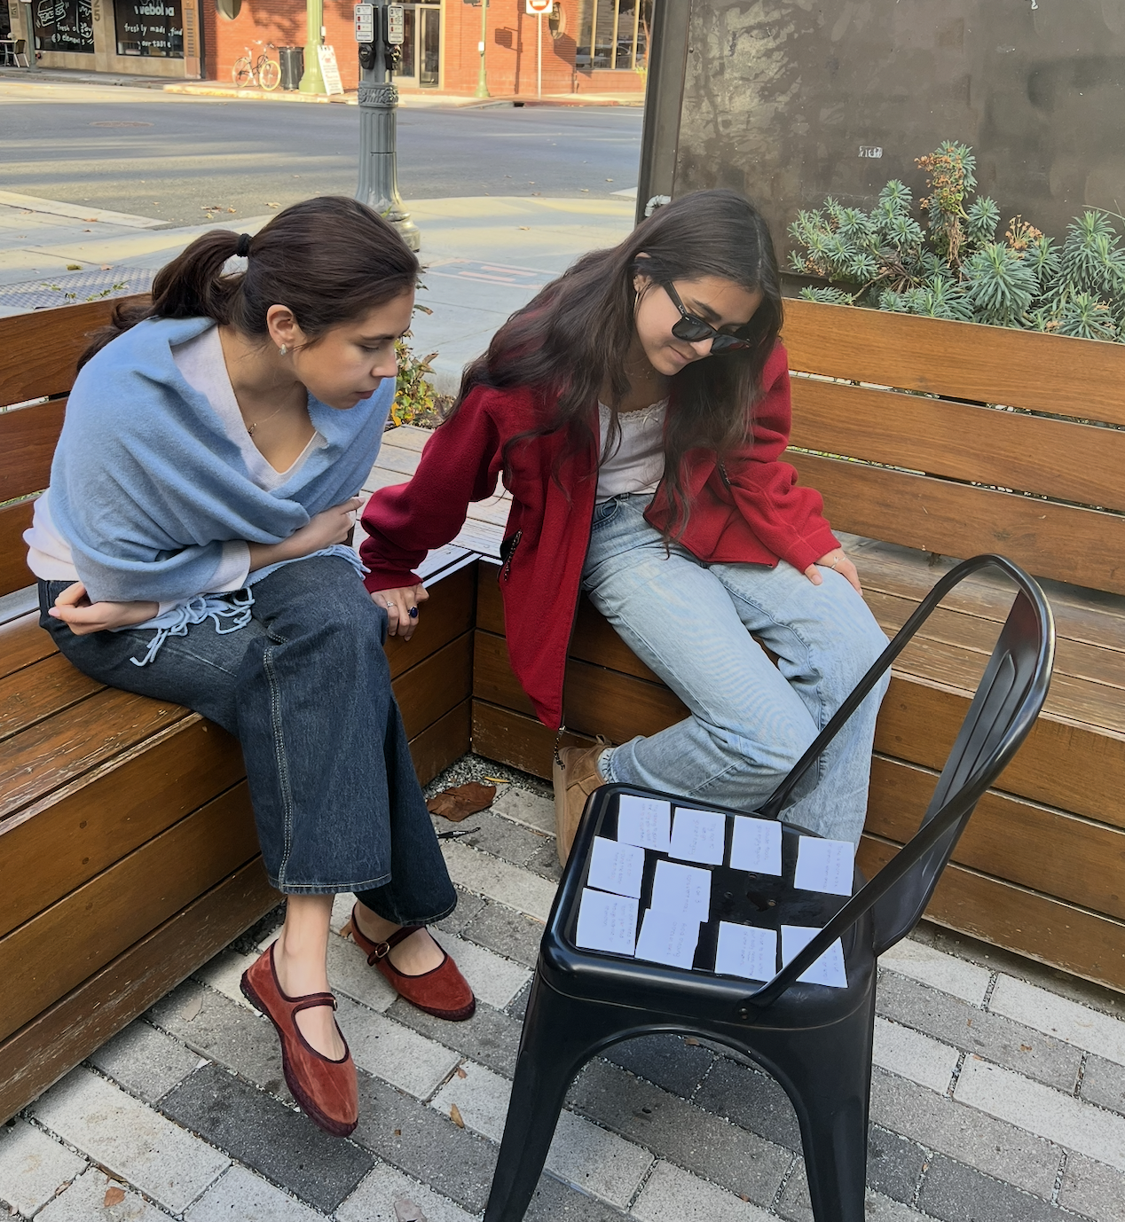
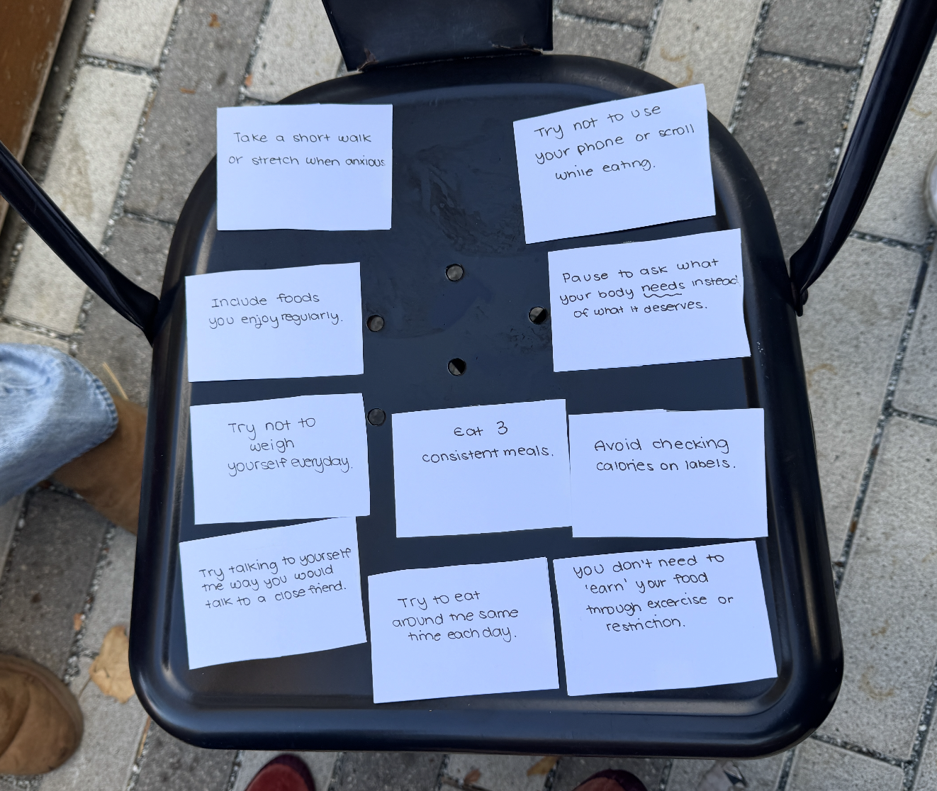
THE EXPERIENCE
5 Participants (22 - 45 years old): Verve & Blue Bottle Cafe
Pre-Screening Question
Lay out cards with common tips about eating and body image (10 cards)
“Take a short walk or stretch when anxious.”
“Try not to use your phone or scroll while eating”
Informed that they could flip card to find out “why” reasoning.
Post-rating surveys on approachability, curiosity, meaning, openness.
Notes:
We created ten ‘advice cards.’ Each had a simple statement on the front, like ‘Try not to weigh yourself every day.’
On the back was a brief explanation — the why. Participants could flip whichever cards they wanted, or none at all.
Afterwards, they rated how approachable, meaningful, or judgmental the experience felt.”

Slide 37
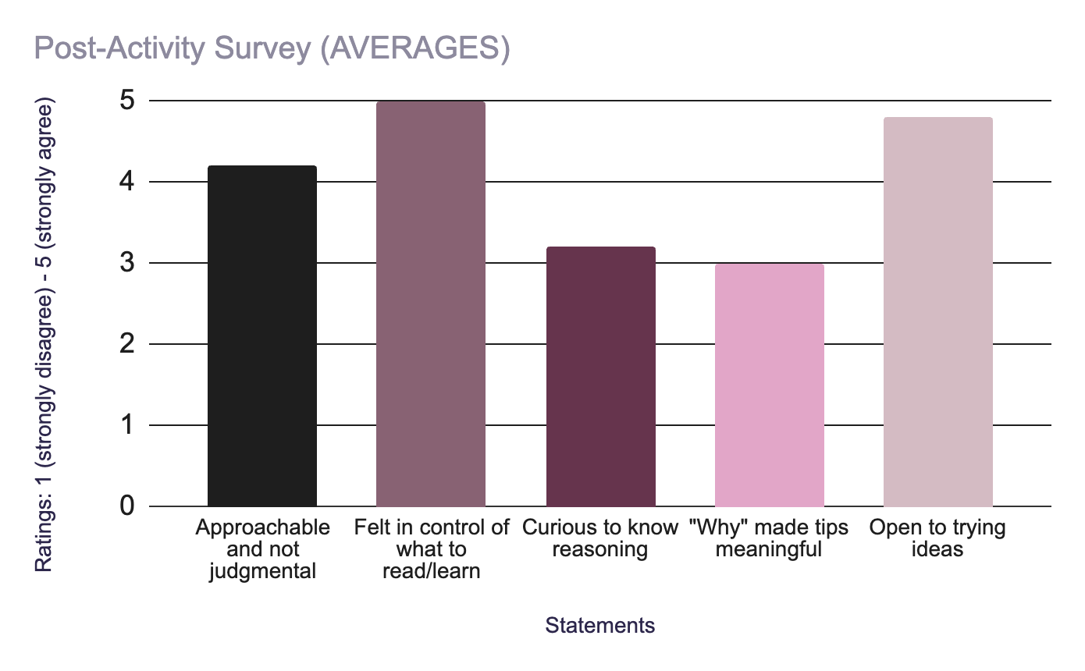

Slide 38
RESULTS
What Worked:
Autonomy fostered trust (even non-flippers felt respected)
No reports of feeling pressured or judged.
For users with less prior knowledge, explanations increased understanding and willingness to try new behaviors
What Didn’t Work:
Experienced participants found explanations redundant.
Low-stakes cards (“no phone while eating”) were flipped more than emotionally heavier ones (“You don’t need to ‘earn’ your food through exercise or restriction.”)
Key Insight:
Autonomy builds trust and engagement, but the ‘why’ should be introduced gradually to match user readiness
Notes:
What Worked
• Autonomy created trust where even the non-flippers reported a positive experience
Tone felt approachable and no one felt pressured or judged.
For users with less prior knowledge, explanations increased understanding and willingness to try new behaviors
.
What Didn’t Work
Experienced participants found explanations redundant
Low-stakes cards (“no phone while eating”) were flipped more than emotionally heavier ones .
Autonomy builds trust and engagement, but the ‘why’ should be introduced gradually to match user readiness

Slide 39
RESULTS
What Worked:
Autonomy fostered trust (even non-flippers felt respected)
No reports of feeling pressured or judged.
For users with less prior knowledge, explanations increased understanding and willingness to try new behaviors
✅ Assumption Outcome: Majority Validated
What Didn’t Work:
Experienced participants found explanations redundant.
Low-stakes cards (“no phone while eating”) were flipped more than emotionally heavier ones (“You don’t need to ‘earn’ your food through exercise or restriction.”)
Key Insight:
Autonomy builds trust and engagement, but the ‘why’ should be introduced gradually to match user readiness
Notes:
What Worked
• Autonomy created trust where even the non-flippers reported a positive experience
Tone felt approachable and no one felt pressured or judged.
For users with less prior knowledge, explanations increased understanding and willingness to try new behaviors
.
What Didn’t Work
Experienced participants found explanations redundant
Low-stakes cards (“no phone while eating”) were flipped more than emotionally heavier ones .
Autonomy builds trust and engagement, but the ‘why’ should be introduced gradually to match user readiness

Slide 40
OUR SOLUTION

Slide 41
OUR APP (At a Glance)
Feature 1
Feature 2
A gentle morning companion that shares short, personalized notes and stories from others who’ve been there.
Bite-sized, customizable learning modules that explain the science and psychology behind recovery guidelines.
Users want gentle, flexible support that respects their autonomy rather than something prescriptive or overwhelming.
Notes:
Our app will bring together our prototypes with the first feature inspired by prototype 1 where users can receive personalized stories from others with similar struggles, help them feel seen and less alone.
The second feature is based on Prototype 3 where users can get customizable modules behind the why for common recovery guidelines, at their own pace and comfort level.
We chose this solution because it reflects what we found in the 3 experience prototypes that people want gent, flexible support that respects their autonomy rather than something that is telling you exactly what to do and overwhelming.
Feature 1 focuses on validation and emotional connection.
Feature 2 focuses on autonomy and understanding
Lists main features of app (essentially involves a combination of the prototypes we tested)
Also if you have time maybe add a sentence explaining why this is the selected solution (“rationale for solution” is one of the marking criteria)
Also explanation for why I included feature 3: can talk about assumes reflection exercise was not as helpful because maybe it’s more about doing rather than reflecting? So based on that we came up with this idea- but ofc it still needs to be tested (Also feel free to delete feature 3 altogether if you think it’s too much of a stretch)

Slide 42
ETHICAL CONSIDERATIONS
Sensitive data collection
App Dependence
Excluded users
Since emotional and behavioral data are involved, consent and anonymization are essential.
The app should foster real-world support and help-seeking, not replace relationships with therapists, peers, or loved ones, for purpose of user retention.
As a digital-first solution, it’s best suited for younger, tech-savvy users—potentially excluding older populations who are less comfortable with app-based tools.
Notes:
For ethical considerations, Our goal is not for the app to replace real-world support systems like friends or community spaces. Instead, it should encourage users to seek and strengthen those connections rather than become reliant on the app itself.
data sensitivity. Since the app involves emotional and behavioral information, things like getting clear consent, keeping everything anonymous, and protecting data are super important to us.
And lastly, there’s the question of who might get left out. Because this is a digital-first tool, it’s naturally more suited for younger, tech-comfortable users. That might mean older folks or those less comfortable with technology could be excluded, and that’s something we’ll need to think about moving forward.

Slide 43
THANK YOU!

Slide 44
APPENDIX

Slide 45
Empathy Maps

Slide 46
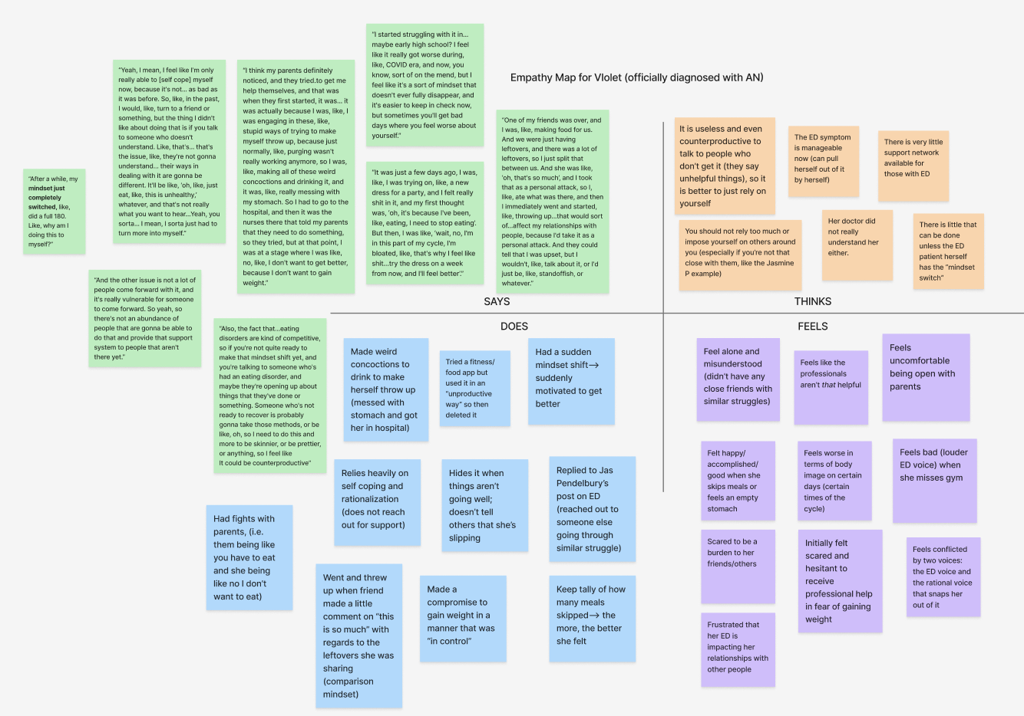

Slide 47
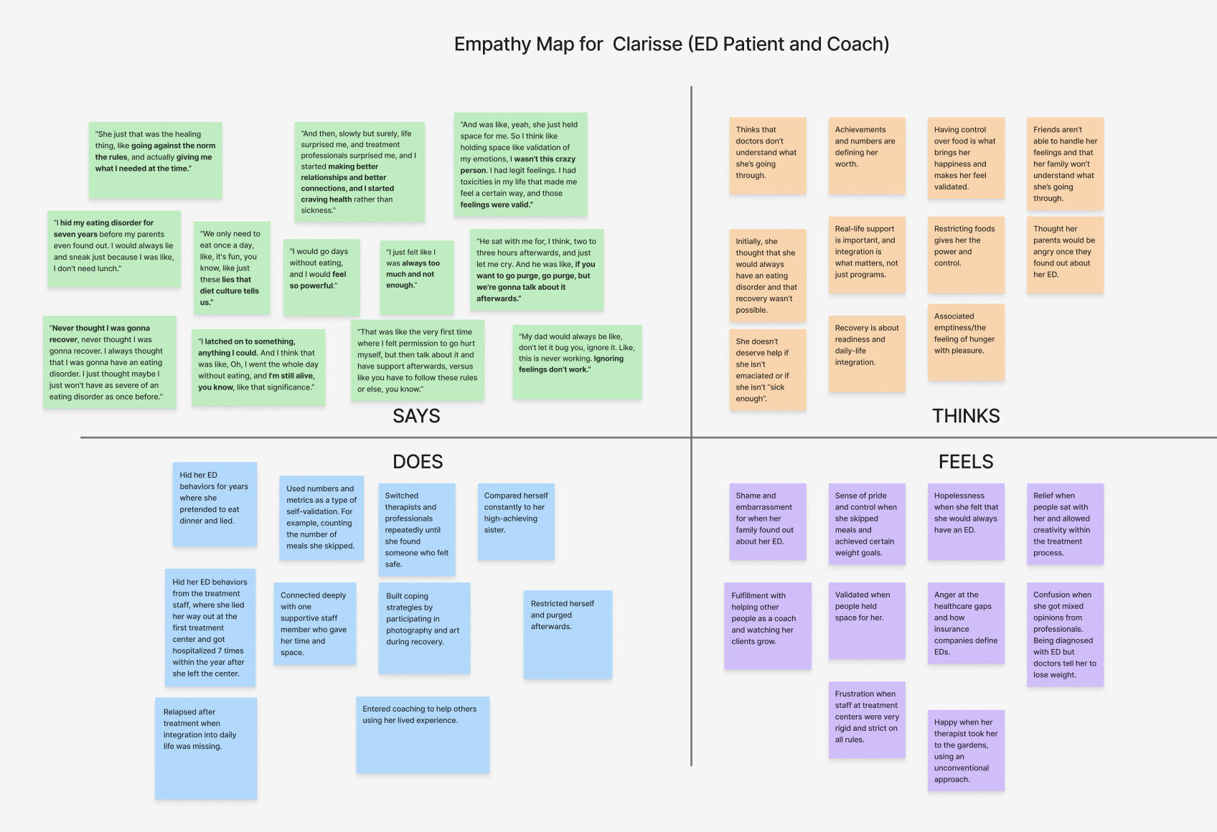

Slide 48
Solutions Brainstorming

Slide 49
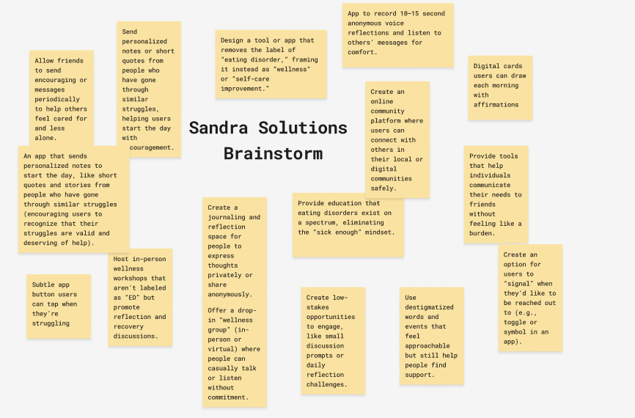

Slide 50
