Slide 1
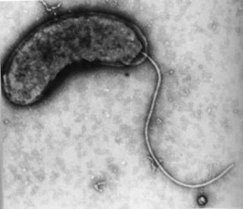
Sulfate-reducing bacteria
Derya Ozuolmez
HMC 2012

Slide 2
Sulfate reducers,
Strict anaerobes,
Belong to 4 phylogenetic lineages;
  Delta-proteobacteria, thermophilic Gram (-) bacteria, Gram (+) bacteria, Euryarchaeota
Reduce sulfate to sulfide,
Electron donors (H₂, HCOO⁻, acetate, butyrate, propionate, ethanol)
Two physiological groups of SRB;
  Incomplete oxidizers: organic compounds to CO₂ and acetate
  Complete oxidizers: organic compounds to CO₂

Slide 3
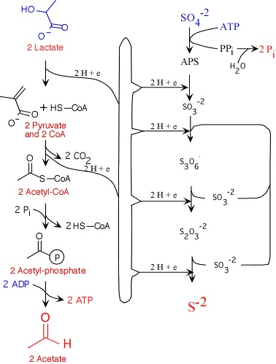

Slide 4
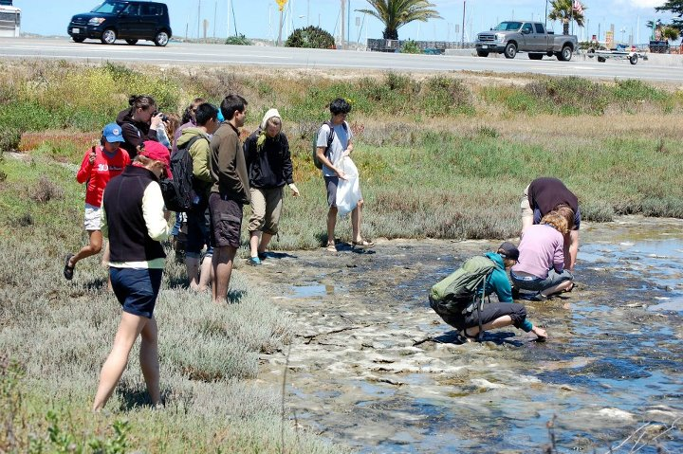
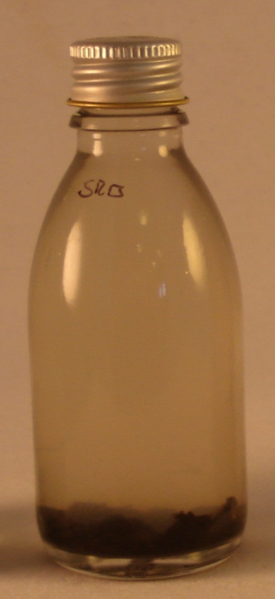
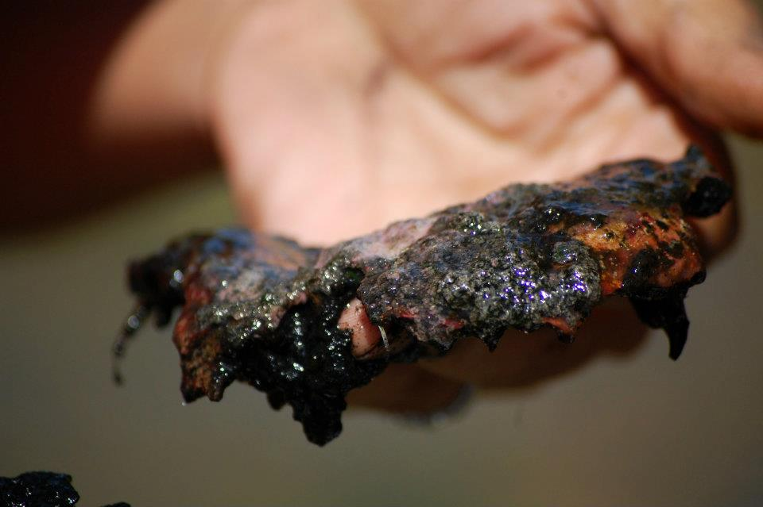
Starting enrichments

Slide 5
Enrichments
Basal marine mineral medium
Na₂SO₄ (30 mM)
Sodium lactate (10 mM)
NaHCO₃ (30 mM)
7 vitamin solution
SL 10 (Trace element sol.)
Resazurin
Na₂S (1 mM)
pH (7.2)
Sediment sample in 50 ml Pfennig bottle
Incubated @ 30ºC
Checked regularly for turbidity, blackening, H₂S smell…
Observed microscopically
3 ml culture was transferred to a new bottle for further enrichment.

Slide 6
Hey, they’re growing!

Slide 7
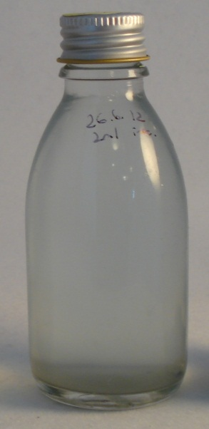
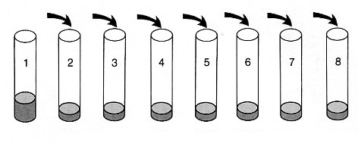
Isolation step…
1 ml
culture
SRB enrichment
culture
3ml 3% agar + 6 ml medium
The headspace gas was exchanged by
purging with N2 during 1 minute.

Slide 8
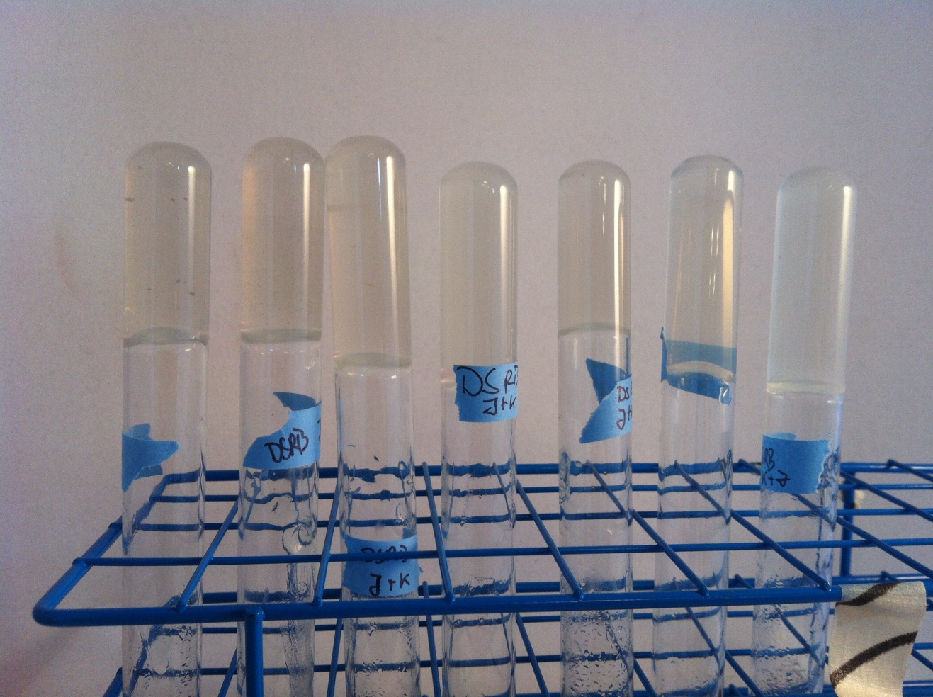
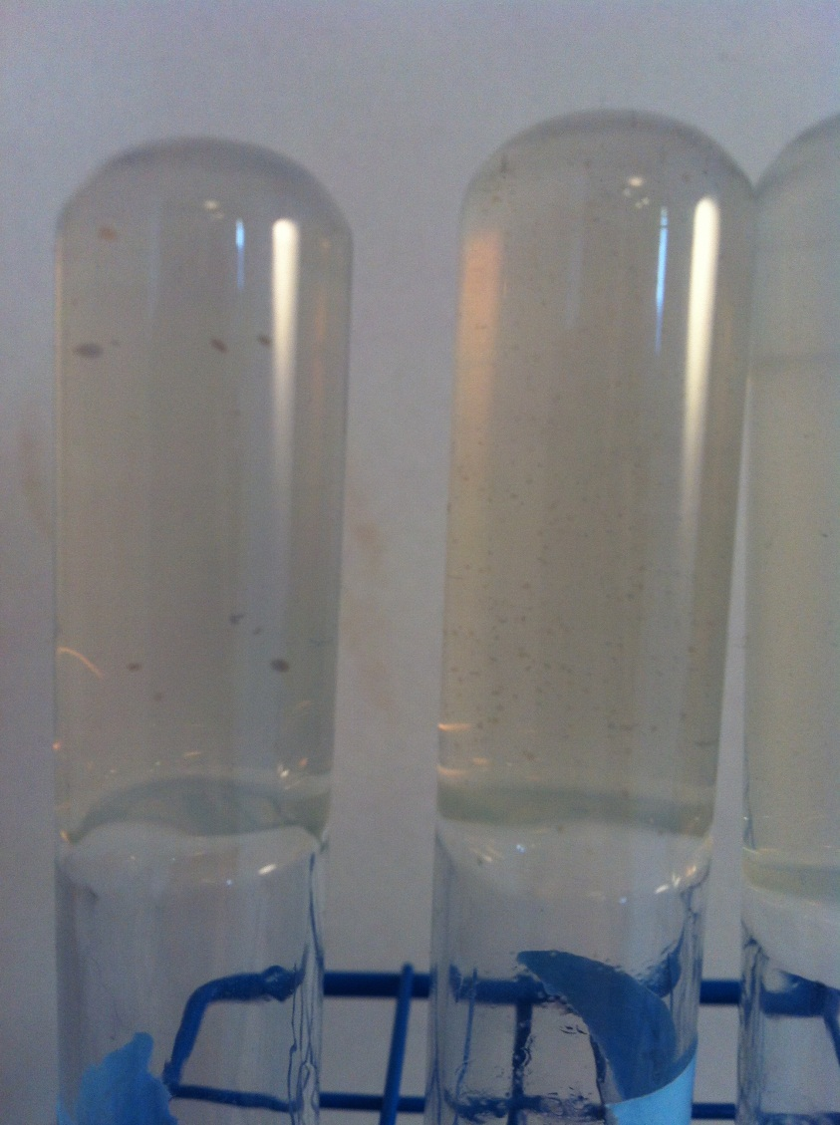
Some nice agar shakes…
By courtesy of Katrin & Jose!!!)

Slide 9
Thank you!
Questions?

Slide 10
Activation of sulfate
ATP
2[H]
6[H]
SO₄²⁻
APS
HSO₃⁻
HS⁻
ATP sulfurylase
APS reductase
Bisulfite reductase (dsr)
PPi
Pyrophosphate

