Slide 1
Programming Abstractions
CS106B
Cynthia Bailey
Chris Gregg

Slide 2
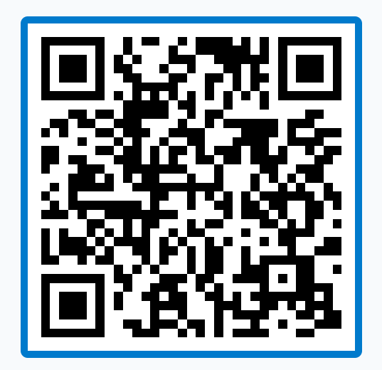
Topics:
pollev.com/cs106b
  Midterm Review
    Overview of what to expect
    Going over solutions to a couple new practice problems
    Q&A
  Additional resources:
    For even more review, see review session led by Jonathan last Thursday! Video and slides available, see pinned Ed post.
  For important announcements, be sure to see the weekly announcements post on the Ed Q&A board! https://edstem.org
  Also on Ed: live lecture Q&A with Chris & Jonathan

Slide 3
Midterm Exam
What to expect

Slide 4
The Midterm Exam
  Time: 2 Hours
    Very first thing you should do: write your SUID on every page.
      Forgetting this would be the saddest reason to lose points! And you will NOT be given extra time after time is called to do this. No writing at all after time is called.
    4 questions.
    I’d plan 25 minutes per problem, which leaves you 20 minutes at the end to re-check your work etc.

Slide 5
The Midterm Exam
  Format: Handwritten on paper
    I would be sure to solve some practice problems with pen & paper so this doesn’t feel completely new and strange!
    In grading, we try to ignore minor “typos” in handwritten code that likely would have been prevented or caught by an IDE
      Just make sure intent is clear—i.e. we are happy to ignore that you wrote “stepcount” instead of “stepCount,” but not if you have variables with both names in your code and we actually do need to know which one it is on a given line. ☺
    You won’t be able to actually compile, run, and test your paper-written code, but you’ll very much want to be thinking in terms of what you would put in “STUDENT_TEST”s for the code you’re writing.
      To simulate a test: pick a concrete example, then try to set your intent aside and painstakingly trace through the example input line by line to check. Repeat for 1-2 more concrete examples.
      (Note: familiarity with our STUDENT_TEST code format is expected knowledge on the exam.)

Slide 6
The Midterm Exam
  Problem Topics:
    (Same general categories as the practice exam)
    C++ Fundamentals
    ADTs
    Big-O
    Recursion

Slide 7
The Midterm Exam
  Rules: Closed book, no devices
    This is actually to make the exam easier, I promise! ☺
  Reference Sheet (included in exam)
    It’s on the course website, so study it ahead of time!
  Cheat Sheet (your own to bring with you)
    One sheet of paper (8.5x11), both sides, handwritten

Slide 8
Sample Problem 1: C++ Fundamentals
What to expect, solution

Slide 9
What to expect
  Strings
  Loops, nested loops
  Multi-part conditionals inside a loop
  Thinking carefully about edge cases

Slide 10
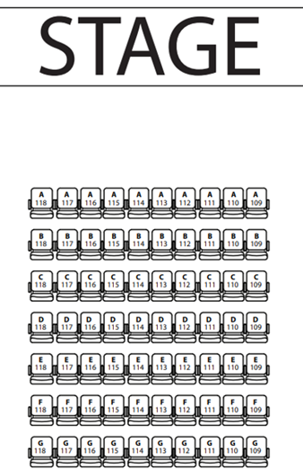
Sample Q1: Grid of theater seat reservations
  You are given a Grid<string> representing the seating chart of a theater.
  Your function will help customers looking to make group reservations by taking the grid and looking for a row with at least n consecutive open seats.
    If the seat has been reserved, the string is that person’s name, otherwise the string is empty string.
  Return the GridLocation of the leftmost seat of the matching block of seats.
    You may assume a satisfying location exists.

Slide 11
Sample Q1: Strategy
  We need to loop over the Grid
    Should we use for (string entry : grid) style loop?
      Not in this case, because we need to be aware of our current row (blocks can’t cross from one row to another)
      Use int row/col nested loops
  Within a row, we need to count free seats
    Start count at 0 again each row
    Iterate over cols, incrementing if empty
      If not empty, reset count to 0
    If we find something that works, immediately store location and return

Slide 12
Sample Q1: Solution
  GridLocation findSeats(Grid<string>& seatGrid, int n) {
  GridLocation loc(0, 0);
  for (int r = 0; r < seatGrid.numRows(); r++) {
  int count = 0; // count consecutive empty seats
  for (int c = 0; c < seatGrid.numCols(); c++) {
  if (seatGrid[r][c] == "") {
  count++;
  if (count == n) {
  loc = { r, c – n + 1 };
  return loc;
  }
  } else {
  count = 0; // if non-empty string, need to reset counter
  }
  }
  }
  return loc; // shouldn’t reach this but keep compiler happy
  }

Slide 13
Your Turn
Q: What’s something you should be sure to include on your cheat sheet to help with a C++ fundamentals question?
  Give one idea per pollev response
  Feel free to give multiple responses
pollev.com/cs106b

Slide 14
Sample Problem 2: ADTs
What to expect, solution

Slide 15
What to expect
  Uses of the ADTs that really “fit” the situation
    Either by our design, or we ask you to choose the best design
  Code that is much simpler (!!) if you use elegant ADT features
    Range-based for loop (example: for (string s : themap))
    Push/pop on a Stack vs manual equivalent on a Vector
    Set operations vs manual equivalent
  One kind of ADT alongside or inside another kind of ADT
  Theme: really let the ADTs “shine”

Slide 16
Sample Q2: ADTs problem
pollev.com/cs106b
Write a function that takes a Queue<int> and returns a Queue<int> where the elements are in reverse of the original order.
The challenge: Your function may declare only one local variable: your choice of either a Stack or a Queue.
Queue<int> reverse(Queue<int> q);
Would you choose a Stack or Queue for this?

Slide 17
Sample Q2 Solution
Queue<int> reverse(Queue<int> q) {
Stack<int> theStack;
while (!q.isEmpty()) {
int x = q.dequeue();
theStack.push(x);
}
while (!theStack.isEmpty()) {
q.enqueue(theStack.pop());
}
return q;
}

Slide 18
Your Turn
Q: What’s something you should be sure to include on your cheat sheet to help with a ADTs question?
  Give one idea per pollev response
  Feel free to give multiple responses
pollev.com/cs106b

Slide 19
Sample Problem 3: Big O
What to expect, solution

Slide 20
What to expect
  ADT operations with known costs, inside loops and recursive function calls
    Your job is mainly to analyze the loop or recursion structure, then you can just plug in what you see for that ADT operation, using the Reference Sheet
    Loops one after the other: additive cost
    Loops nested in one another: multiplicative cost
    Remember to simplify! (O(N), not O(3N + 5))
  (no additional samples for this one—refer to practice exams)

Slide 21
Practice Exam Problem 4: Recursion
What to expect, solution

Slide 22
What to expect
  Similar to pre-backtracking recursion examples from lecture: Fibonacci, Coin Flip, Fractals, permutations

Slide 23
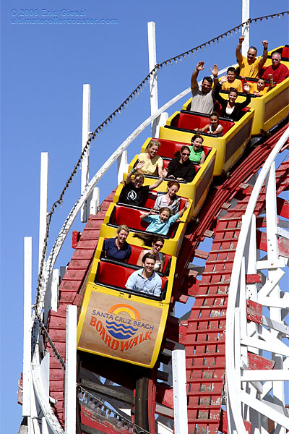
Sample Q4: Roller Coaster seating
This roller coaster at the Santa Cruz Beach Boardwalk is a train of rows that are two seats wide.
There are N amusement park guests in line for the roller coaster, and they must board in order. The train is loaded from front to back.
When guests reach the front of the line, they tell the ride attendant whether they want to ride alone (1 person that row) or share with the next person in line (2 people in that row).
    Assume that the train has at least N rows, so it is long enough to accommodate all N riders in any configuration (rows aren't skipped except there are possibly extra empty rows after all riders have been seated).
  How many different rider configurations are possible?

Slide 24
Sample Q1: Strategy
  N is the number of riders guests, and recursively will track how many remain to be seated
  Base cases: 0 guests, 1 guest, 2 guests
  Recursive case: Each recursive call we either seat 1 or 2 guests (decreasing the remaining guests by 1 or 2). For each choice, recursively explore how many options from there

Slide 25
Sample Q1: Solution
  int countConfigs(int n) {
  if (n < 3) {
  return n;
  }
  return countConfigs(n - 1) + countConfigs(n - 2);
  }

