Slide 1
Programming Abstractions
CS106B
Cynthia Bailey
Chris Gregg

Slide 2

Today’s Topics
pollev.com/cs106b
  C++ Classes
    You’ve used them, now make your own!
  For important announcements, be sure to see the weekly announcements post on the Ed Q&A board! https://edstem.org
  Also on Ed: live lecture Q&A with Chris & Jonathan

Slide 3
Quick Course Overview
  Week 1: C++
  Week 2: ADTs, how to use them
  Weeks 3-4: Recursion
  Weeks 5-10: ADTs, behind the scenes! ← YOU ARE HERE
    actually implement them yourself

Slide 4
Classes and Objects
Key vocabulary and concepts

Slide 5


Classes and objects
  Class: Allows us to add new types to the language! A template for what the type holds and how it works
  Object: One instance of a class type
  Object-oriented programming (OOP): Programs that perform their behavior as interactions between objects.
  Abstraction: Separation between concepts and details.

Slide 6
Classes and objects
  Class: Allows us to add new types to the language! A template for what the type holds and how it works
  Object: One instance of a class type
  Object-oriented programming (OOP): Programs that perform their behavior as interactions between objects.
  Abstraction: Separation between concepts and details.
vector.h
Vector<double> b;
Vector<int> a;
Vector<int> c;

Slide 7
Elements of a class
Member variables: State inside each object
  Also called "instance variables" or "fields"
  Each object has a copy of each member variable
Member functions: Behavior each object can perform
  Also called "methods"
  The method can interact with the data inside that object

Slide 8
Abstraction: Interface vs. code
C++ separates classes into two kinds of code files:
  .h: A "header" file containing the interface (declarations)
  .cpp: A "source" file containing definitions (method bodies)
    class Foo => must write both foo.h and foo.cpp
The content of .h files is #included inside .cpp files
  Makes them aware of the blueprint plans for the class and its members

Slide 9
Abstraction: Interface vs. code
Essentially a collection of function prototypes for the class methods (among other things)
C++ separates classes into two kinds of code files:
  .h: A "header" file containing the interface (declarations)
  .cpp: A "source" file containing definitions (method bodies)
    class Foo => must write both foo.h and foo.cpp
The content of .h files is #included inside .cpp files
  Makes them aware of the blueprint plans for the class and its members
The actual function definitions

Slide 10
C++ Class Implementation
How to actually do this!

Slide 11
Class declaration (.h)
  #ifndef _classname_h
  #define _classname_h
  class ClassName {
  public: // in ClassName.h
  ClassName(parameters); // constructor
  returnType name(parameters); // member functions
  returnType name(parameters); // (behavior inside
  returnType name(parameters); // each object)
  private:
  type _name; // member variables
  type _name; // (data inside each object)
  };
  #endif
This C++ detail provides protection in case multiple .cpp files include this .h, so that its contents won't get declared twice
IMPORTANT: must put a semicolon at end of class declaration

Slide 12
Class example (v1)
  // BankAccount.h
  #ifndef _bankaccount_h
  #define _bankaccount_h
  class BankAccount {
  public:
  BankAccount(string n); // constructor
  void deposit(double amount); // methods
  void withdraw(double amount);
  void setName(string name);
  private:
  string _name; // each BankAccount object
  double _balance; // has a name and balance
  };
  #endif

Slide 13
Using objects
ba1
  // client code in bankmain.cpp
  BankAccount ba1("Cynthia");
  ba1.deposit(2.00);
  ba1.withdraw(1.50);
  ba1.setName("Cyn");
  BankAccount ba2("Chris");
  ba2.deposit(60.00);
  ba2.withdraw(5.00);
  ba2.withdraw(5.00);
An object groups multiple variables together
  Each object contains its own name and balance field inside it
  We can get/set them individually
  Code that uses your objects is called client code
_name = "Cyn"
_balance = 0.50
ba2
_name = "Chris"
_balance = 50.00

Slide 14
Member function bodies
In ClassName.cpp, we write bodies (definitions) for the member functions that were declared in the .h file:
  #include "ClassName.h"
  // member function
  returnType ClassName::methodName(parameters) {
  statements;
  statements;
  }
  Member functions/constructors can refer to the object's member variables.

Slide 15
Member func diagram
// BankAccount.cpp
void BankAccount::withdraw(double amount) {
if (_balance >= amount) {
_balance -= amount;
}
}
// client program
BankAccount cynth(...);
BankAccount chris(...);
...
cynthia.withdraw(5.00);
julie.withdraw(5.00);
void withdraw(double amount) {
if (_balance >= amount) {
_balance -= amount;
}
}
_name | "Cynthia" | _balance | 1.25
void withdraw(double amount) {
if (_balance >= amount) {
_balance -= amount;
}
}
_name | "Chris" | _balance | 9999

Slide 16
Constructors
  ClassName::ClassName(parameters) { // note no return type is specified
  statements to initialize the object;
  }
Constructor: Initializes state of new objects as they are created.
  without constructor:
    BankAccount ba;
    ba.setName("Cynthia"); // tedious, also what is the balance??
  with constructor:
  BankAccount::BankAccount(string name) {
  _name = name;
  _balance = 0.0;
  }
    BankAccount ba("Cynthia"); // convenient, clearly starts $0.0 balance

Slide 17
Private data
  private:
  type name;
We can provide methods to get and/or set a data field's value:
  // "read-only" access to the balance ("accessor")
  double BankAccount::getBalance() {
  return _balance;
  }
  // Allows clients to change the field ("mutator")
  void BankAccount::setName(string newName) {
  _name = newName;
  }

Slide 18
Your Turn!
  // BankAccount.h
  #ifndef _bankaccount_h
  #define _bankaccount_h
  class BankAccount {
  public:
  BankAccount(string n); // constructor
  void deposit(double amount); // methods
  void withdraw(double amount);
  private:
  string _name; // each BankAccount object
  double _balance; // has a name and balance
  };
  #endif
I want to add a second constructor to my BankAccount class
  Current constructor takes the name and initializes
  I’d like to have one that takes both a name and an initial account balance
In PollEv: write the line of code I would need to add to the .h file to do this.
In discussion: what new code goes in the new .cpp file?

Slide 19
Preconditions
Precondition: Something your code assumes is true at the start of its execution
  Often documented as a comment on the function's header.
  If violated, the class often throws an exception.
  // Initializes a BankAccount with the given state.
  // Precondition: balance is non-negative
  BankAccount::BankAccount(string name, double balance) {
  if (balance < 0) {
  error("Balance must be positive.");
  }
  _name = name;
  _balance = balance;
  }

Slide 20
Bouncing Ball Demo
Applying what we learned with the Bank class to a new problem

Slide 21
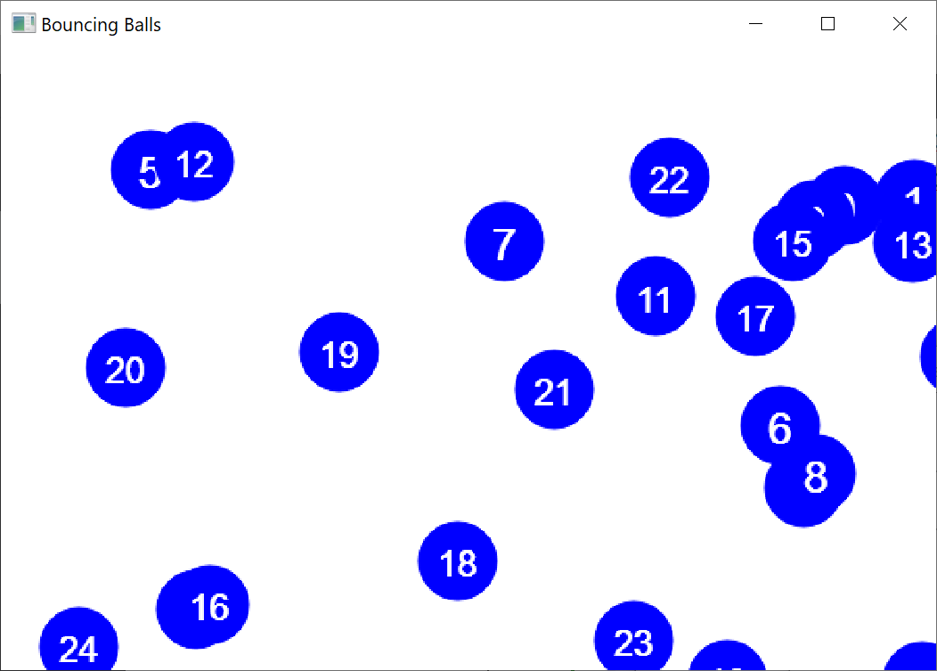
Bouncing Ball demo
Write a class Ball that represents a bouncing ball.
  What state (private instance variables) should each ball store?
  window functions: setColor and drawOval
Finish the provided client code to draw many balls in a window.
  Make each ball appear at a random location.
  Make the balls move at random velocities
  and "bounce" if they hit window edges.
Enhance the provided client code to add colors.
  Make each ball appear a random color choice.

Slide 22
Extra Slides
More cool tricks with C++ classes

Slide 23
Operator overloading (6.2)
unary: + - ++ -- * &
  ! ~ new delete
binary: + - * / % += -=
  *= /= %= & | && ||
  ^ == != < > <= >=
  << >> = [] -> () ,
operator overloading: Redefining the
behavior of a common operator
in the C++ language.
Syntax:
  returnType operator op(parameters); // in the .h file for the class
  returnType operator op(parameters) { // in the .cpp file for the class
  statements;
  };
  For example, for two variables of type Foo, a + b will use the code you write in:
    Foo operator +(Foo& a, Foo& b) {
        // function body
    }

Slide 24
Make objects printable
To make it easy to print your object to cout, overload <<
  ostream& operator <<(ostream& out, Type& name) {
  statements;
  return out;
  }
  ostream is a base class that represents cout, file output streams, ...

Slide 25
<< overload example
  // BankAccount.h
  class BankAccount {
  ...
  };
  // notice operators go OUTSIDE of the class' closing }; brace!
  ostream& operator <<(ostream& out, BankAccount& ba);
  // BankAccount.cpp
  ostream& operator <<(ostream& out, BankAccount& ba) {
  out << ba.getName() << ": $" << ba.getBalance();
  return out;
  }

Slide 26
== overload example
  // BankAccount.h
  class BankAccount {
  ...
  };
  bool operator ==(const BankAccount& ba1,
  const BankAccount& ba2);
  // BankAccount.cpp
  bool operator ==(const BankAccount& ba1,
  const BankAccount& ba2) {
  return ba1.getName() == ba2.getName()
  && ba1.getBalance() == ba2.getBalance();
  }

Slide 27
Destructor (12.3)
// ClassName.h // ClassName.cpp
~ClassName(); ClassName::~ClassName() { ...
Destructor: Called when the object is deleted by the program.
  (when the object falls out of {} scope)
  Useful if your object needs to free any memory as it dies.
    delete any pointers stored as private members
    delete[] any arrays stored as private members
    (we haven’t learned about delete yet, that’s in a couple weeks!)

