Slide 1
Programming Abstractions
CS106B
Cynthia Bailey
Chris Gregg

Slide 2

Today’s Topics
pollev.com/cs106b
  Recursion!
    Code up the Binary Search algorithm from last time
      New decomposition concept: recursive helper function
    Rewrite our Fibonacci code
      New algorithm concept: memo-ization to improve efficiency
    Use recursion to enumerate all possible sequences
      Assignment 3 hints!
  Next week:
    More advanced recursion
    “Backtracking” recursion for solving tricky problems like mazes
  For important announcements, be sure to see the weekly announcements post on the Ed Q&A board! https://edstem.org
  Also on Ed: live lecture Q&A with Chris & Jonathan

Slide 3
Binary Search Refresher
(recall from Wednesday’s lecture)

Slide 4
Does this list of numbers contain X?
Context: we have a collection of numbers in a Vector, in sorted order.
0 | 1 | 2 | 3 | 4 | 5 | 6 | 7 | 8 | 9 | 10
2 | 7 | 8 | 13 | 25 | 29 | 33 | 51 | 89 | 90 | 95
  Efficiency Hack: Jump to the middle of the Vector and look there to find:
    X (answer Yes)
    A number greater than X (rule out entire second half of Vector)
    A number less than X (rule out entire first half of Vector)
  Key observation: with *one* comparison, you ruled out *N/2* of the N cells in the Vector!
0 | 1 | 2 | 3 | 4 | 5 | 6 | 7 | 8 | 9 | 10
2 | 7 | 8 | 13 | 25 | 29 | 33 | 51 | 89 | 90 | 95
0 | 1 | 2 | 3 | 4 | 5 | 6 | 7 | 8 | 9 | 10
2 | 7 | 8 | 13 | 25 | 29 | 33 | 51 | 89 | 90 | 95

Slide 5
Does this list of numbers contain X?
Context: we have a collection of numbers in a Vector, in sorted order.
0 | 1 | 2 | 3 | 4 | 5 | 6 | 7 | 8 | 9 | 10
2 | 7 | 8 | 13 | 25 | 29 | 33 | 51 | 89 | 90 | 95
  Extreme Efficiency Hack: Keep jumping to the middle!
    Let’s say our first jump to the middle found a number less than X, so we ruled out the whole first half:
    Now jump to the middle of the remaining second half:
  Key observation: we do one piece of work, then delegate the rest. Recursion!!
0 | 1 | 2 | 3 | 4 | 5 | 6 | 7 | 8 | 9 | 10
2 | 7 | 8 | 13 | 25 | 29 | 33 | 51 | 89 | 90 | 95
0 | 1 | 2 | 3 | 4 | 5 | 6 | 7 | 8 | 9 | 10
2 | 7 | 8 | 13 | 25 | 29 | 33 | 51 | 89 | 90 | 95

Slide 6
Binary Search Implementation
Now we understand the approach.
What does the code look like?

Slide 7
Basic Recursive Function Design Pattern
Always two parts:
Base case:
  This problem is so tiny, it’s hardly a problem anymore! Just give answer.
Recursive case:
  This problem is still a bit large, let’s (1) bite off just one piece, and (2) delegate the remaining work to recursion.
From previous lecture

Slide 8
Binary Search pseudocode
From previous lecture
bool binarySearch(Vector<int>& data, int key)
{
if (data.size() == 0) {
return false;
}
if (key == data[midpoint]) {
return true;
} else if (key < data[midpoint]) {
return binarySearch(data[first half only], key);
} else {
return binarySearch(data[second half only], key);
}
}
Base cases
Recursive case

Slide 9
Binary Search pseudocode
Issue: copying half the data into a new, smaller Vector each time would be very inefficient, and defeat the purpose of pass-by-reference.
bool binarySearch(Vector<int>& data, int key)
{
if (data.size() == 0) {
return false;
}
if (key == data[midpoint]) {
return true;
} else if (key < data[midpoint]) {
return binarySearch(data[first half only], key);
} else {
return binarySearch(data[second half only], key);
}
}

Slide 10
Binary Search pseudocode
bool binarySearch(Vector<int>& data, int key, int start, int end)
{
if (data.size() == 0) {
return false;
}
if (key == data[midpoint]) {
return true;
} else if (key < data[midpoint]) {
return binarySearch(data[first half only], key);
} else {
return binarySearch(data[second half only], key);
}
}
Idea: pass the whole Vector by reference, but add parameters that indicate the bounds on the portion of the Vector currently in use.

Slide 11
Design Tip: Recursive Helper Function
Sometimes managing data within a recursive function requires extra parameters.
We don’t want to clutter up the parameter list that the outside world sees, so what should we do??
    Make the primary function basically just a quick pass-through to a recursive helper function that does the hard work (and takes some extra parameters to help it do that work).
    In this class, unless otherwise stated, when you are asked to implement a function with a certain function signature, it’s ok to add a recursive helper function behind the scenes.

Slide 12
// this is the primary binary search function
bool binarySearch(const Vector<int>& data, int key) {
return binarySearch(data, key, 0, data.size() - 1);
}
// this is a recursive helper function
bool binarySearch(Vector<int>& data, int key, int start, int end)
{
if (start > end) {
return false;
}
int mid = (start + end) / 2;
if (key == data[mid]) {
return true;
} else if (key < data[mid]) { // YOUR TURN: complete the code below
return binarySearch(data, key, _______, _______);
} else {
return binarySearch(data, key, _______, _______);
}
}

Slide 13
// this is the primary binary search function
bool binarySearch(const Vector<int>& data, int key) {
return binarySearch(data, key, 0, data.size() - 1);
}
// this is a recursive helper function
bool binarySearch(Vector<int>& data, int key, int start, int end)
{
if (start > end) {
return false;
}
int mid = (start + end) / 2;
if (key == data[mid]) {
return true;
} else if (key < data[mid]) {
return binarySearch(data, key, start, mid - 1);
} else {
return binarySearch(data, key, mid + 1, end);
}
}

Slide 14
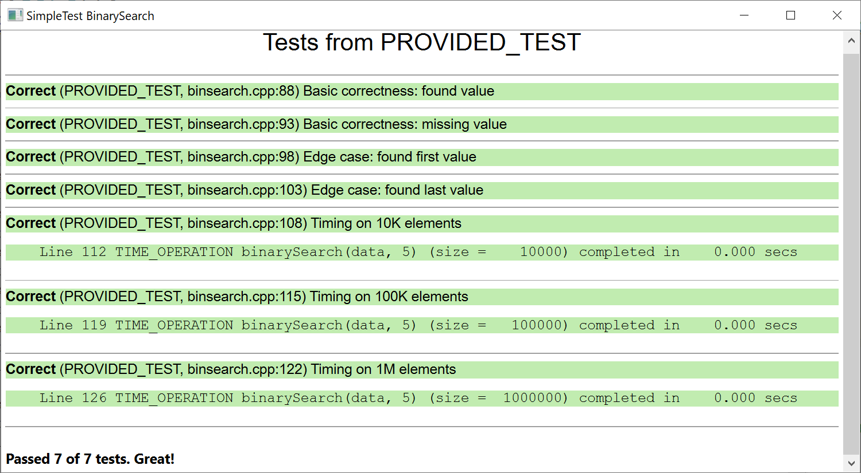
Binary Search performance
log₂(10K) ~= 13
log₂(100K) ~= 16
log₂(1M) ~= 20
Big-O math says it should take a very short time, and it reports a very short time, but we observe a longer time, why?

Slide 15
Binary Search performance
log₂(10K) ~= 13
log₂(100K) ~= 16
log₂(1M) ~= 20
Big-O math says it should take a very short time, and it reports a very short time, but we observe a longer time, why?
Answer: binary search is fast (O(logN)), but preparation to run the test is much more costly! fillWithRandom() is O(N) and sort() is O(NlogN).

Slide 16
Rewriting Fibonacci
Using memoization to Make it much more efficient

Slide 17
Rewriting Fibonacci
N=5
N=4
N=3
N=3
N=2
  Recall that the naïve recursive implementation involved a lot of wasteful duplicative work.
    Once we calculate N=2 case the first time, let’s just remember the answer is 1.
    Now we don’t have to do it again.
N=2
N=1
N=2
N=1
N=1
N=0
N=1
N=0
N=1
N=0

Slide 18
Rewriting Fibonacci
N=5
N=4
N=3
N=3
N=2
  Recall that the naïve recursive implementation involved a lot of wasteful duplicative work.
    Once we calculate N=2 case the first time, let’s just remember the answer is 1.
    Now we don’t have to do it again.
    Once we calculate N=3 case the first time, let’s just remember the answer is 3.
    Now we don’t have to do it again.
N=2
N=1
N=2
N=1
N=1
N=0
N=1
N=0
N=1
N=0

Slide 19
Rewriting Fibonacci
N=5
  Before
  After
N=4
N=3
N=3
N=2
N=2
N=1
N=2
N=1
N=1
N=0
N=1
N=0
N=1
N=0
N=5
N=4
N=3
N=3
N=2
N=2
N=1
N=1
N=0

Slide 20
Memoization implementation
// this is the primary function
int fasterFibonacci(int n)
{
// this will hold our results as {n, Fib(n)}, starting with our base cases
Map<int, int> memos = { {0, 0}, {1, 1} };
return fasterFibonacci(n, memos);
}
// this is a recursive helper function
int fasterFibonacci(int n, Map<int, int>& memos)
{
// if we already know the answer, just return it
if (memos.containsKey(n)) {
return memos[n];
} else {
// calculate new answer and save it for later
int result = fasterFibonacci(n - 1, memos) + fasterFibonacci(n - 2, memos);
memos[n] = result;
return result;
}
}
Another example of needing to make a recursive helper function that takes extra parameters.

Slide 21
Heads or Tails?
Generating Sequences

Slide 22
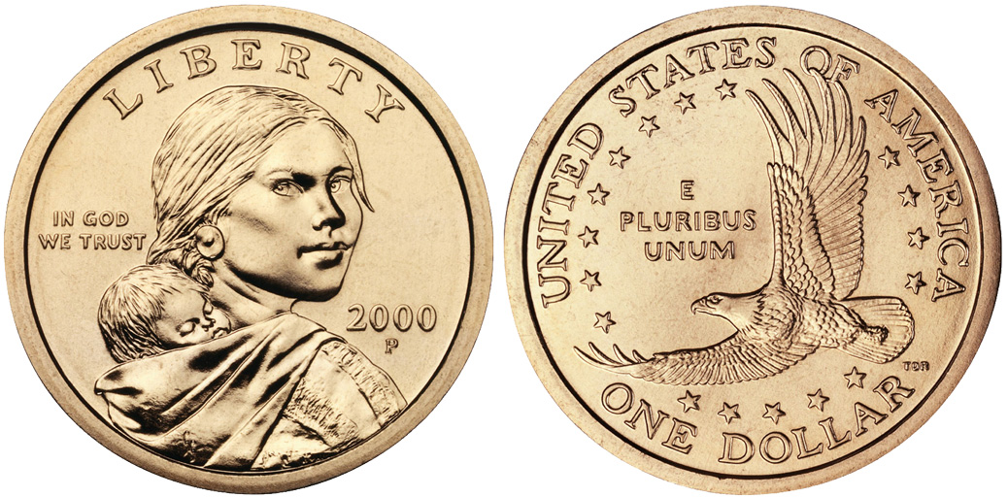
Heads or Tails?
  You flip a coin 5 times
  What are all the possible heads/tails sequences you could observe?
    TTTTT
    HHHHH
    THTHT
    HHHHT
    etc…
  We want to write a program to print each of the possible sequences.

Slide 23
Generating all possible coin flip sequences
void generateAllSequences(int length)
{
string sequence;
generateAllSequences(length, sequence);
}
void generateAllSequences(int length, string sequence)
{
// base case: no more flips to perform
if (length <= 0) {
cout << sequence << endl;
return;
}
// recursive cases: add H or T and continue
generateAllSequences(length - 1, sequence + "H");
generateAllSequences(length - 1, sequence + "T");
}

Slide 24
Your Turn: coin flip sequences
void generateAllSequences(int length)
{
string sequence;
generateAllSequences(length, sequence);
}
void generateAllSequences(int length, string sequence)
{
// base case: no more flips to perform
if (length <= 0) {
cout << sequence << endl;
return;
}
// recursive cases: add H or T and continue
generateAllSequences(length - 1, sequence + "H");
generateAllSequences(length - 1, sequence + "T");
}
  Q: Of these sequences (all of which should be printed), which sequence will be printed first? And which last?
    TTTTT, HHHHH, THTHT, HHHHT
pollev.com/cs106b

Slide 25
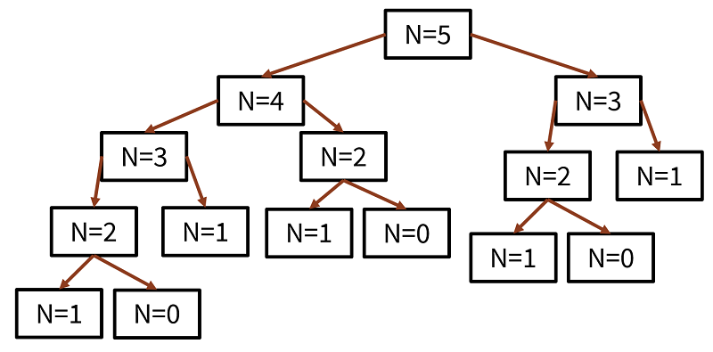
Helpful mental models for recursion: the call stack, and the call tree
  Remember we used this to help us understand Factorial recursion:
  Remember we used this to help us understand Fibonacci recursion:
main()
4
myfunction()x:
xfac:
0
factorial() n:
4
factorial() n:
3
Text, Heap

Slide 26
Call stack for our Heads/Tails code
Recursive code
4
""
void generateAllSequences(int length, string sequence)
{
// base case: no more flips to perform
if (length <= 0) {
cout << sequence << endl;
return;
}
// recursive cases: add H or T and continue
generateAllSequences(length - 1, sequence + "H");
generateAllSequences(length - 1, sequence + "T");
}
Text, Heap

Slide 27
Call stack for our Heads/Tails code
Recursive code
4
""
void generateAllSequences(int length, string sequence)
{
// base case: no more flips to perform
if (length <= 0) {
cout << sequence << endl;
return;
}
// recursive cases: add H or T and continue
generateAllSequences(length - 1, sequence + "H");
generateAllSequences(length - 1, sequence + "T");
}
Text, Heap

Slide 28
Call stack for our Heads/Tails code
Recursive code
4
""
3
"H"
void generateAllSequences(int length, string sequence)
{
// base case: no more flips to perform
if (length <= 0) {
cout << sequence << endl;
return;
}
// recursive cases: add H or T and continue
generateAllSequences(length - 1, sequence + "H");
generateAllSequences(length - 1, sequence + "T");
}
Text, Heap

Slide 29
Call stack for our Heads/Tails code
Recursive code
4
""
3
"H"
void generateAllSequences(int length, string sequence)
{
// base case: no more flips to perform
if (length <= 0) {
cout << sequence << endl;
return;
}
// recursive cases: add H or T and continue
generateAllSequences(length - 1, sequence + "H");
generateAllSequences(length - 1, sequence + "T");
}
Text, Heap

Slide 30
Call stack for our Heads/Tails code
Recursive code
4
""
3
"H"
void generateAllSequences(int length, string sequence)
{
// base case: no more flips to perform
if (length <= 0) {
cout << sequence << endl;
return;
}
// recursive cases: add H or T and continue
generateAllSequences(length - 1, sequence + "H");
generateAllSequences(length - 1, sequence + "T");
}
2
"HH"
Text, Heap

Slide 31
Call stack for our Heads/Tails code
Recursive code
4
""
3
"H"
void generateAllSequences(int length, string sequence)
{
// base case: no more flips to perform
if (length <= 0) {
cout << sequence << endl;
return;
}
// recursive cases: add H or T and continue
generateAllSequences(length - 1, sequence + "H");
generateAllSequences(length - 1, sequence + "T");
}
2
"HH"
Text, Heap

Slide 32
Call stack for our Heads/Tails code
Recursive code
4
""
3
"H"
void generateAllSequences(int length, string sequence)
{
// base case: no more flips to perform
if (length <= 0) {
cout << sequence << endl;
return;
}
// recursive cases: add H or T and continue
generateAllSequences(length - 1, sequence + "H");
generateAllSequences(length - 1, sequence + "T");
}
2
"HH"
1
"HHH"
Text, Heap

Slide 33
Call stack for our Heads/Tails code
Recursive code
4
""
3
"H"
void generateAllSequences(int length, string sequence)
{
// base case: no more flips to perform
if (length <= 0) {
cout << sequence << endl;
return;
}
// recursive cases: add H or T and continue
generateAllSequences(length - 1, sequence + "H");
generateAllSequences(length - 1, sequence + "T");
}
2
"HH"
1
"HHH"
Text, Heap

Slide 34
Call stack for our Heads/Tails code
Recursive code
4
""
Finally hit base case! Print HHHH and return.
3
"H"
void generateAllSequences(int length, string sequence)
{
// base case: no more flips to perform
if (length <= 0) {
cout << sequence << endl;
return;
}
// recursive cases: add H or T and continue
generateAllSequences(length - 1, sequence + "H");
generateAllSequences(length - 1, sequence + "T");
}
2
"HH"
1
"HHH"
0
"HHHH"
Text, Heap

Slide 35
Call stack for our Heads/Tails code
Most recent stack frame “popped” off the stack when we returned.
Recursive code
4
""
3
"H"
void generateAllSequences(int length, string sequence)
{
// base case: no more flips to perform
if (length <= 0) {
cout << sequence << endl;
return;
}
// recursive cases: add H or T and continue
generateAllSequences(length - 1, sequence + "H");
generateAllSequences(length - 1, sequence + "T");
}
2
"HH"
1
"HHH"
We come back to this next line so it’s time to add a T.
Text, Heap

Slide 36
Call stack for our Heads/Tails code
Recursive code
4
""
At the base case again, we print HHHT and return.
3
"H"
void generateAllSequences(int length, string sequence)
{
// base case: no more flips to perform
if (length <= 0) {
cout << sequence << endl;
return;
}
// recursive cases: add H or T and continue
generateAllSequences(length - 1, sequence + "H");
generateAllSequences(length - 1, sequence + "T");
}
2
"HH"
1
"HHH"
0
"HHHT"
Text, Heap

Slide 37
Call stack for our Heads/Tails code
Recursive code
4
""
3
"H"
void generateAllSequences(int length, string sequence)
{
// base case: no more flips to perform
if (length <= 0) {
cout << sequence << endl;
return;
}
// recursive cases: add H or T and continue
generateAllSequences(length - 1, sequence + "H");
generateAllSequences(length - 1, sequence + "T");
}
2
"HH"
1
"HHH"
Text, Heap
This function call has reached the end (did both recursive calls), so it is done and it returns.

Slide 38
Call stack for our Heads/Tails code
Recursive code
4
""
3
"H"
void generateAllSequences(int length, string sequence)
{
// base case: no more flips to perform
if (length <= 0) {
cout << sequence << endl;
return;
}
// recursive cases: add H or T and continue
generateAllSequences(length - 1, sequence + "H");
generateAllSequences(length - 1, sequence + "T");
}
2
"HH"
We come back to this next line so it’s time to add a T.
Text, Heap

Slide 39
Call stack for our Heads/Tails code
Recursive code
4
""
Now ends in T.
3
"H"
void generateAllSequences(int length, string sequence)
{
// base case: no more flips to perform
if (length <= 0) {
cout << sequence << endl;
return;
}
// recursive cases: add H or T and continue
generateAllSequences(length - 1, sequence + "H");
generateAllSequences(length - 1, sequence + "T");
}
2
"HH"
1
"HHT"
Text, Heap

Slide 40
Call stack for our Heads/Tails code
Recursive code
4
""
3
"H"
void generateAllSequences(int length, string sequence)
{
// base case: no more flips to perform
if (length <= 0) {
cout << sequence << endl;
return;
}
// recursive cases: add H or T and continue
generateAllSequences(length - 1, sequence + "H");
generateAllSequences(length - 1, sequence + "T");
}
2
"HH"
1
"HHT"
Add an H after the T
Text, Heap

Slide 41
Call stack for our Heads/Tails code
Recursive code
4
""
At the base case again, we print HHTH and return.
3
"H"
void generateAllSequences(int length, string sequence)
{
// base case: no more flips to perform
if (length <= 0) {
cout << sequence << endl;
return;
}
// recursive cases: add H or T and continue
generateAllSequences(length - 1, sequence + "H");
generateAllSequences(length - 1, sequence + "T");
}
2
"HH"
1
"HHT"
0
"HHTH"
Text, Heap

Slide 42
Call stack for our Heads/Tails code
Recursive code
4
""
3
"H"
void generateAllSequences(int length, string sequence)
{
// base case: no more flips to perform
if (length <= 0) {
cout << sequence << endl;
return;
}
// recursive cases: add H or T and continue
generateAllSequences(length - 1, sequence + "H");
generateAllSequences(length - 1, sequence + "T");
}
2
"HH"
1
"HHT"
Text, Heap
Came back here, time to do the second recursive call.

Slide 43
Call stack for our Heads/Tails code
Recursive code
At the base case again, we print HHTT as the fourth completed sequence, and return.
4
""
3
"H"
void generateAllSequences(int length, string sequence)
{
// base case: no more flips to perform
if (length <= 0) {
cout << sequence << endl;
return;
}
// recursive cases: add H or T and continue
generateAllSequences(length - 1, sequence + "H");
generateAllSequences(length - 1, sequence + "T");
}
2
"HH"
1
"HHT"
0
"HHTT"
Text, Heap

Slide 44
Call stack for our Heads/Tails code
Recursive code
4
""
3
"H"
void generateAllSequences(int length, string sequence)
{
// base case: no more flips to perform
if (length <= 0) {
cout << sequence << endl;
return;
}
// recursive cases: add H or T and continue
generateAllSequences(length - 1, sequence + "H");
generateAllSequences(length - 1, sequence + "T");
}
2
"HH"
1
"HHT"
Text, Heap
This function call has reached the end (did both recursive calls), so it is done and it returns.

Slide 45
Call stack for our Heads/Tails code
Recursive code
4
""
3
"H"
void generateAllSequences(int length, string sequence)
{
// base case: no more flips to perform
if (length <= 0) {
cout << sequence << endl;
return;
}
// recursive cases: add H or T and continue
generateAllSequences(length - 1, sequence + "H");
generateAllSequences(length - 1, sequence + "T");
}
2
"HH"
Text, Heap
This function call has also reached the end (did both recursive calls), so it is also done and returns.

Slide 46
Call stack for our Heads/Tails code
Recursive code
4
""
3
"H"
void generateAllSequences(int length, string sequence)
{
// base case: no more flips to perform
if (length <= 0) {
cout << sequence << endl;
return;
}
// recursive cases: add H or T and continue
generateAllSequences(length - 1, sequence + "H");
generateAllSequences(length - 1, sequence + "T");
}
This function still needs to do its second recursive call with T, but we’ll end our animation here. ☺
Text, Heap

Slide 47
Call tree for Heads/Tails code
Labels are based on the value of the sequence parameter at the time of the function call (without add/erase/add edits we make inside the function).
""
"H"
"T"
"HH"
"HT"
… …
"HHH"
"HHT"
"HTH"
"HTT"
… …
"HHHH"
"HHHT"
"HHTH"
"HHTT"

