Slide 1
Gerrymandering &
& Algorithmic Thinking
Katie Creel

Slide 2
What Problem Should we Solve?
Solving problems ...
with recursive backtracking!

Slide 3
Redistricting for House Elections
435 Districts of (roughly) equal population. Each elects a Representative
US Census measures population every 10 years
... but populations shift over time.
... so redistrict based on the new Census.
Notes:
Tennessee didn’t shift.
court case saying it was mandatory.

Slide 4
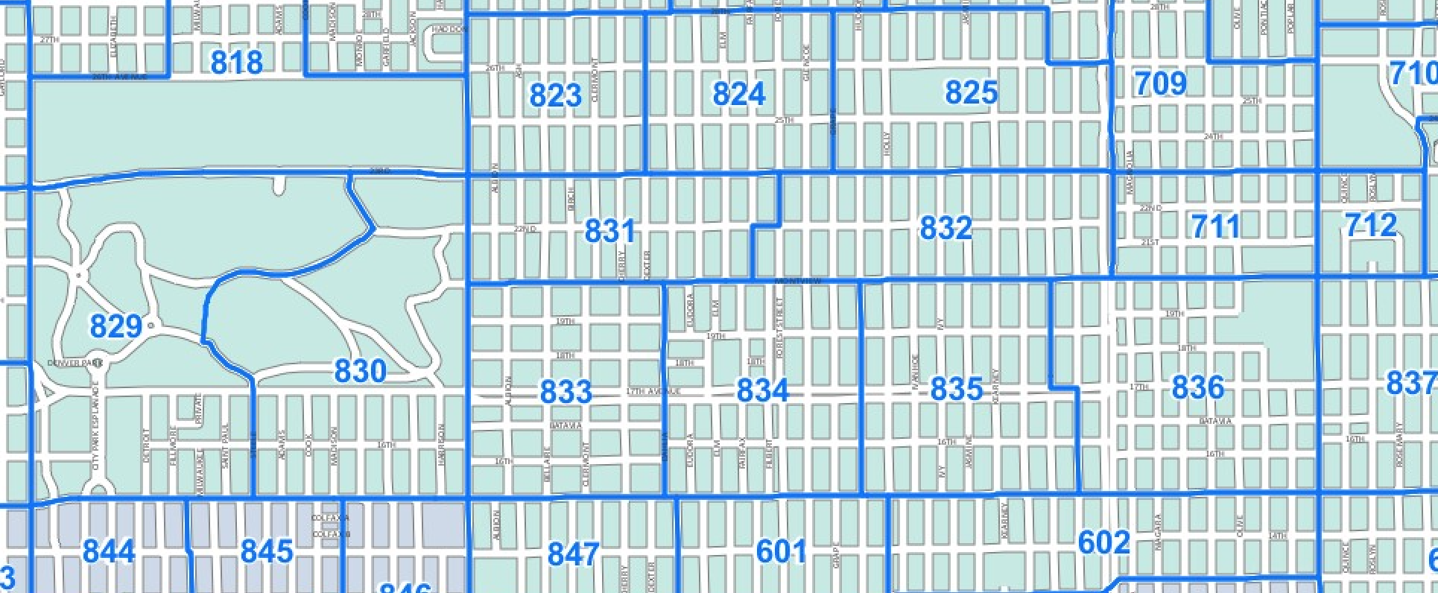
Precincts: tiny boxes

Slide 5
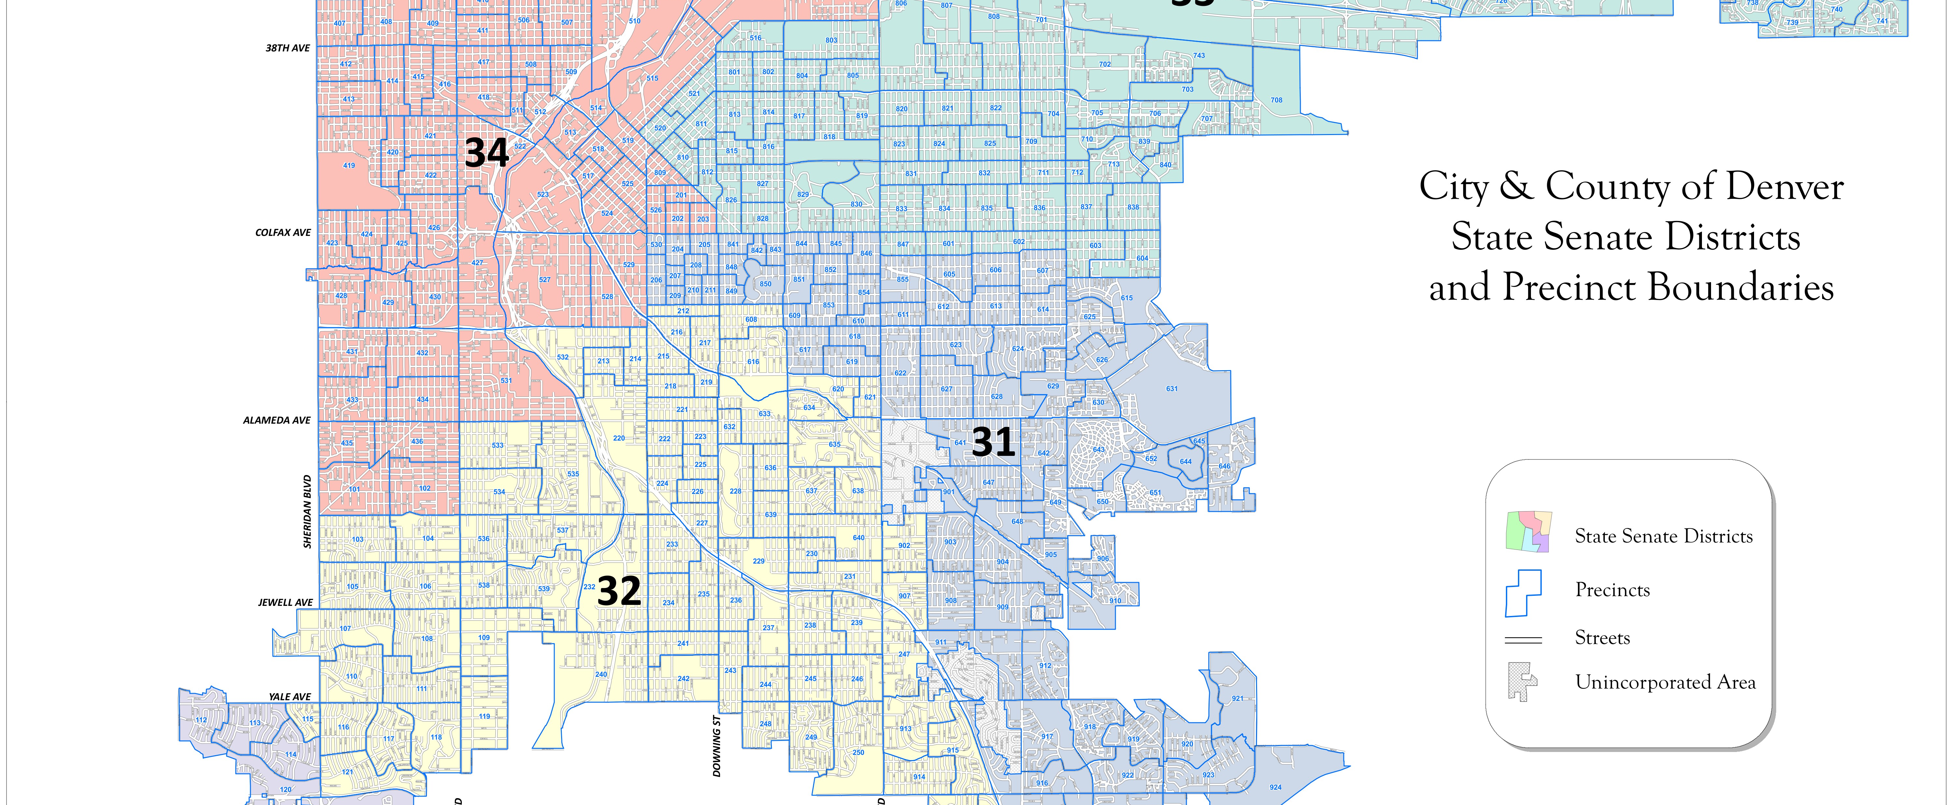
Districts: bigger ... boxes?

Slide 6
The Computational Problem of Redistricting
1. Count residents (census)
2. Apportion representatives to states
3. Partition by sorting precincts into districts
The Math (combinatorics) Problem of Redistricting
If a state has n residents (with attributes) and k representatives, how to form k groups of approximately size n out of census blocks k in accordance with various rules and values.

Slide 7
What algorithms should we use?

Slide 8
Recursion, as always, to the Rescue
Exhaustive algorithm -- generate all the possible solutions, compare them to our metrics.
Recursive backtracking (choose, explore, unchoose) to explore districting maps and identify the worst (or best!) ones.

Slide 9
Constraints and Principles
But what are our metrics?
How should we redistrict responsibly?

Slide 10
Principle 1: One person, one vote
“as nearly as is practicable one man’s vote in a congressional election is worth as much as another’s.” Reynolds v. Sims, 377 U.S. 533 (1964)

Slide 11

One Person One Vote:
The Efficiency Gap Metric
Principles:
Any vote cast for the losing party is a wasted vote for that party
Any vote cast for the winning party that was more than the simple majority needed to win is a wasted vote for that party

Slide 12
One Person One Vote:
The Efficiency Gap Metric
Imagine we are counting votes up from the “bottom” in each district, and the first to hit the line win. The votes remaining on the top are “wasted” in that they didn’t influence the outcome in that district.
Poll: Which party has more wasted votes, Green or Teal?

Slide 13
Calculating the Efficiency Gap
Efficiency Gap (EG) =
abs(wasted green votes – wasted teal votes) / total votes cast

Slide 14
Type of Gerrymandering Addressed
“Partisan Gerrymandering,” or redistricting in order to gain or preserve an advantage for one political party at the cost of equitable political representation for voters.

Slide 15
Are We Done?
Efficiency gap captures the “one person one vote principle” fairly well.
If we were solving only this problem, framed in this way, we might be done.
What else is important?

Slide 16
History of Gerrymandering
In order to find out, we need to understand the ...

Slide 17
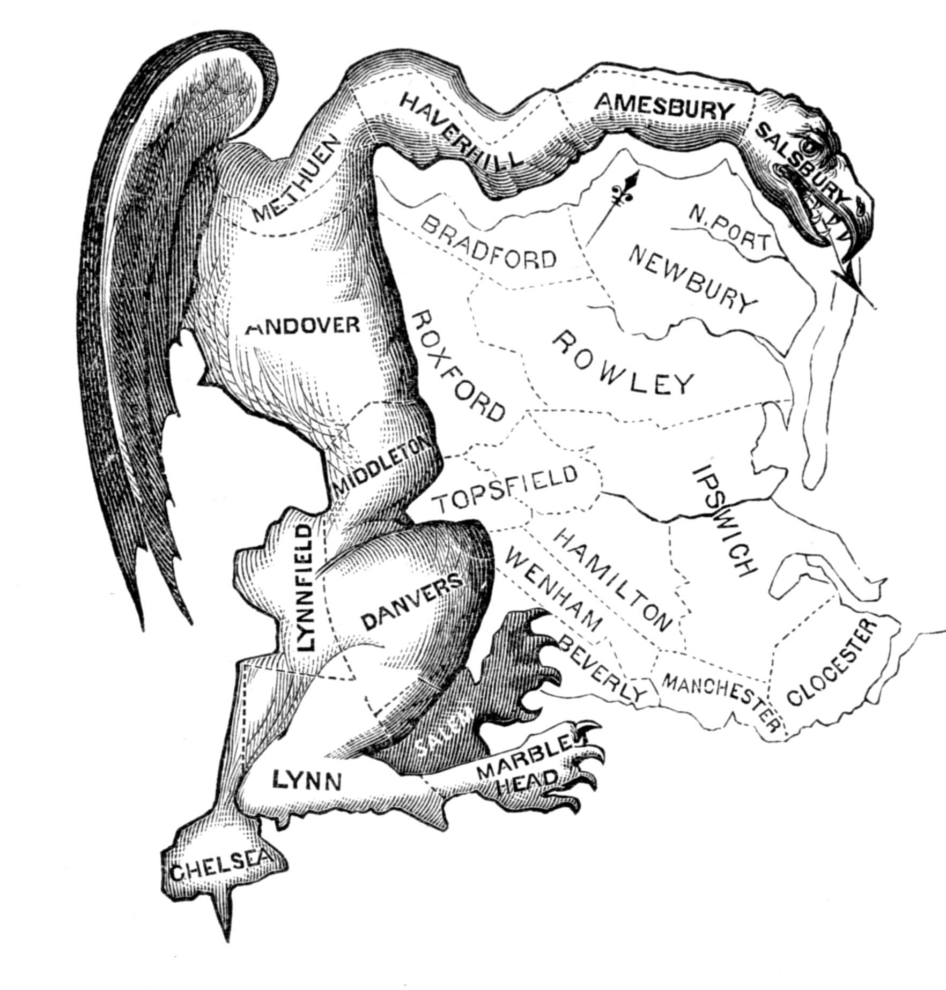
“The Gerry Mander” (1812)
Notes:
Elbridge Gerry, who as the governor of Massachusetts

Slide 18
1870: the 15th Amendment
"right of citizens of the United States to vote shall not be denied or abridged by the United States or by any state on account of race, color, or previous condition of servitude.”
Addresses racial gerrymandering, which abridges the right to vote on account of race.

Slide 19
1965: Voting Rights Act
“The Civil Rights Division has the responsibility for enforcement of provisions of the Voting Rights Act that seek to ensure that redistricting plans do not discriminate on the basis of race, color, or membership in a protected language minority group.”
“[The Civil Rights Act] prohibits not only election-related practices and procedures that are intended to be racially discriminatory, but also those that are shown to have a racially discriminatory result.”

Slide 20
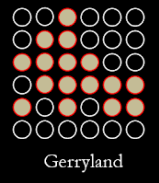
Example: Fairness in Gerryland
Gerryland has 36 people
20 are in the majority group, 16 are in the minority group
There are four districts, each with 9 people.

Slide 21
Example: Fairness in Gerryland
If the minority and majority groups in Gerryland are polarized and tend to prefer different parties, we would expect ~2 candidates from each party should be elected.

Slide 22
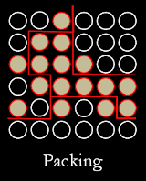
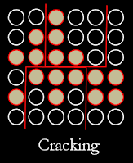
Gerryland & Racially Polarized Voting
only 1 minority-preferred candidate elected
0 minority-preferred candidates elected

Slide 23
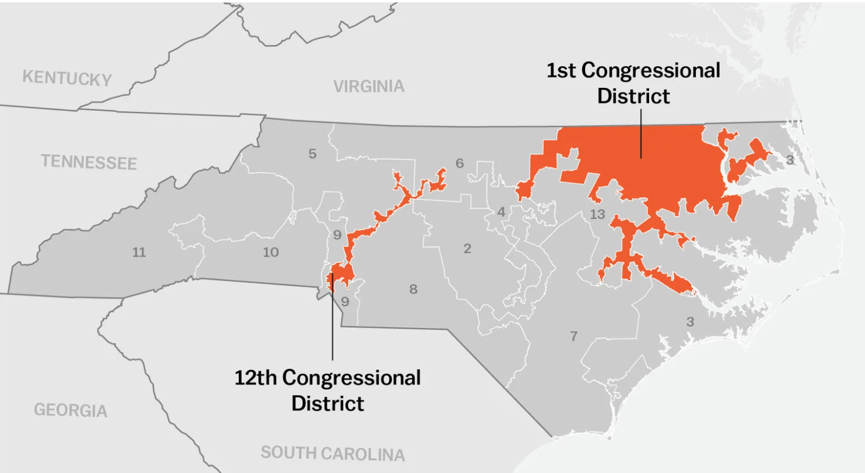
Racial Redistricting: Example of Packing a District
Republican lawmakers in the state, after the 2010 census, had redrawn the map to add more black voters into Districts 1 and 12. The Supreme Court concluded 5-3 that North Carolina violated the Equal Protections Clause of the 14th Amendment by separating voters in different districts on the basis of race without “sufficient justification” for doing so.

Slide 24
Why has Gerrymandering Gotten Worse?
Veteran redistricter: “There’s an old saying: Give a child a hammer, and the world becomes a nail. Give the chairman of a state redistricting committee a powerful enough computer and block-level census data, so that he suddenly discovers he can draw really weird and aggressive districts—and he will.”
New Software: Maptitude, Red­Appl, and autoBound
New Data: block-by-block census data
Software + big data making a problem worse?
This is our problem now.

Slide 25
Principle 2: Communities of Interest
Interpretation A:
a community of interest is a community that shares an identity group
Interpretation B:
a community of interest is “compact” or geographically contiguous

Slide 26
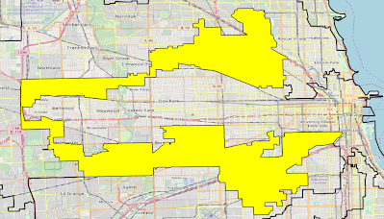
Community of Interest: IL-04: “The Earmuffs”
Follows a predominantly Latine community
Created in the 1990s; elected the first Latine representative to Congress from the Midwest.

Slide 27
Community of Interest:
IL-04: “The Earmuffs”
Follows a predominantly Latine community
Created in the 1990s; elected the first Latine representative to Congress from the Midwest.
Surrounds IL-07, a predominantly African-American district

Slide 28
Interpretation B: Compactness
Geography also matters for political representation
People who live in the same physical area often have interests in common just in virtue of their location

Slide 29
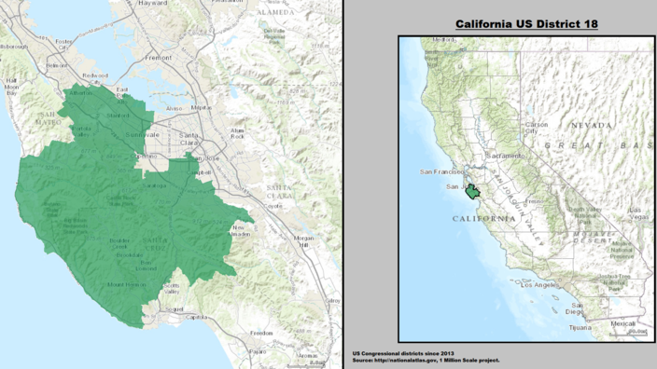
What are the Interests of Santa Clara County & CA District 18?
Silicon Valley
Housing & Land Use Policy
Transportation
Notes:
https://www.theatlantic.com/technology/archive/2019/09/silicon-valley-full-superfund-sites/598531/

Slide 30
Silicon Valley: A Different Story
Semiconductors & microprocessor manufacturing (silicon!) in the 1950s-1990s by Apple, Atari, Fairchild, Hewlett-Packard, Intel, Xerox, etc
Hardware is mostly gone, but left behind 23 Superfund sites contaminated with toxic chemicals
Highest density of Superfund sites in the country
Groundwater is safe, but plumes of toxic gas can escape, including at Google’s Quad Campus in 2012-2013
What do we in Santa Clara Country have in common? A special desire to clean up our Superfund sites!

Slide 31
Principle 1: One person, one vote
Principle 2: Communities of interest (Many interpretations)
What ought we to prioritize in redistricting?
And what is a legitimate way to choose?

Slide 32
The Worst Option: What We Have Now
Biggest problem: US is one of the few countries in which politicians have control over redistricting.
In most other countries, all redistricting is done by an independent commission.
Politicians districting based on their own interests is unfair on either principle.

Slide 33
Procedure 1: Universalizability as Fairness
However we balance these two, the same principles apply to every district, regardless of who is in the majority
Redistricting principles should not change based on local circumstances (or politician interests)
Easier to implement universalizability with a non-partisan independent commission

Slide 34
Principle 2: Community Control as Justice
Allow local communities to directly vote on or otherwise choose the balance of principles which should guide districting (and thus their own representation).
Have an independent non-partisan commission implement the principles in drawing up a map.

Slide 35
Breakout Room Share-out
Question 1: If your group was in charge of creating a redistricting policy & a map drawing algorithm for California, which of these principles would you prioritize?
1. One Person One Vote
Metric to optimize: Efficiency Gap
2. Communities of Interest
Metric to optimize: geographical metrics of similarity
3. Compactness
Metric to optimize: geographical compactness

Slide 36
Breakout Room Share-out
Question 2: Letting your 106B breakout group (or any other small group of software engineers) personally decide redistricting policy is not the most fair way to do redistricting. But who should choose? Which of these high-level procedures/principles should guide who governs redistricting?
Procedure 1: Universalizability as Fairness
Procedure 2: Community Control as Justice

Slide 37
Revising the process
Sometimes our first algorithmic solution does not work as expected
The Voting Rights Act attempts to indicate the fair middle ground between packing and cracking, but the interpretation of the VRA has been closer to packing.
Notes:
Universalizability (one principle for the whole country, consistency), bottom-up (asking the people what they want, community control), revision of the process (keep it fresh and appropriate over time, Yglesias [ethics of care, long-term responsibilities])

Slide 38
Ethics of Care
Few social problems can be solved exactly once by an algorithm
Any algorithmic solution should be revisited often as society changes and we understand its implications better.

Slide 39
Ethics of Care
Caring for an algorithm, and for the community that relies on it, can mean updating the data ... or changing the algorithm and implementation.
Creating “living” algorithms and machine learning models that can grow and change over time is a huge focus in data science and AI right now.

Slide 40
Roles you will be ready to take on (after CS106B)
Make better systems yourself!
Using your CS 106B knowledge to advocate for communities affected by unfair practices that rely on algorithmic decision-making.
Formulating problems carefully based on knowledge of the history of the problem and understanding what people affected by the problem would see as a solution.

Slide 41
email: kcreel@stanford.edu
Office Hours: calendly.com/kathleencreel
Thank you!

