Slide 1
Privacy and Priority Queues:
The Ethics of Ranking Algorithms
Katie Creel

Slide 2
Priority Queue (implemented as heap)
1
10
17
16
2
6
4

Slide 3
Priority Queue ... of People’s Housing Needs
1
10
17
16
2
6
4

Slide 4
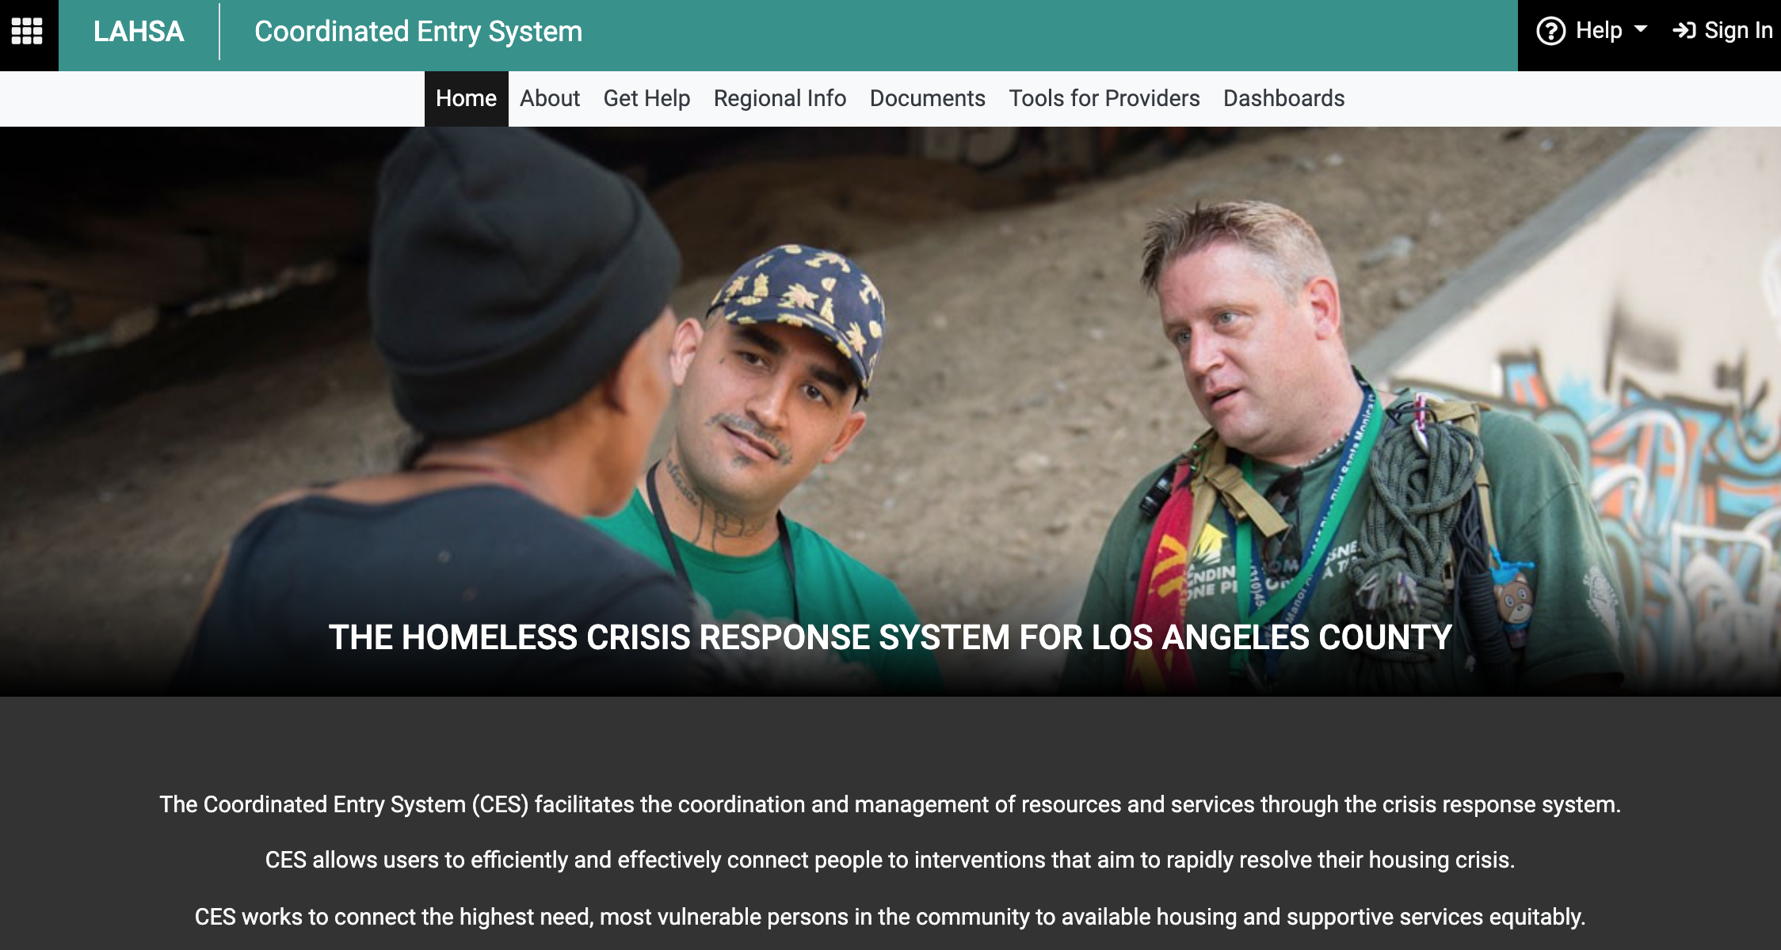
Los Angeles County Coordinated Entry System (CES)
An electronic registry of unhoused persons who are applying or have applied to housing support programs offered by Los Angeles County.

Slide 5
How does it work?
Unhoused person provides (very) personal information including name, DOB, immigration status, current & past mental health, sexual activity, substance.
Algorithm uses personal data to assign a number from 1-17, least vulnerable tomost vulnerable.
Risk score is used to prioritize and assign housing and housing related services.

Slide 6
1. Algorithms need Data
(but storing data incurs risks)
The collection of data itself is demanding for the data subjects. In addition to name, DOB, and demographic information, they are asked for very personal information, like immigration status, history of mental health and substance use.
Generating and storing a large pool of data about a vulnerable population itself incurs risks.
  What if the data leaks or is hacked?
  What if other agencies like ICE attempt to access collected data, such as immigration status + where the person is during the day?

Slide 7
1. Algorithms need Data (but collecting data may have human costs)
Survey data “expires” every six months (although they are not deleted from the system!)
This means the people in the middle have to provide the information every six months, re-taking the survey or interview.
People who are asked to fill out the survey multiple times with without being offered any services may become cynical and disengaged.

Slide 8
[Simplified] CES Binning System
1-4: Least vulnerable -> short-term shelter
No Services Provided
14-17: most vulnerable -> long term apartment

Slide 9
2. Creating Algorithmic Systems Require Resources
The CES has cost LA Country $11 million so far, which is about $1,140 per person who has gotten housing through it.
An algorithmic prioritization system requires (expensive) engineers to build it, social workers to collect data for it, and tech people to maintain it.

Slide 10
2. Better Prioritization vs More Services
The CES did improve matching between people and services, but didn’t increase the total number of apartments, vouchers, or shelter beds available, and therefore didn’t increase the number of people housed.
Would the $11 million have been better spent on giving each person helped by the system $1,140 to put towards a security deposit for an apartment?
Should software engineers have built this system? How would you decide?

Slide 11
Eubank’s Two Questions for Automated Decision-Systems
“Does the tool [or algorithm] increase the self-determination and agency of the decision subjects?”
“Would the tool be tolerated if it was targeted at non-poor [housed, etc] people?” (Eubank 2018)
If the answer is no, Eubank argues that we should reconsider the design or consider not building the system at all.
Notes:
https://www.americanscientist.org/article/high-tech-homelessness

Slide 12
What is Autonomy?
“Individual autonomy is ... the capacity to be one’s own person, to live one’s life according to reasons and motives that are taken as one’s own and not the product of manipulative or distorting external forces, to be in this way independent ...
to govern oneself, to be directed by considerations, desires, conditions, and characteristics that are not simply imposed externally upon one, but are part of what can somehow be considered one’s authentic self” (Christman 2020).
Notes:
https://plato.stanford.edu/entries/autonomy-moral/

Slide 13
Autonomy and Priority
How might a prioritization algorithm diminish autonomy?
  By deciding which kind of housing is appropriate rather than letting the unhoused person decide?
How might it enhance autonomy?
  By providing “expert” advice?
You will decide (on the problem set!)

Slide 14
Visit my office hours any time at calendly.com/kathleencreel
Thank you!

