Slide 1
Gamma-rays, Jets and
Spinning Black Holes
Roger Blandford,
KIPAC
Stanford
with
Jonathan McKinney (KIPAC, Maryland)
Sasha Tschekovskoy (Princeton)
Nadia Zakamska (JHU)
and Fermi-LAT team
Notes:
"Gamma-rays, Jets and Spinning Black Holes".Roger Blandford KIPAC StanfordFermi Gamma-ray Space Telescope, in combination with observatories operating throughout the electromagnetic spectrum, is making comprehensive studies of relativistic jets associated with active galaxies. Rapid variability, swings in polarization and impressive VLBI observations are all providing the clues that we need to understand how jets are launched and collimated and where the emission originates and electrons are accelerated. In addition, recent three dimensional MHD simulations of highly magnetized accretion disks orbiting spinning black holes are exhibiting robust jet production as well as new features that can be sought observationally.

Slide 2
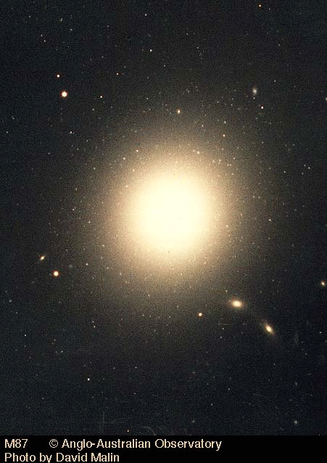
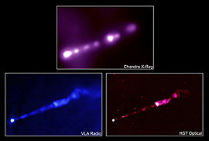
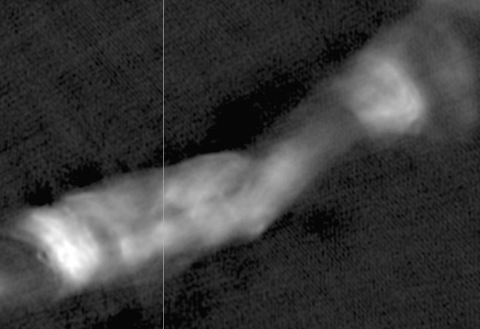
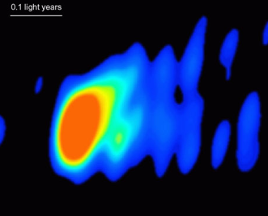
M87
Six billion solar masses
0.01 light yr~10 m
(Doeleman et al.)
Notes:
In 1918, Heber Curtis, working at the Lick Observatory observed that the 87th member of Charles Messier famous catalog of non-comets had no spiral structure.
He noticed a “curious straight ray…apparently connected with the nucleus by a thin line of matter” The ray appeared brightest at its inner end
We now know this as M87 a giant elliptical galaxy at the center of the Virgo cluster of galaxies.
The nucleus of the galaxy contains a seven billion solar mass black hole and the straight ray is a relativistic jet that propagates

Slide 3
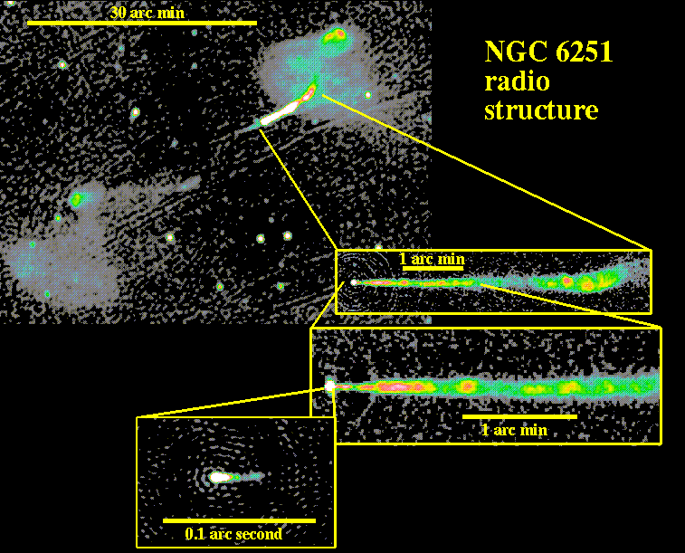
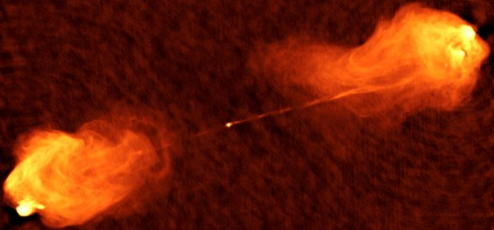
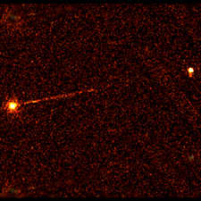
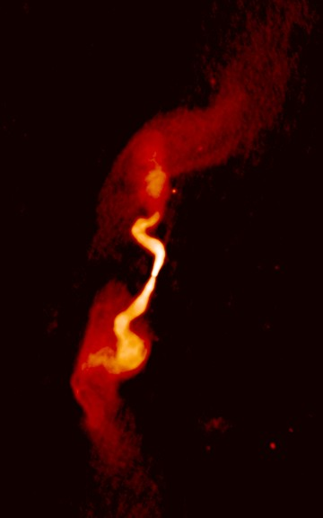
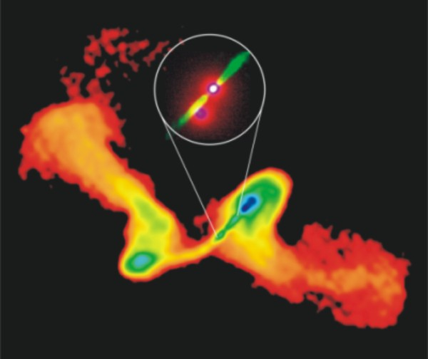
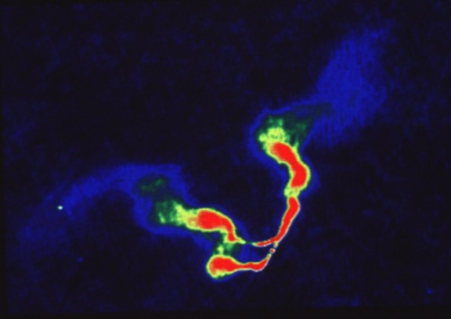
Cygnus A
3C 273
Cygnus A
Cygnus A
Pictor A
3C31
NGC 326
3C75
Notes:
Here are some more jets. I think they are beautiful! In the top left we have M87 with its seven billion solar mass black hole viewed with a resolution about a hundred times the size of the black hole. The Cygnus A and Pictor A jets are extraordinarily straight for outside the surrounding galaxy. The other examples show what happen when the black hole source moves or the jet interacts with the surrounding gas.

Slide 4
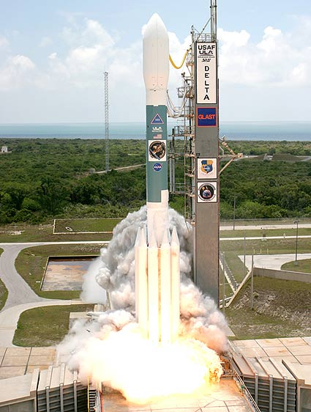
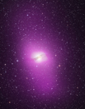
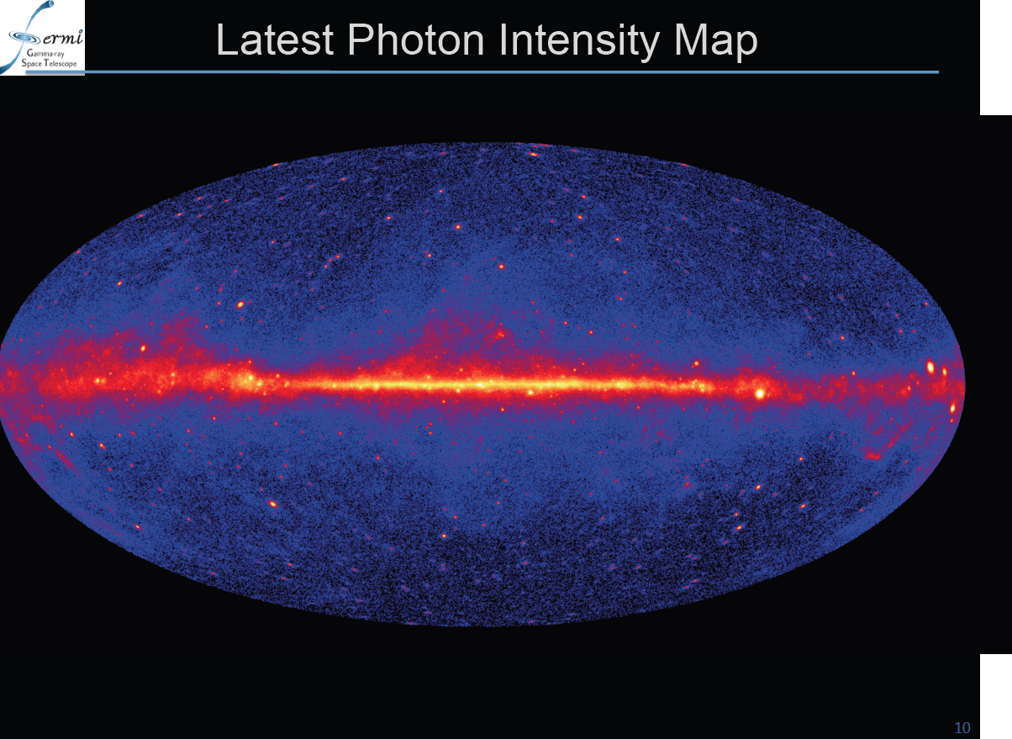
Fermi
Joint NASA-DOE-Italy- France-Japan-Sweden, Germany… mission
Launch June 11 2008
  Cape Canaveral
Large Area Telescope: 0.02-300 GeV
  All sky every 3hr
  ~100 x Compton Gamma Ray Observatory
  ~3 γ-rays per second
  10⁵ electron/positrons per second
Gamma Ray Burst Monitor
  0.01-30MeV
832AGN+268Candidates+594Unidentified!

Slide 5
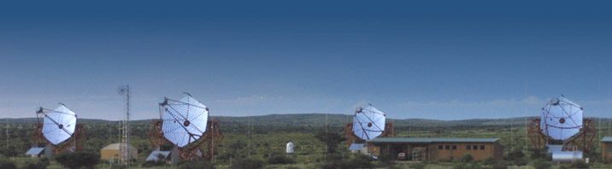

H.E.S.S.
VERITAS
MAGIC
Cerenkov flashes
0.1-30TeV γ-rays
Degree resolution
100 sources
Upgrades

Slide 6
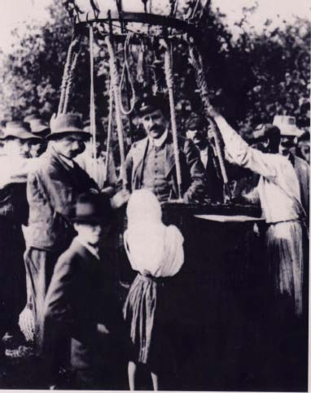
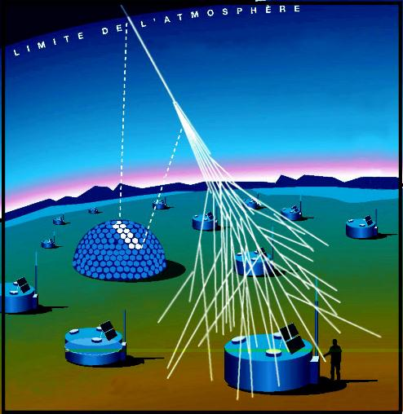

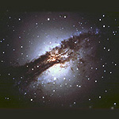
New Windows on the Universe
Ultra High Energy Cosmic Rays
Source energies up to 100 Joule!
May be seeing black hole sources
eg Centaurus A
Auger
Notes:
In this talk, I have tried to persuade you that Black Holes Can, Must, Do and Will Exist. I have also tried to explain how black holes not only swallow gas, they also have a huge impact on their environment and that this can be very positive for galaxies, stars, planets and anything that might be alive on them. Let me finish by outlining some of the things that we might learn about black holes and how this can happen. Firstly I should tell you about cosmic rays. This is appropriate because this is the centenary of their discovery by Victor Hess seen here in his balloon.
We now observe up to energies equivalent to that of a well hit baseball. A single proton can be as energetic as an Ichiro Suzuki outfield hit. Now you may recall my saying that a massive spinning black hole can generate a billion trillion volts. We are waiting to see a home run! If we allow a proton to be accelerated by this voltage associated with the black hole it will end up with the energy of these cosmic rays. Using facilities like Auger in Argentina, we are trying to see if these cosmic rays are made by black holes.

Slide 7
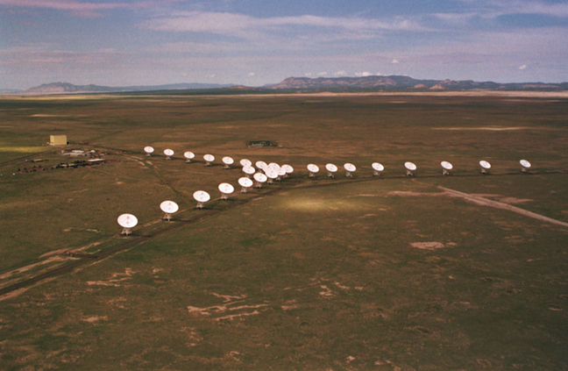
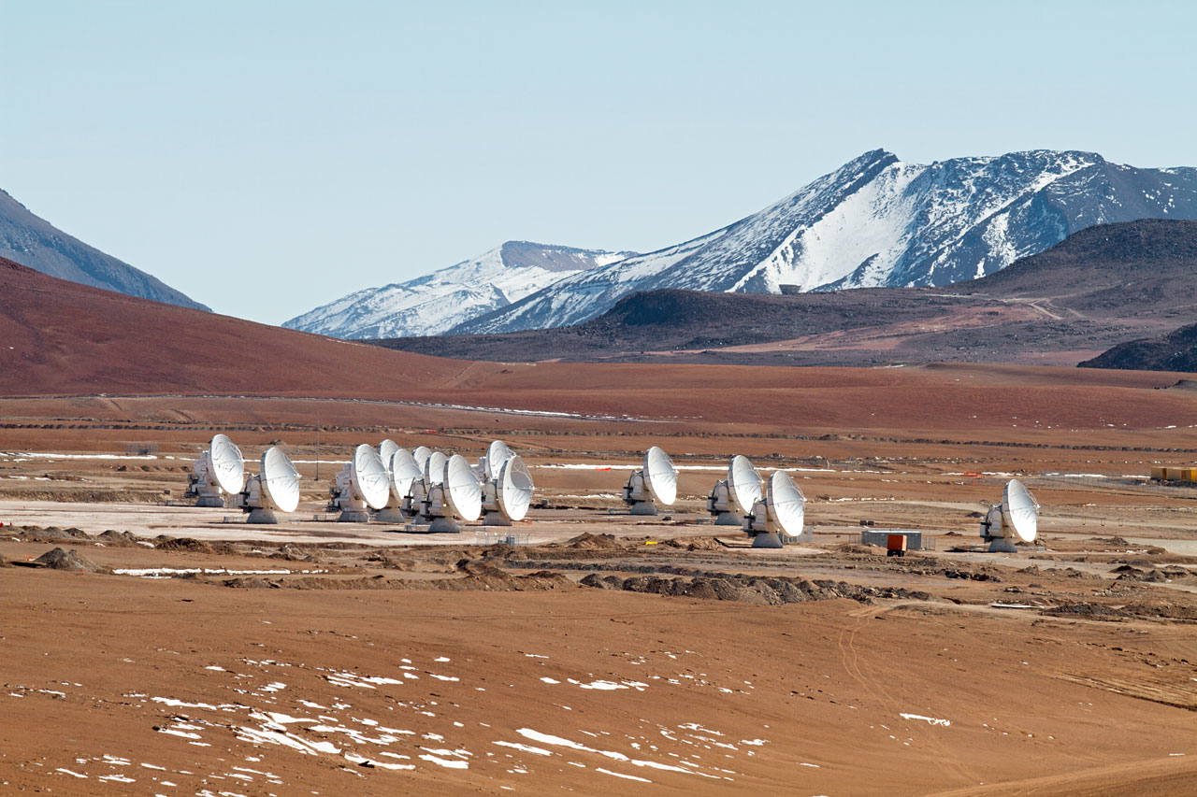
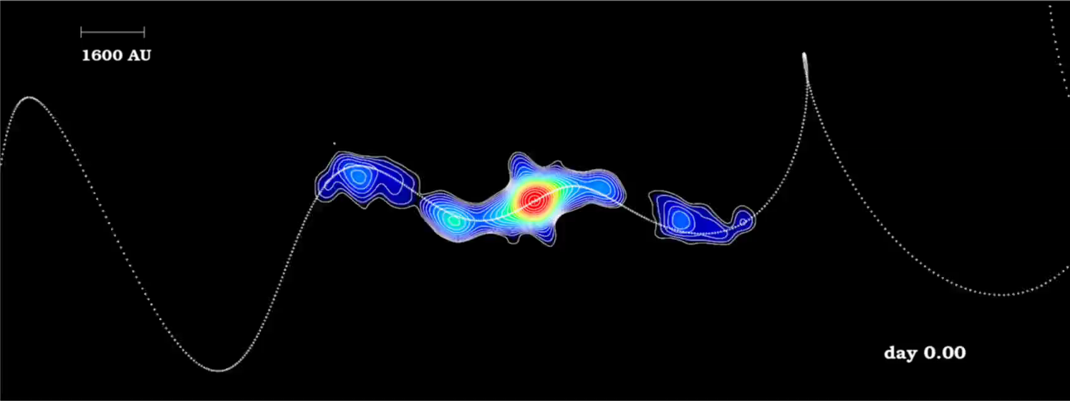
New Radio Telescopes
JVLA
ALMA
SS433
Notes:
We get much better resolution at radio wavelengths and I am very excited by new radio observations especially made with the new Very Large Array in New Mexico. Here you see a movie of the hosepipe at work. This is the track expected and what we see.

Slide 8
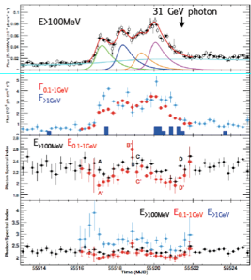
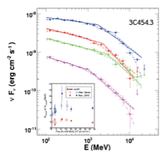
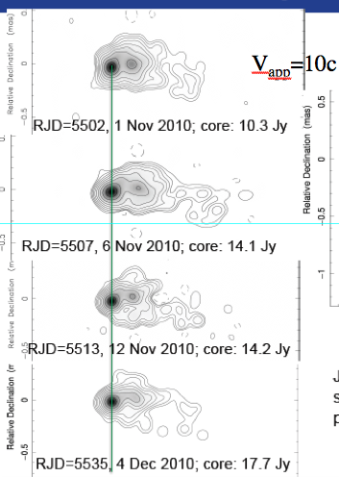
3C454.3
Marscher
2x10⁵⁰erg s⁻¹ isotropic
Breaks due to recombination radiation?

Slide 9
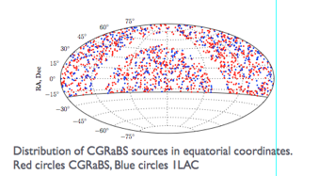
Radio Monitoring (OVRO 40m)
~1500 sources
Radio and γ-ray active
Spectrum, polarization
Max-Moerbeck etal

Slide 10
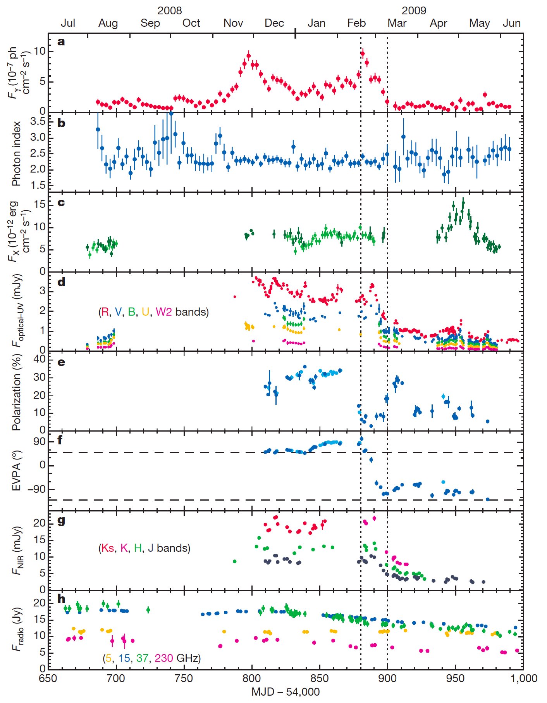
3C 279: multi-λ observation of γ-ray flare
~30percent optical polarization => well-ordered magnetic field
τ~ 20d γ-ray variation
=> r~γ²cτ ~ pc or τ_{disk}?
Correlated optical variation?
Ten day lag!
X-ray, radio uncorrelated => different sites
Rapid polarization swings ~200º => rotating magnetic field in dominant part of source
PKS 1510+089 -720º!
r ~ 100 or 10⁵ m?
Abdo, et al, Hayashida et al

Slide 11
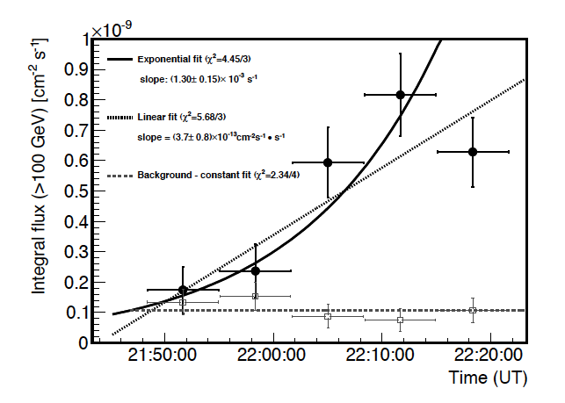
MAGIC variation
PKS 1222+21
  10 min
MKN 501
  5 min?
PKS 2155-304
  2 min?
PKS 1222+21 (Aleksik et al)
How typical?
How fast is GeV variation?

Slide 12
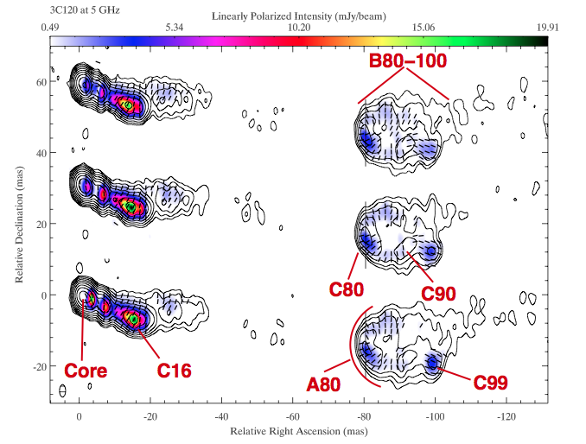
3C120
Do variable γ-rays
come from
recollimation shocks?

Slide 13
Jet Pathology
Anatomy
  Multi-frequency jet structure
    Radio-γ-ray
  Kinematics
    Acceleration, deceleration, shear, recollimation…
  Composition
    EM, pairs, ions?
Physiology
  Acceleration
    Shocks, shear, reconnection, electrostatic, waves…
  Emission mechanisms
    Coherent?
  T^{αβ}?
    Magnetic, gas, ram pressure?
Sociology
  Counts, LF, multivariate properties
    Relationship to galaxy hosts, cosmological evolution, environmental impact
  Backgrounds
    Reionization, TeV transparency

Slide 14
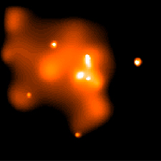
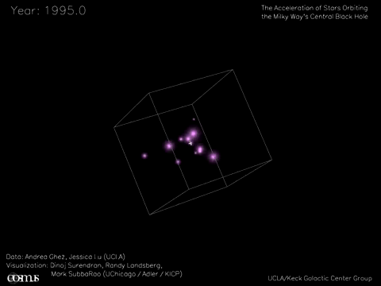
Massive Black Holes
Every “normal” galaxy has
a 10⁶ – 10¹⁰ solar mass
black hole in its nucleus
Black
Hole
The nucleus is “active” when the black hole is fed
through a disk
Our inactive galactic center
has a 4 x 10⁶ solar mass
black hole
Notes:
The black holes I have discussed so far are not much more massive than the sun. There is another type that astronomers observe and these are called massive black holes. It turns out that essentially every normal galaxy has a massive black hole at its center, just like every atom has a tiny nucleus at its center. Out Galaxy is no exception. It has a four million solar mass black hole. We know this because we can actually observe stars orbit around it – an impressive use of modern infrared telescopes. We also know that the central object is very small because the emission that it creates varies in a quarter hour.

Slide 15
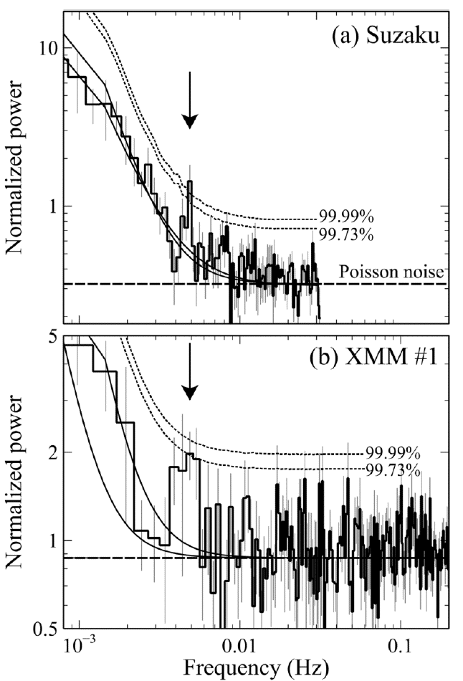
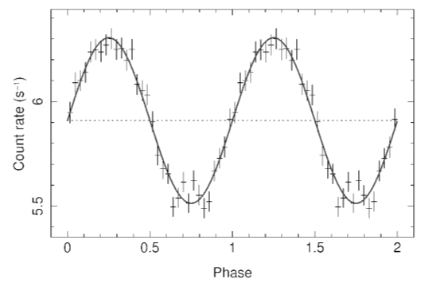
Tidal Disruption/QPO Events
RE J1034+396
  P=1hr?
Sw J1644+57
  P=200s?
Reis et al
Gierlinski et al

Slide 16
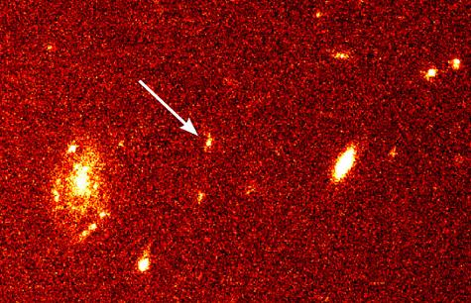
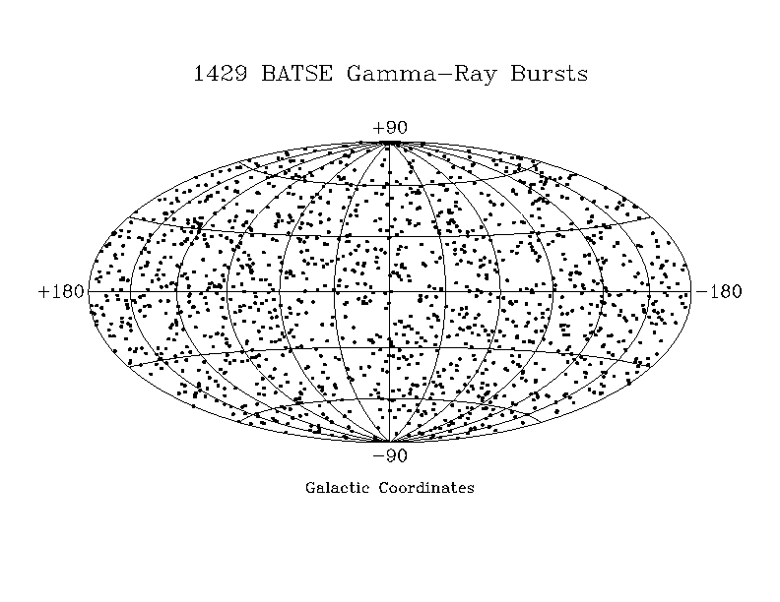
Black Hole Birth Cries?
Long Gamma-ray Bursts
  t_{s}~3-100 s E ~ 10⁵¹ erg (beaming)
  ~1d -1yr afterglows
  Associated with SN?; BH/Magnetar formation
  Jets, Γ > 300?
Short bursts
  t_{s}~ 0.1-3 s
  Coalescing neutron stars??

Slide 17
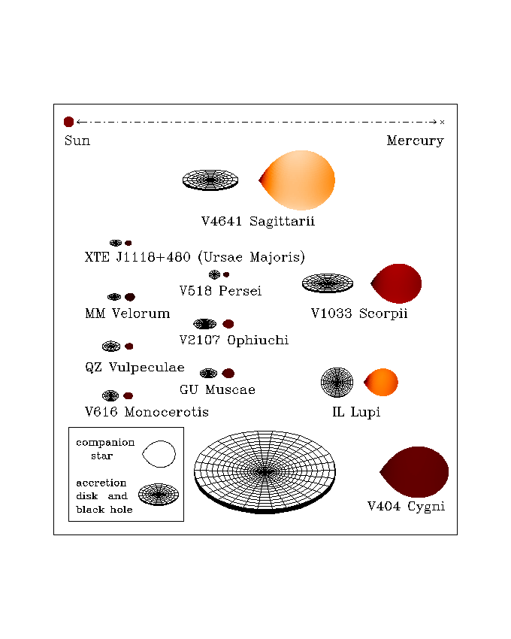
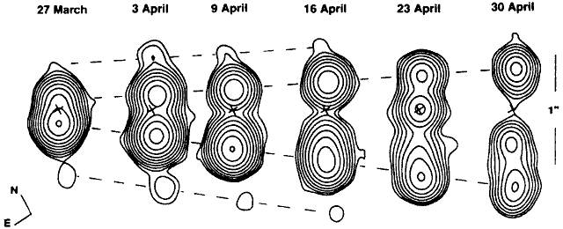
Quasars for the Impatient
~ 20 examples
Γ ~ 2
Circinus X-1 (Γ ~ 15?)
Timescales ~ mass?

Slide 18
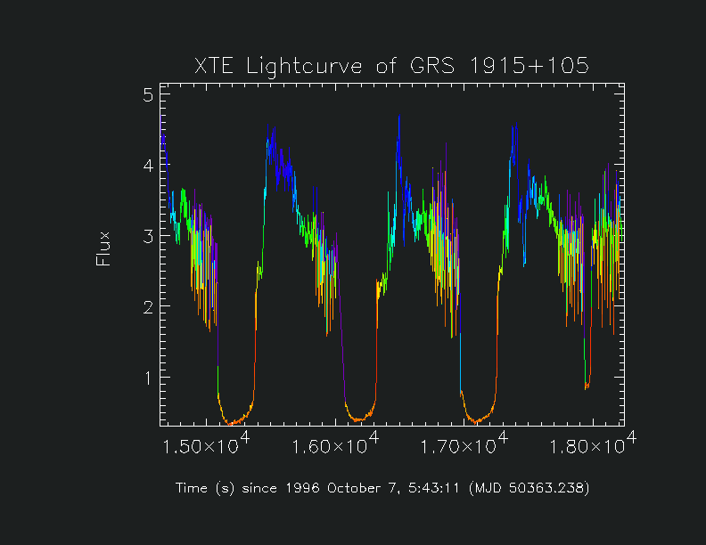

Black Holes can Sing
Quasi-Periodic Oscillations (QPOs)
Notes:
Black Holes and their disks have other properties. One of these is that they can sing. They can oscillate with frequencies that you can hear with strange tones. There are many theories of how they do this. I will shortly add another one.

Slide 19
Astrophysical Black Holes
Kerr Metric
  Mass m=M₈AU=500M₈s=2 x 10⁶² M₈ erg
  Angular momentum a < m
  Event Horizon r₊=m+(m²+a²)^{1/2}
    Area A=8πmr₊=16πm₀², increases
  Irreducible mass m₀=m[{1+(1+a²/m²)^{1/2}}/2]^{1/2}
  Reducible mass m-m₀<0.29m
  Spin Ω = a / 4m₀²
  Ergosphere r_{ergo}=m+(m²+a²cos²θ)^{1/2}
Ω
19

Slide 20
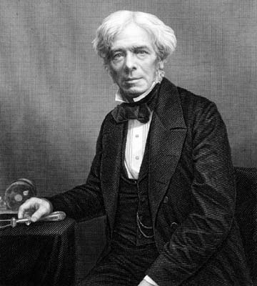
How to get Blood from a Stone
Rules of thumb:
  Φ ∼ B R² ; V ~ Ω Φ;
  I~ V / Z₀; P ~ V I
PWN AGN GRB
B 100 MT 1 T 1 TT
Ω 10 Hz 10 μHz 1 kHz
R 10 km 10 Tm 10 km
V 3 PV 300 EV 30 ZV
I 300 TA 3 EA 300 EA
P 100 XW 1 TXW 10 PXW
B
M
Ω
Unipolar Induction

Slide 21
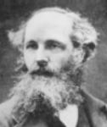

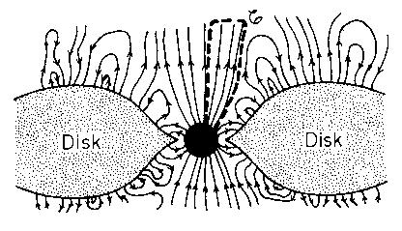
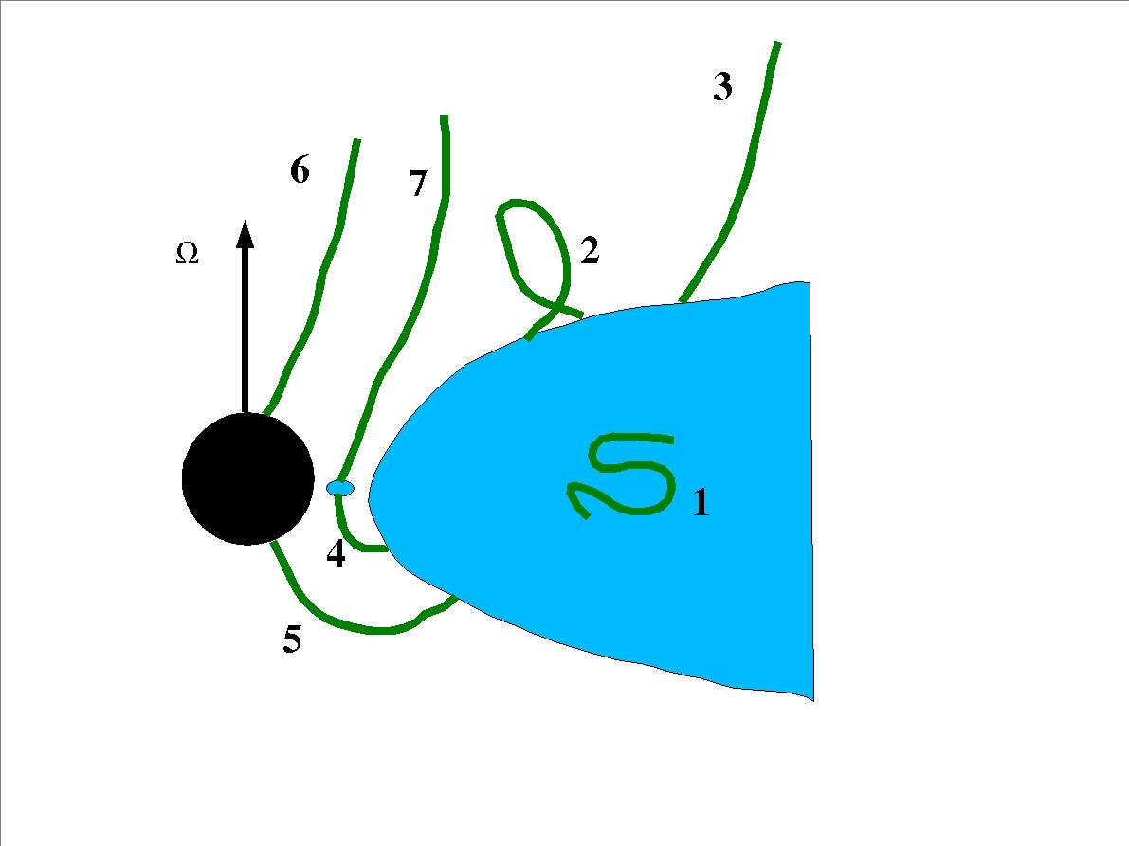
EM/RMHD power
Relativistic Force-Free treatment
  No inertia
Relativistic MHD
  Inertia
Where do the currents close?
  EM->Heat, bulk kinetic energy
How are jets powered?
  Disk or hole?

Slide 22
Dipolar or Quadrupolar?
Odd field
Even current
Even field
Odd current
Ω
x
x
x
x
.
Lovelace, Camenzind, Koide, RB
Also prograde vs retrograde?

Slide 23
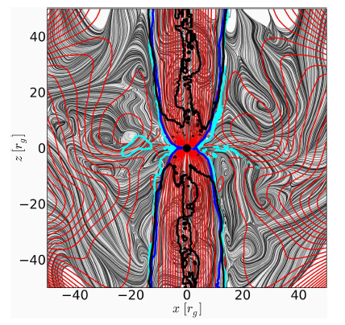
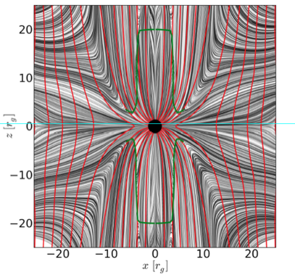
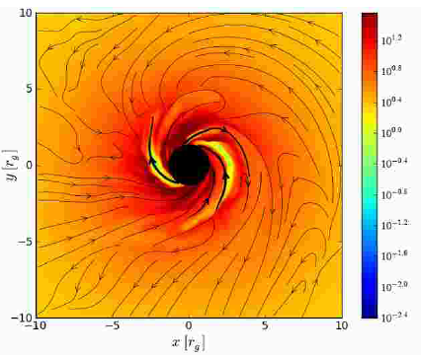
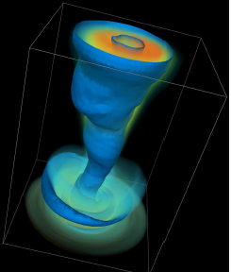
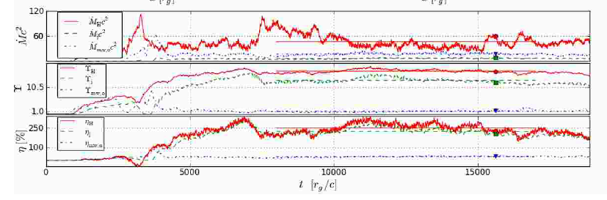
3D GRMHD Simulations
>10⁵m Kerr-Schild,
HARM, 512x768x64
Quasi-steady state
a~ -0.9 - 0.99m
McKinney, RB;
McKinney, Tschekovskoy, RB
Tschevoskoy et al

Slide 24
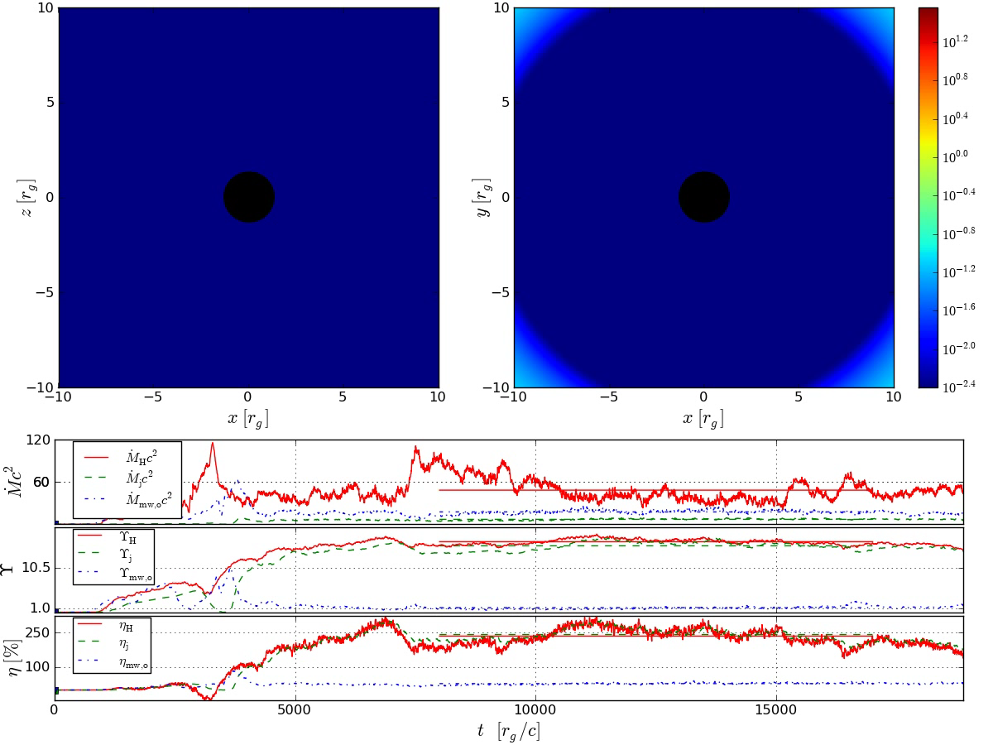
Notes:
Here is a much more sophisticated calculation that my colleague Jonathan McKinney has completed. I think it is the most detailed such calculation to date of magnetized gas accreting onto a spinning black hole. What we have here is a simple starting configuration with a ring of orbiting gas endowed with magnetic field. What we see is that the gas falls inward intensifying the magnetic field and flowing thought it towards the event horizon.
Although the gas flow is quite chaotic the jets that form are quite stable and similar to what is observed. There are many discoveries that we have made using these computational simulations. Here is one of them. Remember that I said that black holes can sing. Well look at the jet. It wobbles around with the disk a bit like a child with a “hula hoop” (if you are old enough to know about this). The oscillation of the disk makes the musical note that we can “hear” in X-ray observations of stellar black hole sources just like a vibrating guitar string.

Slide 25
Magnetically-choked Accretion Flows
Robust, collimated jets
  >10⁵ m
Build up strong dipolar field
  Thick spinning disks, suppress MRI
  Not quadrupolar
Efficient extraction of spin energy-> jets
  Prograde (not retrograde) more efficient
Manetic collimation
  Poorly collimated, slower winds
QPOs,
  Helical instability (m=1) ~Ω/4, Q~100 (jet) ~3 (disk)
Strong intermittency
  Acceleration
McKinney, RB;
McKinney, Tschekovskoy, RB
Tschevoskoy et al

Slide 26
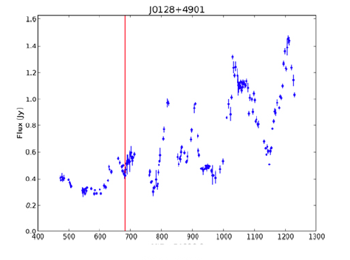
Observation and Simulation
FGST, ACT…OP…Radio, ν all working well
N~1000 sources sampled hourly-weekly
Large data volumes justify serious statistical analyses of multi-λ data
  Irregular sampling, selection effects
  Work in progress
Account for Extreme Jets
  Most variable, fast, bright, polarized…
Modeling must match this increase in sophistication
Simulations are now becoming available
  Understand kinematics, QED, fluid dynamics
  Ignorant about particle acceleration, transport, radiation, field evolution
Simulation
Analysis
Physical
assumptions
Statistics
Observations

Slide 27
Quivering Jets
Observe γ-rays (and optical in 3C279)
Gammasphere τ_{γγ}~1, 100-1000m ~ Eγ
Rapid variation associated with convected flow of features (2min in Mkn 501)
Slow variation associated with change of jet direction on time scale determined by dynamics of disk (precession?) or limited by inertia of surrounding medium or both as with m=1 wave mode.

Slide 28
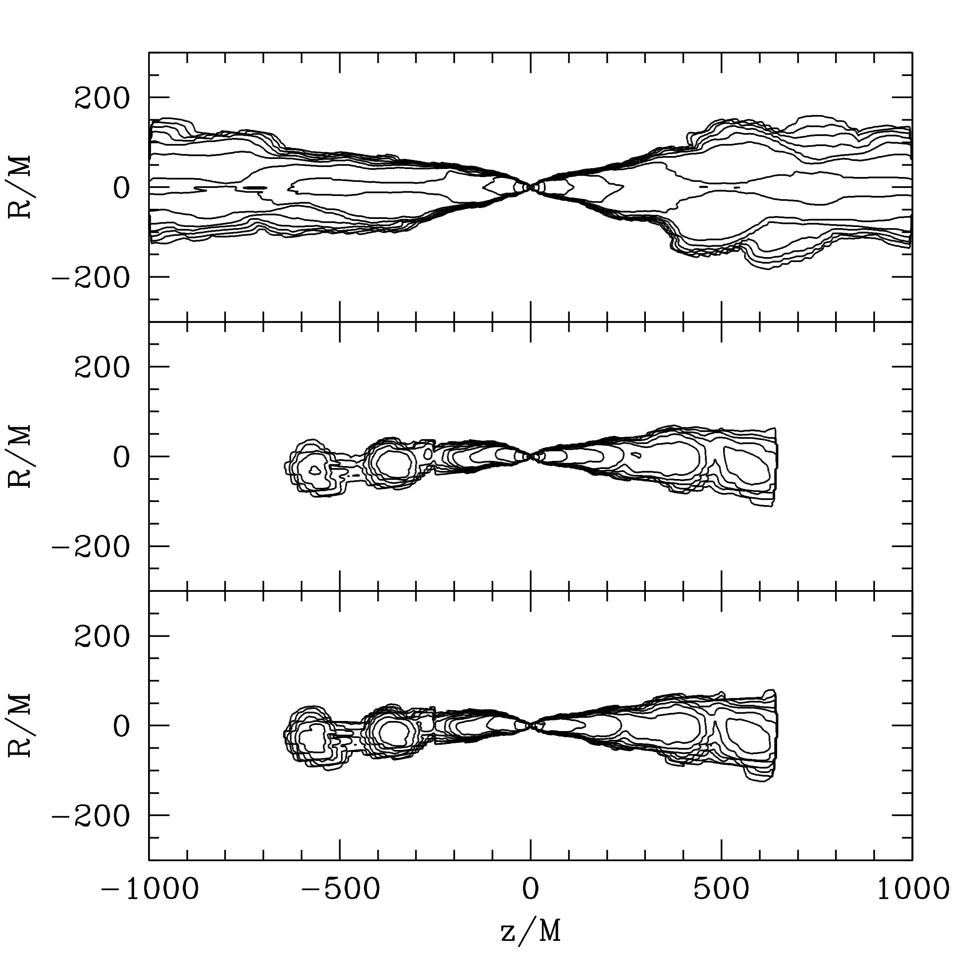
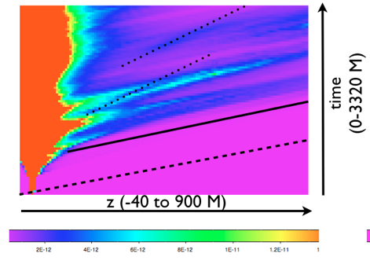
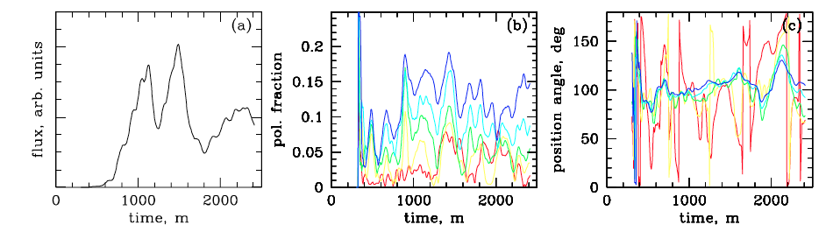
Optical emission from jet with γ ~ 3-4
Disk
Light
Zakamska, RB & McKinney in prep

Slide 29

Total Flux and Degree of Polarization

Slide 30


Faraday Rotation
Observation
Simulation
Zavala& Taylor 2005
Broderick & McKinney
Signature of toroidal field/axial current

Slide 31


Imaging a Black Hole?
For M87 and Galactic Center,
  2m ~10μas ~ 0.3 mm/R_{E}
Event Horizon Telescope (Doeleman et al)
  ALMA VLBI
Dexter, McKinney, Agol
ALMA

Slide 32



LIGO, LISA, Nanograv…
Merging Black Holes
  Ultimate test of dynamical, strong General Relativity
  Orbit, plunge…
  Background
Millisecond pulsar array
  Fermi + radio (44)
  40 ns timing accuracy
RIP

Slide 33
Summary
Jets everywhere!
Radio through γ-ray advances
GRMHD suggest magnetically-choked energy extraction from Kerr black hole
Observing simulations is instructive!
JVLA, ALMA, CTA, EHT, LIGO, NanoGrav…

