Slide 1
Radiation Reaction in the Crab
Roger Blandford
KIPAC
Stanford
Notes:
957 years ago, the distinguished Chinese astrologer Yang Wei-te told his Emperor about a cosmic development.
“Prostrating myself before your majesty, I hereby report that a guest star has appeared.” He goes on to say “The fact that the guest star does not trespass against the lunar mansion means that there is a person of great wisdom and virtue in the country. I beg that this be handed over to the Bureau of Historiography”. It was.
As someone who has spent a good part of the last nine months discussing federal funding of astronomy, I can only admire Yang Wei-te’s technique.

Slide 2
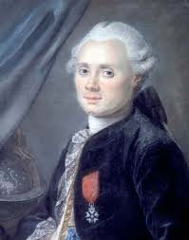
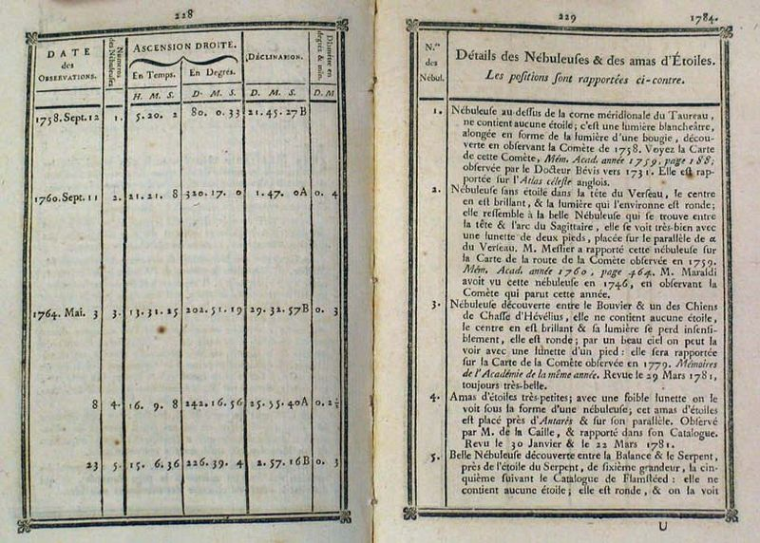
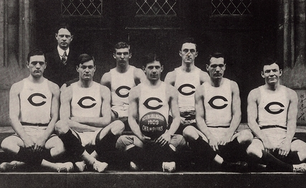
Charles Messier
Notes:
The Crab Nebula was rediscovered by an English amateur John Bevis who included it in a beautiful atlas which was never published because the publishers went bankrupt. He therefore told his French colleague Charles Messier about it. Messier was more interested in comets and found sixteen. To him the Crab Nebula was the most annoying of objects and he included it in a famous catalog of celestial objects that could be confused with comets. It is the first entry. The name is due to an Irishman, the third Earl of Rosse, who thought it looked like a Crab.
In the years that followed many famous astronomers studied the Crab Nebula but it was not until the 20th century that its association with the Chinese supernova was established largely by Hubble through measuring how fast it expanded and seeing that it was about a thousand years old.

Slide 3
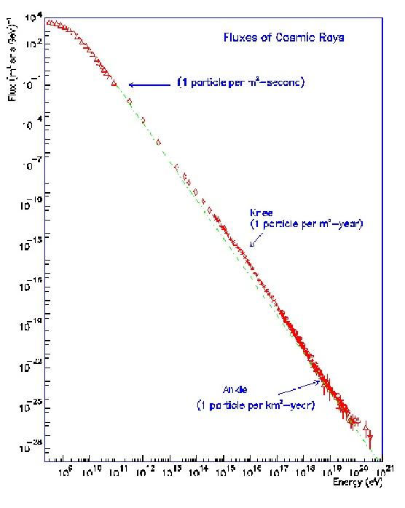
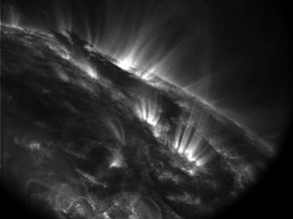
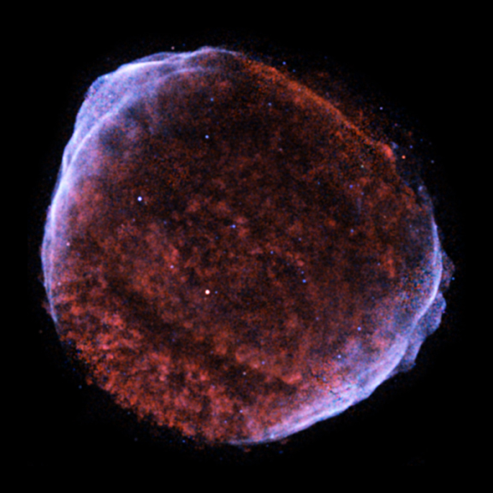
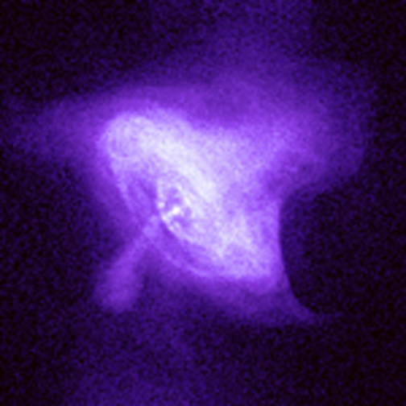
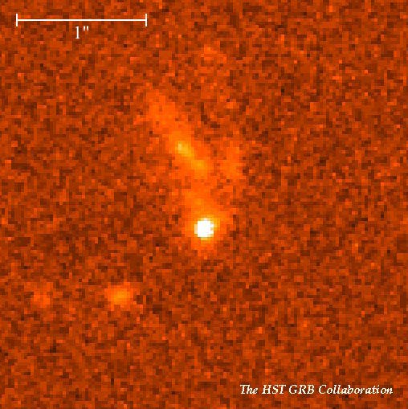
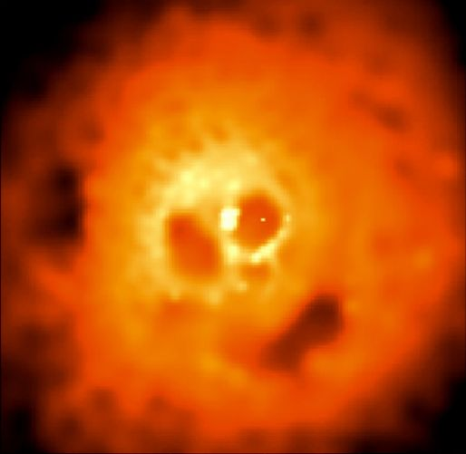
Cosmic Rays
solar
system
supernova remnants
pulsars?
active
galactic
nuclei ??
Cahill Dedication, Caltech
GeV TeV PeV EeV ZeV
Notes:
Cosmic laboratory
Knee
YeV
Chevy Volt loaded 2000kg @400 m/s =160 MJ!

Slide 4
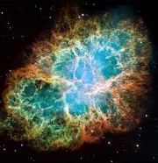
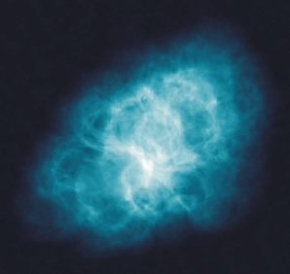
Crab Nebula
Polarized synchrotron radiation (100mG)
Inverse Campton radiation
Notes:
Radio
Minkowski’s star

Slide 5
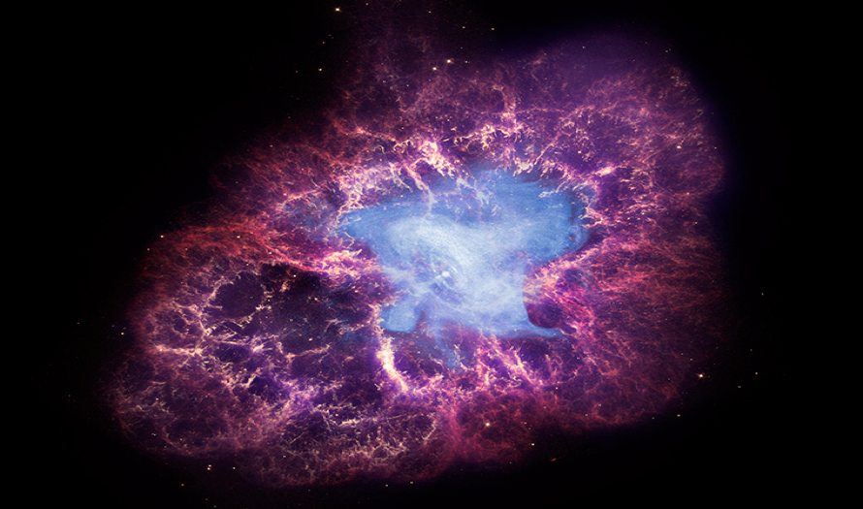
Optical and X-rays Combined
Notes:
Jets

Slide 6
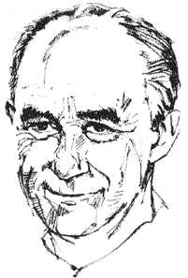
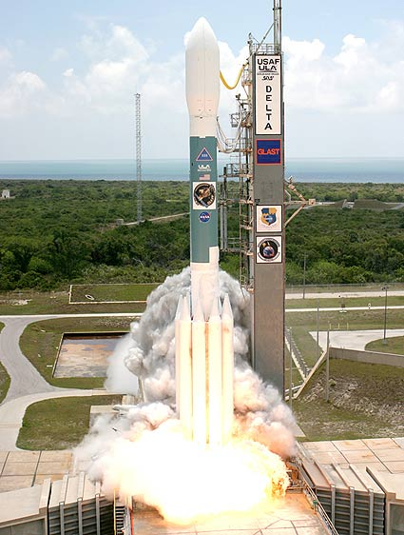
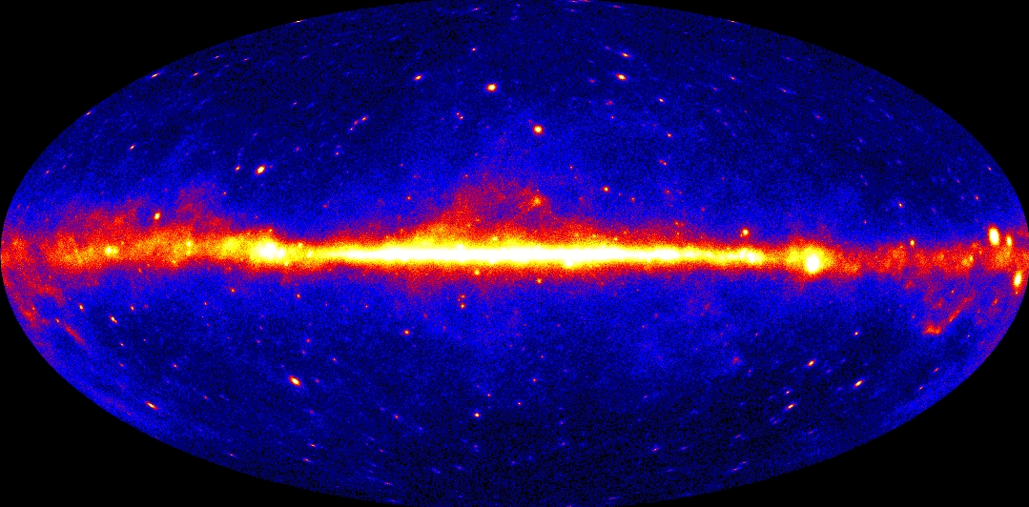
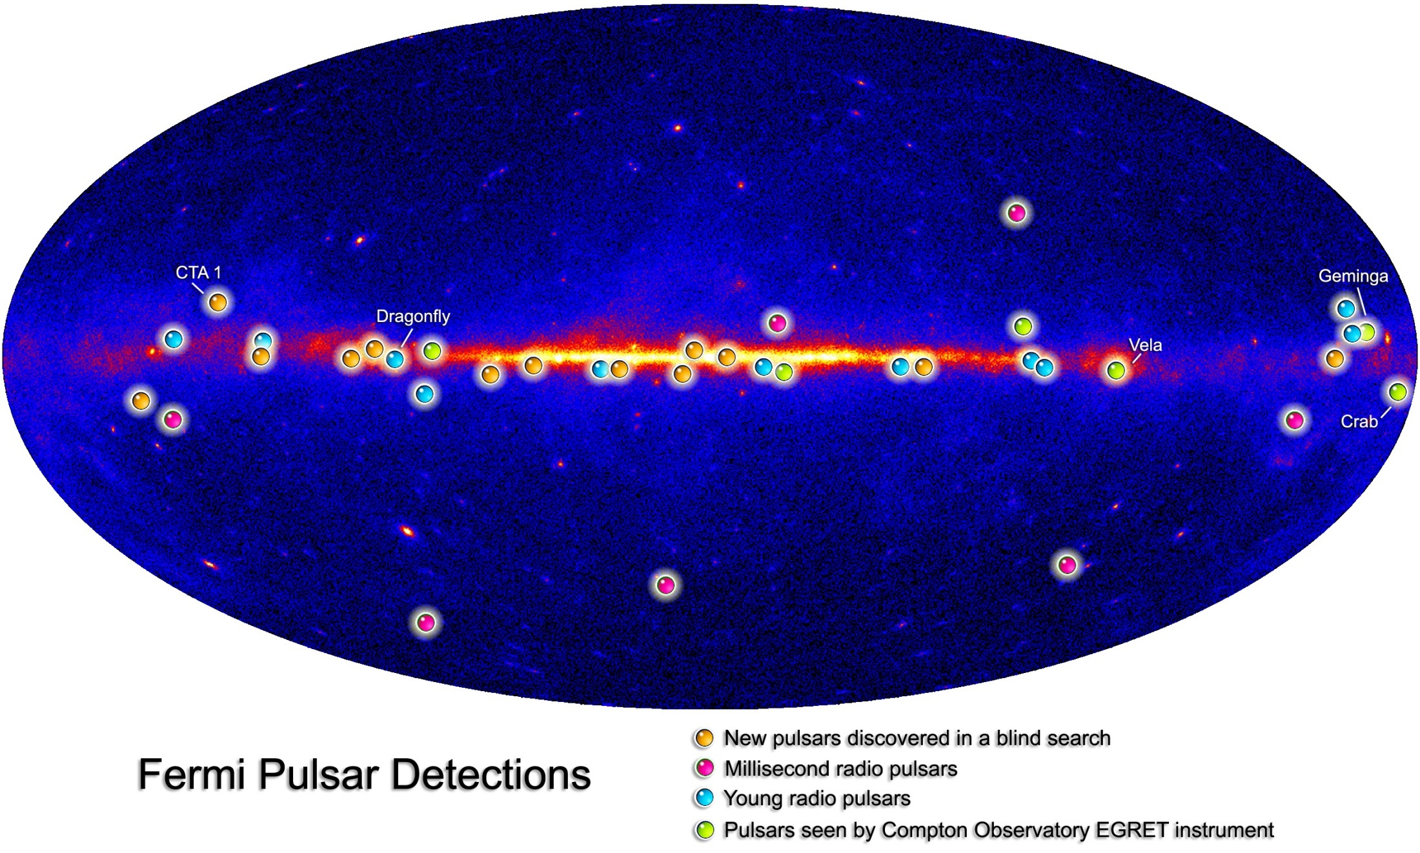
Fermi
Notes:
June 11 2008
GeV

Slide 7
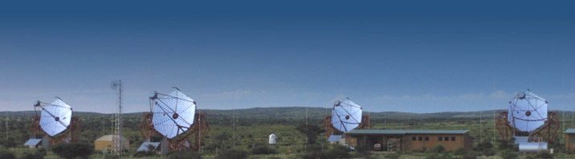
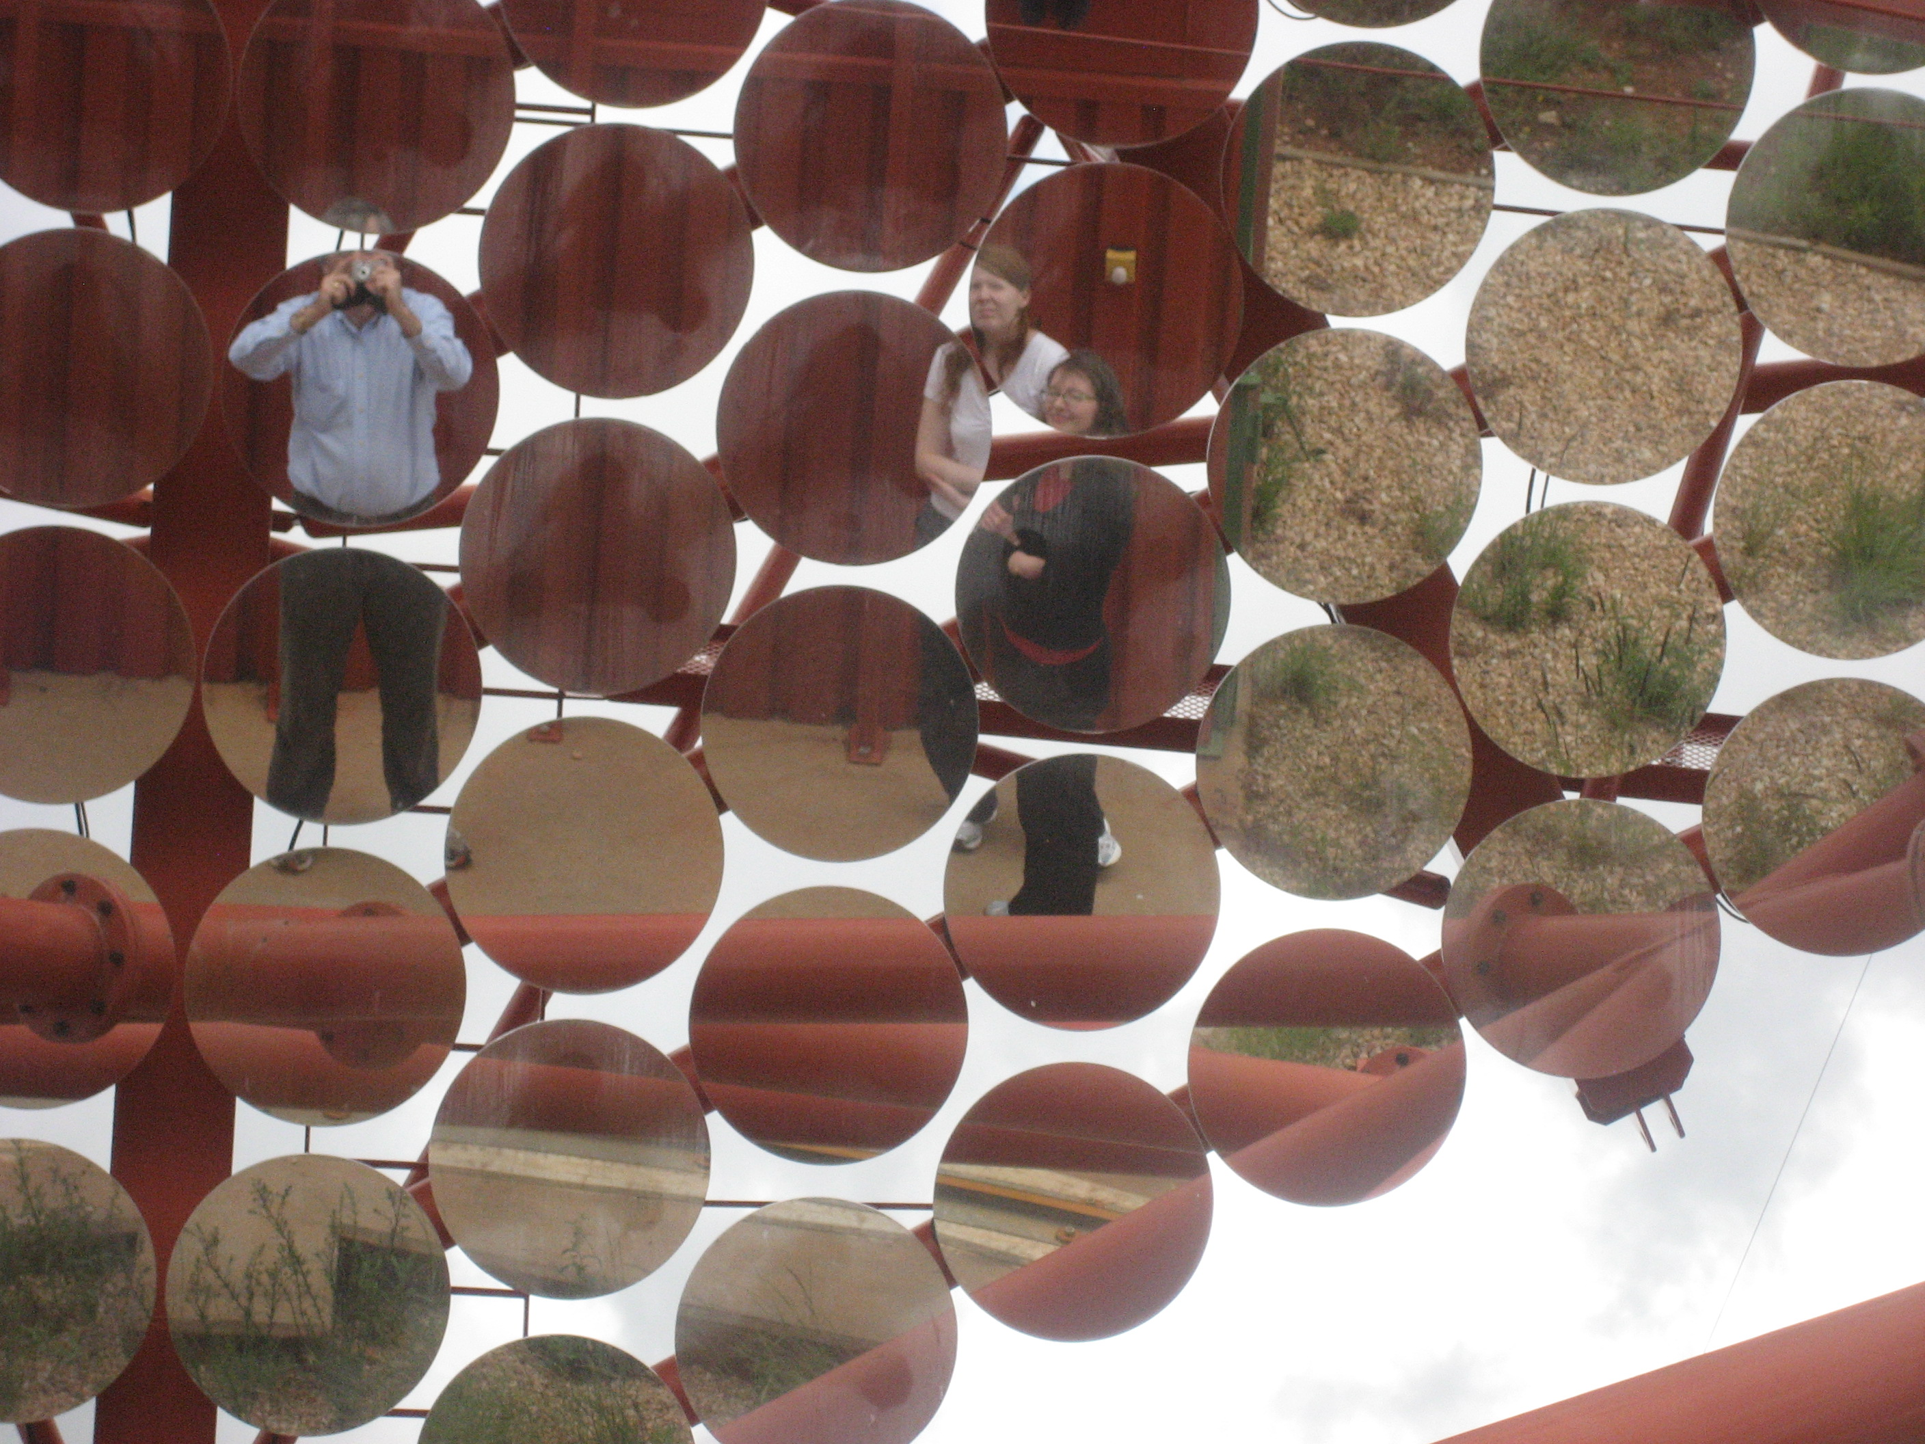
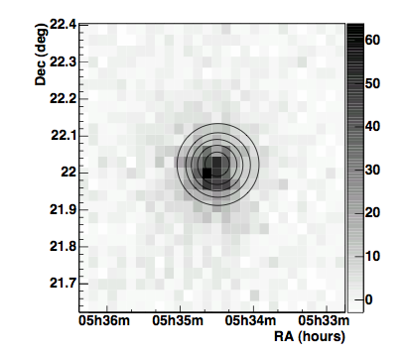
H.E.S.S.
Notes:
TeV Namibia
Ang res

Slide 8
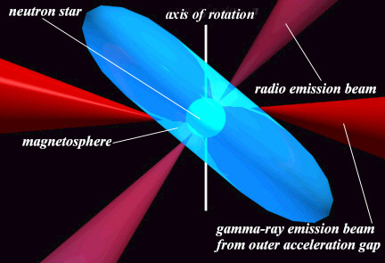
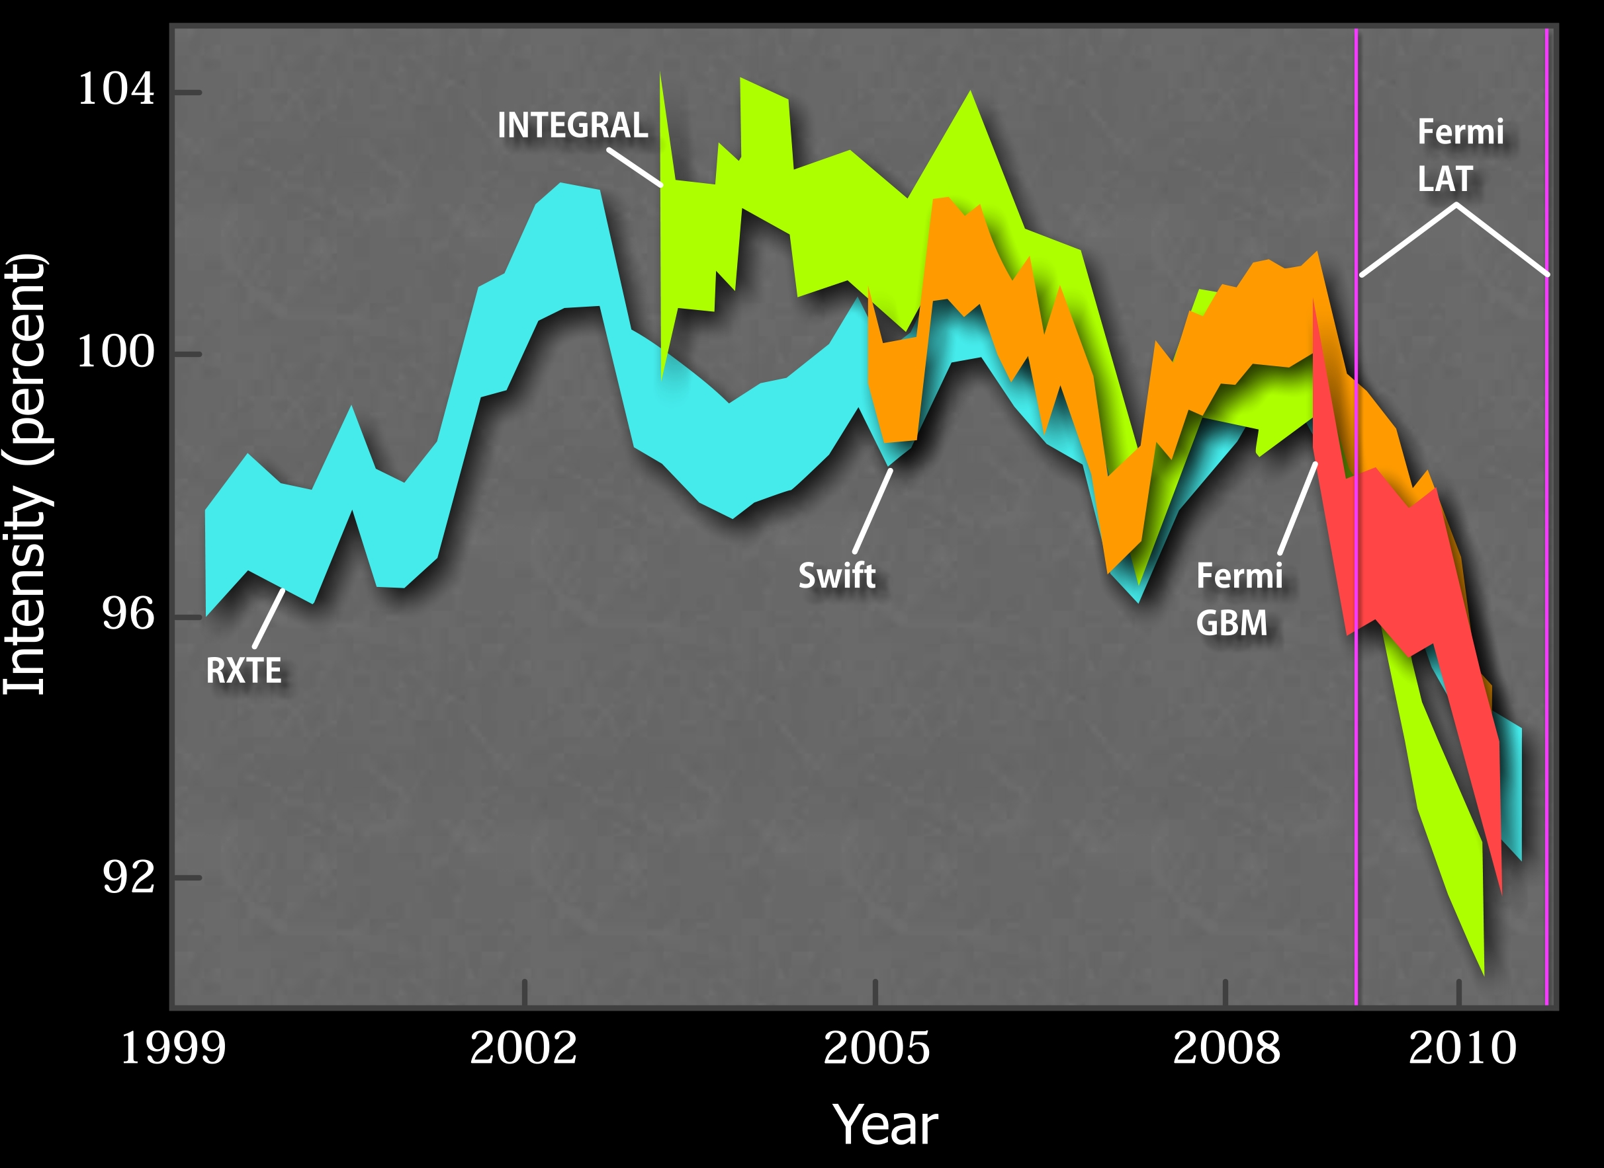
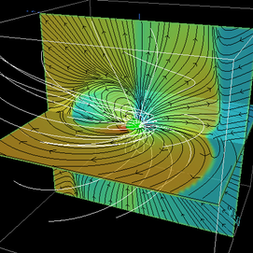
Crab Pulsar
Discovered in 1968
  Predicted by Pacini
  Turning point in history of astronomy
Spinning, magnetized neutron star
  1.4 solar mass, 12km radius, ρ ∼ ρ_{nuc}
  30 Hz ~10¹² G
Giant electrical generator
  30 PV cf 2 x (4-7TeV) @ LHC
  Powers the entire nebula ~10³¹ W
No longer a standard
  Eight percent decline in 5 yr instead of < one percent
Simulate magnetosphere
Notes:
Cocke Disney Taylor
Gold
Gold Standard like also such financial verities unit lose its value
2 msun
V²/Z₀
cf UHECR

Slide 9
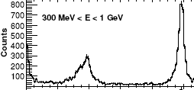
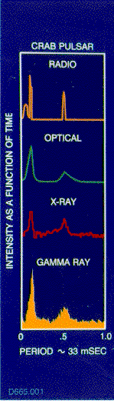
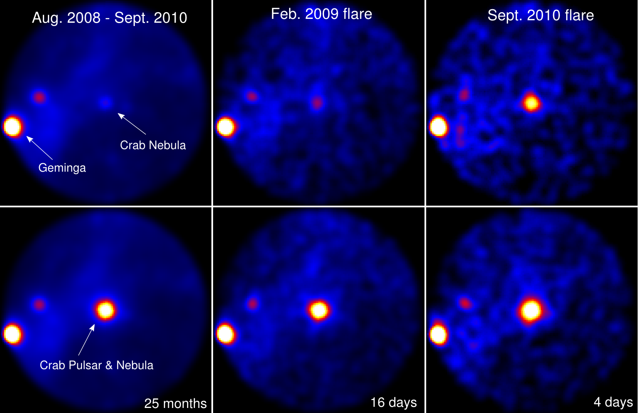
GeV Crab Flares
Buehlerr
Notes:
Also AGILE
Evidence that 12 hr substructure

Slide 10
12 hr variation?
Balbo et al

Slide 11
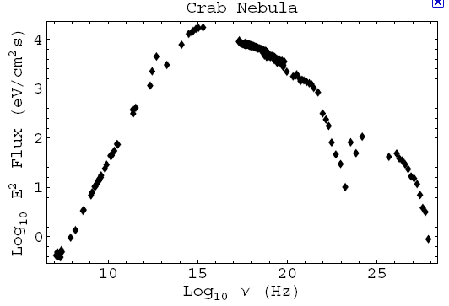
The Entire Spectrum
TeV
Synchrotron
Radiation
Compton
Scattering
Radio
Gamma Rays
Notes:
Few 100 MeV - ~100PeV
30 TeV from Nebula needing 30 TeV electrons.
Higher energy photons too rare to see

Slide 12
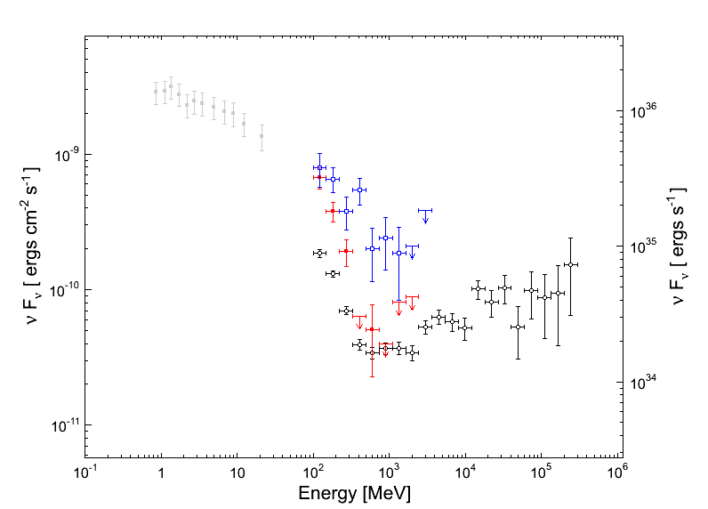
Spectral Changes
Electron rest mass (E=mc²) energy
100X
September Flare
4 day variation
Synchrotron
Radiation
Compton
Scattering

Slide 13
Spectral Changes
September Flare
4 day variation
Synchrotron
Radiation
Limit
Synchrotron
Radiation
Compton
Scattering

Slide 14
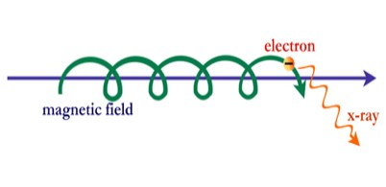
Synchrotron radiation
~ R/γ x 1/γ² ~ R/γ³
dN/dγ⁻¹ ~ α
=> Quantum process!
L_{cool} /R ~ λ/r_{e}
E < B => E_{γ} < m_{e}c²/α ~ 50 MeV
R
More detailed calculations allow you to compute synchrotron
and Compton spectra for a given acceleration environment
Require relativistic expansion, contrary to most prior models
Most explanations require larger magnetic field
(> 0.3 mG) than most prior models
Notes:
Highest energy associated with source

Slide 15
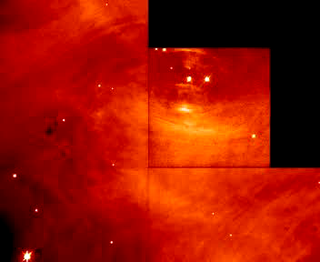
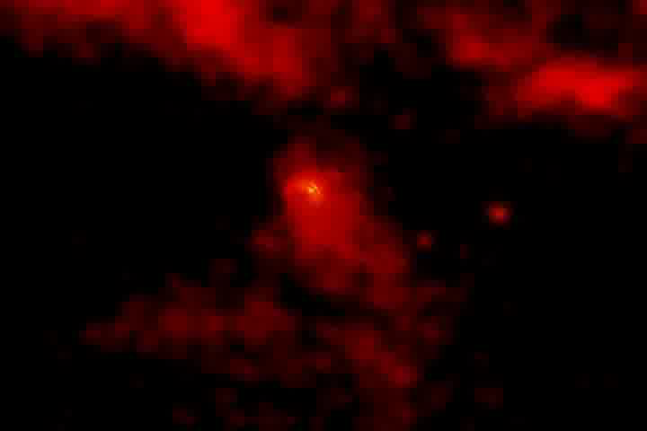
What changes?
Long term variation of nebula likely due to changes in (unstable!) magnetic field
Flares must come from a region much smaller than the nebula.
Highest energy particles associated with a specific source
Not the pulsar – P(t)
Wind, shock, jet or torus?
We hope to identify the site using Chandra Hubble, Gemini, VLA next flare
Hester

Slide 16
Where is the Flare?
Pulsar Wind?
Shock?
Jet?
Torus?

Slide 17
Classical Radiation Reaction
Irrelevant for single electrons!
Marginally relevant for U…
Relevant for accelerators, pulsars…
Irrelevant to Crab
Confused literature and textbooks
Avoid runaway solutions
Classical renormalization/self energy
Role of advanced solutions?

Slide 18
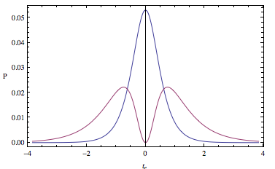
Formalism
r
ξ
dusk
x(τ), u, a, j
1D Jerk
P_{em}
t
Take limit to demonstrate
energy flow.
dawn
P_{res}
Notes:
Galt’sov & Spirin

Slide 19
Summary
Crab Nebula still surprising us.
GeV synchrotron variation implies
  Compact source ~ 10⁻³-10⁻² R_{neb}
  Relativistic motion, γ ~ 3-10
  Strong field, B ~ 0.1 -1 mG
  Highest energy particles ~ 5-15 PeV.
Plausible acceleration sites
  Wind – fast streams
  Shock – oblique,
  Torus - reconnection
  Jet – helical instability
Locate with HST, Chandra, Gemini, VLA
Classical radiation still an interesting problem

