Slide 1
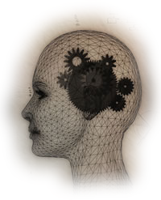
Cognitive Science at Stanford
knowledge
memory
learning
decision
making
perception
representation
categorization
language
reasoning
attention

Slide 2
the questions
How do we acquire, represent, and use knowledge?
How do we make meaning out of sensation?
… or out of words or mathematical expressions?
How do we learn?
How does our experience shape what and how we think?
How do we communicate with and learn language?
How do we remember, why do we forget?
What does it mean to imagine?
How does complex behavior emerge out of simple pieces?
What makes thinking so useful and flexible?
What are thoughts made of?
How does a brain give rise to a mind?

Slide 3
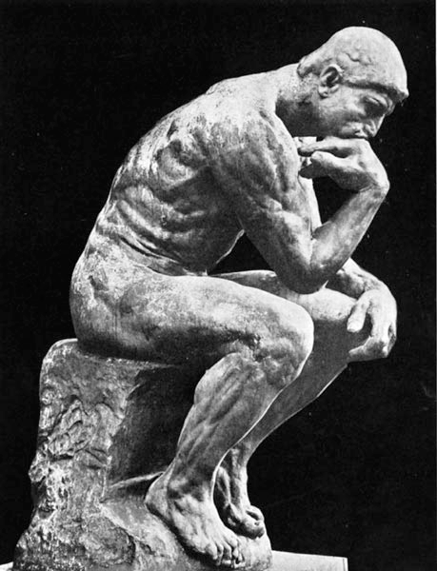
the methods
testing adults
  individually & in interactions
  in-lab, on-line, and in the world
  developing new technology for
  behavioral experiments:
    optimal experiment design
    natural language processing
    big behavioral data

Slide 4
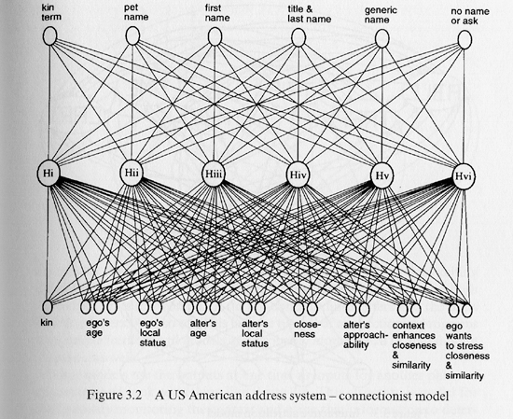

the methods
testing adults
computational/mathematical
modeling
  PDP networks
  probabilistic models
  symbolic computation
Flu
TB
cough

Slide 5
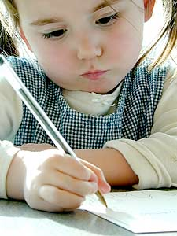
the methods
testing adults
computational/mathematical
modeling
testing children

Slide 6
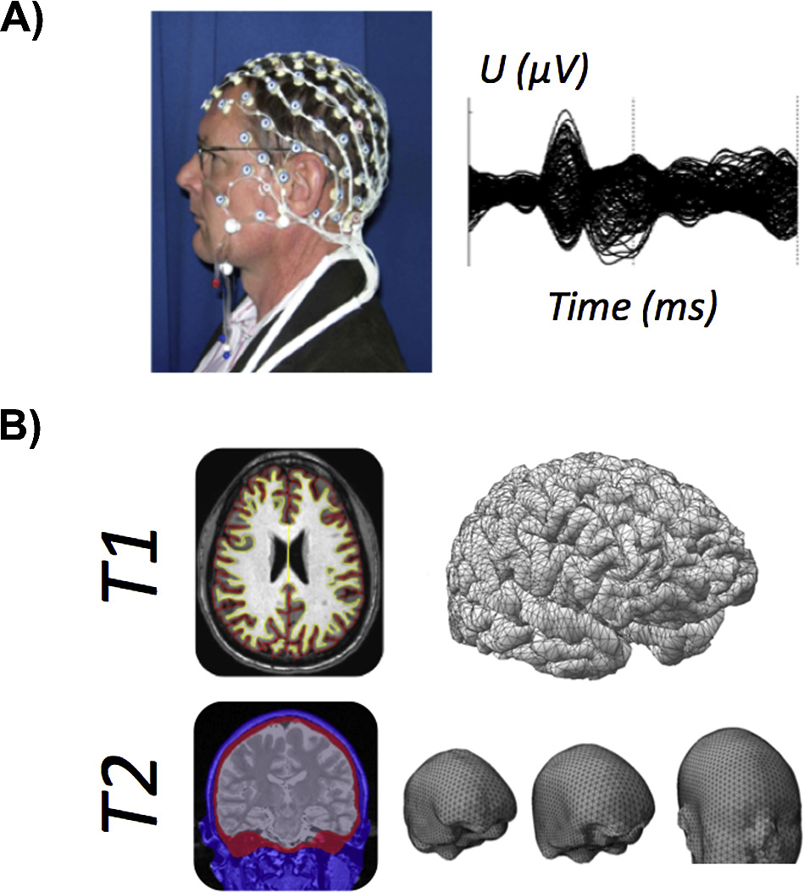
the methods
testing adults
computational/mathematical
modeling
testing children
fMRI, EEG, MEG, TMS

Slide 7
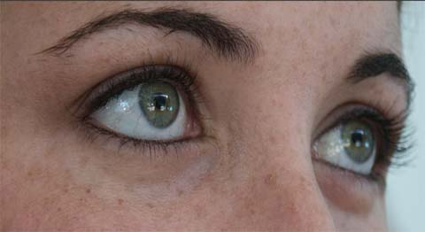
the methods
testing adults
computational/mathematical
modeling
testing children
fMRI, EEG, MEG, TMS
eye-tracking

Slide 8
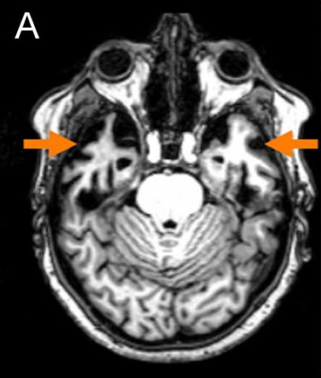
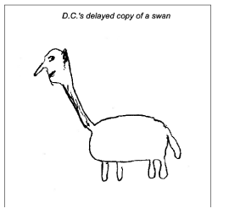
the methods
testing adults
computational/mathematical
modeling
testing children
fMRI, EEG, MEG, TMS
eye-tracking
patient populations

Slide 9
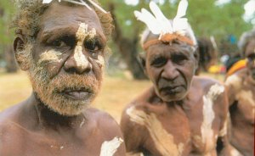
the methods
testing adults
computational/mathematical
modeling
testing children
fMRI, EEG, MEG, TMS
eye-tracking
Patient populations
cross-cultural comparisons

Slide 10
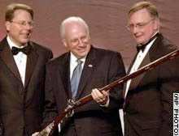

the methods
testing adults
computational/mathematical modeling
testing children
fMRI, EEG, MEG, TMS
eye-tracking
patient populations
computational/mathematical modeling
cross-cultural comparisons
linguistic analyses

Slide 11
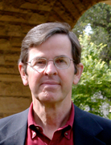
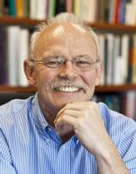

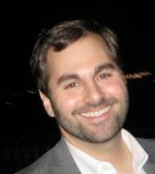

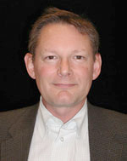
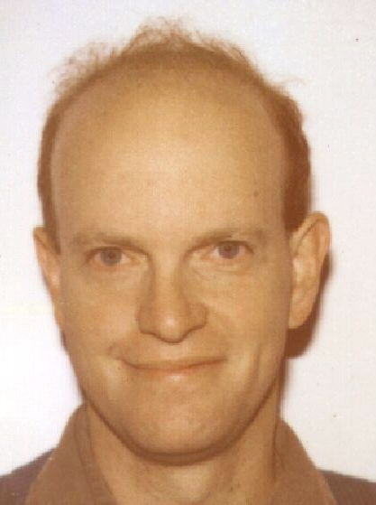
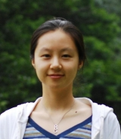
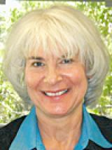
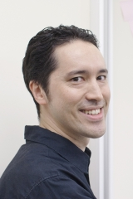

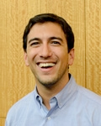
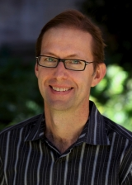
The cognitive faculty
Herbert
Clark
Noah
Goodman
Jay
McClelland
Ewart
Thomas
Michael
Frank
Kalanit
Grill-Spector
Anthony
Norcia
Hyo
Gweon
Brian
Wandell
Ellen
Markman
Russ
Poldrack
Justin
Gardner
Anthony
Wagner
Jamil
Zaki

Slide 12
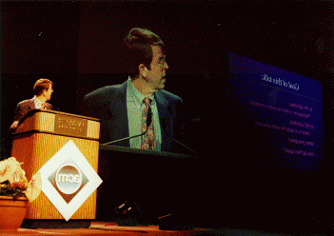
Herbert H. Clark
Cognitive and social processes in language use and discourse.
Speaking, understanding, and memory in conversation.
Word meaning and what speakers mean in saying what they say.
Pretense, deception, irony
wife: I’m leaving.
husband: Who is he?

Slide 13
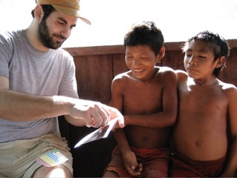
Mike Frank
How do we learn the meanings of words?
  statistical learning abilities
  children's social world
  social and pragmatic
  inferences
How do words help us think?
  creating new concepts
  using abstractions to
  reason about the world
  language as a cognitive technology
Behavioral, observational,
and computational methods

Slide 14
Noah Goodman
Concepts:
  how are they learned?
  how do we use them to reason?
Natural language:
  how do words carry meaning?
  how does context affect
  interpretation?
Social cognition
  how do we reason about others’
  beliefs, desires, emotions,...?
Large-scale behavioral experiments
Computational models,
integrating probability, logic,
algorithms, etc.
Connections to CS and Linguistics:
Artificial intelligence.
Probabilistic programming languages.

Slide 15
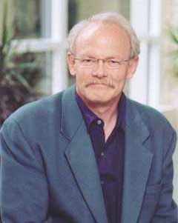
Jay McClelland
The PDP approach to mind:
  Exploring cognitive processes as emerging from the interactions of simple neuron-like processing units
  Understanding development and learning as resulting from changes in the strengths of connections among the units
  Understanding how brain areas work together to give rise to cognitive functions, including memory and decision making
Current directions:
  Representation and processing of numbers and symbolic mathematical expressions
    The role of spatial representation
  Development of mathematical abilities
    How we learn the structured reasoning systems that underlie mathematical concepts, from number to geometry and trigonometry
  Understanding contributions of parietal cortex and other brain areas to mathematical reasoning and problem solving

Slide 16
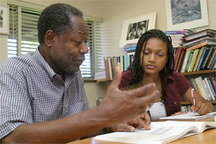
Ewart Thomas
Statistical methods.
Mathematical and experimental analyses of information processing, equity, and small-group processes.
Mathematical modeling of the perception of time and speed.

Slide 17
connections to other areas
cog & developmental
  language learning, knowledge acquisition, modeling
cog & social
  theory of mind, culture & cognition, communication, decision-making, categorization & stereotyping
cog & affective
  cognition & emotion, person perception, theory of emotion
cog & neuro
  neural basis of cognitive faculties
cog & other departments
  linguistics, CS, philosophy, neurobiology, CSLI, symbolic systems
  Center for Mind, Brain, and Computation, and the SNI

Slide 18
Life after Stanford…
John Anderson CMU
Larry Barsalou Emory
Lera Boroditsky UCSD
Silvia Bunge Berkeley
Jonathan Demb Michigan
Mike Frank Stanford
Tom Griffiths Berkeley
Keith Holyoak UCLA
Alex Huk UT Austin
Steven Kosslyn Stanford
Beth Loftus UC Irvine
Beth Marsh Duke
Danny Oppenheimer UCLA
David Rumelhart Stanford
Richard Shiffrin Indiana
Steve Sloman Brown
Noam Sobel Berkeley
Bob Sternberg Yale
S. Thompson-Schill UPenn
Larry Maloney NYU
Greg Murphy NYU
Anthony Wagner Stanford
...

