Slide 1
Representation of Symbolic Expressions in Mathematics
Jay McClelland
Kevin Mickey
Stanford University

Slide 2
Two Questions for Cognitive Science
What is thought?
  One Answer:
    Symbol processing
What is symbol processing?
  One Answer:
    Manipulation of structured ensembles of symbols according to structure sensitive rules

Slide 3
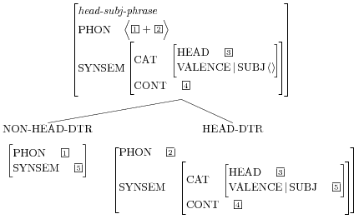
A contemporary bit of linguistic structure

Slide 4
A Brief History
The development of mathematical proof systems and (in the 19th century) formal logic created a mechanical method for deriving new valid expressions from other given expressions.
The creation of the digital computer (thanks to Turing and others) allows computers to implement these methods.
The promise of these methods lead to the creation of new disciplines:
  artificial intelligence
  cognitive psychology
P → Q
¬Q
¬P

Slide 5
Herbert Simon, January 1953
“Over the Christmas Holidays Alan Newell and I programmed a computer to think”
Their “logical theory machine” could prove simple theorems in propositional logic.
The system managed to prove 38 of the first 52 theorems of the Principia Mathematica

Slide 6

MacSyma does the Math
The first comprehensive symbolic mathematics system was constructed between 1968 and 1982
It provided a general purpose system for solving equations and carrying out mathematical computations
It was programmed in Lisp, a powerful symbol processing language
MacSyma contributed to the view (prevalent in the 1980’s still popular with some today) that Lisp is the ‘language of thought’

Slide 7
But is human thinking really symbol manipulation?
Symbol processing could solve any solvable integro-differential equation, but could it
  Recognize a face or a spoken word?
  Understand a joke?
  Use context, as people do, to resolve ambiguity
    Go get me some RAID – the room is full of bugs
Could it come up with an insight or a creative solution to a novel problem?

Slide 8
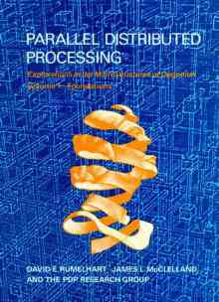

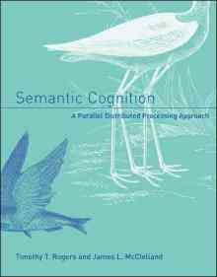
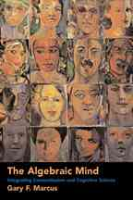
My Earlier Research
Explored neural networks as an alternative to the view that language and cognition involved symbol processing
Led to a debate that might be settled with a little more progress with deep neural nets

Slide 9
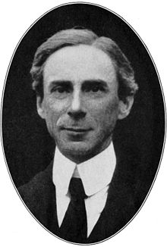
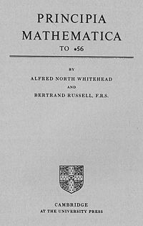
But surely mathematical reasoning is symbolic!
“all mathematics is symbolic logic”
Notes:
On one side of this dichotomy is symbolic logic. A variable is an abstraction over numbers and a number is itself an abstraction over collections of objects. We reason about these abstract symbols using the rules of logic.
Bertrand Russell proclaimed that all mathematics including geometry is symbolic logic. Math is also often regarded as a language, perhaps the language of science. It has a lexicon of symbols and a syntax that governs where these symbols can appear and how they can be manipulated.
These beliefs about mathematics strikingly parallel beliefs and theories about cognition. Newell and Simon characterize problem solving as symbolic manipulation, and Jerry Fodor hypothesized that thought has symbols that are structured and manipulated according to a syntax or set of rules.

Slide 10
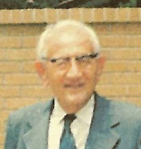
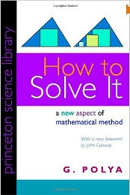
But some did not agree
“Draw a picture”

Slide 11
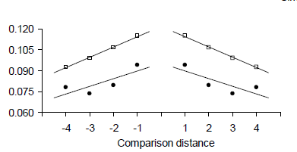
The Symbolic Distance Effect
6
1
9

Slide 12
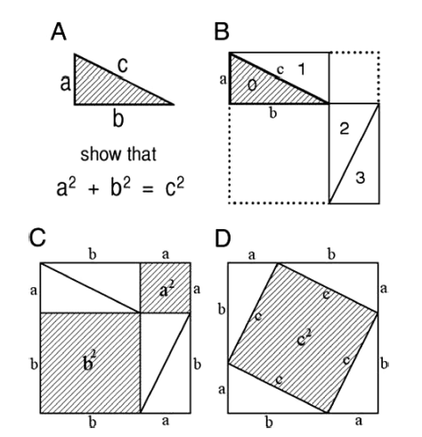

A Proof of the Pythagorean Theorem
Shephard, R.

Slide 13
trigonometry
algebra
symbolic
formulas
logic
rote memory
geometry
visual
graphs
intuition
creativity

Slide 14
cos(20-90)
sin(20) -sin(20) cos(20) -cos(20)

Slide 15
The Probes
func(±k+Δ)
func = sin or cos
sign = +k or -k
Δ = -180, -90, 0, 90, or 180
order = ±k+Δ or Δ±k
k = random angle {10,20,30,40,50,60,70,80}
Each type of probe appeared once in each block of 40 trials

Slide 16
cos(180-40)
sin(40) -sin(40) cos(40) -cos(40)

Slide 17
A Sufficient Set of Rules
sin(x±180) = -sin(x)
cos(x±180) = -cos(x)
sin(-x) = -sin(x)
cos(-x) = cos(x)
sin(90-x)=cos(x)
plus some very simple algebra

Slide 18
How often did you ______ ?
use rules or formulas
visualize a right triangle
visualize the sine and cosine functions as waves
visualize a unit circle
use a mnemonic
other
sin(90–x) = cos(x)
All Students Take Calculus
Never
Rarely
Sometimes
Often
Always

Slide 19
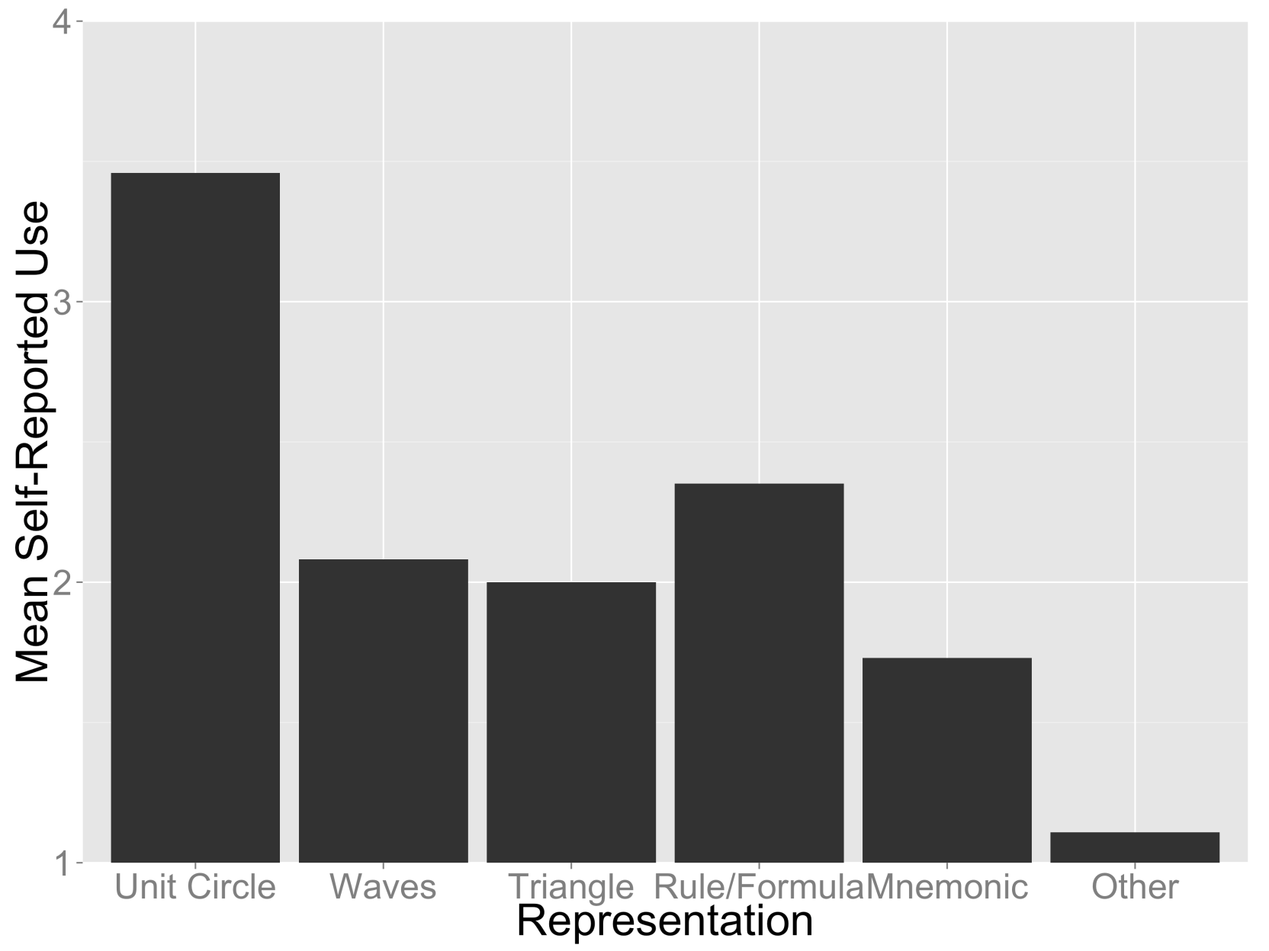
Self Report Results

Slide 20
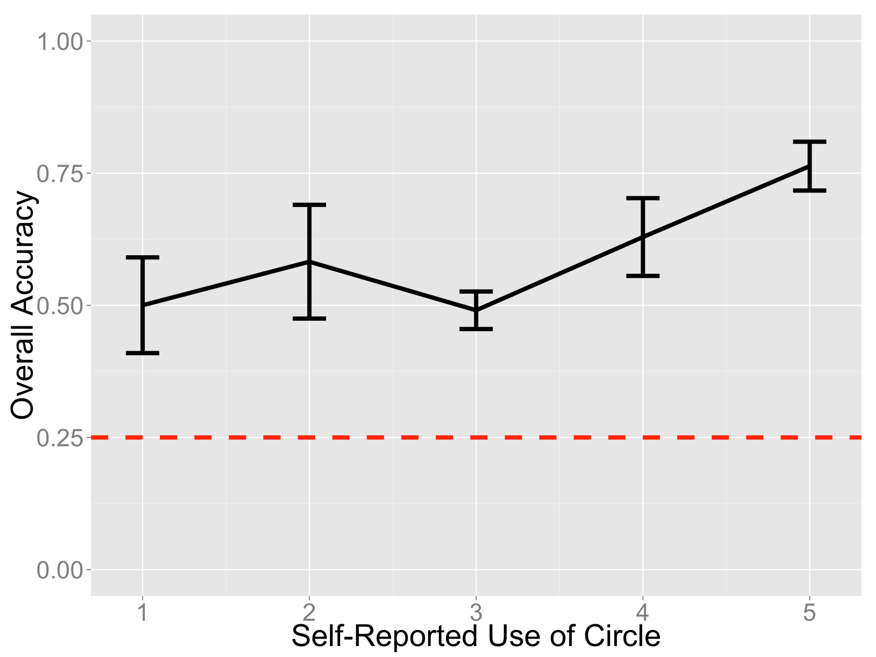
Accuracy by Reported Circle Use

Slide 21
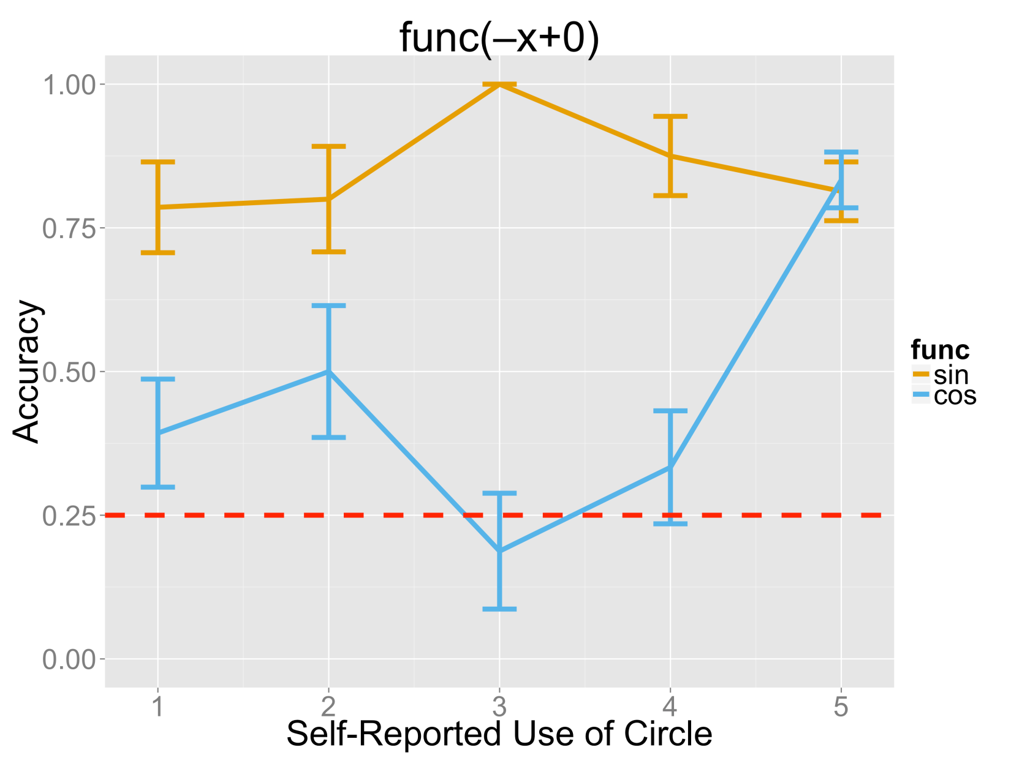
sin(-x+0) and cos(-x+0) by reported circle use
sin
cos

Slide 22
cos(70)

Slide 23
cos(–70+0)

Slide 24
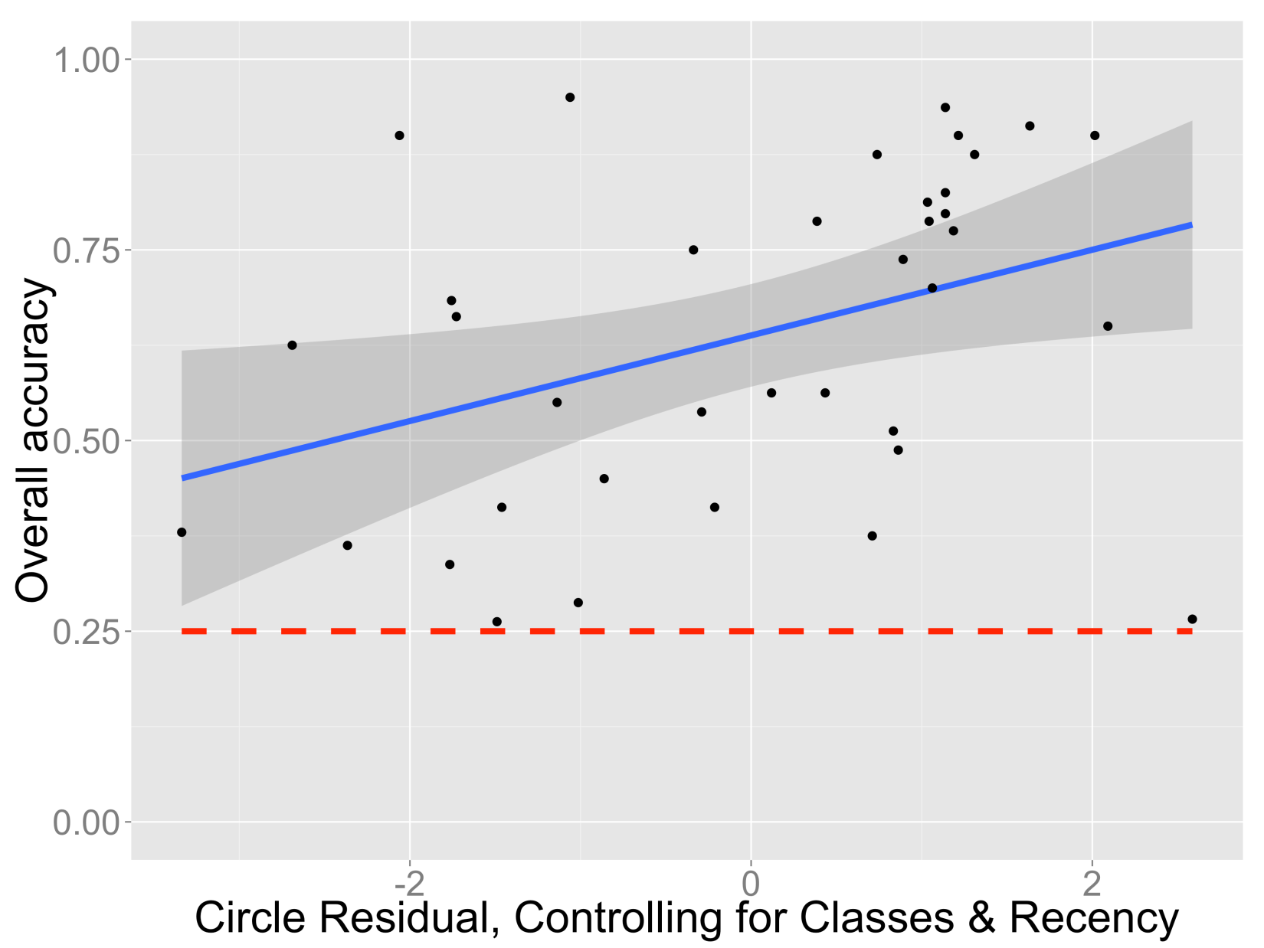
It’s not just amount or recency

Slide 25
Experiment 2
Replicate!
No lesson
Find out what they had been taught
Probe strategy problem by problem
Measure reaction times

Slide 26
Expt 2 Results
Basic pattern replicates
Performance still depends on unit circle use controlling for unit circle exposure
  But some self-described ‘unit circle’ users do not do well on cos(-x+0) or otherwise
New findings from RT and problem-specific strategy reports allow a deeper look at these cases

Slide 27
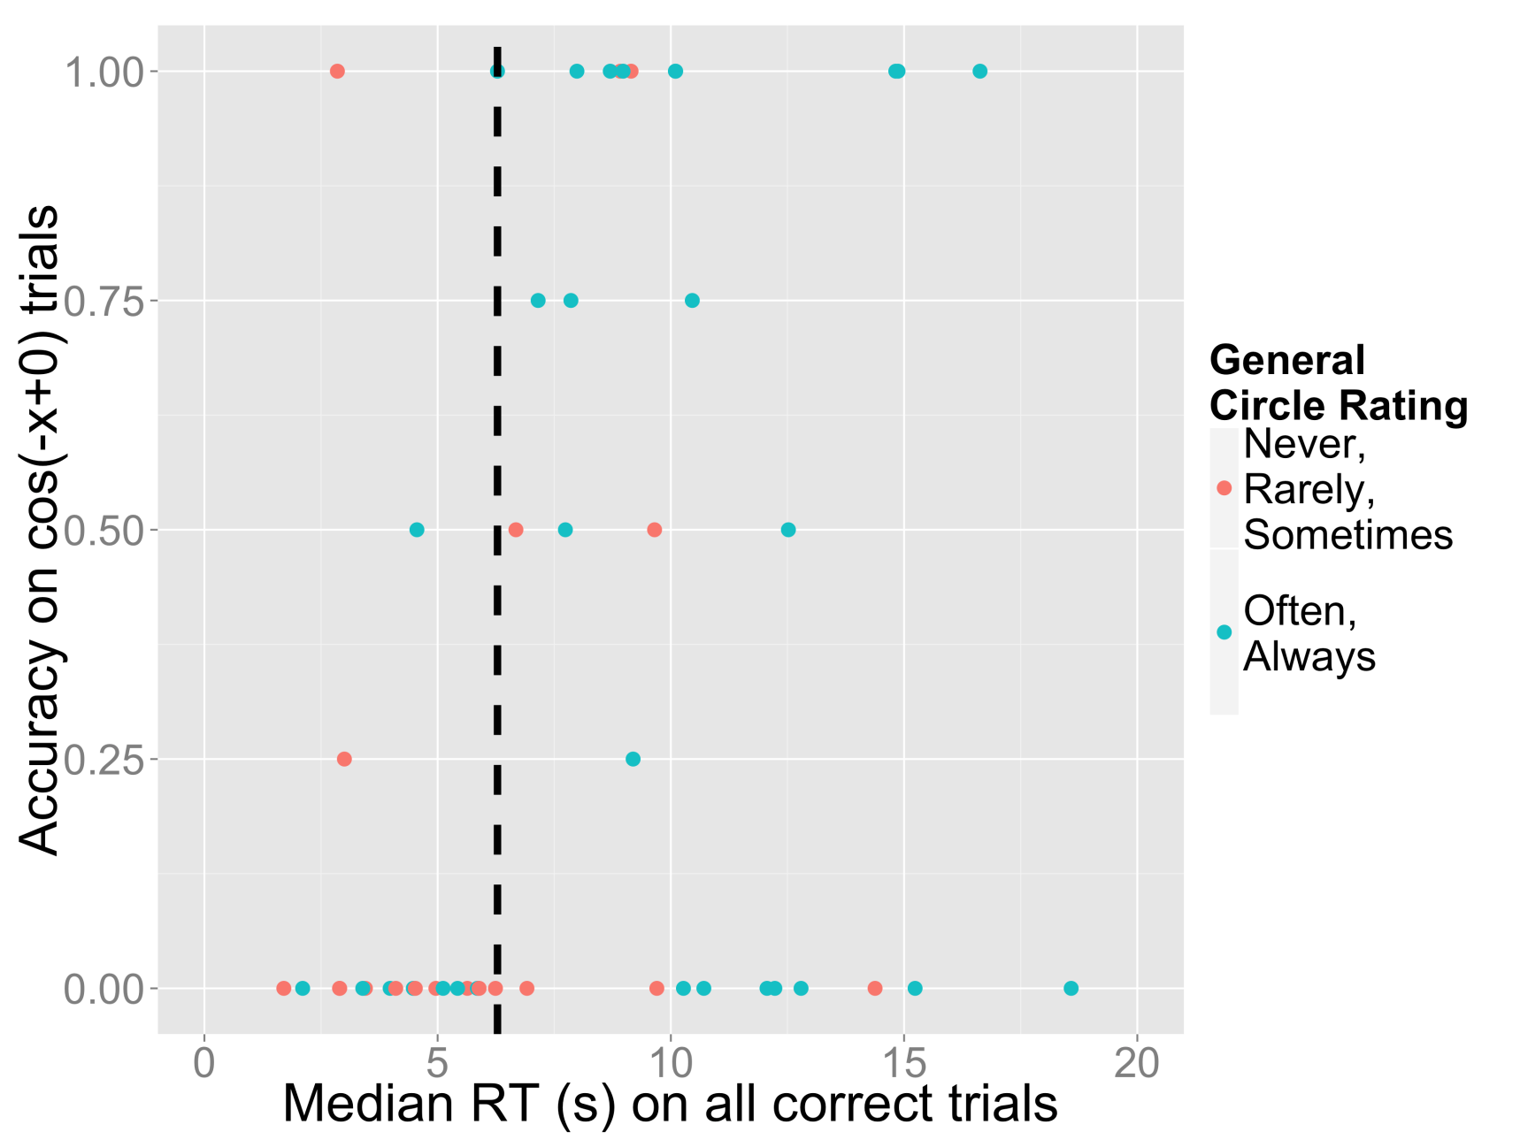
General Circle Use, Speed and cos(-x+0)

Slide 28
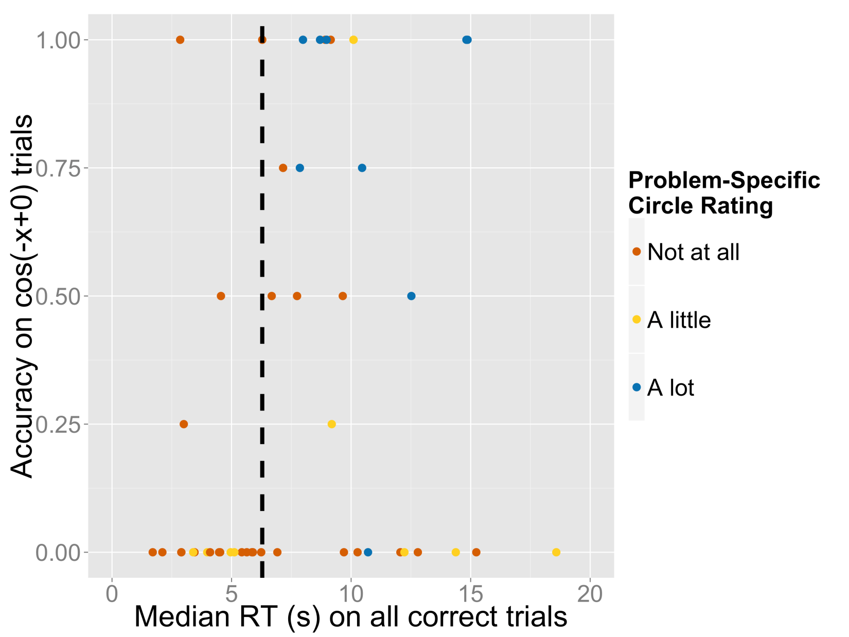
Specific Circle Use, Speed and cos(-x+0)

Slide 29
Experiment 3
Can we help participants use the unit circle?
Most said they had been taught it in their classes
In expt. 1, brief lessons half way through
  Rules
  Waves
  But they had little effect
Experiment 3:
  Unit circle lesson
  Rules lesson
  Expt. 2 as no-lesson control

Slide 30
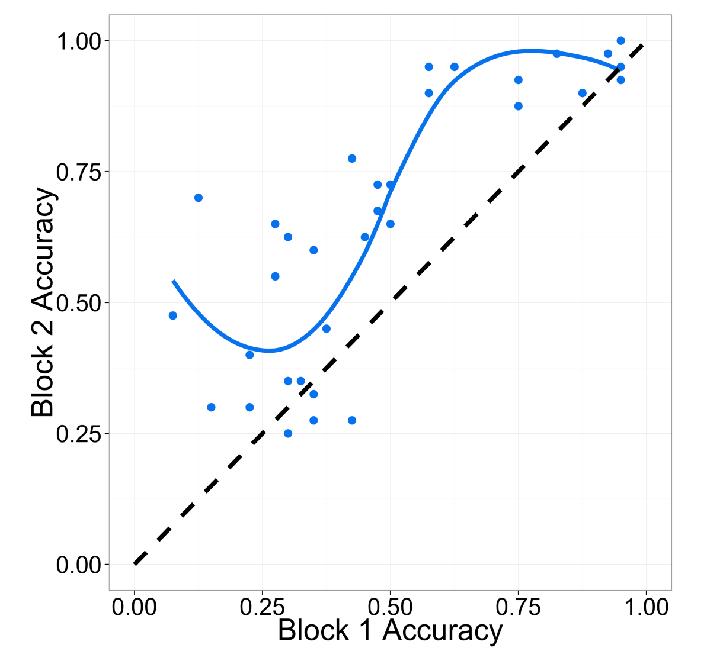
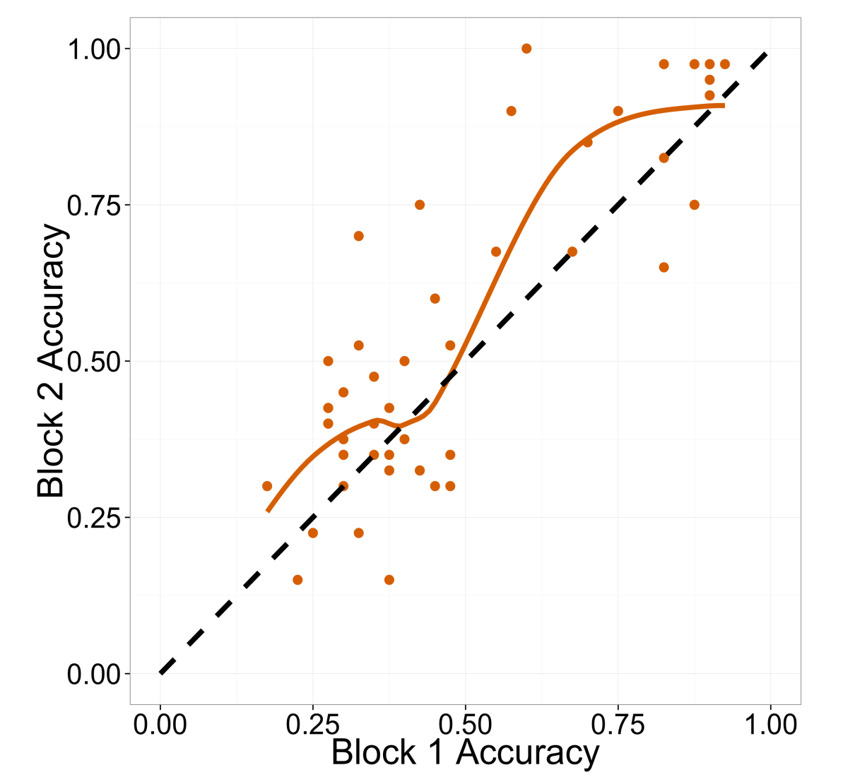
Effect of Unit Circle Lesson by
Pre-Lesson Performance

Slide 31
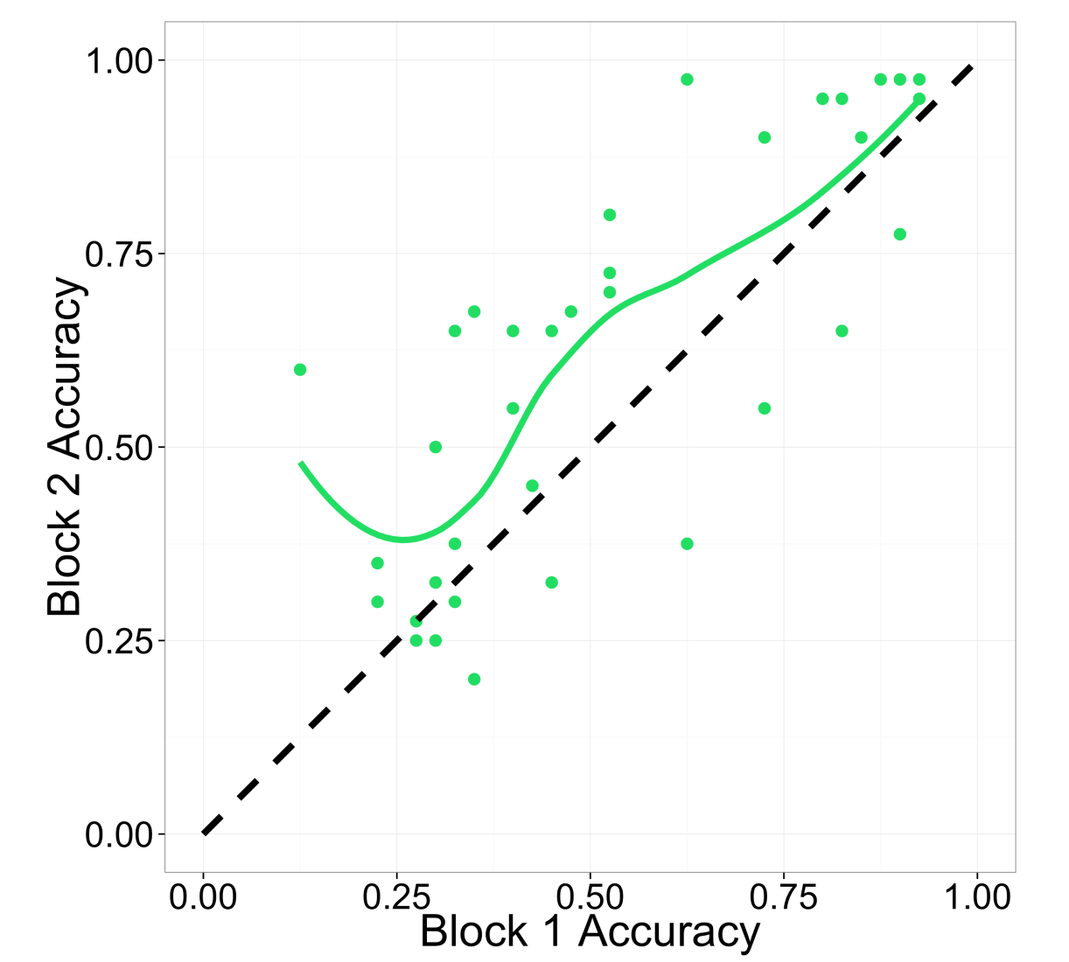
Effect of Unit Circle Lesson vs.
Rule Lesson

Slide 32
Discussion
The right visualization strategy can make some problems easy, at least for many
But not everyone is a visual thinker
Why the unit circle works so well, why rules are so hard needs to be explored
More generally, we want to know:
  Can we help people become visual thinkers?
  Could that make them better mathematicians, scientists and engineers?

Slide 33
What is thinking? What are Symbols?
Perhaps thinking is not always symbolic after all – not even mathematical thinking
Perhaps symbols are devices that evoke non-symbolic representations in the mind
  25
  cos(-70)
And maybe that’s what language comprehension and some other forms of thought are about as well

