Slide 1
Swets et al (1961)

Slide 2
Key ideas
continuity in stimulus-induced mental states
variability in these states
sensitivity (d’)
role of prior probability and payoffs
bias, criterion…
Bayesian inference
normative/optimal model, ideal observer

Slide 3
Your questions
How to get expected ROC given hypothetical underlying distributions?
What is the meaning of the ‘spread’ or ‘variance’, and how does this relate to performance?
What is ‘beta’ exactly and how does it relate to area under curve?
How are ROC curves generated from a rating experiment?
How is the prior and/or placement of the criterion determined by the subject? Is learning involved? If so in what way?

Slide 4
More questions
When do we stay with a theory even if it isn’t a perfect fit and when do we reject it and seek another theory?
How was it that the authors were able to reject the threshold theory even when their own data were and only so-so fit to their own theory?
How do we generalize given the large individual differences in studies such as these?
How do we distinguish between signals lost in noise and signals that decay before they can be reported?

Slide 5
Plan
Go over the basic elements of the theory
Generate a hypothetical ROC curve
Consider effect of prior and payoff
Consider effect of unequal variance
Consider the data reported in the experiments

Slide 6
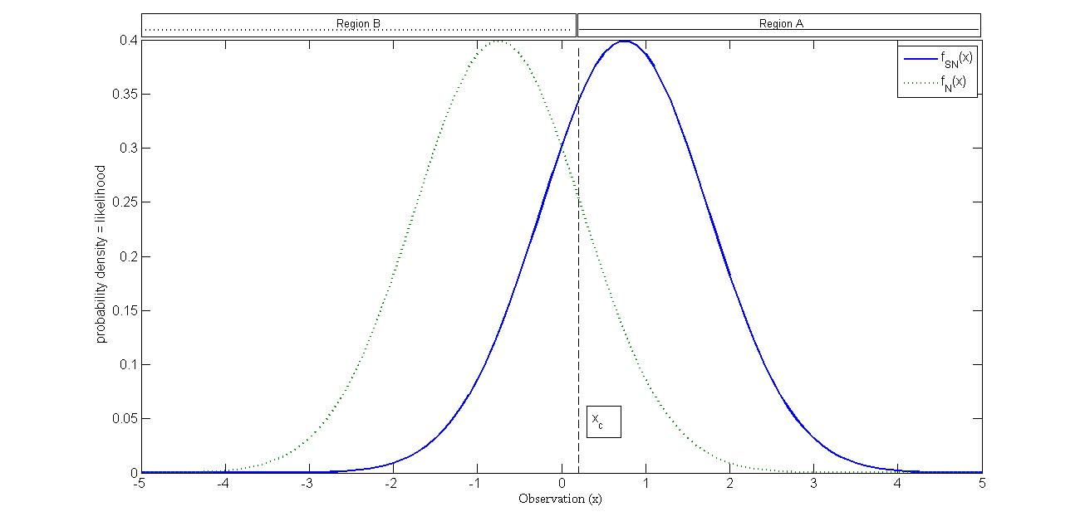

Key Concepts
Prior p(SN), p(N)
Likelihood f_{SN}(x) = p(x|SN), f_{N}(x) = p(x|N)
likelihood ratio = f_{SN}(x)/f_{N}(x)
Posterior p(SN|x), p(N|x)
Criterion, Beta
[Maximizing strategy inherent in model vs. probability matching]

Slide 7
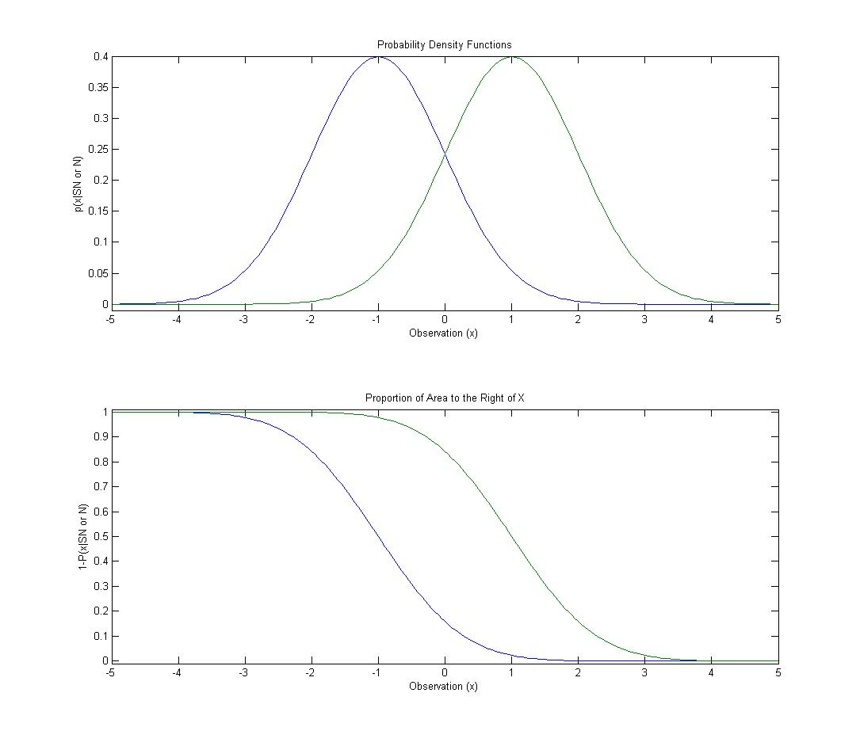

Slide 8
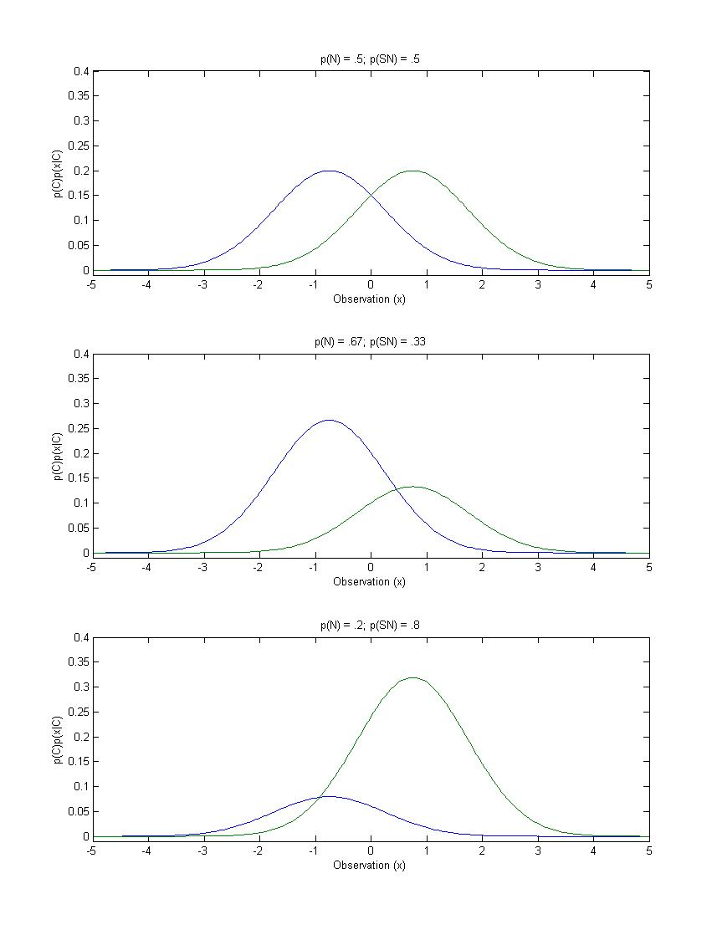

Slide 9
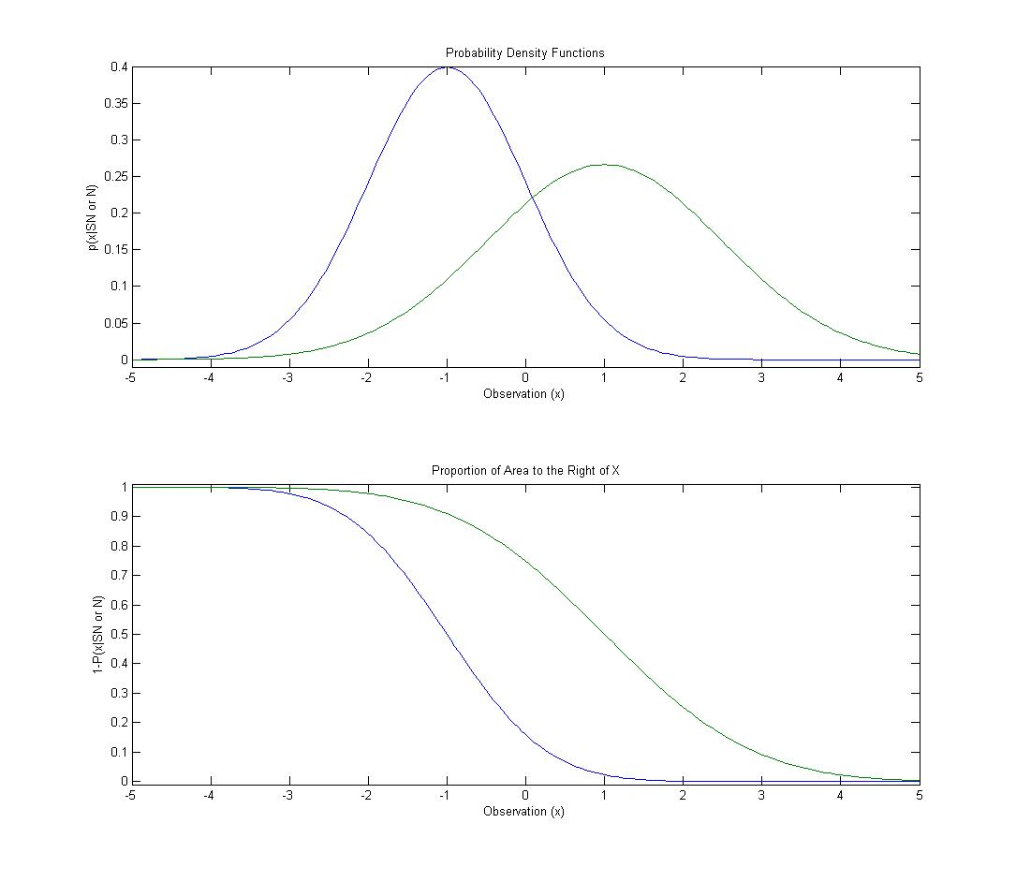

Slide 10
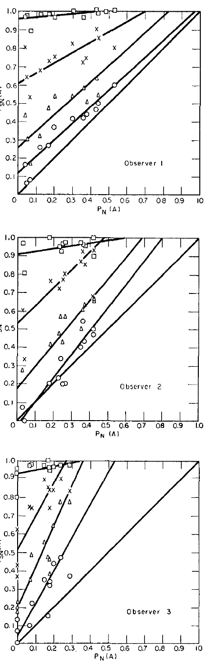
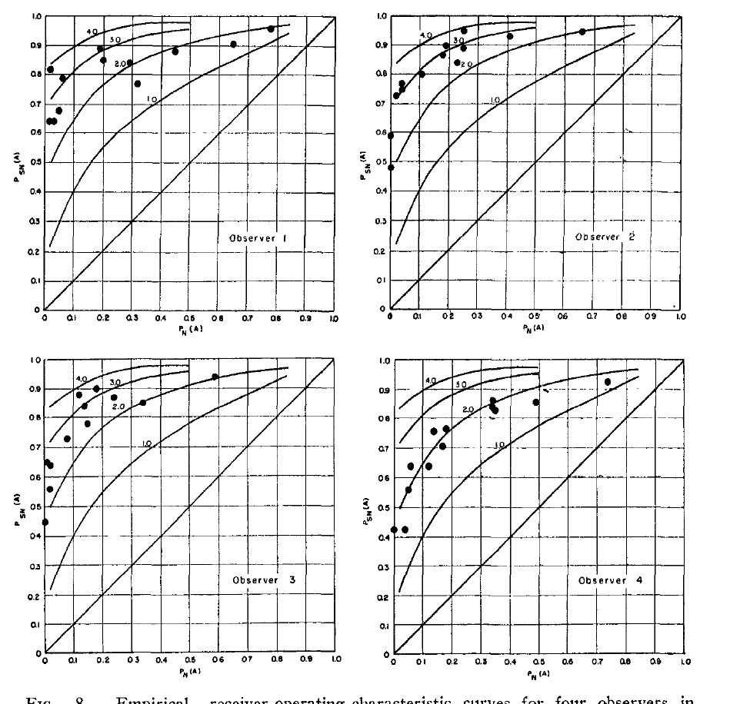

Slide 11
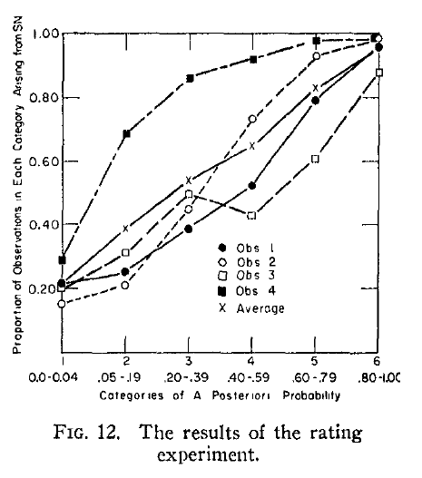

Slide 12
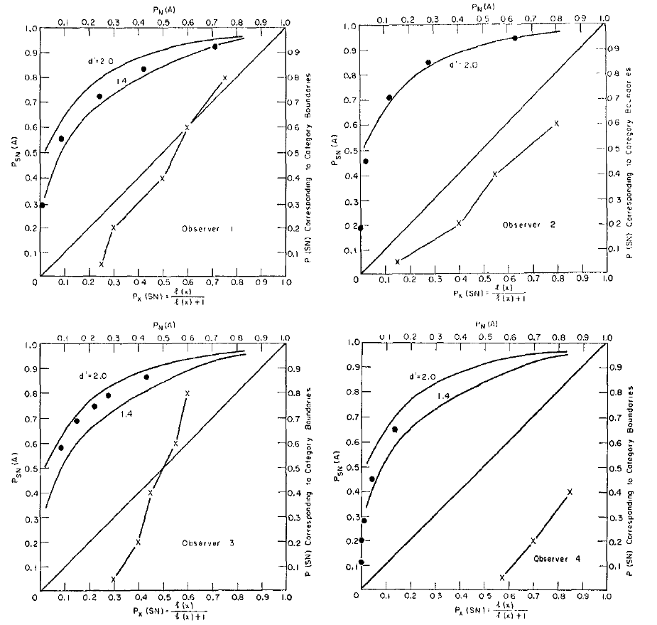

Slide 13
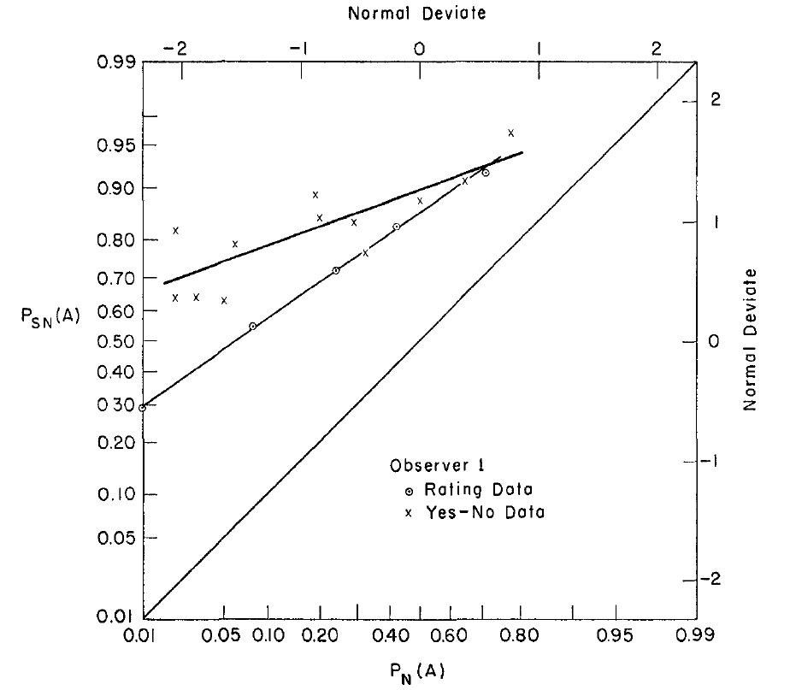

Slide 14
Subliminal Perception?
“It may be, therefore, that subliminal perception exists only when a high criterion is incorrectly identified as a limen.”

Slide 15
More questions
When do we stay with a theory even if it isn’t a perfect fit and when do we reject it and seek another theory?
How was it that the authors were able to reject the threshold theory even when their own data were and only so-so fit to their own theory?
How do we generalize given the large individual differences in studies such as these?
How do we distinguish between signals lost in noise and signals that decay before they can be reported?

