Slide 1
Similarity and Attribution
Contrasting Approaches To
Semantic Knowledge Representation and Inference
Jay McClelland
Stanford University

Slide 2
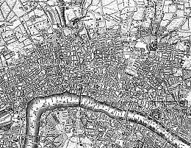

Emergent vs. Stipulated Structure
Old London
Midtown Manhattan

Slide 3
Where does structure come from?
It’s built in
It’s learned from experience
There are constraints built in that shape what’s learned

Slide 4



The Rumelhart Model
The Quillian
Model

Slide 5
DER’s Goals for the Model
Show how learning could capture the emergence of hierarchical structure
Show how the model could make inferences as in the Quillian model

Slide 6


Early
Later
Later
Still
E
x
p
e
r
i
e
n
c
e

Slide 7
Start with a neutral representation on the representation units. Use backprop to adjust the representation to minimize the error.

Slide 8
The result is a representation similar to that of the average bird…

Slide 9
Use the representation to
infer what this new thing can do.

Slide 10
Questions About the Rumelhart Model
Does the model offer any advantages over other approaches?
Can the mechanisms of learning and representation in the model tell us anything about
    Development?
    Effects of neuro-degeneration?

Slide 11





Phenomena in Development
Progressive differentiation
Overgeneralization of
  Typical properties
  Frequent names
Emergent domain-specificity of representation
Basic level advantage
Expertise and frequency effects
Conceptual reorganization

Slide 12
Neural Networks and
Probabilistic Models
The Rumelhart model is learning to match the conditional probability structure of the training data:
  P(Attribute_{i} = 1|Item_{j} & Context_{k}) for all i,j,k
The adjustments to the connection weights move them toward values than minimize a measure of the divergence between the network’s estimates of these probabilities and their values as reflected in the training data.
It does so subject to strong constraints imposed by the initial connection weights and the architecture.
  These constraints produce progressive differentiation, overgeneralization, etc.
Depending on the structure in the training data, it can behave as though it is learning something much like one of K&T’s structure types, as well as many structures that cannot be captured exactly by any of the structures in K&T’s framework.

Slide 13
The Hierarchical Naïve Bayes Classifier Model (with R. Grosse and J. Glick)
The world consists of things that belong to categories.
Each category in turn may consist of things in several sub-categories.
The features of members of each category are treated as independent
  P({f_{i}}|C_{j}) = Π_{i} p(f_{i}|C_{j})
Knowledge of the features is acquired for the most inclusive category first.
Successive layers of sub-categories emerge as evidence accumulates supporting the presence of co-occurrences violating the independence assumption.
Living Things
Animals Plants
Birds Fish
Flowers Trees
…

Slide 14
A One-Class and a Two-Class Naïve Bayes Classifier Model
Property | One-Class Model | 1st class in two-class model | 2nd class in two-class model
Can Grow | 1.0 | 1.0 | 0
Is Living | 1.0 | 1.0 | 0
Has Roots | 0.5 | 1.0 | 0
Has Leaves | 0.4375 | 0.875 | 0
Has Branches | 0.25 | 0.5 | 0
Has Bark | 0.25 | 0.5 | 0
Has Petals | 0.25 | 0.5 | 0
Has Gills | 0.25 | 0 | 0.5
Has Scales | 0.25 | 0 | 0.5
Can Swim | 0.25 | 0 | 0.5
Can Fly | 0.25 | 0 | 0.5
Has Feathers | 0.25 | 0 | 0.5
Has Legs | 0.25 | 0 | 0.5
Has Skin | 0.5 | 0 | 1.0
Can See | 0.5 | 0 | 1.0

Slide 15

Accounting for the network’s feature attributions with mixtures of classes at different levels of granularity
Regression Beta Weight
Epochs of Training
Property attribution model:
P(f_{i}|item) = α_{k}p(f_{i}|c_{k}) + (1-α_{k})[(α_{j}p(f_{i}|c_{j}) + (1-α_{j})[…])

Slide 16
Should we replace the PDP model with the Naïve Bayes Classifier?
It explains a lot of the data, and offers a succinct abstract characterization
But
  It only characterizes what’s learned when the data actually has hierarchical structure
So it may be a useful approximate characterization in some cases, but can’t really replace the real thing.

Slide 17

An exploration of these ideas in the domain of mammals
What is the best representation of domain content?
How do people make inferences about different kinds of object properties?

Slide 18
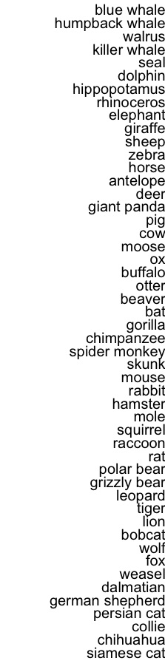
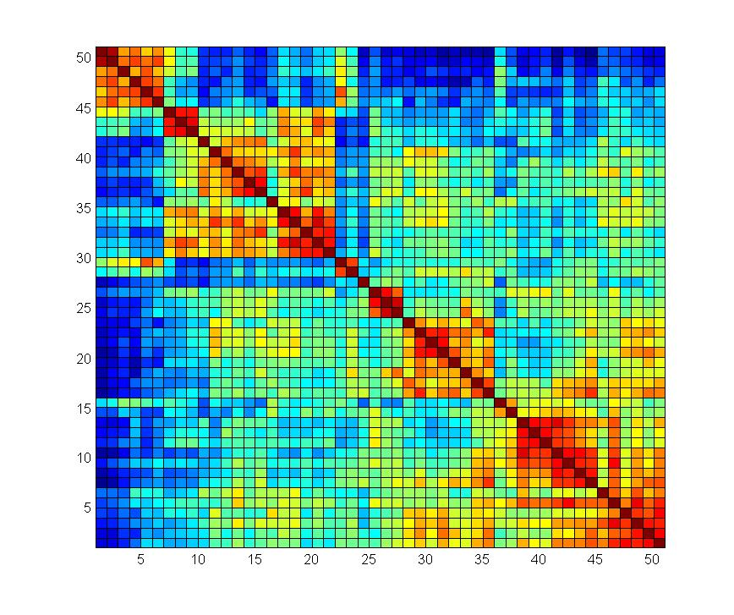

Slide 19

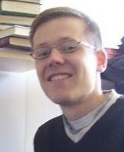
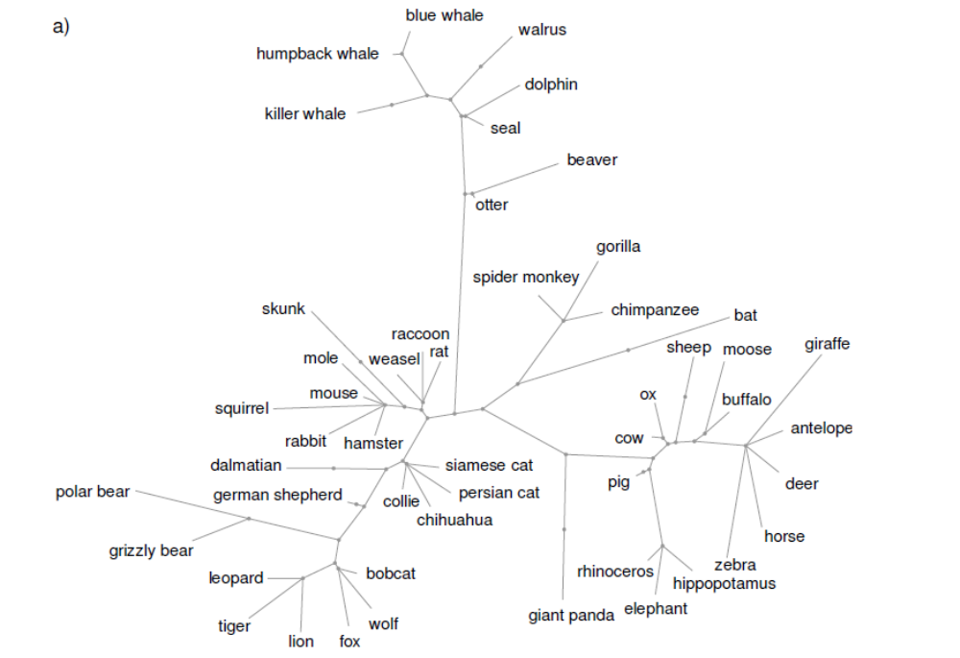
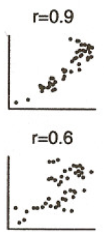
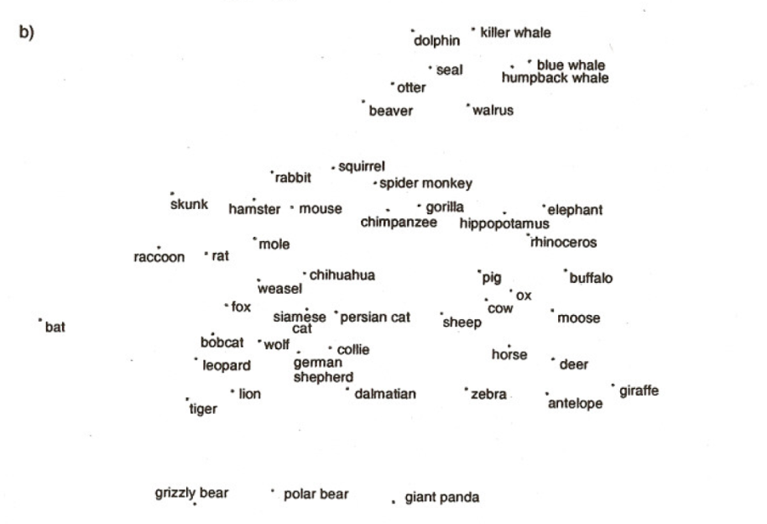
Structure Extracted by a Structured Statistical Model

Slide 22
Predictions
Similarity ratings and patterns of inference will violate the hierarchical structure
Patterns of inference will vary by context

Slide 23
Experiments
Size, predator/prey, and other properties affect similarity across birds, fish, and mammals
Property inferences show clear context specificity
Property inferences for blank biological properties violate predictions of K&T’s tree model for weasels, hippos, and other animals

Slide 26
Learning the Structure in the
Training Data
Progressive sensitization to successive principal components captures learning of the mammals dataset.
This subsumes the naïve Bayes classifier as a special case when there is no real cross-domain structure (as in the Quillian training corpus).
So are PDP networks – and our brain’s neural networks – simply performing familiar statistical analyses?
  No!

Slide 27
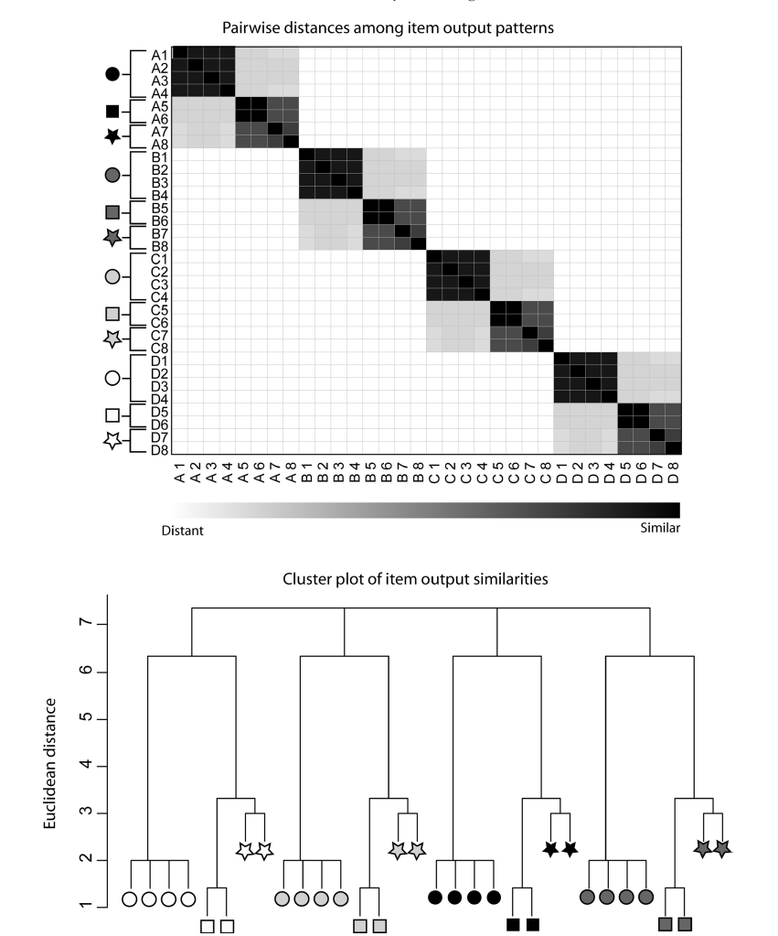
Extracting Cross-Domain Structure

Slide 28
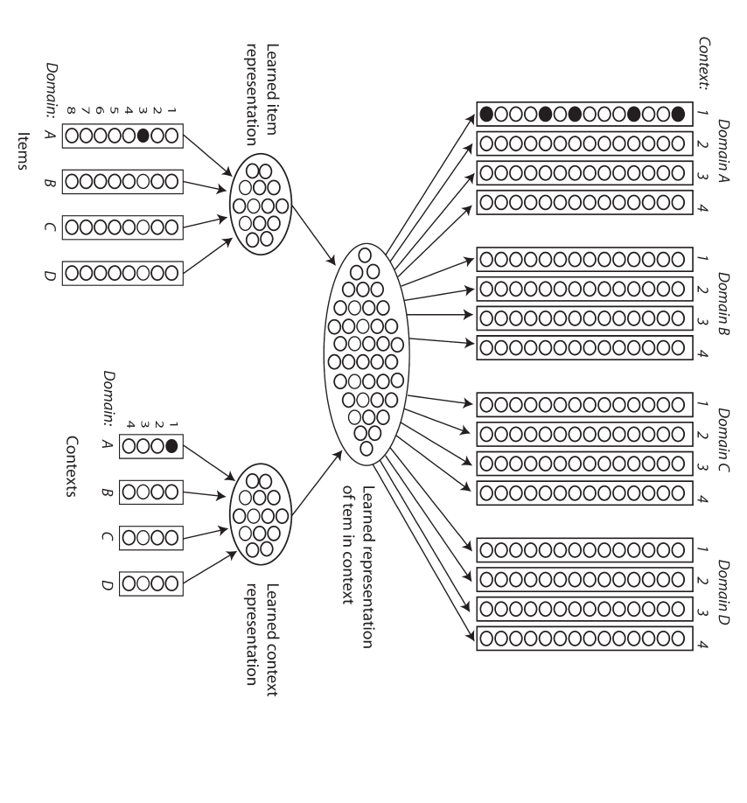
v

Slide 29
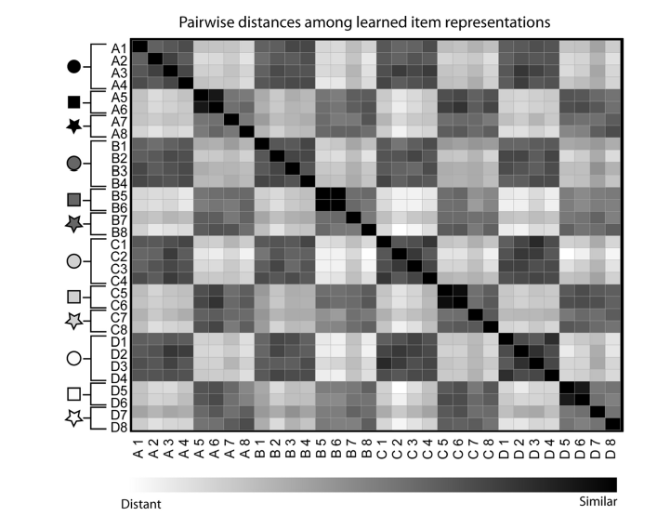
Input Similarity
Learned Similarity

Slide 30

A Newer Direction
Exploiting knowledge sharing across domains
  Lakoff:
    Abstract cognition is grounded in concrete reality
  Boroditsky:
    Cognition about time is grounded in our conceptions of space
Can we capture these kinds of influences through knowledge sharing across contexts?
    Work by Thibodeau, Glick, Sternberg & Flusberg shows that the answer is yes

Slide 31
Summary
Distributed representations provide the substrate for learned semantic representations in the brain that develop gradually with experience and degrade gracefully with damage
Succinctly stated probabilistic models can sometimes nicely approximate the structure learned, if the training data is consistent with them, but what is really learned is not likely to exactly match any such structure.
The structure should be seen as a useful approximation rather than a procrustean bed into which actual knowledge must be thought of as conforming.

