Slide 1
Human Cognition: Is it more like a computer or a neural net?
Jay McClelland
Stanford University
November 14, 2017

Slide 2
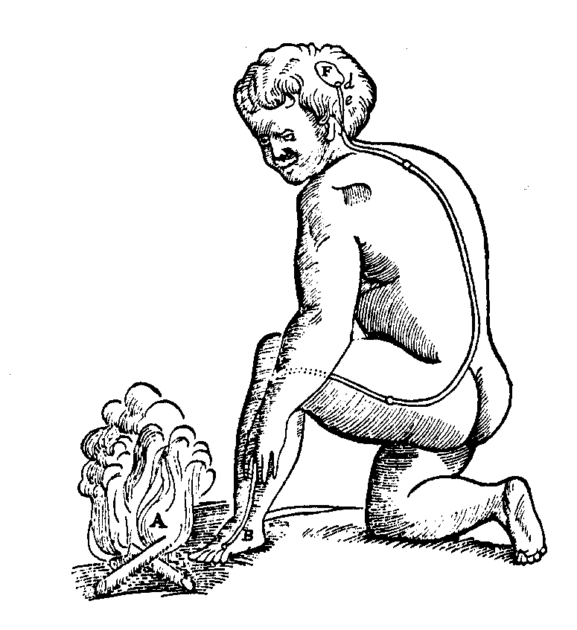
Decartes’ Legacy
Mechanistic approach to sensation and action
Divine inspiration creates mind
This leads to four dissociations:
  Mind / Brain
  Higher Cognitive Functions / Sensory-motor systems
  Human / Animal
  Descriptive / Mechanistic

Slide 3
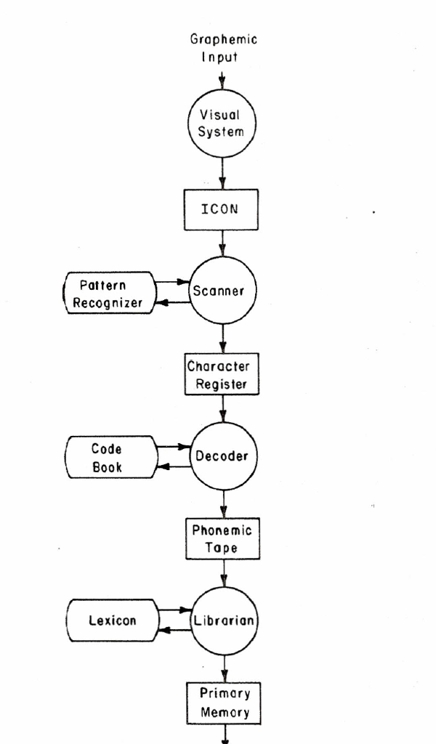
Early Computational Models of Human Cognition (1950-1980)
The computer contributes to the overthrow of behaviorism.
Computer simulation models emphasize strictly sequential operations, using flow charts.
Simon announces that computers can ‘think’.
Symbol processing languages are introduced allowing some success at theorem proving, problem solving, etc.
Minsky and Pappert kill off Perceptrons.
Cognitive psychologists and AI researchers distinguish between algorithm and hardware.
Neisser deems physiology to be only of ‘peripheral interest’
Psychologists investigate mental processes as sequences of discrete operations
Comprehension
system
Gough’s (1972) model of
reading.

Slide 4
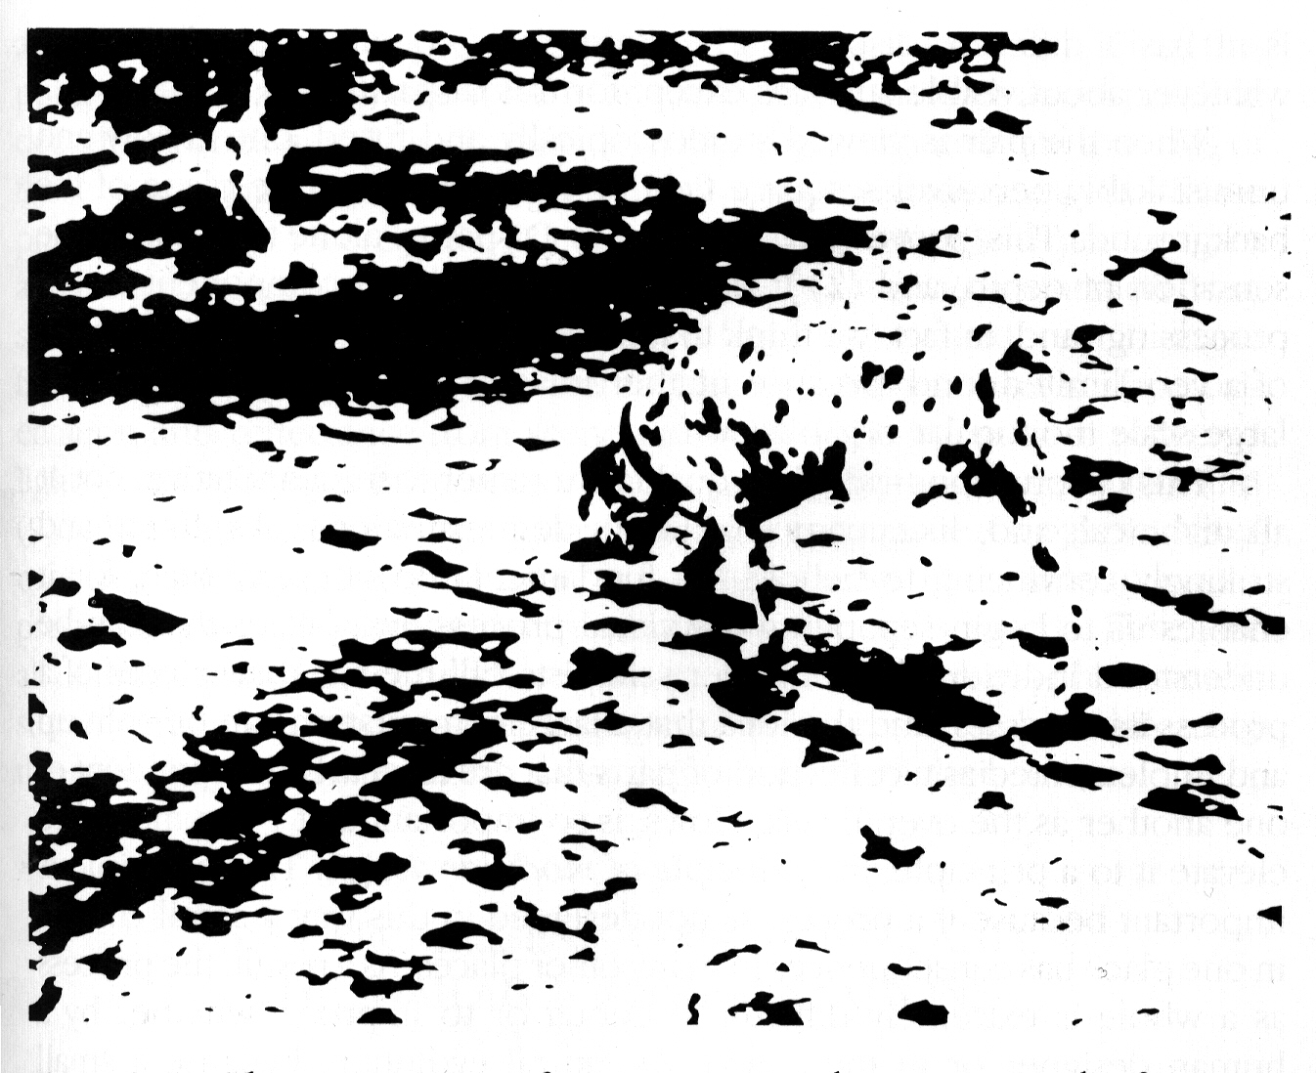

Slide 5
Ubiquity of the Constraint Satisfaction
Problem
In sentence processing
  I saw the grand canyon flying to New York
  I saw the sheep grazing in the field
In comprehension
  Margie was sitting on the front steps when she heard the familiar jingle of the “Good Humor” truck. She remembered her birthday money and ran into the house.
In reaching, grasping, typing…

Slide 6
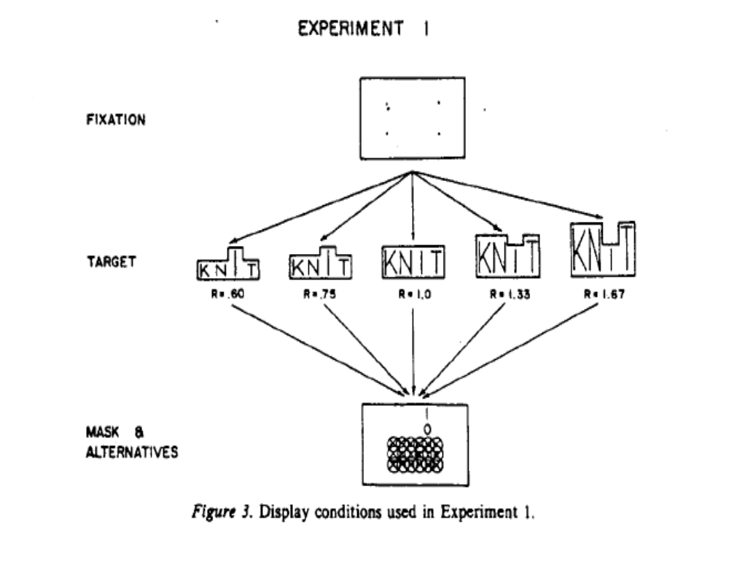
The Word Superiority Effect
_E__
O
READ
READ

Slide 7
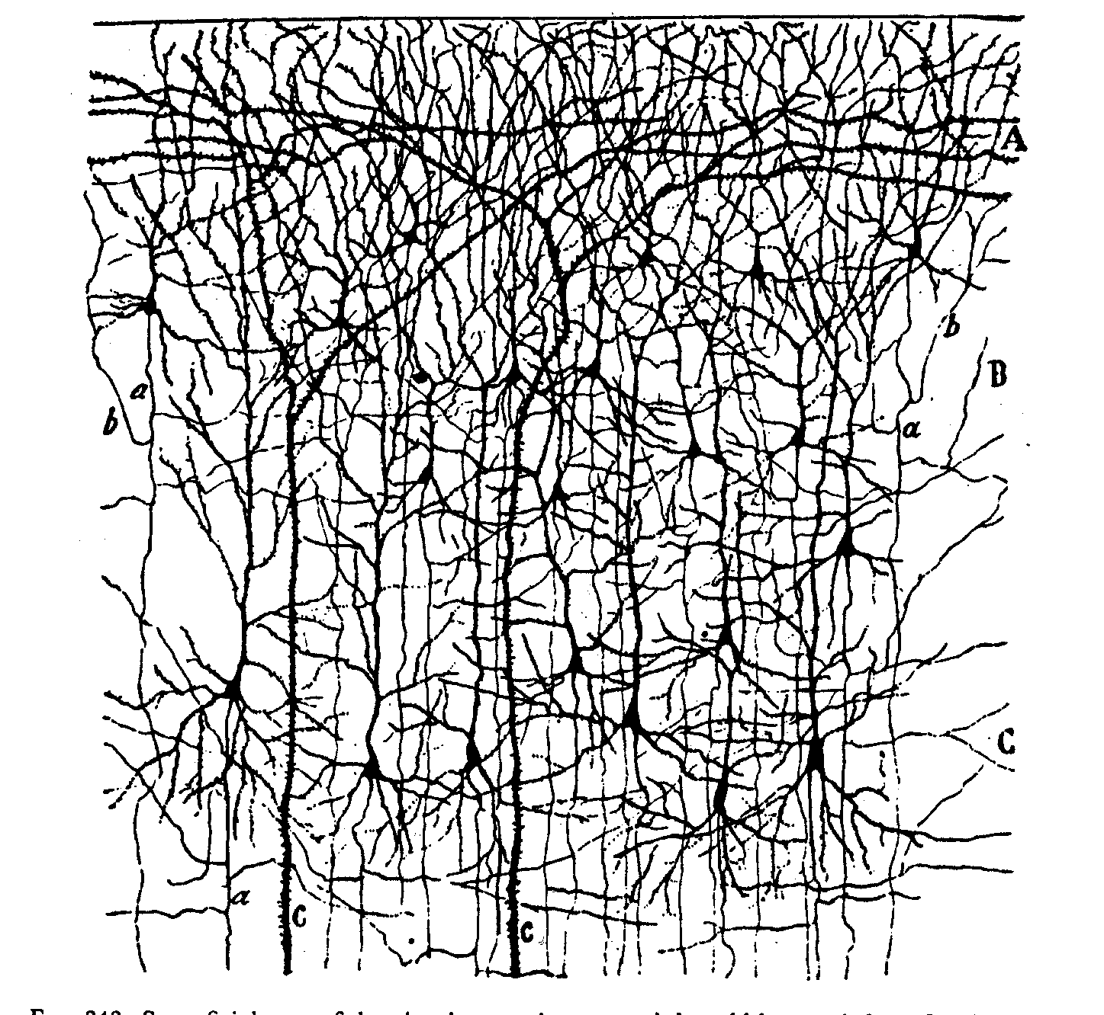

Slide 8
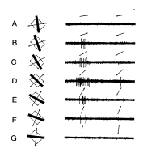
Graded and variable nature of neuronal responses

Slide 9
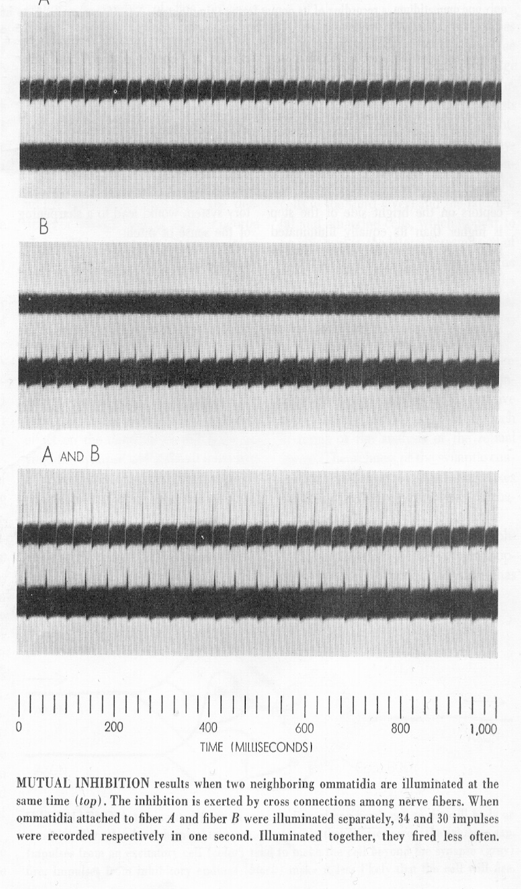

Lateral Inhibition in Eye of Limulus
(Horseshoe Crab)

Slide 10
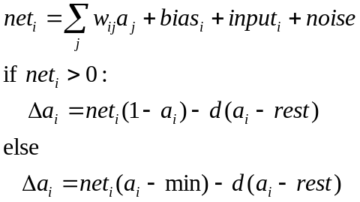
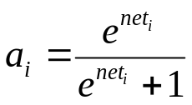
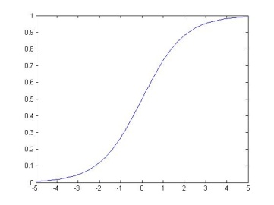
Input and activation of units in PDP models
Biologically inspired form of unit update:
An activation function that
links PDP models to Bayesian
ideas:
ReLU units are simple and far more useful that we once expected!
max=1
Input from
unit j
a
w_{ij}
0
rest
min=-.2
unit i
a_{i} or p_{i}
net_{i}

Slide 11

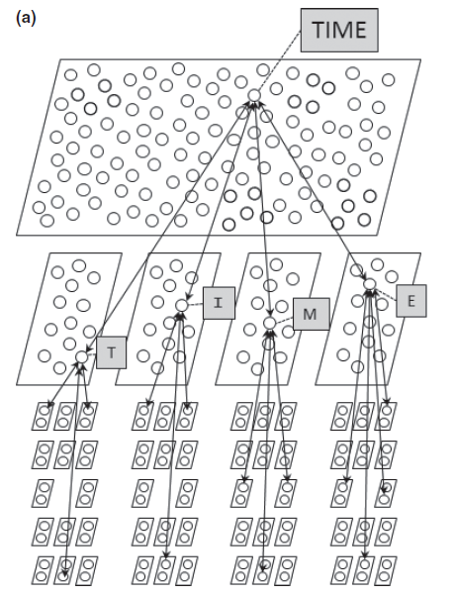
The Interactive Activation Model

Slide 12
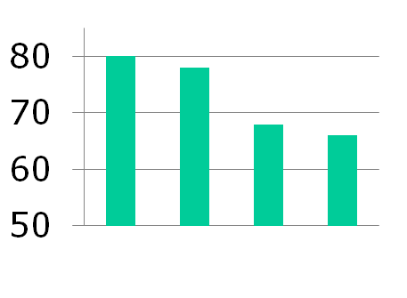
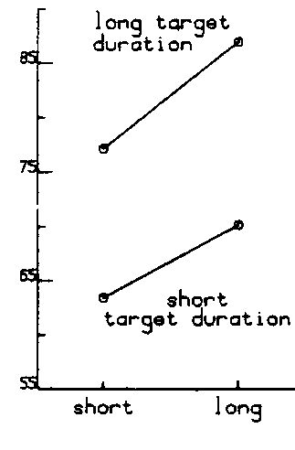
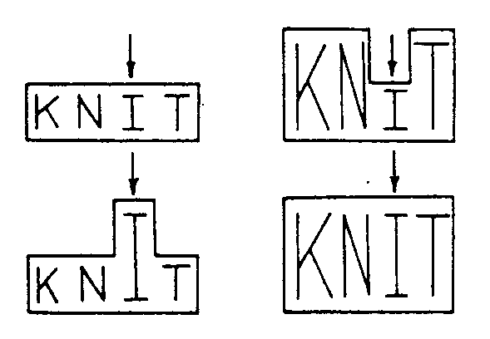

Findings Addressed by the Model
The word superiority effect (Reicher, 1969)
  Subjects identify letters in words better than single letters or letters in scrambled strings.
The pseudoword advantage
  The advantage over single letters and scrambled strings extends to pronounceable non-words (e.g. LEAT LOAT…)
The contextual enhancement effect
  Increasing the duration of the presentation of context letters increases accuracy of target identification.
Percent Correct
W PW Scr L

Slide 13
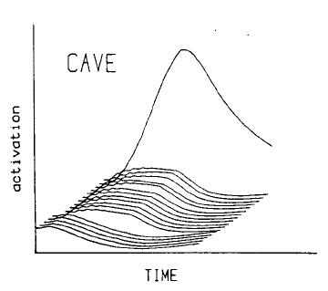
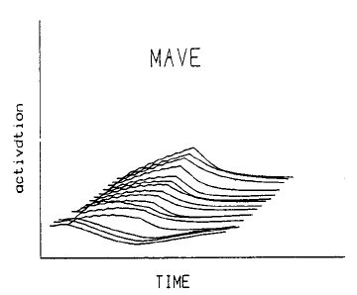
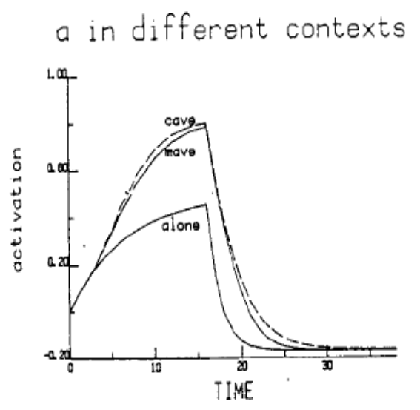
Word and Letter Level Activations for Words and Pseudowords
The idea of a ‘conspiracy effect’ rather than rule-based processing
leads to a new question:
Are rules necessary to account for the processing
of novel forms?

Slide 14
Take-Away Messages From The Interactive Activation Model
A neural network can approximate real-time Bayesian computations because the knowledge is wired into the architecture
Putting knowledge in connections allows it to become automatic and reflexive, extending the power of the nervous system into knowledge-rich domains
This is a very different form of knowledge than knowledge in a lookup table or a book

Slide 15
OK so perception might involve a neural network, but what about language?

Slide 16
Regularization Errors: Do they signify knowledge of a rule?
Chomsky’s central claim:
  We process items we’ve never seen before
  To do so, he claimed, we need rules, not ‘associations’
Psychological evidence for rules:
  Children sometimes say ‘goed’ or ‘taked’ instead of ‘went’ or ‘took’
  They also produce regular past tenses for non-words
    ‘This man is vacking. Yesterday he ___’
  Does that mean they have discovered the past tense rule?
    To make the past tense of a word, add ‘-ed’
  Or could such a behavior occur in a neural network?

Slide 17
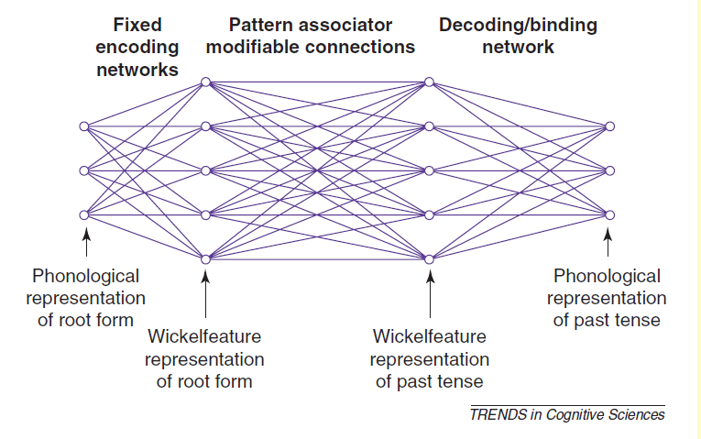
Past Tense Network
Trained with ~500 word vocabulary, mostly regular words
Tends to regularize exceptions early in training (like children do) then gradually overcomes this tendency, and processed many untrained items correctly
Function approximation may be the response to Chomsky’s essential claim: A neural network learns to approximate a function from examples, and still works with other examples it has never seen
So is language based on rules or connections?

Slide 18
Both Sides of Debate
Pro:
  Model dealt with quasi-regular patterns as well as regular
    zeep -> zept
    gling -> glang
  Related models addressed findings in many other domains
    Spelling -> sound
    …
Conta:
  Model’s training experience was not human-like in some ways
  Model produced some forms humans don’t produce
    mail -> membled

Slide 19
What kinds of constraints are required to support learning?
Innate domain knowledge:
  Chomsky’s ‘Universal Grammar’
  Spelke’s ‘Core Knowledge systems’
  Lake et al’s ‘Startup Software’
  Essential programming constructs such as a ‘recursion operator’ in the probabilistic language of thought
Connectionists ask: must we really assume such things are built in?

Slide 20
Google Translate – A connectionist model of language understanding
The hen was too slow.
The fox that chased the hen was too slow.
La gallina era demasiado lenta.
El zorro que persiguido a la gallina era demasiado lento.
There are still sentences Google Translate does not get right,
so the debate continues…

Slide 21
Is there anything left for a
Symbolic Approach to Cognition?
Perception, language, and even aspects of semantic cognition might be thought of as ‘natural’ cognitive abilities – the kind of knowledge we have without having to go to school.
Are there domains where this approach might not be applicable?
  What about number, mathematics, and scientific reasoning abilities?

Slide 22
Math As Symbol Processing?
Computers are great at math in some ways – they can easily be used to describe and apply any explicit mathematical procedure
But, when programmed by humans, they can’t really be said to be doing creative mathematical thinking
Many mathematicians have argued, in fact, that the real insights in mathematics come from intuition
Might the insight or intuition be something that comes from constraint satisfaction within an interactive neural net?
The insights, though, must build on experience, which may be acquired gradually like many other cognitive skills. We learn how to see that a mathematical idea must be true – and then mistake our acquired intuition for innate knowledge

Slide 23
A perspective on formal cognitive abilities
Exact number, logic, mathematics and science are the products of cultural advancements that gradually resulted in the emergence of formal systems of thought and education that extend human reasoning abilities.
  Contra Plato and more recent nativists, the ability to reason about abstract mathematical concepts is not innate.
  Instead it is the product of acquiring culturally constructed skills that only developed within the last 5 thousand years.
  This emphasis on the role of education and social context in shaping the way we think has been advocated by others (Scribner & Cole, 1973).
Advanced forms of intelligence are more the product of context and experience than of the innate features of the human mind.

