Slide 1
The PDP Approach to Understanding the Mind and Brain
Jay McClelland
Stanford University
January 21, 2014

Slide 2
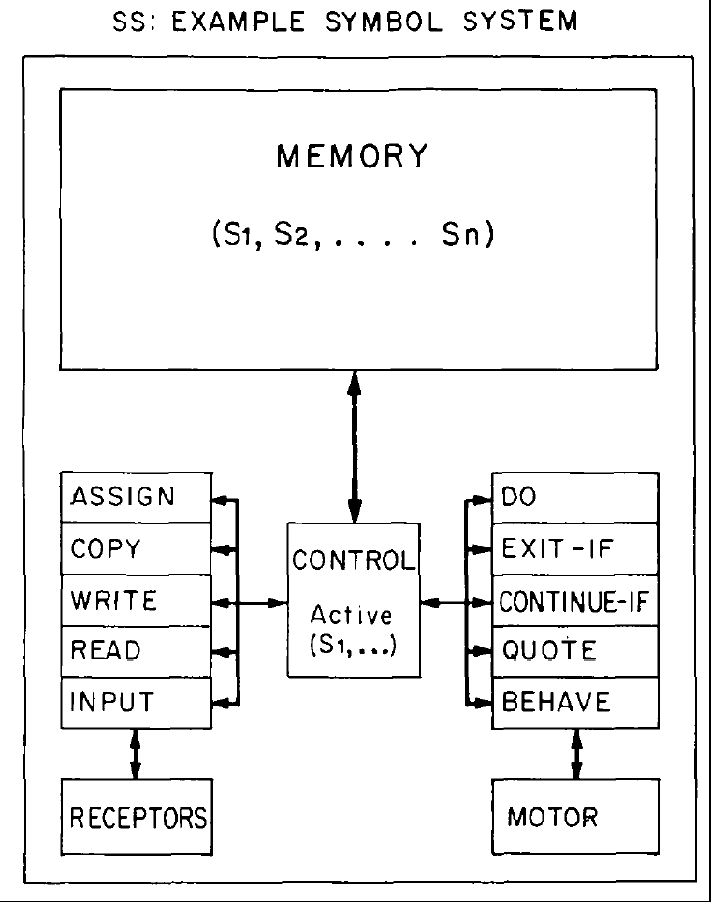
Early Computational Models of Human Cognition (1950-1980)
The digital computer instantiates a ‘physical symbol system’
Simon announces that he and Allan Newell have programmed a computer to ‘think’.
Symbol processing languages are introduced allowing success at theorem proving, problem solving, etc.
Human subjects asked to give verbal reports while problem solving follow paths similar to those followed by N&S’s programs.
Psychologists investigate mental processes as sequences of discrete stages.
Early neural network models fail to live up to expectations; Minsky and Pappert kill them off.
Cognitive psychologists distinguish between algorithm and hardware; Neisser deems physiology to be only of ‘peripheral interest’.

Slide 3
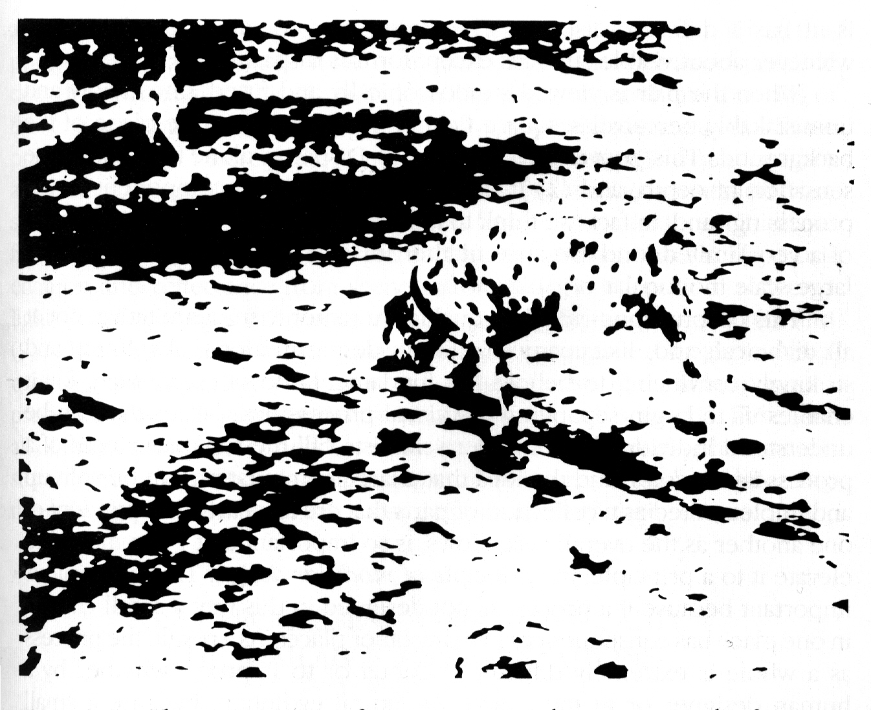

Slide 4
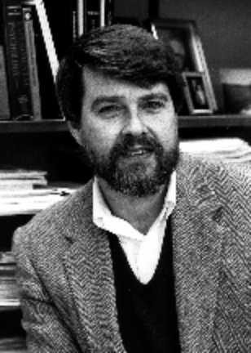
Ubiquity of the Constraint
Satisfaction Problem
In sentence processing
  I saw the grand canyon flying to New York
  I saw the sheep grazing in the field
In comprehension
  Margie was sitting on the front steps when she heard the familiar jingle of the “Good Humor” truck. She remembered her birthday money and ran into the house.
In reaching, grasping, typing…
David E.
Rumelhart

Slide 5
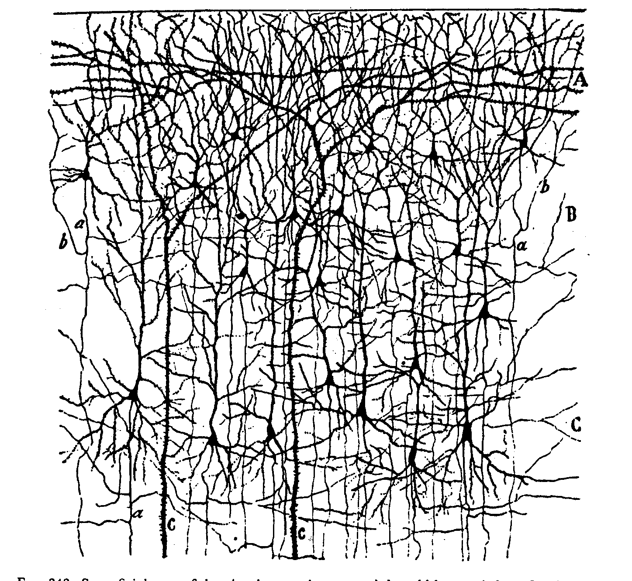

Slide 6
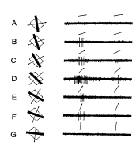
Graded and variable nature of neuronal responses

Slide 7
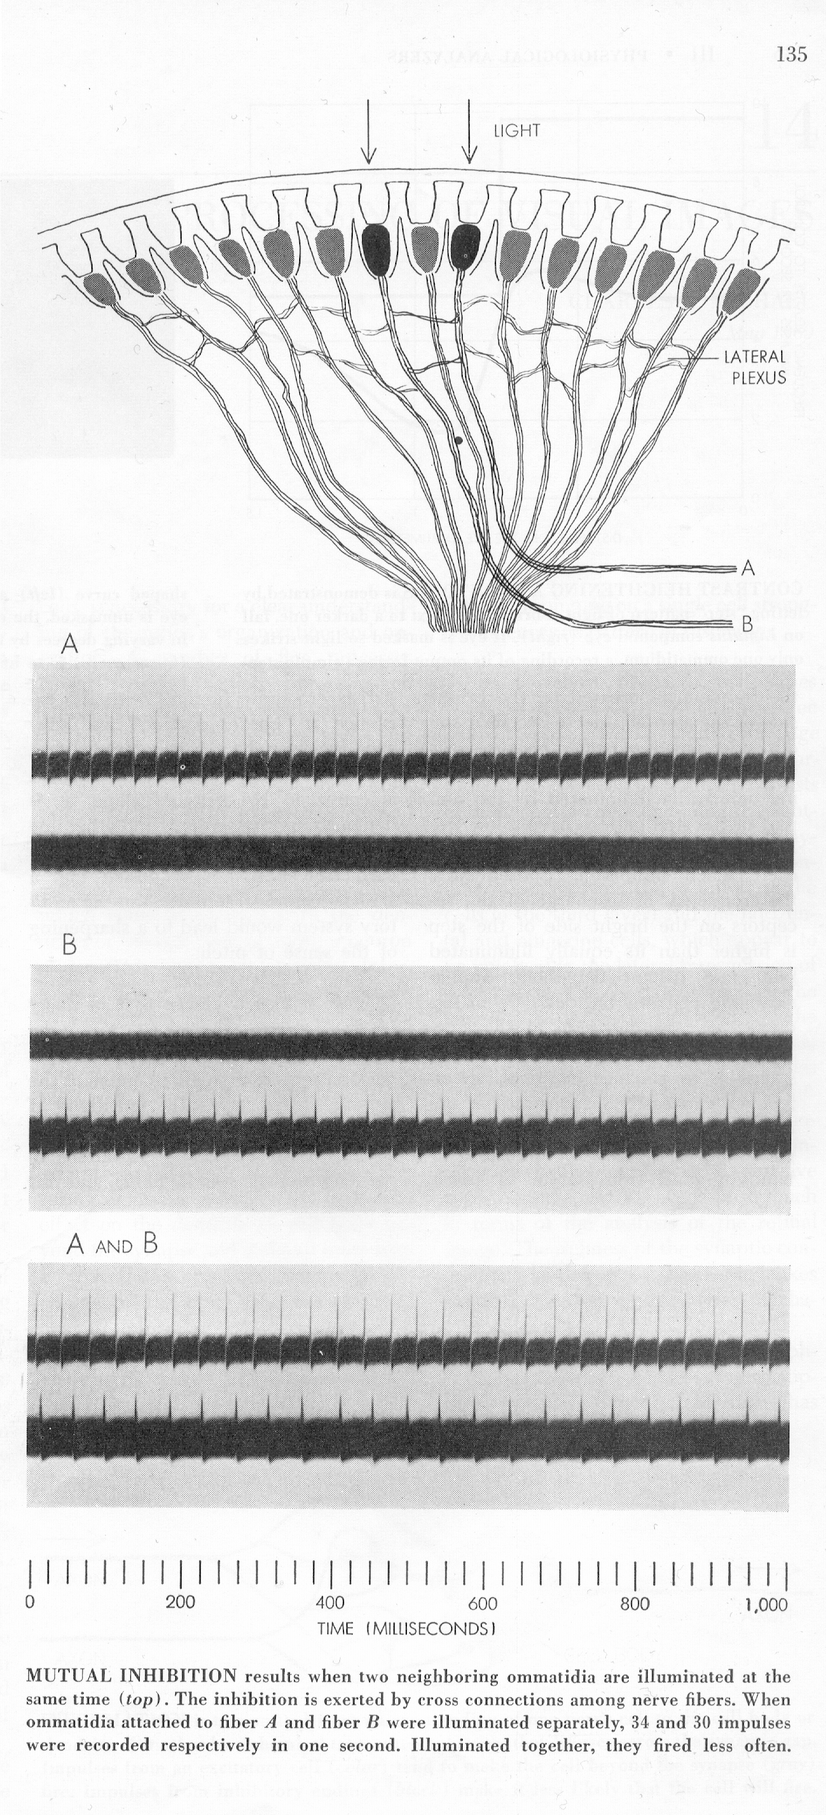
Lateral Inhibition in Eye of Limulus
(Horseshoe Crab)

Slide 8

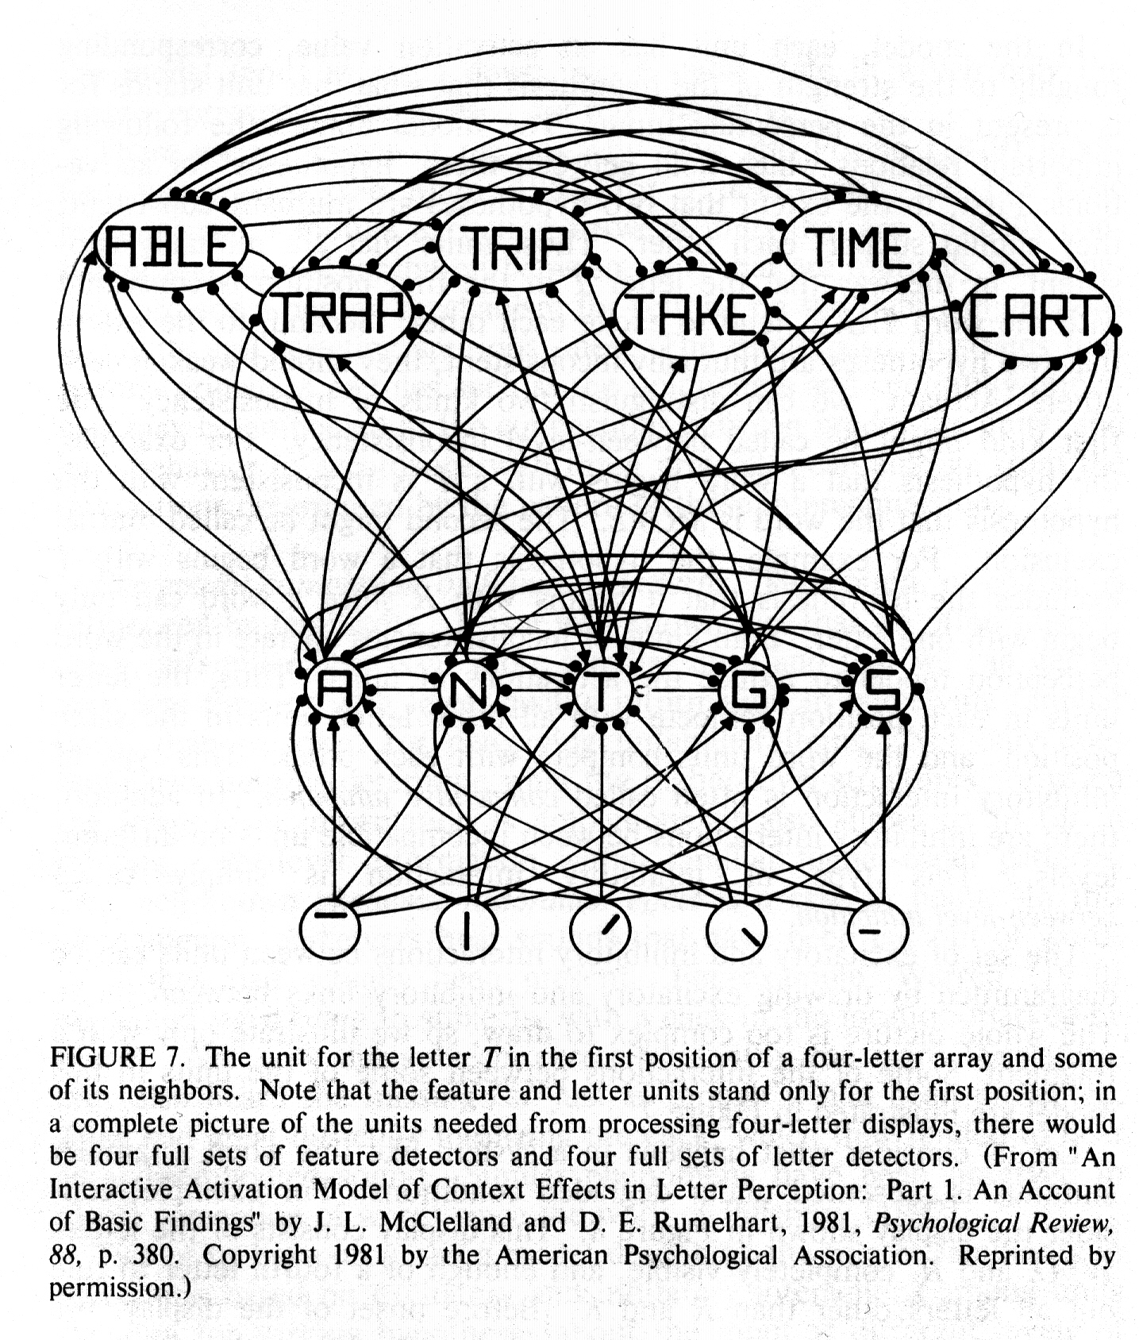
The Interactive Activation Model

Slide 9
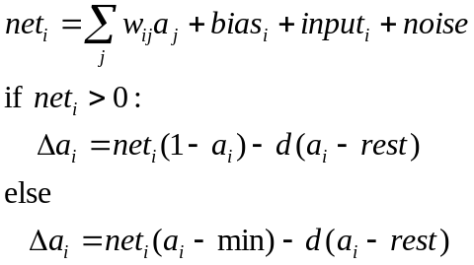

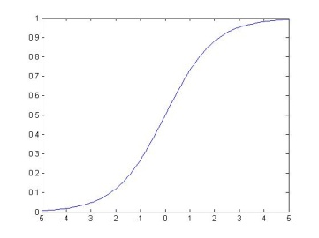

Input and activation of units in PDP models
General form of unit update:
An activation function that
links PDP models to Bayesian computation:
Or set activation to 1 probabilistically:
max=1
Input from
unit j
a
w_{ij}
0
rest
min=-.2
unit i
a_{i} or p_{i}
net_{i}

Slide 10
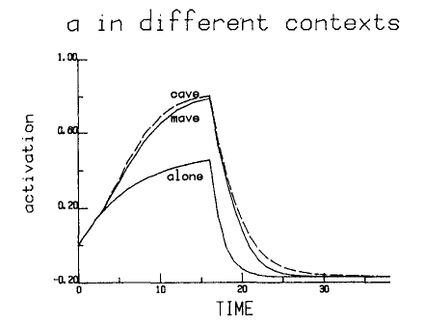
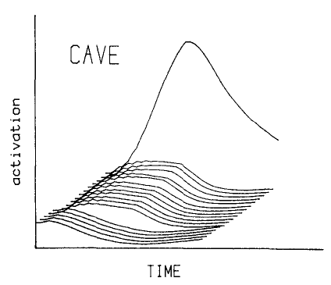
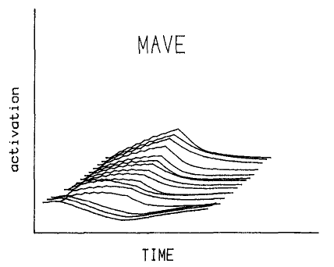
Rules or Connections?
The IA model only knows rules, but human perceivers show perceptual facilitation when they perceive letters in non-words as well.
Does our perceptual system follow rules based on a ‘grammar’ or legal forms?
Syl -> {Ons} + Body
Body -> Vwl + {Coda}
The IA model simulates perceptual facilitation in pseudowords as well as words
The knowledge is in the connections

Slide 11
IA Model as a Bridge to a new Framework
It is different from the PSS framework in that:
  Knowledge is in the connections, hence
  Directly wired into the processing machinery rather than stored as such
  Patterns are not retrieved by constructed
  Intrinsically inaccessible to inspection
But it is similar in that:
  Programmed by its designer
  Embodies designer’s choices about how to represent knowledge
  Units correspond directly to cognitive entities

Slide 12
Distributed Connectionist Models
What if we could learn from experience, without making prior commitments to the way cognitive entities are represented
  Do there have to be units corresponding to such entities in our minds?
  Do we need separate subsystems for items that follow the rules and items that do not?
Two prominent application areas:
  Past tense inflection
    Pay – paid, lay – laid, tay – taid;
    See-saw, Say – said, Have – had…
  Spelling to sound
    HINT, MINT, PINT

Slide 13
Core Principles of Parallel Distributed Processing Models using Learned Distributed Representations
/h/ /i/ /n/ /t/
Processing occurs via interactions among neuron-like processing units via weighted connections.
A representation is a pattern of activation.
The knowledge is in the connections.
Learning occurs through gradual connection adjustment, driven by experience.
Learning affects both representation and processing.
H I N T

Slide 14

Learning in a Feedforward PDP Network
Propagate activation ‘forward’ producing a_{r} for all units using the logistic activation function.
Calculate error at the output layer:
δ_{r} = f’(t_{r} – a_{r})
Propagate error backward to calculate error information at the ‘hidden’ layer:
δ_{s} = f’(Σ_{r}w_{rs} δ_{r})
Change weights:
Δw_{rs}=δ_{r}a_{s}
/h/ /i/ /n/ /t/
H I N T

Slide 15
Characteristics of Past Tense and Spelling-sound models
They use a single system of connections to correctly capture performance with regular, exceptional, and novel items
  MINT, PINT, VINT
  LIKE, TAKE, FIKE
Tend to over-regularize exceptions early in learning as if they have ‘discovered’ a rule.
The knowledge in the connections that informs processing of regular items also informs processing of the regular aspects of exceptions
  Quasi-regularity: The tendency for exceptions to exhibit characteristics of fully regular items
    PINT, YACHT – said, thought
Exhibit graded sensitivity to frequency and regularity and a frequency by regularity interaction.

Slide 16
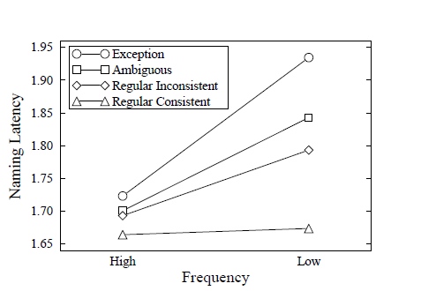
Frequency by Regularity Interaction
PINT
TREAD
MINT
LAKE

Slide 17
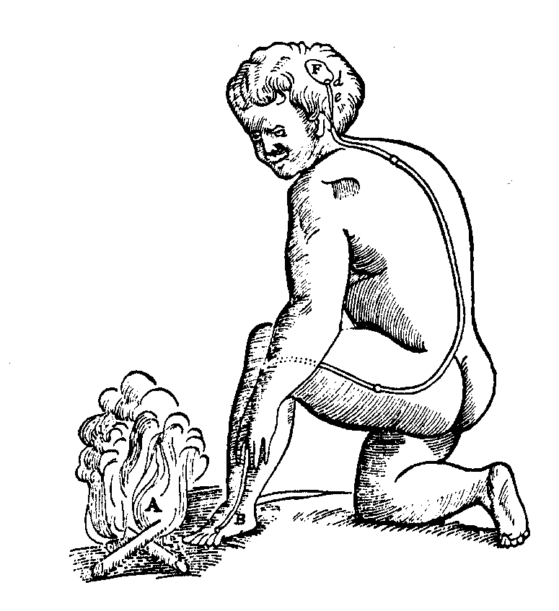
Decartes’ Legacy
Descartes’ idea that the ‘mind’ and higher cognition is distinct from the physiological mechanisms of sensation and action persists to a degree to this day.
Everyone accepts that neural networks underlie sensory and motor processes but are they really relevant to understanding thought?
Recent and future work with neural networks addressing semantic and mathematical cognition addresses this question.

