Slide 1
The PDP Approach to Understanding the Mind and Brain
Jay McClelland
Stanford University
January 21, 2014

Slide 2
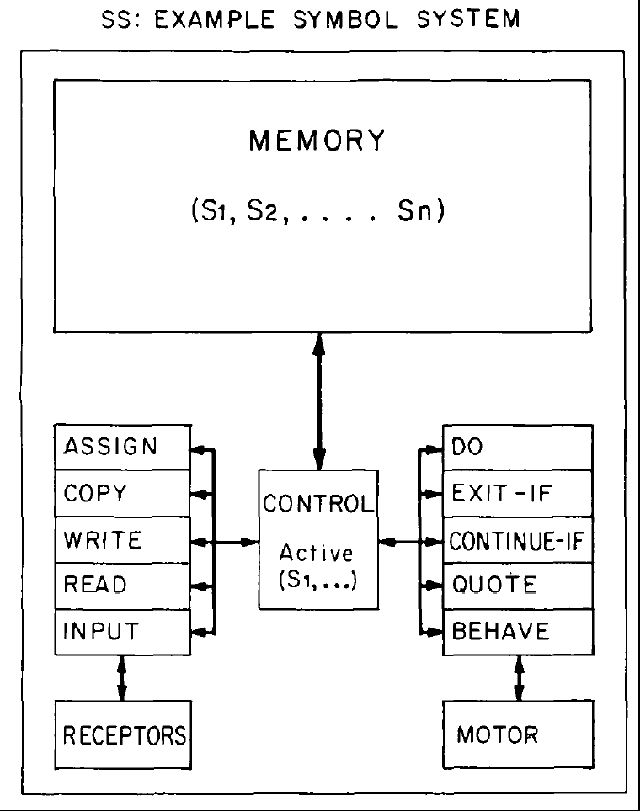
Early Computational Models of Human Cognition (1950-1980)
The digital computer instantiates a ‘physical symbol system’
Simon announces that he and Allan Newell have programmed a computer to ‘think’.
Symbol processing languages are introduced allowing success at theorem proving, problem solving, etc.
Human subjects asked to give verbal reports while problem solving follow paths similar to those followed by N&S’s programs.
Psychologists investigate mental processes as sequences of discrete stages.
Early neural network models fail to live up to expectations; Minsky and Pappert kill them off.
Cognitive psychologists distinguish between algorithm and hardware; Neisser deems physiology to be only of ‘peripheral interest’.

Slide 3
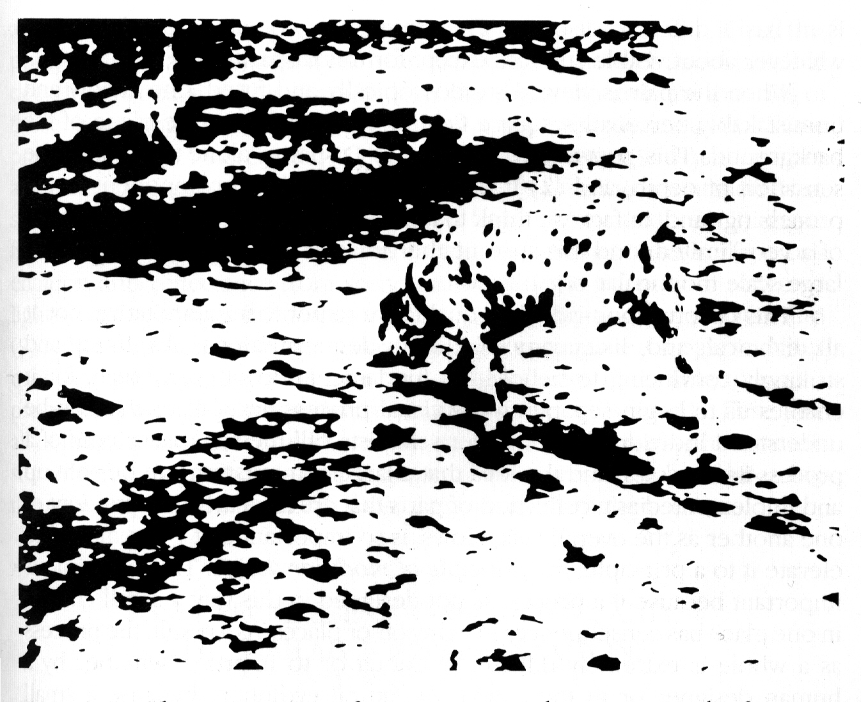

Slide 4
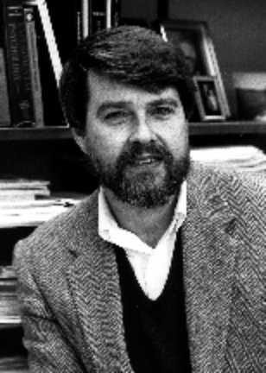
Ubiquity of the Constraint
Satisfaction Problem
In sentence processing
  I saw the grand canyon flying to New York
  I saw the sheep grazing in the field
In comprehension
  Margie was sitting on the front steps when she heard the familiar jingle of the “Good Humor” truck. She remembered her birthday money and ran into the house.
In reaching, grasping, typing…
David E.
Rumelhart

Slide 5
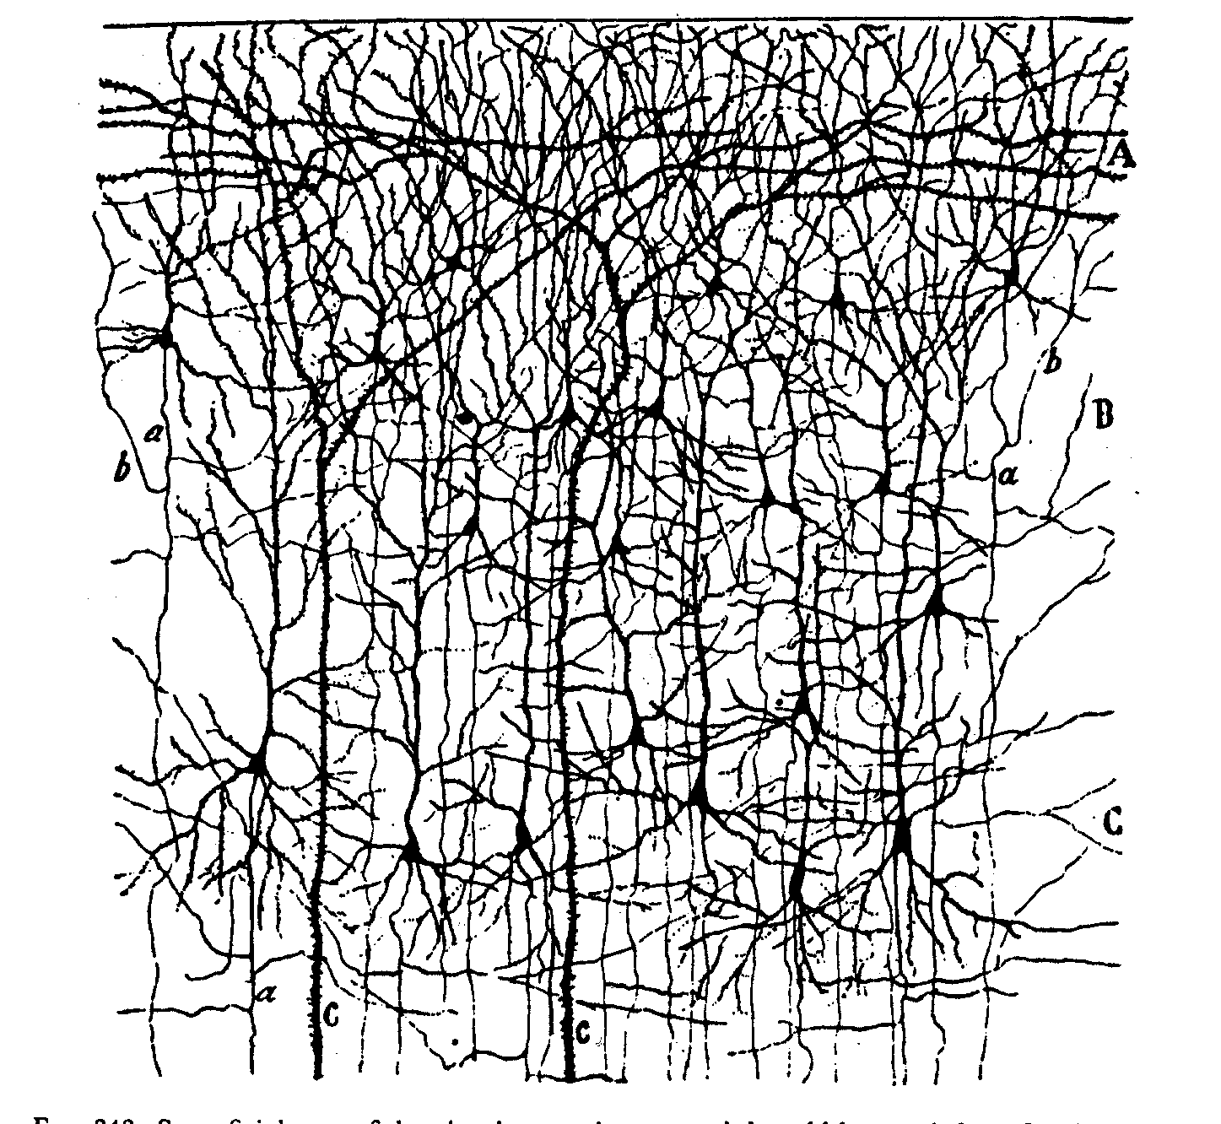

Slide 6
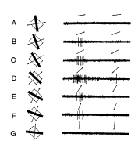
Graded and variable nature of neuronal responses

Slide 7
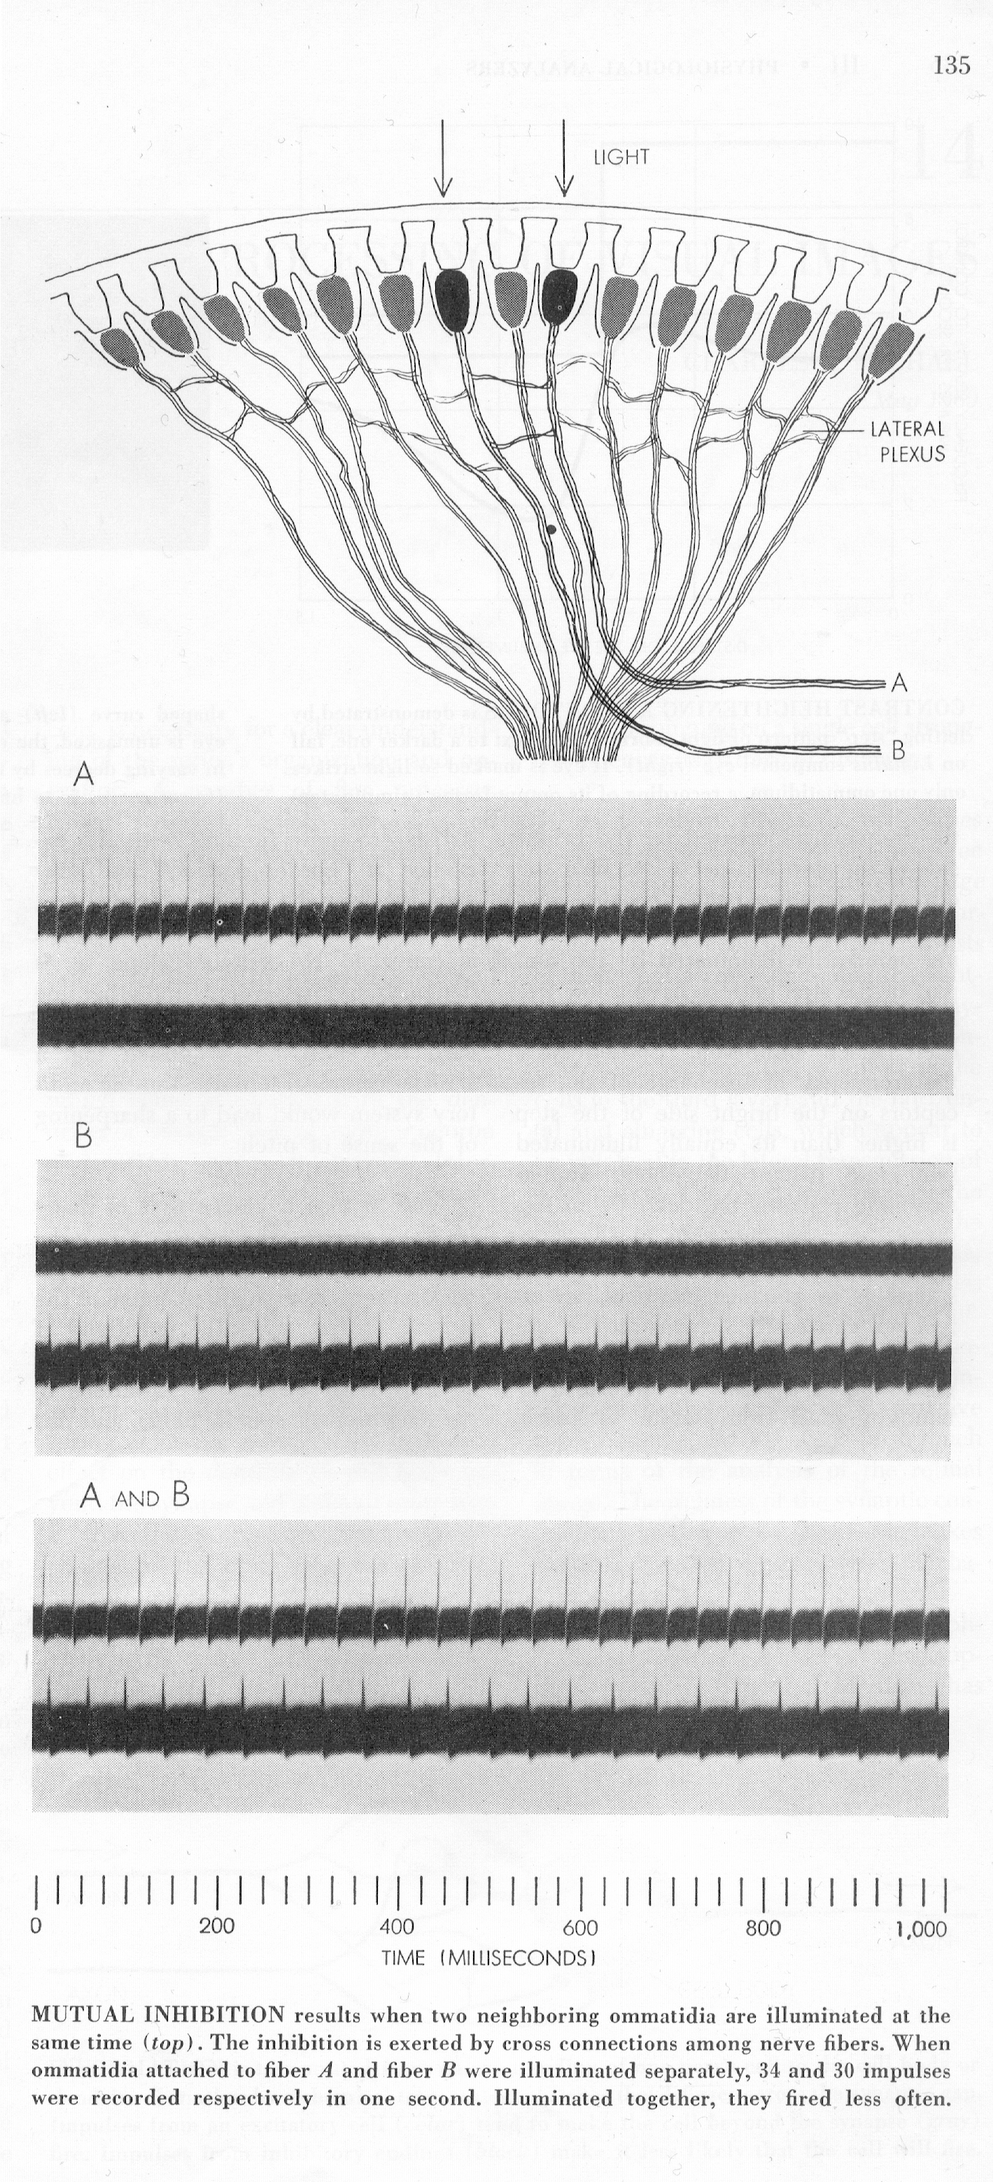
Lateral Inhibition in Eye of Limulus
(Horseshoe Crab)

Slide 8

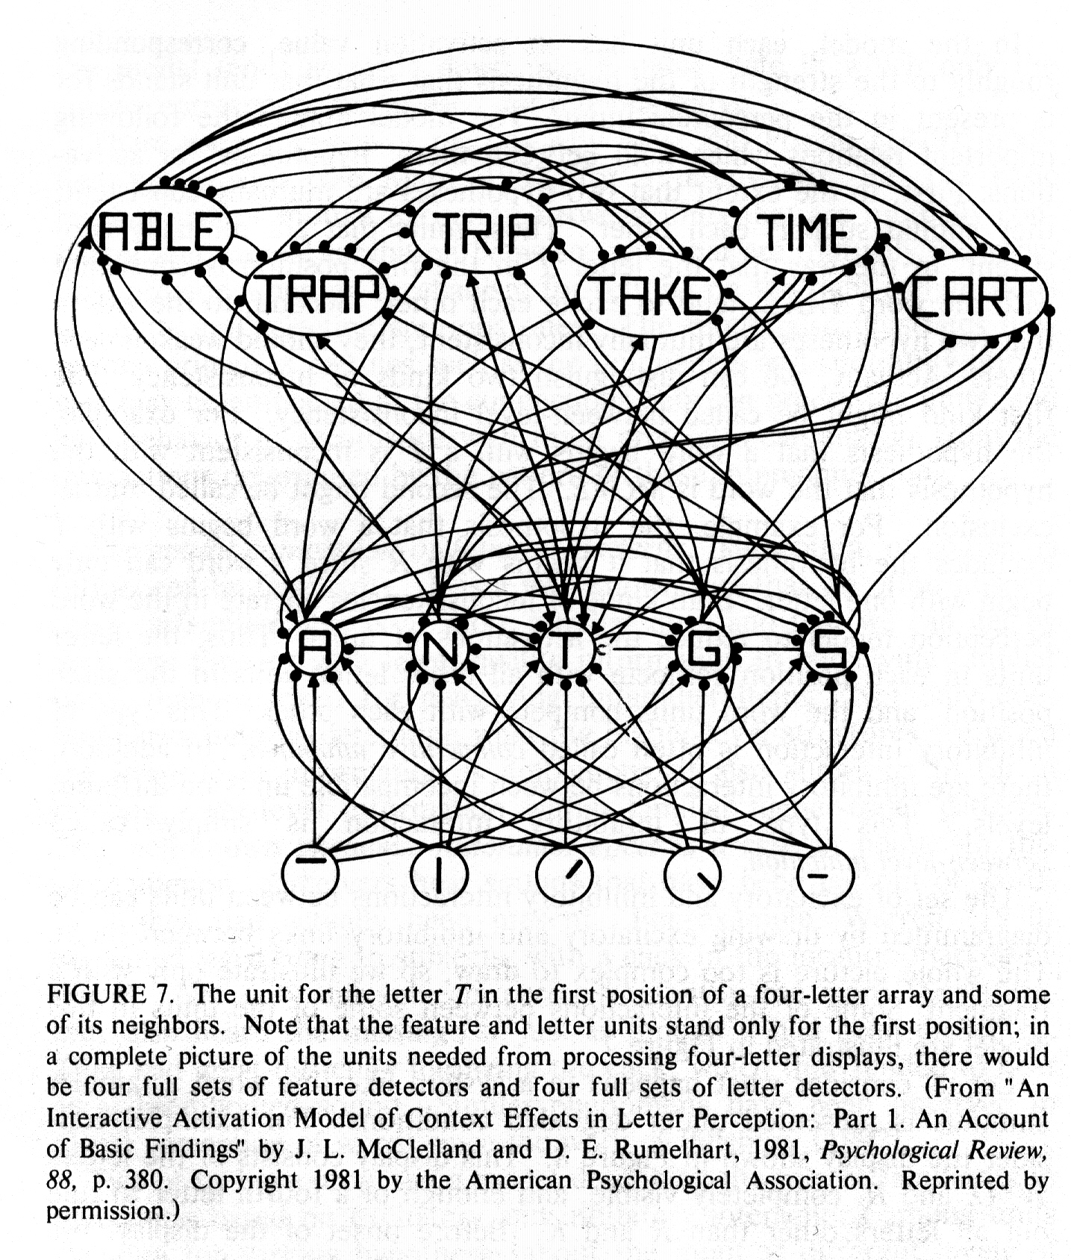
The Interactive Activation Model

Slide 9
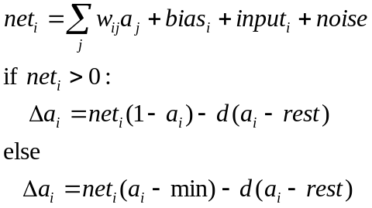

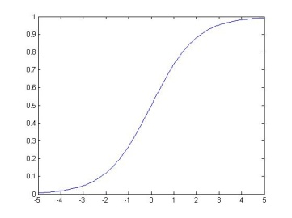

Input and activation of units in PDP models
General form of unit update:
An activation function that
links PDP models to Bayesian computation:
Or set activation to 1 probabilistically:
max=1
Input from
unit j
a
w_{ij}
0
rest
min=-.2
unit i
a_{i} or p_{i}
net_{i}

Slide 10
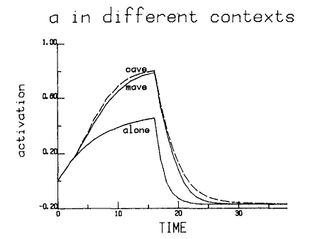
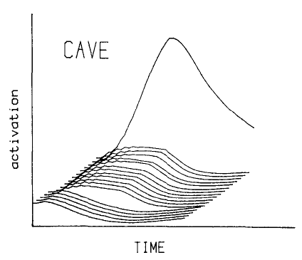
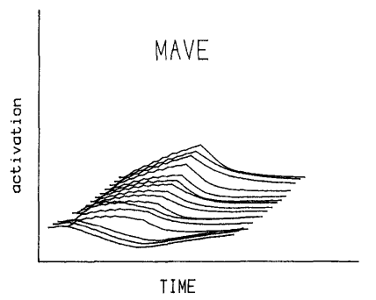
Rules or Connections?
The IA model only knows rules, but human perceivers show perceptual facilitation when they perceive letters in non-words as well.
Does our perceptual system follow rules based on a ‘grammar’ or legal forms?
Syl -> {Ons} + Body
Body -> Vwl + {Coda}
The IA model simulates perceptual facilitation in pseudowords as well as words
The knowledge is in the connections

Slide 11
IA Model as a Bridge to a new Framework
It is different from the PSS framework in that:
  Knowledge is in the connections, hence
  Directly wired into the processing machinery rather than stored as such
  Patterns are not retrieved by constructed
  Intrinsically inaccessible to inspection
But it is similar in that:
  Programmed by its designer
  Embodies designer’s choices about how to represent knowledge
  Units correspond directly to cognitive entities

Slide 12
Distributed Connectionist Models
What if we could learn from experience, without making prior commitments to the way cognitive entities are represented
  Do there have to be units corresponding to such entities in our minds?
  Do we need separate subsystems for items that follow the rules and items that do not?
Two prominent application areas:
  Past tense inflection
    Pay – paid, lay – laid, tay – taid;
    See-saw, Say – said, Have – had…
  Spelling to sound
    HINT, MINT, PINT

Slide 13
Core Principles of Parallel Distributed Processing Models using Learned Distributed Representations
/h/ /i/ /n/ /t/
Processing occurs via interactions among neuron-like processing units via weighted connections.
A representation is a pattern of activation.
The knowledge is in the connections.
Learning occurs through gradual connection adjustment, driven by experience.
Learning affects both representation and processing.
H I N T

Slide 14

Learning in a Feedforward PDP Network
Propagate activation ‘forward’ producing a_{r} for all units using the logistic activation function.
Calculate error at the output layer:
δ_{r} = f’(t_{r} – a_{r})
Propagate error backward to calculate error information at the ‘hidden’ layer:
δ_{s} = f’(Σ_{r}w_{rs} δ_{r})
Change weights:
Δw_{rs}=δ_{r}a_{s}
/h/ /i/ /n/ /t/
H I N T

Slide 15
Characteristics of Past Tense and Spelling-sound models
They use a single system of connections to correctly capture performance with regular, exceptional, and novel items
  MINT, PINT, VINT
  LIKE, TAKE, FIKE
Tend to over-regularize exceptions early in learning as if they have ‘discovered’ a rule.
The knowledge in the connections that informs processing of regular items also informs processing of the regular aspects of exceptions
  Quasi-regularity: The tendency for exceptions to exhibit characteristics of fully regular items
    PINT, YACHT – said, thought
Exhibit graded sensitivity to frequency and regularity and a frequency by regularity interaction.

Slide 16
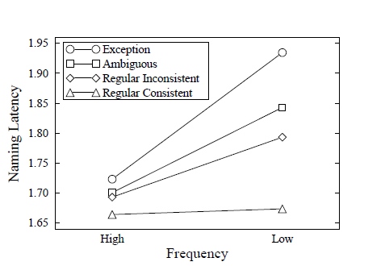
Frequency by Regularity Interaction
PINT
TREAD
MINT
LAKE

Slide 17
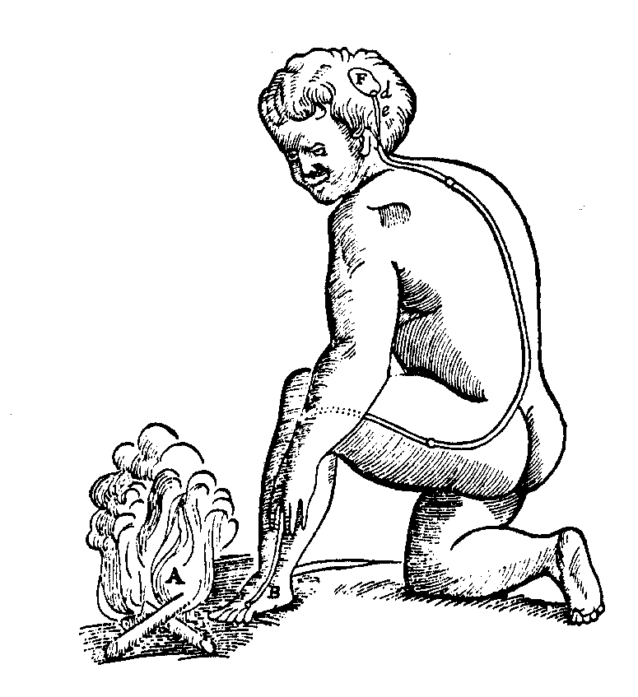
Decartes’ Legacy
Mechanistic approach to sensation and action
Divine inspiration creates mind
This leads to four dissociations:
  Mind / Brain
  Higher Cognitive Functions / Sensory-motor systems
  Human / Animal
  Descriptive / Mechanistic

Slide 18
Can Neural Networks Also Address Higher-Level Cognitive Phenomena?
One Example Domain:
Semantic Cognition

Slide 19

Quillian’s
Hierarchical
Propositional Model

Slide 20

The Rumelhart Model

Slide 21
Some Phenomena in Conceptual Development
Progressive differentiation of concepts
Illusory correlations and U-shaped developmental trajectories
Conceptual reorganization
Domain- and property-specific constraints on generalization
Acquired sensitivity to an object’s causal properties

Slide 22
The Training Data:
All propositions true of
items at the bottom level
of the tree, e.g.:
Robin can {fly, move, grow}

Slide 24
The Rumelhart Model

Slide 25


Slide 26
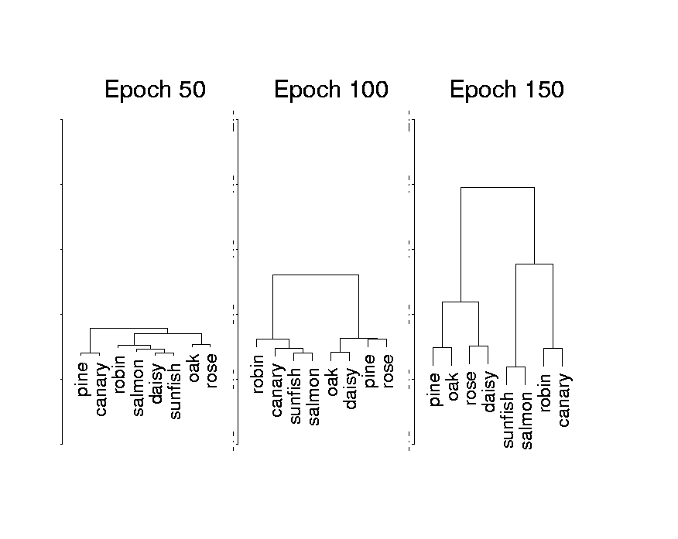

Slide 27


Slide 28
Disintegration of Conceptual Knowledge in Semantic Dementia
Loss of differentiation
Overgeneralization of frequent names
Illusory correlations

Slide 29


Picture naming
and drawing in
Sem. Demantia

Slide 30


Slide 31
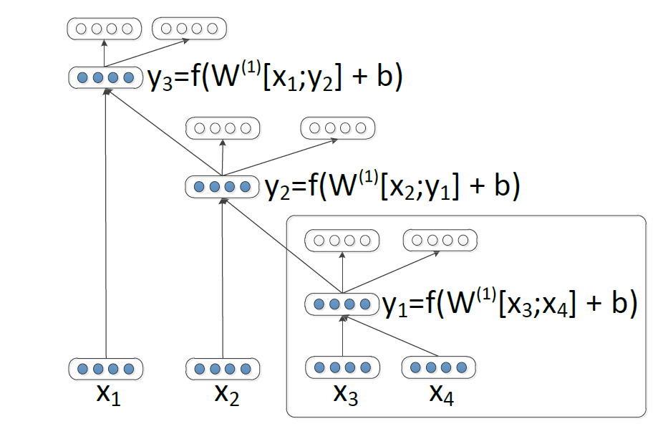
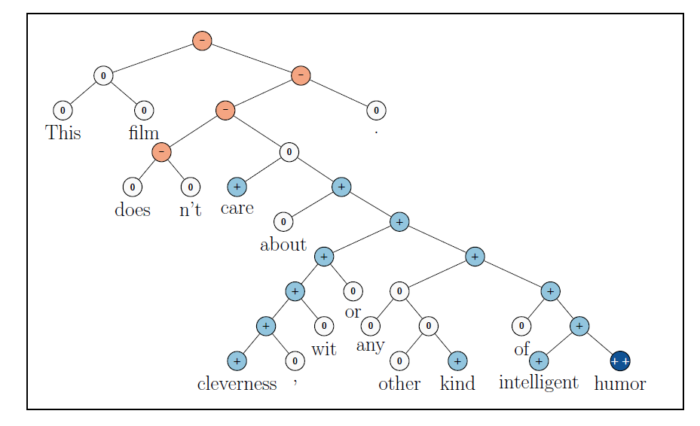
Current Work Using ‘Deep’ Networks
Machine Speech Recognition
Machine Object Classification
Machine Translation and Language Understanding
  Socher et al (2013)

Slide 32
Implications of this approach
Knowledge that is otherwise represented in explicit form is inherently implicit in PDP:
  Rules
  Propositions
  Lexical entries…
None of these things are represented as such in a PDP system.
Knowledge that others have claimed must be innate and pre-specified domain-by-domain often turns out to be learnable within the PDP approach.
Thus the approach provides a new way of looking at many aspects of knowledge-dependent cognition and development.
While the approach allows for structure (e.g. in the organization and interconnection of processing modules), processing is generally far more distributed, and causal attribution becomes more complex.

Slide 33
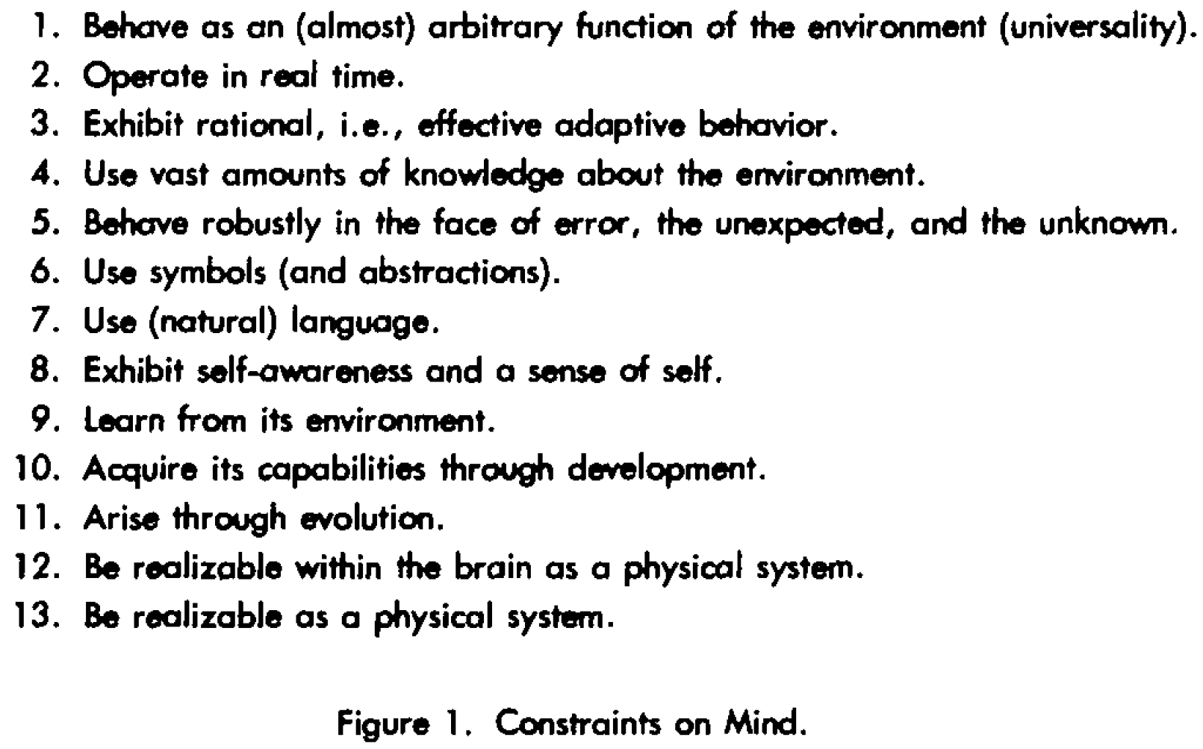

Slide 34
In short…
Models that link human cognition to the underlying neural mechanisms of the brain simultaneously provide alternatives to other ways of understanding processing, learning, and representation at a cognitive level.

