Slide 1
Awakening from the Cartesian Dream:
The PDP Approach to Understanding the Mind and Brain
Jay McClelland
Stanford University
February 7, 2013

Slide 2
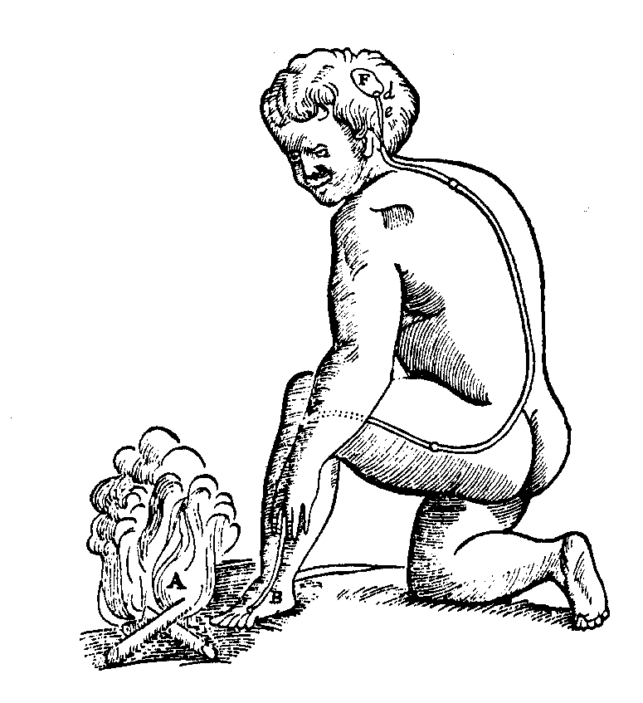
Decartes’ Legacy
Mechanistic approach to sensation and action
Divine inspiration creates mind
This leads to four dissociations:
  Mind / Brain
  Higher Cognitive Functions / Sensory-motor systems
  Human / Animal
  Descriptive / Mechanistic

Slide 3
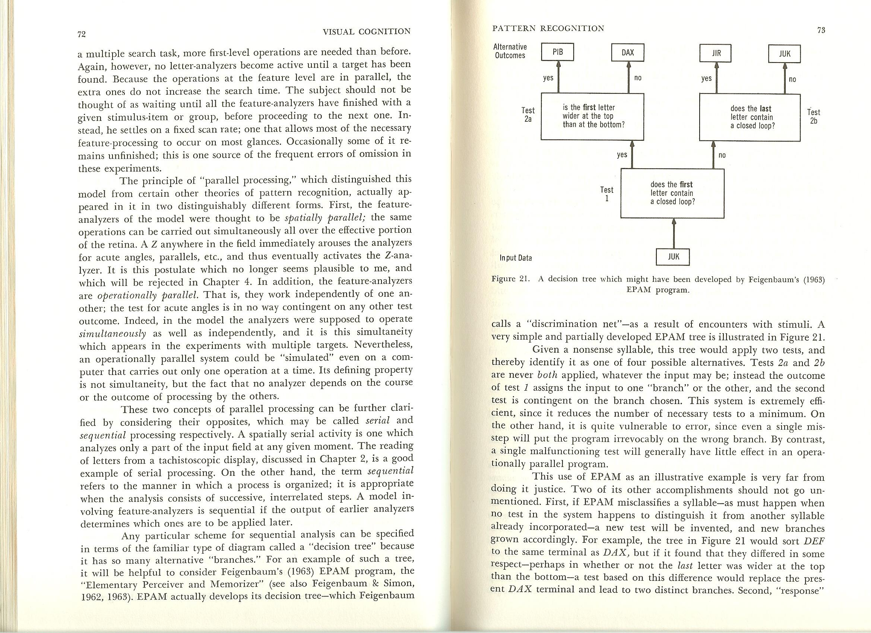
Early Computational Models of Human Cognition (1950-1980)
The computer contributes to the overthrow of behaviorism.
Computer simulation models emphasize strictly sequential operations, using flow charts.
Simon announces that computers can ‘think’.
Symbol processing languages are introduced allowing some success at theorem proving, problem solving, etc.
Minsky and Pappert kill off Perceptrons.
Cognitive psychologists distinguish between algorithm and hardware.
Neisser deems physiology to be only of ‘peripheral interest’
Psychologists investigate mental processes as sequences of discrete stages.

Slide 4
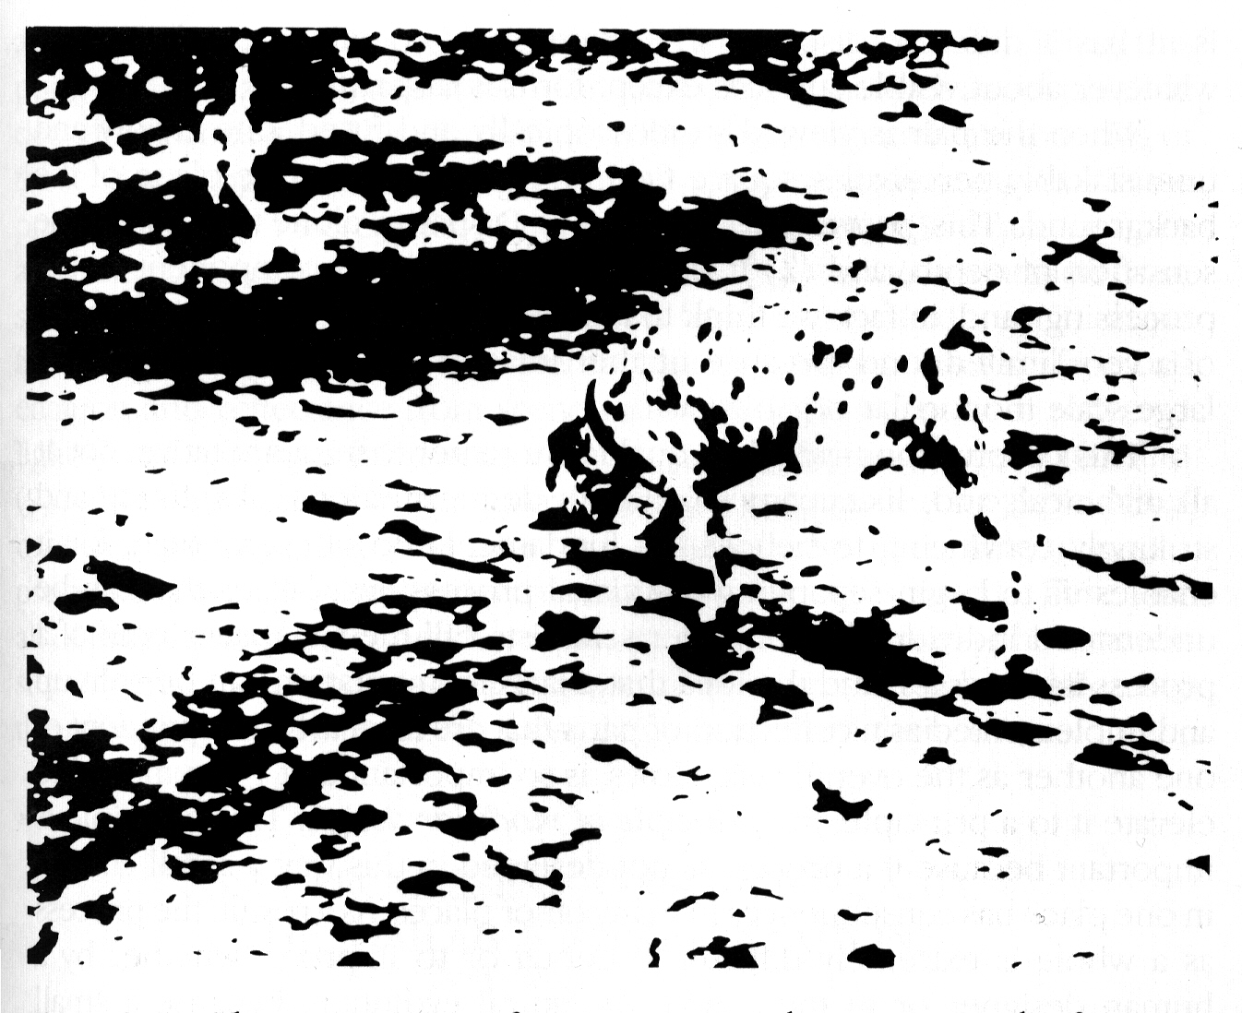

Slide 5
Ubiquity of the Constraint Satisfaction
Problem
In sentence processing
  I saw the grand canyon flying to New York
  I saw the sheep grazing in the field
In comprehension
  Margie was sitting on the front steps when she heard the familiar jingle of the “Good Humor” truck. She remembered her birthday money and ran into the house.
In reaching, grasping, typing…

Slide 6
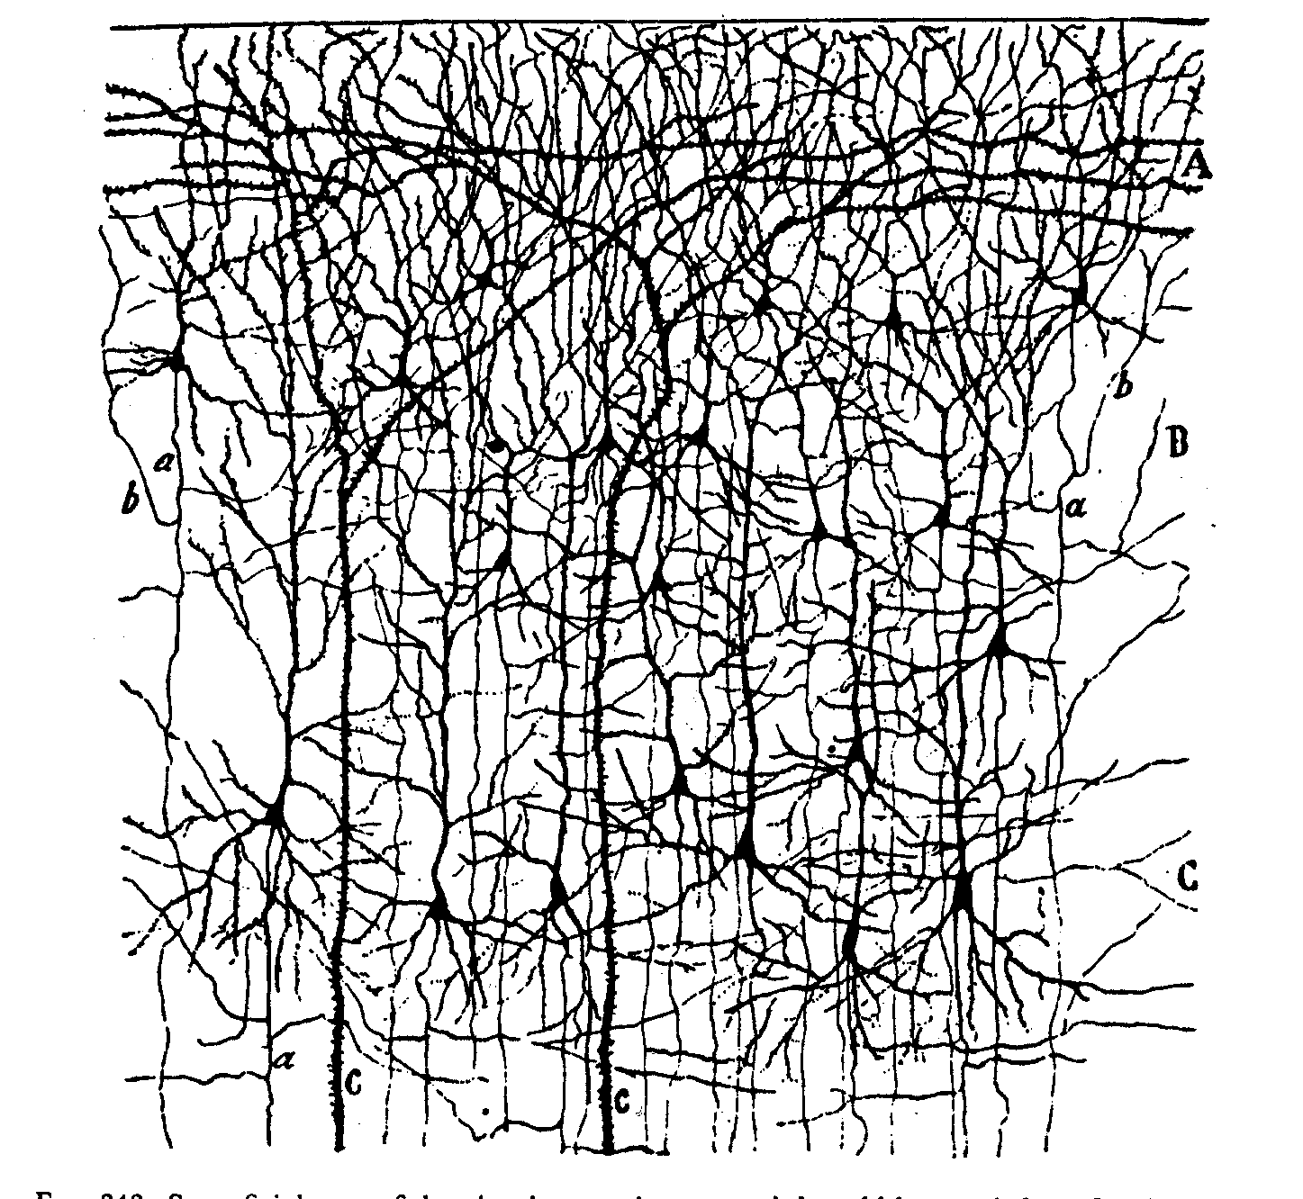

Slide 7
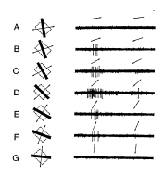
Graded and variable nature of neuronal responses

Slide 8
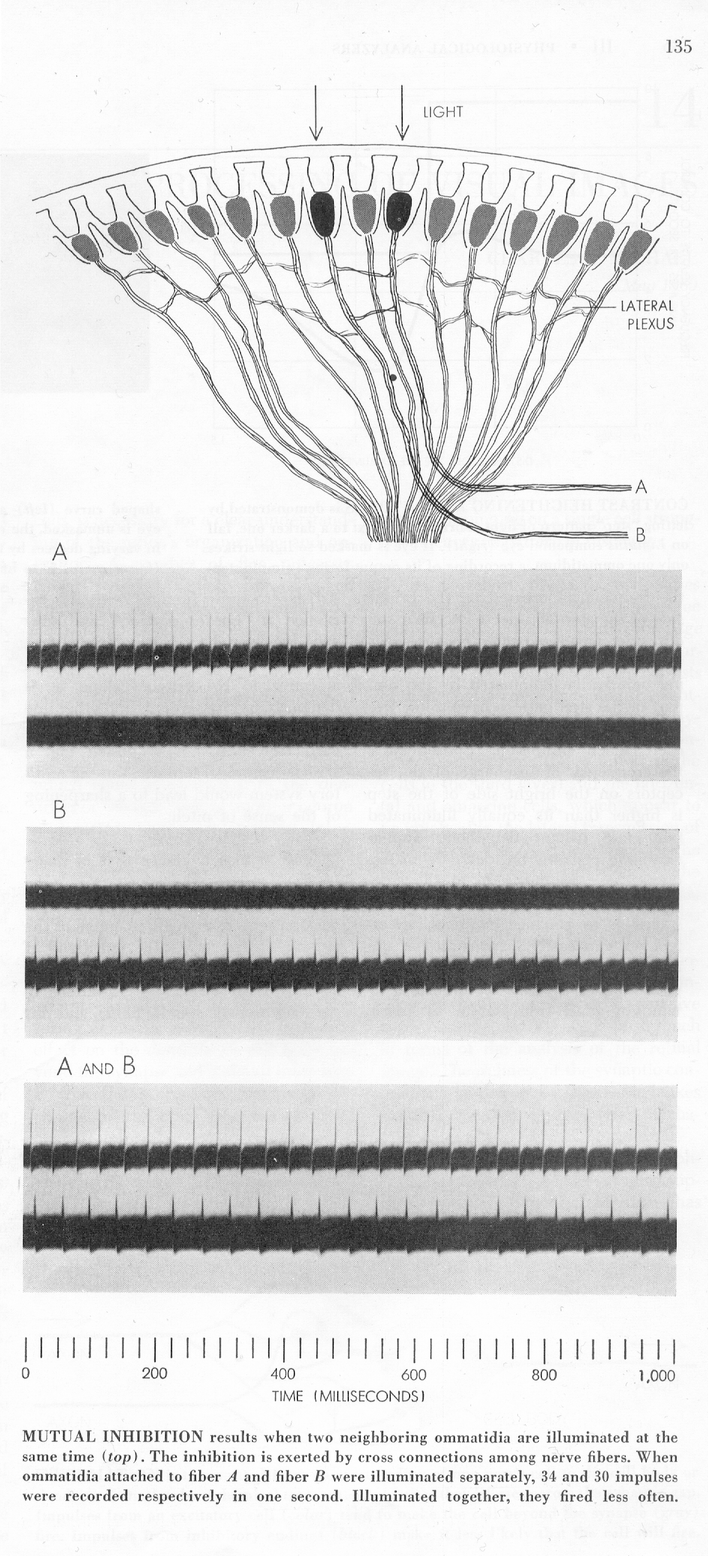
Lateral Inhibition in Eye of Limulus
(Horseshoe Crab)

Slide 9

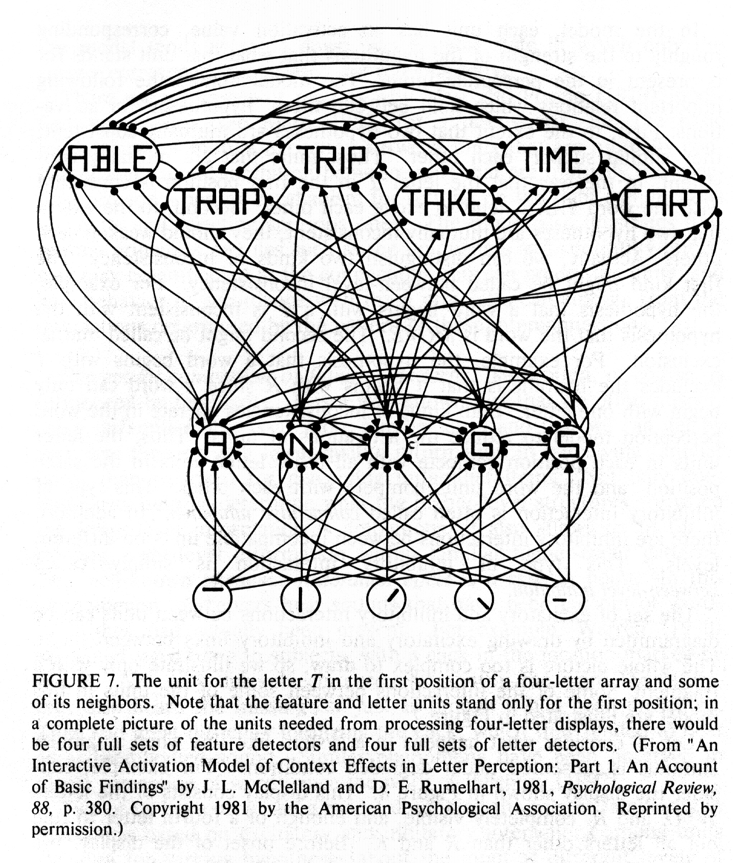
The Interactive Activation Model

Slide 10
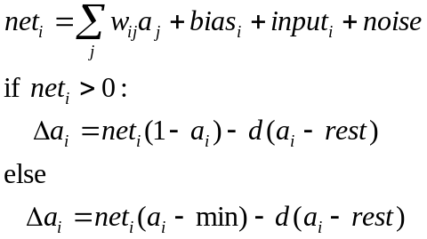
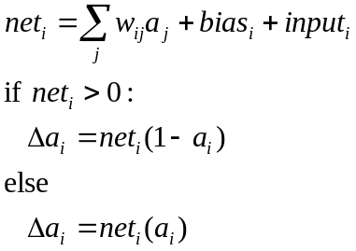
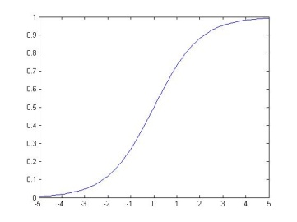


Input and activation of units in PDP models
General form of unit update:
Simple version used in cube
simulation:
An activation function that links PDP models to Bayesian ideas:
Or set activation to 1 probabilistically:
max=1
Input from
unit j
a
w_{ij}
0
rest
min=-.2
unit i
a_{i} or p_{i}
net_{i}

Slide 11
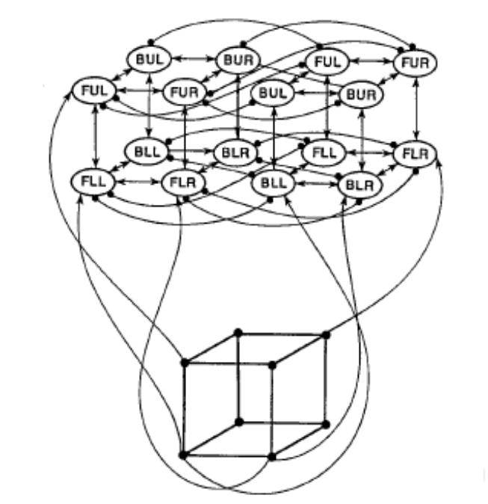
The Cube Network
Positive weights have value +1
Negative weights have value -1.5
Stimulus provides input of .5 to all units

Slide 12
Cognitive Neuropsychology (1970’s)
Deep and surface dyslexia (1970’s):
  Deep dyslexics can’t read non-words (e.g. VINT), make semantic errors in reading words (PEACH -> ‘apricot’)
  Surface dyslexics can read non-words, and regular words (e.g. MINT) but often regularize exceptions (PINT).
Work leads to ‘box-and-arrow’ models, reminiscent of flow-charts

Slide 13
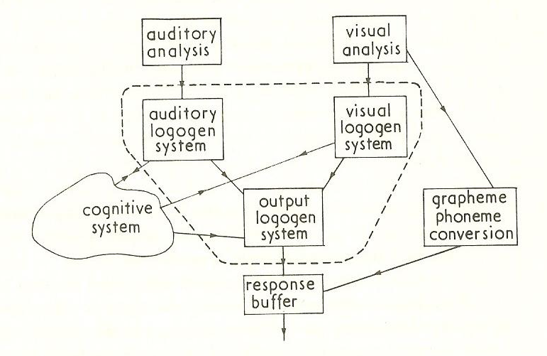

Slide 14
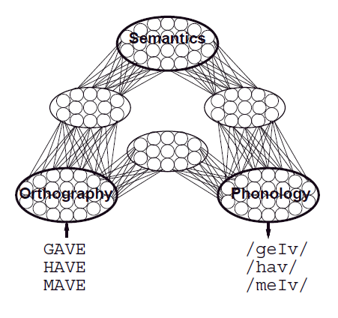
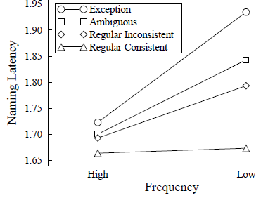
Graceful Degradation in Neuropsychology
Patient deficits graded in severity
Error patterns have systematic characteristics:
  Deep dyslexic produce both visual and semantic errors:
    symphony -> sympathy
    symphony -> orchestra
  Errors in surface dyslexia (and normal reading) depend on a word’s frequency, and on a word’s neighbors
PINT
TREAD
MINT
LAKE
Effects of lesions to units and connections in distributed PDP models nicely capture both of these features of patient deficits.

Slide 15
Core Principles of Parallel Distributed Processing
/h/ /i/ /n/ /t/
Processing occurs via interactions among neuron-like processing units via weighted connections.
A representation is a pattern of activation.
The knowledge is in the connections.
Learning occurs through gradual connection adjustment, driven by experience.
Learning affects both representation and processing.
H I N T

Slide 16
Learning in a Feedforward PDP Network
Propagate activation ‘forward’ producing a_{i} (a_{j}) for all units using the logistic activation function.
Calculate error at the output layer:
δ_{i} = f(t_{i} – a_{i})
Propagate error backward to calculate error information at the ‘hidden’ layer:
δ_{j} = f(Σ_{i}w_{ij}f(t_{i} – a_{i}))
Change weights:
Δw_{ij}=δ_{i}a_{j}
/h/ /i/ /n/ /t/
H I N T

Slide 17
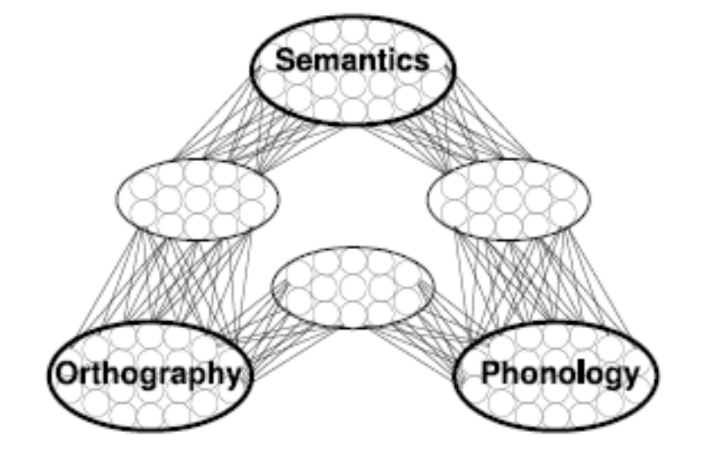
Additional Features of the PDP Framework
Processing is in general thought to be continuous, bidirectional, and distributed within and across components of the cognitive system:
  Each part contributes to the processing that takes place in other parts.
  The outcome of processing anywhere can depend on processing everywhere.
Processing can be very robust for highly typical and frequent items in well-practiced tasks such that considerable degradation can be tolerated before there is an apparent deficit.
CONTEXT

Slide 18
Implications of this approach
Knowledge that is otherwise represented in explicit form is inherently implicit in PDP:
  Rules
  Propositions
  Lexical entries…
None of these things are represented as such in a PDP system.
Knowledge that others have claimed must be innate and pre-specified domain-by-domain often turns out to be learnable within the PDP approach.
Thus the approach provides a new way of looking at many aspects of knowledge-dependent cognition and development.
While the approach allows for structure (e.g. in the organization and interconnection of processing modules), processing is generally far more distributed, and causal attribution becomes more complex.

Slide 19
In short…
Models that link human cognition to the underlying neural mechanisms of the brain simultaneously provide alternatives to other ways of understanding processing, learning, and representation at a cognitive level.

Slide 20
The PDP Enterprise…
Attempts to explain human cognition as an emergent consequence of neural processes.
  Global outcomes, local processes
Forms a natural bridge between cognitive science on the one hand and neuroscience on the other.
Is an ongoing process of exploration.
Depends critically on computational modeling and mathematical analysis.

