Slide 1
Emergence of Semantic Structure from Experience
Jay McClelland
Stanford University

Slide 2
Things to Commemorate
Ten Years of the Rumelhart Prize
The 25th anniversary of PDP

Slide 3
A Question Arising
What has come of the framework that Dave dedicated himself to initiating?
This is the topic of:
  The special issue in Cognitive Science
  My lecture today

Slide 4


Slide 5

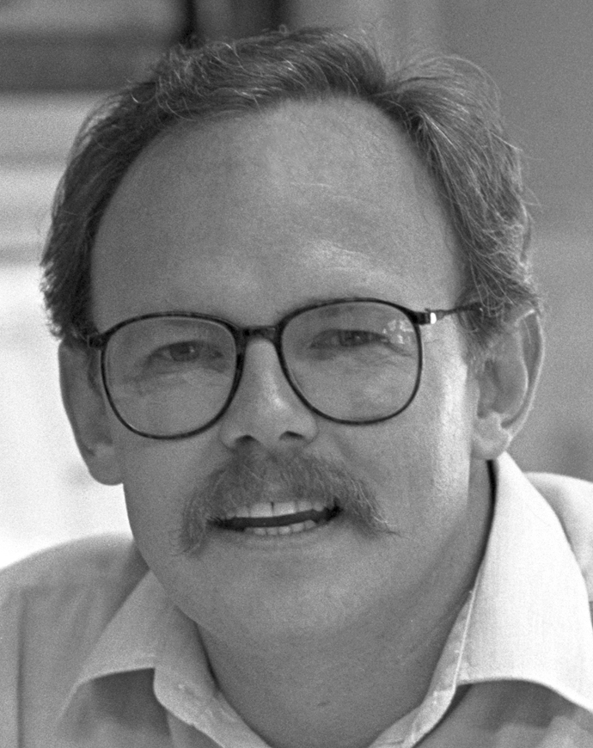
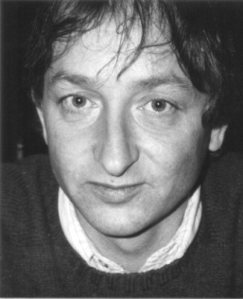

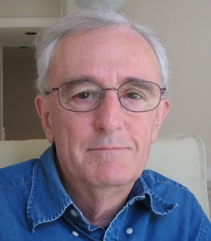


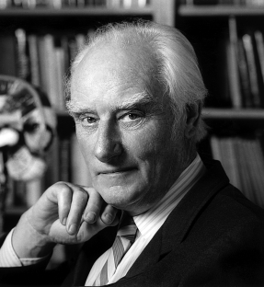



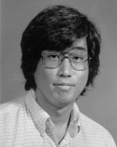
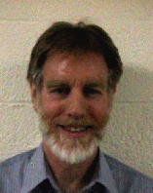






The PDP Book
Collaborators
Rumelhart
McClelland
Hinton
Smolsensky
Zipser
Elman
Jordan
Crick
Norman
Munro
Stone
Kawamoto
Williams
Sejnowski
And Friends
Todd
Levin
Cottrell
Mozer
Glushko

Slide 6
Three Ideas
Brain-style computation
Cooperative computation and distributed representation
Emergence of intelligence
Can these ideas help us understand semantic cognition?

Slide 7
Distributed Representations in the Brain:
Overlapping Patterns for Related Concepts (Kiani et al, 2007)
dog
goat
hammer
Many hundreds of single neurons recorded in monkey IT.
1000 different photographs were presented twice each to each neuron.
Hierarchical clustering based on the distributed representation of each picture:
  The pattern of activation over all the neurons
dog goat hammer

Slide 8
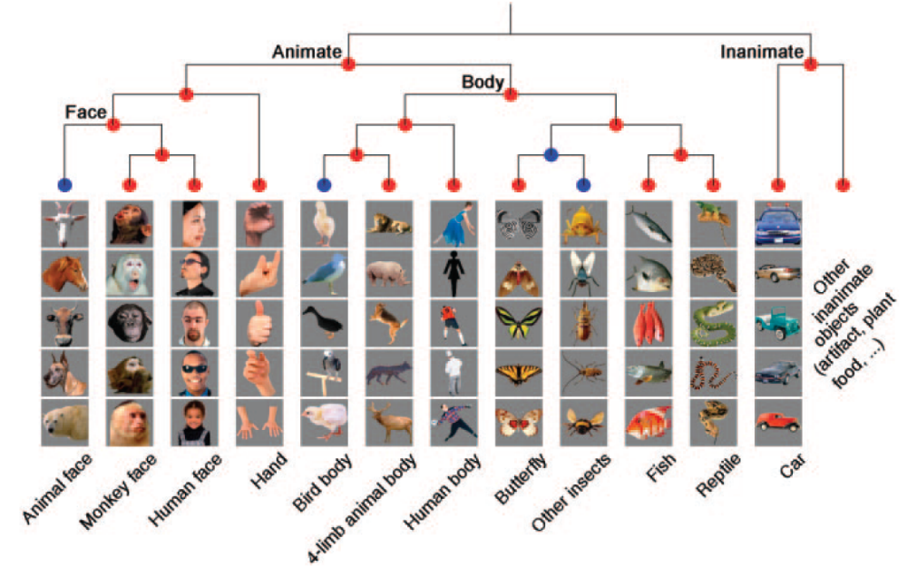
Kiani et al, J Neurophysiol 97: 4296–4309, 2007.

Slide 9


The Rumelhart Model
The Quillian
Model

Slide 10
DER’s Goals for the Model
Show how learning could capture the emergence of hierarchical structure
Show how the model could make inferences as in the Quillian model

Slide 11


Early
Later
Later
Still
E
x
p
e
r
i
e
n
c
e

Slide 12
Start with a neutral representation on the representation units. Use backprop to adjust the representation to minimize the error.

Slide 13
The result is a representation similar to that of the average bird…

Slide 14
Use the representation to
infer what this new thing can do.

Slide 15
Questions About the Rumelhart Model
Does the model offer any advantages over other approaches?
  Do distributed representations really buy us anything?
  Can the mechanisms of learning and representation in the model tell us anything about
    Development?
    Effects of neuro-degeneration?

Slide 16
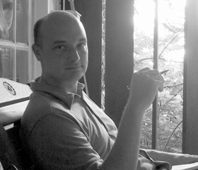




Phenomena in Development
Progressive differentiation
Overgeneralization of
  Typical properties
  Frequent names
Emergent domain-specificity of representation
Basic level advantage
Expertise and frequency effects
Conceptual reorganization

Slide 17


Disintegration in Semantic Dementia
Loss of differentiation
Overgeneralization

Slide 18
The Hierarchical Naïve Bayes Classifier Model (with R. Grosse and J. Glick)
The world consists of things that belong to categories.
Each category in turn may consist of things in several sub-categories.
The features of members of each category are treated as independent
  P({f_{i}}|C_{j}) = Π_{i} p(f_{i}|C_{j})
Knowledge of the features is acquired for the most inclusive category first.
Successive layers of sub-categories emerge as evidence accumulates supporting the presence of co-occurrences violating the independence assumption.
Living Things
Animals Plants
Birds Fish
Flowers Trees
…

Slide 19
A One-Class and a Two-Class Naïve Bayes Classifier Model
Property | One-Class Model | 1st class in two-class model | 2nd class in two-class model
Can Grow | 1.0 | 1.0 | 0
Is Living | 1.0 | 1.0 | 0
Has Roots | 0.5 | 1.0 | 0
Has Leaves | 0.4375 | 0.875 | 0
Has Branches | 0.25 | 0.5 | 0
Has Bark | 0.25 | 0.5 | 0
Has Petals | 0.25 | 0.5 | 0
Has Gills | 0.25 | 0 | 0.5
Has Scales | 0.25 | 0 | 0.5
Can Swim | 0.25 | 0 | 0.5
Can Fly | 0.25 | 0 | 0.5
Has Feathers | 0.25 | 0 | 0.5
Has Legs | 0.25 | 0 | 0.5
Has Skin | 0.5 | 0 | 1.0
Can See | 0.5 | 0 | 1.0

Slide 20

Accounting for the network’s feature attributions with mixtures of classes at different levels of granularity
Regression Beta Weight
Epochs of Training
Property attribution model:
P(f_{i}|item) = α_{k}p(f_{i}|c_{k}) + (1-α_{k})[(α_{j}p(f_{i}|c_{j}) + (1-α_{j})[…])

Slide 21
Should we replace the PDP model with the Naïve Bayes Classifier?
It explains a lot of the data, and offers a succinct abstract characterization
But
  It only characterizes what’s learned when the data actually has hierarchical structure
So it may be a useful approximate characterization in some cases, but can’t really replace the real thing.

Slide 22
The Nature of Cognition, and the Place of PDP in Cognitive Theory?
Many view human cognition as inherently
  Structured
  Systematic
  Rule-governed
In this framework, PDP models are seen as
  Mere implementations of higher-level, rational, or ‘computational level’ models
  … that don’t work as well as models that stipulate explicit rules or structures

Slide 23
The Alternative
We argue instead that cognition (and the domains to which cognition is applied) is inherently
  Quasi-regular
  Semi-systematic
  Context sensitive
On this view, highly structured models:
  Are Procrustian beds into which natural cognition fits uncomfortably
  Won’t capture human cognitive abilities as well as models that allow a more graded and context sensitive conception of structure

Slide 24
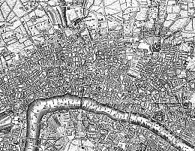

Emergent vs. Stipulated Structure
Old London
Midtown Manhattan

Slide 25

An exploration of these ideas in the domain of mammals
What is the best representation of domain content?
How do people make inferences about different kinds of object properties?

Slide 26
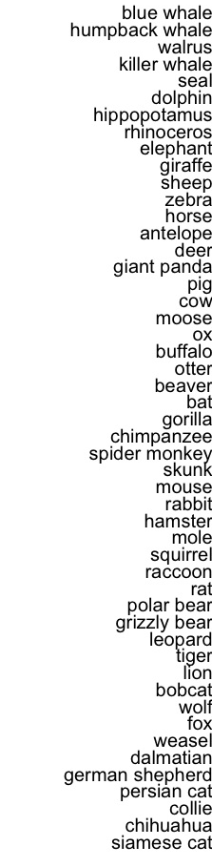
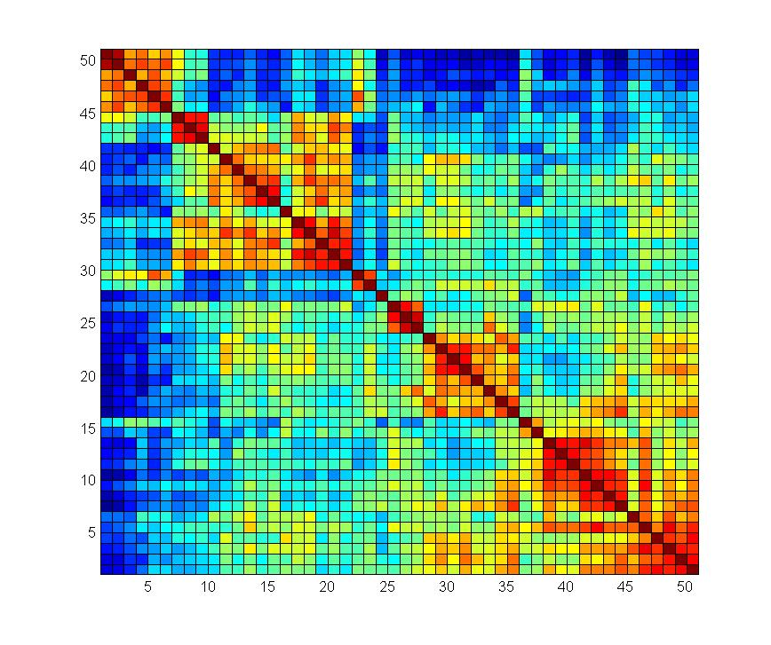

Slide 27

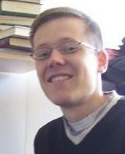
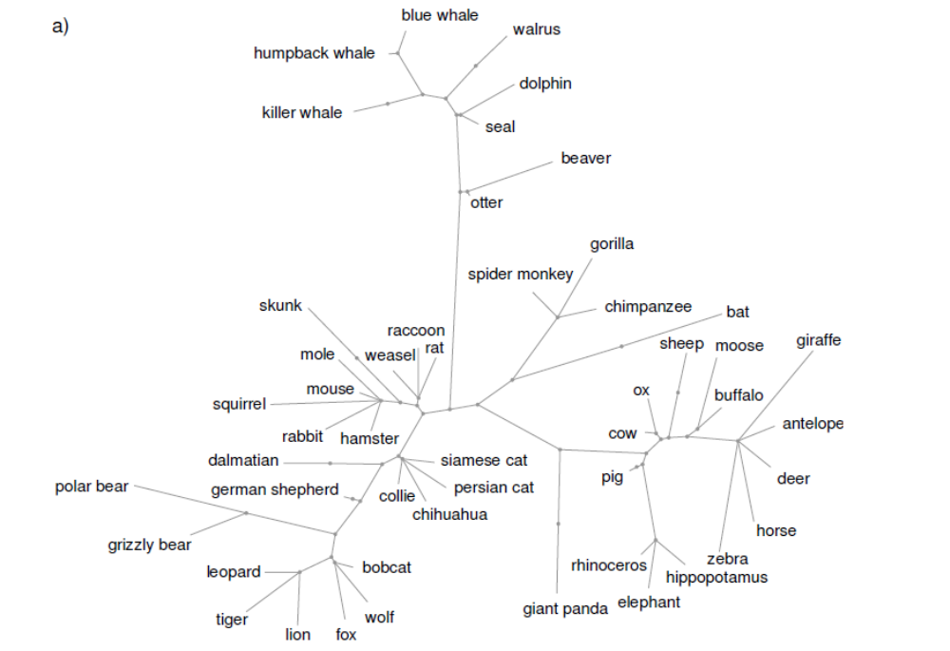
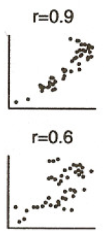
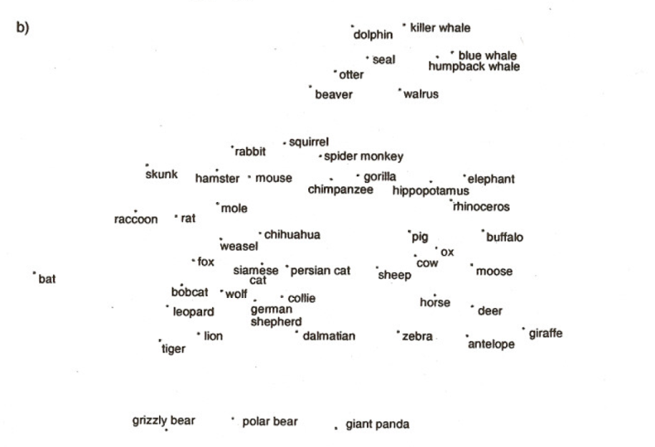
Structure Extracted by a Structured Statistical Model

Slide 30
Predictions
Similarity ratings (and patterns of inference) will violate the hierarchical structure
Patterns of inference will vary by context

Slide 31
Experiments*
Size, predator/prey, and other properties affect similarity across birds, fish, and mammals
Property inferences show clear context specificity
Future experiments will examine whether inferences (even of biological properties) violate a hierarchical tree for items like weasels, pandas, and beavers
*Poster 173, This Evening

Slide 32
Applying the Rumelhart model to the mammals dataset
Behaviors
Body Parts
Foods
Locations
Movement
Visual Properties
Items
Contexts

Slide 33
Simulation Results
We look at the model’s outputs and compare these to the structure in the training data.
The model captures the overall and context specific structure of the training data
The model progressively extracts more and more detailed aspects of the structure as training progresses

Slide 34
Simulation Output

Slide 35
Training Data

Slide 36
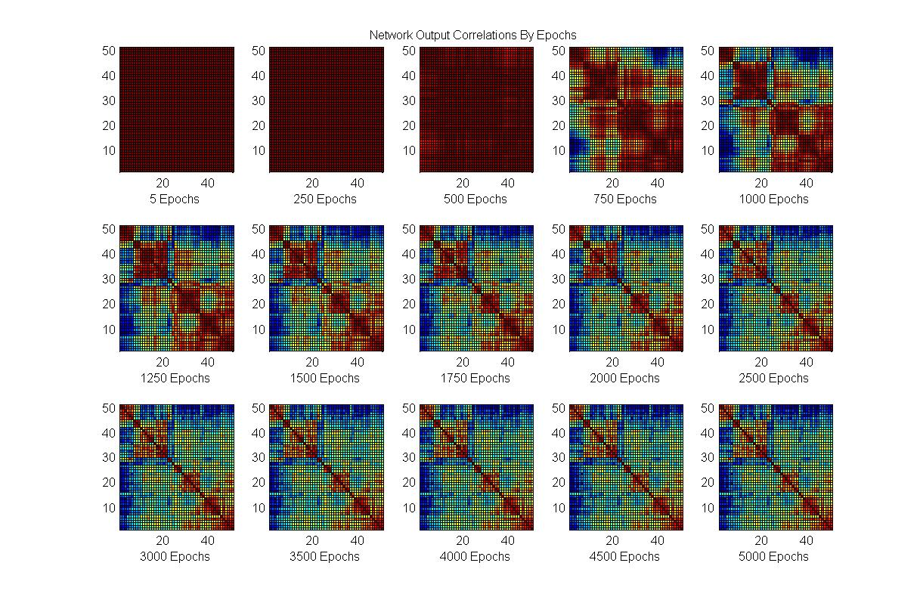
Network Output

Slide 37
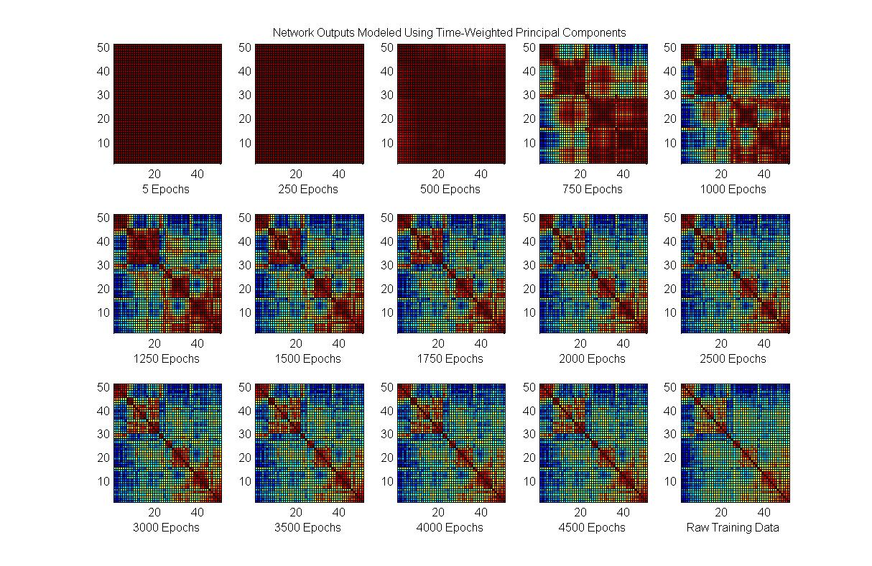
Progressive PCs

Slide 38
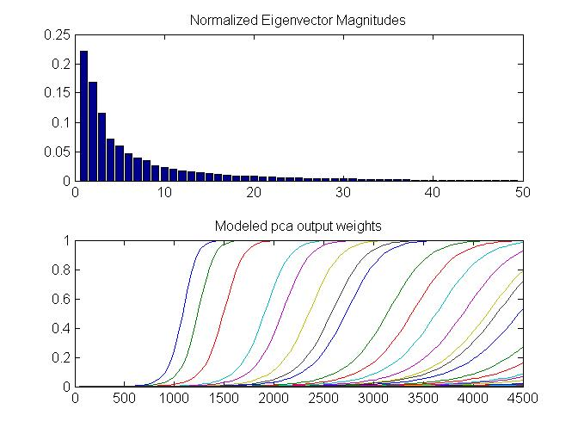

Slide 39
Learning the Structure in the
Training Data
Progressive sensitization to successive principal components captures learning of the mammals dataset.
This subsumes the naïve Bayes classifier as a special case when there is no real cross-domain structure (as in the Quillian training corpus).
So are PDP networks – and our brain’s neural networks – simply performing familiar statistical analyses?
  No!

Slide 40
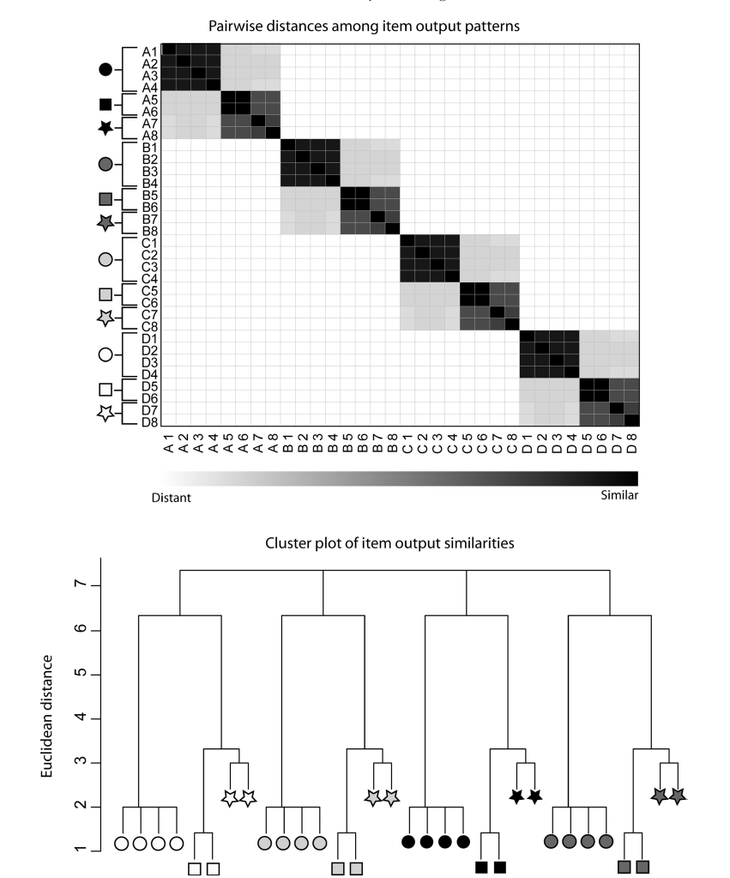
Extracting Cross-Domain Structure

Slide 41
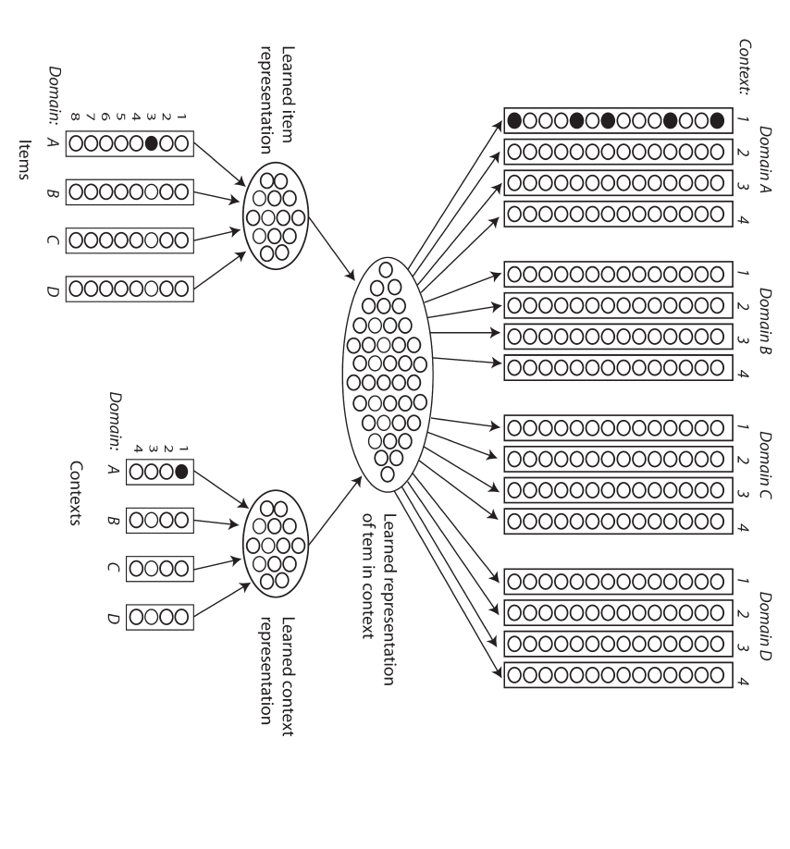
v

Slide 42
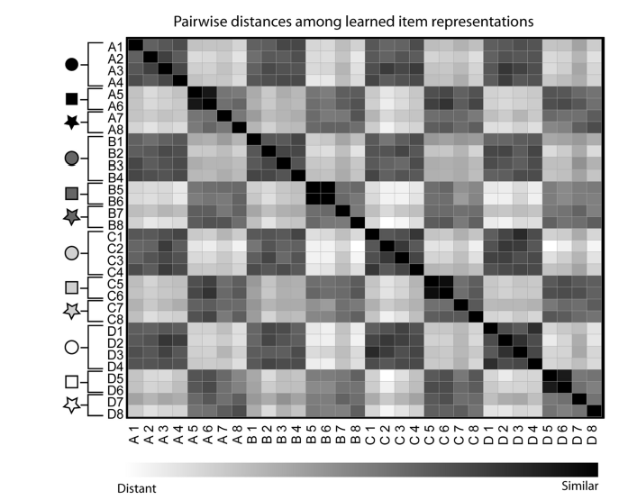
Input Similarity
Learned Similarity

Slide 43

A Future Direction that Dave would have Wanted to Pursue
Exploiting knowledge sharing across domains
  Lakoff:
    Abstract cognition is grounded in concrete reality
  Boroditsky:
    Cognition about time is grounded in our conceptions of space
Can we capture these kinds of influences through knowledge sharing across contexts?
  This is work in progress with Tim and Paul Thibodeau.

Slide 44
Concluding Comments
Yes, cognition is more structured than we can fully capture with the Rumelhart model
  A long-term goal has been to capture a far more general form of context sensitivity.
  We all seek to understand how we can capture the systematic well enough, while still capturing cognitions graded, quasi-structured, and context sensitive characteristics.
  My own work on this will continue to explore emergentist approaches.
Achieving a full understanding of emergent structure will not be easy
  Structured models will help us with this.
  But my guess is they will remain no more than useful approximate characterizations.
  Emergentist, PDP-like approaches will continue to play an important role in this effort.

Slide 45
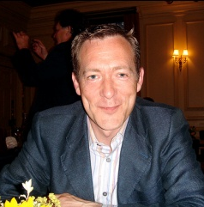

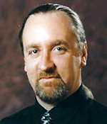
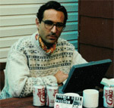

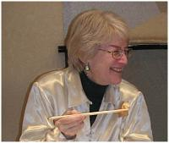
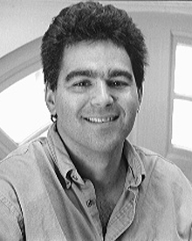
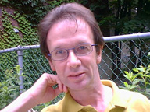




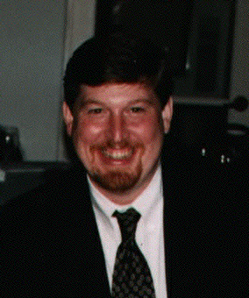
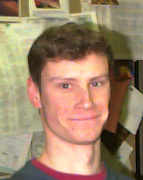

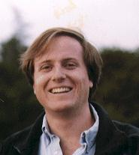
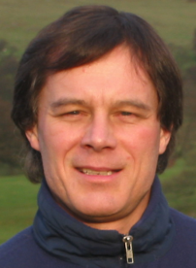

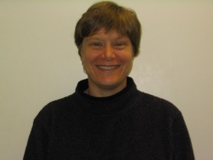

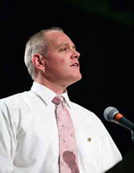
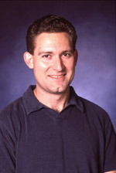

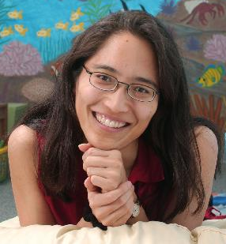

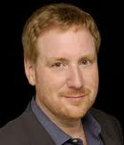


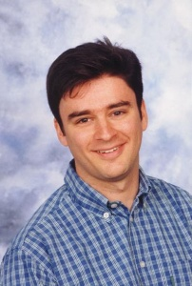


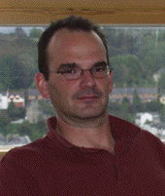
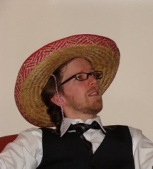
Collaborators while at
Carnegie Mellon

Slide 46


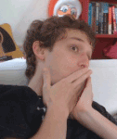





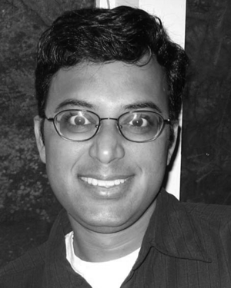




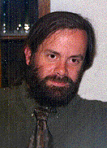

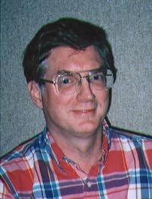
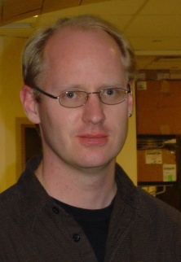
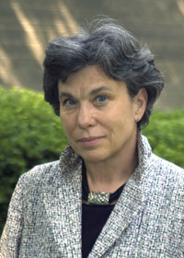
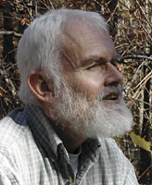

Newest
Collaborators

Slide 47

And my lifelong collaborator

Slide 49
Some of Dave’s Characteristics
A total commitment to the goal of developing a computational understanding of mind.
A belief that cognitive science – to become a “real science” – would need quantitatively rigorous theory.
A vision beyond the theoretical horizons of his time.
The ability to think deeply on his own and to work effectively with others to achieve his scientific goals.

Slide 50
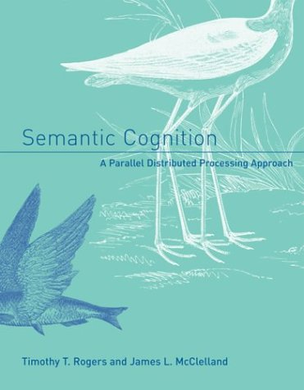
In Rogers and McClelland (2004) we also address:
  Conceptual differentiation in prelinguistic infants.
  Many of the phenomena addressed by classic work on semantic knowledge from the 1970’s:
    Basic level
    Typicality
    Frequency
    Expertise
  Disintegration of conceptual knowledge in semantic dementia
  How the model can be extended to capture causal properties of objects and explanations.
  What properties a network must have to be sensitive to coherent covariation.

