Slide 1
Constraint Satisfaction and Schemata
Psych 205

Slide 2
Goodness of Network States and their Probabilities
Goodness of a network state
How networks maximize goodness
The Hopfield network and Rumelhart’s continuous version
Stochastic networks: The Boltzmann Machine, and the relationship between goodness and probability

Slide 3
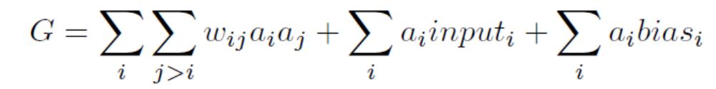

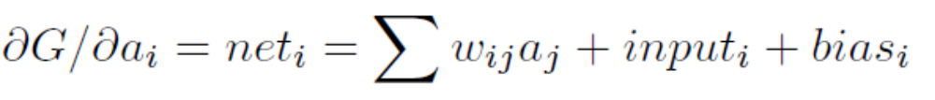
Network Goodness and How to Increase it

Slide 4
The Hopfield Network
Assume symmetric weights.
Units have binary states [+1,-1]
Units are set into initial states
Choose a unit to update at random
If net > 0, then set state to 1.
Else set state to -1.
Goodness always increases… or stays the same.

Slide 5
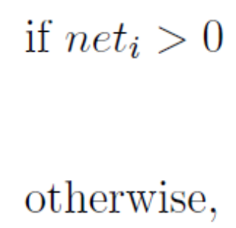
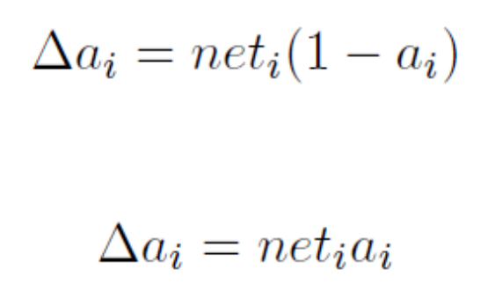
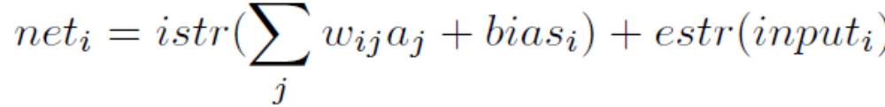
Rumelhart’s Continuous Version
Unit states have values between 0 and 1.
Units are updated asynchronously. Update is gradual,
according to the rule:
There are separate scaling parameters for external and
internal input:

Slide 6
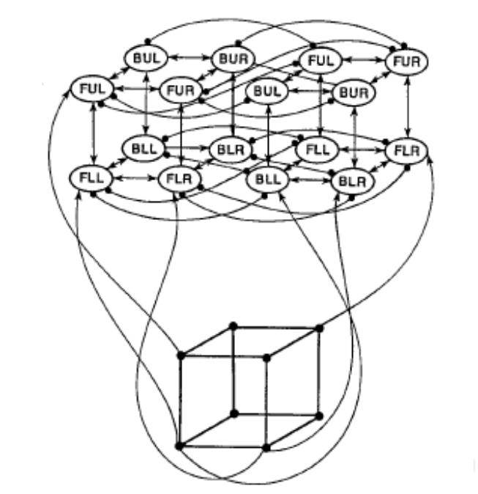
The Cube Network
Positive weights have value +1
Negative weights have value -1.5
‘External input’ is implemented as a positive bias of .5 to all units.
These values are all scaled by the istr parameter in calculating goodness
in the program (istr = 0.4).

Slide 7
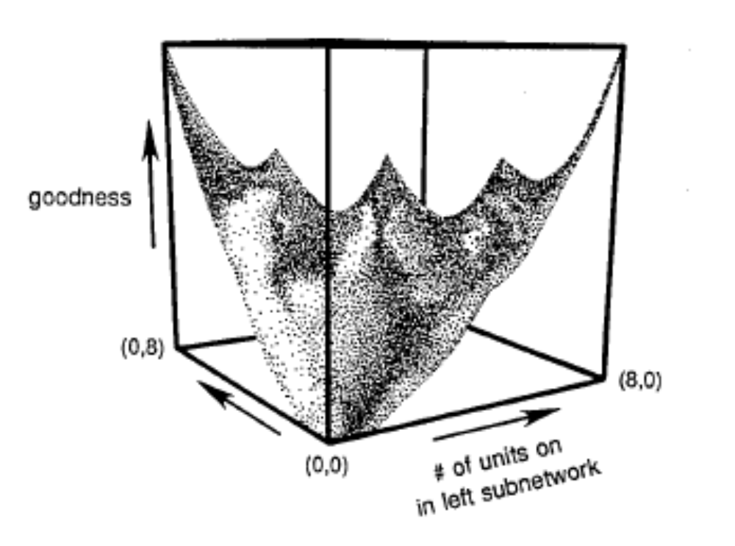
Goodness Landscape of Cube Network

Slide 8


Rumelhart’s Room Schema Model
Units for attributes/objects found in rooms
Data: lists of attributes found in rooms
No room labels
Weights and biases:
Modes of use:
  Clamp one or more units, let the network settle
  Clamp all units, let the network calculate the Goodness of a state (‘pattern’ mode)

Slide 9
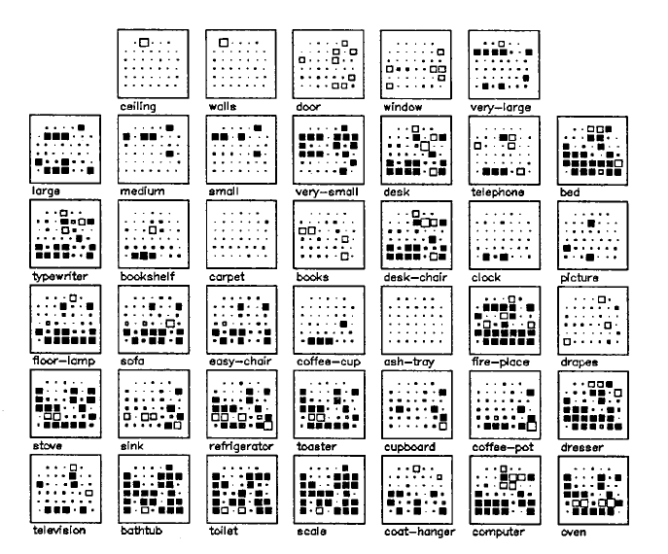
Weights for all units

Slide 10
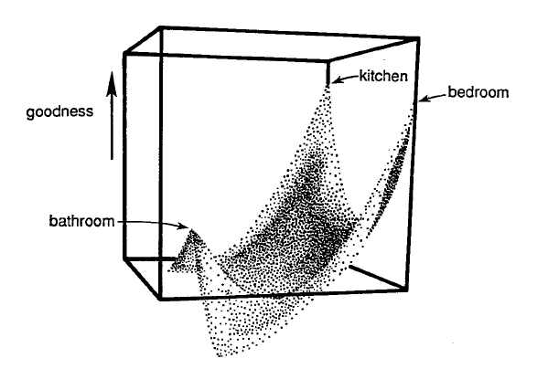
Goodness Landscape for
Some Rooms

Slide 11
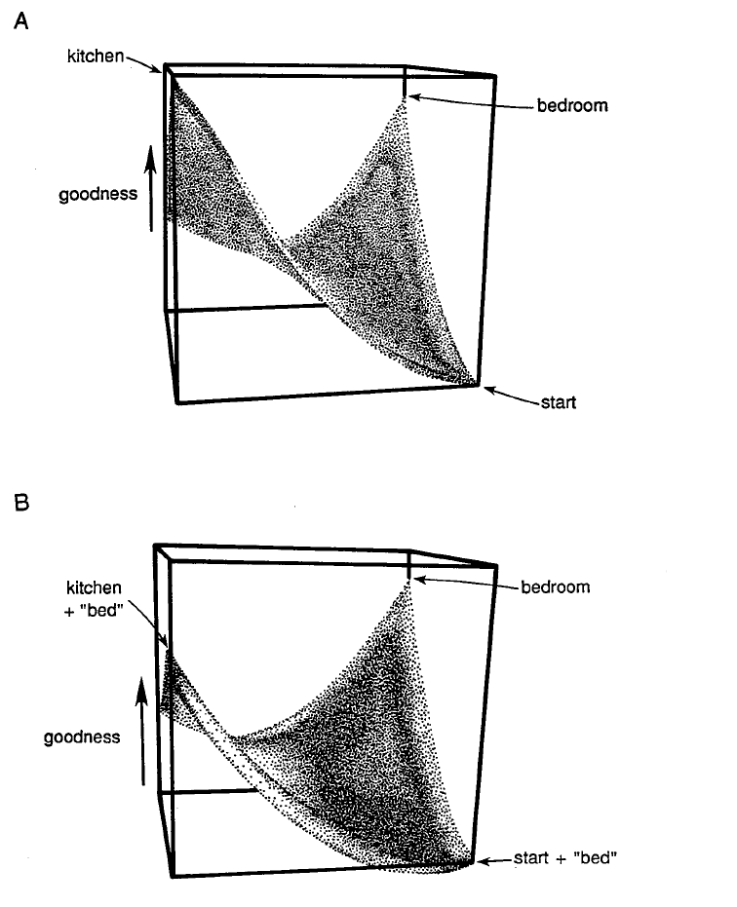
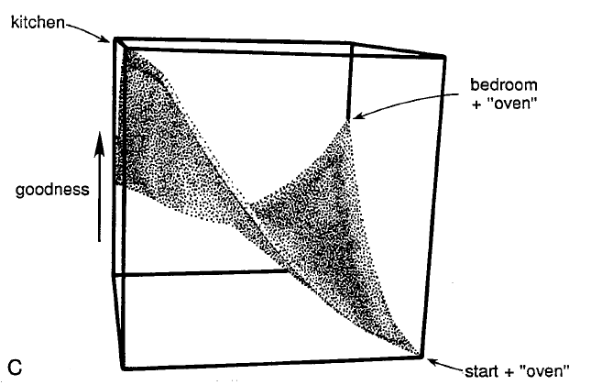
Slices thru landscape with three different starting points

Slide 12
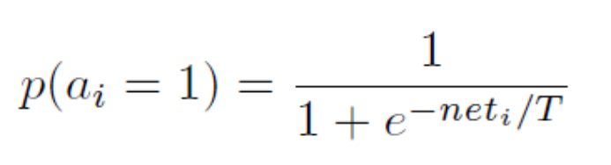
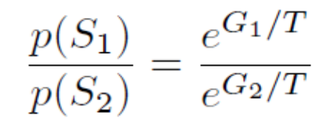

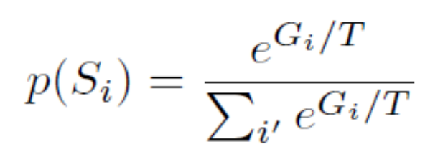
The Boltzmann Machine:
The Stochastic Hopfield Network
Units have binary states [0,1], Update is asynchronous. The activation
function is:
Assuming processing is ergodic: that is, it is possible to get from any state to any
other state, then when the state of the network reaches equilibrium,
the relative probability and relative goodness of two states are related as follows:
or
More generally, at equilibrium we have the Probability-Goodness Equation:

Slide 13
Simulated Annealing
Start with high temperature. This means it is easy to jump from state to state.
Gradually reduce temperature.
In the limit of infinitely slow annealing, we can guarantee that the network will be in the best possible state (or in one of them, if two or more are equally good).
Thus, the best possible interpretation can always be found (if you are patient)!

