Slide 1
Rapid integration of new schema-consistent information in the Complementary Learning Systems Theory
Jay McClelland, Stanford University

Slide 2
Complementary Learning Systems Theory
(McClelland et al 1995; Marr 1971)
action
name
Temporal
pole
motion
color
valance
form
Medial Temporal Lobe

Slide 3
Principles of CLS Theory
Hippocampus uses sparse, non-overlapping representations, minimizing interference among memories, allowing rapid learning of the particulars of individual memories
Neocortex uses dense, distributed representations, forcing experiences to overlap, promoting generalization, but requiring gradual, interleaved learning
Working together, these systems allow us to learn both
  Details of recent experiences
  Generalizations based on these experiences

Slide 4
A model of neocortical learning for gradual acquisition of knowledge about objects (Rogers & McClelland, 2004)
Relies on distributed representations capturing aspects of meaning that emerge through a very gradual learning process
The progression of learning and the representations formed capture many aspects of cognitive development
  Differentiation of concept representations
  Generalization, illusory correlations and overgeneralization
  Domain-specific variation in importance of feature dimensions
  Reorganization of conceptual knowledge

Slide 5
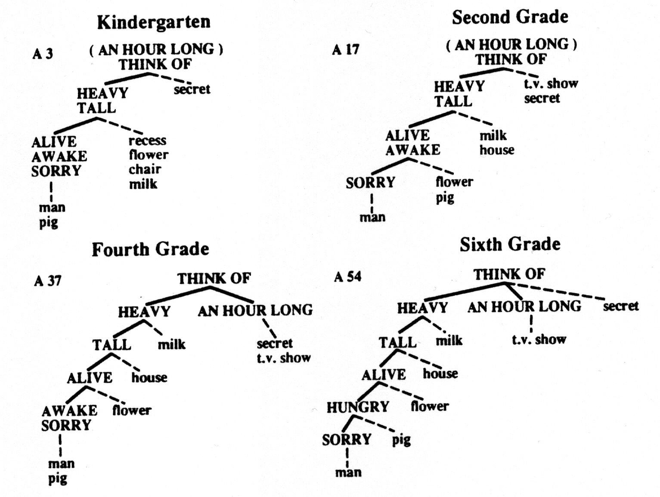

Slide 6

The Rumelhart Model

Slide 7

The Training Data:
All propositions true of
items at the bottom level
of the tree, e.g.:
Robin can {grow, move, fly}

Slide 8
Target output for ‘robin can’ input

Slide 9
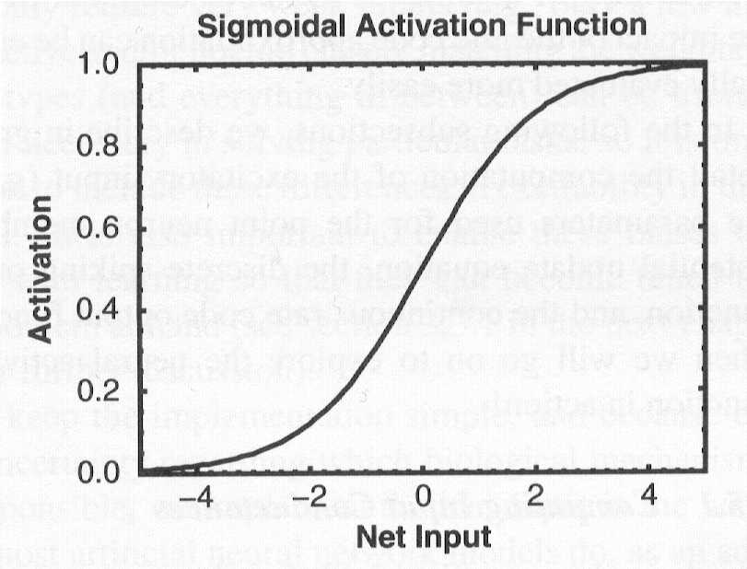
Forward Propagation of Activation
a_{j}
w_{ij}
net_{i}=Σa_{j}w_{ij}
a_{i}
w_{ki}

Slide 10
Back Propagation of Error (δ)
a_{j}
w_{ij}
δ_{i} ~ Σδ_{k}w_{ki}
a_{i}
w_{ki}
δ_{k} ~ (t_{k}-a_{k})
Error-correcting learning:
At the output layer: Δw_{ki} = εδ_{k}a_{i}
At the prior layer: Δw_{ij} = εδ_{j}a_{j}
…

Slide 12


Slide 13

Early
Later
Later
Still
E
x
p
e
r
i
e
n
c
e

Slide 14
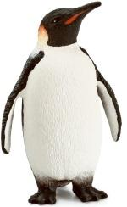
Adding New Information to the Neocortical Representation
Penguin is a bird
Penguin can swim, but cannot fly

Slide 15
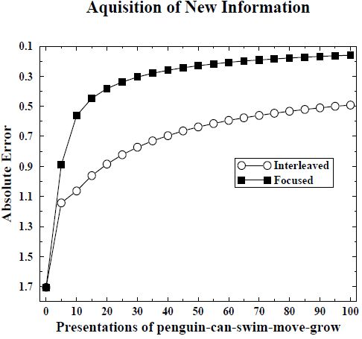
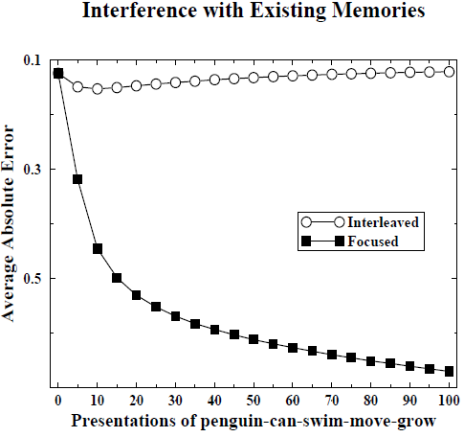
Catastrophic Interference and Avoiding it with Interleaved Learning

Slide 16
Complementary Learning Systems Theory
(McClelland et al 1995; Marr 1971)
action
name
Temporal
pole
motion
color
valance
form
Medial Temporal Lobe

Slide 17
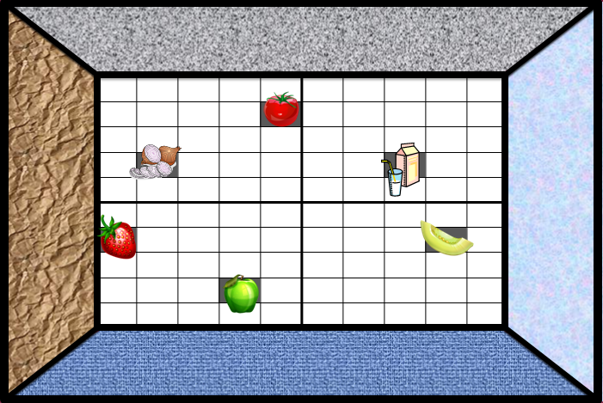
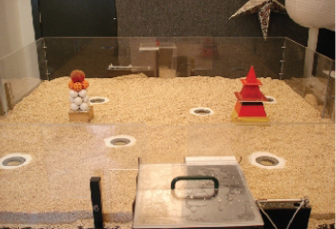
Tse et al (Science, 2007, 2011)

Slide 18
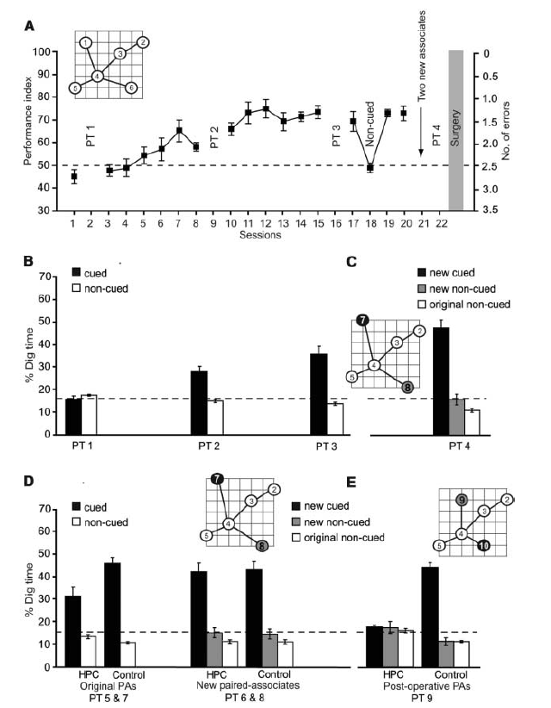

Slide 19


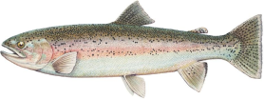
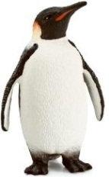
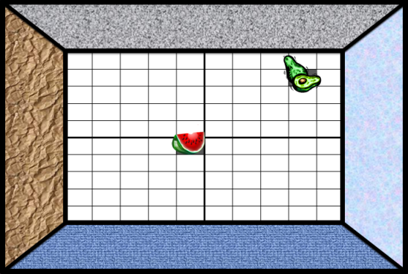
Schemata and
Schema Consistent Information
What is a ‘schema’?
  An organized knowledge structure into which new items could be added.
What is schema consistent information?
  Information consistent with the existing schema.
Possible examples:
  Trout
  Cardinal
What about a penguin?
  Partially consistent
  Partially inconsistent
What about previously unfamiliar odors paired with previously unvisited locations in a familiar environment?

Slide 20

New Simulations
Initial training with eight items and their properties as indicated at left.
Added one new input unit fully connected to representation layer to train network on one of:
  penguin-isa & penguin-can
  trout-isa & trout-can
  cardinal-isa & cardinal-can
Features trained
  can grow-move-fly or grow-move-swim
  isa LT-animal-bird or LT-animal-fish
Used either focused or interleaved learning
Network was not required to generate item-specific name outputs (no target for these units)

Slide 21
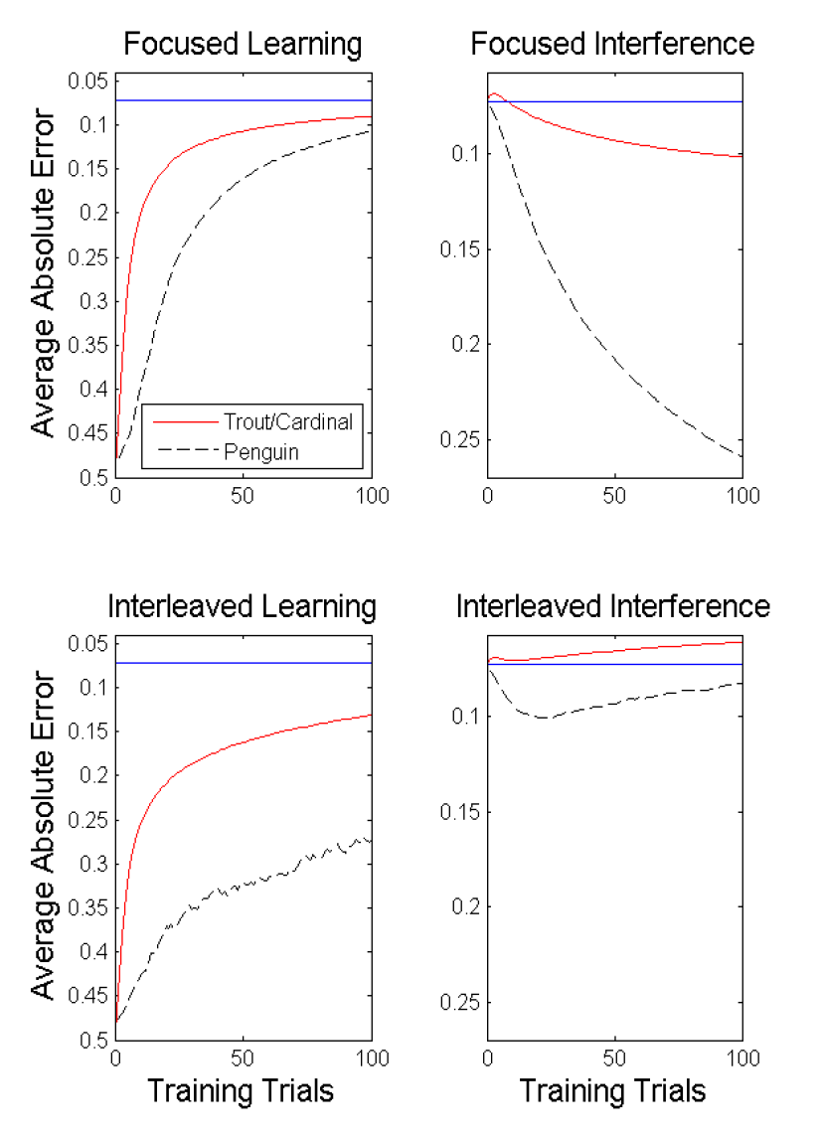

Slide 22
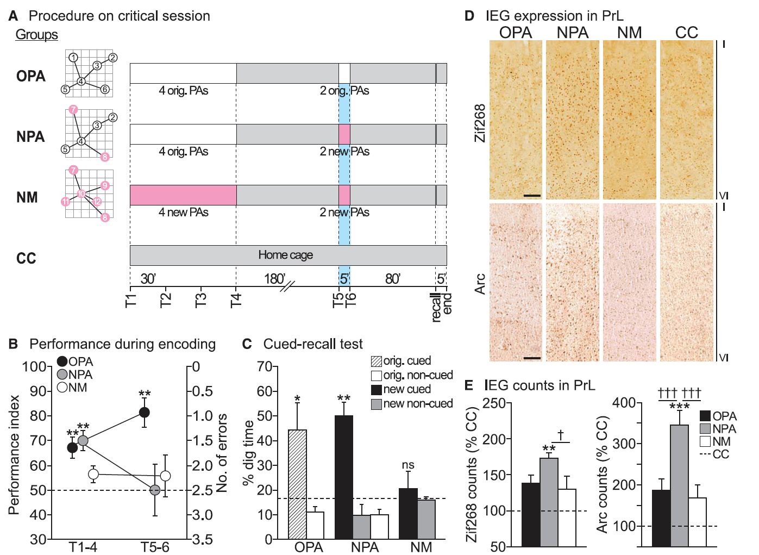

Slide 23
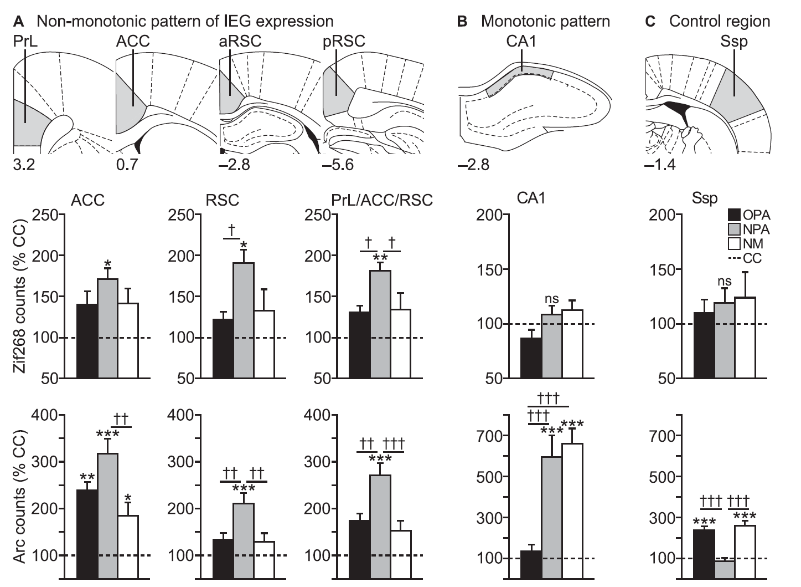

Slide 24
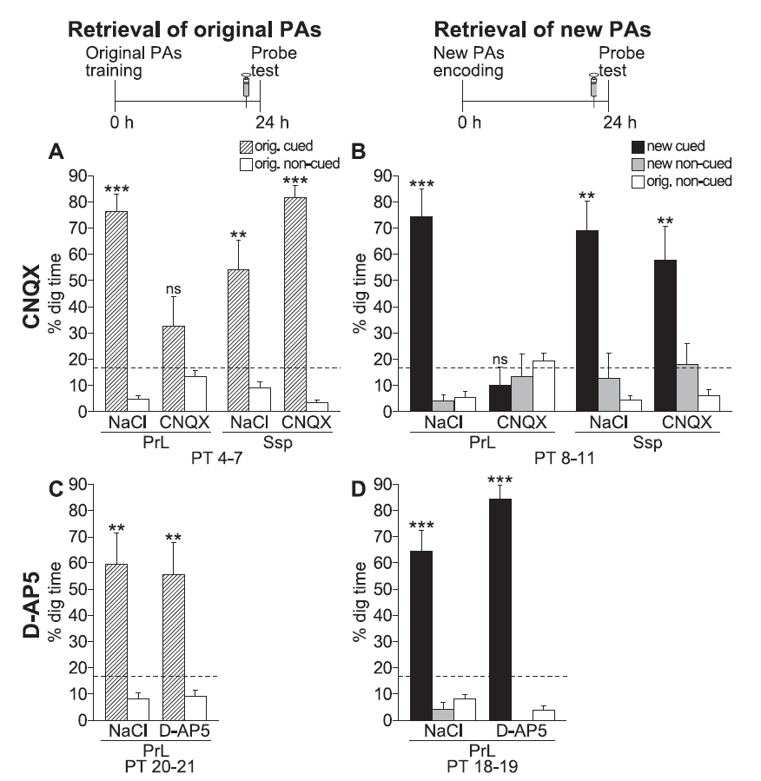

Slide 25
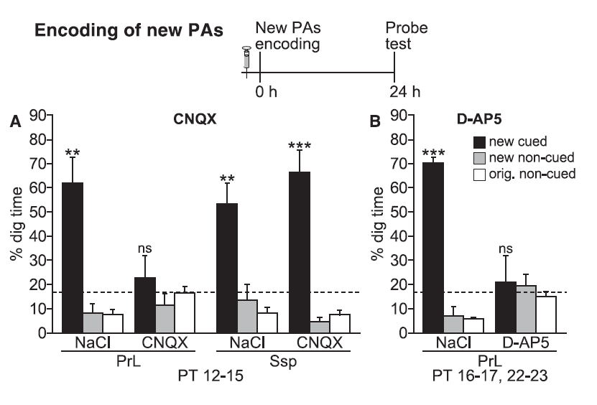

Slide 26
Simulation of Tse et al 2011
three old items (2 birds, 1 fish)
two old (1b 1f) and one new (f or b)
three new items
  xyzzy isa LT_PL_FI / can GR_MV_SG
  yzxxz isa LT_AN__TR / can GR_____FL
  zxyyx isa LT_PL_FL / can GR_MV_SW
  random items

Slide 27
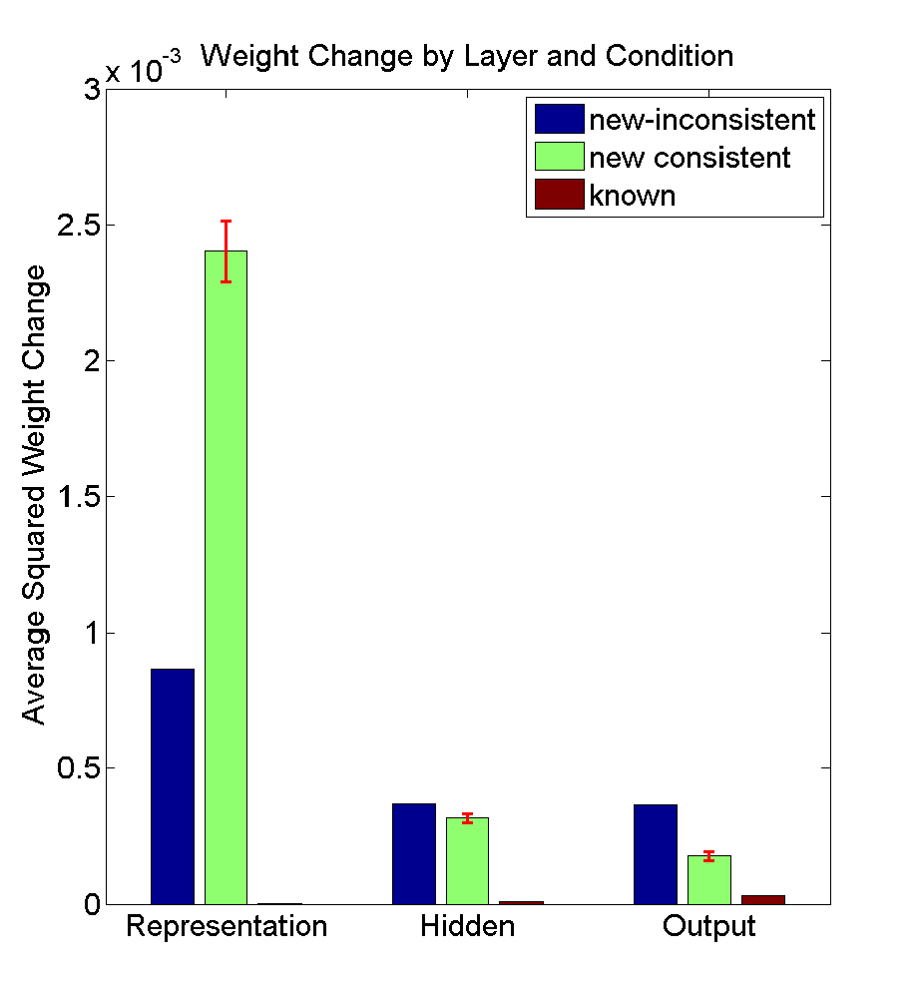

Slide 28
What’s Happening Here?
For XYZZX-type items:
  Error signals cancel out either within or across patterns, causing less learning with inconsistent information.
For random-type items:
  Signals may propagate weakly when features must be activated in inappropriate contexts

Slide 29
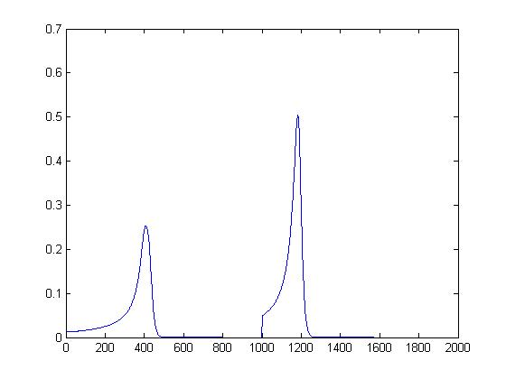
Is This Pattern Unique to the Rumelhart Network?
Competitive learning system trained with horizontal or vertical lines
Modified to include ‘conscience’ so each unit is used equally and so that weight change is proportional act(winner)^1.5
Learning accellerates gradually til mastery then must start over.

Slide 30
Open Question(s)
What are the critical conditions for fast schema-consistent learning?
  In a back-prop net
  In other kinds of networks
  In humans and other animals

