Slide 1


Cognitive Neuroscience:
Emergence of Mind from Brain
An Introduction to the Cognitive Neuroscience Series
James L. McClelland
Stanford University

Slide 2
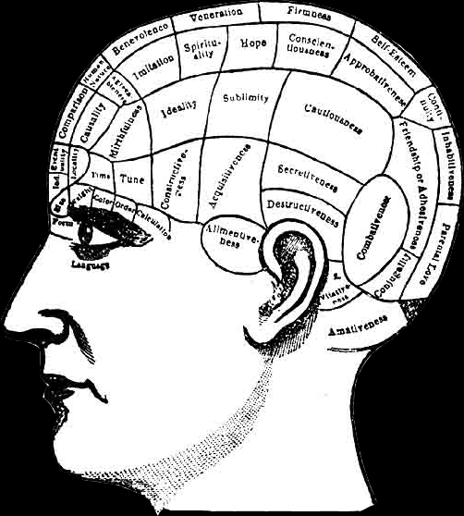
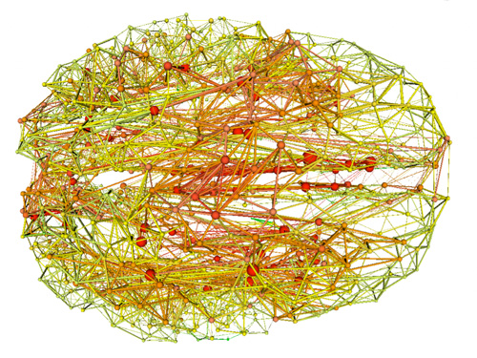
How Does the Brain Give Rise to Experience, Thought, and Behavior?
One perspective:
  The modular view of mind
Our perspective:
  Emergence from interactions of neurons within and across brain areas
Notes:
top: http://uncyclopedia.wikia.com/wiki/File:Phrenology.png
botom: newsinfo.iu.edu

Slide 3
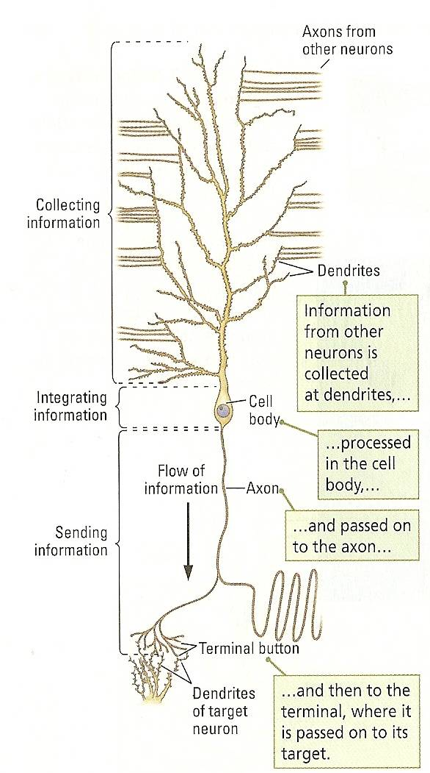
Circuit Components of the Mind: Neurons
Neurons: cells that integrate and communicate information
Notes:
Neuron: K&W, Fig 3-4, p 74
K&W = Kolb B and Whishaw IQ An Introduction to Brain and Behavior 3rd ed. 2011 Worth, New York

Slide 4
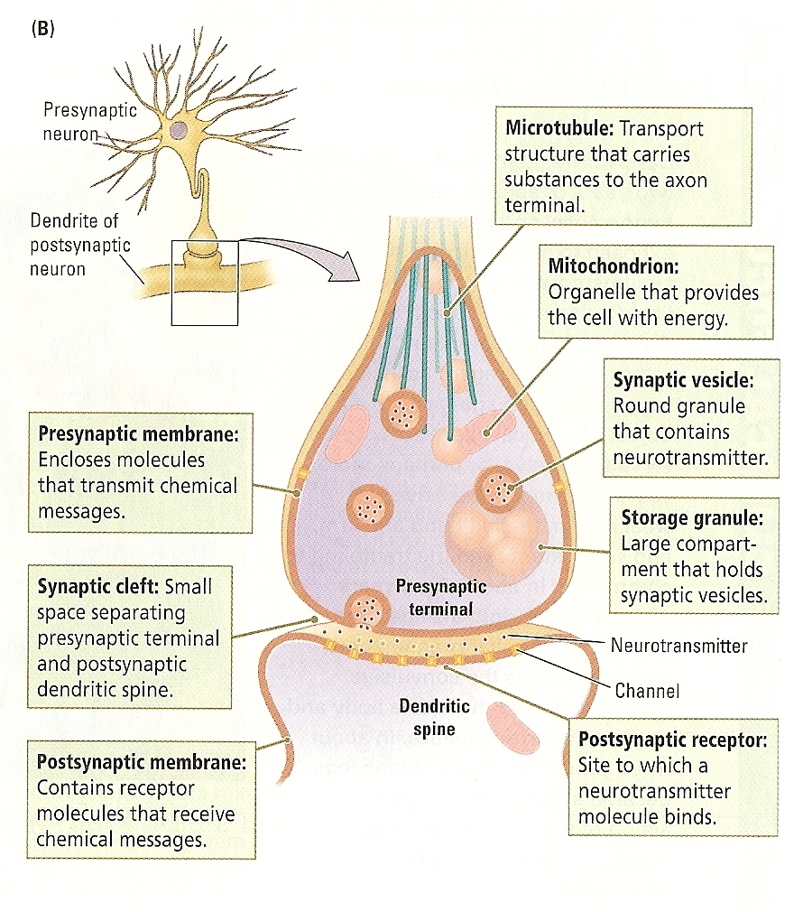
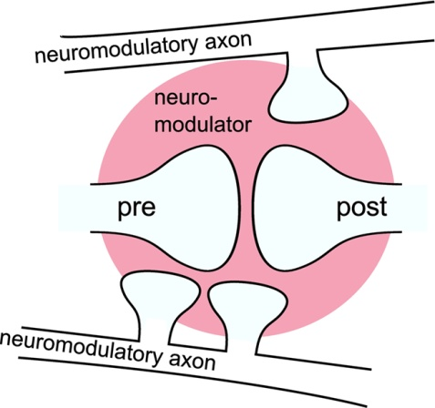
Synapses: The connections between neurons
Neurons receive excitatory and inhibitory synapses from other neurons
Other neurons have modulatory influences
Notes:
lower left figure:
AUTHOR=Potjans Wiebke, Morrison Abigail, Diesmann Markus
TITLE=Enabling functional neural circuit simulations with distributed computing of neuromodulated plasticity
JOURNAL=Frontiers in Computational Neuroscience
VOLUME=4
YEAR=2010
NUMBER=00141
URL=http://www.frontiersin.org/Journal/Abstract.aspx?s=237&name=computational_neuroscience&ART_DOI=10.3389/fncom.2010.00141
DOI=10.3389/fncom.2010.00141
Main figure is K&W, Fig 5-2 p 137

Slide 5
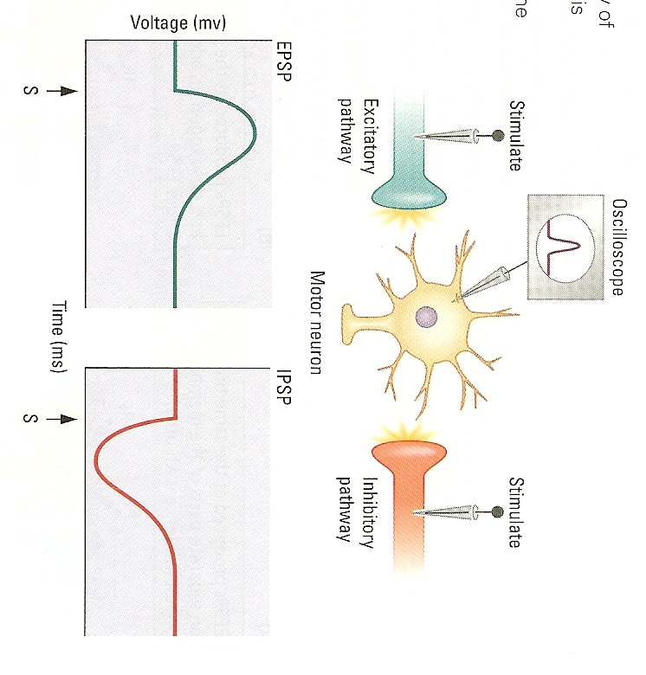
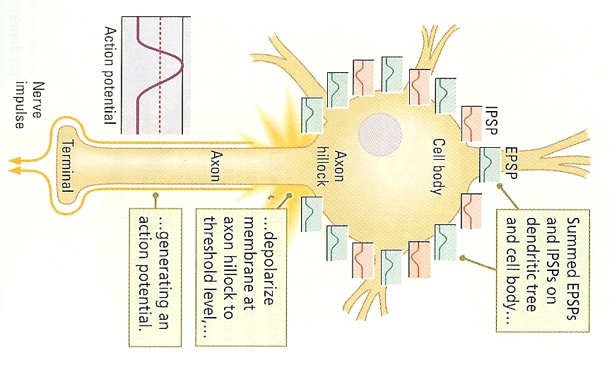
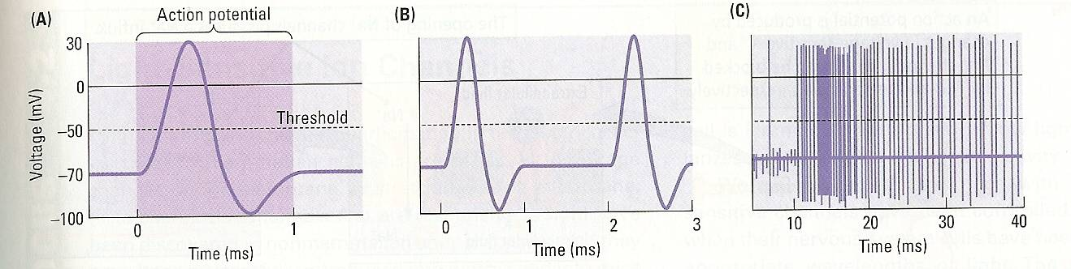
Integration of Synaptic Inputs and The Propagation of Information via Action Potentials
Excitatory and inhibitory influences add together within the dendrites and combine to determine the net depolarization of the neuron.
If net depolarization is strong enough the neuron emits an action potential.
Action potentials produce transmitter release at synapses, influencing target neurons
Notes:
Top L: K&W Fig 4-22 p 125;
Top R: K&W, Fig 4-25 p 127
Bottom: K&W, Fig 4-17, p 117

Slide 6
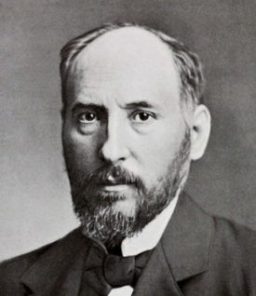
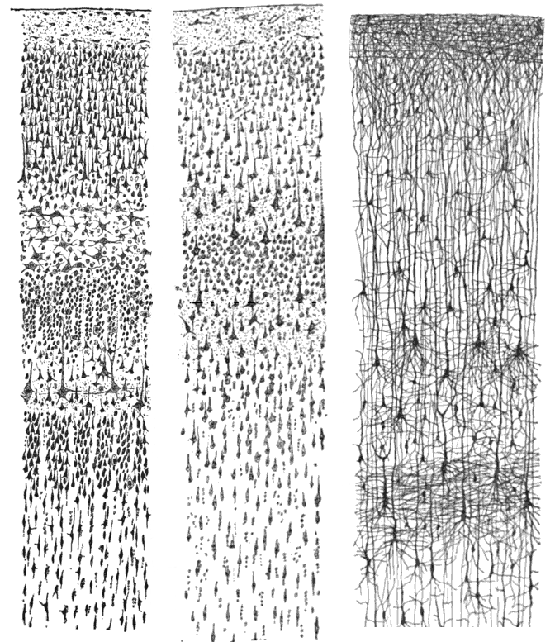
Scale of Neural
Computation
S. Ramon y Cajal
There are 10-100 billion neurons in the brain
Each with up to 10,000 synapses
That’s ~10¹³ computing elements, each capable or propagating signals at 10-100 times per second
Notes:
Wikimedia Commons, public domain (picture)
Wkimedia Commons, drawing:
2009-11-20 for image, 1899 for original artwork Source "Comparative study of the sensory areas of the human cortex" by Santiago Ramon y Cajal, published 1899, ISBN 9781458821898 Author User:Looie496 created file, Santiago Ramon y Cajal created artwork

Slide 7
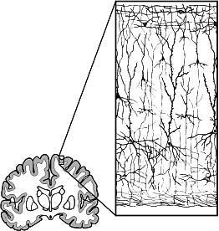
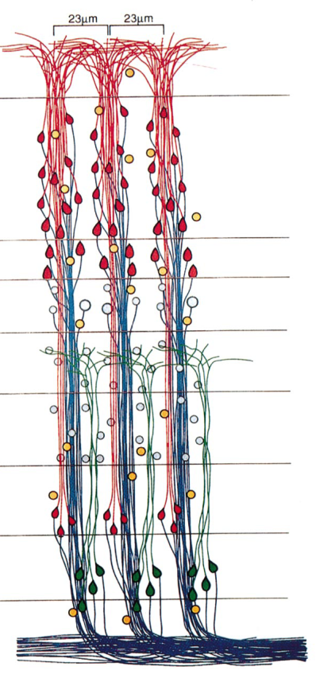
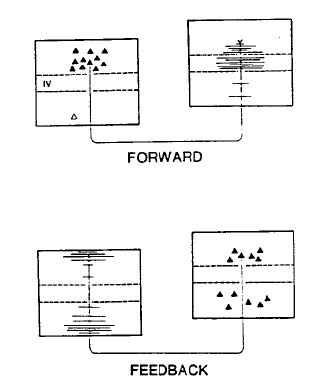
Grey Matter, White Matter and Overall Connectivity
Neuronal cell bodies are in the Neocortex
White matter contains fibers connecting different cortical areas.
Columnar organization within cortex
Short- and long-range connections
Bi-directional connectivity between areas
Notes:
Top left: From http://www.cs.brown.edu/~tld/projects/cortex/
Lower right: Peters A, Sethares C. Organization of pyramidal neurons in area 17 of monkey visual cortex. J Comp Neurol 1991; 306: 1–23. As reprinted in V. B. Mountcastle (1997). The columnar organization of the neocortex.
Lower left: Reprinted as Fig 11 in PDP:V.II:20: Orig from The connections of the middle temporal visual area and their relation to a cortical hierarchy in the Macaque Monkey. By J. H. R. Maunsell and D. C. Van Essen, 1983, Journal of Neuroscience, 3, p. 2579. © SfN

Slide 8
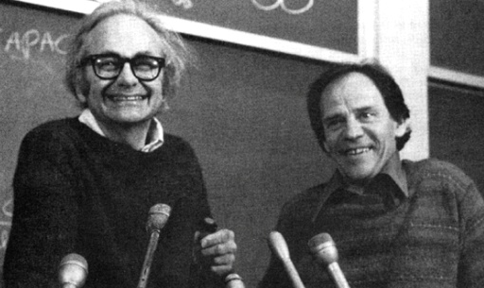
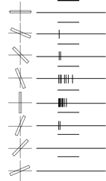
Representation of Perceptual Information in Neurons
Hubel & Wiesel
Neurons as ‘perceptual predicates’
  ‘There’s an edge of
  orientation θ
  at position [x,y]’
Higher firing rate =
stronger support
or better fit
Controversial, but
perhaps useful?
Notes:
http://jp.physoc.org/content/587/12/2817/F3.expansion.html
‘Recounting the impact of Hubel & Weisel’ – Fig 3. A.
===
Picture:
http://www.google.com/imgres?hl=en&client=firefox-a&hs=iH6&sa=X&rls=org.mozilla:en-US:official&biw=1081&bih=1470&tbm=isch&prmd=imvns&tbnid=3S798ZNps-sBXM:&imgrefurl=http://www.ksu.ru/f1/neuro/AutoPlay/Docs/02_03.htm&docid=b5ccGxIDdxoXlM&imgurl=http://www.ksu.ru/f1/neuro/AutoPlay/Docs/hubel_wiesel.jpg&w=629&h=425&ei=WT8tUP2pForyyAHfpYCYBg&zoom=1&iact=hc&vpx=139&vpy=553&dur=4703&hovh=184&hovw=273&tx=66&ty=202&sig=102982519056803285637&page=1&tbnh=166&tbnw=231&start=0&ndsp=42&ved=1t:429,r:8,s:0,i:116

Slide 9
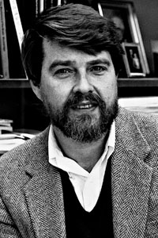
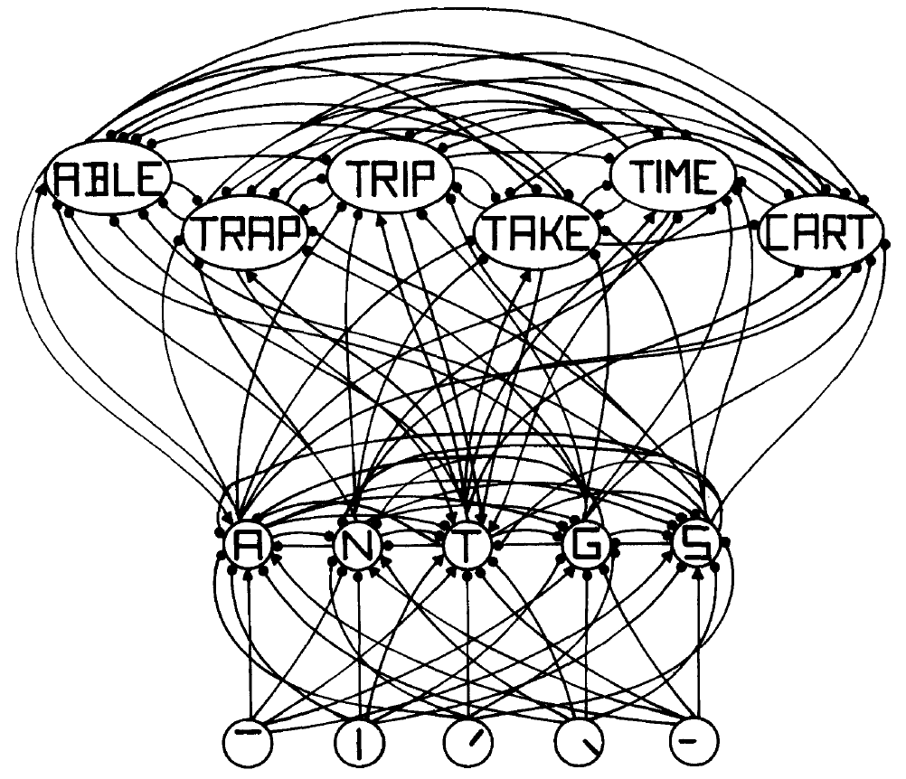
Processing of Information in
Neural Populations
Excitation and convergence
Inhibition and competition
David E.
Rumelhart
Notes:
Fig 3. p 380 from
McClelland, J. L. & Rumelhart, D. E. (1981). An interactive activation model of context effects in letter perception: Part 1. An account of Basic Findings. Psychological Review, 88, 375-407.
Picture of Rumelhart from my files.

Slide 10

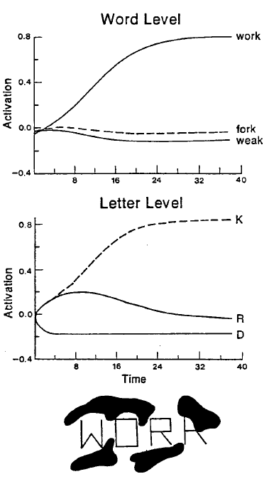
Processing of Information in Neural Populations
Excitation and convergence
Inhibition and competition
Recurrence, attractor-states, and interactive activation
Notes:
Fig 8 p. 20 from
McClelland, J. L., Rumelhart, D. E., & Hinton, G. E. The Appeal of Parallel Distributed Processing. Chapter 1 of Rumelhart, D. E., McClelland, J. L., & the PDP research group. (1986). Parallel distributed processing: Explorations in the microstructure of cognition. Volume I. Cambridge, MA: MIT Press.

Slide 11
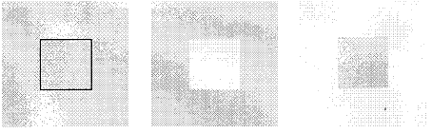
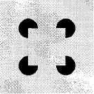
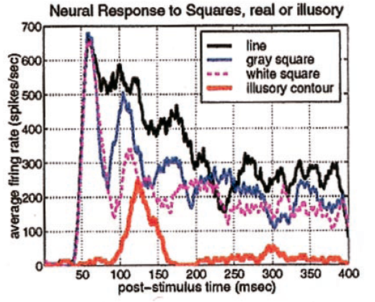
Interactivity in the Brain
Position-specific illusory contour response in V1 neurons occurs after a delay
Inactivation of ‘higher’ cortical areas reduces sharpness of neural responses in lower areas including thalamus
x
x
x
x
Notes:
Fig 2 d, e, f; fig 2 a; Fig 3 d p 1908 From Lee & Nguyen, doi: 10.1073/pnas.98.4.1907 PNAS February 13, 2001 vol. 98 no. 4 1907-1911

Slide 12
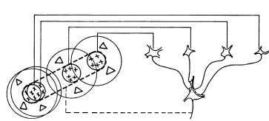
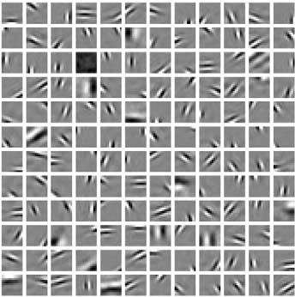
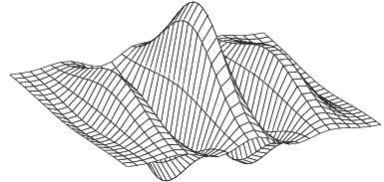
Characterizations of Neural Representations in Visual Cortex
Edge detectors
Gabor filters
Sparse, efficient codes
Notes:
Clockwise from top right:
From D. H. Hubel and T. N.Wiesel, The Journal of Physiology (1959) 148:
"Receptive ﬁelds of single neurones in the cat’s striate cortex“
http://www2.it.lut.fi/project/gabor/
Sparse coding of sensory inputs
Bruno A Olshausen and David J Field
Current Opinion in Neurobiology 2004, 14:481–487

Slide 13
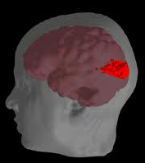
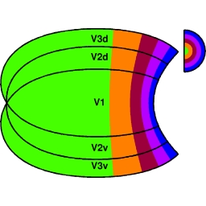
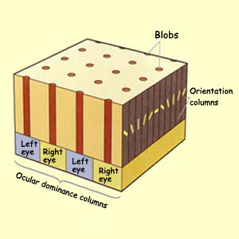
Maps in Visual
Cortex
Visual space is laid out
topographically in visual
cortex (left space in right
hemisphere, right space in
left).
Note expansion of central
vision.
At each location, neurons
sensitive to different eyes
and orientations can be
found, interleaved with
neurons sensitive to
different colors (blobs).
Notes:
The two images on the right are from:
http://www.d.umn.edu/~jfitzake/Lectures/DMED/Vision/Cortex/CorticalProcessing.html
Head/brain image:
© Pittsburgh Supercomputing Center (PSC)
Revised: September 2, 1997
URL: http://www.psc.edu/science/Goddard/goddard.html
http://www.psc.edu/science/goddard.html
http://www.psc.edu/science/Goddard/Images/hpcc1_big.jpeg

Slide 14
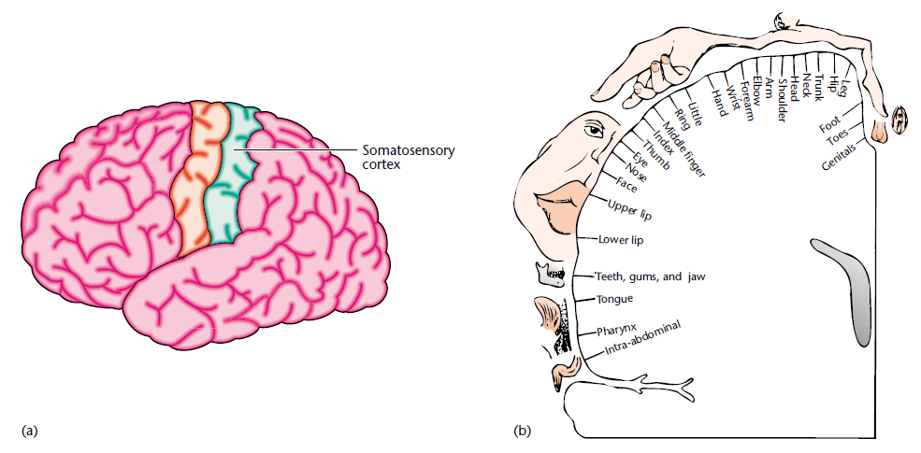
Topographic Representation of the Body in Somatosensory Cortex
Notes:
Petersen, Rasmus S and Diamond, Mathew E, Topographic Maps In the Brain, Encyclopedia of the Life Sciences © John Wiley & Sons 2002, Fig 2

Slide 15
Representation in higher order cortical areas
Local vs. Distributed Representation
  A matter of perspective?
  A matter of degree?
  Must individual neurons represent entities we can name with words?

Slide 16
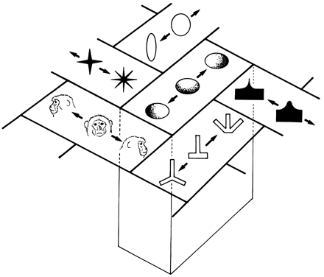
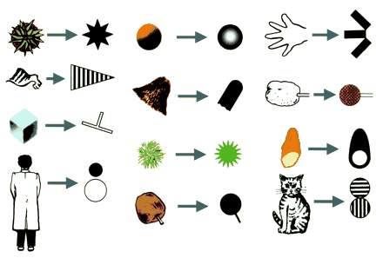
Representation in
Inferotemporal Cortex
Neurons that respond
to specific objects
respond as much or
more to similar
schematic patterns
Neighboring neurons
in IT have similar
response properties
Notes:
Figure 2 (lower left) and 7 (upper right)
Columns for Complex Visual Object Features in the Inferotemporal Cortex: Clustering of Cells with Similar but Slightly Different Stimulus Selectivities
Keiji Tanaka
Cereb. Cortex (2003) 13 (1): 90-99. doi: 10.1093/cercor/13.1.90

Slide 17
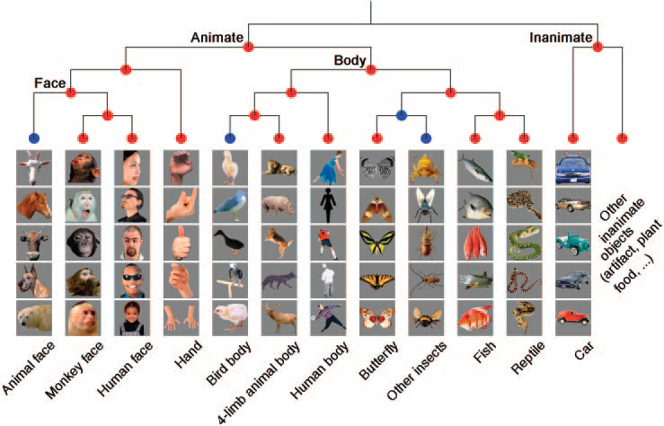
Similarity Structure of Activity Patterns in Monkey Inferotemporal Cortex
Notes:
Object Category Structure in Response Patterns of Neuronal Population in
Monkey Inferior Temporal Cortex
Roozbeh Kiani Hossein Esteky Koorosh Mirpour and Keiji Tanaka
J Neurophysiol 97: 4296–4309, 2007.
First published April 11, 2007; doi:10.1152/jn.00024.2007.

Slide 18
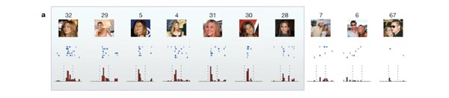
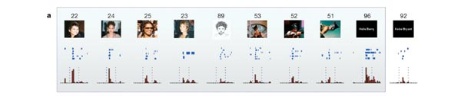
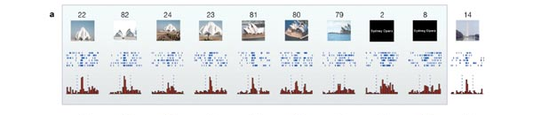
The Jennifer Aniston, Halle Berry, and Sydney Opera/Baha’i Temple Neurons
Notes:
Fig 1, 2 and 3 From the following article:
Invariant visual representation by single neurons in the human brain
R. Quian Quiroga, L. Reddy, G. Kreiman, C. Koch & I. Fried
Nature 435, 1102-1107(23 June 2005)
doi:10.1038/nature03687

Slide 19
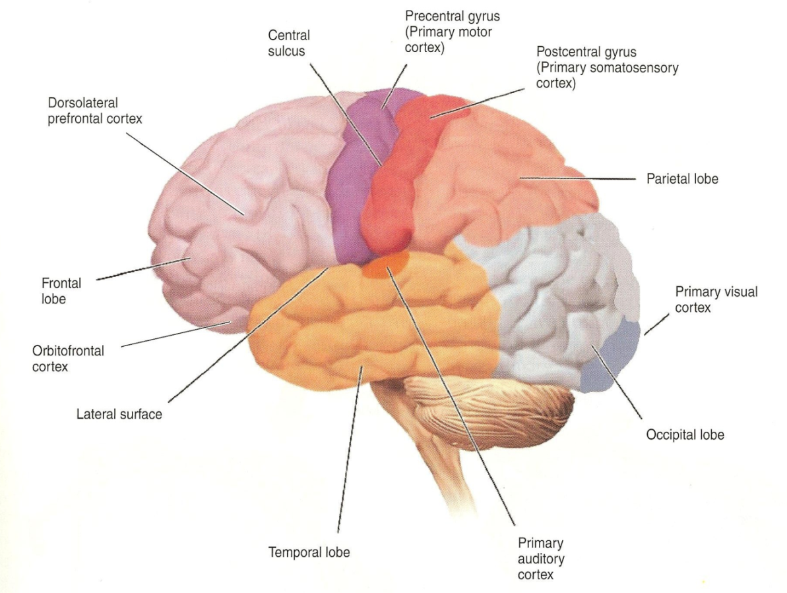
Macro Organization:
Primary, Secondary, and Tertiary Brain Areas
Notes:
Fig 1.16 p 17 in Banich, MT & Compton, RJ Cognitive Neuroscience (3rd ed) Wadsworth Cenage Learning 2011

Slide 20
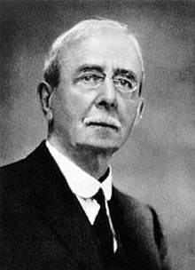
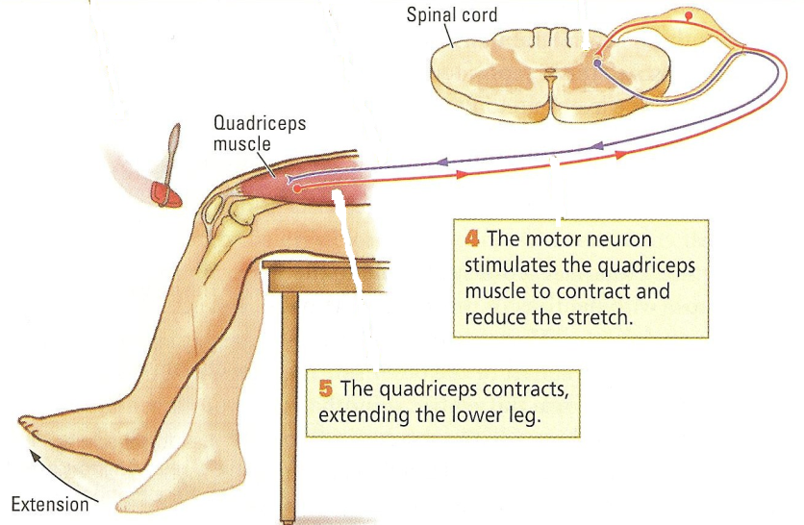
Short-circuits at lower levels
There are short circuits in the brain to allow for fast responses, these circuits also allow for contextual influences
Sir Charles
Sherrington
Notes:
Sherrington photo from:
http://www.nndb.com/people/860/000127479/charles-sherrington.jpg
Reflex figure: K&W, fig 11-21 p 382

Slide 21
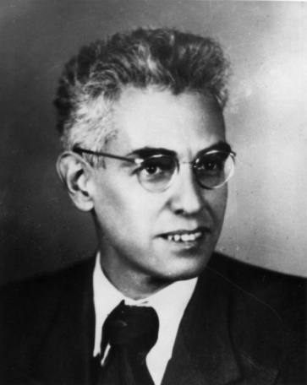
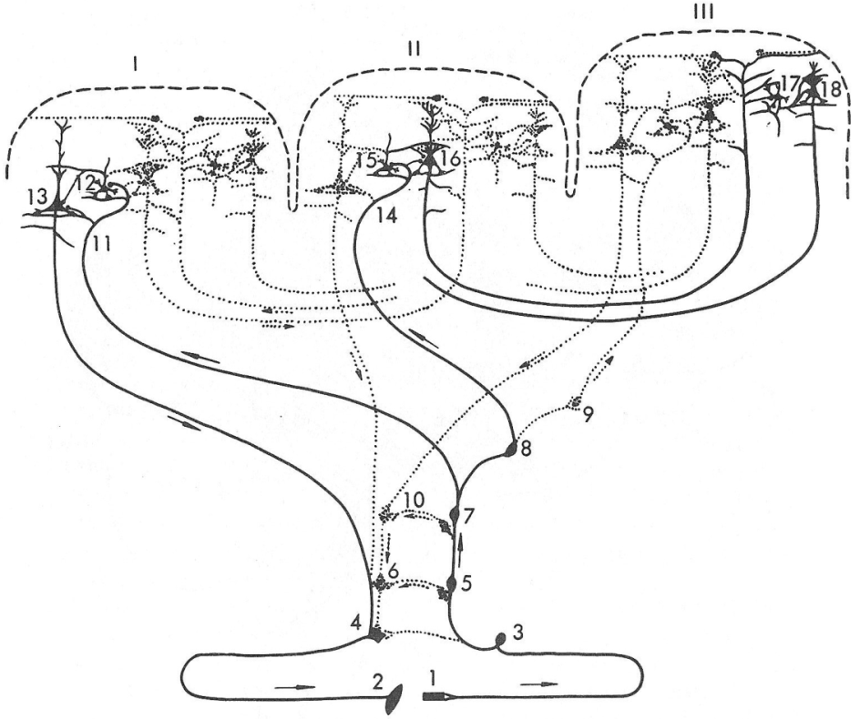
Luria’s Concept of the
Dynamical Functional System
A. R. Luria
Notes:
http://upload.wikimedia.org/wikipedia/commons/2/20/Luria.jpg
Luria, A. R. Higher Cortical Functions in Man, Fig 8 p 44. New York, Basic Books, 1966

Slide 22
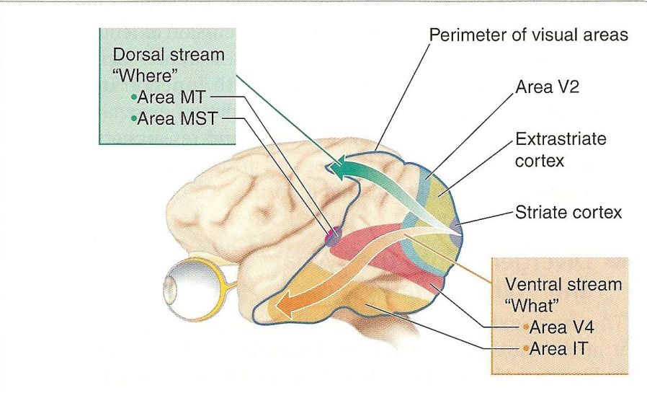
Marco Architecture:
What vs. Where / How
Notes:
Banich & Compton Cognitive Neuroscience 2011. Wadsworth. Fig 6.17 p 164.

Slide 23
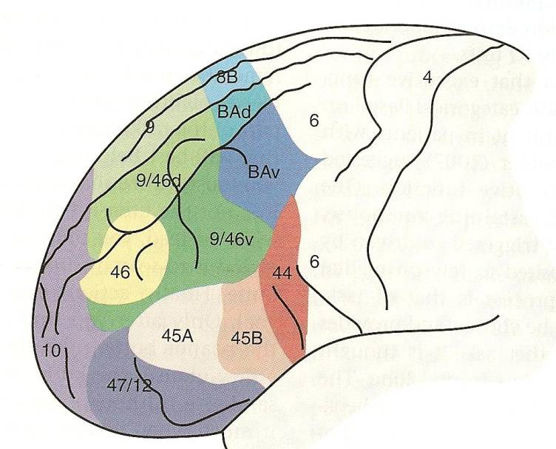
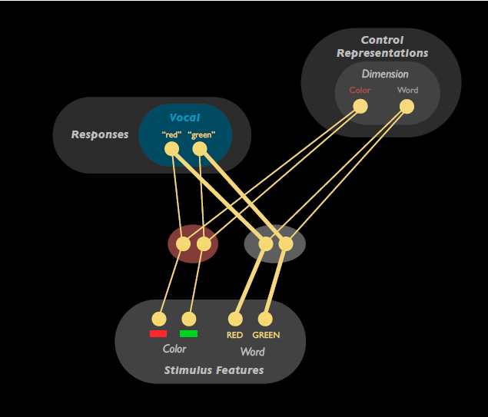
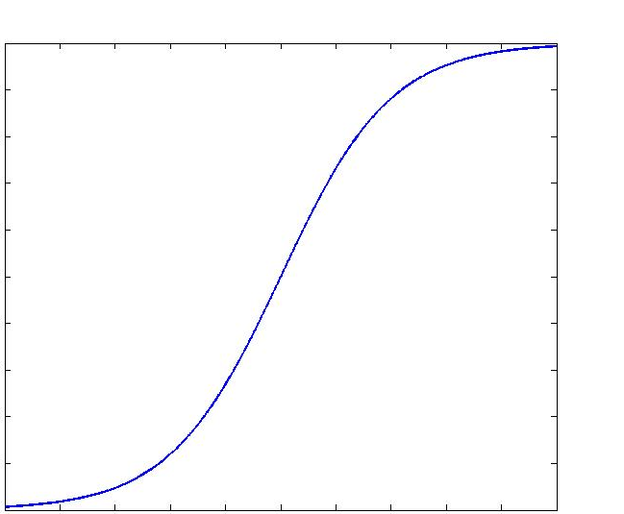
How Goals and Task Constraints Affect Processing
Pre-frontal cortex critical for control
Control is exerted by biasing processing
Output
RED
Input
Notes:
Top Right: Banich & Compton, Figure 12-2a p 342.
Bottom left: From Botvinick and Cohen, The computational and neural basis of cognitive control: Charted territory and new frontiers. Cognitive Science, in press.

Slide 24
How Goals and Task Constraints Affect Processing
Pre-frontal cortex critical for control
Control is exerted by biasing processing
Output
RED
Input
Notes:
Top Right: Banich & Compton, Figure 12-2a p 342.
Bottom left: From Botvinick and Cohen, The computational and neural basis of cognitive control: Charted territory and new frontiers. Cognitive Science, in press.

Slide 25
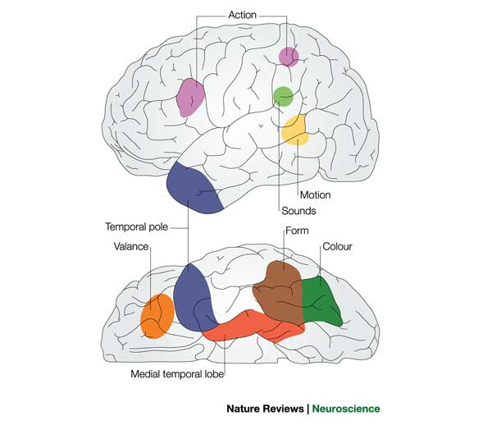
Semantic processing and the knowledge that supports it
How do I bring to mind what I know about something – e.g. from its name, or when I hear it bark?
Bidirectional propagation of activation among neurons within and between brain areas.
The knowledge underlying propagation of activation is in the connections.
Experience affects this knowledge through a gradual connection adjustment process that takes place over extended time periods
language
Notes:
Figure in Box 2, p 315 of McClelland, J. L. & Rogers, T. T. (2003). The parallel distributed processing approach to semantic cognition. Nature Reviews Neuroscience, 4, 310-322.

Slide 26
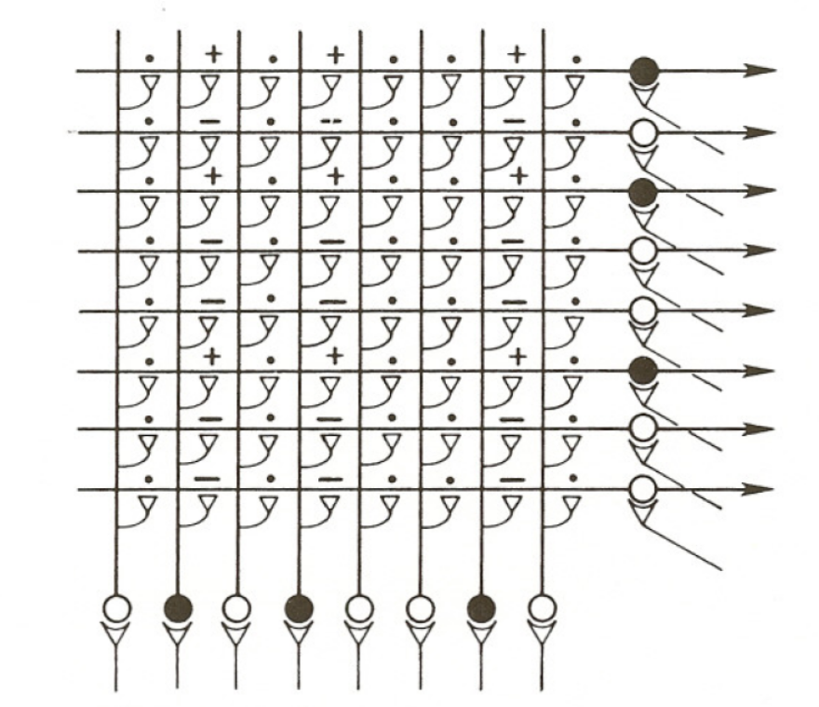
An Associative Neural Network
A network with modifiable connections that can learn to associate patterns in different modalities.
Multiple associations can be stored without any grandmother neurons.

Slide 27
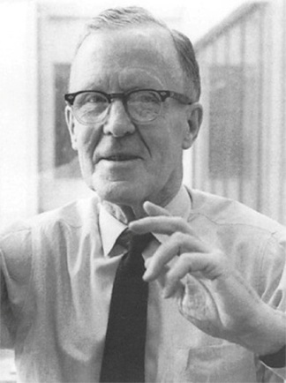
Hebb’s Postulate and
Other Learning Rules
“When an axon of cell A is near enough to excite a cell B and repeatedly or persistently takes part in firing it, some growth process or metabolic change takes place in one or both cells such that A’s efficiency, as one of the cells firing B, is increased.”
D. O. Hebb, Organization of Behavior, 1949
In other words: “Cells that fire together wire together.”
Unknown
Mathematically, this is often written as:
Δw_{ba} = εa_{b}a_{a}
More complex and sophisticated ideas have been under continual exploration for over a half a century, including:
Reward-modulated learning
Competitive learning
Error correcting learning
Spike-time dependent plasticity
D. O. Hebb
Notes:
Drawings from an earlier slide – see notes there
Picture of Hebb from Fig 4:
AUTHOR=Markram Henry, Gerstner Wulfram, Sj珶琀爀m Per Jesper
TITLE=A history of spike-timing-dependent plasticity
JOURNAL=Frontiers in Synaptic Neuroscience
VOLUME=3
YEAR=2011
NUMBER=00004
URL=http://www.frontiersin.org/Journal/Abstract.aspx?s=1082&name=synaptic_neuroscience&ART_DOI=10.3389/fnsyn.2011.00004
DOI=10.3389/fnsyn.2011.00004
http://www.frontiersin.org/synaptic_neuroscience/10.3389/fnsyn.2011.00004/full
A history of spike-timing-dependent plasticity
Henry Markram¹*, Wulfram Gerstner¹ and Per Jesper Sjöström

Slide 28
What we know, and what we don’t know
We understand a fair amount about basic sensory mechanisms, especially in vision, but much less about many other things
  We don’t know how conscious experience is supported by the brain
We understand attractor networks, but cognitive processes are not static
  There’s a lot to learn about fluid context-sensitive perception and performance
We understand how control can modulate processing, but not how control itself is maintained and organized across extended time periods

Slide 29

Conclusion
The thesis of this lecture:
  Human thought and experience arise from interactions of neurons widely distributed within and across brain areas.
Thanks to all those whose ideas have contributed to the formulation and further elaboration of this thesis.
And thanks to you for listening to
this introduction to Cognitive
Neuroscience!
Jay McClelland

