Slide 1
Emergence of Semantic Structure from Experience
Jay McClelland
Stanford University

Slide 2
The PDP Approach to Semantic Cognition
Distributed representation
Experience-driven learning
-> Development, adult performance, and effects of brain damage on semantic cognition

Slide 3
Distributed Representations in the Brain:
Overlapping Patterns for Related Concepts (Kiani et al, 2007)
dog
goat
hammer
Many hundreds of single neurons recorded in monkey IT.
1000 different photographs were presented twice each to each neuron.
Hierarchical clustering based on the distributed representation of each picture:
  The pattern of activation over all the neurons
dog goat hammer

Slide 4
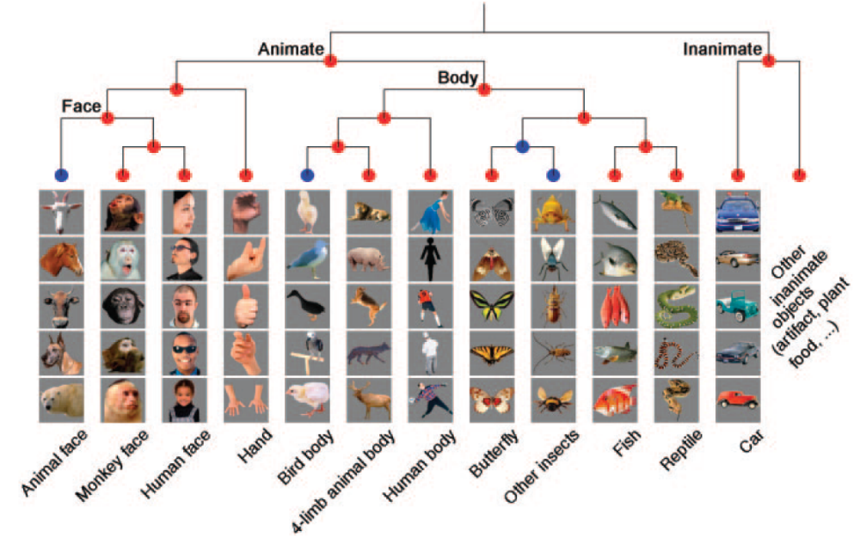
Kiani et al, J Neurophysiol 97: 4296–4309, 2007.

Slide 5



The Rumelhart Model
The Quillian
Model

Slide 6


Early
Later
Later
Still
E
x
p
e
r
i
e
n
c
e
Newer versions of this type of model
exhibit the same behavior with up
240 concepts with a deeper hierarchy
of categories.

Slide 7
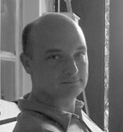




Phenomena in Development
Progressive differentiation
Overgeneralization of
  Typical properties
  Frequent names
Emergent domain-specificity of representation
Basic level advantage
Expertise and frequency effects
Conceptual reorganization

Slide 8


Disintegration in Semantic Dementia
Loss of differentiation
Overgeneralization

Slide 9
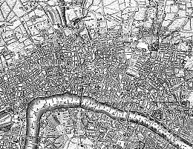

Emergent vs. Stipulated Structure
Old London
Midtown Manhattan

Slide 10
New Directions For these Ideas
(all in collaboration with students)
Naturalistic inductive inference
  If a gorilla has biotin in its blood, how likely is it that a monkey has biotin? A fox? A whale?
Solving analogies
  UNPRECEDENTED : FORERUNNERS ::
    unnecessary : prerequisites
    nauseating : medicine
    bloodthirsty : anemia
    holistic : proof
    adulterated : purity
Metaphorical grounding
  Transfer of structured knowledge from one domain (such as space) to another (such as time)
Development of mathematical and scientific reasoning abilities
  In naïve physics (balance scale)
  In mathematics (geometry and trigonometry)

