Slide 1
Emergence of Semantic Knowledge from Experience
Jay McClelland
Stanford University

Slide 2
Approaches to Understanding Intelligence
Symbolic approaches
  explicit symbolic structures
  structure-sensitive rules
  discrete computations even if probabilistic
Emergence-based approaches
  Symbolic structures and processes as approximate characterizations of emergent consequences of
    Neural mechanisms
    Development
    Evolution
    …

Slide 3
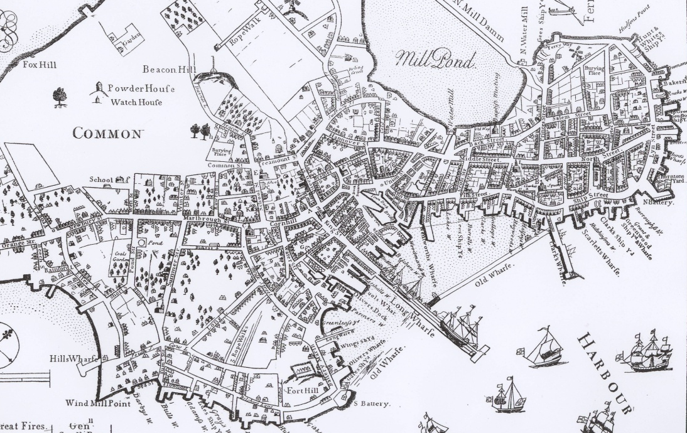

Emergent vs. Stipulated Structure
Old Boston
Midtown Manhattan

Slide 4
Explorations of a Neural Network Model
Neurobiological basis
Initial implementation
Emergence of semantic knowledge
Disintegration of semantic knowledge in neurodegenerative illness
Characterizing the behavior of the model
Further explorations

Slide 5
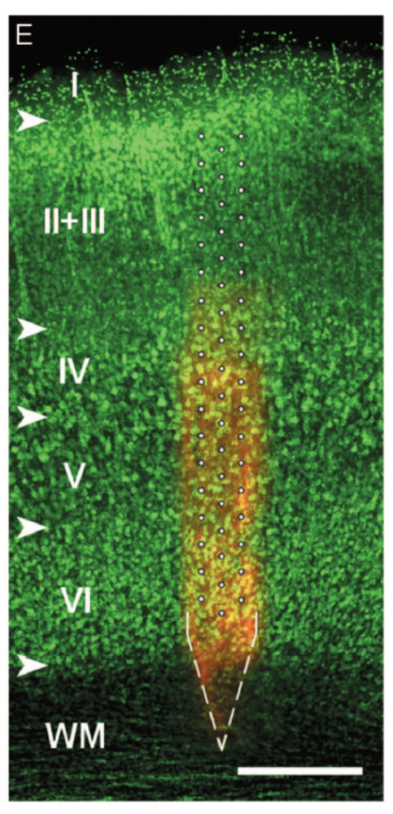
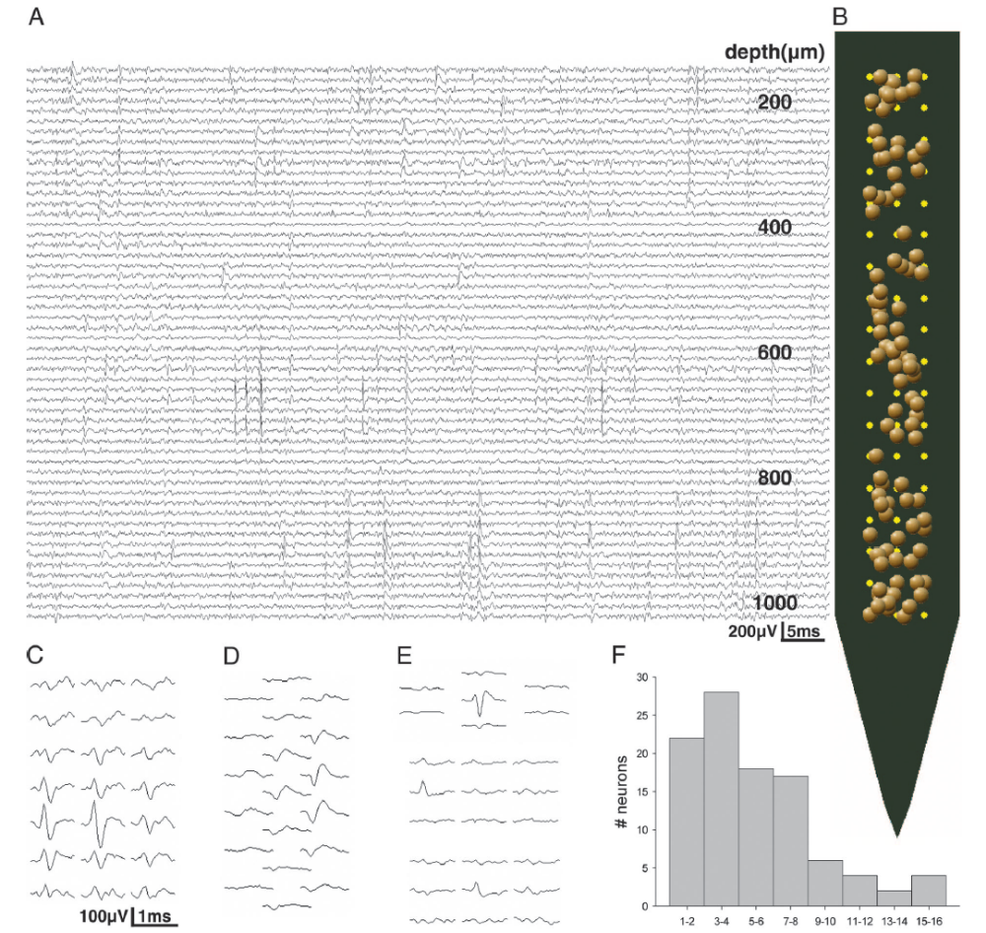

Slide 7
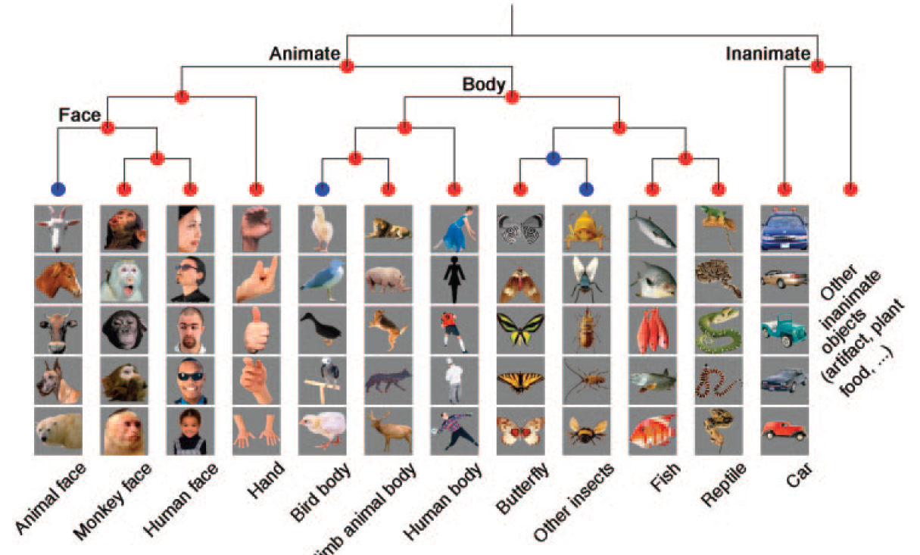
Kiani et al (2007) Pattern Similarity From Monkey Neurons

Slide 8
Rumelhart’s Distributed
Representation Model
Goals:
Show how a neural network could capture semantic knowledge implicitly
Demonstrate that learned internal representations can capture hierarchical structure
Show how the model could make inferences as in a symbolic model

Slide 9

The Quillian
Model

Slide 10

The Rumelhart Model

Slide 11
The Training Data:
All propositions true of
items at the bottom level
of the tree, e.g.:
Robin can {grow, move, fly}
7

Slide 12



Slide 13
Start with neutral pattern.
Adjust to find a pattern that accounts for new information.

Slide 14
The result is a pattern similar to that of the
average bird…

Slide 15
Use this pattern to infer
what the new thing can do.

Slide 16

Phenomena in Development
(Rogers & McClelland, 2004)
Progressive differentiation
U-shaped over-generalization of
  Typical properties
  Frequent names
Emergent domain-specificity
Basic level, expertise & frequency effects
Conceptual reorganization
Tim Rogers

Slide 17
Phenomena in Development
(Rogers & McClelland, 2004)
Progressive differentiation
U-shaped over-generalization of
  Typical properties
  Frequent names
Emergent domain-specificity
Basic level, expertise & frequency effects
Conceptual reorganization
Tim Rogers

Slide 18
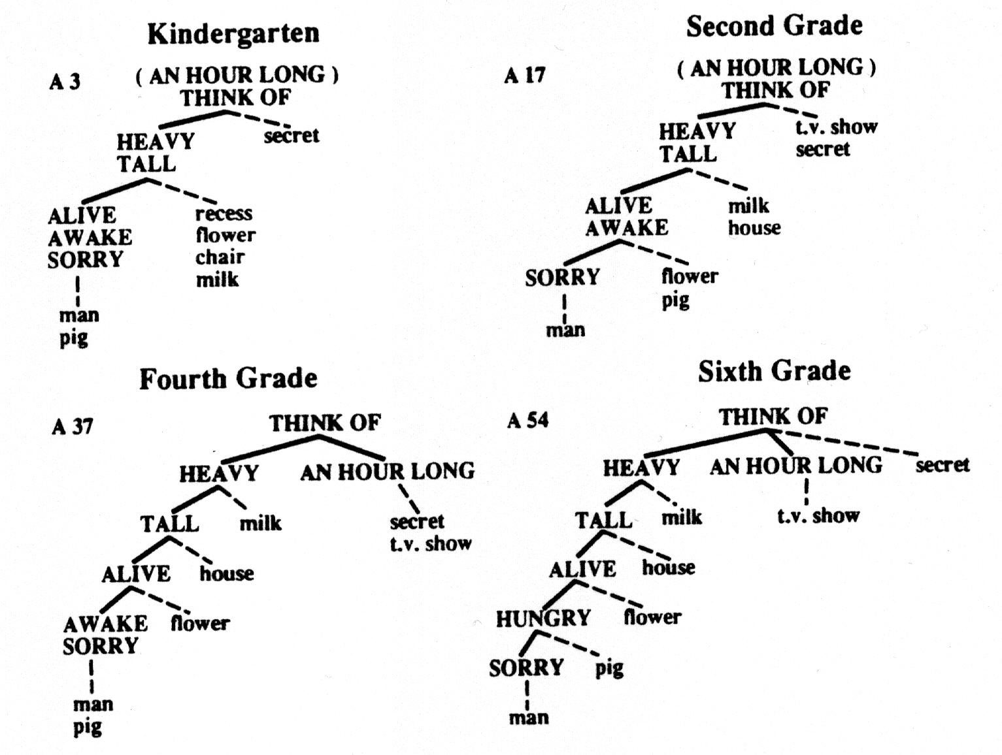
5

Slide 19
Differentiation over time

Slide 20
Early
Later
Later
Still
E
x
p
e
r
i
e
n
c
e

Slide 21
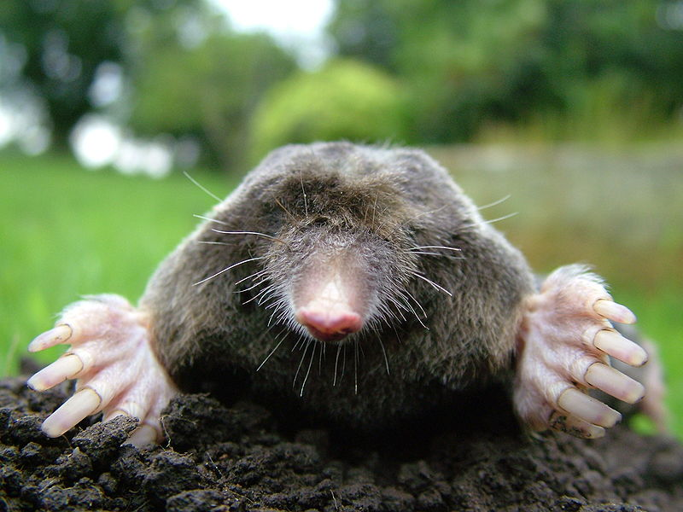

Slide 22

Overgeneralization of Typical Properties
Pine has leaves
Activation
Epochs of Training

Slide 23
Overgeneralization of Frequent Names
Children typically see and talk about far more dogs than any other animal
They often call other, less familiar animals ‘dog’ or ‘doggie’
But when they are a little older they stop
This occurs in the model, too

Slide 24
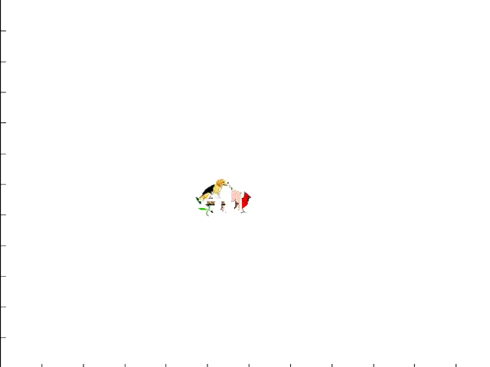

Slide 25


Overgeneralization of Frequent Names
Activation
Epochs of Training

Slide 26
Reorganization of Conceptual Knowledge (Carey, 1985)
Young children don’t really understand what it means to be a living thing
By 10-12, they have a very different understanding
Carey argues this requires integration of many different kinds of information
The model can exhibit reorganization, too

Slide 27
The Rumelhart Model
small

Slide 28
The Rumelhart Model
small

Slide 29
The Rumelhart Model
small

Slide 30

Reorganization Simulation Results
EARLY LATER

Slide 31


Disintegration in Semantic Dementia
Loss of differentiation
Overgeneralization

Slide 32
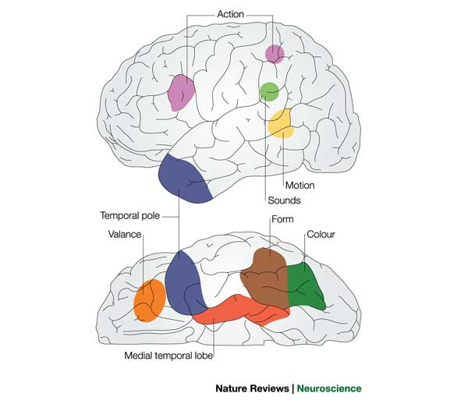
Grounding the Model in The Brain
Specialized brain areas subserve each kind of semantic information
Semantic dementia results from degeneration near the temporal pole
Initial learning and use of knowledge depends on the medial temporal lobe
language

Slide 33
Architecture for the Organization of Semantic Memory
action
name
Temporal
pole
motion
color
valance
form
Medial Temporal Lobe

Slide 34
Explorations of a Neural Network Model
Neurobiological basis
Initial implementation
Emergence of semantic knowledge
Disintegration of semantic knowledge in neurodegenerative illness
Characterizing the behavior of the model
Further explorations

Slide 35
Neural Networks and Probabilistic Models
The model learns the conditional probability structure of the training data:
  P(A_{i} = 1|I_{j} & C_{k}) for all i,j,k
… subject to constraints imposed by initial weights and architecture.
Input representations are important too
The structure in the training data and lead the network to behave as though it is learning a
  Hierarchy
  Linear Ordering
  Two-dimensional similarity space…

Slide 36
The Hierarchical Naïve Bayes Classifier as a Model of the Rumelhart Network
Items are organized into categories
Categories may contain sub-categories
Features are probabilistic and depend on the category
We start with a one-category model, and learn p(F|C) for each feature
We differentiate as evidence accumulates supporting a further differentiation
Brain damage erases the finer sub-branches, causing ‘reversion’ to the feature probabilities of the parent
Living Things
Animals Plants
Birds Fish
Flowers Trees
…

Slide 37
Overgeneralization of Typical Properties
Pine has leaves
Activation
Epochs of Training

Slide 38

Accounting for the network’s feature attributions with mixtures of classes at different levels of granularity
Regression Beta Weight
Epochs of Training
Property attribution model:
P(f_{i}|item) = α_{k}p(f_{i}|c_{k}) + (1-α_{k})[(α_{j}p(f_{i}|c_{j}) + (1-α_{j})[…])

Slide 39
Should we replace the PDP model with the Naïve Bayes Classifier?
It explains a lot of the data, and offers a succinct abstract characterization
But
  It only characterizes what’s learned when the data actually has hierarchical structure
  In natural data, all items don’t neatly fit in just one place, and some important dimensions of similarity cut across the tree.
So it may be a useful approximate characterization in some cases, but can’t really replace the real thing.

Slide 40
Further Explorations
Modeling cross-domain knowledge transfer and ‘grounding’ of one kind of knowledge in another
Mathematical characterization of natural structure, encompassing hierarchical organization as well as other structural forms
Exploration of the protective effects of ongoing experience on preservation of knowledge during early phases of semantic dementia

Slide 41
Thanks!

